Slide 1
How to use experimental data for CFD comparison
Sandia National Laboratories

Slide 2
Introduction
Users need access to MATLAB.
Data set contains 6 different ECN Spray M conditions (M1, M2, M20C(M2-cold), M60C(M3-cold), M90C, and M3).
Liquid penetration and width data for methanol (MeOH) and PACE-20 is available. PACE-20 fuel composition is available here*.
Extinction/LVF data at 6 different planes (Z=10, 12, 15, 20, 25, 30mm) enabled by Sandia 3D-CT is also available.
Part I will introduce liquid penetration and width data.
Part II will introduce 3D-CT data.
*https://ecn.sandia.gov/gasoline-fuel-composition/

Slide 3
Part I: liquid/vapor characterization
Sandia National Laboratories

Slide 4
Data type
liquid_data_2e-4_thr.mat is data containing liquid width at (Z=15, 25, 35mm) and liquid penetration length based on projected liquid volume threshold of 0.2e-3.
liquid_data_2e-3_thr.mat is data containing liquid width at (Z=15, 25, 35mm) and liquid penetration length based on projected liquid volume threshold of 2e-3.
Please refer a presentation at ECN 6.3 by Lukas Weiss https://ecn.sandia.gov/ecn-workshop/ecn7-workshop/ for image processing.

Slide 5
If you open liquid_data_2e-4_thr.mat…
We have two variables: axis_title and liquid_data_low_thr
axis_title indicates what each column of liquid_data_low_thr represents
Column 1 contains time (ms)
Columns 2-13 contain liquid data (average and individual), standard deviation, and 95% probability of the data error values at Z=15, 25, 35mm
Columns 14-16 contain liquid length defined by 3 different methods
Columns 17 and 18 contain standard deviation information

Slide 6
Understanding liquid penetration data
Columns 14, 15, 16 indicate liquid penetration length.
Column 14 was defined as a liquid length between nozzle tip and axial farthest length in an image of averaged PLV from 300 injections.
Column 15 was defined as an averaged liquid length from 3 groups (plumes (2,3,4), (1,5), (6,7,8)) based on an image of averaged PLV from 300 injections.
Column 16 was defined as an averaged liquid length from instantaneous PLV images of 300 injections.

Slide 7
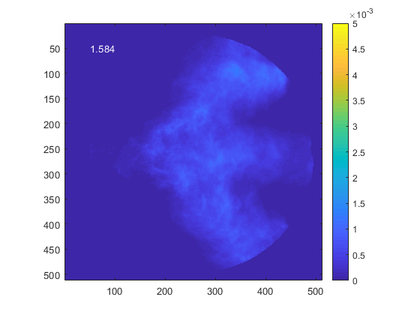
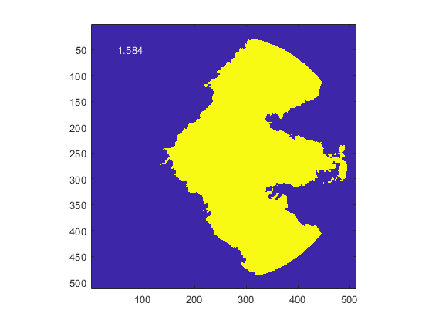
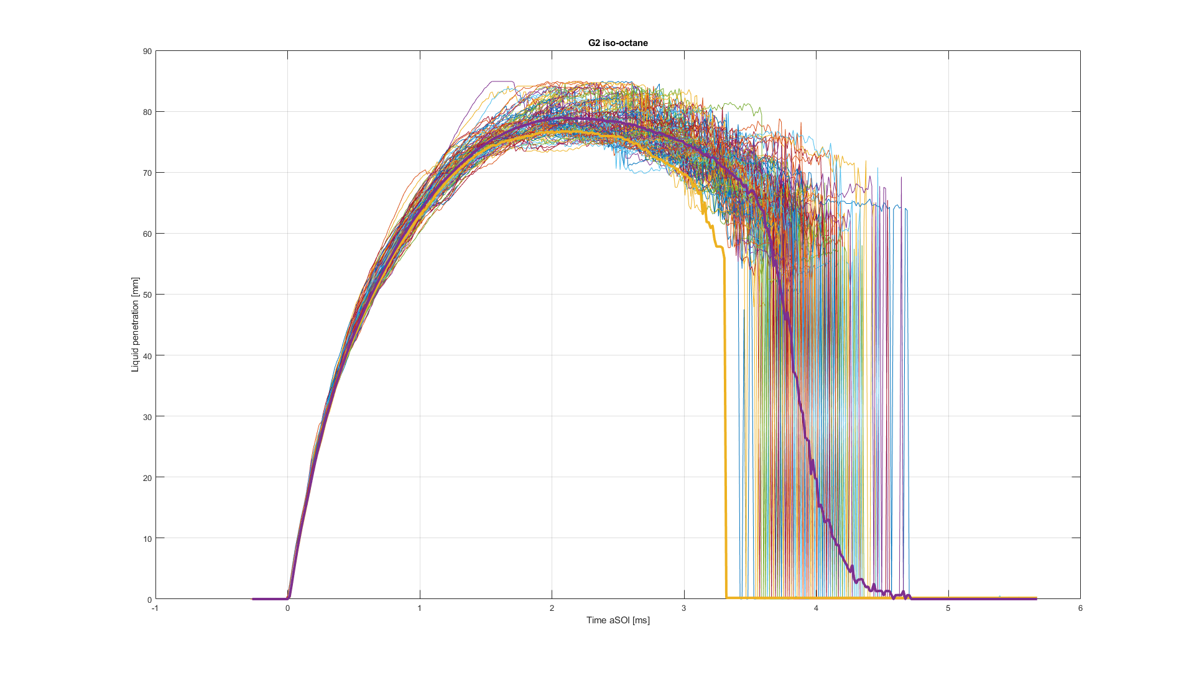
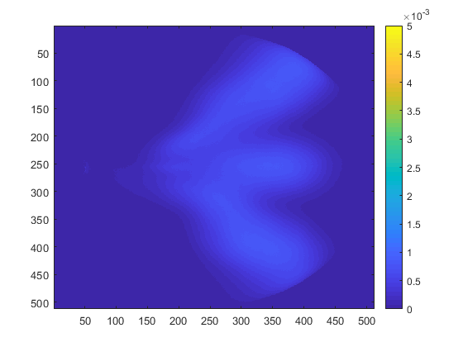
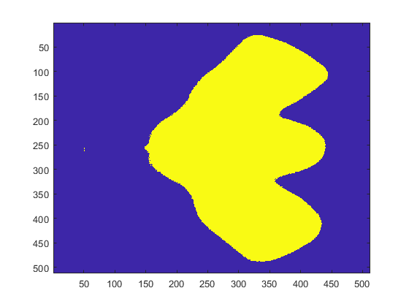
Example
Column 16
Measure by instantaneous PLV and average Column 16
PLV
Binarized
Column 14
Binarized
PLV
Avg. PLV and measure
Column 14
Column 15
Take average of 3 groups
Column 16 is usually larger than column 14 since detailed features of instantaneous spray still remain.
Binarized

Slide 8
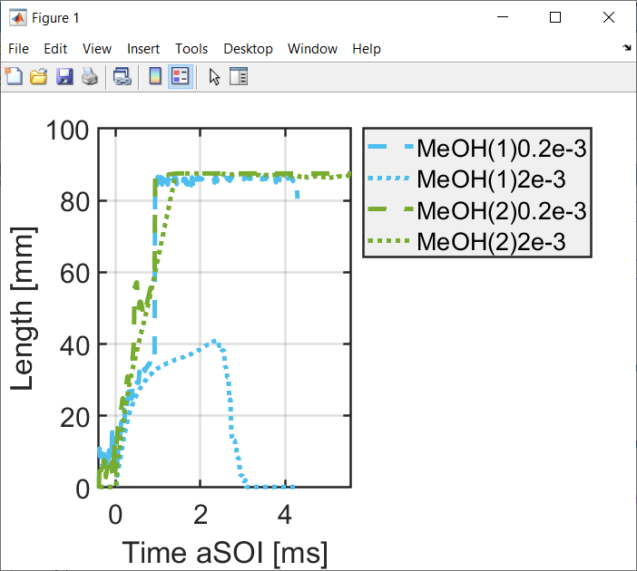
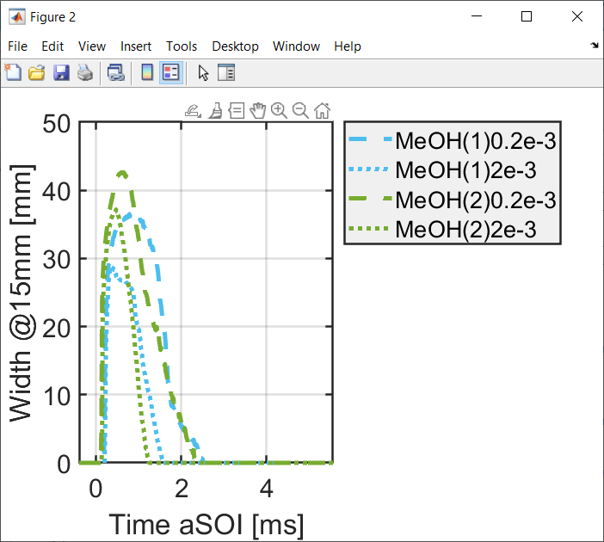
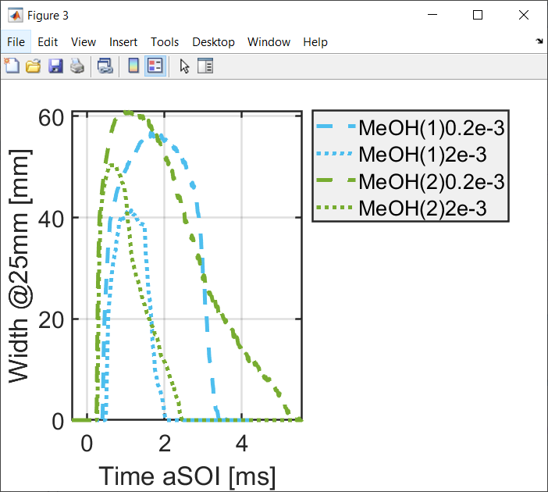
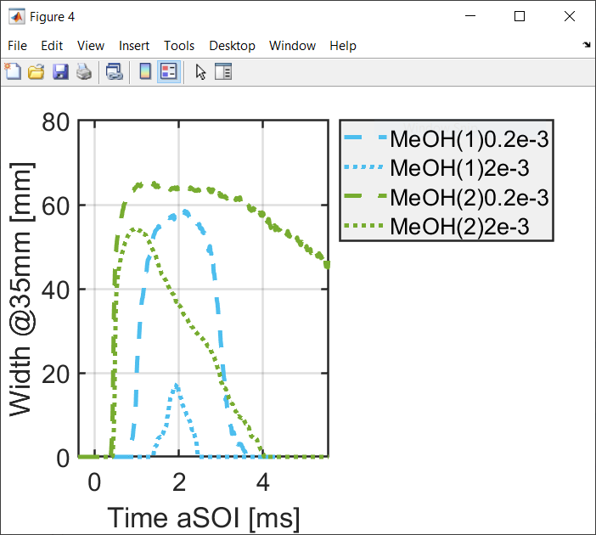
Plotting practice
Download liquid data and run the example code M_length_M1_M2_comparison.m for length comparison
Please change file inventory to where you downloaded data.
The example script, when run, should produce results like below.

Slide 9
Part II:
3D-CT spray data
Sandia National Laboratories

Slide 10
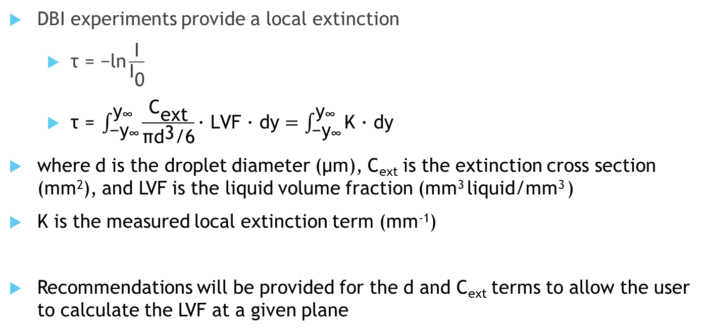
Diffused Backlight Illumination (DBI) Measurements
DBI experiments provide a local extinction
  $\text{τ}\text{ = −}\text{ln}\frac{\text{I}}{{\text{I}}_{\text{0}}}$
  $\text{τ}\text{ =} \int_{{\text{−}\text{y}}_{\text{∞}}}^{{\text{y}}_{\text{∞}}}{\frac{{\text{C}}_{\text{ext}}}{\text{π}{\text{d}}^{\text{3}}\text{/6}}\text{∙} \text{LVF}\text{ ∙ }\text{dy}=\int_{{\text{−}\text{y}}_{\text{∞}}}^{{\text{y}}_{\text{∞}}}{\text{K}\text{ ∙ }\text{dy}}}$
where d is the droplet diameter (μm), C_{ext} is the extinction cross section (mm²), and LVF is the liquid volume fraction (mm³ liquid/mm³ )
K is the measured local extinction term (mm⁻¹)
Recommendations will be provided for the d and C_{ext} terms to allow the user to calculate the LVF at a given plane

Slide 11
Ext_planes
Ext_planes.mat is data containing the local extinction, K, at 6 different planes (Z=10, 12, 15, 20, 25, 30mm)
Variable Ext_YZ presents K at YZ plane at different timesteps (ms) aSOI (time_vec)
Ext_XY presents the value K on the XY plane at 6 different axial locations for each timestep
Example codes available: “Ext_YZ.m” and “Ext_XY.m”
Y-Z plane at “Ext_YZ”
X-Y plane at “Ext_XY”

Slide 12
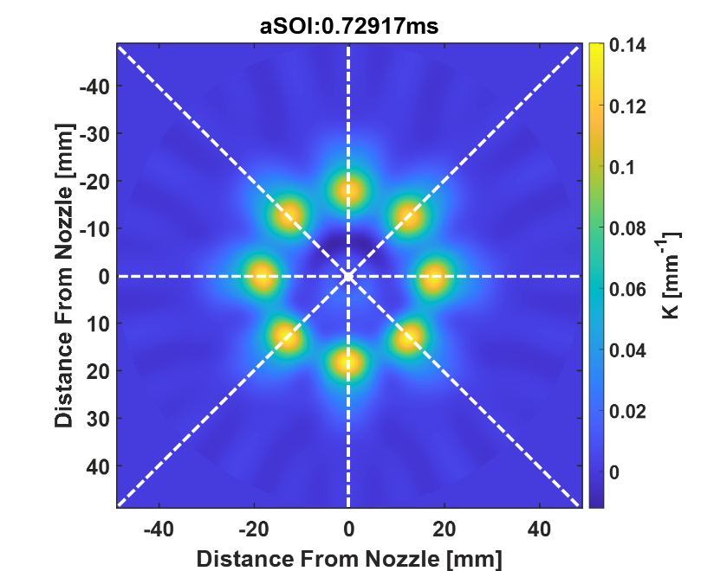
Centerline
Centerline data indicated averaged K (of 8 plumes) at 6 planes
It shows K along a radial distance through plume center
Example code available: “Ext_centerline.m”
Z= 30mm
Tomographically reconstructed spray in XY plane

Slide 13
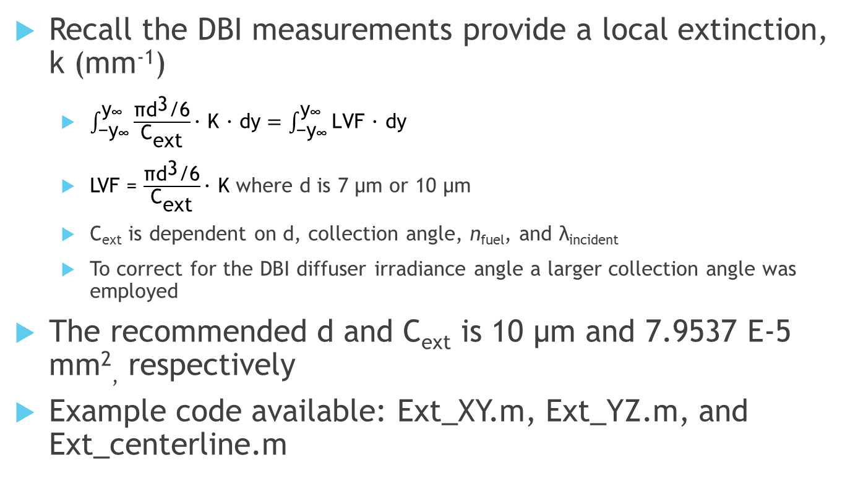
Determining the LVF
Recall the DBI measurements provide a local extinction, k (mm⁻¹)
  $\int_{{\text{−}\text{y}}_{\text{∞}}}^{{\text{y}}_{\text{∞}}}{\frac{\text{π}{\text{d}}^{\text{3}}\text{/6}}{{\text{C}}_{\text{ext}}}\text{∙} \text{K}\text{ ∙ }\text{dy}}=\int_{{\text{−}\text{y}}_{\text{∞}}}^{{\text{y}}_{\text{∞}}}{\text{LVF}\text{ ∙ }\text{dy}}$
  LVF = $\frac{\text{π}{\text{d}}^{\text{3}}\text{/6}}{{\text{C}}_{\text{ext}}}\text{∙} \text{K}$ where d is 7 μm or 10 μm
  C_{ext} is dependent on d, collection angle, n_{fuel}, and λ_{incident}
  To correct for the DBI diffuser irradiance angle a larger collection angle was employed
The recommended d and C_{ext} is 10 μm and 7.9537 E-5 mm², respectively
Example code available: Ext_XY.m, Ext_YZ.m, and Ext_centerline.m

Slide 14
Plume Angles
This data presents plume center (angle) at different axial (Z) locations.
Example code available: “plume_angles.m”
Plume angle was defined by an angle from center of injector to plume center.

