Slide 1
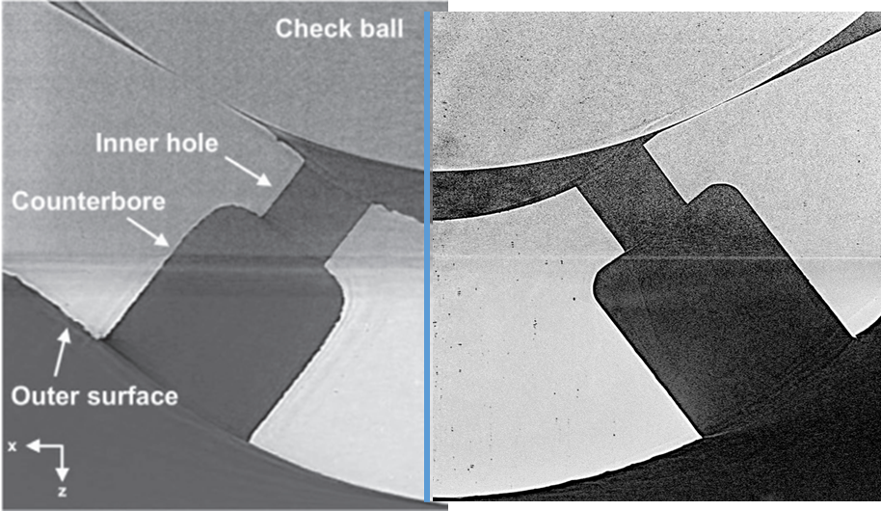
geometry scans performed for the same Spray M and “single-hole atomizer” with the same ball and build
Single-Hole Atomizer
SHA #730
Spray M #755
full serial number 038450BA0411213755PL
Spray G
Spray M
1.459 mm
6.00 mm
Moon, Powell (APS, above).
CT imaging at Argonne APS
Credit: Chi Moon and Chris Powell
Provided to Sandia (Pickett) for initial analysis
CT imaging at MS St
Credit: Kyungwon Lee and Joonsik Hwang

Slide 2
Analysis after some rotation and centering:
Orifice inlet is very sharp – laser machined. Spray G made by EDM
Notes:
D:\xray\sha\aps\sprayM_Slice.m

Slide 3
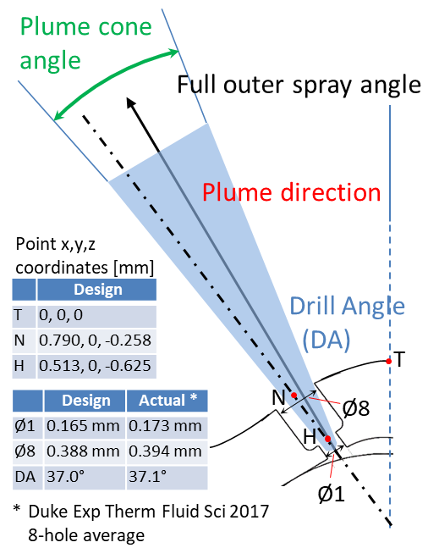
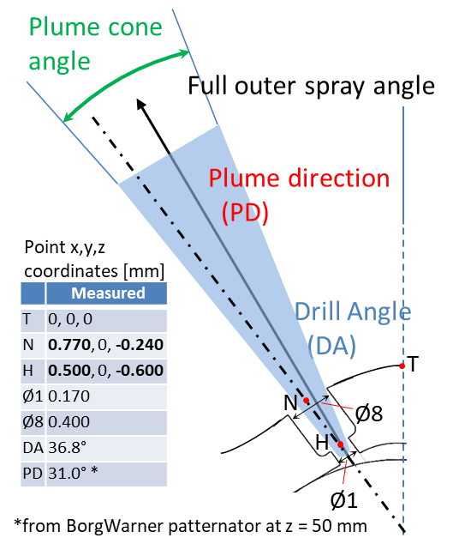
new recommended settings for Spray M Lagrangian simulations
Spray G
Spray M
Mesh and STL files available at
https://ecn.sandia.gov/gasoline-spray-combustion/computational-method/mesh-and-geometry/
No 3D CFD mesh/geometry available yet
Notes:
from plumeDefinitions.pptx

Slide 4
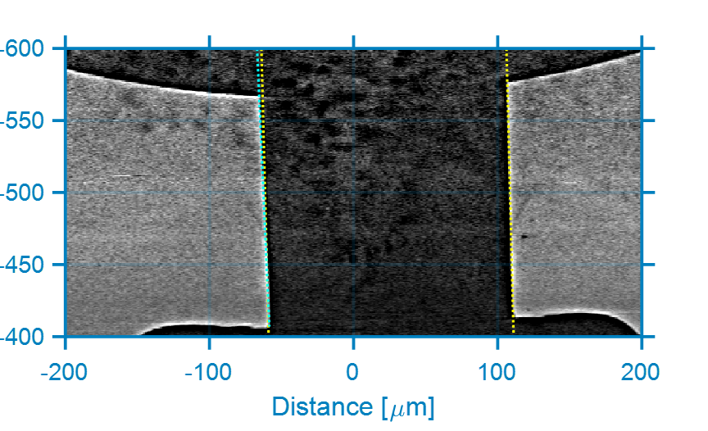
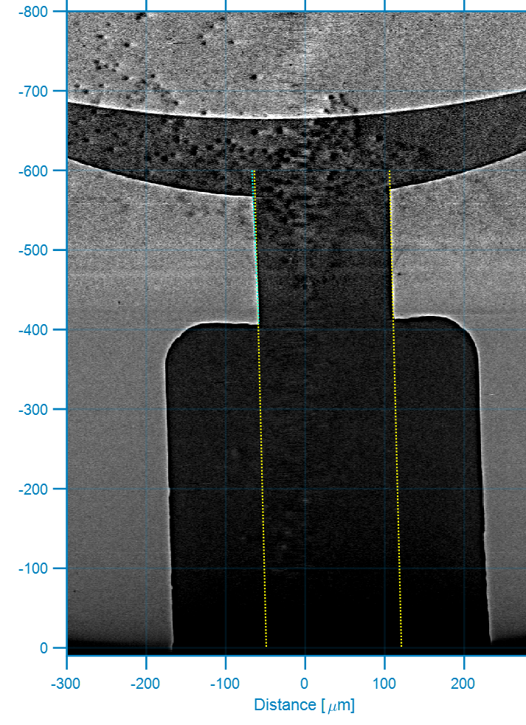
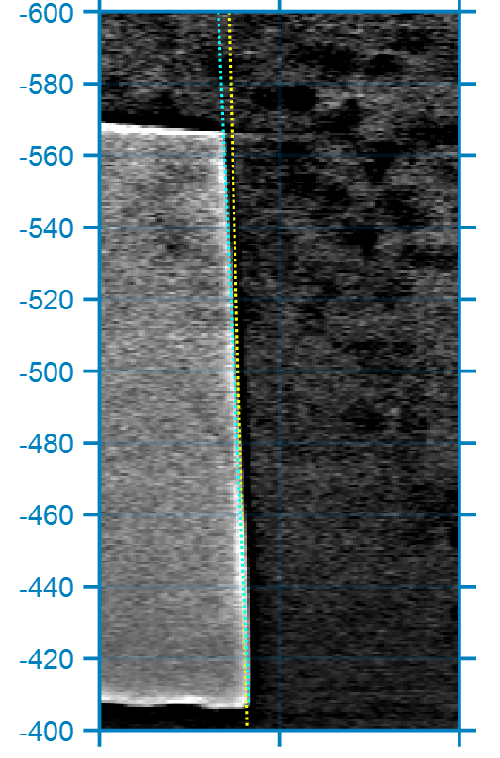
Coordinates are centered on sac and ball symmetry—hole is offset and canted by ~ 1.4 degrees
Inlet radius to hole is very sharp – laser drilled
Hole is barely convergent:
Measure a 1.08 degree full angle convergence, or a K factor = (d_inlet – d_outlet) / 10 μm = 0.3
170 μm cylinder,
rotated 1.4°
CT imaging at APS
Credit Chris Powell and Chi Moon
Notes:
Adding analysis from Argonne x-ray experiments for same hole. See D:\xray\sha\aps\shaSlice.m for figures

Slide 5
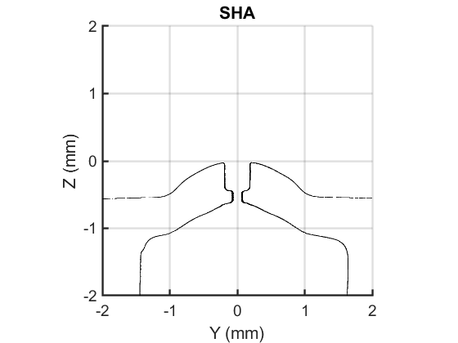
Hole and counterbore are processed from STL with the hole “cleaned”, but I do not believe the reconstruction has the accuracy to render the hole inlet appropriately.
Processed sac, hole, counterbore radius in Matlab. But “corrected” the hole to make it a perfect cylinder based upon original x-ray image on slide 1, and measured optical microscopy from Sandia and MS St. Using diameter of 0.170 mm for hole measured at Sandia. MS St measure 0.175 mm
Orange line is wireframe used by Marco Arienti to create a triangular tessellation (FE mesh) of surface
Available for internal-flow simulations
Notes:
D:\xray\sha\MSSTATE_ECN_INJ\pointSHA.m
figure(88) is a cut after some centering
Orange line (measured) is stored as
"D:\xray\sha\MSSTATE_ECN_INJ\ECN_single_hole\SHAwireframeRadiusMeasured.csv"

