Slide 1
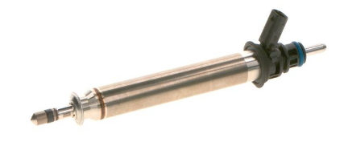
Geometry of ECN-designated HDEV4 piezo injector for hydrogen research
Abdullah Zaihi, Hong Im, Moez Ben Houidi, William Roberts
KAUST
Lyle Pickett, Bernice Mills, Steven Luna
Sandia National Laboratories CRF
First presented at ECN9.17 on 7 aug 2025, new edits:
After performing 5.8 μm x-ray CT scans, kaust Provided STL file to Sandia
Sandia performed minor modifications On imported CONVERGE file to make it possible to translate the pintle to a closed position

Slide 2
x-ray CT scans of HDEV4 injector
45° from image axis
PN 0261500804
HDEV42
0.025 mm slot
Scan by Bernice Mills (Sandia) using Zeiss Versa 620 with 10 μm voxel resolution
3.89 mm annulus
3.60 mm annulus
Notes:
D:\xray\hdev4h2\scanThroughhdev4Inject.m

Slide 3
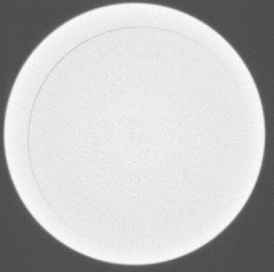
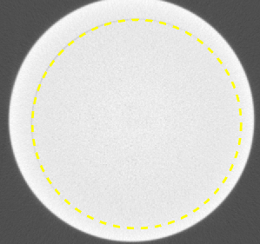
Identifying the region of contact with seat
3.60 mm diameter is in contact with pintle (or below 10 um voxel resolution over ½ of diameter) when closed

Slide 4
What happens in this region as the needle lifts?

Slide 5
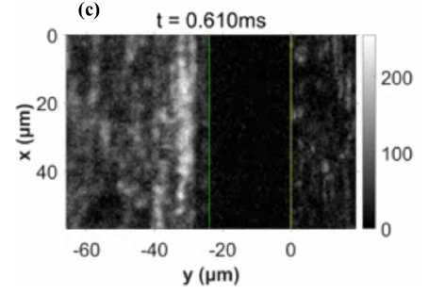
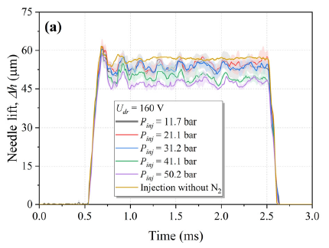
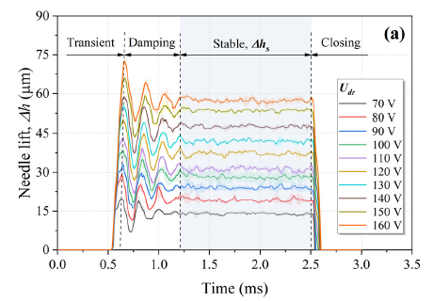
Needle motion measurements Wu 2025 (KAUST)
https://doi.org/10.1063/5.0252859
Using time-varying lift to compute theoretical flow limit, Wu et al. measured C_{d} = 0.8 with P_{inj} = 50 bar
0.16 ms ramp
~ 54 μm lift
Notes:
https://doi.org/10.4271/2025-01-8466, D:\xray\hdev4h2\theoreticalMdot.m shows A is 0.48 mm^2 at full lift

Slide 6


$$\dot{m}=1.08 g/s$$
Using the smaller seat diameter has about a 10% effect on perceived flow area
$$\dot{m}=1.00 g/s$$
flow already in divergent section at annulus exit
flow will restrict at smaller diameter/annular opening
Minimum flow area is is actually a catenoid, not a cone!
https://math.stackexchange.com/questions/2930021/why-is-the-catenoid-the-minimal-surface-of-revolution
Notes:
https://math.stackexchange.com/questions/2930021/why-is-the-catenoid-the-minimal-surface-of-revolution
D:\xray\hdev4h2\theoreticalMdot.m

Slide 7



$$\dot{m}=1.08 g/s$$
Using the smaller seat diameter has about a 10% effect on perceived flow area
STL file provided by KAUST (Zaihi & Im) at 54.4 μm lift height
$$\dot{m}=1.00 g/s$$
flow already in divergent section at annulus exit
flow will restrict at smaller diameter/annular opening
Minimum flow area is is actually a catenoid, not a cone!
https://math.stackexchange.com/questions/2930021/why-is-the-catenoid-the-minimal-surface-of-revolution
Notes:
https://math.stackexchange.com/questions/2930021/why-is-the-catenoid-the-minimal-surface-of-revolution
D:\xray\hdev4h2\theoreticalMdot.m

Slide 8
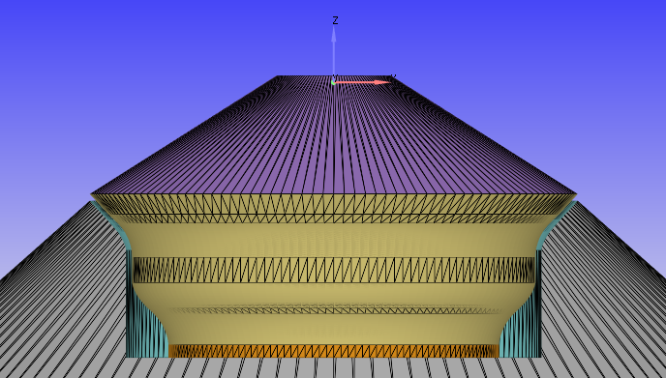
Pintle lifted by 54.4 um with regions shown suitable for a moving valve simulation using CONVERGE
STL file provided by KAUST (Zaihi & Im) at 54.4 μm lift height
Small modifications by Luna and Pickett to define regions for pintle translation
Coordinate system with Z = 0 for closed injector
Region to stretch/compress during pintle motion
Notes:
C:\pickett\ecn\h2hdev4lift54um

Slide 9
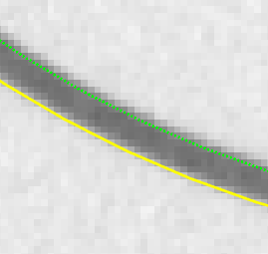
annular area only 0.52 mm²
annular area only 0.52 mm²
-> flow restriction upstream will restrict flow and cause pressure drop, from 50 bar to ~37bar
flow area ~ 2.3 mm²
Notes:
D:\xray\hdev4h2\scanThroughhdev4Inject.m, D:\xray\hdev4h2\theoreticalMdot.m
Used STEMS measurement of 1.2 g/s and can get this only with 37 bar upstream pressure

Slide 10
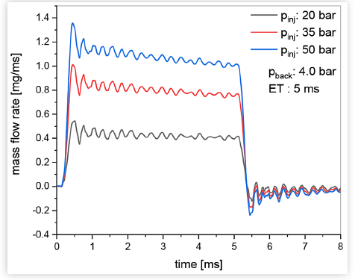
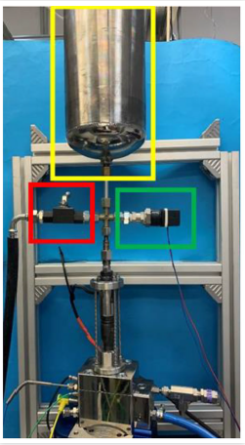
rate of injection by Montanaro 2025, using 220V
This ROI must have had a higher lift height than 0.054 mm
ROI decrease during injection despite massive upstream volume
8 mm ID lines
https://doi.org/10.4271/2025-01-8466
Notes:
https://doi.org/10.4271/2025-01-8466, D:\xray\hdev4h2\theoreticalMdot.m shows A is 0.48 mm^2 at full lift

Slide 11
Status
HDEV4 Geometry/grid is provided to ECN participants for CFD simulations
  Lift height recommended for simulations is 0.0544 mm
  Smallest flow area not at exit of annulus
Significant restrictions exist inside the injector, with flow losses and decreasing pressure just upstream of valve seat

Slide 12
acknowledgements
Sandia National Laboratories is a multi-mission laboratory managed and operated by National Technology and Engineering Solutions of Sandia, LLC, a wholly owned subsidiary of Honeywell International, Inc., for the U.S. Department of Energy’s National Nuclear Security Administration under contract DE-NA0003525.

