Slide 1
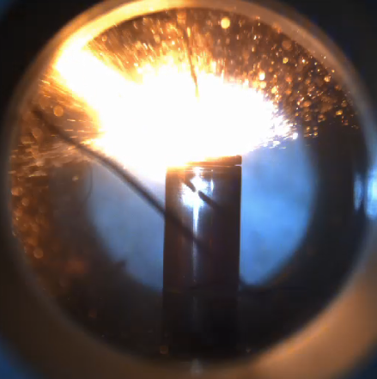
Li-ion Battery thermal runaway
ECN topic
ECN 10 workshop
Guidelines
Michele BARDI (IFPEN)
Lyle Pickett (Sandia)

Slide 2
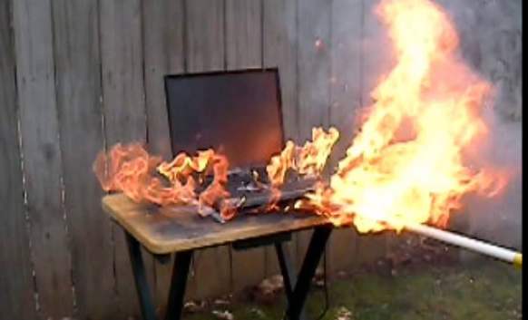
Thermal runaway topic
Li-ion battery thermal runaway is a challenging
safety issue for mobility electrification
Why is the ECN addressing batteries?
  It concerns mobility
  It involves several phenomena that we know and we have the tools to study:
    Combustion
    Di- (or tri-) phase jets
    Heat transfer
    Challenging conditions for diagnostics (high temperature, short time scales)

Slide 3
Thermal runaway topic
Li-ion battery thermal runaway is a challenging
safety issue for mobility electrification
Why ECN is dealing with batteries?
  It concerns mobility
  It involves several phenomena that we know and we have the tools to study :
    Combustion : different and partially unknown fuels
    Di- (or tri-) phase jets : fluid composition not constant, “burst-disk” vent sources
    Heat transfer: convection, radiation, conduction, flame propagation and runaway propagation
    Challenging condition testing (high temperature, short time scales): relevant boundary condition and parametric variation to be understood

Slide 4
Thermal runaway topic
Combustion community is starting to study Li-ion thermal runaway
  Experimentally and numerically
The topic objectives:
  Apply the “Spray A” approach on thermal abuse experiments
    Create a ref Experimental protocol on a reference battery cell ( LGM50LT- 21700)
    Investigating minor discrepancies among experimental results
    Databases from three different lab are currently available
  Compare simulations approach to reproduce experimental results
    Focus on cell internal temperature distribution
    Reaction timing (safety vent opens, thermal runaway)
    Battery Cell flow (vent jets, flame features, BC mass loss)
  To form a “peloton” on the subject
    Share good experimental / modeling practice
    It seems to be a wide world to explore (much more parameters to investigate / much more boundary conditions to explore)
    Generate new exchange between combustion and battery communities

Slide 5









Thanks to all Contributors!
Participation in this topic is growing

Slide 6
Reference case
Common battery chosen
  LG M50LT from the same production lot
  120 battery cells purchased and shared by IFPEN
Reference Running-in or preconditioning
  3 charge / discharge cycles
  CC/CV ref cycle from manufacturer
Test Definition:
  Thermal Abuse
  “Slow cooking mode”
    Heating with a controlled heating ramp at constant gradient
    Reference case : 1.5 °C/min
    Parametric Variation: 0.5 °C/min ; 0.2 °C/min
  BC state of charge (SOC):
    Ref Case: 100%
    Parametric variations: 50% ; 25% ; 75%

Slide 7
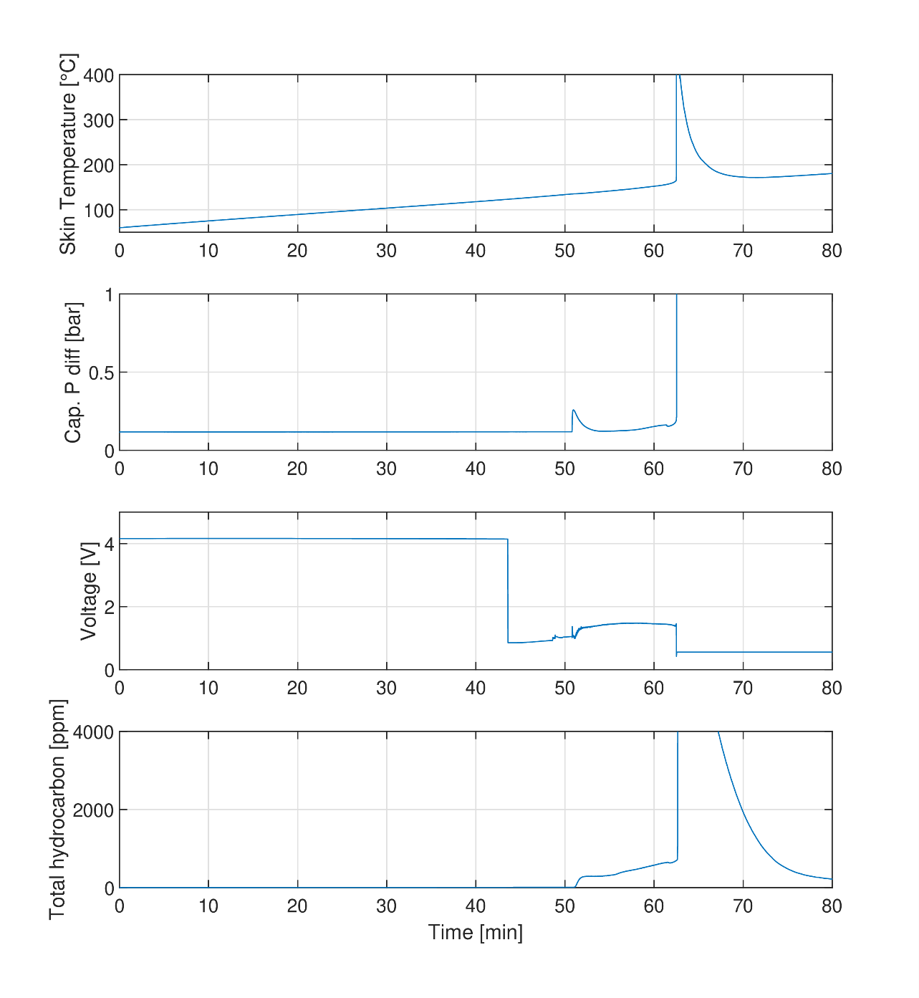

Sample Test results
Exothermic
onset
Voltage Drop
Gas Venting
Global runaway description measurement :
Richardet et al, SAE 2023-04-0165
García, et al., Energy Conversion and Management 2021
The following main events are in general described during TR in a thermal abuse case
1. Exothermic reaction onset
  -Observed mainly with HWS method
2. Voltage drop : CID (current interrupting device) stop battery form charge/decharge (non reversible)
3. Gas Venting
- Temperature variation
- Pressure increase
-Gas Analysis

Slide 8
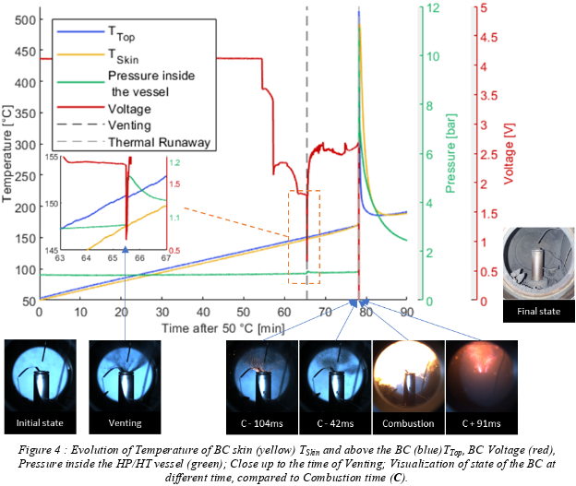

A new ECN topic: Data analysis and output parameters
Measurement data:
Richardet et al, ECM 2023
Output Parameters already extracted:
Venting time/ temperature
Runaway Time/ temperature
Voltage drop time / temperature
Time resolved Mass Loss during the thermal abuse
Exothermic reaction onset (obtained in ARC)
Temperature rate at onset
Temperature at 100 °C/min
Temperature at 10 °C/min
Time from onset temperature to maximum temperature
∆T from onset temperature to maximum temperature
Pressure increase (venting / thermal runaway)
Output parameter under investigation
Vented Gas Mass
Venting jet characterization
Ignition characterization
Flame characterization
Gas analysis (venting and runaway)
Others are open to discussion

Slide 9
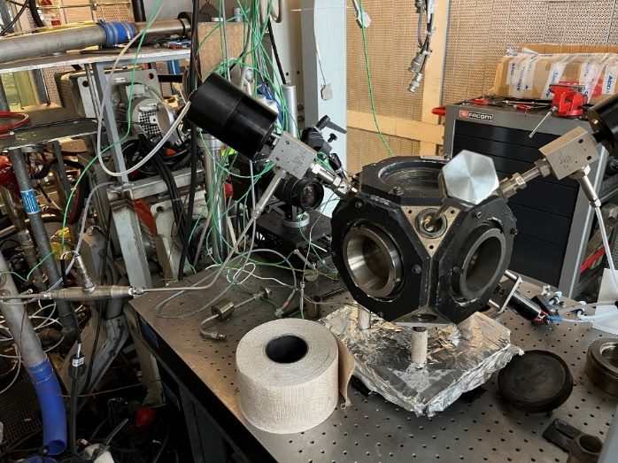
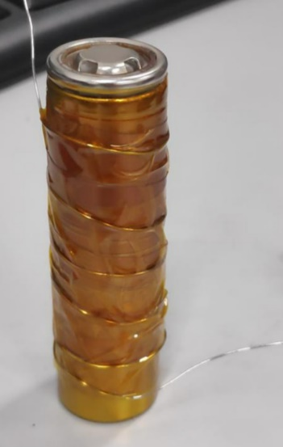
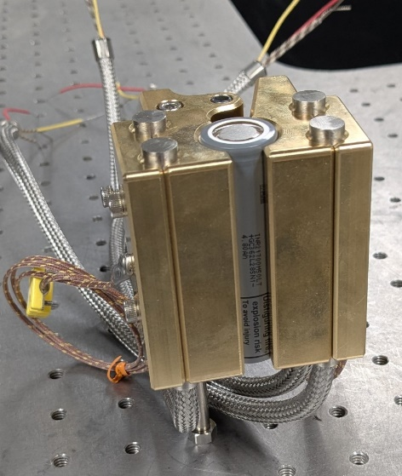
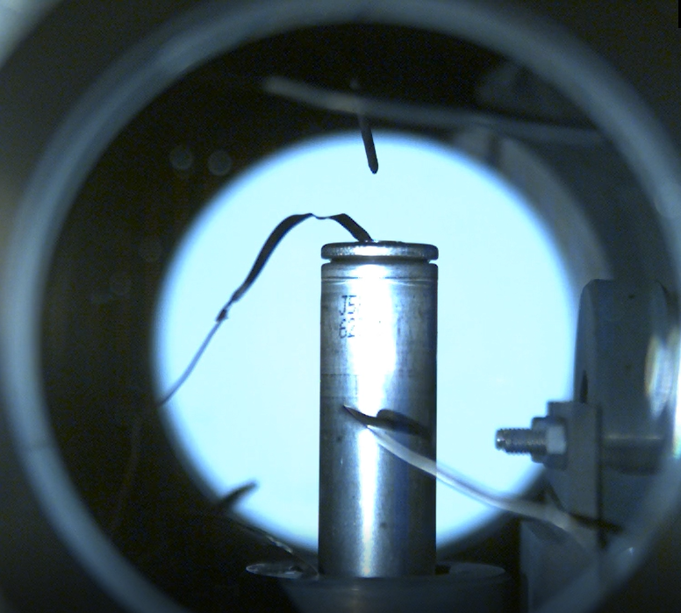
Experimental approaches
Complementary database from last workshop on LGM50LT thermal runaway
  Three different thermal abuse tests using the same heating ramp
Plastic casing removed for experiment
IFPEN : Semi closed volume
Air convection heat transfer
CMT : Adapted ARC
Electrical heater in contact with BC
ARC heater in « Exothermic mode » to keep ambient air at skin temperature
Sandia : Homogeneous contact heater
Multipoint skin temperature mapping

Slide 10
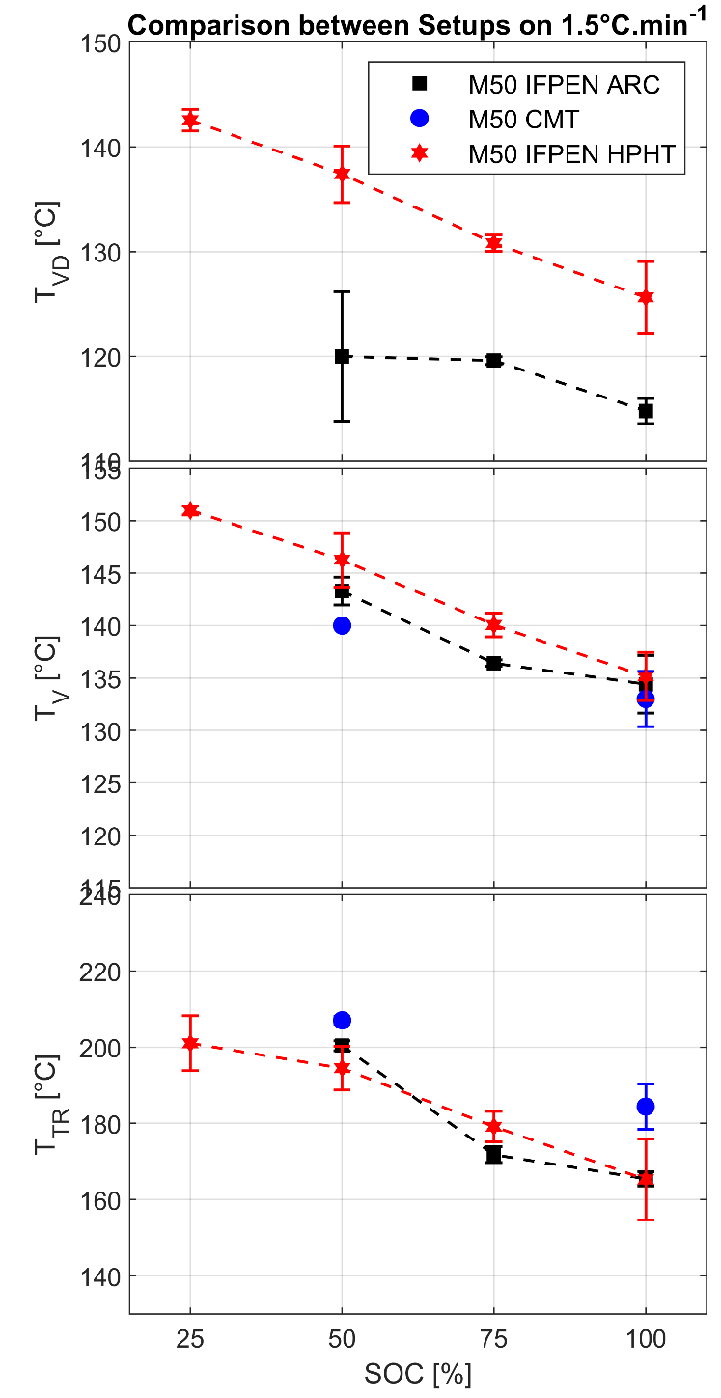
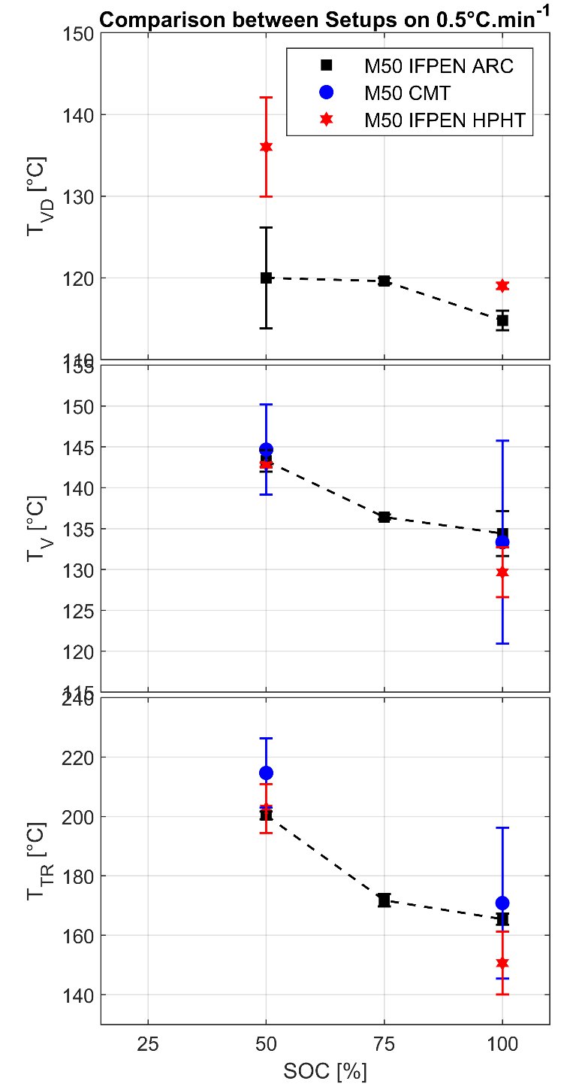
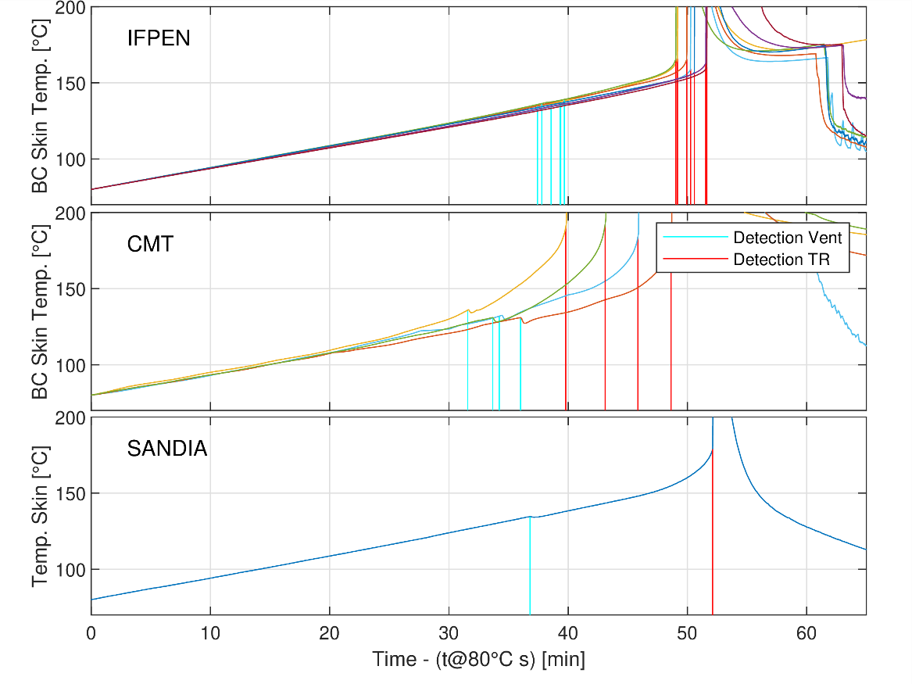
Results overview
Results from the three protocols + ARC reference
  Parametric variations (heating ramp / SOC)
  Statistics over many repetitions
  More experiments with more parametric variation or complementary measurements are welcome: let’s make this database grow!!
  The data are open access and could be shared with new contributors

Slide 11

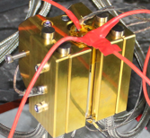
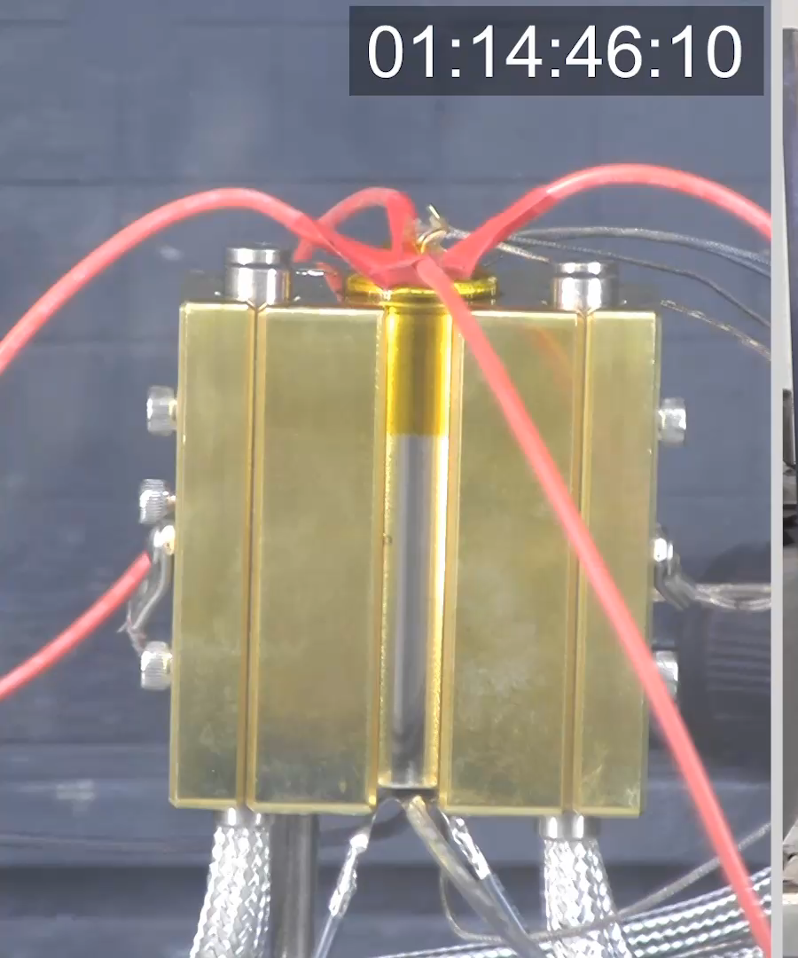
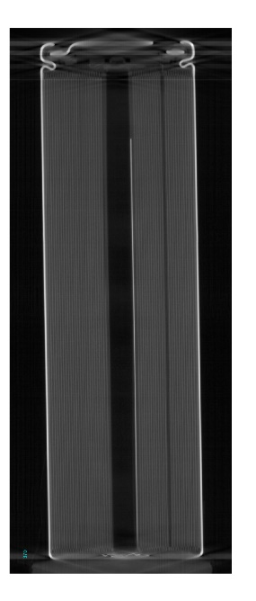
TC_high
TC_mid
TC_low
On cylinder at back gap, and affixed with Kapton tape
Battery cell temperature distribution
SANDIA specific approach
Homogeneous heating is provided by a solid brass block encompassing the cell, where the block/heater is controlled to 1.5°C/min
BC ̎skin ̎ or ̎casing ̎ temperature is measured at different points
This setup provides a map of the BC temperature distribution to detect onset of exothermic reactions within the cell
3D X-ray scan of the BC cell is available to know detailed internal geometry, including casing
TC_top
Positive terminal
TC_bottom
Negative terminal
Comparison to numeric models enables investigation of the temperature distribution of the BC during the thermal abuse
First simulation has been run (see Pickett ECN9.18) –
Mesh/grid for cell is available for new simulations (next slide)
New Contribution for simulations/experiments at 1.5°C/min condition are encouraged for ECN10
Vent at 4486 s
Runaway 5419 s, or 15.5 min later

Slide 12




Positive terminal not modeled
Casing
SS 304
Air Insulator
R_{c} = 0
Cathode tab
Aluminum
R_{c} = 0
h = 10
W/m^2/K
h = 10
W/m^2/K
Heater
Brass
Non-isotropic conduction
Boundary at cartridge heater set to T ramp at 1.5°C/min
Radial
Poor conduction
50 x lower
Brass-SS
R_{c} = 0.004
SS casing - jellyRoll
R_{c} = 0.005 K m^2/W
Simulation begins with T = 80° C initial condition
JellyRoll
NMC811 with graphite anode
Notes:
Used paraView with the idreg plot

Slide 13
Guidelines in summary
Battery cell thermal runaway has several open questions
We would like to tackle them starting from a reference test case
Battery cell LGM50LT 21700 / Thermal abuse with slow cook approach (1.5°C/min)
Experimental contributions:
  New diagnostics applied to the reference case or new data on the test conditions already tested would help the database to increase
    E.g. BC mass loss during venting, TR heat release, Gas Composition, etc.
Numerical contributions
  All numerical approaches trying to reproduce the reference case would be valuable contributions
  First propositions:
    Investigation of the temperature distribution/evolution and heat propagation within the BC
    Investigating heat released during thermal runaway
If willing to contribute in following this topic, please contact topic organizers
    Michele Bardi ( michele.bardi@ifpen.fr ) and Lyle Pickett ( LMPicke@sandia.gov )
    The database of experimental and numerical data will be shared

