Slide 1
ECN10 AMMONIA GUIDELINES
Topic LEADS
M Battistoni, UNIPG
G Bracho, CMT-UPV
Presented: 7 August 2025
to participate, please contact us:
michele.battistoni@unipg.it
gbracho@mot.upv.es

Slide 2
CONTENTS
Overall Introduction
Ammonia topics
  Spark Ignition Mode. Internal flow, Non-reacting spray
  Compression Ignition Mode. Non-reacting spray // Combustion

Slide 3
OVERALL INTRODUCTION
General guidelines
  From nozzle flow through vaporizing spray, combustion and emissions
  Improving synergy among groups working on ammonia as a fuel
Motivation
  Growing interest on zero-carbon fuel for transportation and power
  Availability of ammonia as chemical→ ammonia for power
Ammonia combustion can be achieved through
    High compression ratios
    Spark-ignition under near-stoichiometric/lean conditions
    Pilot-ignition under lean and very lean conditions
    Booster/enhancer, like H2 from reforming

Slide 4
OVERALL INTRODUCTION
Highlights for ECN10:
  Spray D: Based on diesel hardware (bigger nozzle 250 μm & 300 μm) – 2 units available at CMT (Ref. 0446.B00.02K & 0446.B00.02J respectively)
  Spray M: GDI type injector, injection pressure up to 350 bar. Single-hole & 8-hole nozzles (hole diameter 170 μm, with 400 μm counterbore)

Slide 5
OVERALL INTRODUCTION
(*) air or pure N2 is equivalent at these conditions, as ignition is not expected
(**) only for CFD, ignition study
Operating conditions
Reference Nozzles
  Spray M, single-hole & 8-hole (hole diameter 170 μm, with 400 μm counterbore)
  Spray D, Single-hole (modified version → 300 μ m, 250 μm) (available at CMT) → data for simulation
Fuels
  Ammonia
  Reacting conditions: dodecane-pilot injection + ammonia.
Injector type | Name | T fuel [K] | P fuel [bar] | T amb [K] | P amb [bar] | rho amb [kg/m3] | O2 [%] | Injection duration [ms]
M (1,8) | Ambient fuel | 293 | 70, 150, 200 | 293 | 0.5, 1, 7, 15 | varies | 21 (*) | > 1
 | Cold/Hot fuel | 253, 323, 373 | 70, 150 | 293 | 1 | - | 21 (*) | > 1
 | Hot fuel, high back-press. | 373 | 150 | 293 | 6 | - | 21 (*) | > 1
D | Compression Ignition Mode (dual-fuel) | 298 289 | 400 600 800 | 900, 1000 | varies | 22.8 | 0, 21 | 3
 | Only NH₃ | 298 | 1500 (**) | 1400, 1500 (**) | varies | 22.8 | 15 (**) | 3
Notes:
In spray D, I have included Tfuel = 298

Slide 6
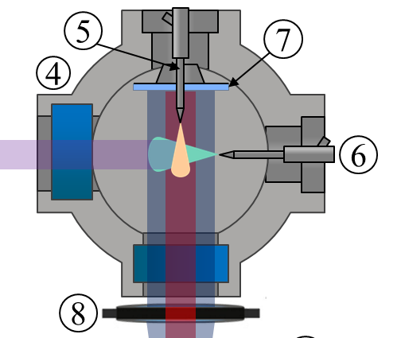
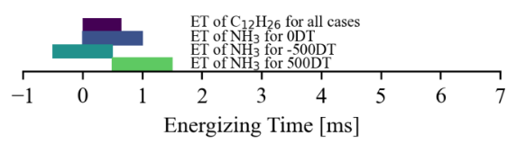
OVERALL INTRODUCTION
(*) air or pure N2 is equivalent at these conditions, as ignition is not expected
(**) only for CFD, ignition study
Operating conditions
Injector type | Name | T fuel [K] | P fuel [bar] | T amb [K] | P amb [bar] | rho amb [kg/m3] | O2 [%] | Injection duration [ms]
M (1,8) | Ambient fuel | 293 | 70, 150, 200 | 293 | 0.5, 1, 7, 15 | varies | 21 (*) | > 1
 | Cold/Hot fuel | 253, 323, 373 | 70, 150 | 293 | 1 | - | 21 (*) | > 1
 | Hot fuel, high back-press. | 373 | 150 | 293 | 6 | - | 21 (*) | > 1
D | Compression Ignition Mode (dual-fuel) | 298 289 | 400 600 800 | 900, 1000 | varies | 22.8 | 0, 21 | 3
 | Only NH₃ | 298 | 1500 (**) | 1400, 1500 (**) | varies | 22.8 | 15 (**) | 3
Dodecane injector
- The position of the injectors is given in the diagram, but other inclinations could work better for flame interaction.
Dodecane injector: Spray C type
Dwell time (DT) between injections: +500us / -500us / simultaneous
NH3 injector
3 ms
Notes:
In spray D, I have included Tfuel = 298

Slide 7
CONTENTS
Overall Introduction
Ammonia topics
  Spark Ignition Mode. Internal flow, Non-reacting spray
  Compression Ignition Mode. Non-reacting spray // Combustion

Slide 8
1. Internal flow, near field, vaporization and mixing 1/2
OBJECTIVES
Study:
Internal flow and near-field dynamics: primary break-up, cone angle, flash boiling, and related flow features of single-hole vs. multi-hole
Parameters:
  Effect of ambient pressure
  Effect of fuel temperature (cold, ambient, hot)
  Effect of injection pressure
  Open questions:
  Does flash-boiling always occur? Does it start inside the orifice or externally?
  How much does jet collapse affect mixing behavior? (single vs. multi-hole)
  Are ammonia liquid properties affecting spray formation and mixing fields, in such a way that new predictive models are needed?
  Modeling paths: dense-fluid, thermodynamic break-up, mechanical break-up, evap.?
  What minimum temperature do we reach? Does it get compensated heating the fuel? Does it change with ambient conditions?

Slide 9
1. Internal flow, near field, vaporization and mixing 2/2
REQUESTED INFO (both Experiments and Simulations, where applicable)
  Mass & momentum flow rates
  Tip penetration, near nozzle cone angle vs. time
  Transverse integrated mass (TIM) vs. axial distance
  2D contours of liquid volume fraction (LVF) and on cross-sections for sim.
  2D contours of projected liquid density and projected liquid volume (PLV)
  Mean droplet size (SMD) and PDF of liquid drop diameters
  Liquid and vapor mass fractions (either as projected quantities or as cut-plane values for sim.)
  Temperature fields, both liquid and gas phase
  Velocity fields, both liquid and gas phase
  Mixing fields
  In addition: raw data from simulations in VTK format are accepted as well. Quantities of interest will be extracted and shared with the ECN (with permission of submitters). Please contact the organizers to discuss submission of VTK format files.

Slide 10
CONTENTS
Overall Introduction
Ammonia topics
  Spark Ignition Mode. Internal flow, Non-reacting spray
  Compression Ignition Mode. Non-reacting spray // Combustion

Slide 11
2. CI Mode – Non-reacting spray 1/2
OBJECTIVES
Study:
Near-nozzle field and spray development: primary break-up, cone angle, is there any flash boiling?
Parameters:
  Effect of gas temperature
  Low temperature fuel vs. Heated fuel
  Effect of injection pressure
  Open questions:
  Does flash-boiling occur? Is there cavitation inside the orifice?
  Are ammonia liquid properties affecting spray formation and mixing fields, in such a way that new predictive models are needed? (specially during the start of injection)
  Modelling paths with ammonia: break-up & evap.?
  How is the temperature distribution in the spray? (temperature drop near the nozzle)

Slide 12
2. CI Mode – Non-reacting spray 2/2
REQUESTED INFO (both Experiments and Simulations, where applicable)
  Mass & momentum flow rates
  Tip penetration, near nozzle cone angle vs. time
  Transverse integrated mass (TIM) vs. axial distance
  2D contours of liquid volume fraction (LVF) and on cross-sections for sim.
  2D contours of projected liquid density and projected liquid volume (PLV)
  Temperature fields, both liquid and gas phase
  Velocity fields, both liquid and gas phase
  Mixing fields
  In addition: raw data from simulations in VTK format are accepted as well. Quantities of interest will be extracted and shared with the ECN (with permission of submitters). Please contact the organizers to discuss submission of VTK format files.

Slide 13
2. CI Mode - COMBUSTION 1/2
PROPOSED EXPLORATORY STUDY
  Ammonia & dodecane Pilot-ignition: experiments available → data available for comparisons with other experiments and numerical simulations
  Numerical analysis (‘blind experiment’) of single ammonia spray combustion under diesel-like environment (highest gas temperature)
  Evaluation of potential future research within ECN
FOCUS OF ANALYSIS
  Ammonia ignition sequence / potential
  NOx formation

Slide 14
2. CI Mode - COMBUSTION 2/2
CONDITIONS
  Dual-fuel configuration: n-dodecane pilot injection (set-up from slide 6)
  Spray D – Injection pressure 600/800/1500 bar
  Ambient density 22.8 kg/m3
  Ambient temperature 1000K (1400/1500 K for “CFD single fuel”)
  Ambient oxygen 21% (15%)
  Chemical mechanism:
    Otomo et al. Int J Hydrogen Energy 2018; 43: 3004–3014
    n-dodecane/ammonia by Kurumus et. al (Aalto University)
    Other mechs are also welcome for comparison purposes (please contact organizers)
REQUESTED INFO (both Experiments and Simulations, where applicable)
  Ignition delay time
  Time-resolved tip penetration, Tmax, heat release rate
  Species and temperature fields

Slide 15
CONCLUSION
Call for contributors!

