Slide 1
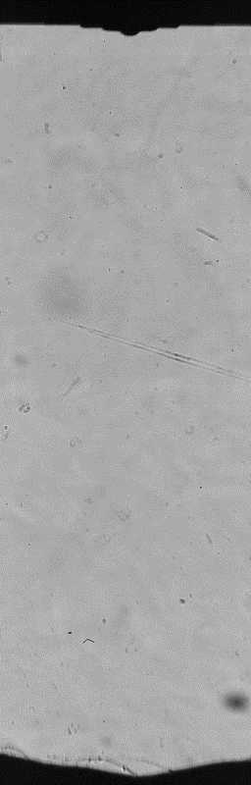

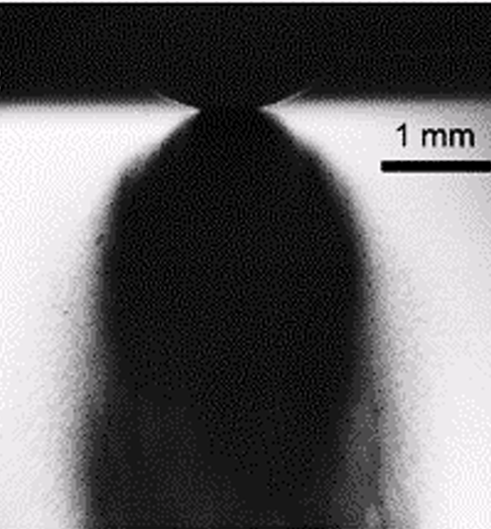
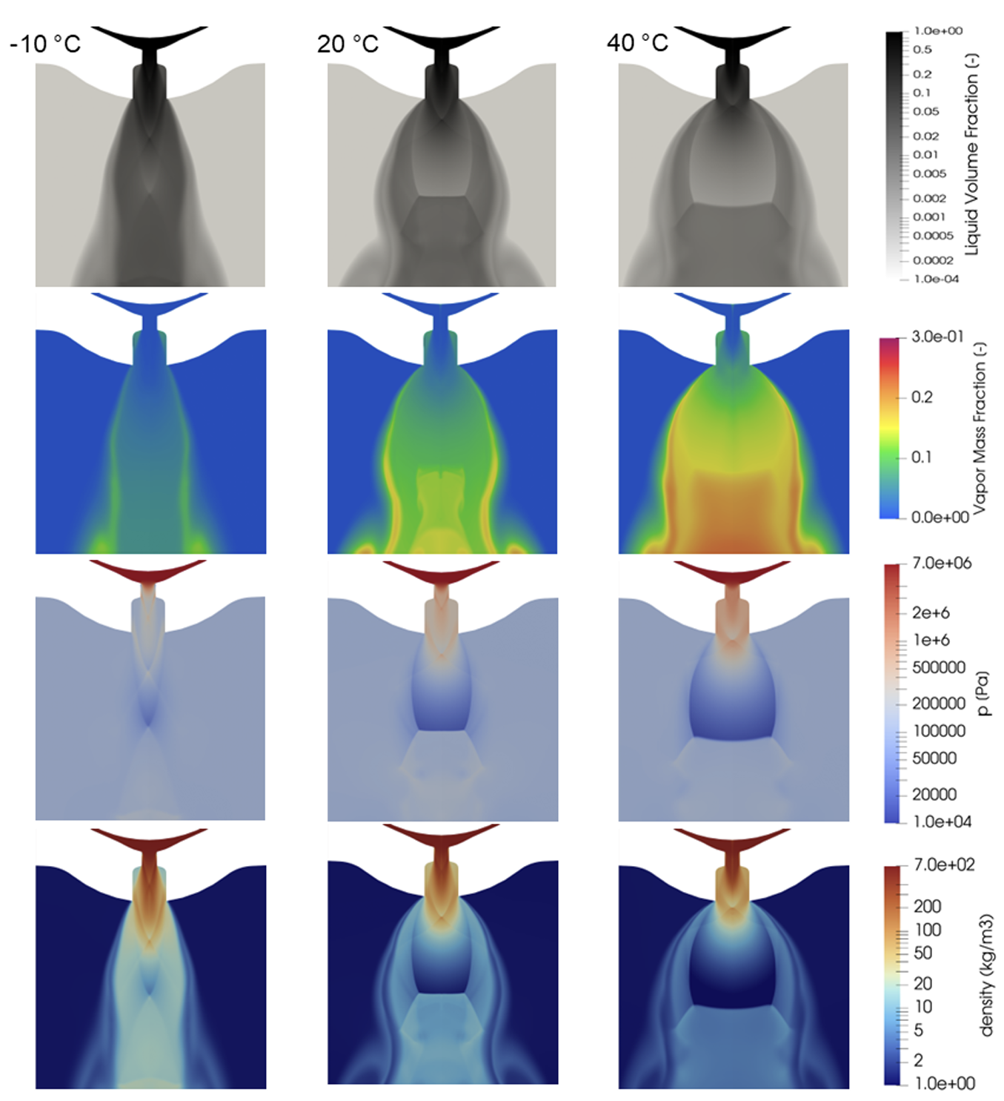
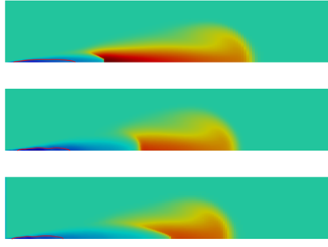
ECN10: AMMONIA spray and combustion
Topic LEADS
M Battistoni, UNIPG
G Bracho, CMT-UPV
CHIBA, december 14, 2025

Slide 2
The AMMONIA case
Availability of ammonia as chemical → ammonia as fuel for power
Hydrogen carrier: zero-carbon fuel for transportation and power
Ammonia properties are not optimal for combustion ☹
But combustion can be achieved through ☺
High compression ratios
High-energy discharge spark-ignition in near-stoichiometric/lean conditions
Pilot-ignition (dual fuel) in lean and very lean conditions
Booster/enhancer, like H2 from reforming

Slide 3
ECN10 AMMONIA sprays and combustion
Agenda (15:30-17:30) Speaker Time (including Q&A)
Spark Ignition Engines:
Internal flow & Non-reacting spray (Michele Battistoni, Perugia) 15:30-16:00
Ammonia spray experimental database (Christine Rousselle, Orleans) 16:00-16:30
Compression Ignition Engines:
Non-reacting spray & Combustion (Gabriela Bracho, CMT UPV) 16:30-17:15
Gas Turbines:
Ammonia sprays in GT (Kunkuma Somarathne, Tohoku) 17:15-17:30
Topic LEADS
M Battistoni, UNIPG
G Bracho, CMT-UPV
Chiba, December 14, 2025

Slide 4
ECN10 AMMONIA sprays and combustion
Agenda (15:30-17:30) Speaker Time (including Q&A)
Spark Ignition Engines:
Internal flow & Non-reacting spray (Michele Battistoni, Perugia) 15:30-16:00
Ammonia spray experimental database (Christine Rousselle, Orleans) 16:00-16:30
Compression Ignition Engines:
Non-reacting spray & Combustion (Gabriela Bracho, CMT UPV) 16:30-17:15
Gas Turbines:
Ammonia sprays in GT (Kunkuma Somarathne, Tohoku) 17:15-17:30
Topic LEADS
M Battistoni, UNIPG
G Bracho, CMT-UPV
Chiba, December 14, 2025

Slide 5
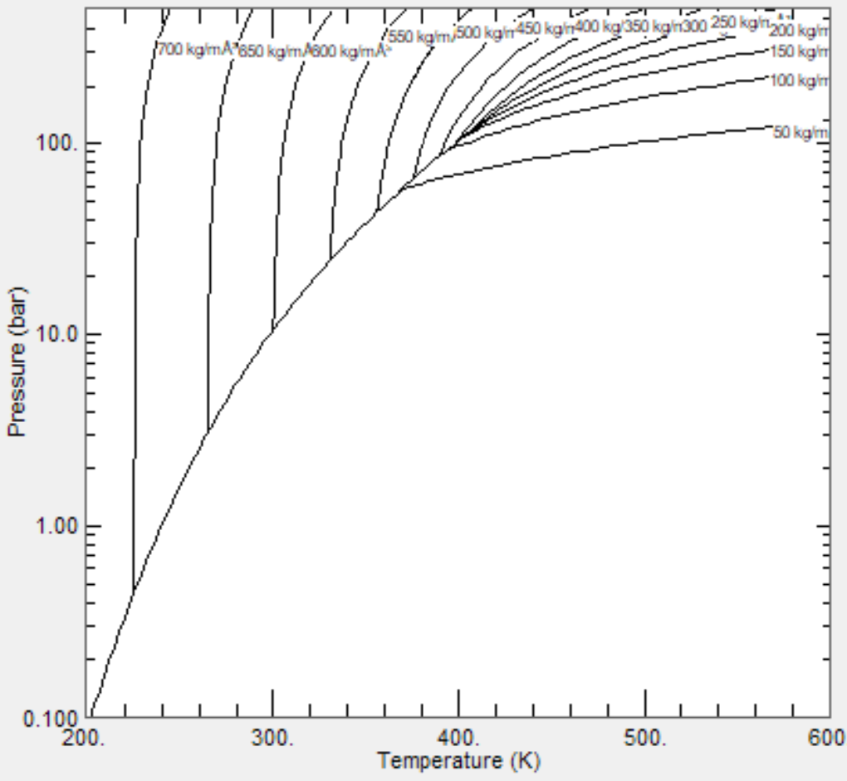
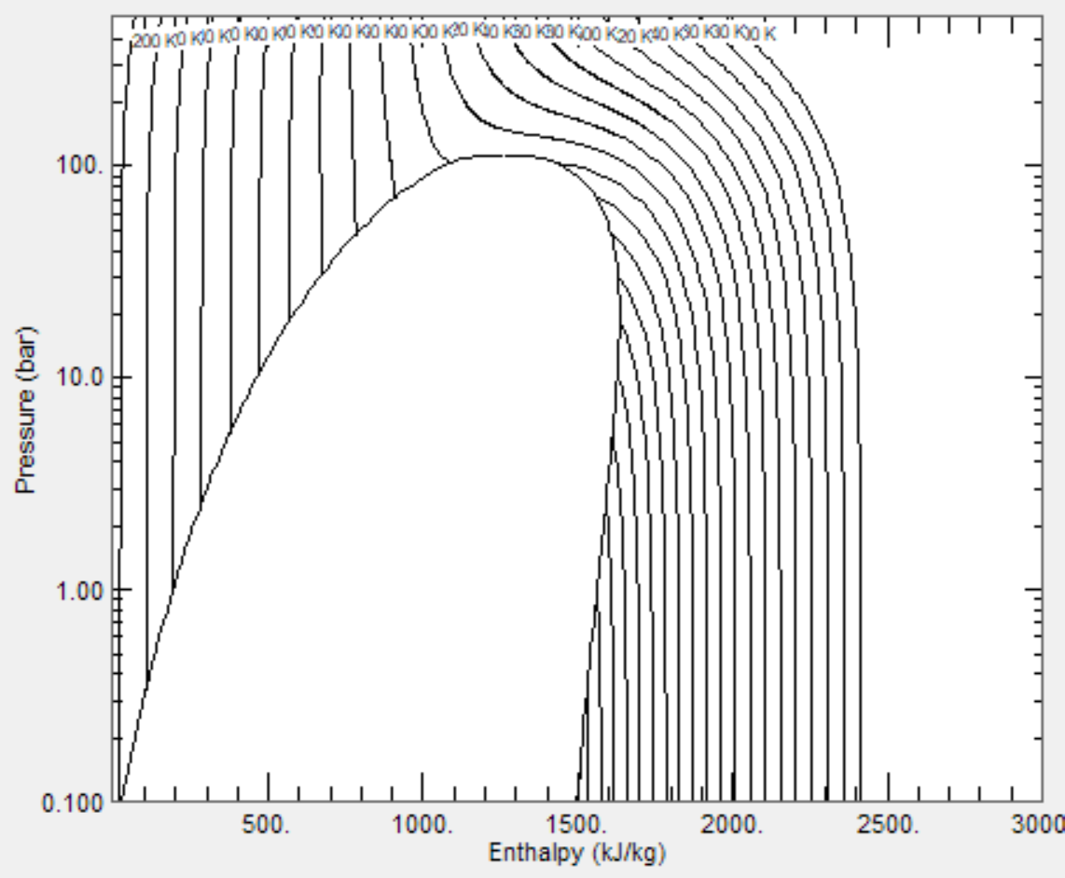
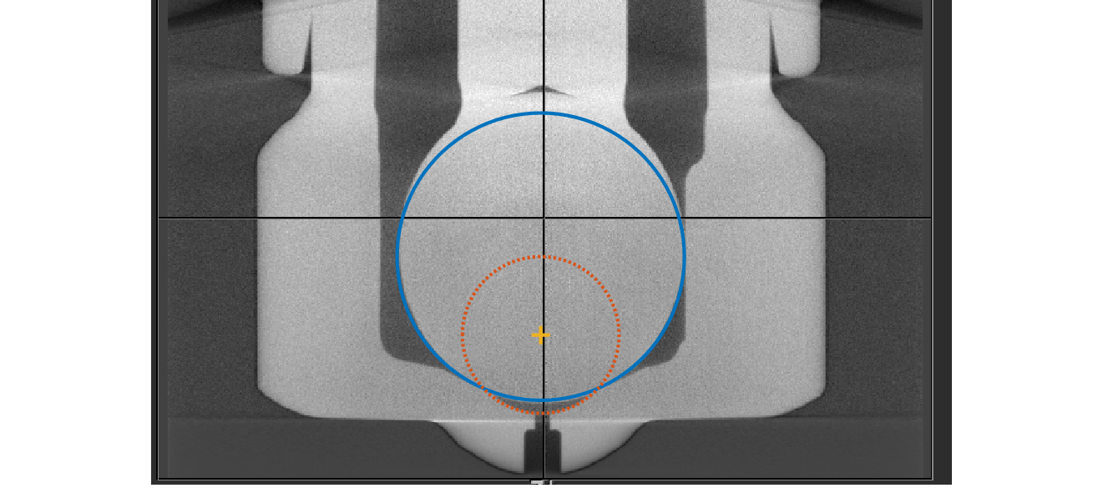
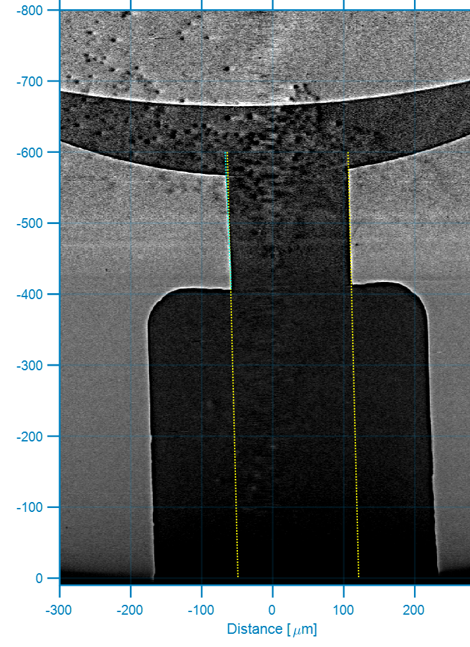
ECN10 conditions for ammonia SPRAYS in SI engines
Injector type | Name | T fuel [K] | P fuel [bar] | T amb [K] | P amb [bar] | rho amb [kg/m3] | O2 [%] | Inj. duration [ms]
M (1 hole, 8 holes) | Ambient fuel | 293 | 70, 150, 200 | 293 | 0.5, 1, 7, 15 | varies | 21 (*) | > 1
 | Cold/Hot fuel | 253, 323, 373 | 70, 150 | 293 | 1 | - | 21 (*) | > 1
 | Hot fuel, high back-press. | 373 | 150 | 293 | 6 | - | 21 (*) | > 1
Reference Nozzles
Spray M, single-hole & 8-hole (hole diameter 170 μm, with 400 μm counterbore)

Slide 6
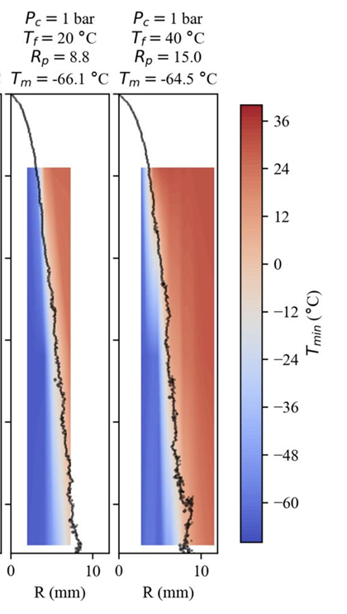
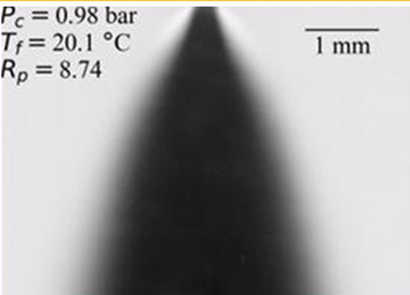
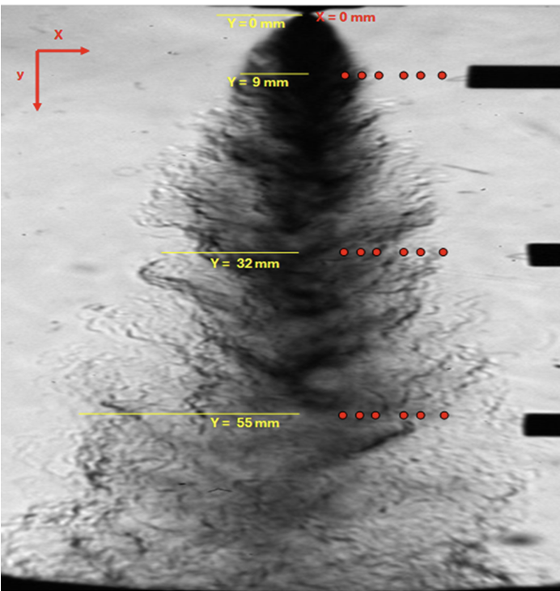
Contributors – experiments
Group | Injector |  | Techniques & Conditions
 | M/G (8 holes) | M (single-hole)
U-ORLEANS Christine Rousselle Camille Hespel |  |  | Macroscopic Schlieren (to track both liquid and vapor phases) Diffuse back-illumination Droplet size measurements (Malvern analyzer) Thermocouple “point” in-spray measurements
NTNU Karl O. P. Bjørgen |  |  | Near field Schlieren
Diffuse back-illumination
Near field Schlieren
Macroscopic Schlieren
Thermocouple “point” in-spray measurements

Slide 7
Contributors – CFD Modelers
Institution/Group |  | Conditions
 | M (single-hole)
U-Perugia / U-L’Aquila Michele Battistoni, Jacopo Zembi, Francesco Duronio |  | M (single hole) ambient fuel: (base+2) sweep of amb P.: 0.5, 1, 7 p inj = 70 cold and hot fuel: (base+3) sweep of T fuel: 263, 293, 323, 1-70
KAUST Mohammad Raghib Shakeel, Xinlei Liu |  | M (single hole): ambient fuel: (base+2) sweep of inj. P.: 70, 150, 200 p amb = 1 (base+2) sweep of amb P.: 0.5, 1, 7 p inj = 70 cold & hot fuel: (base+3) sweep of T fuel: 253, 293, 323, 373, 1-70
PoliMI Alessandro Nodi, Tommaso Lucchini, Lorenzo Sforza, Mattia Pelosin, Gianluca D'Errico |  | M (single hole): ambient fuel: (base+2) sweep of inj. P.: 70, 150, 200 p amb = 1 (base+2) sweep of amb P.: 0.5, 1, 7 p inj = 70 cold fuel: (base+3) sweep of T fuel: 253, 273, 293, 1-70

Slide 8
Contributors – CFD Modelers
Institution/Group | Approach | CFD code | Compressibility and EOS | Turbulence model
U-Perugia / U-L’Aquila Michele Battistoni, Jacopo Zembi, Giacomo Neri, Francesco Duronio | Lagrangian | CONVERGE v4.1.2 | Gas: compressible, RK EOS Liquid: point particles, Properties from code library | k–epsilon, with Ceps1= 1.55
 | Eulerian Mixture model with three species. HRM phase change RealFluid prop. for the vapor Hybrid pimple/central scheme | OpenFOAM 2023 | Compressible Gas ideal, Liquid barotropic, Vapor Real Fluid | k-omega-SST
KAUST Mohammad Raghib Shakeel, Xinlei Liu | Lagrangian | CONVERGE v5.0.1 | Gas: compressible, RK EOS, Liquid: point particles, properties from OF library (NIST) | RNG k-epsilon
PoliMI Alessandro Nodi, Tommaso Lucchini, Lorenzo Sforza, Mattia Pelosin, Gianluca D'Errico | Lagrangian | LibICE-8 in OpenFOAM-8 | Gas: compressible, ideal gas Liquid: point particles, properties from OF library (NIST) | k-epsilon

Slide 9
Contributors – CFD Modelers
Institution/Group | Cells / mesh / domain | Needle motion | Internal nozzle | Injection Boundary conditions | Flash Atomization | Other breakup models
U-Perugia / U-L’Aquila Michele Battistoni, Jacopo Zembi, Giacomo Neri, Francesco Duronio | 1 Million 3D |  |  | Suggested ROI, Cd = 0.62 Blob injection cone angle = 20° (fixed) | Flash atomization: FB breakup model | KH-RT
 | 500’000 axisym. | No | Yes | Imposed pressure, with initial ramp
KAUST Mohammad Raghib Shakeel, Xinlei Liu | 3.5 Million 3D |  |  | Suggested ROI, Cd = 0.47 Distribution with SMD = 50 um cone angle = 60° (fixed) | Flash atomization: FB breakup model | KH-RT
PoliMI Alessandro Nodi, Tommaso Lucchini, Lorenzo Sforza, Mattia Pelosin, Gianluca D'Errico | 1.5 Million 3D – 90° sector |  |  | Suggested ROI Blob injection cone angle = 24° (fixed) | Flash atomization: FB breakup model | KH-RT

Slide 10
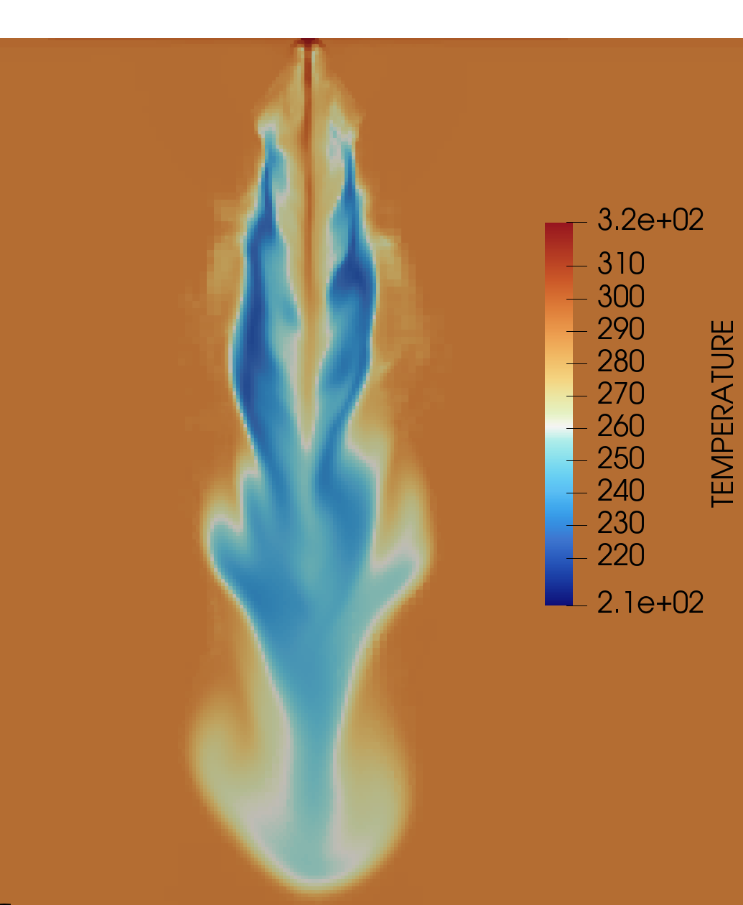
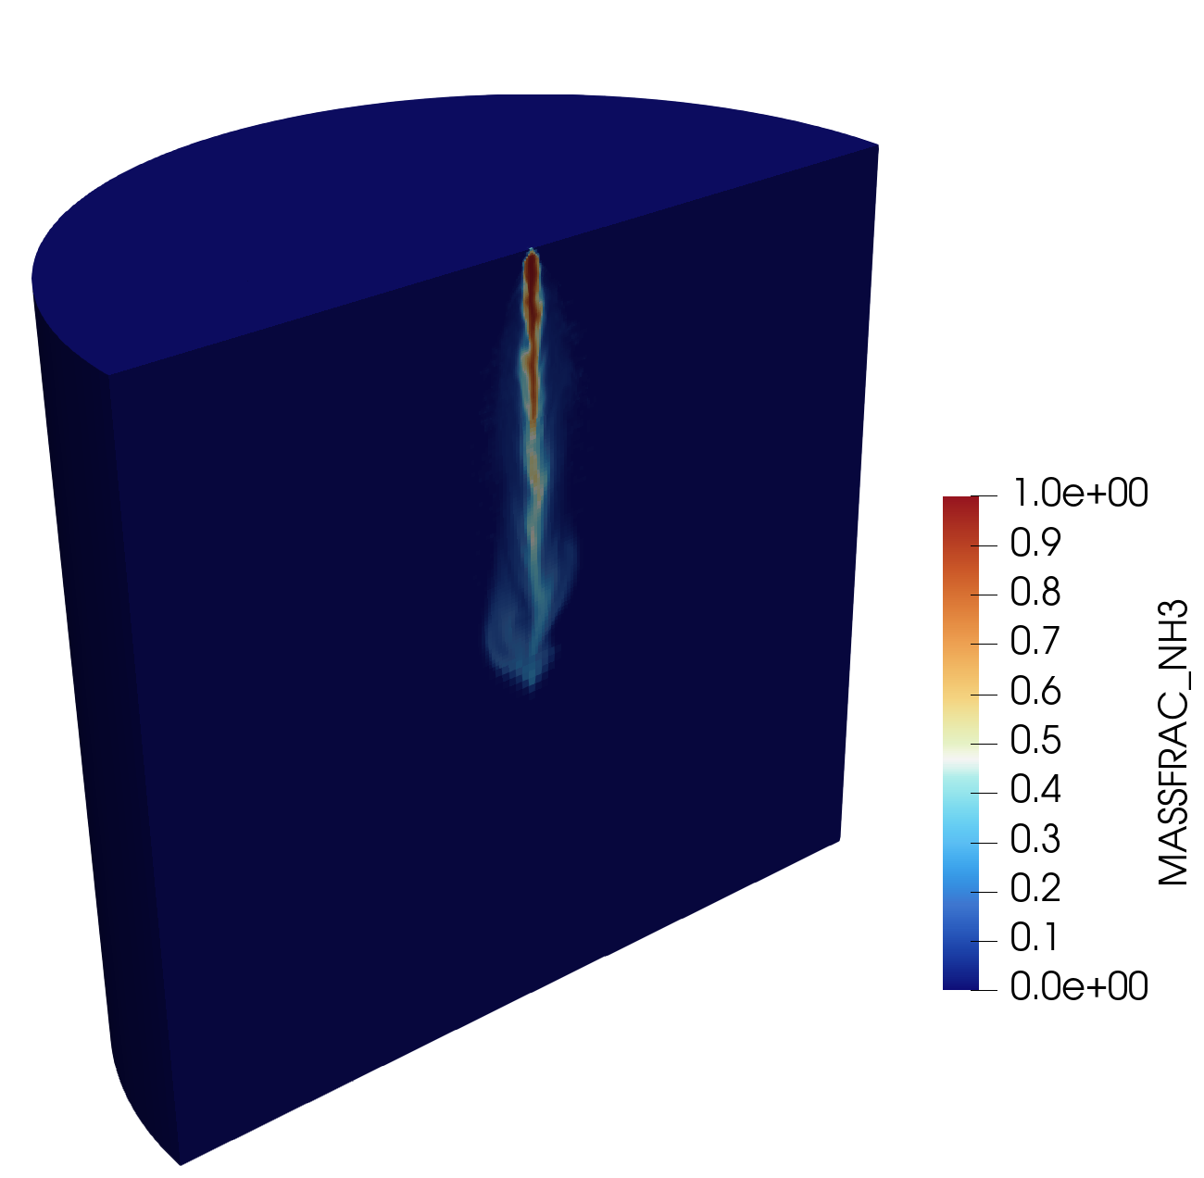
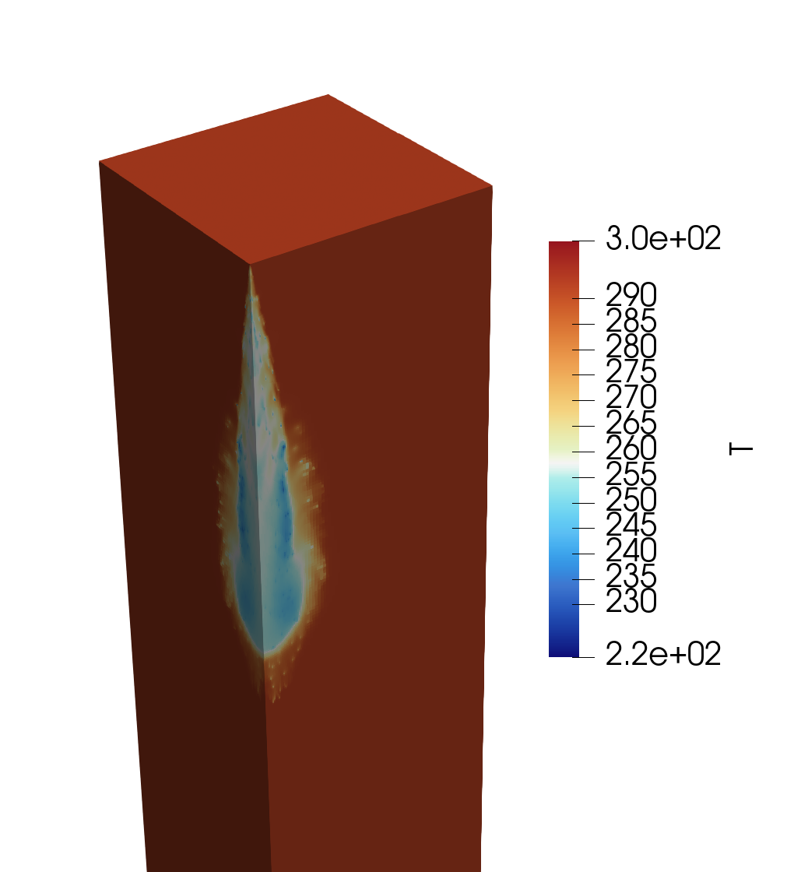
Spray views / EXAMPLES
KAUST
(Lagrangian)
U-PERUGIA / U-L’AQUILA
(Lagrangian)
POLIMI
(Lagrangian)
U-PERUGIA / U-L’AQUILA
(Eulerian)

Slide 11

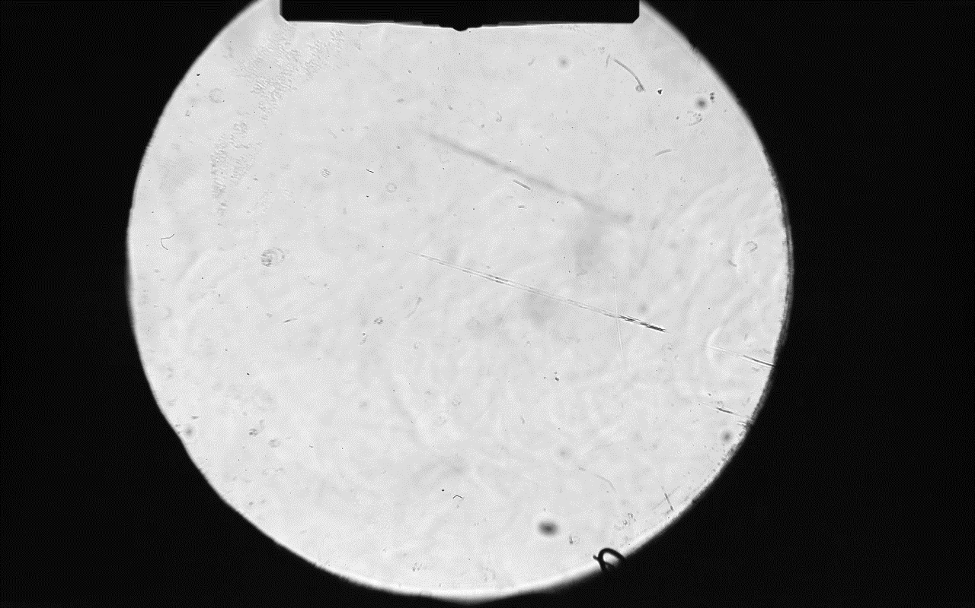



Ammonia spray flash boiling

Slide 12
M sh – ESTIMATED ROI

Slide 13
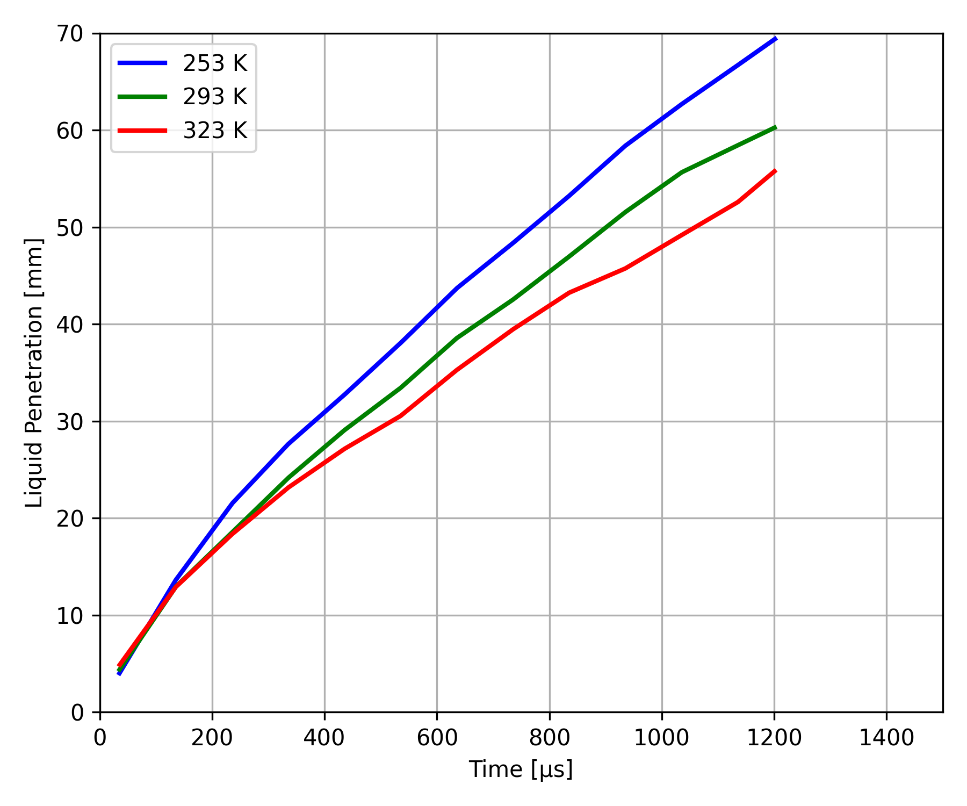
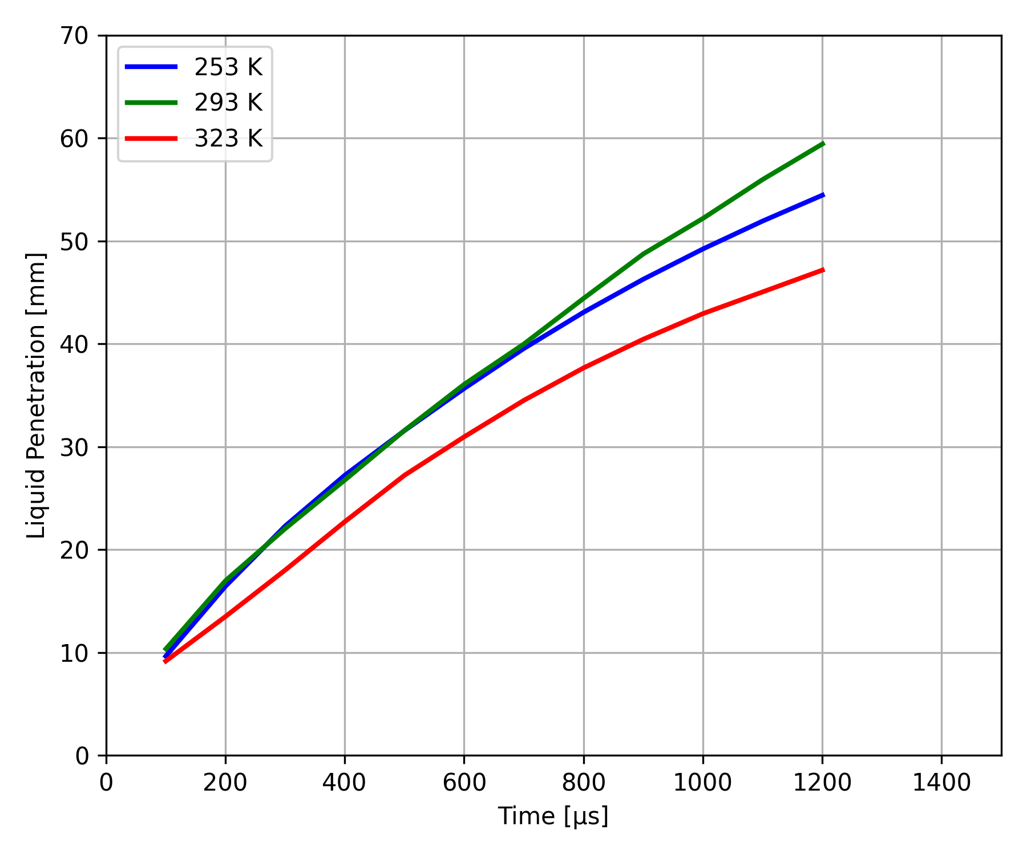
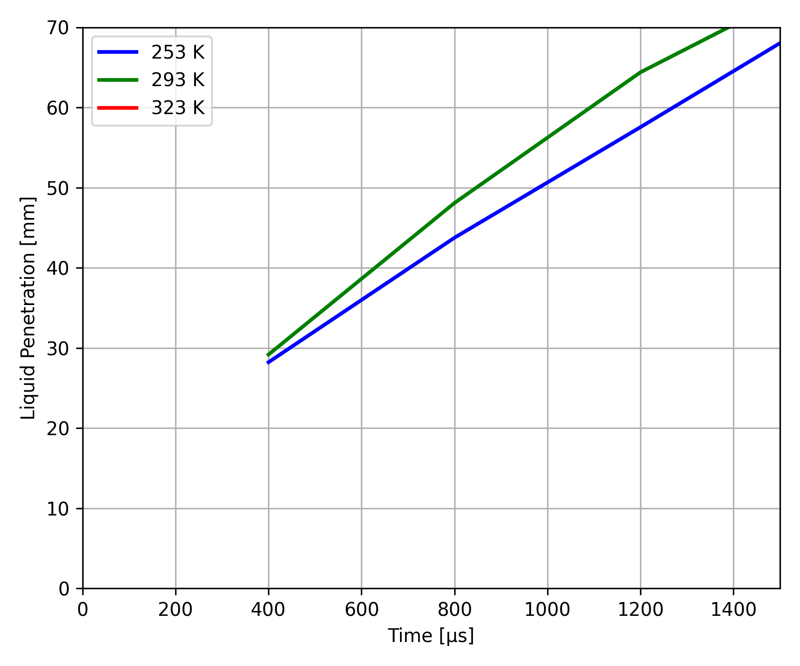
M sh – PENETRATION – FUEL TEMPERATURE
P_{inj} = 70 bar
P_{amb} = 1 bar
T_{fuel} = variable
EXP
UNIPG/UNIVAQ
KAUST
POLIMI

Slide 14
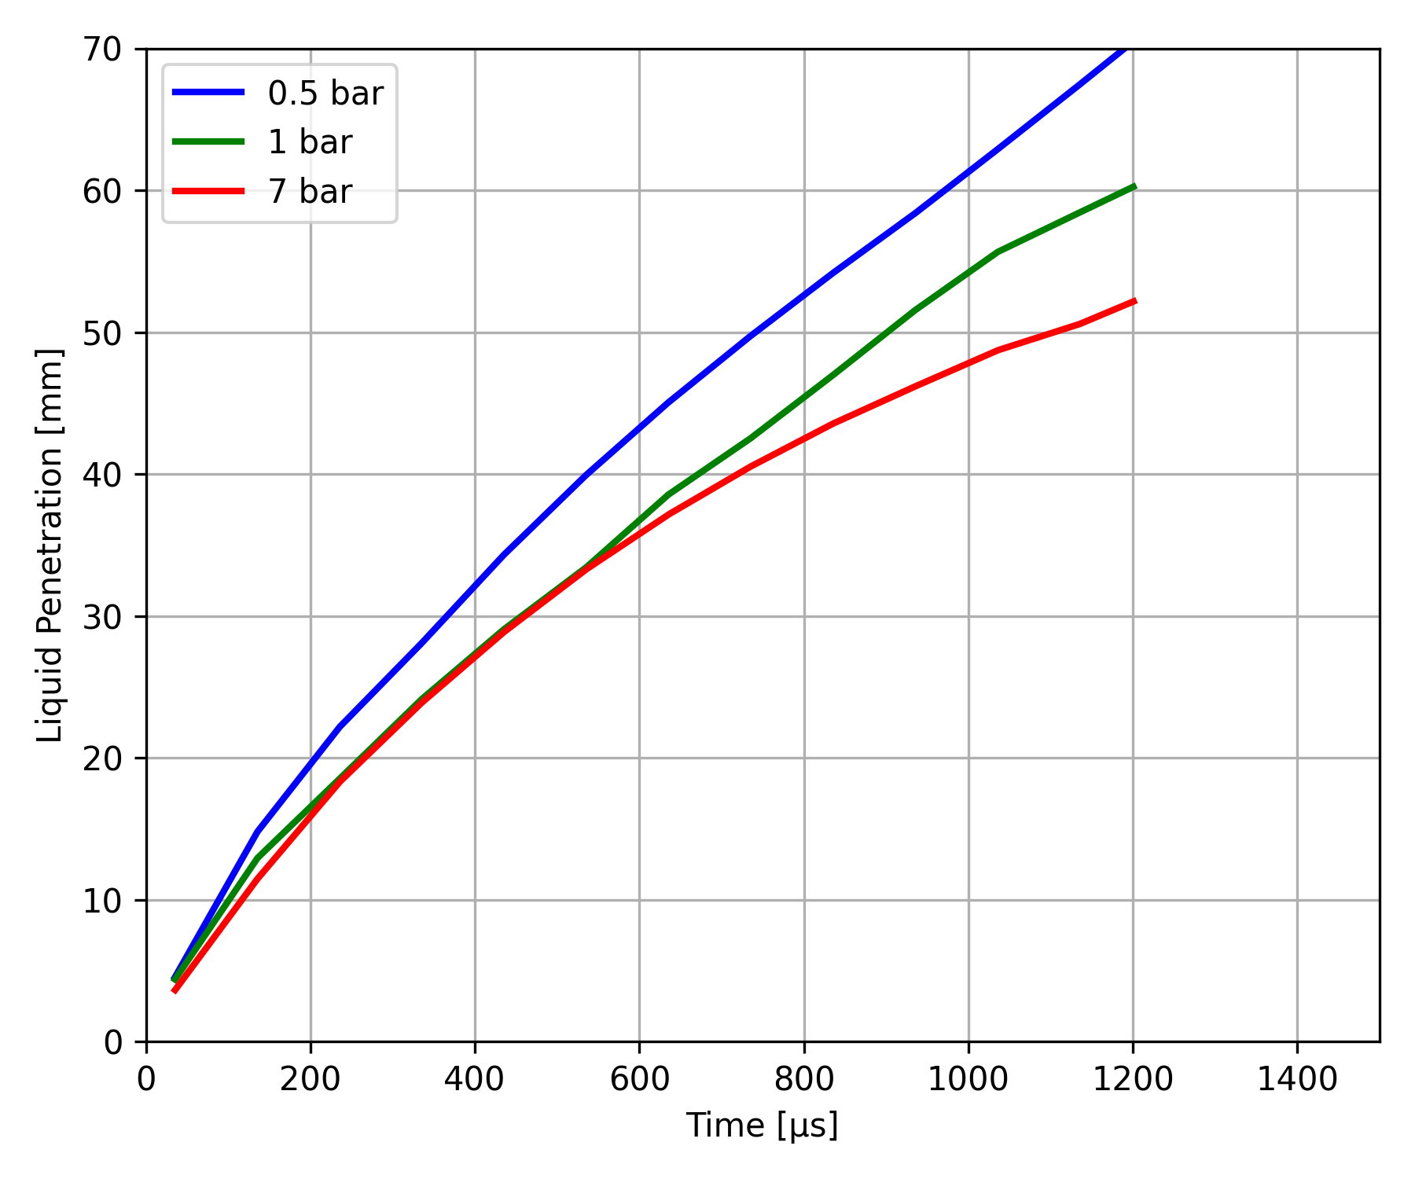
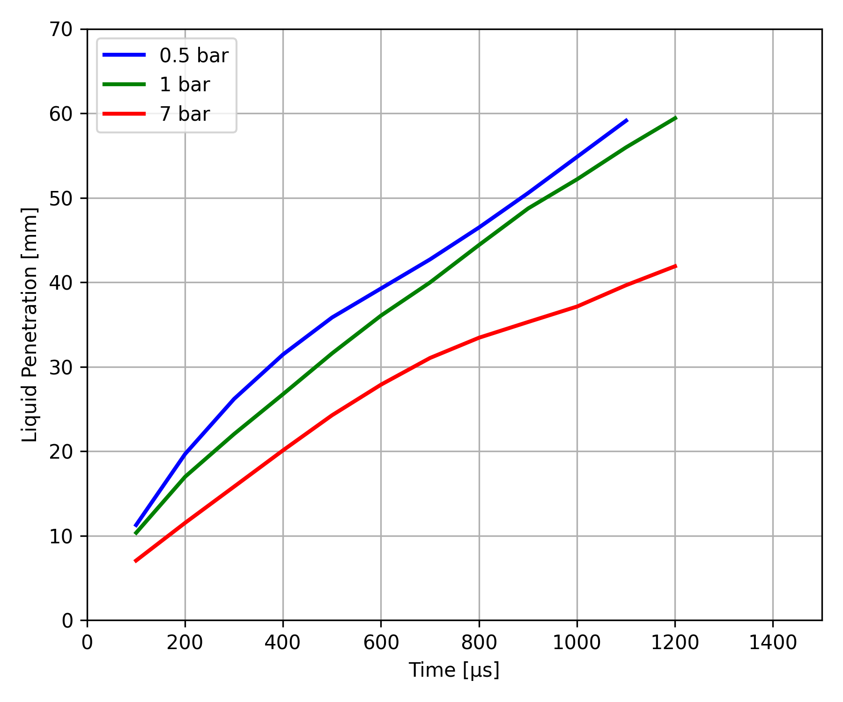
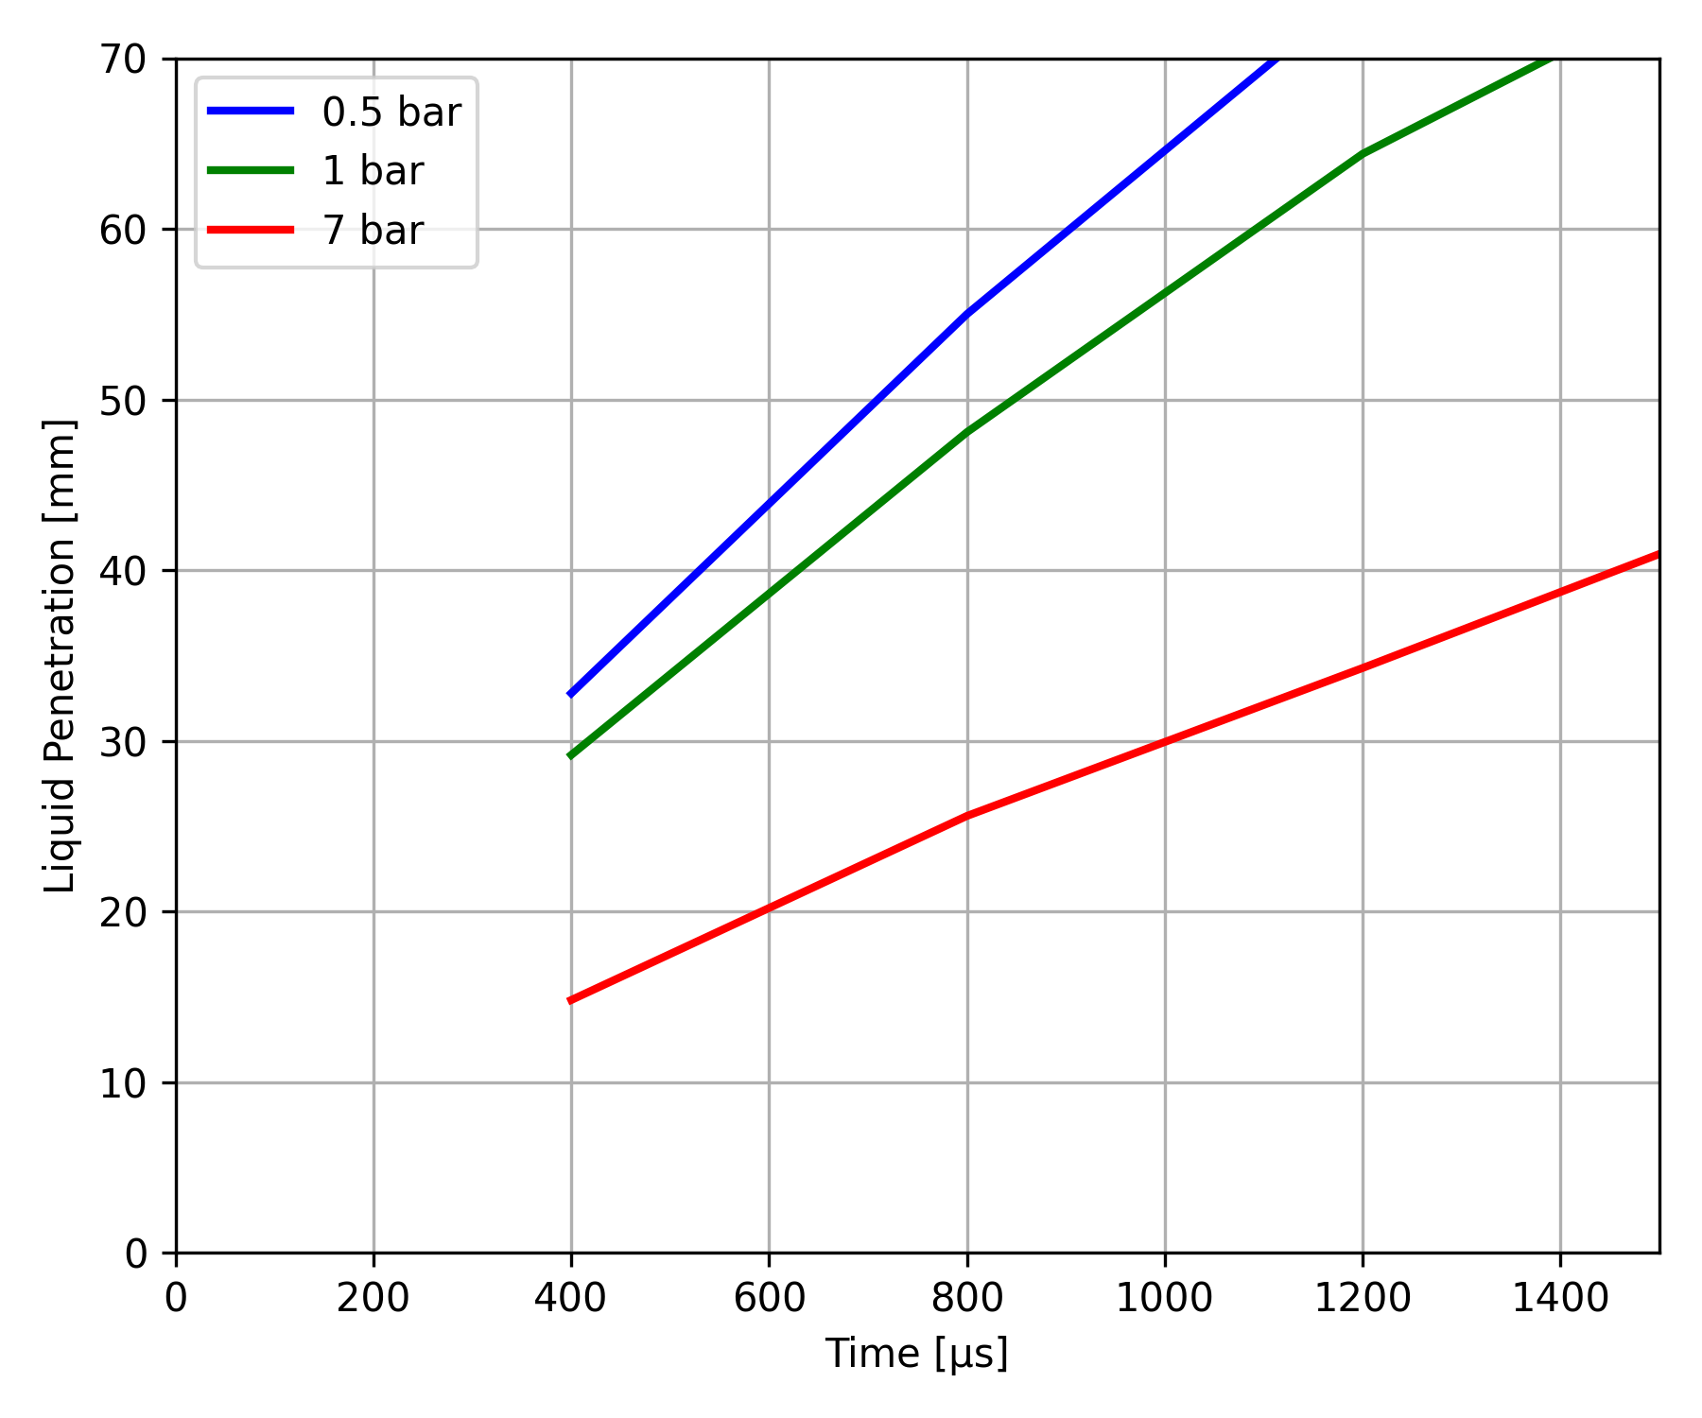
M sh – PENETRATION – ambient pressure effect
P_{inj} = 70 bar
P_{amb} = variable
T_{fuel} = 293 K
EXP
UNIPG/UNIVAQ
KAUST
POLIMI

Slide 15
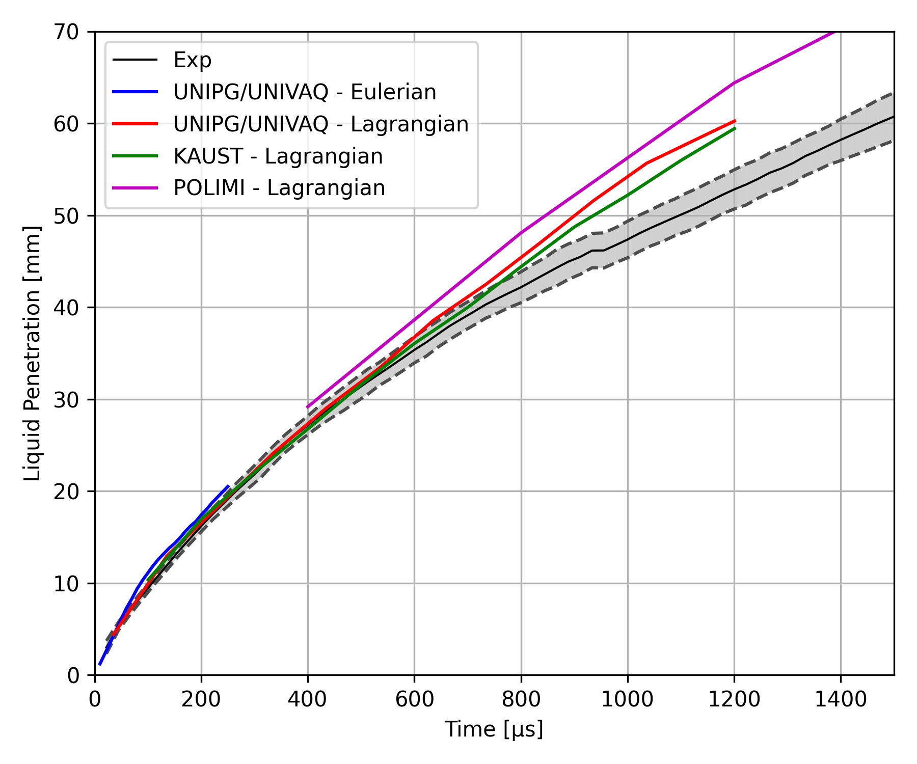
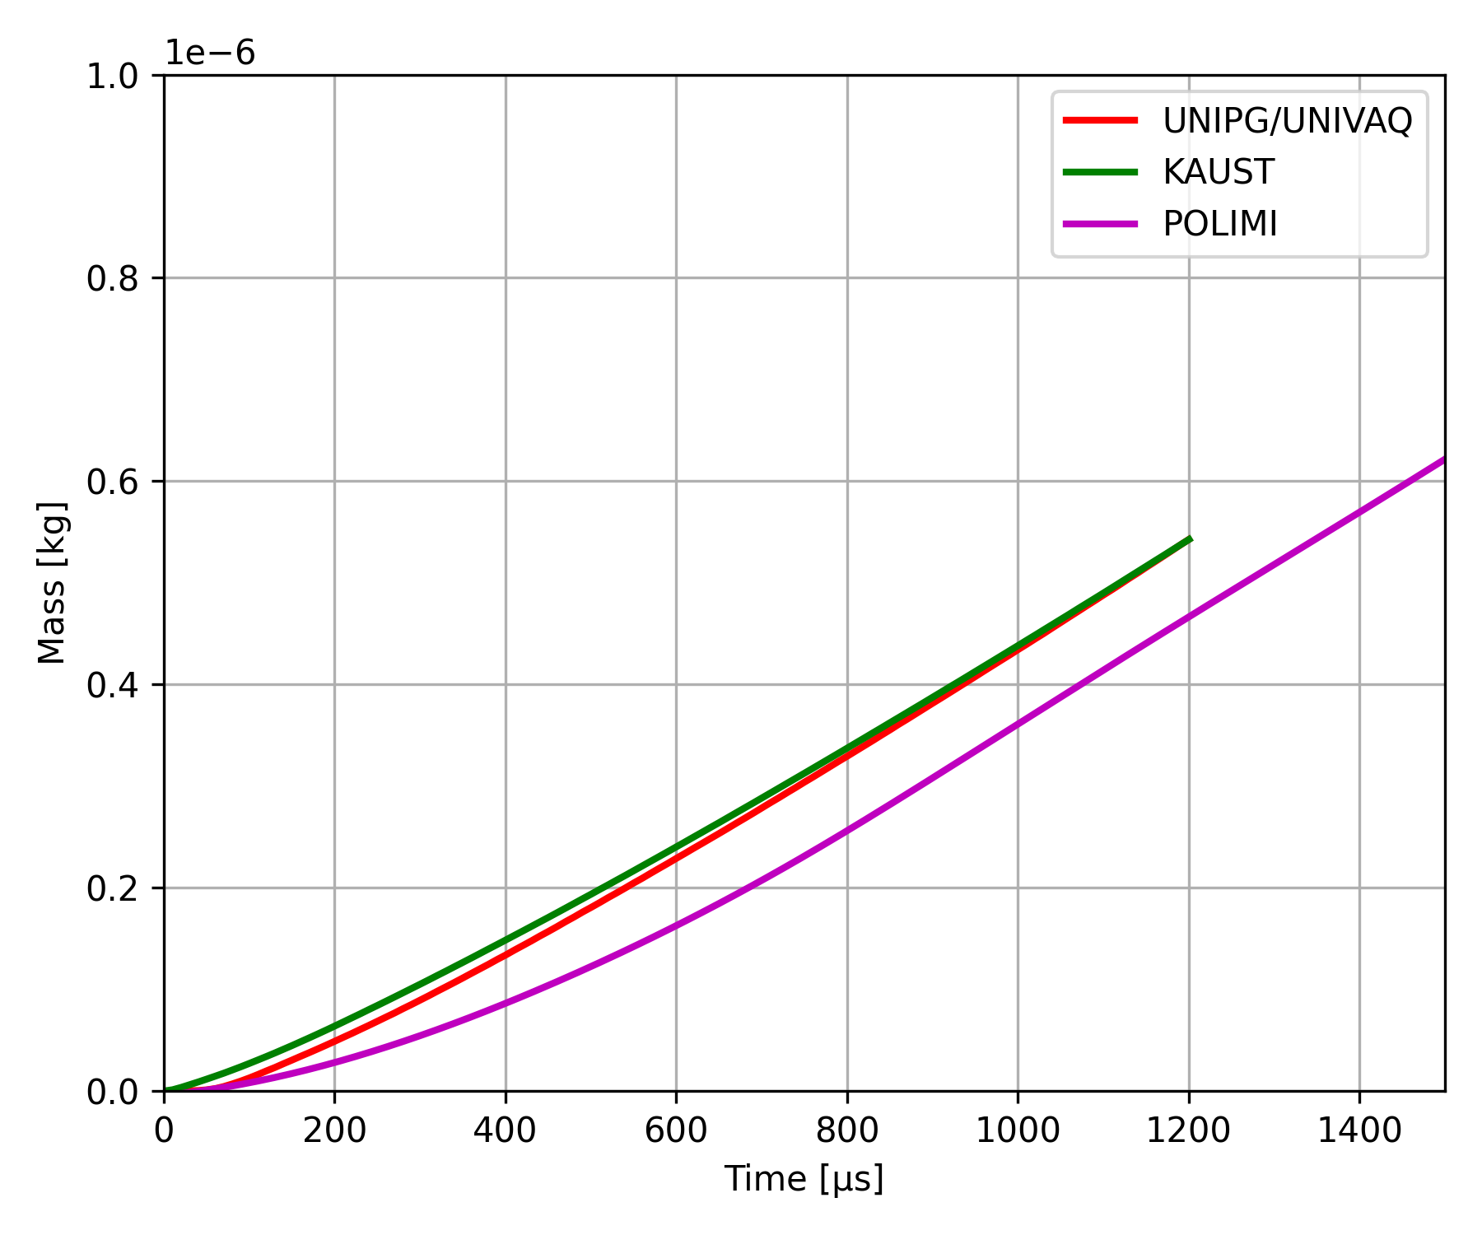
Baseline case: 293 K, 1 bar (Pinj = 70 bar, Tamb = 293 K)
Liquid penetration
Vaporized mass

Slide 16
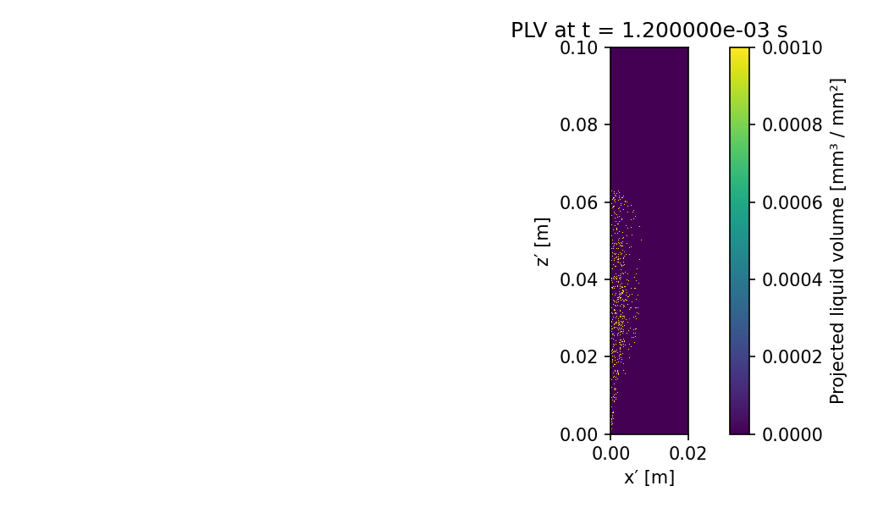
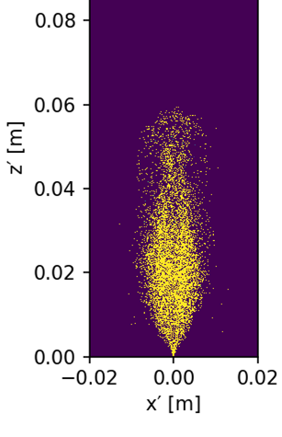
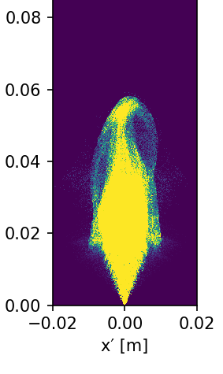
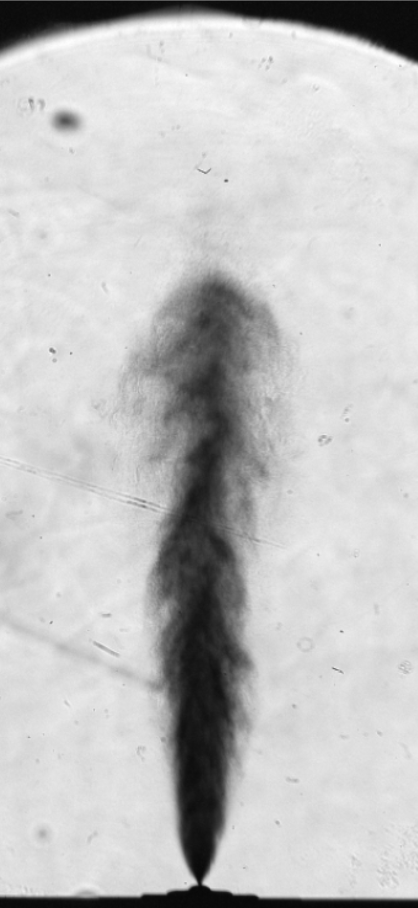
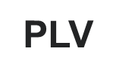
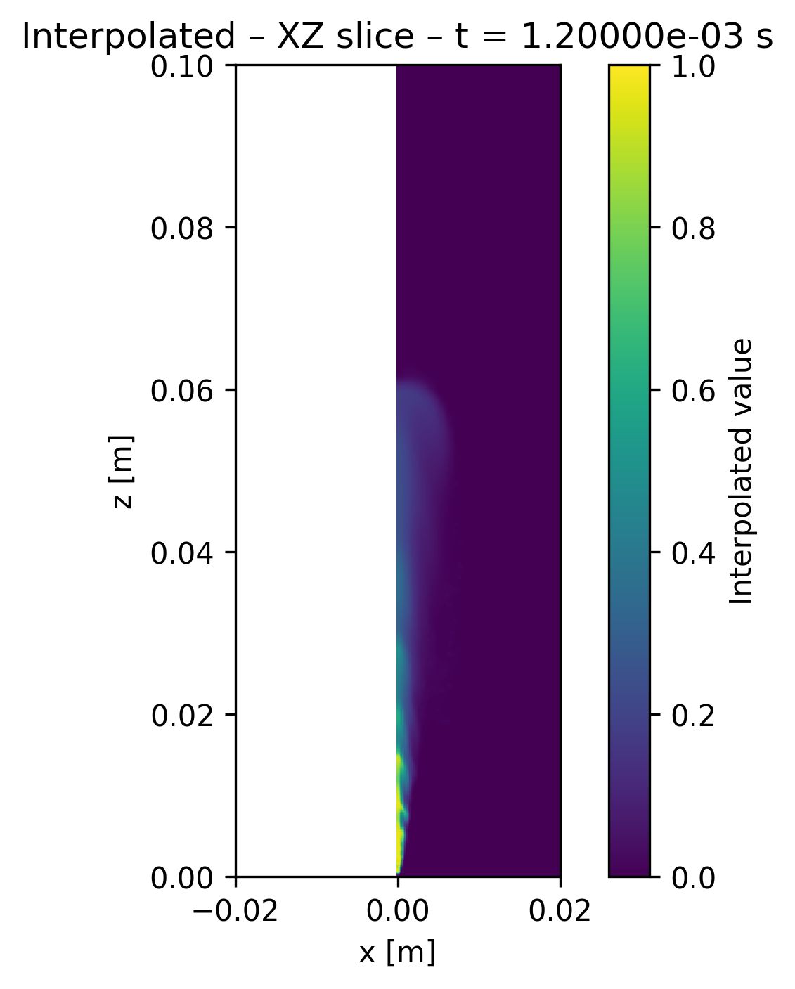
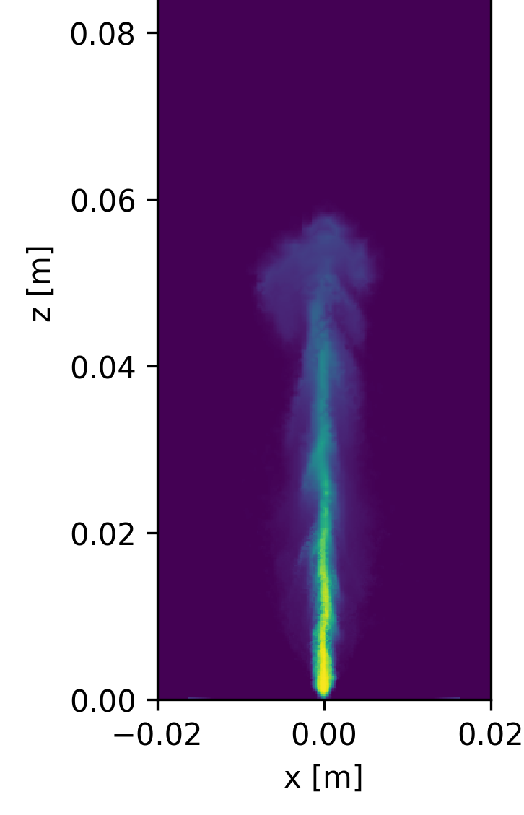
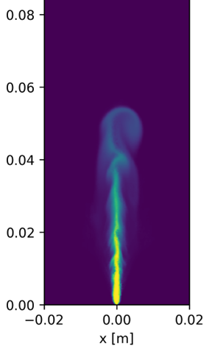
Baseline case: 293 K, 1 bar (Pinj = 70 bar, Tamb = 293 K) PLV and Y_{NH3}
1200 μs
PERUGIA/L’AQUILA
KAUST
POLIMI
Y_{NH3}

Slide 17
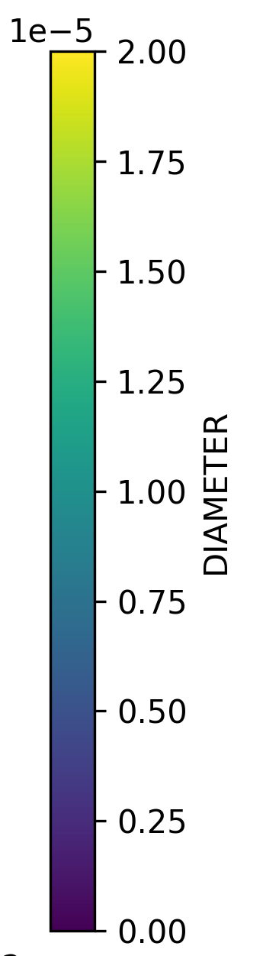
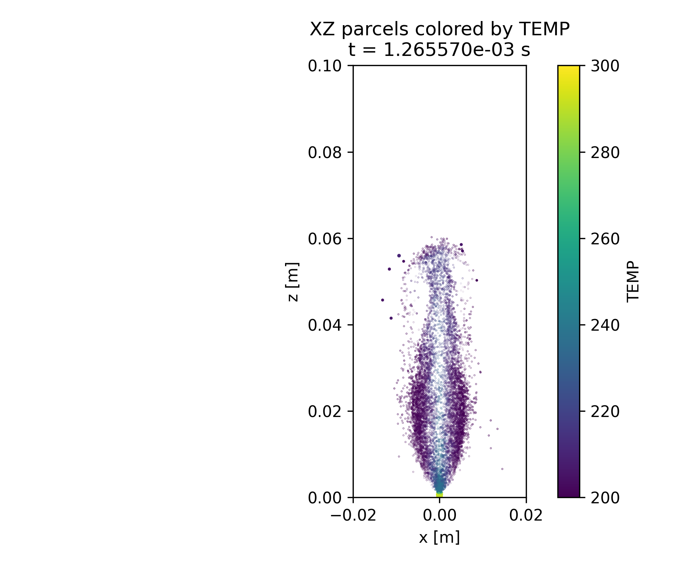
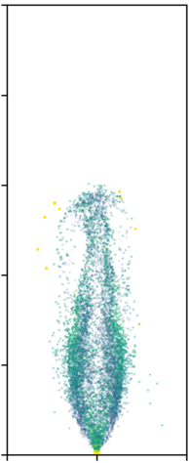
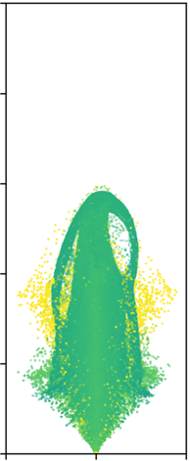
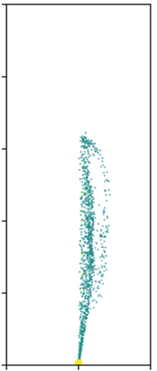
Baseline case: 293 K, 1 bar (Pinj = 70 bar, Tamb = 293 K) droplet diameter, d
1200 μs
PERUGIA/L’AQUILA
KAUST
POLIMI
m
d
droplet slice:
± 1 mm thick

Slide 18
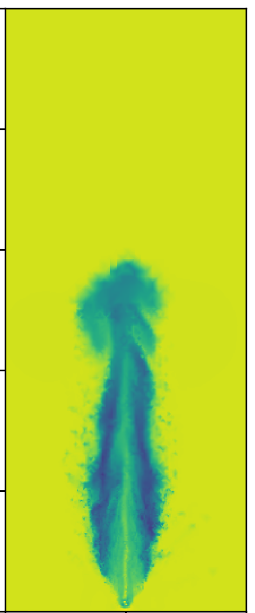
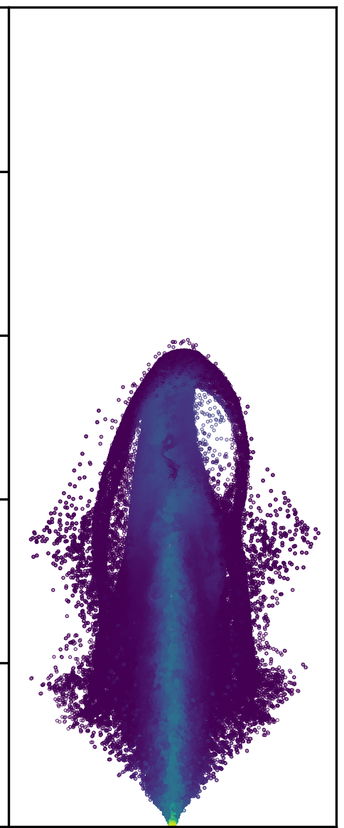
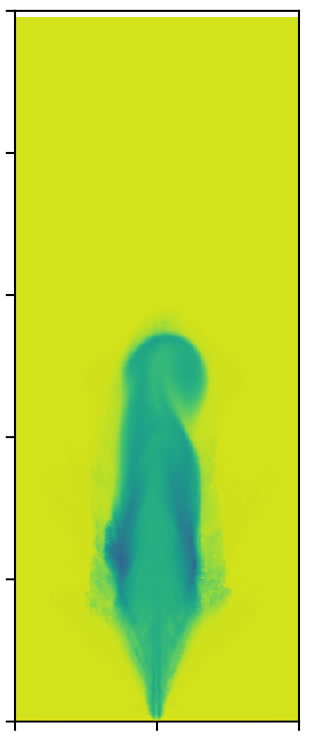
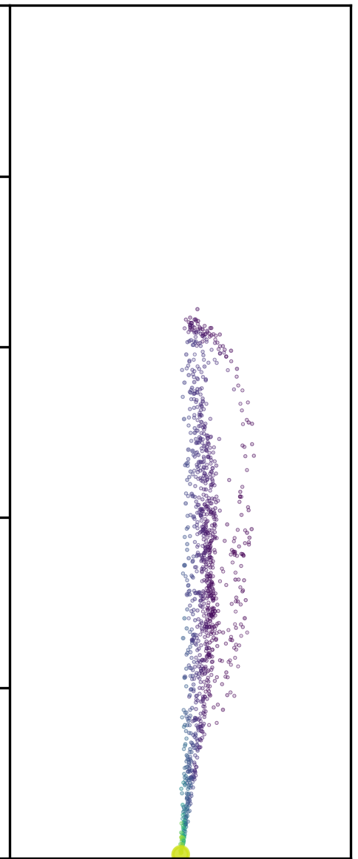
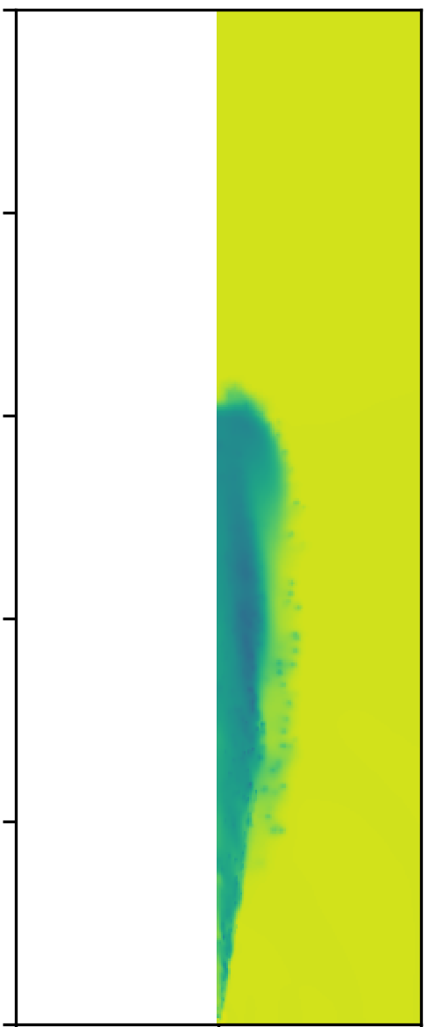
Baseline case: 293 K, 1 bar (Pinj = 70 bar, Tamb = 293 K) Temperatures, T_{liq} & T_{gas}
1200 μs
PERUGIA/L’AQUILA
KAUST
POLIMI
K
T_{liq}
T_{gas}
droplet slice:
± 1 mm thick
cut plane

Slide 19
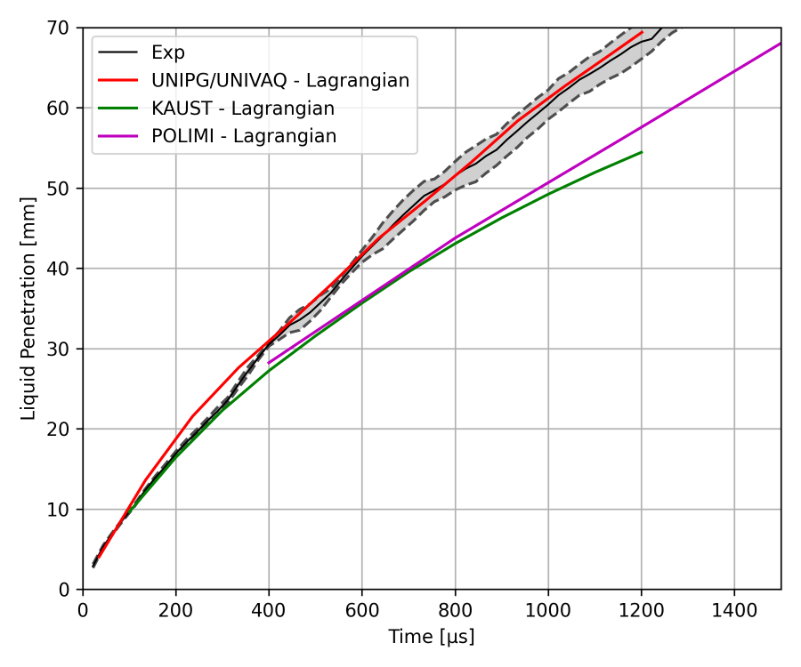
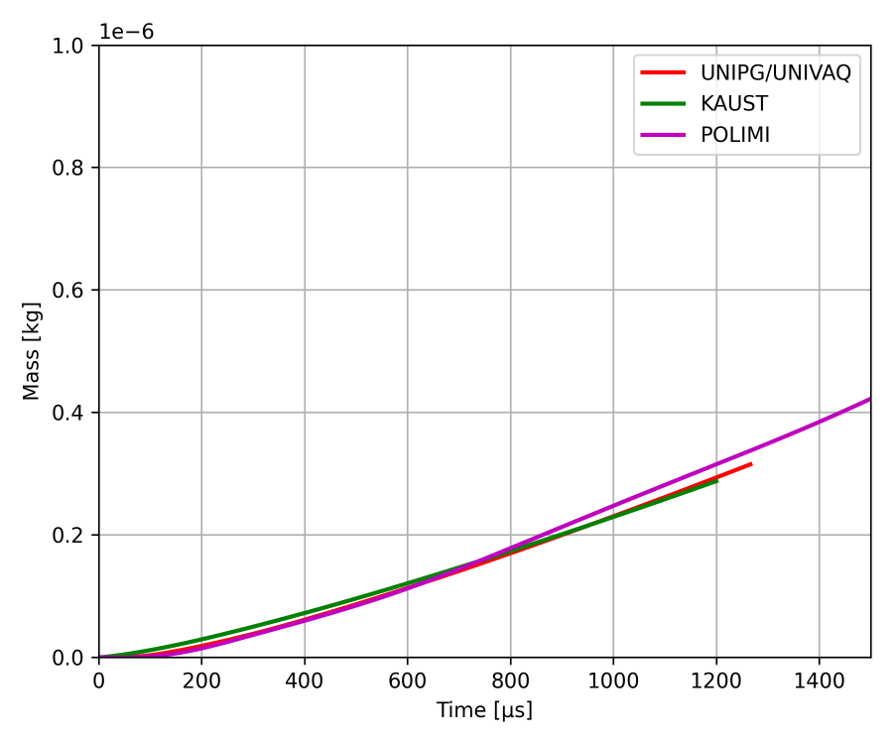
case: 253 K, 1 bar (Pinj = 70 bar, Tamb = 293 K)
Liquid penetration
Vaporized mass
* 263 K

Slide 20
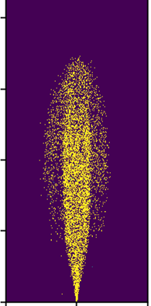
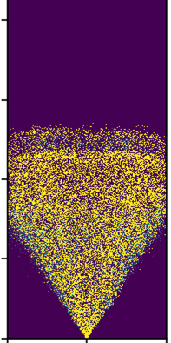
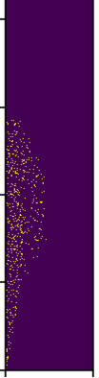
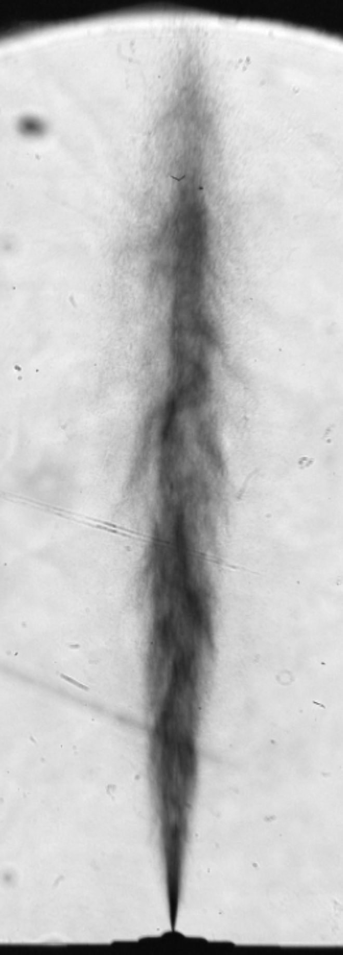
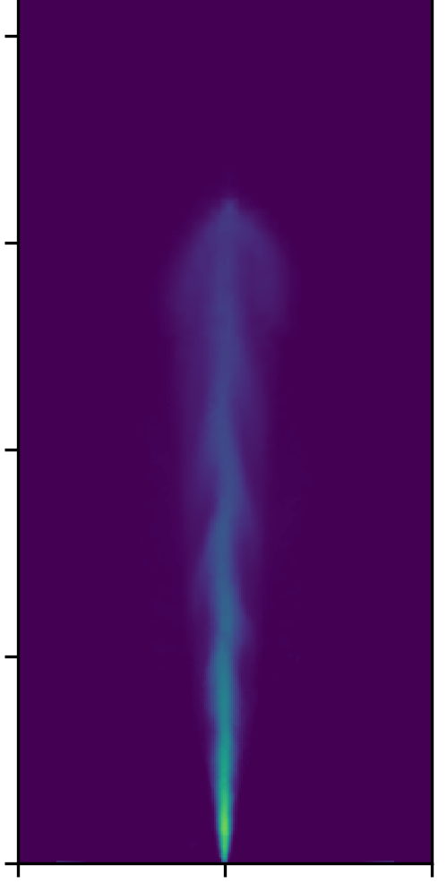

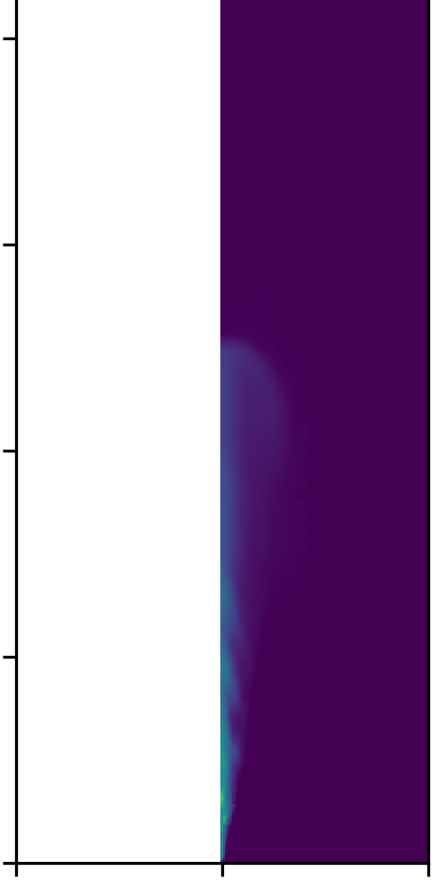
case: 253 K, 1 bar (Pinj = 70 bar, Tamb = 293 K) PLV and Y_{NH3}
1200 μs
PERUGIA/L’AQUILA
KAUST
POLIMI
* 263 K
Y_{NH3}

Slide 21
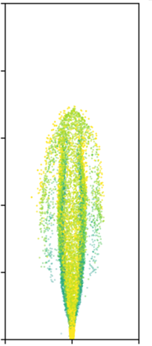


case: 253 K, 1 bar (Pinj = 70 bar, Tamb = 293 K) droplet diameter, d
1200 μs
PERUGIA/L’AQUILA
KAUST
POLIMI
m
* 263 K
d
droplet slice:
± 1 mm thick

Slide 22






case: 253 K, 1 bar (Pinj = 70 bar, Tamb = 293 K) Temperatures, T_{liq} & T_{gas}
1200 μs
PERUGIA/L’AQUILA
KAUST
POLIMI
K
T_{liq}
T_{gas}
* 263 K
droplet slice:
± 1 mm thick
cut plane

Slide 23


case: 323 K, 1 bar (Pinj = 70 bar, Tamb = 293 K)
Liquid penetration
Vaporized mass

Slide 24





case: 323 K, 1 bar (Pinj = 70 bar, Tamb = 293 K) PLV and Y_{NH3}
1200 μs
PERUGIA/L’AQUILA
KAUST
POLIMI
* 313 K
Y_{NH3}

Slide 25


case: 323 K, 1 bar (Pinj = 70 bar, Tamb = 293 K) droplet diameter, d
1200 μs
PERUGIA/L’AQUILA
KAUST
POLIMI
m
* 313 K
d
droplet slice:
± 1 mm thick

Slide 26




case: 323 K, 1 bar (Pinj = 70 bar, Tamb = 293 K) Temperatures, T_{liq} & T_{gas}
1200 μs
PERUGIA/L’AQUILA
KAUST
POLIMI
K
T_{liq}
T_{gas}
* 313 K
droplet slice:
± 1 mm thick
cut plane

Slide 27


case: 293 K, 0.5 bar (Pinj = 70 bar, Tamb = 293 K)
Liquid penetration
Vaporized mass

Slide 28






case: 293 K, 0.5 bar (Pinj = 70 bar, Tamb = 293 K) PLV and Y_{NH3}
1200 μs
PERUGIA/L’AQUILA
KAUST
POLIMI
Y_{NH3}

Slide 29



case: 293 K, 0.5 bar (Pinj = 70 bar, Tamb = 293 K) droplet diameter, d
1200 μs
PERUGIA/L’AQUILA
KAUST
POLIMI
m
d
droplet slice:
± 1 mm thick

Slide 30






case: 293 K, 0.5 bar (Pinj = 70 bar, Tamb = 293 K) Temperatures, T_{liq} & T_{gas}
1200 μs
PERUGIA/L’AQUILA
KAUST
POLIMI
K
T_{liq}
T_{gas}
droplet slice:
± 1 mm thick
cut plane

Slide 31


case: 293 K, 7 bar (Pinj = 70 bar, Tamb = 293 K)
Liquid penetration
Vaporized mass

Slide 32






case: 293 K, 7 bar (Pinj = 70 bar, Tamb = 293 K) PLV and Y_{NH3}
1200 μs
PERUGIA/L’AQUILA
KAUST
POLIMI
Y_{NH3}

Slide 33



case: 293 K, 7 bar (Pinj = 70 bar, Tamb = 293 K) droplet diameter, d
1200 μs
PERUGIA/L’AQUILA
KAUST
POLIMI
m
d
droplet slice:
± 1 mm thick

Slide 34






case: 293 K, 7 bar (Pinj = 70 bar, Tamb = 293 K) Temperatures, T_{liq} & T_{gas}
1200 μs
PERUGIA/L’AQUILA
KAUST
POLIMI
K
T_{liq}
T_{gas}
droplet slice:
± 1 mm thick
cut plane

Slide 35


SMD: local data
Baseline case: 293 K, 1 bar
case: 253 K, 1 bar
z = 50 mm

Slide 36



TEMPERATURE: local data
case: 253 K, 1 bar
Baseline case: 293 K, 1 bar
case: 323 K, 1 bar
Gas
Droplet
z = 9 mm

Slide 37

NEAR NOZZLE
5 bar; -10 °C
1 bar; -10 °C
1 bar; 20 °C
1 bar; 40 °C
1 bar; 50 °C

Slide 38


Internal and near field Eulerian simulations (UNIPG/UNIVAQ)
Grid resolution: min 2.5 µm
Simulated time: 0.3 ms
P_{inj} = 71 bar, T_{fuel} = -10, 20, 40 °C
P_{amb} = 1 bar, T_{amb} = 28 °C
2D axi-symmetric: k-ω SST

Slide 39



Eulerian spray: penetration
(UNIPG/UNIVAQ)
263 K 293 K 313 K
Liquid volume fraction
293 K
Vapor mass fraction
* Duronio, Battistoni, Rousselle et al. - IJHMT
paper under review

Slide 40



Morphology:
(UNIPG/UNIVAQ)
2. turbulent structures
1. near nozzle
263 K
293 K
313 K
293 K

Slide 41
Morphology: shock cell
(UNIPG/UNIVAQ)

Slide 42

Morphology: shock cell visible in experiments only aT very high degree of superheat
(UNIPG/UNIVAQ)
Rp = 191
(0.1 bar, 50 °C)
Rp = 8.8
(1 bar, 40 °C)

Slide 43





Temperature radial profiles
(UNIPG/UNIVAQ)
263 K
293 K
313 K
263 K
293 K
313 K

Slide 44
Conclusion and outlook
Attempts to systematically compare and analyze spray data from different institutions
We need actual ROI measurements
Ammonia easily undergoes flash-boiling: predicting its effects at engine combustion chamber scale is the challenge
More work on multi-hole
Need to standardize
injectors (single hole M, other?)
conditions (agree on one BASE CONDITION, and fewer parametric variations)

