Slide 1
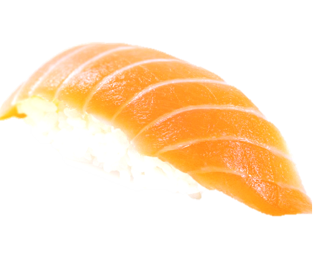
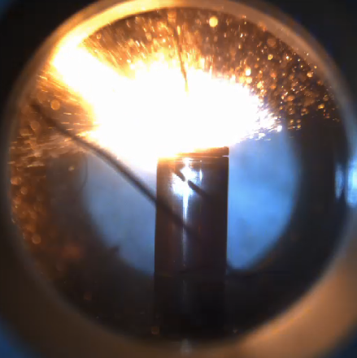
Li-ion Battery thermal runaway
ECN topic
ECN 10 workshop
December 15th 2025, Chiba
Michele BARDI (IFPEN)
Lyle Pickett (Sandia)
Notes:
We are using AI to understand the nature of orangish radiations captured during thermal runaway and we are obtaining some convincing clues

Slide 2
ECN approach is adapted to study thermal runaway ?
Thermal runaway itself, could vary significantly depending on many parameters:
  Battery Cell (BC) format
  Active material chemistry
  Safety venting system
  Abuse type
  Ageing
  …
➔ selecting a single reference case means to look at only one side of the problem
The number of diagnostics to be applied is huge and it is also dependent on the BC characteristics
  A standardized diagnostics could work for the studied Battery cell but useless for other cases

Slide 3
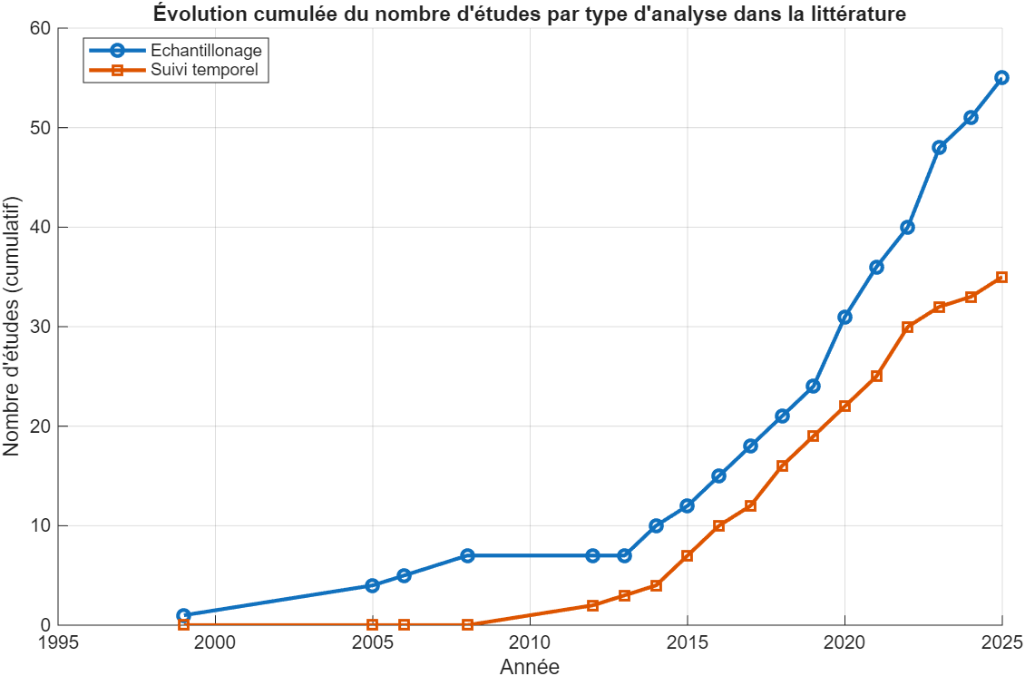
ECN approach is adapted to study thermal runaway ?
Literature is terribly sparse
  Ex. Vented gas analysis for our test case
Only few works on NMC811,
Only one on LGM50 (not M50LT)
Abbott et al, 2022
*From Lucas Richardet Manuscript / Thesis defense planned for February 17th

Slide 4
ECN approach is adapted to study thermal runaway ?
However, the market safety standards still requires trustworthy model prediction to enhance battery pack design and improve BMS
The challenge might be bigger than in other topics, but also, in this case a peloton working on a similar case would foster the collective knowledge
The objective of this presentation is to gather all the pieces of information produced within our group going beyond the reference case and to complement them with relevant insights from the literature
  …Taken together, these elements form a coherent and complementary dataset …
  …. much like rice grains around raw fish turn simple ingredients into a good sushi…

Slide 5













Potential contributors
Proceedings from last workshop are online and the detailed presentation could be shared on demand
All the data presented in the past can be shared / reference battery cell can be sent
New data is available

Slide 6
Thanks to all the contributors
Special thanks to direct contributors
  Sandia: Rishi Roy, Nicolas Rasmount, John Hewson, Martin Reith, Alex Bates, Loraine Torres-Castro, Bernice Mills, Koby Rouviere, Gabriel Bruno Meier, Lucas Samuel Gray
  IFPEN: Lucas Richardet, Jules Ravix, Stephane Chevillard, Matthieu Lecompte
  CMT: Antonio García *, Javier Monsalve-Serrano , Javier Marco Gimeno
  Argonne National Laboratory: Chris Powell, Brandon Sforzo
  Convergent Science: Kislaya Srivastava
  Waterloo university: Vinny Gupta
  KAUST: Ahmad Alsewailem, Aamir Farooq
  Sydney University: Assaad Masri

Slide 7
Agenda
Some memories from Naples
What’s new since ECN 9?
  New insights from battery analysis and testing
  New insights from numerical modelling
New tools on ECN website
Conclusions and future directions

Slide 8
Reference case definition
The chosen abuse case is of particular interest:
  It enables to separate temporally (some of) the different phases of thermal runaway
  Possibility to follow the “chemistry” within the cell
  Less time consuming than ARC tests
  Easily reproducible in different laboratories
What do we miss:
  We “follow” chemistry but only on the measurement of Tskin
  Electric or mechanical abuse might have significantly different behavior
    Less relevant for real conditions
    Thermal abuse still important for understanding propagation

Slide 9
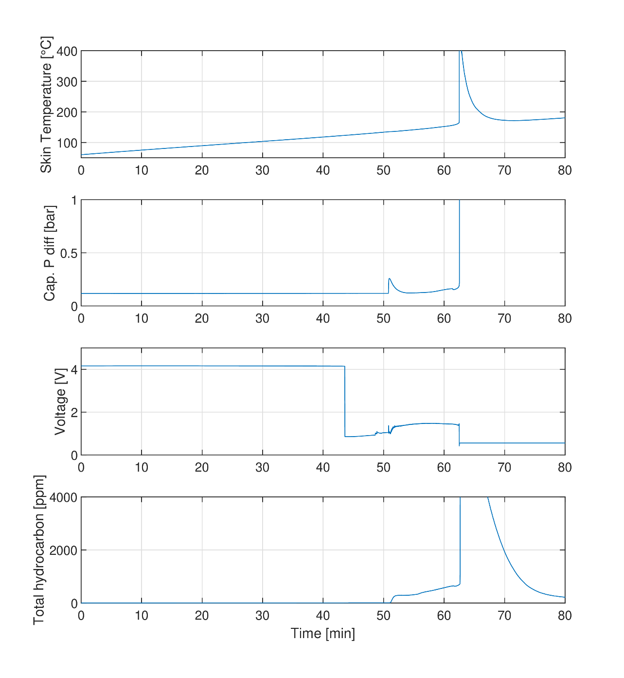
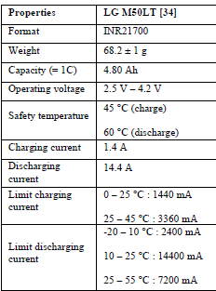
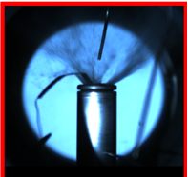
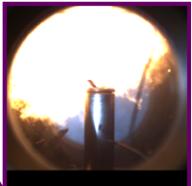
Reference case
CID activation (VD)
Exothermic
onset
1 Gas Vent
Thermal runaway (TR)
Smoking
Common commercial battery cell
  LG M50LT from the same production lot
  120 battery cells purchased and shared by IFPEN
  Others purchased by SANDIA
Reference Running-in
  3 charge / discharge cycles
  CC/CV ref cycle from manufacturer
Test Definition:
  Thermal Abuse
  “Slow cooking mode”
    Heating with a controlled heating ramp at constant gradient
    Reference case : 1.5 °C/min
    Parametric Variation: 0.5 °C/min ; 0.2 °C/min
  BC state of charge (SOC):
    Ref Case: 100%
    Parametric variations: 50% ; 25% ; 75%

Slide 10
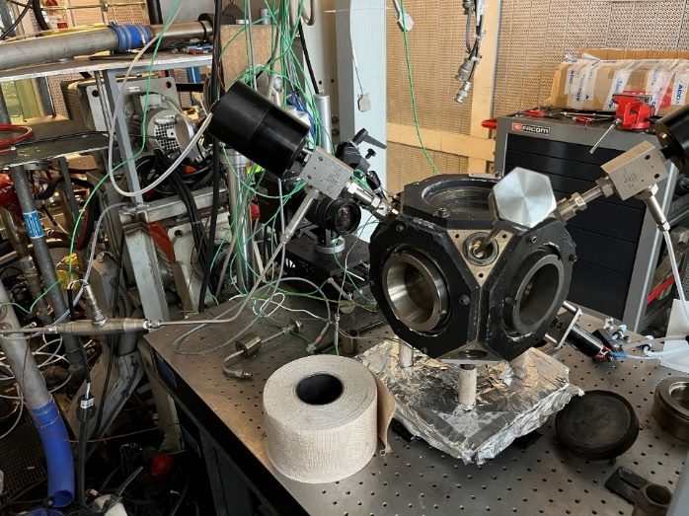
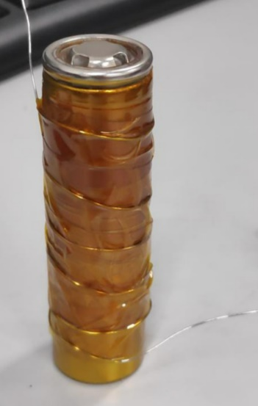
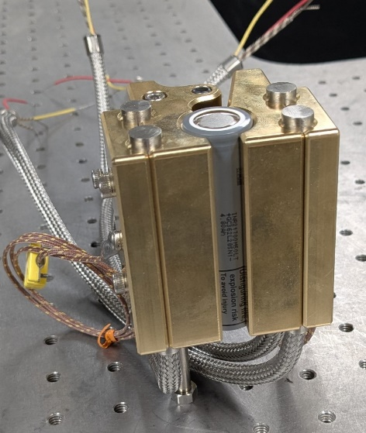
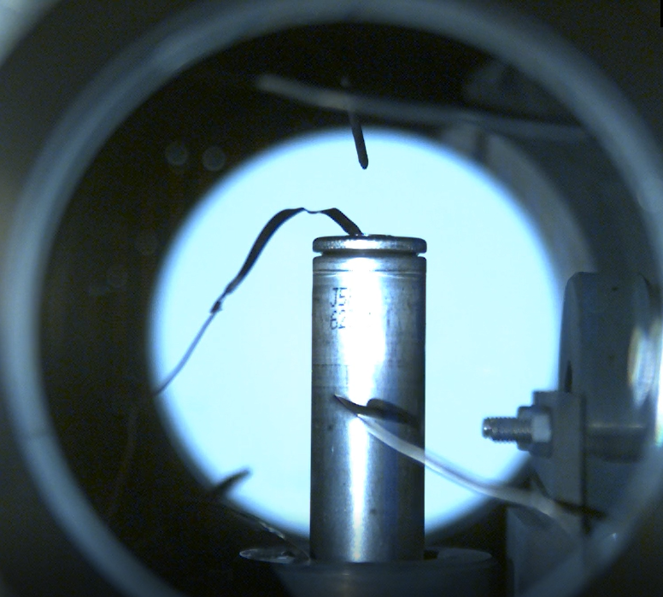
Experimental approaches
Complementary database from last workshop on LGM50LT thermal runaway
  Three different thermal abuse tests using the same heating ramp
IFPEN : Semi closed volume
Air convection heat transfer
CMT : Adapted ARC
Electrical heater in contact with BC
ARC heater in « Exothermic mode » to keep ambient air at skin temperature
Sandia : Homogeneous contact heater
Multipoint skin temperature mapping

Slide 11
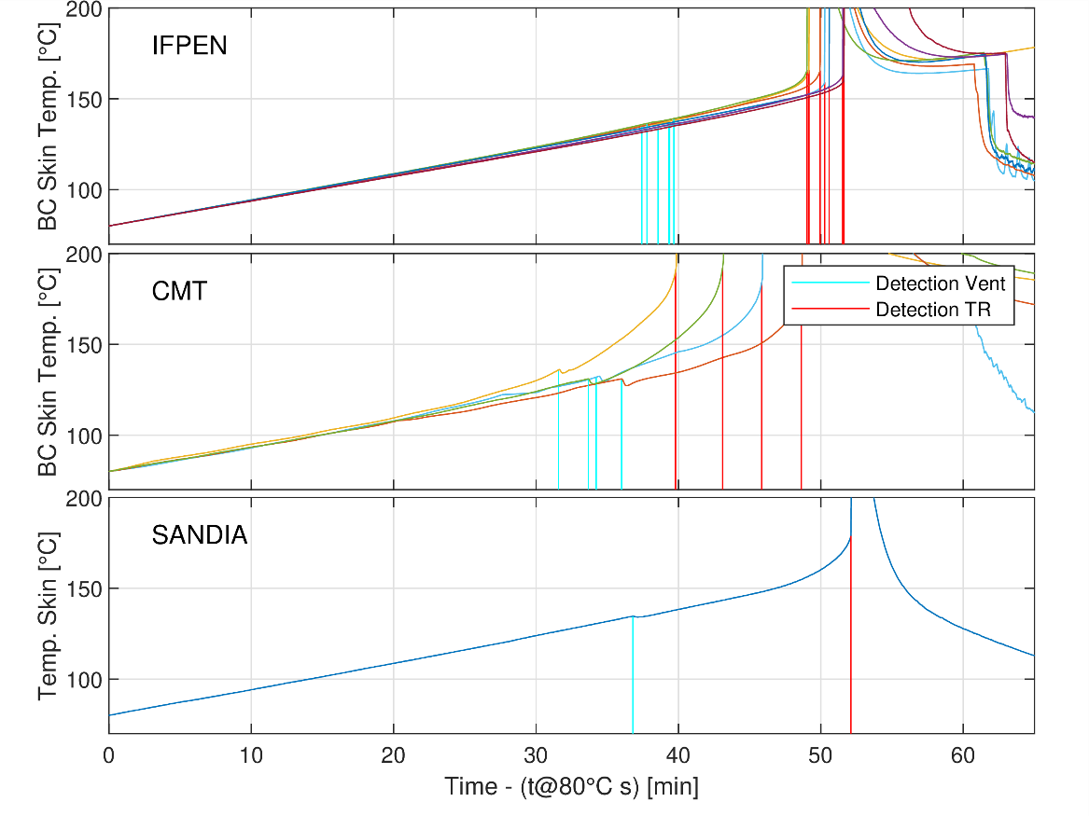
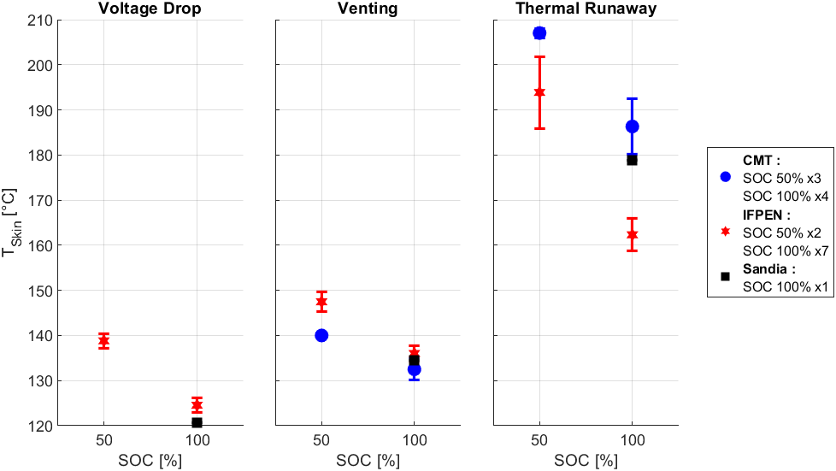
Reference Case Definition
What do we learn from last workshop?
  The same abuse protocol was applied in different facilities
  Results are consistent in different facilities in terms of critical temperatures
  The repeatability and reproducibility of the results is obtained
    The highest dispersion is observed for TR temperature
    For “conduction cases” a higher “slow” T increase before TR is observed
  We can work together also in this subject!
  The protocol makes sense
  Results are consistent, and differences needs to be understood
SOC 100%
T VD = 120 – 125 °C°
T_{venting} = 132 – 138°C
T_{TR} = 163 – 190 °C

Slide 12
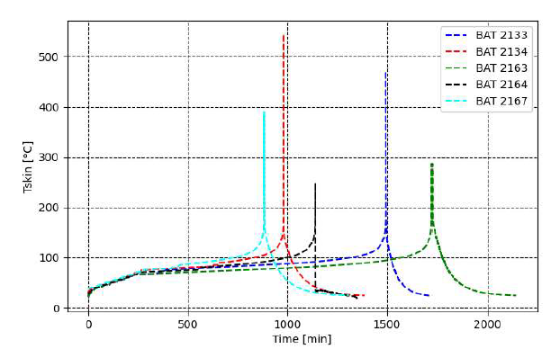
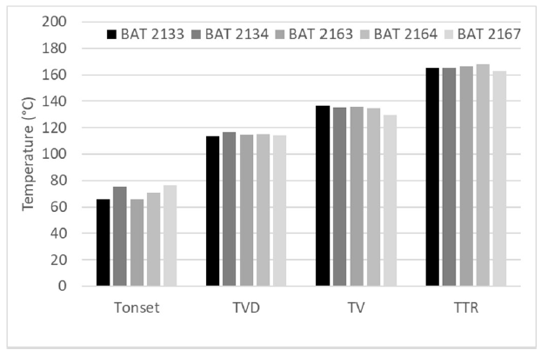
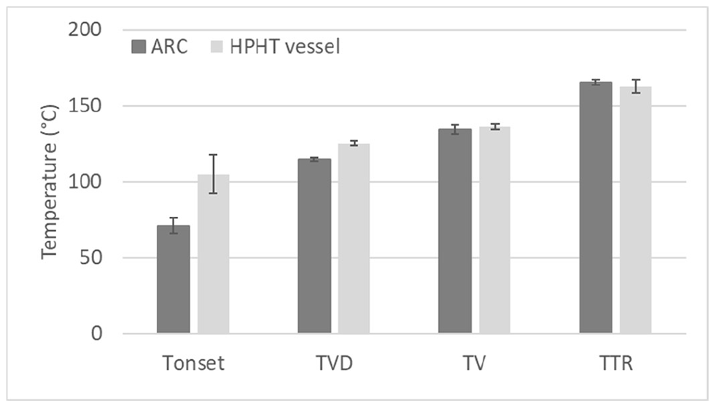

ARC characterization
ARC is the most accurate system to detect the onset of cell reactivity (T_{onset}) between 70-80°C
Despite important variability in timing, the characteristics temperatures are repeatable
T_{venting} and T_{TR} is consistent to the ones obtained in the slow cook case
T_{VD} is consistently lower: CID behavior is affected by the longer test duration of ARC test?
  CID and safety vent are activated both by pressure and at different levels
Lecompte et al, SAE 2023-24-0160
Notes:
ARC. Say: If our models of runaway and gas generation are accurate, they should work for both T ramp as well as ARC method. Is T_VD (voltage drop or circuit open) lower because ARC gives so much more time for gas generation -- we should predict this.

Slide 13
What’s new since ECN9?
  Detailed description of a “living” LGM50 LT
    Detailed CT Xray scan from Argonne
    Jelly roll geometrical measurement
    Electrochemical characterization (EIS)
  Components reactivity characterization
    DSC / TGA / DTA approach
    Detailed temperature mapping
    Internal BC pressure
  Safety vent characterization
    Burst pressure
    Mass Loss and external pressure rise
    Detailed description and insights
    N2 venting VS real venting
    Gas analysis
  Thermal Runaway
    Imaging and jet orientation
    Gas analysis
CFD Progress (and contributions)
in all these areas
CFD simulations
Battery 2D thermal modeling and parametric sensitivities
Insight BC reactivity calibration approach
Gas generation modeling
Thermal Runaway Venting simulation

Slide 14
What is our objective
To share a consolidated database of experimental results with new insights
To dig into cell to cell difference and provide a reference characterization
To put together a detailed table of reference conditions which includes LGM50LT detailed characteristics needed from modelers
  This includes to standardize the unknown with common “best guess” that would enhance results comparison and interaction
To propose a reference simulation test case (already available online)

Slide 16
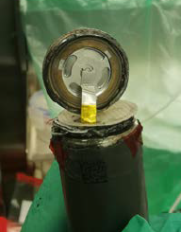
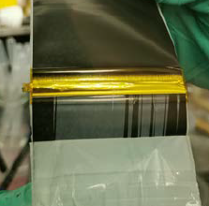
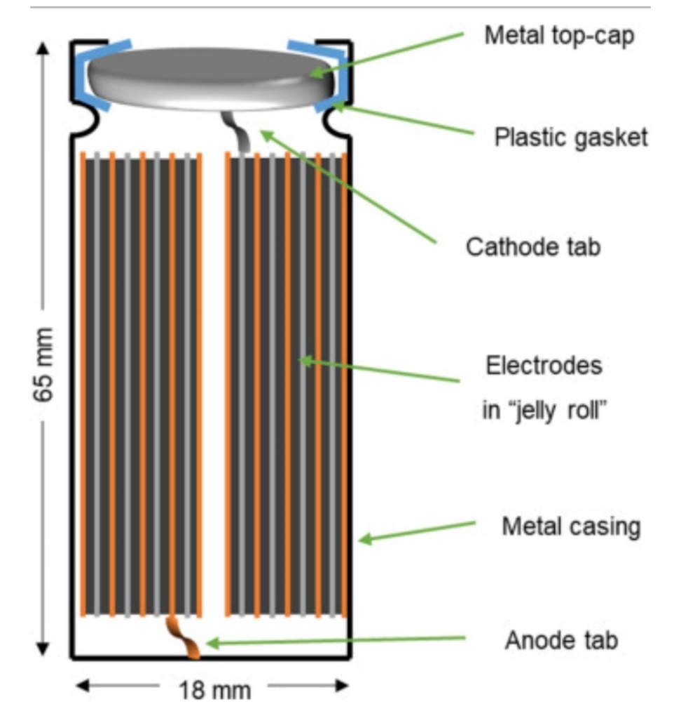
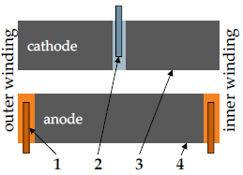
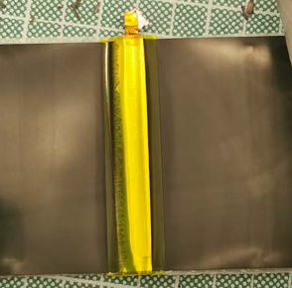
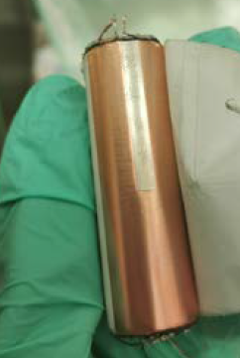

Overview what’s inside an M50Lt from literature
Proposed coordinate system:
Datum at [0,0,0] is bottom center cylinder
let positive x direction be marked as vector from center to ground tab as shown
z direction is positive up
y
z
Jelly roll features after disassembly
x
Cathode tab is placed about midway in roll (see next slide). It appears to made of aluminum and in the location where it is placed there is a discontinuation of the cathode NMC material
x
y
ground /anode tab
https://doi.org/10.3390/batteries9060309
Notes:
see https://doi.org/10.3390/batteries9060309 and supplemental material https://zenodo.org/records/7798920#.ZCw1nBTP0uV for Fig. 18 on SM-2
The wavelength evaluation was conducted on two sides: The tab-free side (homogeneous side) and the side with two tabs (inhomogeneous side). The mean composite thickness and standard deviation on the homogeneous side are 325.23 μm ± 32.8 μm (anode-to-anode) and 326.37 μm ± 25.15 μm (cathode-to-cathode). The inhomogeneous side has a mean composite thickness and standard deviation of 326.34 μm ± 25.24 μm and 326.33 μm ± 25.22 μm, respectively (see Figure 5c). The mean thickness values for both sides were very similar, resulting in an overall mean thickness of 326 μm. The standard deviations are more significant than the coating tolerances of electrodes, typically varying between ±2 μm and ±5 μm, according to experts. These differences can be explained by three factors: (i) The tab influence, as the tabs compress the coating and cause mechanical damage visible in several successive windings (see Figure 5d). (ii) Measurement errors due to the resolution. (iii) The coating tolerances for the studied cell are unknown.
After determining the composite thickness t in the rolled state by evaluating the CT measurements, the cell was opened, and the different components of the composite were measured individually. The following values were obtained as an average by recording five values in randomly selected positions: ts = 11 μm, t1 = 52.5 μm, ta = 82.5 μm, tAl = 25 μm, and tCu = 10 μm. This results in a composite thickness of 327 μm. The difference between CT and post-mortem measurement is less than 0.3%. Therefore, the radius in the wound state increases between winding n and winding n+1 by exactly the composite thickness t, and thus the jelly roll can be approximated very well with the Archimedean spiral.
Along the marked line in the CT image, 24.5 windings with the entire composite (1× double-side coated anode, 1× double-side coated cathode, and two separators) are identified. Using the corresponding inner and outer diameters of 4 mm and 19.9 mm measured in the CT image and the analytical Archimedean spiral equation (see Equations (2)–(4)), 24.4 windings are calculated. The deviation between measurement and analytical verification is less than 0.4%

Slide 17
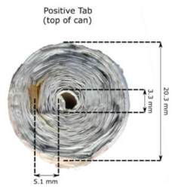
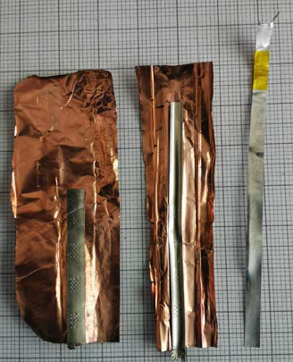
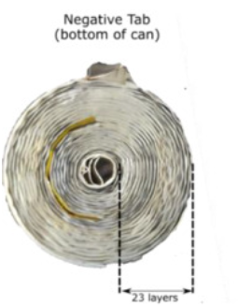
Tab material and construction
https://doi.org/10.1016/j.electacta.2022.140700
https://doi.org/10.3390/batteries9060309
Outer ground tab
Steel?
Center ground tab
Spring Steel?
cathode tab
aluminum
Suggest that the center tab is strong spring steel to keep the roll in place
Obviously the ground tabs are spot welded to the copper foil
The cathode tab (compliant aluminum) has also been spot welded to thinner aluminum sheet
Notes:
https://doi.org/10.1016/j.electacta.2022.140700

Slide 18
emergence of cathode tab connected to CID
Sandia scan
41µm voxel size
Sandia scan
12µm voxel size
Separator termination
Aluminum collector
Cathode tab
Copper Collector
(Cu, Z=29)
18

Slide 19
emergence of cathode tab connected to CID
Sandia scan, 8 μm voxel
Separator termination
Aluminum collector
Cathode tab
Copper Collector
(Cu, Z=29)
19
Notes:
W:\batPhys\scripts\scanThroughCathodeTabBT08.m, save('W:\batPhys\data\xray\20250409 C167a_FP 8um1 Top recon DR Slices 0 to 35000 BT08\CIDallJellyRoll.mat','im');

Slide 20
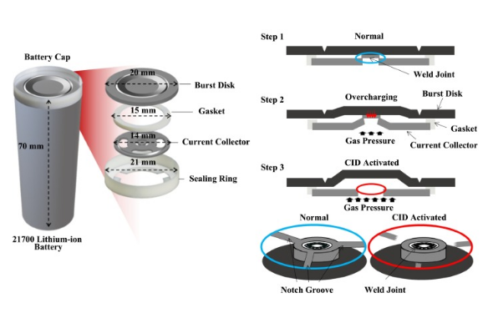
Burst DISK/ CID details
burst disk
toggles up and then ruptures
CID “button”
current collector
sealing ring
insulator gasket
https://doi.org/10.1016/j.est.2023.108838
https://doi.org/10.3390/batteries9060309
Notes:
W:\batPhys\scripts\scanThroughCathodeTabBT08.m
https://doi.org/10.1016/j.est.2023.108838

Slide 21

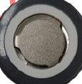
Burst disk dimensions
Deforms, breaks circuit, and then ruptures
burst disk groove
11.4 mm diameter
3 mm tab
Positive terminal
(at top of battery)
10 mm diameter
Notes:
W:\batPhys\scripts\scanThroughCathodeTabBT08.m , Figure(66) is the groove;

Slide 22
Internal structure of M50LT above the center ground tab, BT08
Sandia scan
8µm voxel size
Anode
(graphite-SiOx)
Current Collector
(Cu, Z=29)
Current Collector (Al, Z=13)
Separator
(PE, PP)
Cathode (NMC811) Z=28, 27, 25
Notes:
D:\xray\batPhys\bt08closeup8umVoxel.m

Slide 23
Jelly roll length of IF2
IF2: V2= 3.566V; Mass= 67.62 g
IF7: V7= 3.563V; Mass= 67.88 g
IF2: 155a image 1000
Archimedean spiral fit: 24.72 rolls/windings of cathode with 927 mm length and 0.319 mm thickness per total layer
Notes:
W:\batPhys\scripts\jellyRollLength.m

Slide 24
Jelly roll length of IF7
IF2: V2= 3.566V; Mass= 67.62 g
IF7: V7= 3.563V; Mass= 67.88 g
IF7: 156a image 1000
Archimedean spiral fit: 24.85 rolls/windings of cathode with 935.4 mm length and 0.319 mm thickness per total layer
Differences
0.9% roll length
0.4% weight
Notes:
W:\batPhys\scripts\jellyRollLength.m

Slide 25
Where do x-ray scans show are places of potential trouble – internal shorts?
Endpoints of roll and high curvature or bends create exceptional stress on separator at these locations
Cathode tab region
Inside of jellyroll
Outside of jellyroll
12µm voxel size
Aluminum collector
Cathode tab

Slide 26
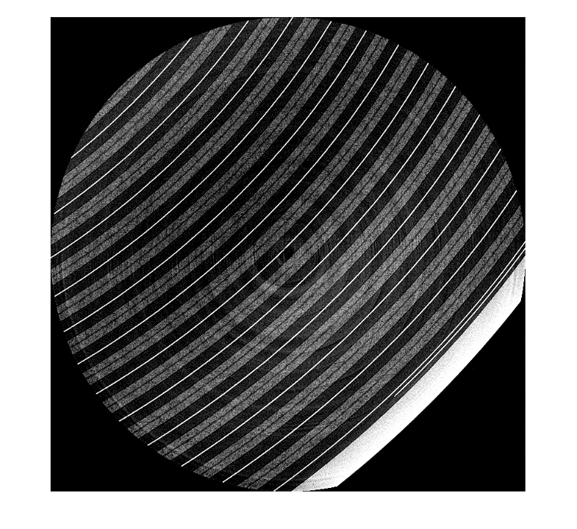
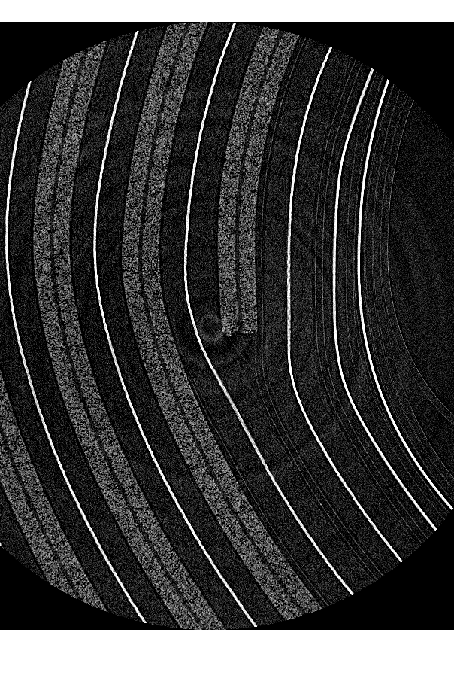
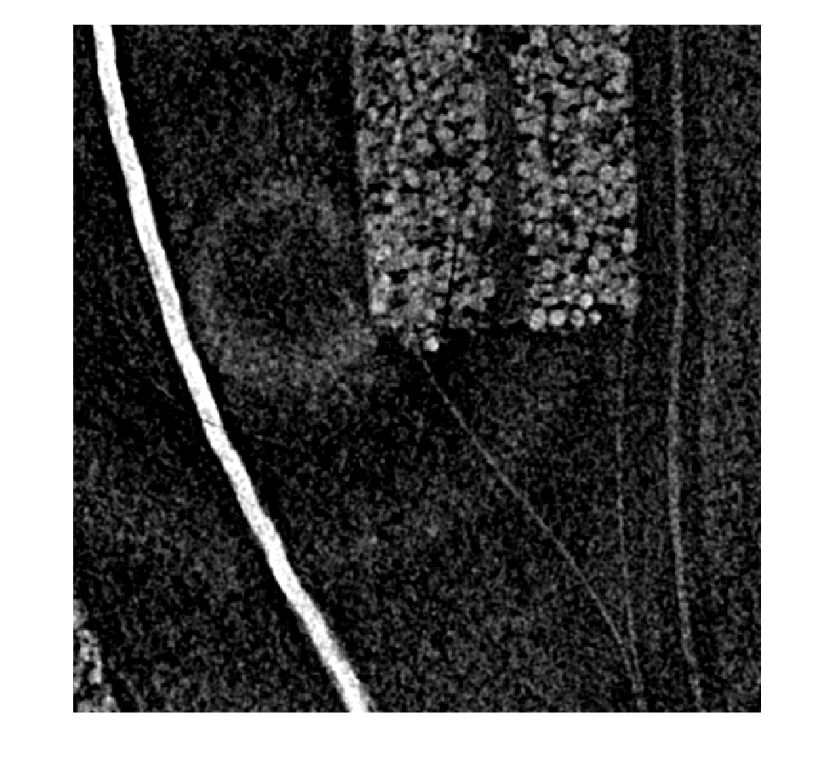
Scans by the Argonne at the Advanced Photon Source reveal exceptional detail, and potential flaws at cathode end point (on scans of BT08, also scanned by Sandia)
Cathode end point at inner winding
Separator
Copper current collector
End point
Exceptional stresses on cathode and separator – potentially a SHORT !

Slide 27
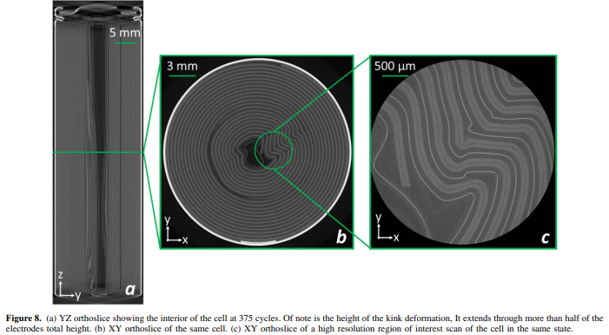
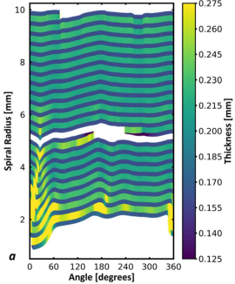
Literature on M50 cell aging shows terrific deformation at cell center –what position of a cell is likely to undergo runaway first when abused?
Kok et al. 2023, UCL, London
https://iopscience.iop.org/article/10.1149/1945-7111/acf412/pdf
M50 similar to M50LT but M50 lacks central spring-steel ground
Xray CT performed at different state of charge and different cycles
LG 21700 M50 cell aged to 375 cycles
At 375 cycles, cell has 82% capacity and is still considered “ok” and “first-life”
Enlarged anode thickness
2.5 V

Slide 28
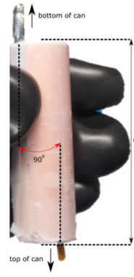
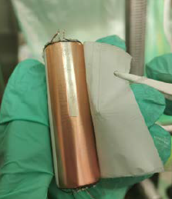

M50LT cell shows a layer of plastic around the outside of jellyroll – affects contact resistance to casing!
Design, properties, and manufacturing of cylindrical Li-ion 4 battery cells – A generic overview 5
Sabri Baazouzi 1,*, Niklas Feistel 1, Johannes Wanner 1, Inga Landwehr 1, Alexander Fill 2 and Kai Peter Birke
Detail on M50LT opening:
The cell jellyroll is electrically isolated from the cell casing by a thin plastic layer (thickness 20 µm) in the radial direction. In the axial direction, there is a thick plastic disc (thickness 0.22 mm) at the bottom and a perforated fibrous membrane (thickness 0.2 mm) at the top (Fig. S1). These components significantly lower the axial thermal conductivity by forming a barrier for heat conduction through the current collectors to the casing. The jellyroll is comprised of an electrode stack of two separators, a double-side coated positive electrode, and a double-side coated negative electrode.
Gaps between casing at end and boundary of jelly roll
Notes:
Supplementary Material 2 (SM-2) 1
Opening of the battery cells 2
Main article 3
Design, properties, and manufacturing of cylindrical Li-ion 4 battery cells – A generic overview 5
Sabri Baazouzi 1,*, Niklas Feistel 1, Johannes Wanner 1, Inga Landwehr 1, Alexander Fill 2 and Kai Peter BirkeThe cell jellyroll is electrically isolated from the cell casing by a thin plastic layer (thickness 20 µm) in the radial direction. In the axial direction, there is a thick plastic disc (thickness 0.22 mm) at the bottom and a perforated fibrous membrane (thickness 0.2 mm) at the top (Fig. S1). These components significantly lower the axial thermal conductivity by forming a barrier for heat conduction through the current collectors to the casing. The jellyroll is comprised of an electrode stack of two separators, a double-side coated positive electrode, and a double-side coated negative electrode. The copper current collector was not completely coated (Fig. S1).

Slide 29
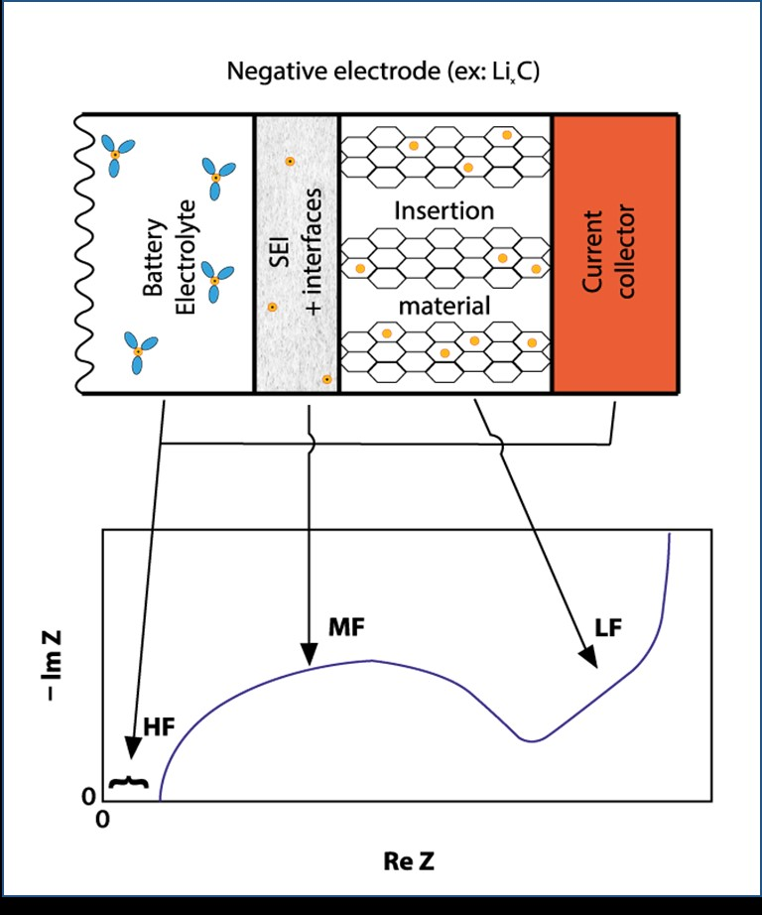
Initial cell characterization
How electrochemical impedance spectroscopy works
“half –cell”
Vary frequency of current source and measure response on battery – show results on Nyquist Plot:
High-Frequency region and intercept indicates the immediate resistance from the electrolyte, current collectors, and connectors
Mid-Frequency region: indicates charge transfer resistance and interfacial phenomena. Charge transfer reactions at the electrode surfaces and the properties of the solid-electrolyte interphase (SEI) layer. How efficiently do ions move between the electrolyte and the electrode material?
Low-Frequency region: indicates a diffusion region. A sloped line (Warburg element) at low frequencies represents the diffusion rate of lithium ions within the electrode material itself. Diffusion increases at higher temperature.
Nyquist Plot
Notes:
https://www.biologic.net/topics/why-use-electrochemical-impedance-spectroscopy-for-battery-research/

Slide 30
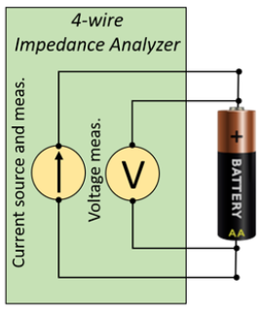
contact resistance needs to be understood for interpretation of electrochemical Impedance Spect. signal
2-wire data
Use 4-wire probe to account for wire resistance
3.4 V
Variation by adjusting wire
~ 3 mΩ
Variation by reinstalling battery
~ 3 mΩ
Battery contact resistance variability, even if spot welding to positive terminal, will exist even with 4-wire setup!

Slide 31
SPOt welds may create different electrical contact resistance
https://doi.org/10.3390/batteries9060309
Outer ground tab
Steel
Center ground tab
Spring Steel
cathode tab
aluminum
Suggest that the center tab is strong spring steel to keep the roll in place
Obviously the ground tabs are spot welded to the copper foil
The cathode tab (compliant aluminum) has also been spot welded to thinner aluminum sheet

Slide 32
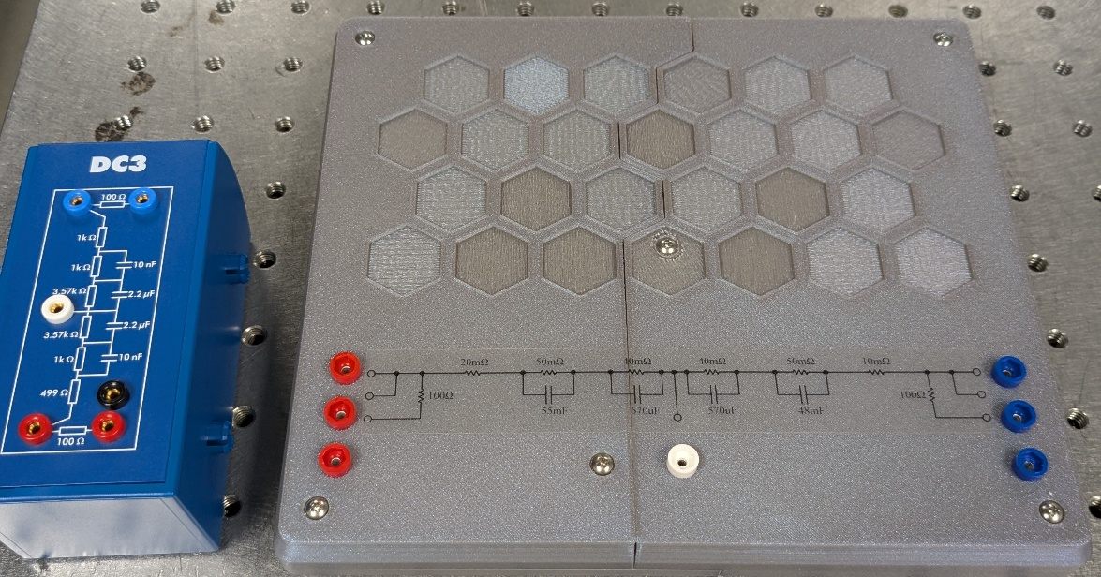
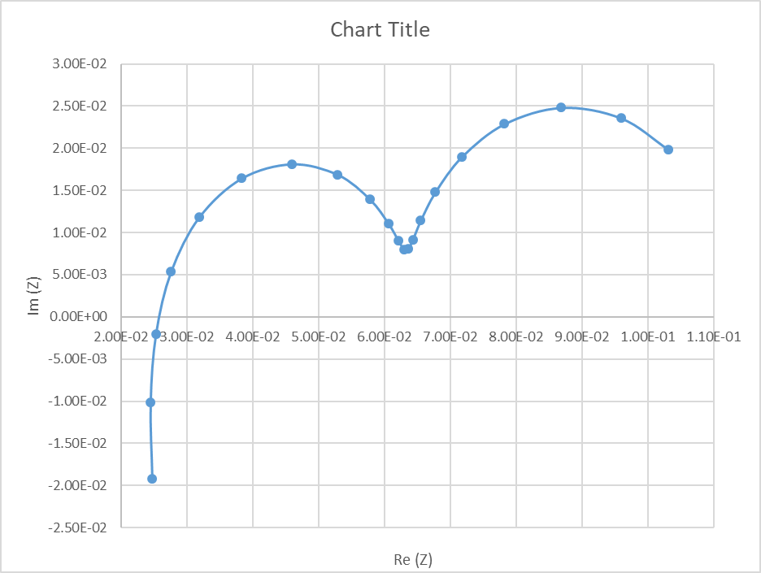
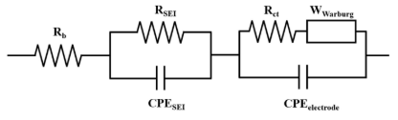

BatterY EIS constantly changes so we need a calibration reference for our small batteries
SD1
Probe resistances and setup create difficulty in standardization of EIS
Dummy cells provided for EIS “calibration” do not represent the M50LT battery properly (Ω is 6 magnitudes too high)
We (Gabriel Meier, Sandia) created a reference circuit (SD1) to represent our M50LT cells – it is available to the ECN community
Real (Z)
Im (Z)

Slide 33
EIS variation cell-to-cell (IF1-10)
~70 mΩ variation in Re(Z) but also shape differences
IF7
IF8
IF6
IF3
IF10
IF9
IF5
IF4
IF1
IF9
EIS was measured for each cell at 30% SOC

Slide 34
EIS variation cell-to-cell (BT8-19)
~30 mΩ variation in Re(Z) – x scale stretched

Slide 35
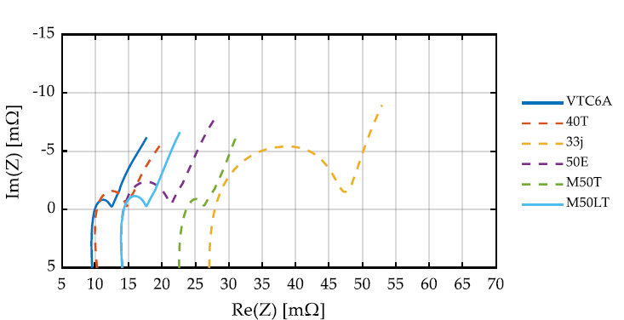
COmparison of EIS for M50T and M50LT
https://doi.org/10.3390/batteries9060309
M50 has no center spring on the anode -- is that why Re(Z) is higher?
M50LT

Slide 36
Variation in EIS features between cell to cell
IF02
IF01
BT12
Hypothesis: Quantifying even subtle differences in EIS before cells are subjected to runaway can help understand the safety/ robustness of each manufactured cell

Slide 37
EIS Variation of IF8 with Open Circuit Voltage
Real (Z)
Im (Z)

Slide 38
EIS Variation of IF6 with Temperature

Slide 39
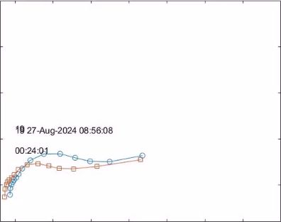
Evolution of EIS near Runaway
Overcharge Test 1
Two different cells tested with overcharge
Cell-to-cell variation exists near thermal runaway

Slide 40
Using EIS data for ECN research
“half –cell”
We propose that EIS be performed on all cells that are a part of ECN research
Database on open circuit voltage, others, also desired
Need standard for “as-received” and after cycling several times
Sandia will perform these measurements on all cells in our possession
  Would like to have the capability elsewhere as well
Nyquist Plot
Notes:
https://www.biologic.net/topics/why-use-electrochemical-impedance-spectroscopy-for-battery-research/

Slide 41
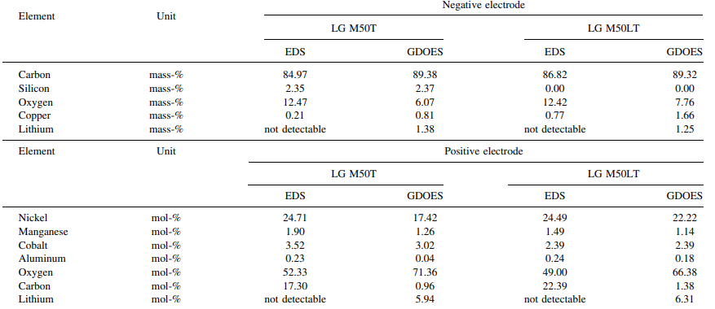
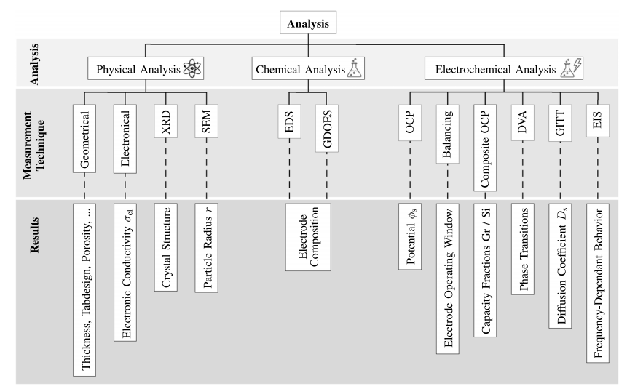
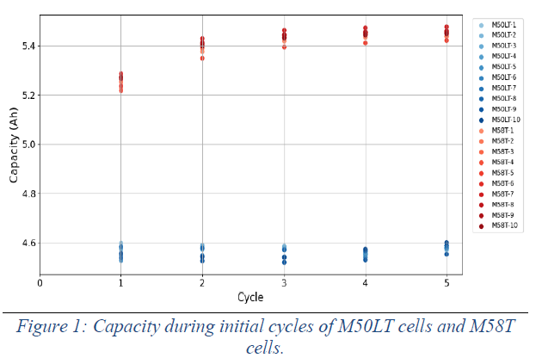
Active materials composition
Stapf et al, Journal of the electrochemical society, 2025, https://iopscience.iop.org/article/10.1149/1945-7111/add112/pdf
Positive and Negative electrode
Si is a chemically active measurement which presence should be considered for modeling (aging, but also thermal runaway behavior)
No Si detected in the anode
Increase of Ni % in the cathode
Interpretation:
  Reduction of Si to improve aging performance
  Increase of Ni content to compensate loss in capacity
What we were considering a NMC 811 is closer to an NMC9 .5 .5
Ni_{0,86}Mn_{0,6}Co_{0,8}
SiO₂ for M58 batteries to increase capacity
Analysis rainbow from Stapf et al
Cruz Rodriguez, Jesus Armando, et al. SAE 2025-24-0149. 2025.
Notes:
EDS = Energy dispersive spectroscopy (coupled with SEM) semi quantitative
GDOES = glow discharge optical emission spectroscopy (very quantitative)

Slide 42
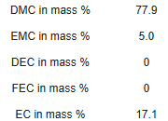
Active materials composition
Ohneseit 2023
https://www.mdpi.com/2313-0105/9/5/237
Electrolyte composition has an important impact on BC performance (ionic conductivity / diffusivity).
In the thermal runaway has also an important impact
- Boiling temperature and saturation pressure prior to venting
- Flammability since its composition is dominant of the ejecta prior TR
Electrolyte composition:
Very few information (only one publication on M50)
Solvent amount obtained after drying : 3,17 g
  Stapf et al, Journal of the electrochemical society, 2025, https://iopscience.iop.org/article/10.1149/1945-7111/add112/pdf
Separator: Polyetilene + Al₂O₃
Salt : LiPF₆
Binder: polyvinylidene fluoride (PVDF) (Cathode) / Styrene butadiene rubber (SBR) (Anode)
Data for M50 (not M50LT)
Best guess for composition
Best guess
Stapf et al, Journal of the electrochemical society, 2025, https://iopscience.iop.org/article/10.1149/1945-7111/add112/pdf
Notes:
electrolyte, is it for M50LT cell? talk about how we standardize on our assumption and express uncertainty.

Slide 43
Available cell literature shows differences between M50, M50T, M50LT
Stapf et al, Journal of the electrochemical society, 2025, https://iopscience.iop.org/article/10.1149/1945-7111/add112/pdf

Slide 44
What’s new since ECN9?
  Detailed description of a “living” LGM50 LT
    Detailed CT Xray scan from Argonne
    Jelly roll geometrical measurement
    Electrochemical characterization (EIS)
  Components reactivity characterization
    DSC / TGA / DTA approach
    Detailed temperature mapping
    Internal BC pressure
  Safety vent characterization
    Burst pressure
    Mass Loss and external pressure rise
    Detailed description and insights
    N2 venting VS real venting
    Gas analysis
  Thermal Runaway
    Imaging and jet orientation
    Gas analysis
CFD Progress (and contributions)
in all these areas
CFD simulations
Battery 2D thermal modeling and parametric sensitivities
Insight BC reactivity calibration approach
Gas generation modeling
Thermal Runaway Venting simulation

Slide 45
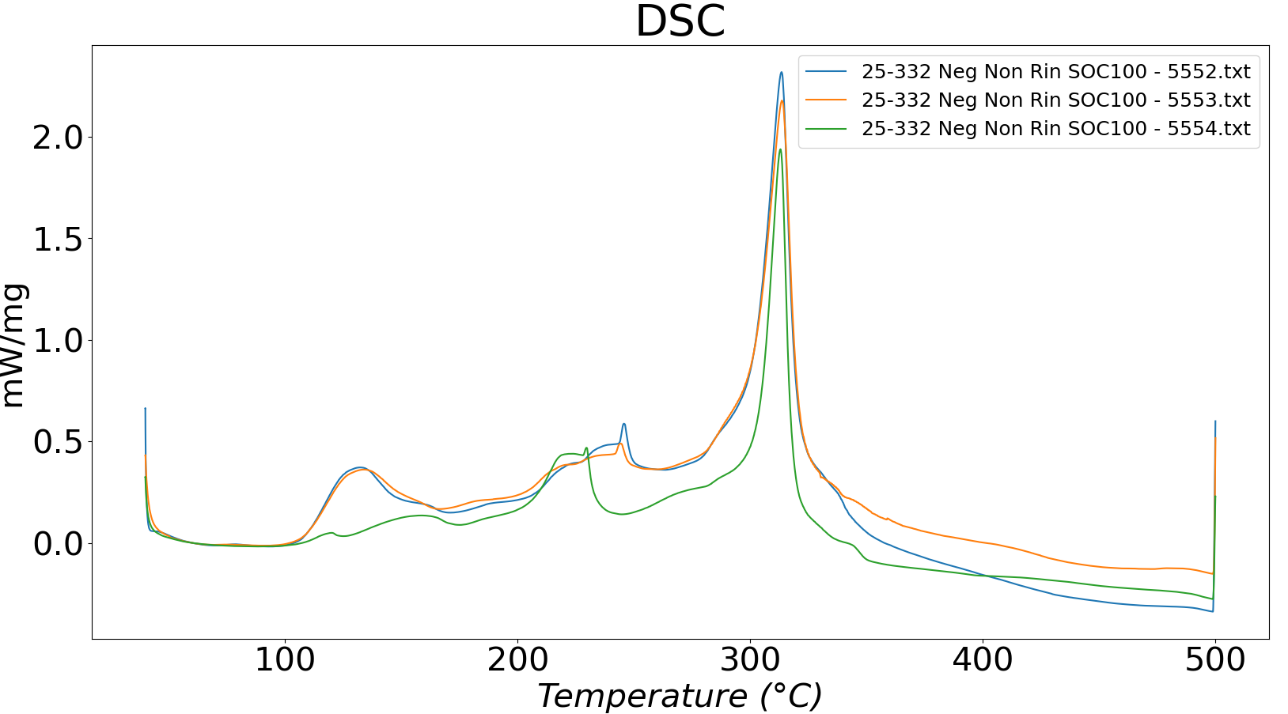
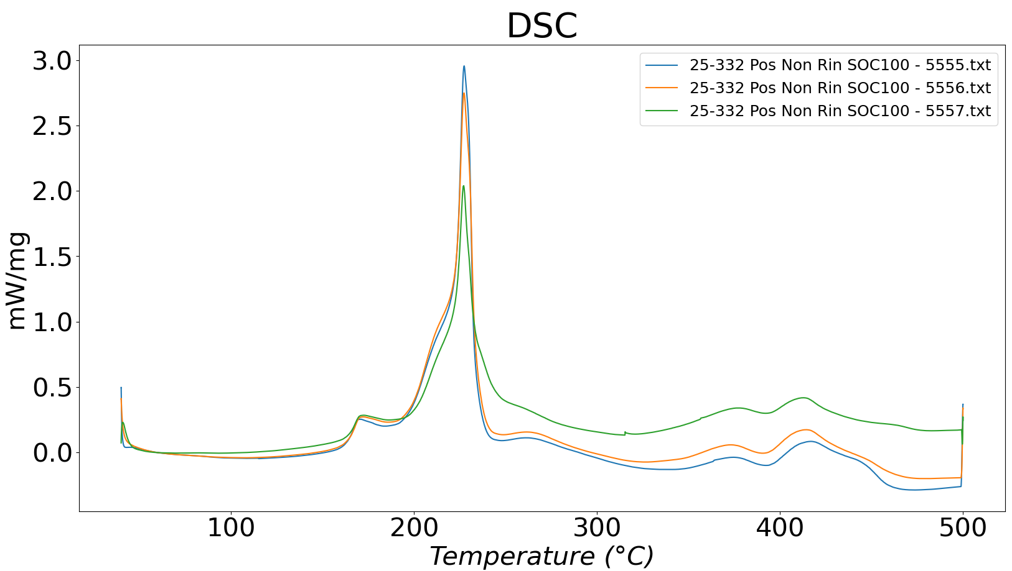
Reactivity rate from DSC
Reactivity rate
  DSC / TGA / DTA
Negative
Positive
Electrolyte evaporation / SEI decomposition
Graphite reaction with electrolyte
Further dissociation O2 production
NMC first deration (no masse loss)
Electrolyte decomposition
Cruz Rodriguez, Jesus Armando, et al. SAE 2025-24-0149. 2025.
Notes:
DSC analysis provide important information of exhotermal reactions that can be linked to specific steps of thermal runaway
This is of high importance for understanding and potentially significant for calibrating reactivity model such as the one from Kim
What we learned is that taking separately the reactivity from anode and cathode does not work

Slide 46
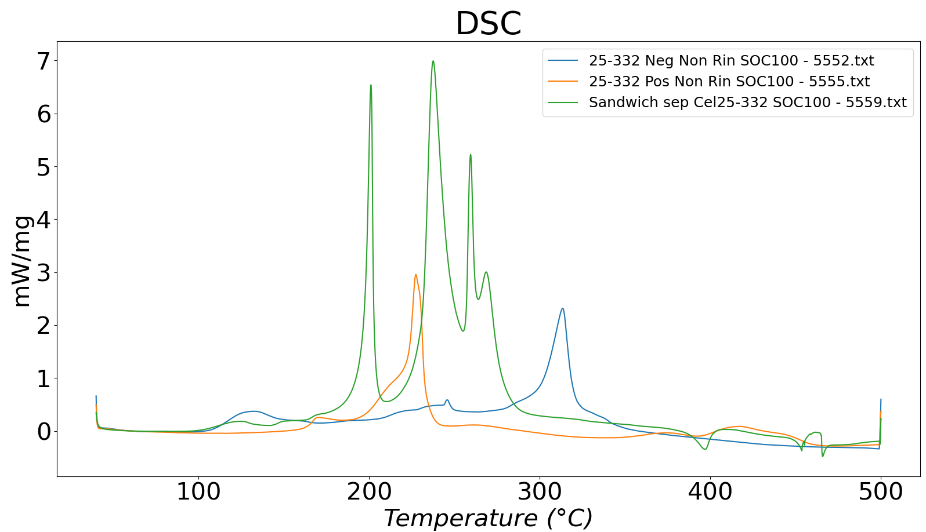
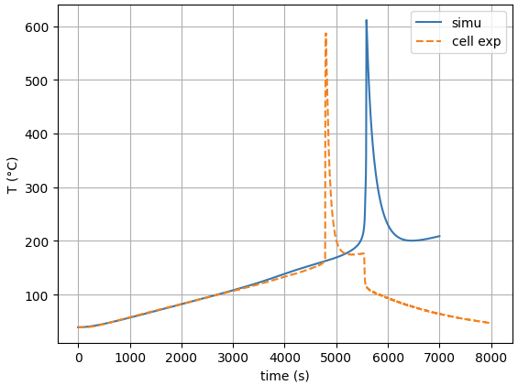
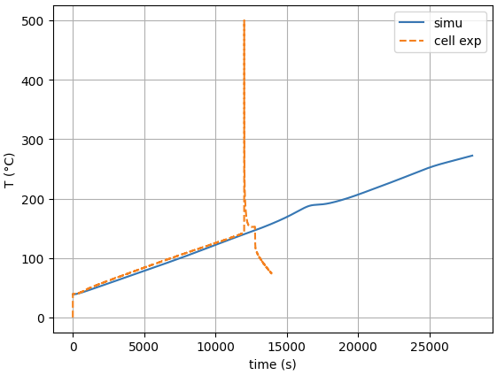
Reactivity rate from DSC
Anode + Cathode heat release does not simply add when tested together
Other materials in the battery might also affect the reactions (Cu in tabs..)
Kim model bases on the fitting of the different reactions would for sure have some conceptual limitations
Anode + Cathode
Cathode
Anode
1,5 C°/min
0,5 C°/min
J. Ravix contribution
Kim model applied by fitting perfectly anode / Cathode alone

Slide 47

BC Internal pressure measurement
21700 NMC 811
Garcia et al
  https://www.sciencedirect.com/science/article/pii/S2352152X2403874X
  Test realized on a different NMC 811 BC
BC internal pressure can provide an important insight to evaluate reactivity
  The exponential behavior of pressure evolution before vent opens might explain a lower sensitivity of Tvent to testing protocol
More in general BC internal pressure measurement provide an important marker of cell reactivity and such measurements would be important for the reference battery

Slide 48
What’s new since ECN9?
  Detailed description of a “living” LGM50 LT
    Detailed CT Xray scan from Argonne
    Jelly roll geometrical measurement
    Electrochemical characterization (EIS)
  Components reactivity characterization
    DSC / TGA / DTA approach
    Detailed temperature mapping
    Internal BC pressure
  Safety vent characterization
    Burst pressure
    Mass Loss and external pressure rise
    Detailed description and insights
    N2 venting VS real venting
    Gas analysis
  Thermal Runaway
    Imaging and jet orientation
    Gas analysis
CFD Progress (and contributions)
in all these areas
CFD simulations
Battery 2D thermal modeling and parametric sensitivities
Insight BC reactivity calibration approach
Gas generation modeling
Thermal Runaway Venting simulation

Slide 49




Safety vent testing data
IFPEN open caps + STL
After the venting test one caps was submitted to a 3D scan
The scan showed that the caps opens along the groves detected in previous scan
An STL file was generated, and it is available for 3D simulations
Sandia Scan
Opening grove

Slide 50





Positive terminal
3 mm flap retained on burst disk
Opened burst disk pressed flat to positive terminal
1.13 mm opening
Current collector underneath burst disk

Slide 51



CID trips (wires shift up in video) at ~28 minutes
Vent with substantial smoke
Top
Bottom
HiFront
LoFront
HiBack
LoBack
  Garcia et al, https://www.sciencedirect.com/science/article/pii/S2352152X2403874X
21700 Cell #6
CID likely presses against positive terminal to increase T at top
Temperature rise more profound at top of battery
Notes:
W:\batPhys\scripts\ExamineCell6_TemperatureAndVoltage.m, figure 9
W:\batPhys\scripts\trimMovie.m

Slide 52

First Vent temperature is lower for a cell that has been previously overcharged/abused and did not vent
Cell subjected to overcharge about 30 minutes prior
CID activated but it did not vent
Now send cell through slow-cook 1.5°C/min thermal ramp
Regular thermal ramp with 100% SOC cell
The first venting temperature is relatively consistent across the thermal abuse tests performed; however, it can be significantly affected by the prior “history” of the BC.

Slide 53




Safety vent Characterization
Specific tests at ambien temperature were performed at IFPEN to evaluate burst pressure of M50LT safety caps
  Safety caps were unmounted from their original cells
  Installed on a specific setup
  Progressively increasing load pressure until the opening of the safety vent
  A Xray tomography was carried out on one of the open safety vent
6 tests performed
$P_{open}$ avg | Variance
24.2 bar | 1.64
BC safety vent
Vent opening pressure
Venting cone shape
Internal volume pressure decay
Piezo electric pressure sensor
Safety vent testing tool
Schlieren Sample image
The temperature can have an important effect on caps opening and this sensitivity should be checked in the future

Slide 54

Safety vent Characterization
Specific tests at ambien temperature were performed at IFPEN to evaluate burst pressure of M50LT safety caps
  Safety caps were unmounted from their original cells
  Installed on a specific setup
  Progressively increasing load pressure until the opening of the safety vent
  A Xray tomography was carried out on one of the open safety vent
real venting - DBI
N2 venting - Schlieren
N2 venting VS real venting:
The jets seems to be narrower at the beginning and close at the end
  Consequence on elastic deformation of safety vent?
Timing of events is similar
Liquid presence in real venting is significant

Slide 55
Fundamentals of flash boiling electrolytes
Saturation Curve for DMC electrolyte
Strong cooling during expansion from high P to 1 bar
5.0 bar
P= 1 bar
x = 0.32
Massive vapor formation
Notes:
W:\batPhys\specs_21700\EES\DMCflashPlots.m

Slide 56


Venting characterization
During the first instants the spray is mainly composed by gas
During most of the duration significant number of droplets are detected creating a dense spray
During the final phase droplet exiting at high velocity can be detected: we can deduce that a gas jet is dragging them
Bryan Rodrigues-Seabras at ECN9.16
More vent is expected at 100% SOC ?
What besides the electrolyte will vent?
The O2 in CO2 can come only from the cathode material
total electrolyte 3.17 g Stapf et al, Journal of the electrochemical society, 2025, https://iopscience.iop.org/article/10.1149/1945-7111/add112/pdf

Slide 57

Venting characterization
Richardet et al, 2026 (submitted)
Gas analysis of this specific battery have been performed and will be soon published
The measurement is challenging and the uncertainties are not negligible
A consistency is clearly observed for the main species at the venting
This provides a useful reference for this simulations including gas venting

Slide 58

What is the electrolyte, and where is it located?
Is the data at the right true for the M50LT
https://www.batterydesign.net/lg-21700-m50/
  says electrolyte volume fraction is 37% in cathode and 25% in anode and 47% in separator
  Find these references
The notes has a reference for a moment of inertia method to measure the electrolyte distribution below:
Electrolyte composition
Electrolyte more liberated and filling the center void at 100% SOC
Ohneseit 2023
https://www.mdpi.com/2313-0105/9/5/237
https://iopscience.iop.org/article/10.1149/1945-7111/acce72/meta
Notes:
https://iopscience.iop.org/article/10.1149/1945-7111/acce72/meta

Slide 59

Thermal runaway
New videos have been captured in a larger thermal runaway cell at IFPEN
Synchronized Schlieren / NL color imaging
In this video we see that a smoke emission (dark) is detected before bright spot appears
  Gas emission might be related to strong degradation leading to internal short circuit? Is smoke related to separator degradation?
Gas emission is not steady, with different violent events happening
At a certain point the “flame” angle is reduced, and a straight vertical jet is observed: the safety vent is pushed away by hot gas
Incandescent particles are emitted during the entire event
The event duration (in this case) is ~300 ms

Slide 60



Additional insights on Thermal runaway
Pressure increase in a closed volume can be an additional measurement for mass loss during venting and smoking
High speed Tskin measurement (in multiple points) could be an important indicator of TR origin

Slide 61



Waterloo university Setup
High speed visible spectrometry
Li
K
Na
https://www.sciencedirect.com/science/article/pii/S0378775325015332?via%3Dihub
TR venting Velocity field based on particle displacement

Slide 62

Gas emissions during Thermal runaway
Richardet et al, 2026 (submitted)
Data available in the litterature for reference but not on M50LT
Specific data soon available from Richardet et al

Slide 63
What’s new since ECN9?
  Detailed description of a “living” LGM50 LT
    Detailed CT Xray scan from Argonne
    Jelly roll geometrical measurement
    Electrochemical characterization (EIS)
  Components reactivity characterization
    DSC / TGA / DTA approach
    Detailed temperature mapping
    Internal BC pressure
  Safety vent characterization
    Burst pressure
    Mass Loss and external pressure rise
    Detailed description and insights
    N2 venting VS real venting
    Gas analysis
  Thermal Runaway
    Imaging and jet orientation
    Gas analysis
CFD Progress (and contributions)
in all these areas
CFD simulations
Battery 2D thermal modeling and parametric sensitivities
Insight BC reactivity calibration approach
Gas generation modeling
Thermal Runaway Venting simulation

Slide 64



Numerical heatup Contributions using hatchard-Kim Method
SEI decomposition
Anode- electrolyte reaction
Cathode - electrolyte reaction
Electrolyte decomposition
IFPEN
 | Ea [J/mol] | P E factorA [1/s] | Enthalpy H [J/kg]
SEI | 1.26E+05 | 5.38E+15 | 1.02E+05
Neg electrode | 1.30E+05 | 1.57E+14 | 2.12E+06
Pos electrode | 1.19E+05 | 1.37E+12 | 2.77E+05
electrolyte | 2.58E+05 | 1.98E+26 | 4.00E+05
Sandia
 | Ea [J/mol] | P E factorA [1/s] | Enthalpy H [J/kg]
SEI | 1.35E+05 | 1.67E+15 | 2.57E+05
Neg electrode | 1.35E+05 | 2.50E+13 | 1.71E+06
Pos electrode | 1.40E+05 | 6.67E+13 | 3.14E+05
electrolyte | 2.74E+05 | 5.14E+25 | 1.55E+05
Specific carbon content | 8.48E+02 | kg/m3
Specific positive content | 1.41E+03 | kg/m3
Specific electrolyte content | 4.07E+02 | kg/m3
 | SANDIA | IFPEN
Solver | Converge | Converge
Model order | 2D | 2D
Zones | 4 zones | 1 zone
Reactivity model | Hatchard Kim | Hatchard Kim
Model parameters | Corrected standard values | Customized fitting

Slide 65





Positive terminal not modeled
Casing
SS 304
Air Insulator
R_{c} = 0
Cathode tab
Aluminum
R_{c} = 0
h = 10
W/m^2/K
h = 10
W/m^2/K
Heater
Brass
Non-isotropic conduction
Boundary at cartridge heater set to T ramp at 1.5°C/min
Jellyroll conduction (at 80 C):
Axial and azimuthal is 34 W/(m K)
But radial has poor conduction:
50 x less
Defaults
Brass-SS
R_{c} = 0.004
Simple modeling of elements within M50LT
Sandia 3D and 2D modeling
SS casing - jellyRoll
R_{c} = 0.005 K m^2/W
JellyRoll
LCO or
NMC811 with graphite anode
Notes:
Used paraView with the idreg plot

Slide 66


Temperature measurements at various positions on casing and on brass clamshell heater
TC_high
TC_mid
TC_low
On cylinder at back gap, and affixed with Kapton tape
Kapton tape to affix top TC and support electrical leads
TC_top
Positive terminal
TC_bottom
Negative terminal
Plastic casing has been removed

Slide 67
Preview of simulated casing T vs Experiment
Vent
Cooling by flashing electrolyte

Slide 68

A simplified 2D setup, available on ECN website
With only 4 elements:
Air
gap
Goal: Provide a simple setup that many groups
in the community can use, code/model comparisons
Jelly-
roll
Heater
More easily vary contact resistances, as well as chemical kinetic parameters
Casing

Slide 69

The exposed casing temperature is about 2 K colder than that under the clamp of the heater. We see this 2 K difference throughout rampup
Notes:
Used C:/pickett/batPhys/sims/coolCathode/output/ here

Slide 70




All 2D and 3D simulation shows initial heat release in central region of the jellyroll
53 s
2844 s
3444 s
3504 s
Temperature difference, T – T_mean_jellyRoll

Slide 71

Investigation of numerics
Temporal resolution is important to adequately model thermal runaway
Getting temperature differential between heater, casing and jellyroll also requires enough temporal resolution
Casing temperatures
CFL variation resulting in small variations in temperature differential between jellyroll and heater have a noticeable impact on time of runaway → ~10 min variation
Currently also assessing spatial resolution

Slide 72
Getting temperature differential between heater, casing and jellyroll requires enough temporal resolution
Brass heater
Converged CFL
Simulation – Experiment casing center T [K]
Expected inner casing T
Poor CFL
Brass heater

Slide 73

Simulation – Experiment casing center T [K]
Expected inner casing T

Slide 74

As a differential in temperature, comparison shows when cell begins to heat the brass heater
Casing temperatures
CFL variation resulting in small variations in temperature differential between jellyroll and heater have a noticeable impact on time of runaway → ~10 min variation
Currently also assessing spatial resolution

Slide 75
Investigation of contact resistance
Modifying contact resistance has some impact on heat up process
How about thermal runaway?
Casing temperatures
Shell temperature will mostly depend on resistance between casing and heater
Standard & doubled jellyroll-casing resistance
Both doubled & doubled heater-casing resistance

Slide 76
Investigation of contact resistance
But: increasing contact resistance actually accelerates thermal runaway
→ increased contact resistance keeps energy ‘trapped’
Shell temperatures
Resistance between casing and jellyroll is most important
What are the right contact resistance settings? Still working on it
Impact of plastic sheet between jellyroll and casing?
Doubled jellyroll-casing resistance leads to earliest runaway

Slide 77

Alternative approach: calibrate model by using multiple cases
Contribution by J. Ravix (IFPEN)
  Converge setup using Kim approach
  Factors calibrated on multiple cases
  Parameters forced to stay in a certain range and similarity to reference values
  ECN web meeting presentation to come

Slide 78

Alternative approach: calibrate model by using multiple cases
Contribution by J. Ravix (IFPEN)
  Converge setup using Kim approach
  Activation energies and pre exp. Factors calibrated on multiple cases
  Parameters forced to stay in a certain range and similarity to reference values
  ECN web meeting presentation to come
Experimental fitting

Slide 79


Alternative approach: Vent gas generation

Slide 80

Alternative approach: simulation of thermal runaway venting

Slide 81



2D axi-symmetric setup to simulate venting as a dense fluid – future work
Ravix, IFPEN
Luna, Rieth, Pickett
Sandia

Slide 82
What’s new since ECN9?
  Detailed description of a “living” LGM50 LT
    Detailed CT Xray scan from Argonne
    Jelly roll geometrical measurement
    Electrochemical characterization (EIS)
  Components reactivity characterization
    DSC / TGA / DTA approach
    Detailed temperature mapping
    Internal BC pressure
  Safety vent characterization
    Burst pressure
    Mass Loss and external pressure rise
    Detailed description and insights
    N2 venting VS real venting
    Gas analysis
  Thermal Runaway
    Imaging and jet orientation
    Gas analysis
CFD Progress (and contributions)
in all these areas
CFD simulations
Battery 2D thermal modeling and parametric sensitivities
Insight BC reactivity calibration approach
Gas generation modeling
Thermal Runaway Venting simulation

Slide 83

I dont’ know where to place this part
Simulations we have been discussing are rouled by the temperature distribution and consider the cell active material homogeneous
  However the cell is complexe and TR is likely generated in specific weak points

Slide 84

Future directions
BC format: towards larger diameter cylindrical
  EU founded project
    4696 format
LFP 21700
More measurement within the BCs
More quantitative data on TR process
Indicators for differenciating BCs with different TR behavior
  Potential new contributors
    GM
    Waterloo Uny
    Sydney University
    KAUST
    ARGONNE

Slide 85
DMC: (CH3O)₂CO
CH4 formation from DMC
  DMC + 2Li⁺ + 2e⁻ + 4H₂ → Li₂CO₃ + 2CH₄
  Abbott has significant formation of CH4 at venting..
CO/CO2 formation
  DMC + 3O₂ → 3CO₂ + 3H₂O
  (CH₂OCO₂Li)₂ + H₂O → Li₂CO₃ + 2CH₂OH + CO₂
  DMC + 2Li⁺ + 2e⁻ → 2CH₃OLi + CO
  2CO₂ + 2Li⁺ + 2e⁻ → Li₂CO₃+ CO

Slide 86

https://doi.org/10.1016/j.apenergy.2022.120119 (Zhou et al.,)

Slide 87


Internal pressure measurement
21700 NMC 811
Garcia et al
  https://www.sciencedirect.com/science/article/pii/S2352152X2403874X
BC internal pressure can provide an important insight to evaluate reactivity
  Plot of DMC vapor pressure vs T and comparison to chemical activity

Slide 88



Alternative approach: calibrate model by using multiple cases
Parameters results

Slide 89

From garcia et al Overcharge

Slide 91


Comparison between synthetic venting and real venting

Slide 93

Does a c
Is a correct Fit of DSC data enough?

Slide 94
Reactivity rate from DSC
By fitting accurately DSC data of separated electrodes the results are off when the model is applied to the reference case
1,5 C°/min
0,5 C°/min

Slide 95




Electrolyte
Négative
Positive
Sandwich
Sandwich

Slide 96
Is temperature heterogeneity within the cell negligible? 0 – 3D modeling?
Contribution from Martin / Vincent
  Sensitivity to contact résistances (recall some image of 3D scan vs CFD Sandia setup)
  Comparison from 0D/3D
  Comparison to a 46 diameter cell case (even more important!)

Slide 97
Venting gas composition
Richardet et al, 2026 (submitted)

Slide 98

Lecompte et al, SAE 2023-24-0160
Time variability of ARC tests is also an open question. 1D simulations indicates dispersion in mass composition as a possible cause (+/- 5% on different compositions)
  SEI mass has the most important effect
Sensibilité timing TR en ARC à variation en composition masse
Variation températures disponible
2023-24-0160

Slide 99

Pressure measurement within BC
Gas composition littérature overview and methodologies
  Overview (Lucas can help)
  Numerical approach (short review – Jules can help? Martin?)
Ejecta measurement and simulation
  Visu (Liquid or gas?)
  Approach from KAUST (Raman?)
  Simulation
NMC M50 thermal runaway gas composition

Slide 100
Gas generation measurement
Present the problem of vented gas quantification
  Results from the litterature
    Vented mass mass measurement (IFPEN)
    Garcia et al
    Abbott.. Others?

