Slide 1
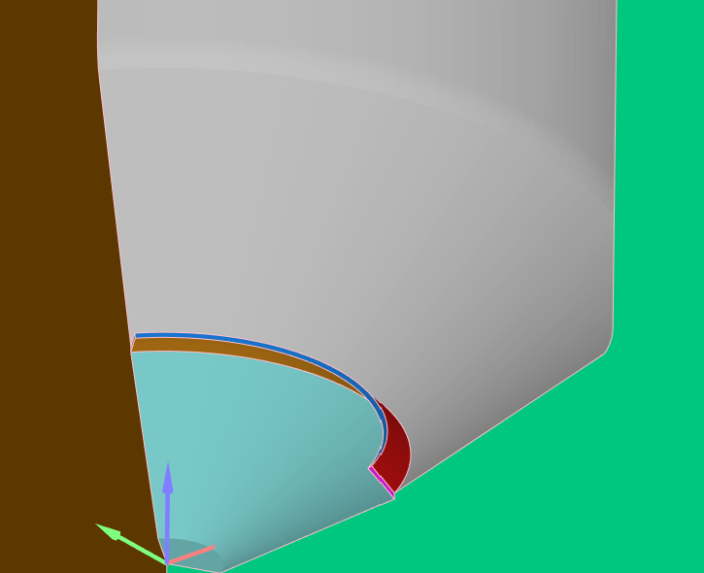
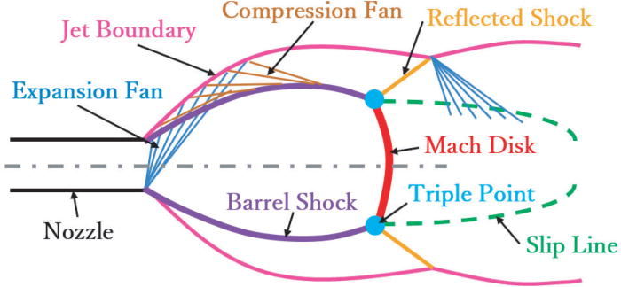
ECN 10 workshop
Guidelines
Hydrogen Injection
Noud Maes (TU/e) n.c.j.maes@tue.nl
Moez Ben Houidi (KAUST) moez.benhouidi@outlook.com Alessandro Montanaro(STEMS) alessandro.montanaro@stems.cnr.it

Slide 2
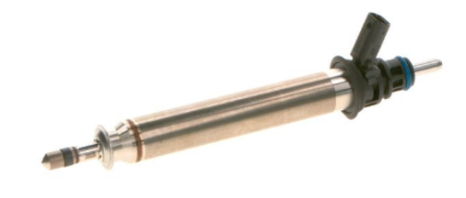
Hydrogen Injection (Low Pressure Direct Injection)
MOTIVATIONS
Heavy-duty, off-road, & stationary applications are the main driver for hydrogen
Better understanding of injection, mixture formation, and ignition of hydrogen DI
OBJECTIVES
Investigate hydrogen injection processes using an injector with an outward-opening needle (ECN9 Bosch HDEV4, PN-0261500804) as the agreed baseline for both experimental and simulation work
Focus on experiments and simulations to deepen the understanding of hydrogen injection and mixing dynamics
TARGET CONDITIONS
Variations beyond the baseline are welcome; we will use these to refine testing conditions
Access geometry, needle lift, and ROI details here https://ecn.sandia.gov/hydrogen/bosch-hdev-injector/
 | Pinj [bara] | Pamb [bara] | Ambient gas | Hydrogen Purity | T fuel & Tamb [K] | ET [ms] | Drive voltage [V]
Reference | 20 | 1 | N2 | >99.98% | ~298 | 2 | 160
Variations | 30, 50 | 2 | - | - | - | - | -

Slide 3
Hydrogen Injection (Low Pressure Direct Injection)
INFORMATION OF INTEREST
Injection and mixing data
Experiments:
mass flow rate, needle lift, injector geometry
jet penetration, and area (line of sight Schlieren)
mixing fields (local concentration, temperature, and velocity)
Simulations:
nozzle discharge/effective injection pressure
jet penetration, and area (CFD Schlieren)
time-resolved mixing-, temperature-, velocity-, and turbulence fields
DATA SUBMISSION
Preferred file format: MATLAB (.mat) or Excel (.xlsx) for processed data (e.g., jet penetration, area).
For 2D/3D data: a structured, evenly spaced grid format (e.g., matrix with fixed resolution in x, y, and z if applicable) helps ensure smooth comparisons:
include axis references (units, origin) and resolution (e.g., grid spacing).
adjust resolution to balance details and file size.
Optional: please share a short routine (MATLAB/Python) to demonstrate how to open and plot the data.

Slide 4
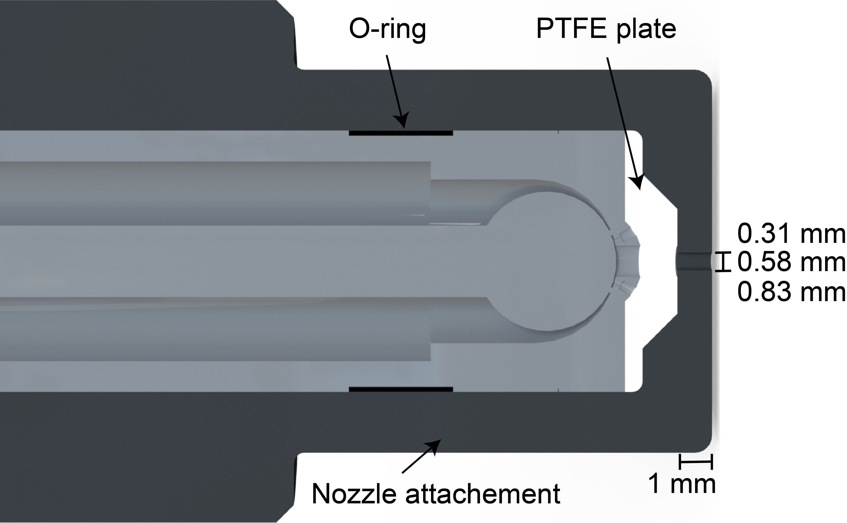
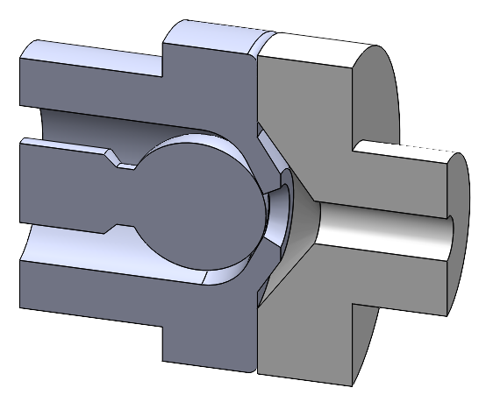
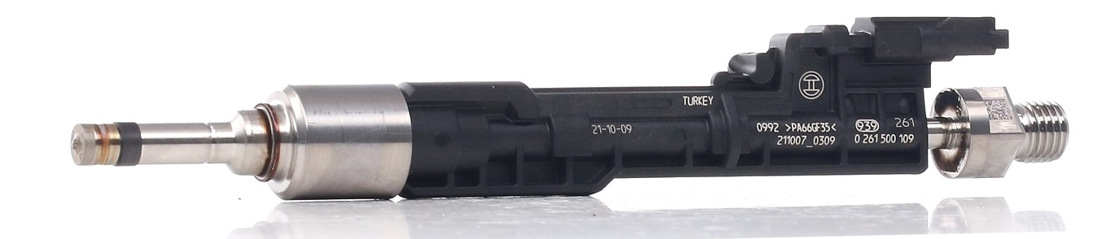
Hydrogen Injection (single-hole orifice for LPDI)
TARGET CONDITIONS
Typical Controlled Ignition engine conditions at BDC
Follow standard HDEV4 test conditions
Focus on single-hole orifice injection for LPDI configurations, differing from hollow cone injections (HDEV4).
INFORMATION OF INTEREST
General overview: any available data or insights on ongoing activities
Injection and mixing data
Experiments:
mass flow rate
jet penetration, and area (line-of-sight Schlieren)
mixing fields (local concentration, temperature, velocity, etc.)
Simulations:
nozzle discharge/effective injection pressure
jet penetration, and area (line-of-sight CFD Schlieren)
time-resolved mixing, temperature, velocity, and turbulence fields in the mid-plane
TU/e (OEM 06F 906 036)
UNSW
Sandia (ECN spray M)
KAUST (modified OEM 0261500109)
HDEV4 with cap (Rolke et al. doi: 10.3389/fmech.2022.868855)
Others?

Slide 5
Hydrogen Injection (HIGH Pressure Direct Injection)
TU/e (OEM 06F 906 036)
UNSW
TU/e (OEM 06F 906 036)
TARGET CONDITIONS
Typical Compression Ignition engine TDC conditions
Standard test conditions will be discussed in ECN10
INFORMATION OF INTEREST
Any available information for general overview of activities is welcome?
Injection and mixing data
Experiments:
mass flow rate
jet penetration, and area (line-of-sight Schlieren)
mixing fields (local concentration, temperature, velocity, etc.)
Simulations:
nozzle discharge/effective injection pressure
jet penetration, and area (line-of-sight CFD Schlieren)
time-resolved mixing, temperature, velocity, and turbulence fields in the mid-plane
Auto-ignition, pilot ignition and flame structure data
Experiments: Ignition delay, time-resolved OH* (or OH LIF, CH*, etc.)
Simulations: Ignition delay, time-resolved species maps (H₂, OH, NO, H₂O)
Sandia (ECN spray M)
KAUST (modified OEM 0261500109)
Others?

