Slide 1

Welcome to Chiba Univ.
ECN 10th WS at Chiba Univ. 2025.12.14
Yasuo Moriyoshi Chiba University

Slide 2
History
1990: Moriyoshi earned doctorate under Prof. Kamimoto at Tokyo Institute of Technology and joined Engine Laboratory at Chiba University (Muroki/Furuyama Lab) as a research associate.
1995: Promoted to an associate professor and served as a visiting researcher at University of Texas Austin for three months.
2007: Kuboyama earned his doctorate at Tokyo Institute of Technology and joined as an industry-academia collaboration researcher.
2011: SERC Inc., a university spin-off venture, was established.
2014: Next-Generation Mobility Power Source Research Center building (674m²) was completed as a Green Innovation Center designated by the Ministry of Economy, Trade and Industry.
2

Slide 3
Outline of Our Laboratory
Staff
Prof. Yasuo Moriyoshi and Prof. Tatsuya Kuboyama
3 Res.Profs.: K. Morikawa, T. Miyamoto, Z. Wang 13 Researchers
Students
Dr. candidates: 8 （3Japan, 4China, 1Hungary)
Master: 18 Japanese, 1 Malaysia
Bachelor: 10 Japanese
3

Slide 4

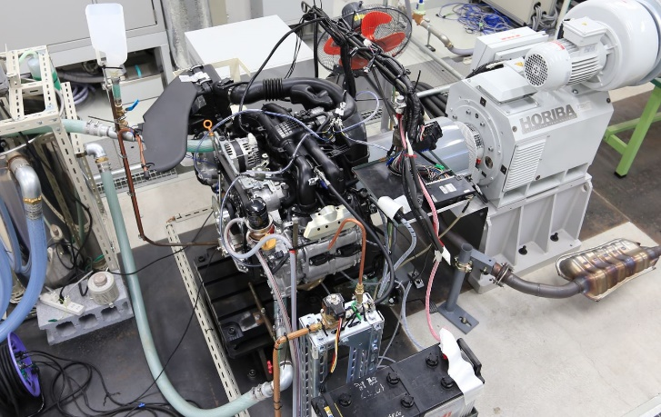
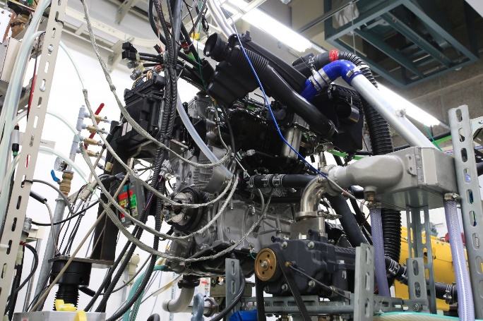
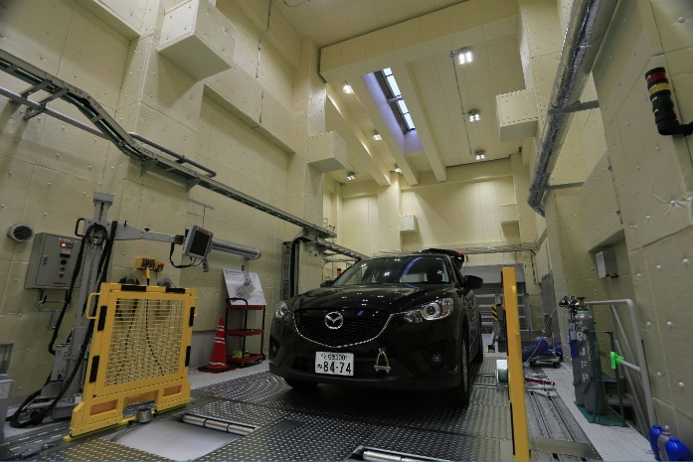
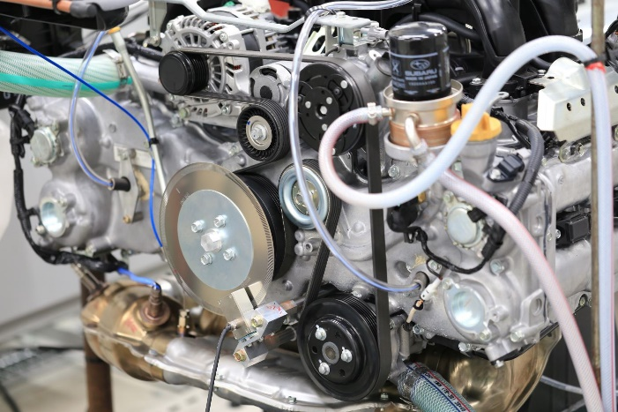
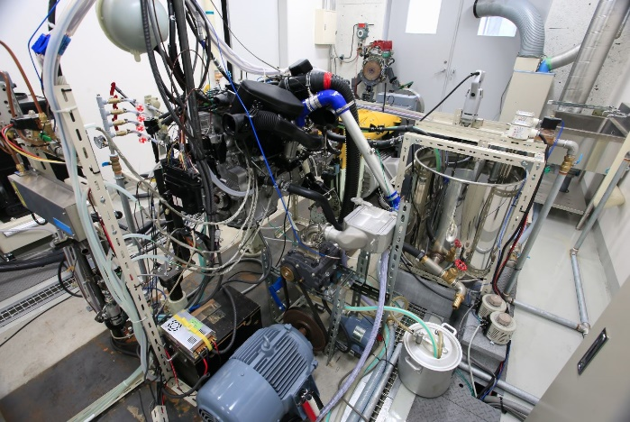
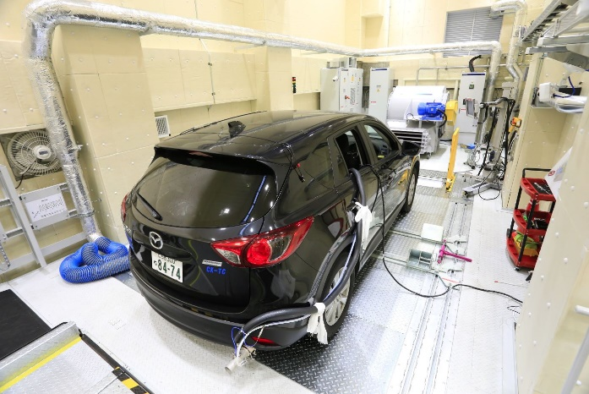
Center for Power Source Research for Next-Generation Mobility at Chiba Univ.
Engine test using simulation bench
Chassis dynamometer with PEMS
SIP lean burn test
This center was established to enhance Industry-academia-government collaboration on IC Engine research in Japan (METI program in 2014)

Slide 5

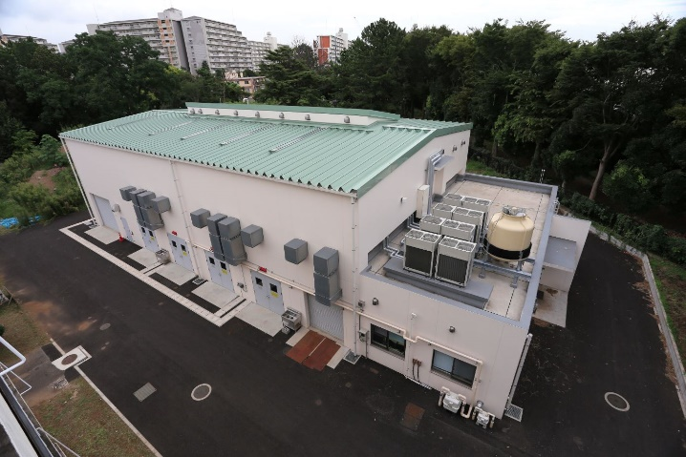
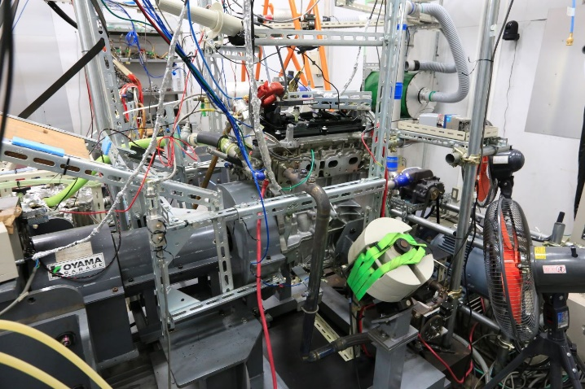
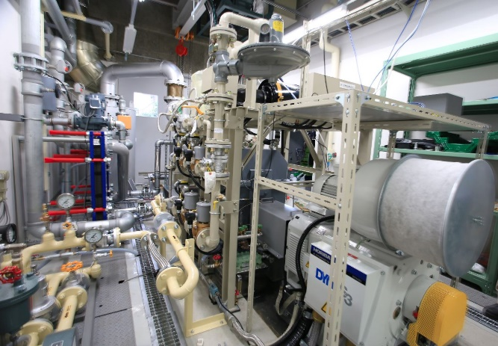
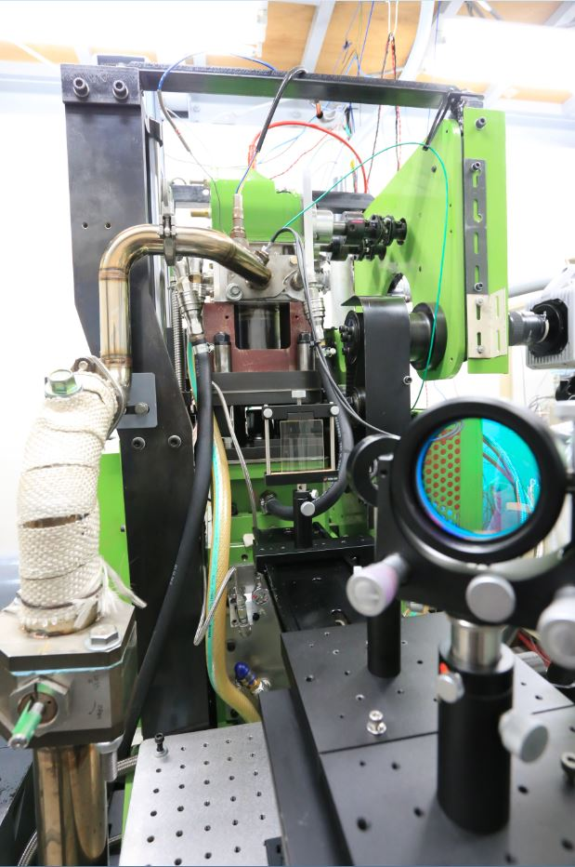
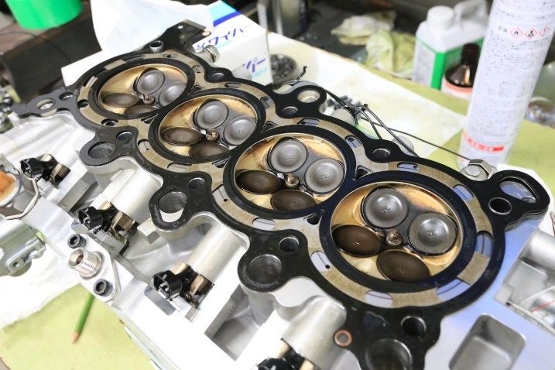
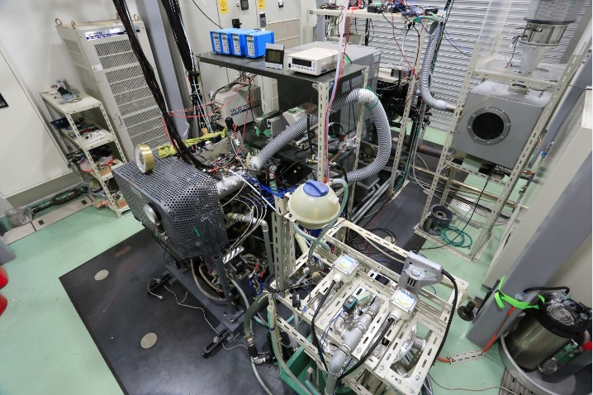
Center for Power Source Research for Next-Generation Mobility at Chiba Univ.
Arc / Low temp plasma Ignition test
Gas engine test
HCCI engine
PFI engine test
19 engines, 3 RCEMs and constant volume chambers are available. Vehicle test with chassis dyno and PEMS under RDE are carried out
Optical engine

Slide 6
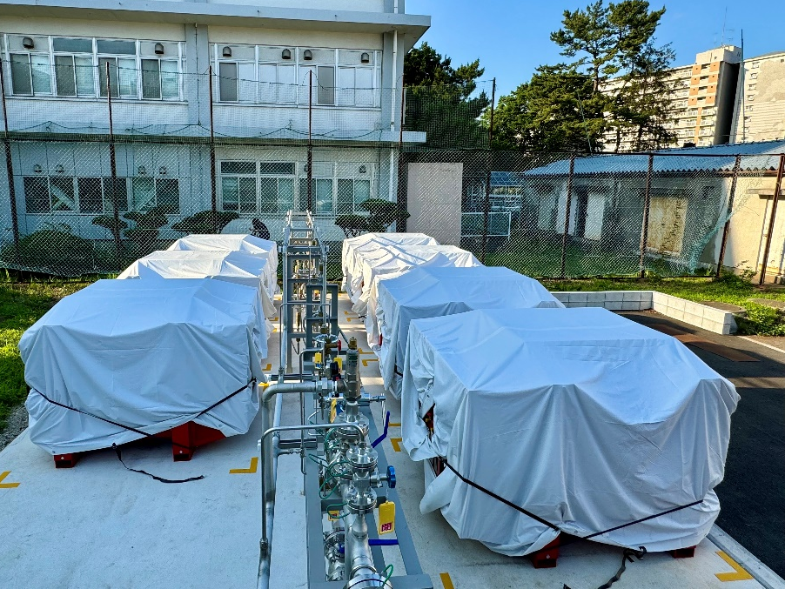
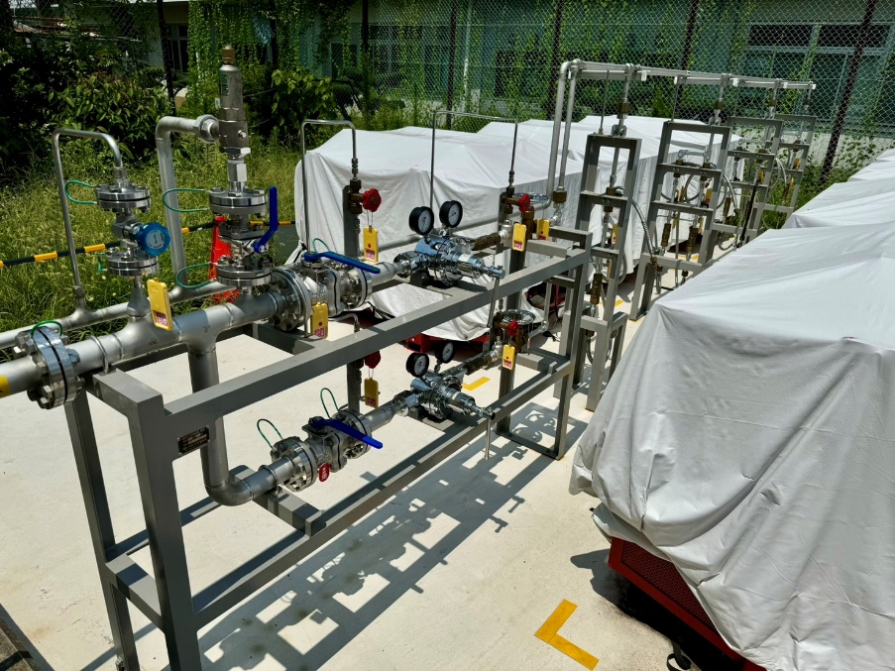
Hydrogen Storage Facilities
Hydrogen 7 bundles with 140 cylinders were completed.
Limit of legal secondary storage facility: 980 Nm³
3 hydrogen engines are in operation and one more will be soon in operation.

Slide 7
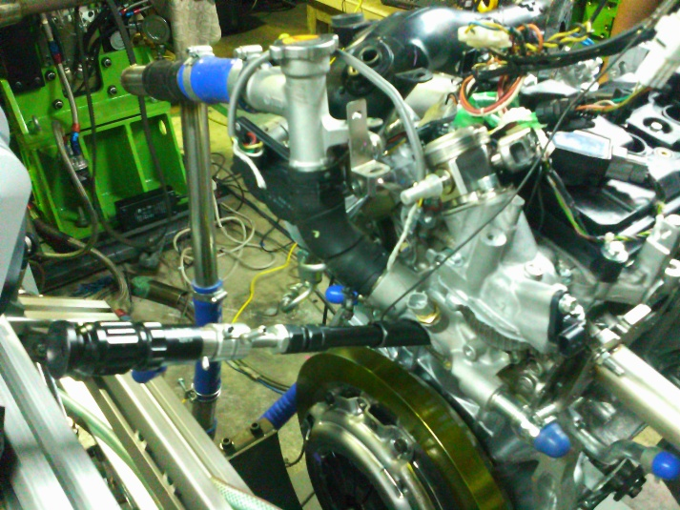
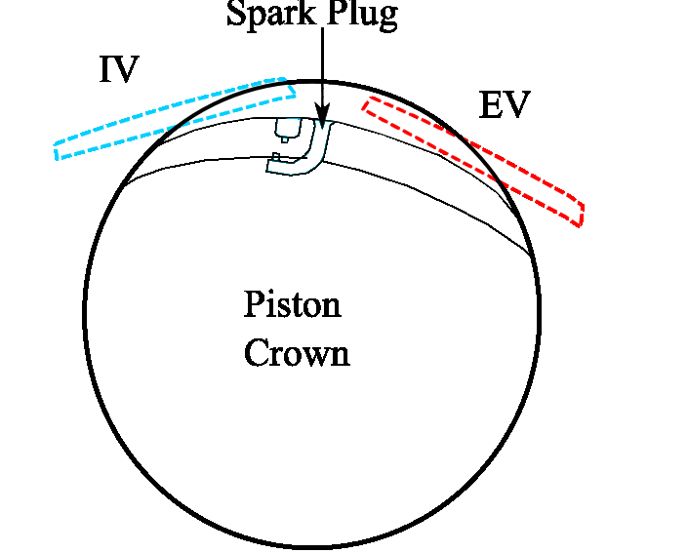
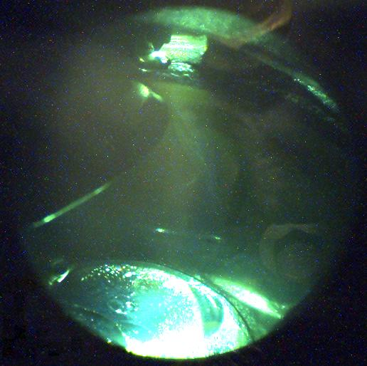
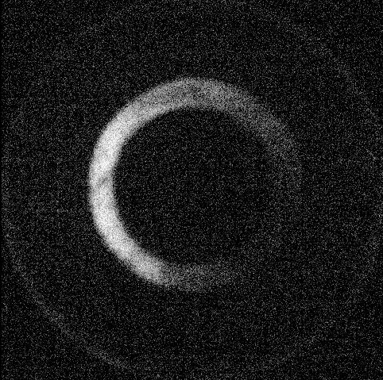
Visualization of PI with an endoscopic technique
High speed
camera
Band pass filter
Light source
Light source
In.
In.
Endoscope
Endoscope
Exh.
Exh.
Reflection of incident light by the quartz window
Notes:
For visualization, an endscope and a high speed camera were used.
The endoscope was installed into the cylinder head as shown in these figures.
A band pass filter was used for light induced fluorescence technique.
Light from the external light source is guided into the cylinder coaxially along with the optical axis of the endscope.
Or, from top of the cylinder head.
These figures show the visualization area through the endoscope.
The spark plug can be seen here.
The left side is intake side, and the right side is exhaust side.
Sometimes, you can see the ring shaped light in pictures.
This is the refrection of the incident light by the quartz window.

Slide 8
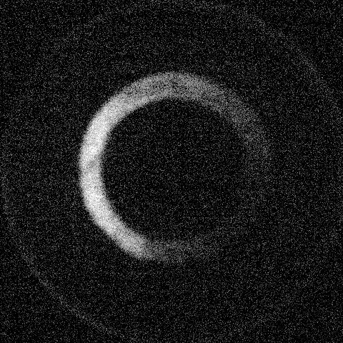
Preignition caused by droplet ignition
Light induced fluorescence image
Oil droplet comes into the view field and autoignites.
Notes:
In this slide, I would like to show you the light induced fluorescence image from oil droplet.
Inside the yellow circle,
A particle with weak fluorescence light flies into the visible area, from the right side of the image.
Let’s see the movie.

Slide 9

Glowing particles initiate pre-ignition
Highspeed photography without light source
Some floating glowing particles induce pre-ignition
Notes:
The next one is preignitnon induced by the glowing particles.
It is considered that these particles are deposit or particles generated during combustion,
especially combustion with luminous flame around the piston crevice area, as I mentioned previous slide.

Slide 10

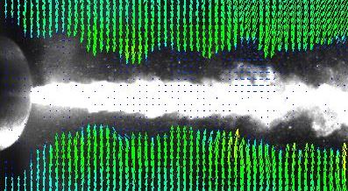
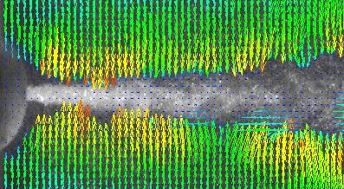
Spray Visualization
Velocity mag. [m/s]
0
1
2
3
4
・ Ambient pressure
・ Ambient temperature
: 4.0 MPa
: 788 K
・ Engine speed
・ Start of injection
・ Injection duration
: 600 rpm
: 5 deg.BTDC
: 3.0 ms (10.8 deg.@600 rpm)
Normal PIV
Fluorescent PIV
5 mm
Affected by spray droplets
Flow velocity near the boundary is unmeasurable
Up to the flow velocity near the spray boundary can be measured
In this study, we measured the flow velocity around an aerosol spray using fluorescent PIV (in collaboration with Okayama University of Science).

Slide 11
I look forward to two days of lively discussion and information exchange.
I would be grateful if you could continue your participation in COMODIA 2025 following this workshop.
Please enjoy your stay in Chiba.

