Slide 1
ECN 10
December 14 and 15 2025
Chiba University

Slide 2
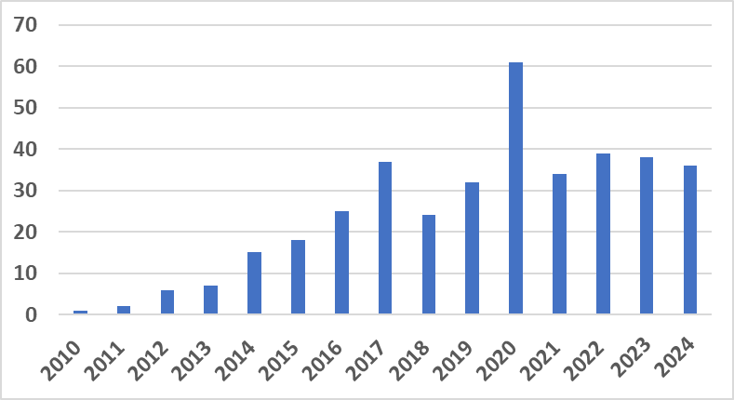
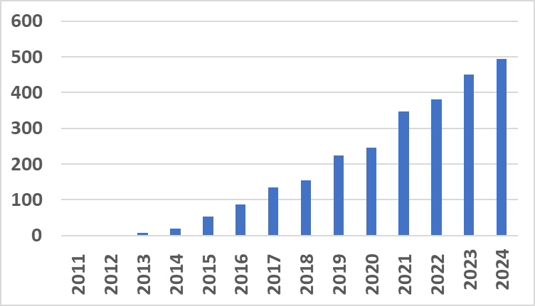
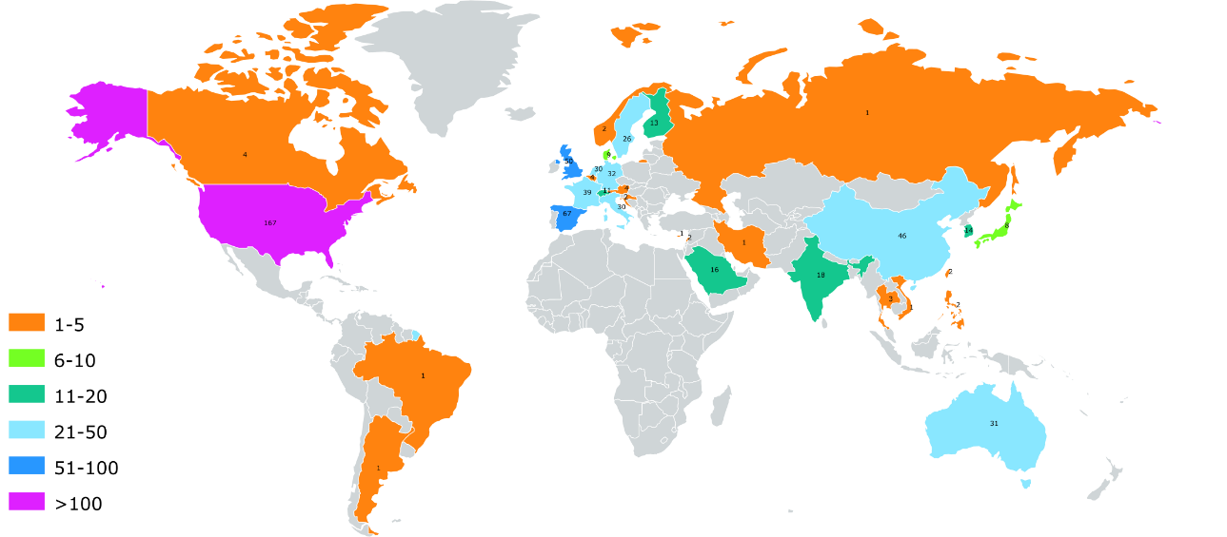
ECN Publication record 2025
WOS Database
IJER
special
Issue
ECN7
Number of ECN
publications/year
  200 laboratories actively involved (publishing ECN related work)
  390 WOS publication (2010-2025)
  800 laboratories using the ECN work (citing the ECN related work)
  ECN production is stable since 2016 (30-40 publications/year) but its visibility (number of citations) continues increasing
  h index: 46 (40 in 2023, 36 in 2022, 23 in 2019, 20 in 2018)
  Most cited article cited 202 times
Number of ECN
citations/year
ECN publishing
countries

Slide 3
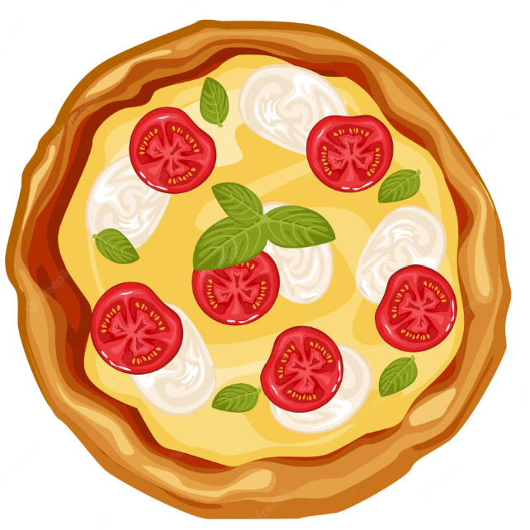
ECN9 How do all of these research topics fit together?
Are there overlaps and synergistic activities between topics?
Yes, like a pizza ! ?
Perfect combination of ingredients from new world (tomatoes) and old world (dough cooked on a hot stone)
3

Slide 4
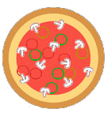

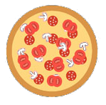
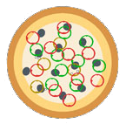
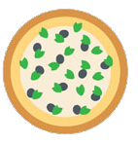
Who makes the best pizza in the world?
Sustainable Fuel SI
Hydrogen
Great pizza is found all over!
No ECN vehicle technology topic clearly has the edge over another
Helpful combinations may exist, even if ingredients aren’t completely mixed
We believe that the interdependencies of the ECN technical topics still offer “Network” benefits
Ammonia
Batteries
Sustainable Fuel CI
4

Slide 5
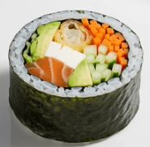
But what are we seeing in japan that shows a synergistic mix of ingredients?
Another perfect combination of ingredients
ECN technical topics also blend together
5

Slide 6
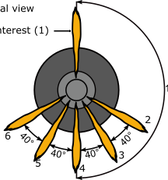
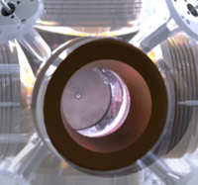
I am starting to see sushi everywhere within the ECN!
21700 NMC811
6

Slide 7

Question
At ECN9 we know what happened when you said the word peloton “pizza”, what do you think will happen if you say the word “sushi” at ECN10?
Instead of throwing a sushi-roll, which may be difficult, we have some other sweet “jellyroll” candy

Slide 8
Today. Sunday
9:00 Welcome by Yasuo Moriyoshi & Tets Aizawa (Local hosts)
9:10 Engine Combustion Network Directions
Raúl Payri (CMT), Lyle Pickett (Sandia), Gilles Bruneaux (IFPEN)
Technical program (includes presentation and discussion in the time allowed)
9:30-12:00 Hydrogen Injection, Noud Maes (TU/e) & Moez Ben Houidi (KAUST) & Alessandro Montanaro (STEMS)
(10:30-11:00 Coffee break)
12:00-13:00 Lunch (Lunchbox served at the venue)
13:00-15:00 Sustainable Fuel SI, Francesco Duronio (L’Aquila) & Joonsik Hwang (KAIST)
15:00-15:30 Coffee break
15:30-17:30 Ammonia Injection & Combustion, Michele Battistoni (Perugia) & Gabriella Bracho (CMT)
18:00 Banquet

Slide 9
Monday 15 Dec 2025
8:30-10:30 Battery Safety & Thermal Runaway, Michele Bardi (IFPEn) & Lyle Pickett (Sandia) & Antonio García (CMT)
10:30-11:00 Coffee break
11:00-12:00 Sustainable Fuel CI, Julien Manin (Sandia) & Daiana De Leon (IIMPI)
12:00-13:00 Lunch (Lunchbox served at the venue)
13:00-13:30 Future directions #1 (pick between Hydrogen Injection, Battery Safety, & Sust. Fuel CI)
13:30-14:00 Future directions #2 (pick between Sustainable Fuel SI & Ammonia)
14:00-15:00 Report from committees & Discuss ECN future
15:30-19:00 ECN fun activity (Ocean-view hot spring and Japanese restaurant near Kaihimmakuhari)

Slide 10
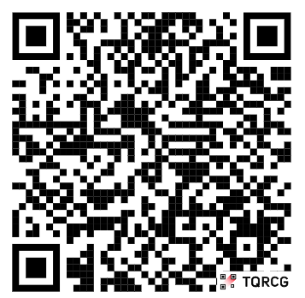
ECN 10 future direction beekast
https://my.beekast.com/4dce9d14fa546ea38ba892b299211f

