Slide 1

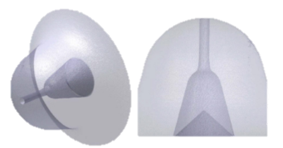

D134
Celebrating the memory of
Feb 2014 – Jan 2025
Presenter: Lyle M Pickett (Sandia)
Contributor: Junghwa Yi (Sandia)

Slide 2
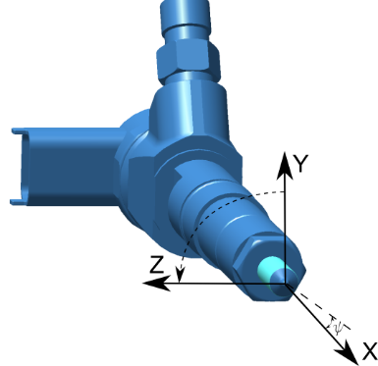
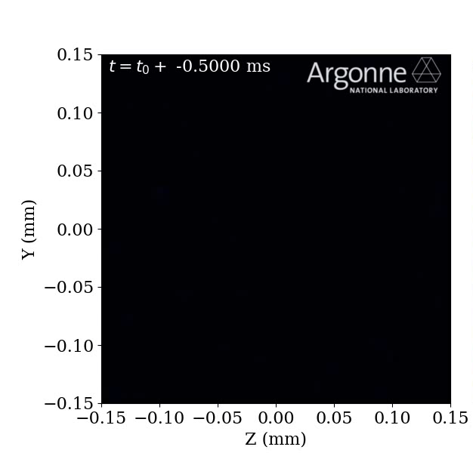


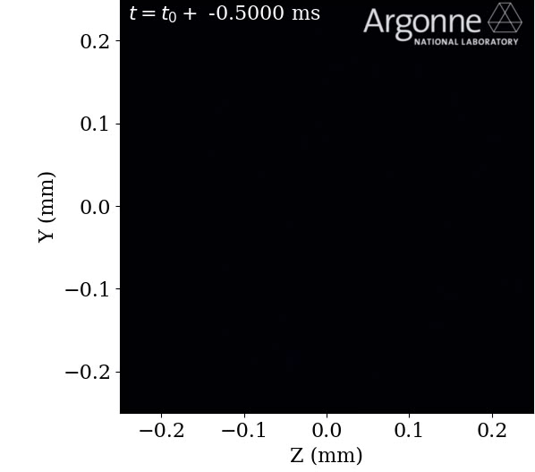
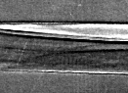
Injector 209134
APS: Powell & Sforzo, ECN6
D134
Aka “Sandia Spray D,” aged 11, of Livermore, passed away after a long and valiant battle with dimethyl ether (DME).
One of the pioneering “big hole injectors,” Spray D (D134) was developed alongside Spray C to minimize cavitation while maintaining a similar flow number.
Known as the humble injector, D134 was not as flashy or violent as her brother C137. Although relegated to backup slides during ECN6, she maintained a steady spray throughout injection and was highly tolerant to the extremes of diesel combustion.
X = 0.1
C137

Slide 3
Injector 209134
Over the years, D134 contributed significantly to the scientific community through advanced diagnostics, including diffused extinction imaging, spray tomography, Rayleigh scattering, PLIF formaldehyde imaging, and others. It later served in groundbreaking studies involving renewable fuels such as OME, ethanol, methanol, and DME under diesel injection conditions.
A private memorial was held by the Sandia Spray team—Lyle, Julien, their postdoc, Junghwa, and Kevin—who worked closely with Spray D throughout its research life.
In lieu of flowers, donations may be made to support the other Spray D injectors, including D133 which made the long journey back from Georgia Tech to Sandia.
D134 will be deeply missed and fondly remembered for its contributions to combustion science.

Slide 4
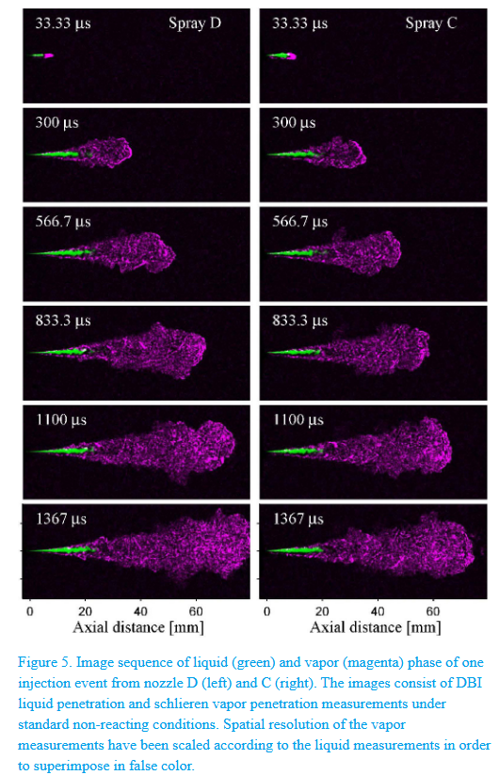
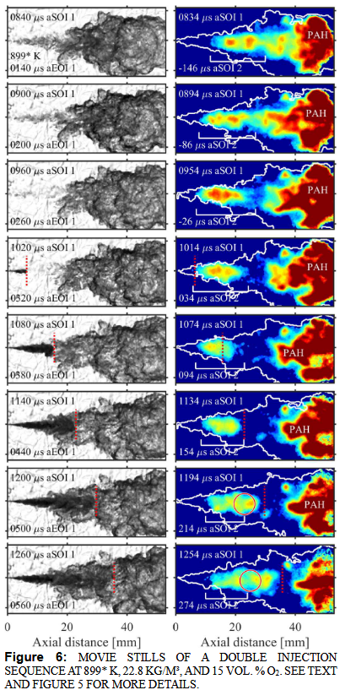
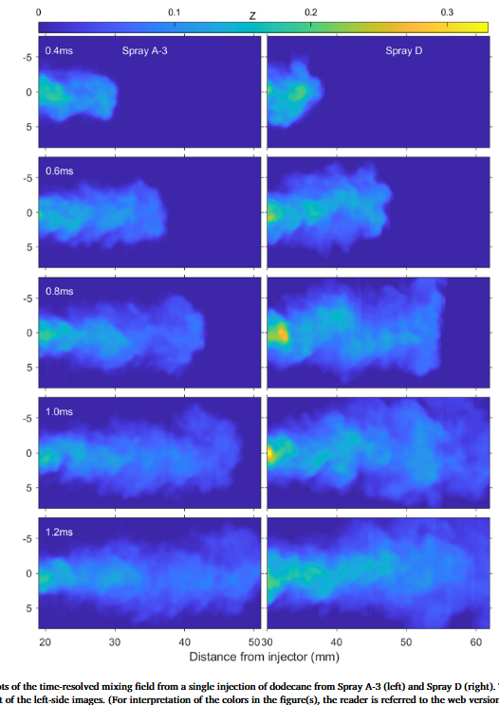
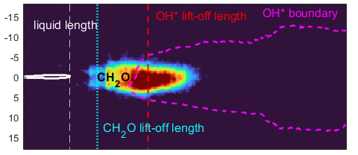
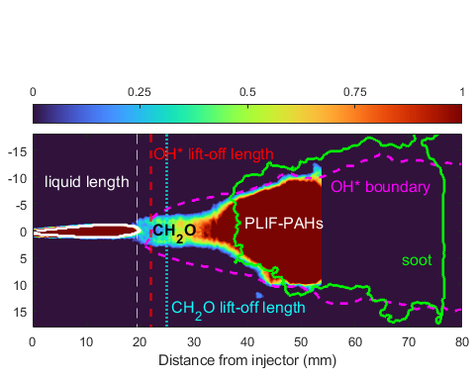
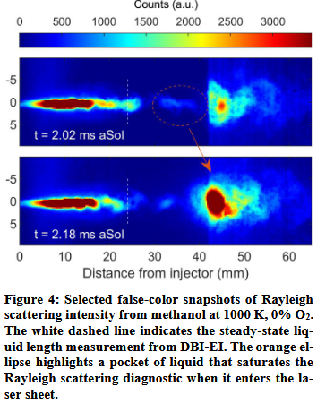
Selected achievements
Fredrik R. Westlye SAE 2016
Noud Maes ASME 2020
Kevin Wan Heat Mass Transf. 2024
Junghwa Yi COMODIA 2025
nC12
nC12
nC12
DME, 900K O₂ 15%
Spray D
nC₁₂, 900K O₂ 15%
methanol
Spray D
And much more…

Slide 5
Diary of D134 from ECN website History
Date | Location | User | Notes
June 2014 | North Star Imaging | ? | commercial x-ray tomography
July 2014 | Sandia | Fredrik | Optical microscopy of the nozzle orifice performed
Aug 2014 | CMT | ? | ROI and ROM experiments
September 2016 | Caterpillar | ? | Soot experiments in heated flow chamber
November 2017 | Argonne | Christopher | Spray tomography
January 2018 | Sandia | ? | Pyrolysis
February 2018 | Argonne | Bandon | Spray tomography
July 2019 | Sandia | Noud | High-Speed formaldehyde PLIF
2021 | Sandia | Kevin | OME fuel: High-Speed formaldehyde PLIF
2023 | Sandia | Kevin | ethanol and methanol fuel: High-Speed formaldehyde PLIF
Jul-Dec 2024 | Sandia | Junghwa | DME fuel: High-Speed formaldehyde PLIF. Injector began leaking when pressurized in November
28 Jan 2025 | Sandia | Junghwa | Injector leaking and not operating. Presumed damage from DME to injector or to fuel system

Slide 6

Room
Weapon
Murderer

Slide 7

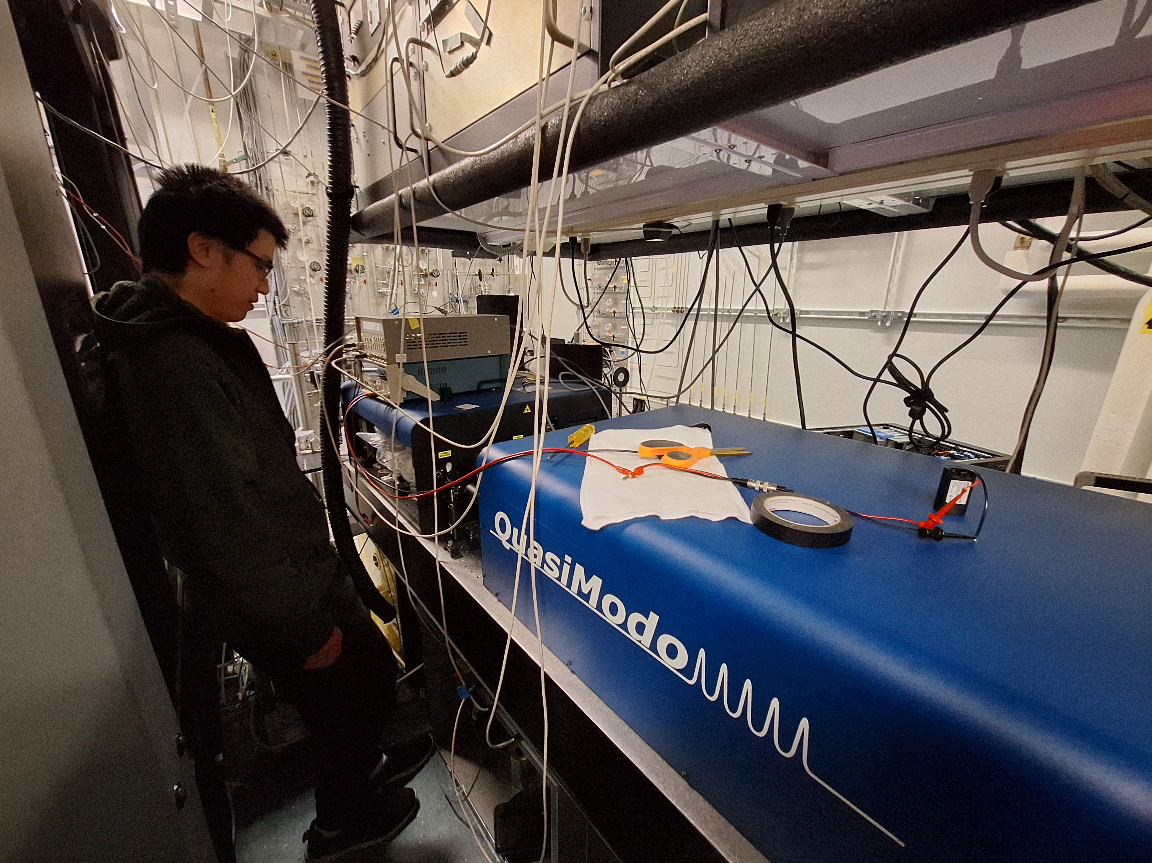
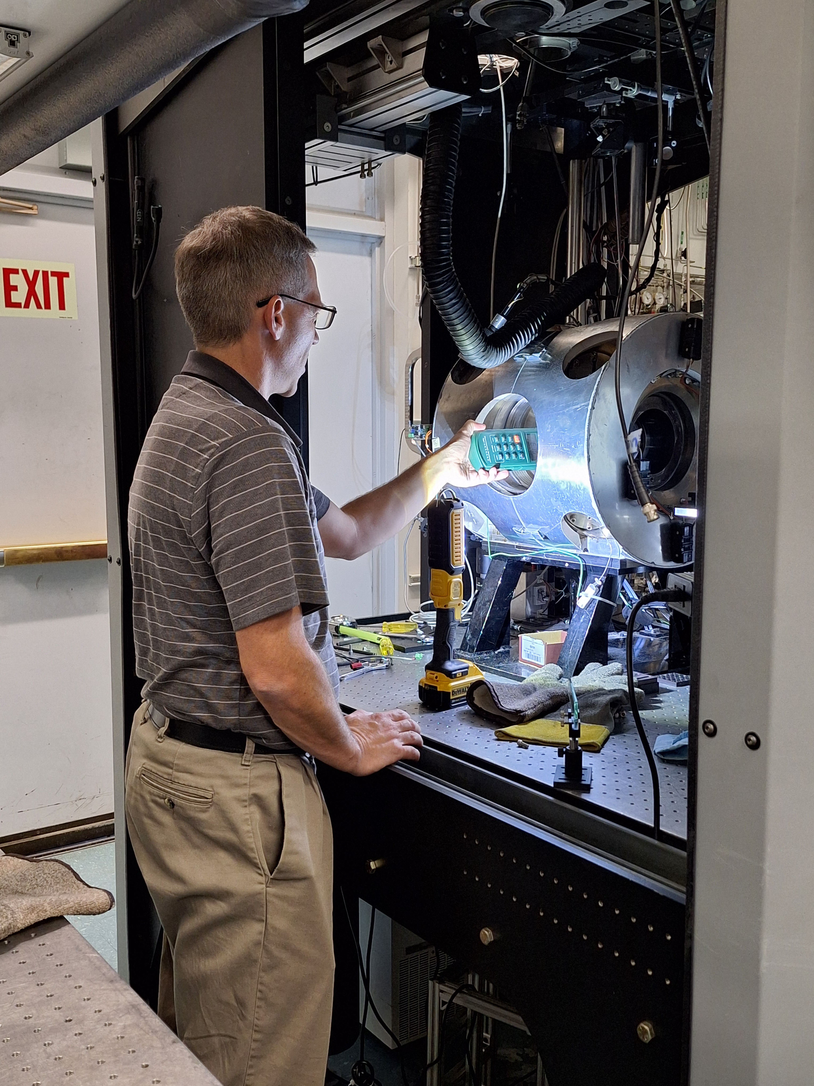
Room
Sandia Lab. (Livermore, CA), 906/166

Slide 8
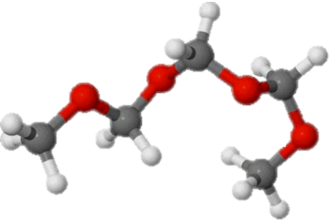
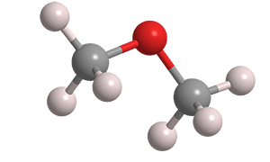
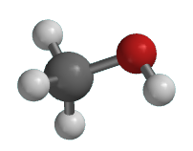
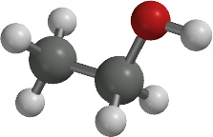
Weapon
Fuels: OMEx, Ethanol, Methanol, DME
Fuel | OME3 | ethanol | methanol | DME | nC12
Viscosity (1 bar 20C) | ~0.65 mPa·s | 1.144 mPa·s | 0.594 mPa·s | ~0.085 mPa·s | 1.34 mPa·s
Operating conditions: 1500 bar, no lubrication
Increased wear, leak through seals and clearances, cavitation damages the surface

Slide 9
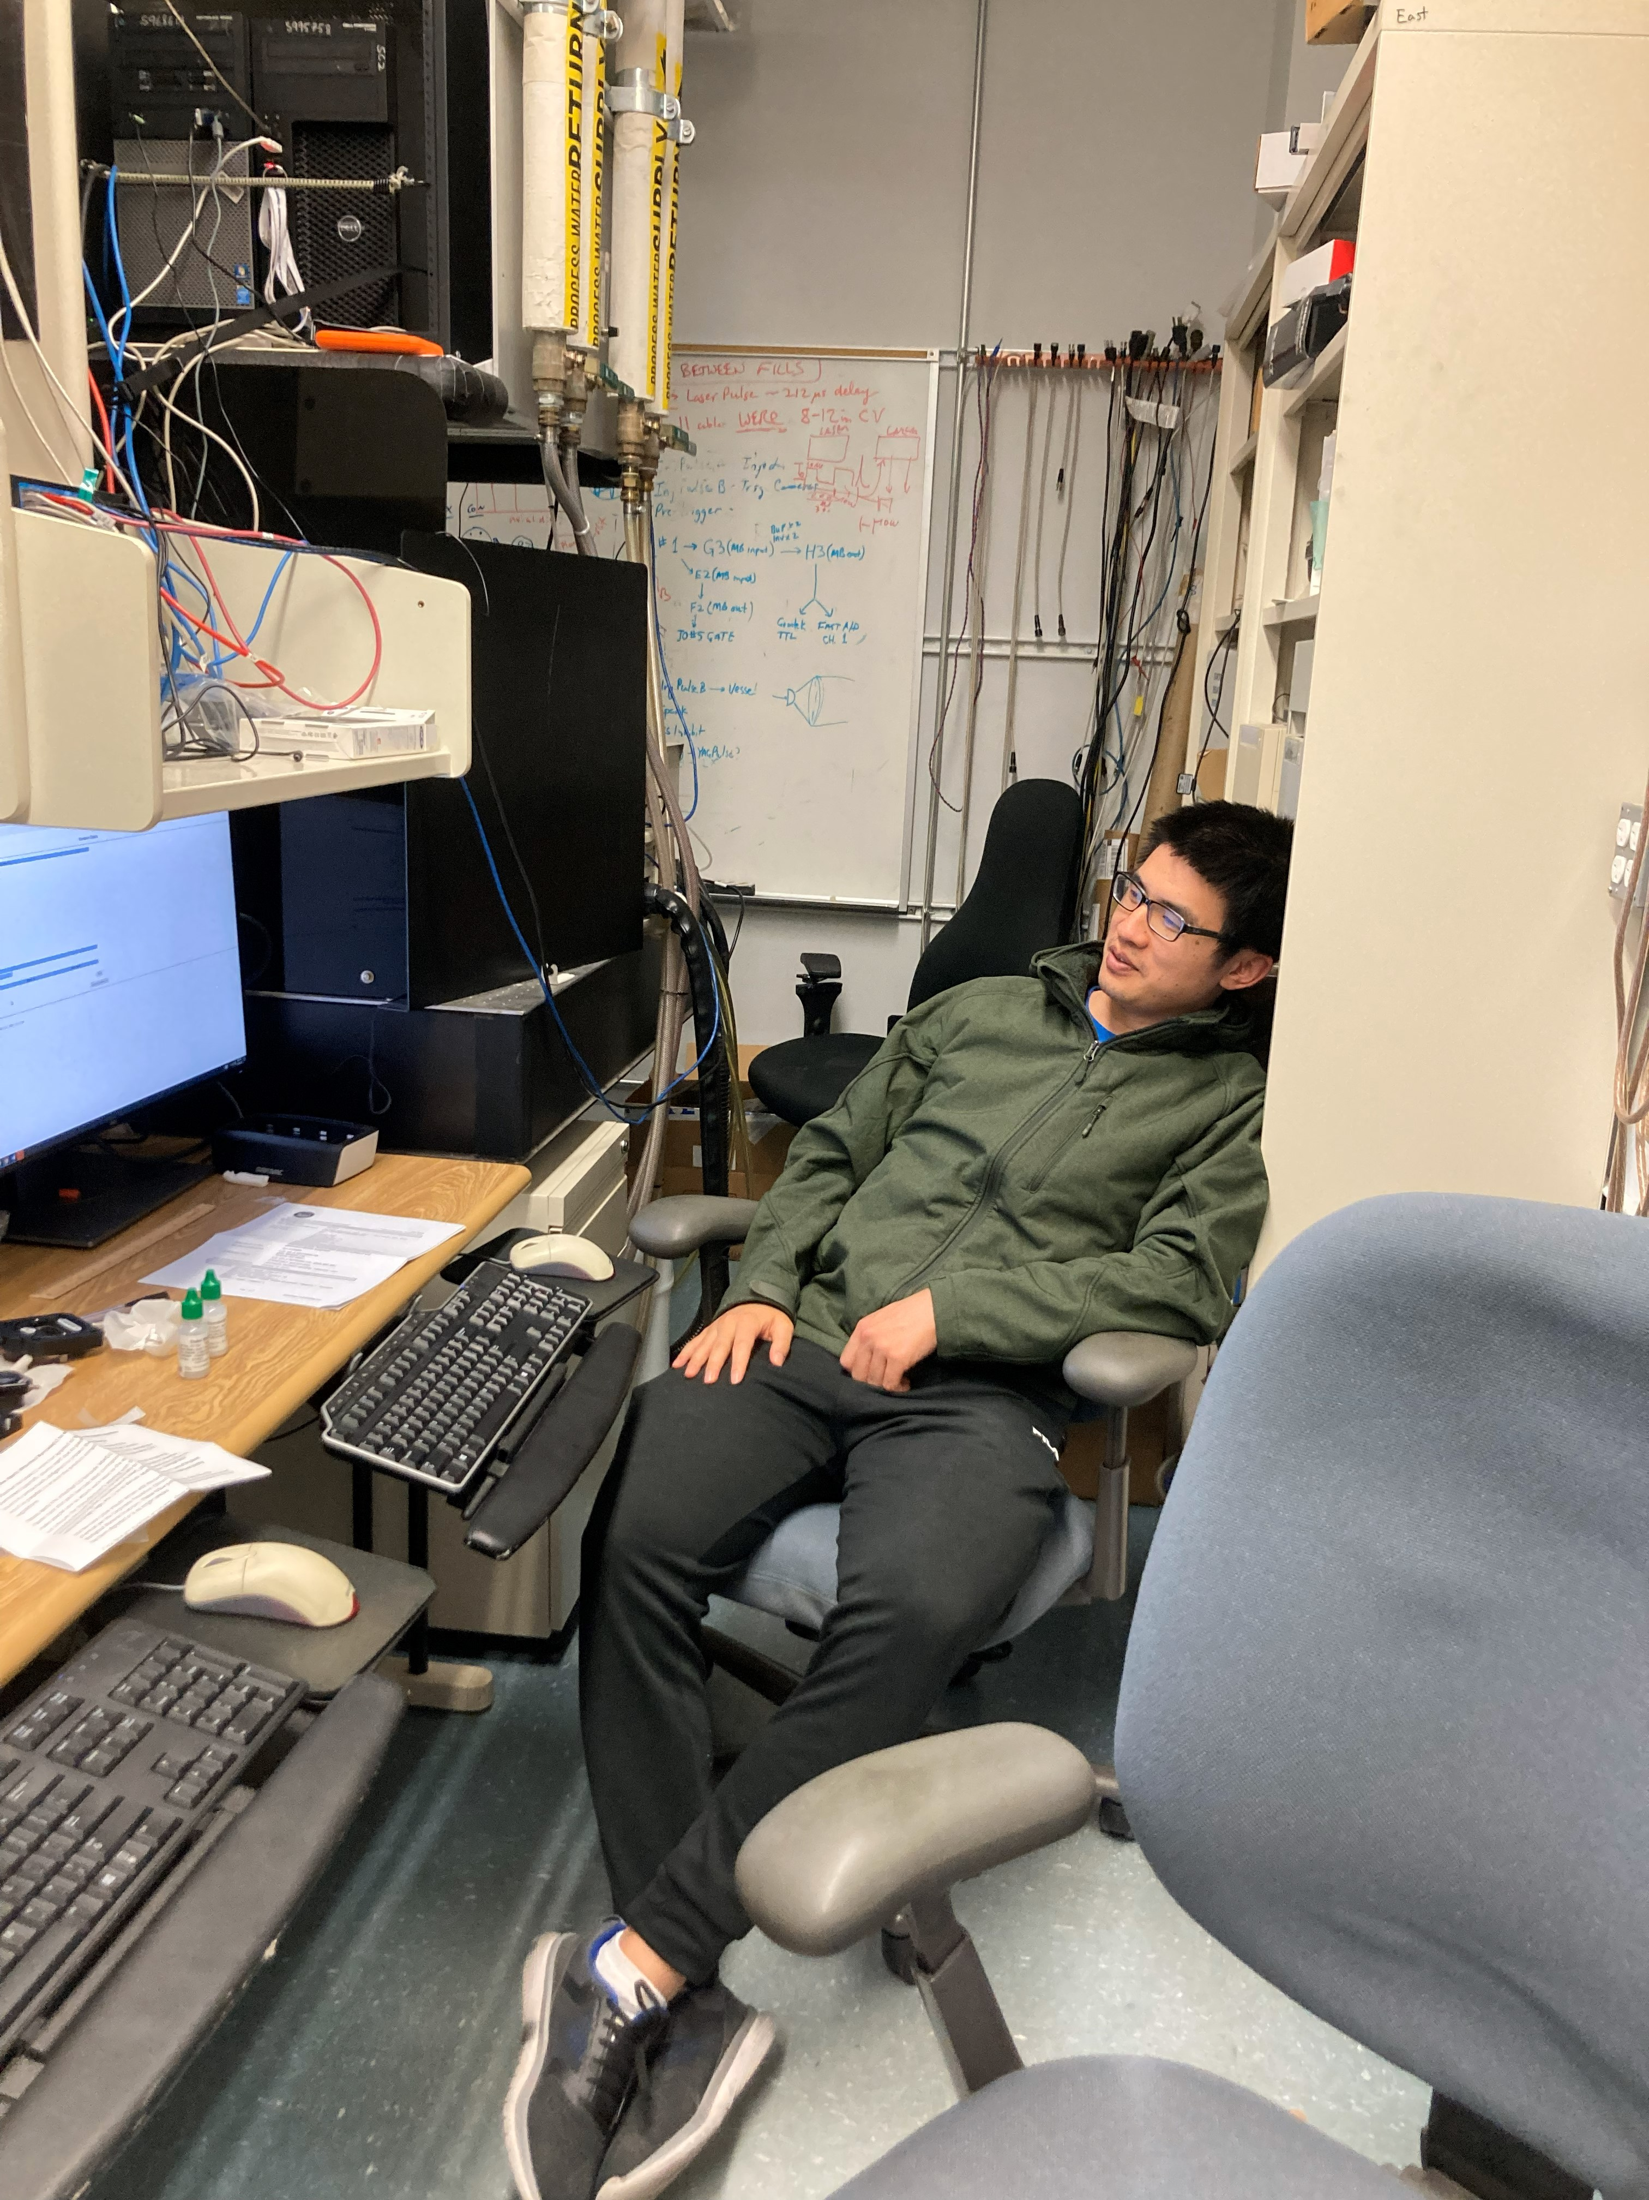
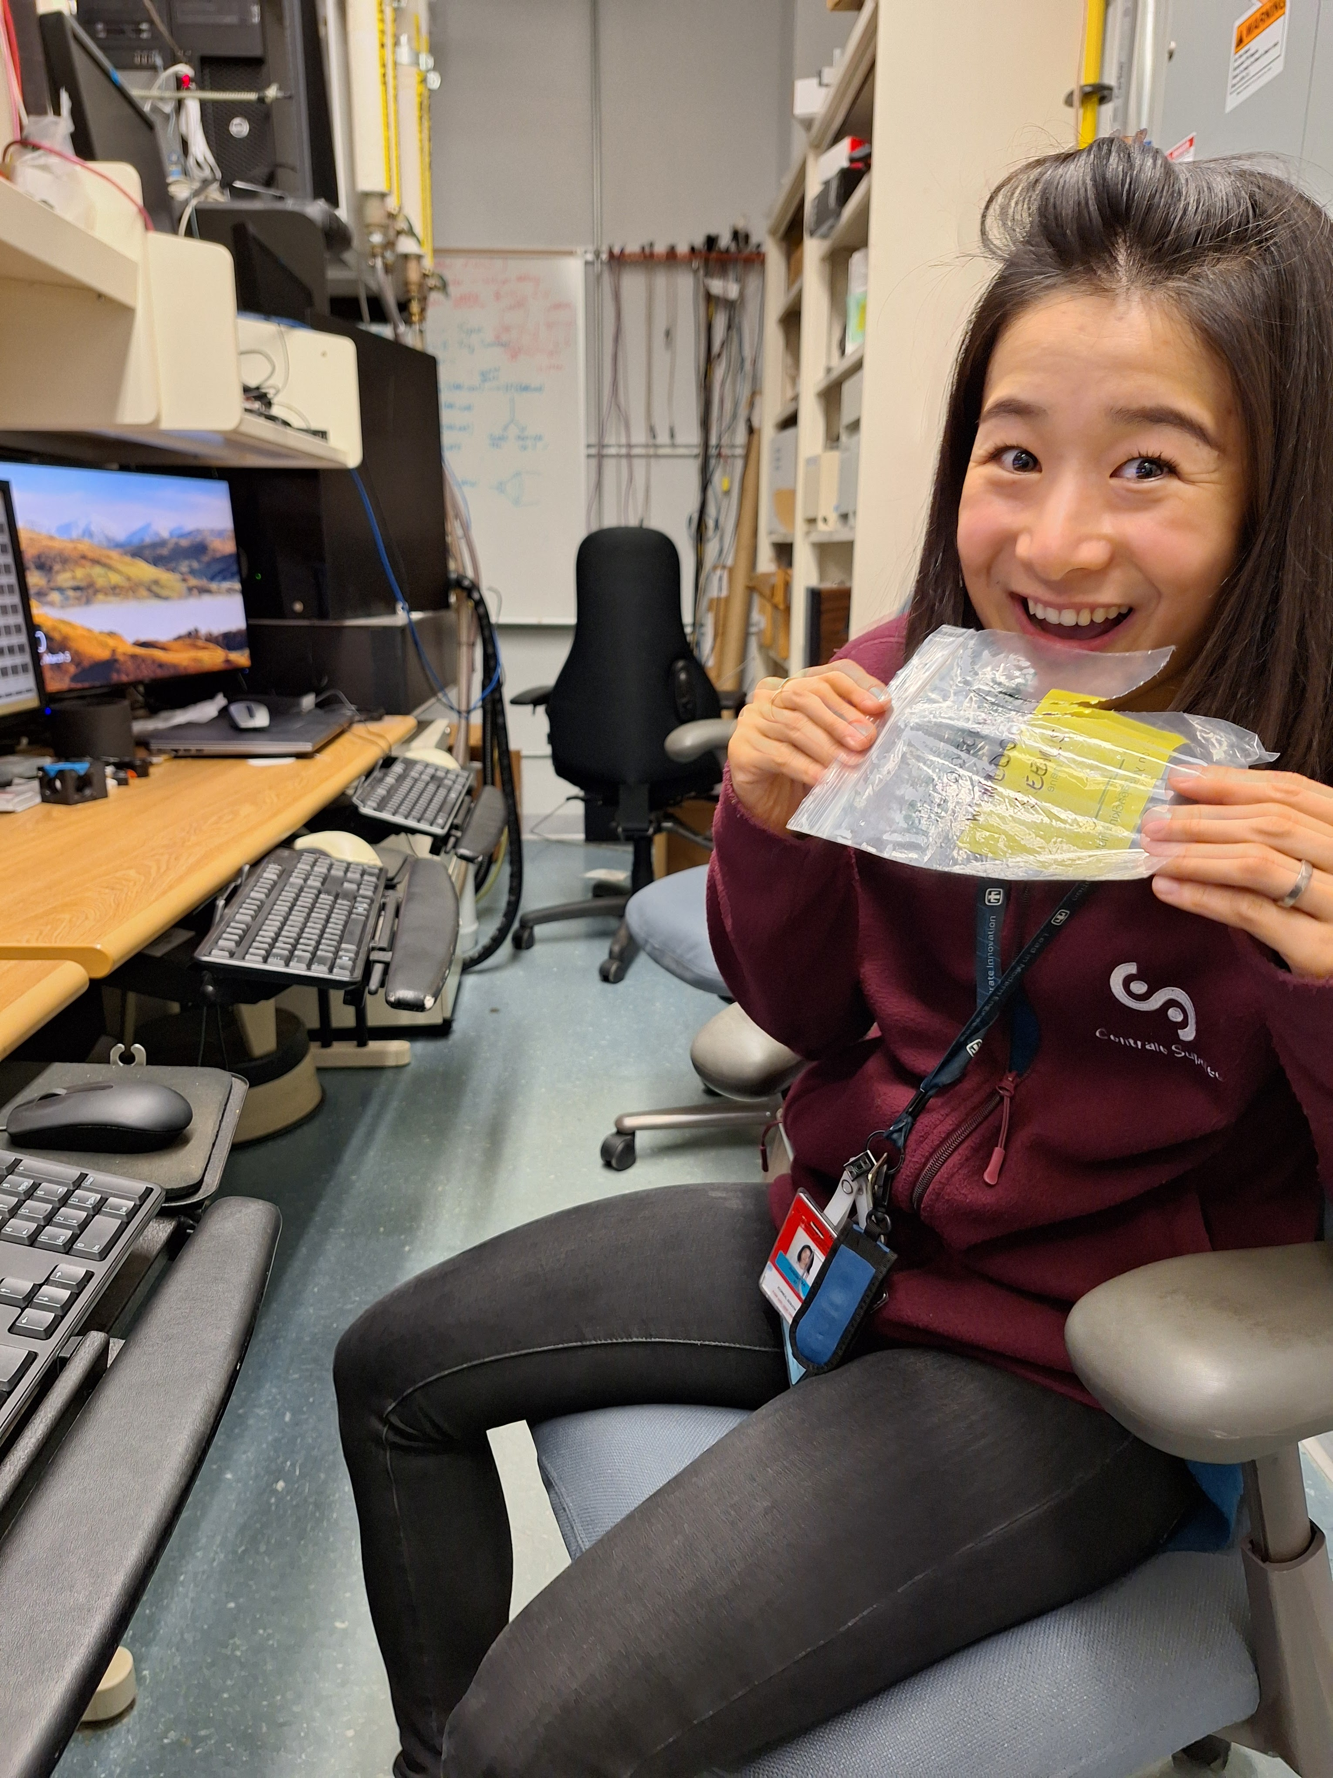
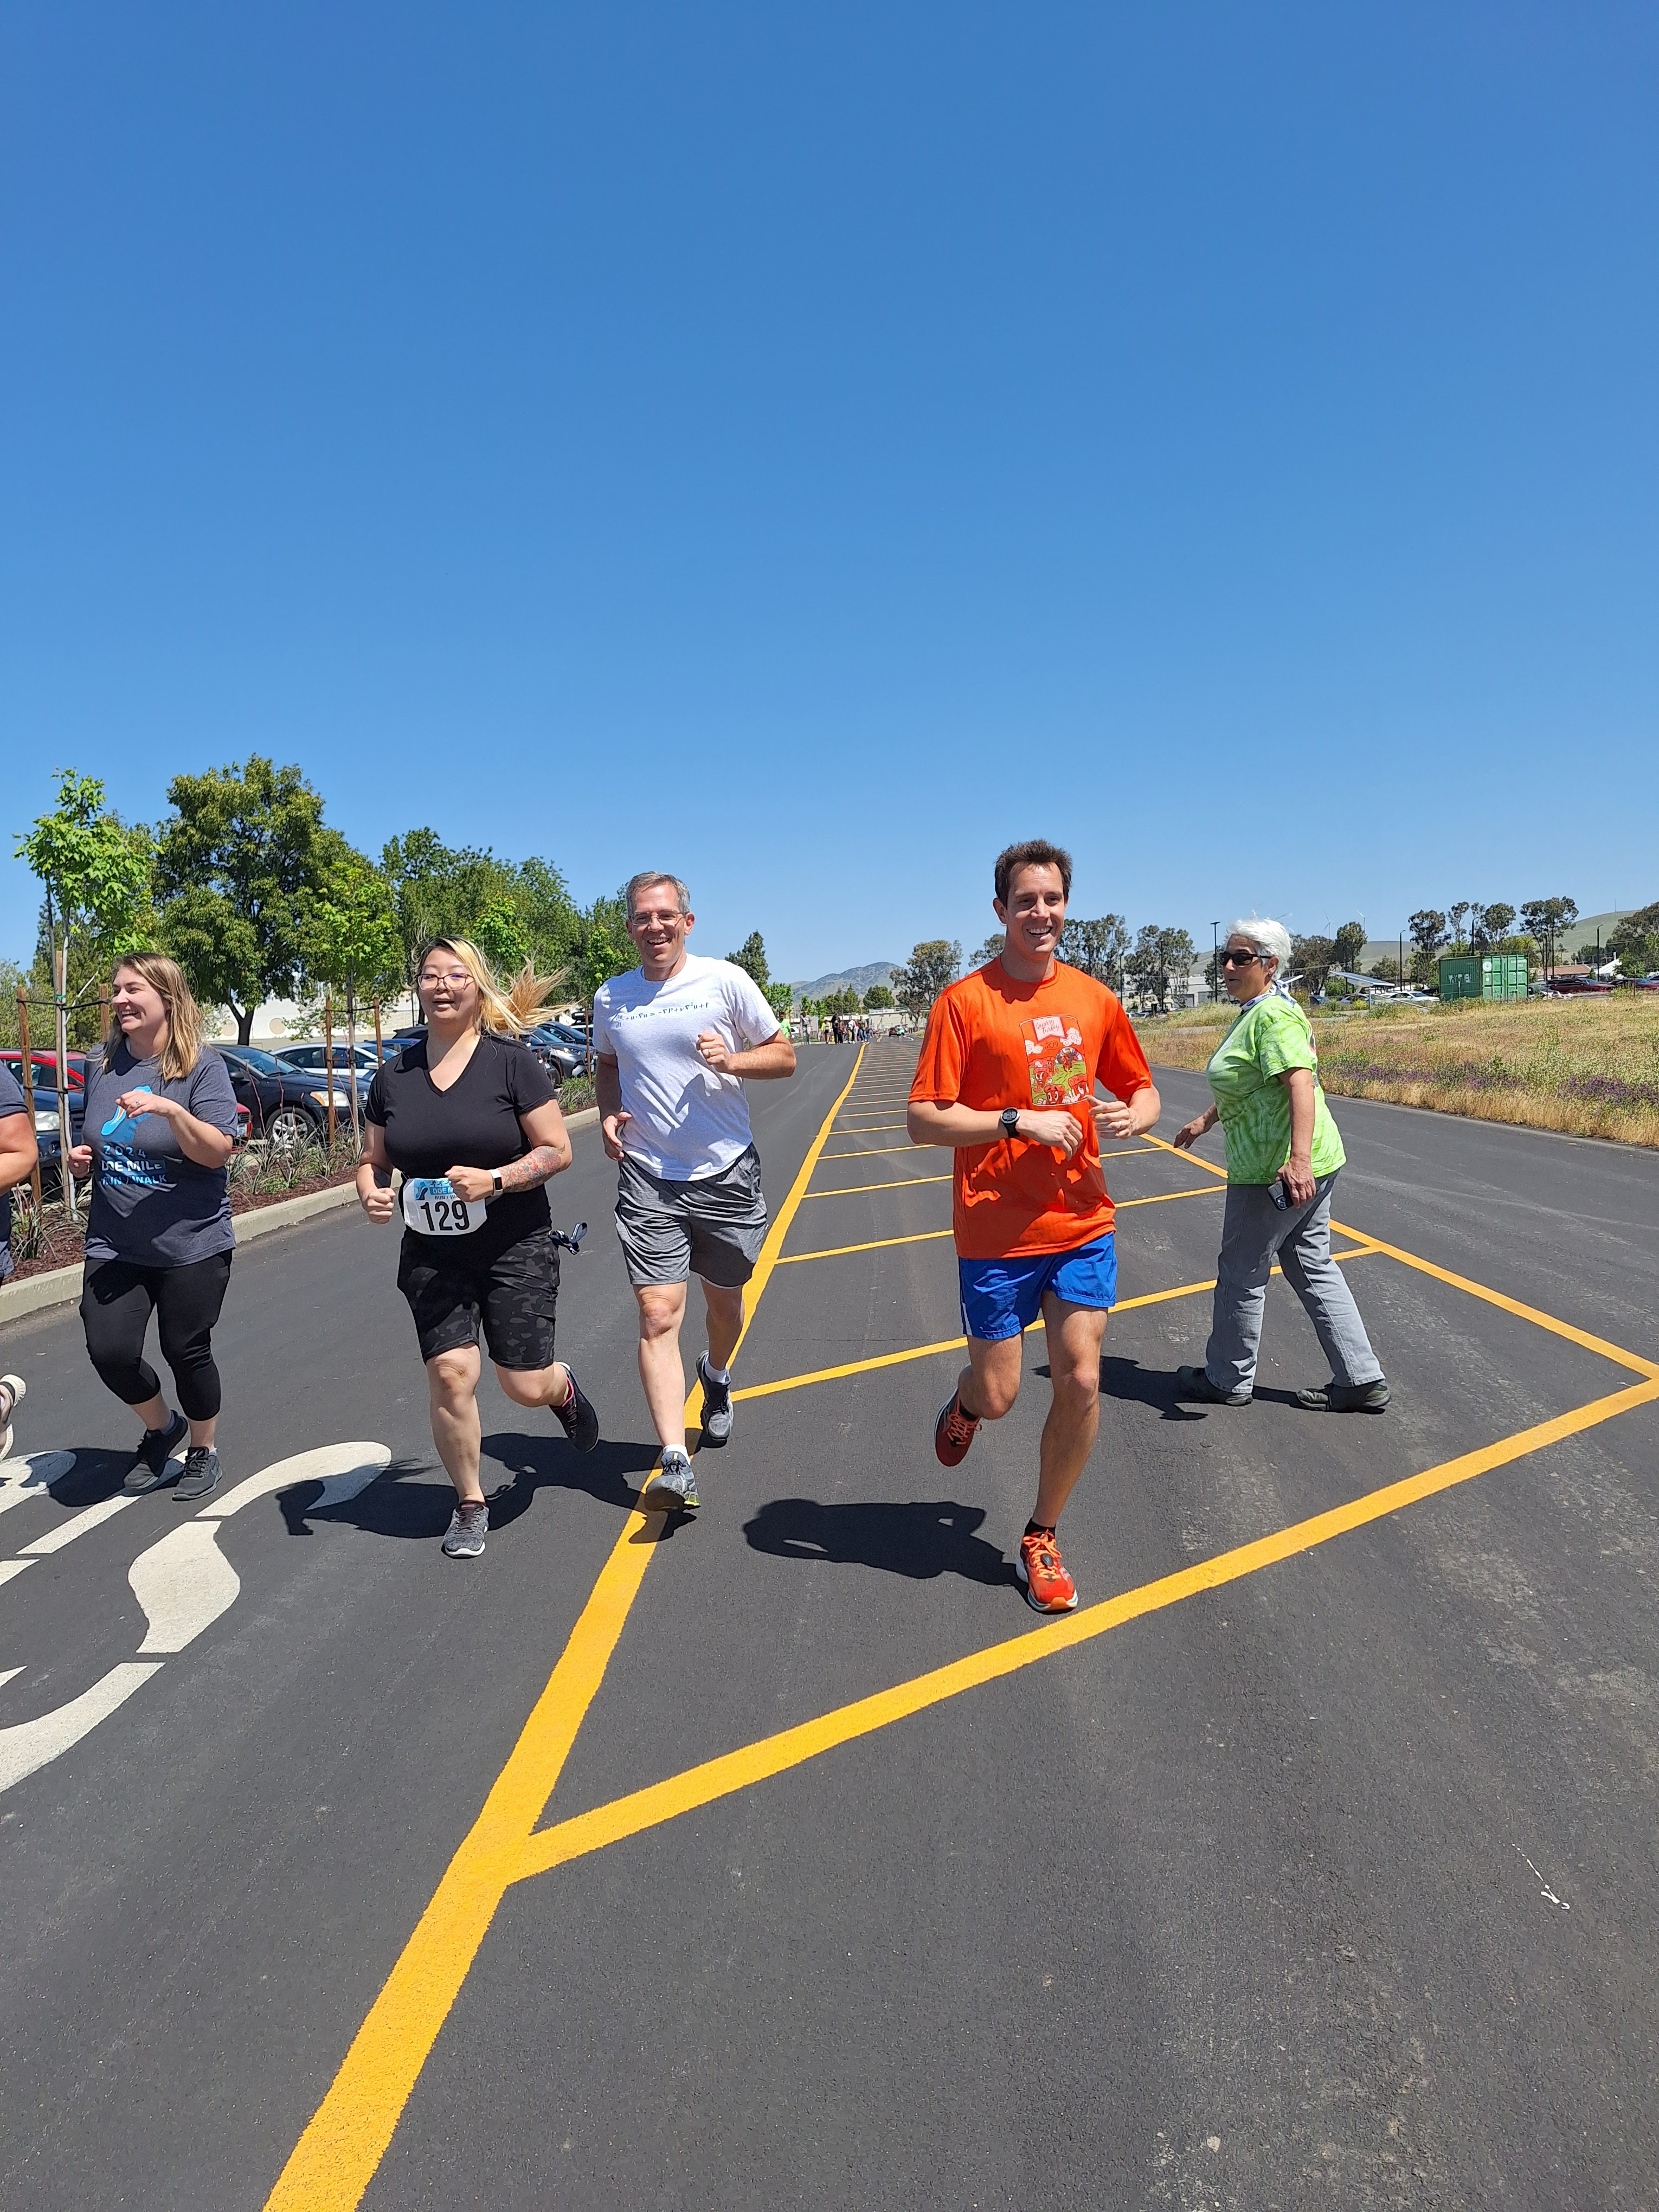
Murderer
Possible candidates
Tired postdoc 1
Crazy postdoc 2
Little greedy PIs
Lyle
Julien

Slide 10
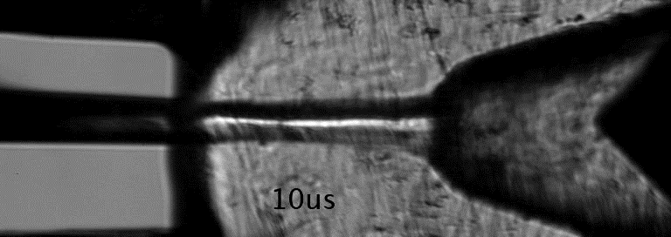
Let’s keep hope alive for D134
D134 survivors include the few remaining Spray D injectors.
D134 also has a number of transparent nozzle replicates
Influential for the chicken-foot injectors that have been donated but used very little to date
A resuscitation may be attempted, if it can be mounted to a different injector body
Let’s emulate its smooth character and convergent nature!

