Slide 1
Ecn 10
Sustainable Fuel Spark Ignition
Methanol Guidelines
Francesco Duronio
Università degli Studi dell'Aquila
Simulations: Internal flow, free spray, and wall impingement
francesco.duronio@univaq.it
Joonsik Hwang
KAIST
Experiments: Characteristics of Spray M (large-scale and near-nozzle flow)
jhwang@kaist.ac.kr

Slide 2
Introduction
General guidelines
Internal/external nozzle flow, free spray, wall-wetting, combustion and emissions with Single-hole, Spray G, and Spray M injector
Motivation
Growing interest on Methanol as a promising fuel for decarbonization
Primary component as e-fuel
Well-established industry with high production capacity
Not fully resolved technical issues (oil dilution, wall wetting etc.)
Need for improvement in modeling and successful implementation
Objectives
Quantitative measurements on liquid spray and wall film
Improvements on prediction capability of CFD simulation

Slide 3
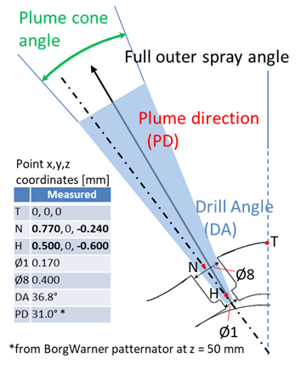
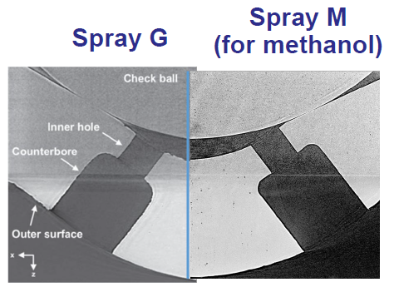
Target fuel and injector
Listed in priority order:
100% Methanol
PACE-20 (Gasoline surrogate fuel, 9 components)
E00 (36 % n-pentane, 46 % iso-octane, and 18 % n-undecane, by volume)
100% iso-octane
ECN Spray M injector
Component | % by volume
ethanol | 9.55%
n-pentane | 13.95%
1-hexene | 5.41%
toluene | 9.19%
n-heptane | 11.53%
iso-octane | 25.05%
1,2,4-trimethylbenzene | 11.87%
cyclopentane | 10.50%
tetralin | 2.95%
G
790
165
Moon, Powell (APS)
S. Wagnon, Development of an Optimized Gasoline Surrogate Formulation for PACE Experiments and Simulations, Advanced Engine and Fuel Technologies 2020 Annual Progress Report, 2021

Slide 4
Target conditions (Free Spray)
M2 M F20C
M1 M
Spray M
Condition
Fuel T 20C
Spray M
Condition
MeOH
MeOH
Name | T_{fuel} [K] | T_{a} [K] | ρ_{a} [kg/m³] | P_{a} [kPa] | P_{inj} [MPa] | Hydraulic Injection Duration [ms] | Total Fuel (mg)
M1 M | 363 | 573 | 3.5 | 600 | 20 | 0.74 | 9.75
M1 P20 | 363 | 573 | 3.5 | 600 | 20 | 0.74 | 9.7
G1 P20 | 363 | 573 | 3.5 | 600 | 20 | 0.74 | 9.4
M2 M | 363 | 333 | 0.5 | 50 | 20 | 0.74 | 9.9
M2 P20 | 363 | 333 | 0.5 | 50 | 20 | 0.74 | 9.7
G2 P20 | 363 | 333 | 0.5 | 50 | 20 | 0.74 | 9.4
M2 M F20C | 293 | 293 | 0.5 | 50 | 20 | 0.74 | 9.9
M2 M F60C | 333 | 333 | 0.5 | 50 | 20 | 0.74 | 9.9
M2 M F90C | 363 | 363 | 0.5 | 50 | 20 | 0.74 | 9.9
Electric signal duration set 0.68ms

Slide 5

Target conditions (Wall impingement)
Lehnert.
MW2 M F20C
Spray M
Wall
Impingement
Condition
Fuel T 20C
Wall
MeOH
40mm
Name | T_{fuel} [K] | T_{a} [K] | ρ_{a} [kg/m³] | P_{a} [kPa] | P_{inj} [MPa] | Hydraulic Injection Duration [ms] | Wall Distance (mm) | T_{wall} [K] | Total Fuel (mg)
MW2 M F20C | 293 | 293 | 0.5 | 50 | 20 | 0.74 | 40 | 293 | 9.9
MW2 M F60C | 333 | 333 | 0.5 | 50 | 20 | 0.74 | 40 | 293 | 9.4
MHW2 M F60C | 333 | 333 | 0.5 | 50 | 20 | 0.74 | 40 | 333 | 9.9
MW2 M F90C | 363 | 363 | 0.5 | 50 | 20 | 0.74 | 40 | 293 | 9.7
GW2 P20 F20C | 293 | 293 | 0.5 | 50 | 20 | 0.74 | 40 | 293 | 9.9
Electric signal duration set 0.68ms

Slide 6
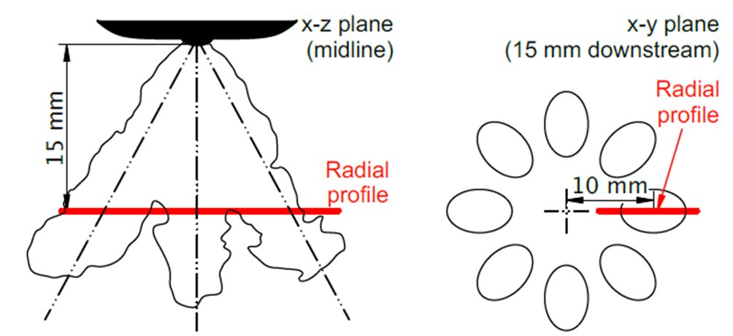
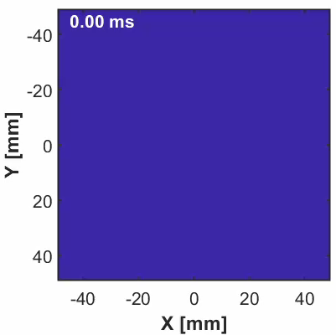
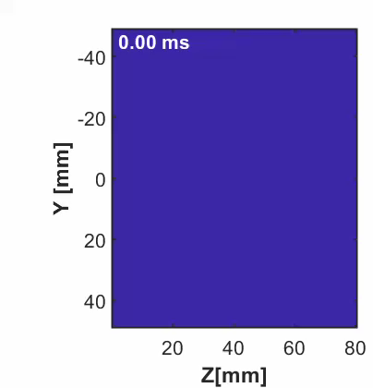
Duke et al. Experimental Thermal and Fluid Science 88:608-621, 2017
Experimental data guideline
2D Line-of-sight extinction/Schlieren data
Liquid/vapor length and width (at z=15mm and 25mm)
Liquid/vapor boundary
Liquid boundary defined with PLV threshold of 0.2e-3 (low) 2e-3 (high)
*Please provide details of your experimental setup such as diffuser information, extinction coefficient used in image processing
3D data (Computed tomography)
Liquid volume fraction (x-y) cut plane at z=10mm, 15mm, and 30mm
Liquid volume fraction (y-z) cut plane at x=0mm (Primary orientation)
$$\int_{−y_{∞}}^{y_{∞}}{LVF∙dy=τ\frac{π{d^{3}}/6}{C_{ext }^{∗}}=0.2∙{10}^{−3} \frac{mm^{3} liquid}{{mm}^{2}} AND 2.0∙{10}^{−3} \frac{mm^{3} liquid}{{mm}^{2}}}$$

Slide 7
CFD simulation data guideline
Internal flow simulations
Predict near field phenomena such as plume dispersion (rather than tuned spray angles) or in-nozzle vaporization.
Provide coupling between expensive simulations (VOF, LES) and less expensive simulations (Lagrangian spray) to establish reliable inputs.
Lagrangian spray simulation
Focus on spray collapse and plume-interaction under flash boiling conditions
Preferential evaporation
Fuel effect on evaporation, spray breakup, and coalescence
Spray-wall interactions for different wall, fuel, and ambient temperatures
Spray modeling approaches with different resolutions, computational costs, and methodologies (Eulerian-Lagrangian, Eulerian-Eulerian) are encouraged to bridge the gap between high-fidelity and engineering-level simulations

Slide 8
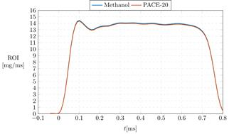
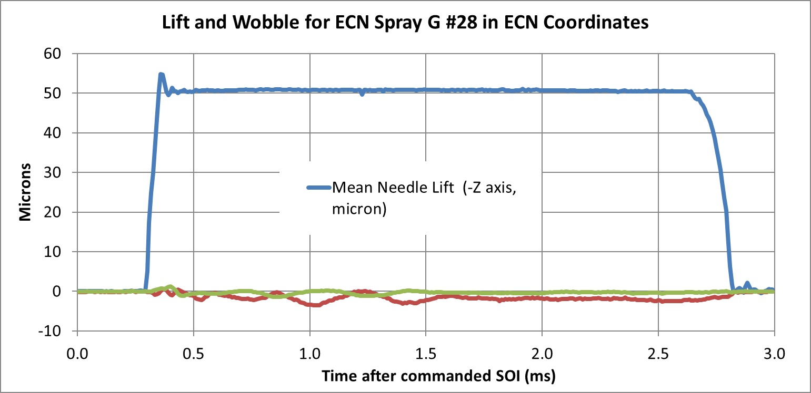
INTERNAL FLOW SIMULATIONS
Phase transition model | HRM, HEM, …
Interface treatment | What interface treatment was used? For example, it is insufficient to say “VOF” but rather explain whether a geometric interface construction was used or some interfacial compression scheme was employed with flux limiting. If a diffuse interface treatment was used, provide a reference describing the governing equations.
Coupling | Does the internal simulation couple to a Lagrangian spray simulation? If so, how?
Additional models | Were any special phenomena considered? Examples are compressibility and dissolved gas nucleation.
Needle lift | What needle lift was used, fixed or variable? If a fixed needle lift was used, what was the value?
Submission guideline
Table to fill with simulation setup info:
Provided data (ECN website);
  ROI
  Needle lift
  Spray data
Methodology | Eulerian-Eulerian (internal flow simulations)/Eulerian-Lagrangian (far field)
Software | CONVERGE, OpenFOAM, etc .. | …
Condition investigated | M1, M2, …
Domain dimensions | LxWxH
Meshing strategy | Static mesh, Fixed refinement regions, Adaptive mesh refinement, overset grids, …
Fluids properties | An explanation of how fluid properties were calculated or tabulated. This may be a reference to a database or equation of state. Please specify for any phase/species involved in the simulation.
Turbulence model | What turbulence closure is used?
Relevant initial conditions | What is the initial gas and liquid velocity and turbulence distribution at the time of injection?
Relevant boundary conditions | Provide a table of boundary conditions that were used for each equation.
Mesh sensitivity study | Please comment on the grid sizing chosen.
LAGRANGIAN SPRAY SIMULATIONS
Injection model | Did you specify ROI, or another variable such as needle position or injection pressure? Parcel distribution,
Injection parameter | Parcel count, mass injected, plume direction, plume angle, initial droplet size, and temperature
Breakup modeling | Relevant information regarding the breakup model/s adopted, and eventual references where interested readers can learn more about the details.
Vaporization modeling | Relevant information regarding the phase-change model, and eventual references where interested readers can learn more about the details.
Other Lagrangian models | Drop drag, turbulent diffusion…
G1
https://ecn.sandia.gov/gasoline-spray-combustion/target-condition/primary-spray-g-datasets/
Argonne measurement on Spray G#28

Slide 9

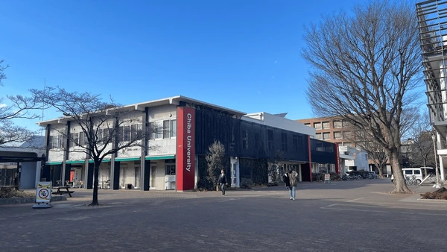

Submission due is October 20th 2025
We look forward to your contribution for ECN10!

