Slide 1
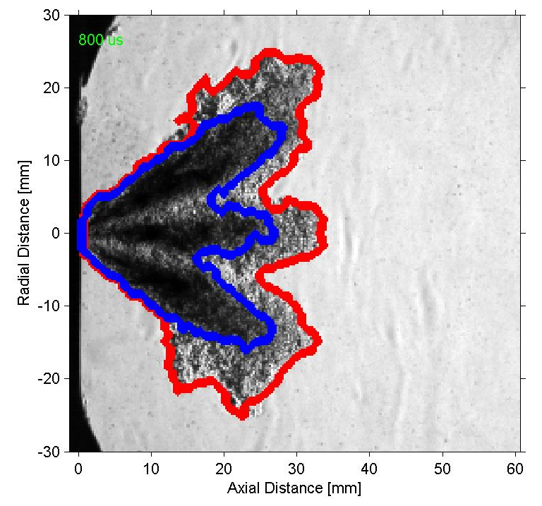
Gasoline Spray (Spray G)
ECN4 Workshop
Spray G Organizers:
Scott Parrish (GM)
Lyle Pickett (Sandia)

Slide 2
Spray G - Injector Specification
Considerations for injector specification
  Hopefully the output of the group will be transferable and relevant to future advanced engine implementations
  It is important to keep in mind the spray requirements of advanced applications such as stratified spray-guided, HCCI and boosted dilute systems
  The interaction between adjacent spray plumes is of great importance to both current production and advanced gasoline applications
  Spray plume interaction is influenced by a number of things including:
    spray pattern
    L/D ratio
    hole manufacturing method
    proximity of the holes on the nozzle
  Successful mixture preparation relies on a proper combination of all these parameters

Slide 3
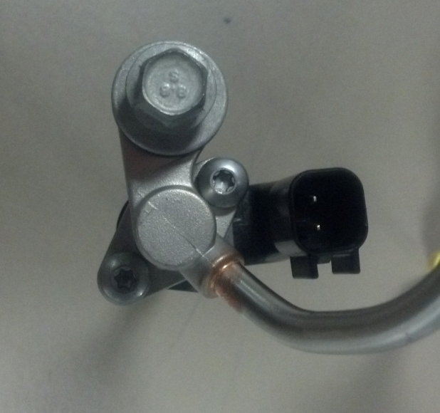
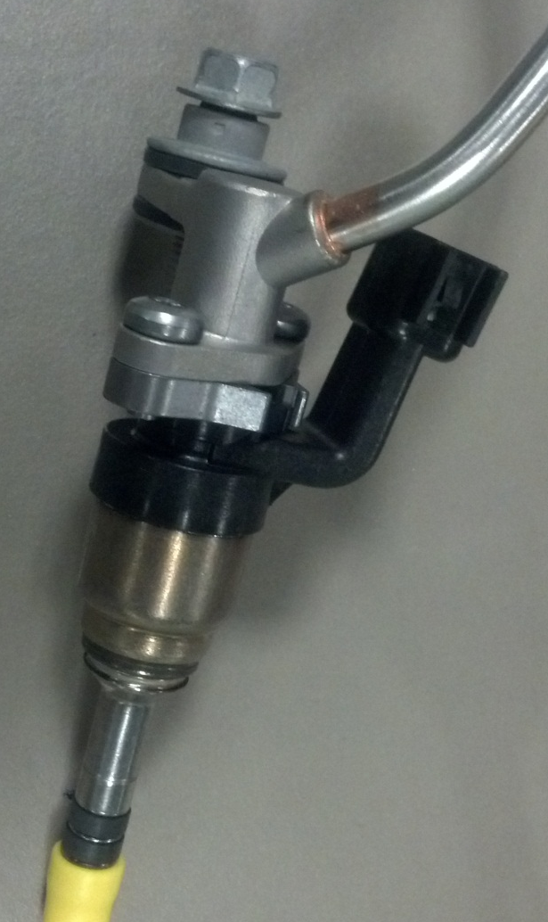
Spray G - Injector
Parameter
Number of holes 8
Spray shape circular
Spray angle 80°
Bend angle 0 °
L/D ratio 1.4
Hole shape straight
Manufacturing EDM
Flow rate 15 cc/s @ 10 MPa

Slide 4
Spray G – Preliminary Data (Delphi)
  Thanks to Delphi! Dan Varble, Lee Markle
  “Burn In” (20 million cycles)
  Leak rate
  Spray patternation (high resolution mechanical)
  Spray imaging (spray angle, penetration)
  Drop sizing (laser diffraction)
  High-speed near tip imaging (end of injection quality)
  Flow curves (5,10,15,20 Mpa)
  Maximum opening pressure
  Note: Preliminary spray data from Delphi was acquired according to the SAE J2715 standard NOT at Spray G conditions

Slide 5
Spray G – Operation Conditions
Considerations for choosing operating conditions
  Operating conditions of gasoline engines vary widely
  Most all current production engines operate with early injection where sprays can be subjected to low pressures resulting in flash boiling
  Most advanced engine concepts rely on late injection where sprays are subjected to elevated ambient pressures and temperatures

Slide 6
Spray G – Operating Conditions
Parameter Spray G (ECN2) Spray G2 (ECN3) Spray G3 (ECN3)
Fuel Iso-octane Iso-octane Iso-octane
Fuel pressure 20 Mpa 20 Mpa 20 MPa
Fuel temperature 90ᵒ C 90ᵒ C 90ᵒ C
Injector temperature 90ᵒ C 90ᵒ C 90ᵒ C
Ambient temperature 300 C 60, 20 C 60, 20 C
Ambient density 3.5 kg/m 0.5, 0.53 kg/m 1, 1.12 kg/m
Ambient Pressure 6 Bar (N₂) 0.5, 0.6 Bar (N₂) 1, 1 Bar (N₂)
Injected quantity 10 mg 10 mg 10 mg
Number of injections 1 1 1

Slide 7
Spray G - Average Flow (GM)

Slide 8
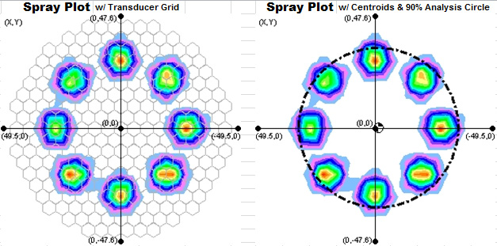
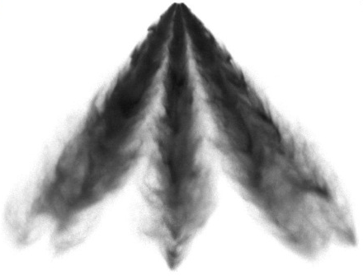
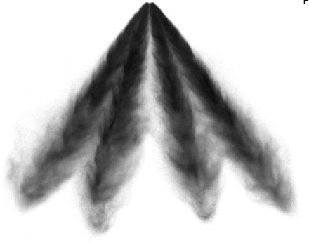
Spray G - Injector Orientations
Primary
Secondary
5
6
5
6
4
4
7
3
7
3
8
8
2
6,7,8
1,5
2,3,4
7,8
1,6
2,5
3,4
1
1
2
Camera
Camera

Slide 9
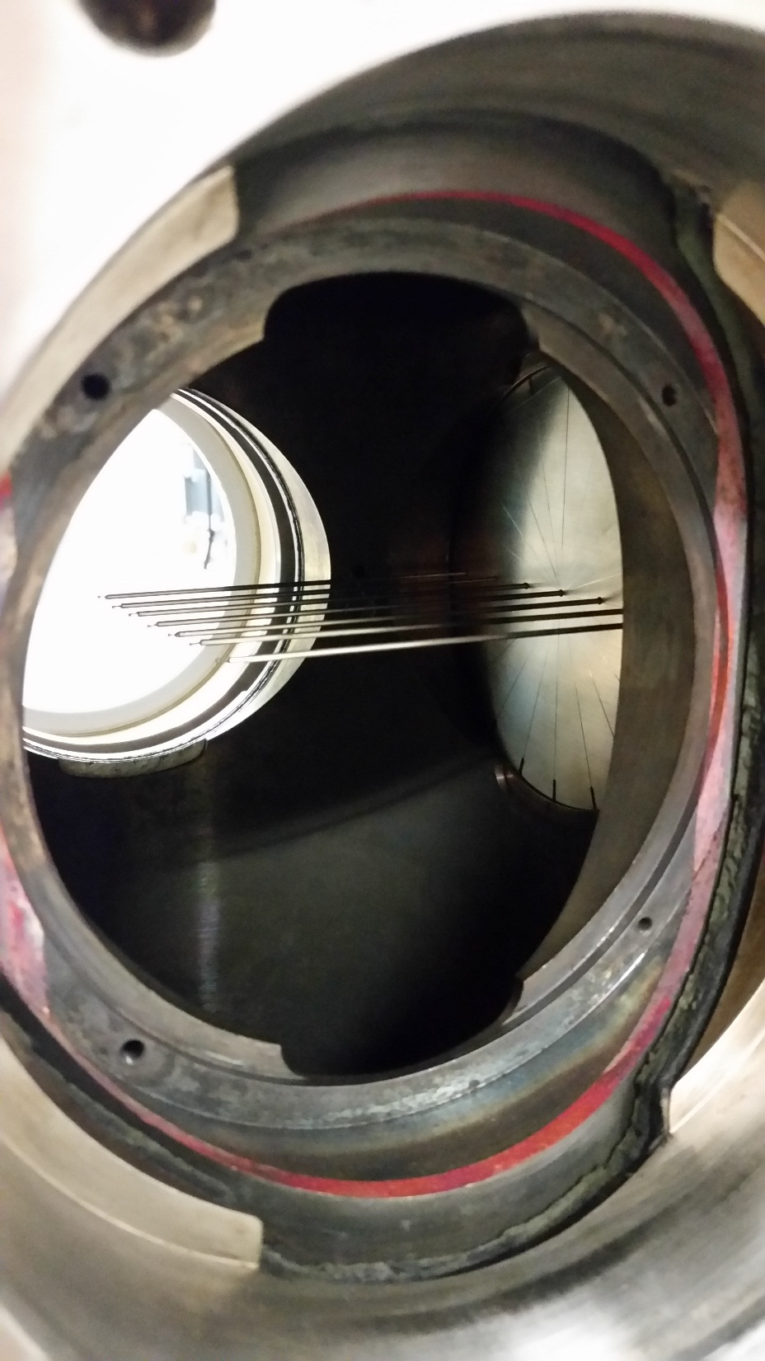
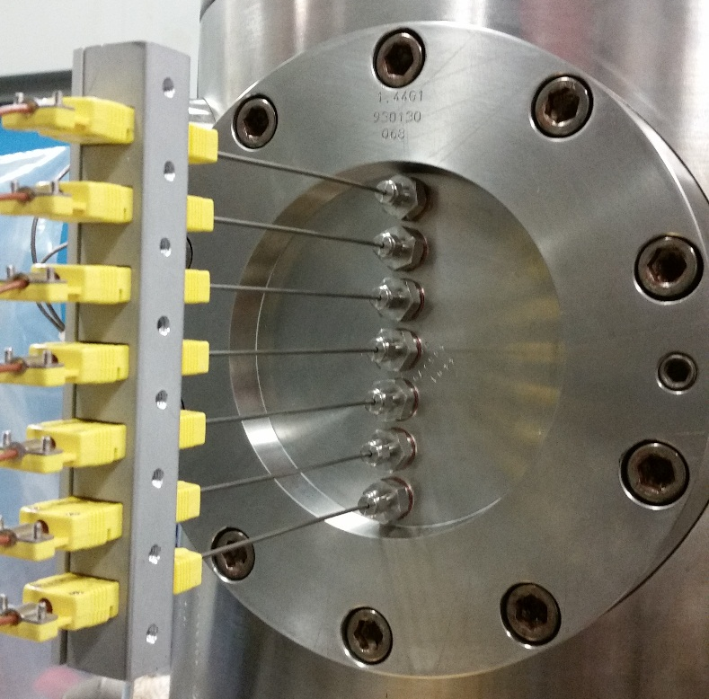
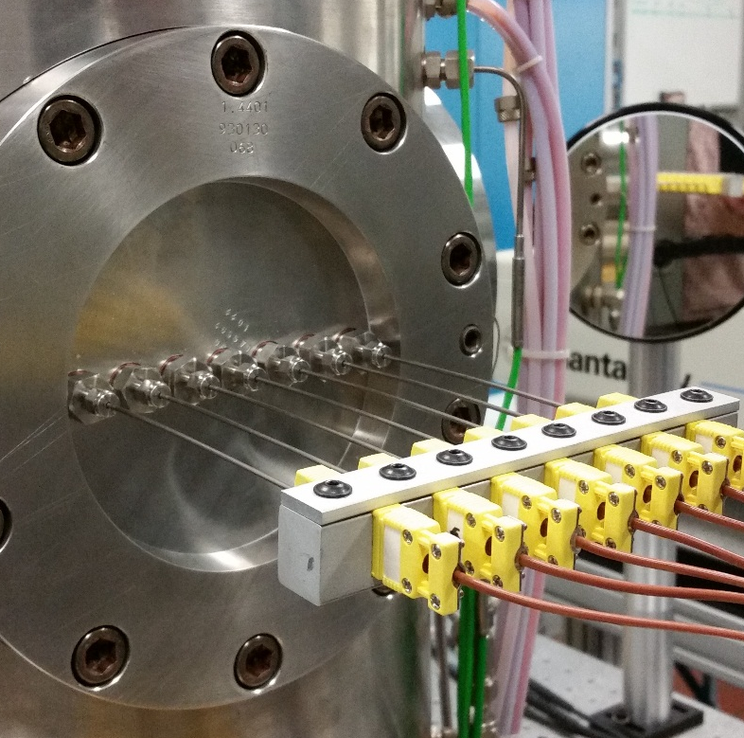
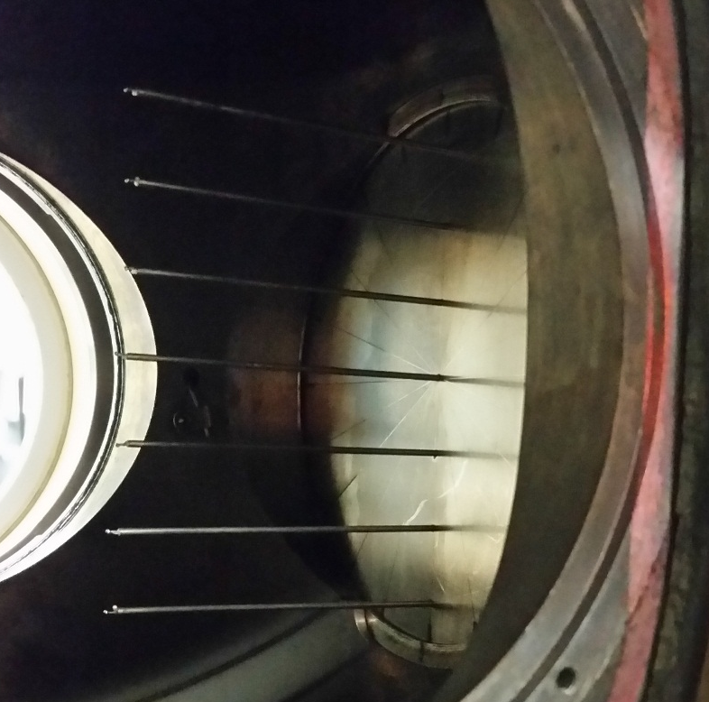
Spray G – Boundary Condition Verification
Vertical Plane
Horizontal Plane

Slide 10
Spray G – Boundary Condition Verification
Vertical Plane
Horizontal Plane
 | 1 | 2.5 | 5 | 10 | 15 | 20 | 30 | 40 | 50 | 60 | 70 | 80
54 | -2 | -5 | -1 | -3 | 2 | -1 | -2 | 2 | 5 | 6 | 4 | 4
36 | -4 | -7 | -2 | -4 | 1 | -1 | -3 | 1 | 4 | 5 | 4 | 4
18 | -36 | -11 | -4 | -5 | -1 | -2 | -3 | 0 | 3 | 4 | 3 | 3
0 | -37 | -11 | -7 | -6 | -2 | -3 | -5 | -1 | 2 | 3 | 2 | 2
-18 | -40 | -17 | -9 | -7 | -3 | -3 | -5 | -2 | 1 | 2 | 2 | 2
-36 | -16 | -14 | -7 | -5 | -2 | -3 | -5 | -1 | 3 | 3 | 3 | 2
-54 | -9 | -8 | -7 | -6 | -3 | -3 | -5 | -2 | 1 | 2 | 2 | 2
 | 1 | 2.5 | 5 | 10 | 15 | 20 | 30 | 40 | 50 | 60 | 70 | 80
54 | -8 | -3 | 0 | -2 | 0 | 1 | 2 | 5 | -4 | -2 | -3 | -1
36 | -8 | -2 | 0 | -2 | 1 | 3 | 3 | 6 | -1 | 0 | -1 | 1
18 | -23 | -6 | -1 | -1 | 1 | 5 | 4 | 6 | 0 | 0 | 0 | 1
0 | -32 | -7 | -2 | -2 | 1 | 4 | 4 | 5 | -1 | 0 | 0 | 0
-18 | -23 | -7 | -3 | 0 | 1 | 4 | 3 | 4 | -2 | 0 | 0 | -1
-36 | -7 | -2 | 2 | 1 | 1 | 4 | 3 | 3 | -2 | 0 | 0 | -1
-54 | -6 | -3 | 2 | 2 | 2 | 2 | 1 | 1 | -4 | -2 | -2 | -2
Vertical Position (mm)
Vertical Position (mm)
Horizontal Position (mm)
Horizontal Position (mm)

Slide 11
Spray G – Program (A Look Back at ECN3)
13:00 Introduction
Experimental Activities
  13:15 3.1 Injector geometry assessment
        Yongjin Jung* (KAIST), Peter Hutchins (Infineum/ESRF)
  13:20 3.2 Rate-of-injection
        Raúl Payri* (CMT), Scott Parrish (GM),
  13:30 3.3 Spray Visualization (liquid/vapor penetration & angle)
        Julien Manin* (SNL), Gilles Bruneaux (IFPEN), Scott Parrish (GM), Luigi Allocca (IM), Josh Lacey (Melbourne)
  14:00 3.4 Drop size measurement (Phase Doppler Interferometry)
        Scott Parrish* (GM)
Modeling Activities
    14:15 3.5 Internal flow modeling using ideal geometry
          Ron Grover* (GM)
    14:30 3.6 Spray modeling
          Noah Van Dam* (UW), Lucchini (Politecnico di Milano), Som (ANL)
15:00 Discussion Period
15:30 Break
*Discussion Leader

Slide 12
Spray G – Program (ECN4)
9:30 Introduction
Topic 8 – Spray G Nozzle Geometry and Internal Nozzle Flow
Organizer: Chris Powell (Argonne)
9:40 Nozzle Geometry and Near-Nozzle Experiments
    Daniel Duke (Argonne)
10:20 Internal and Near-Nozzle Flow Modeling
    Ron Grover (GM)
11:00 Break
Topic 9 – Evaporative Spray G
Organizer: Daniel Vaquerizo (CMT)
11:30 Macroscopic Spray Visualization and Modeling
    Josh Lacey (Melbourne)
12:10 Spray Mixing Experiments and Modeling
    Lama Itani (IFPEN) & Lyle Pickett (Sandia)
12:50 Discussion Period
13:00 Lunch

Slide 13
Backup Slides

Slide 14
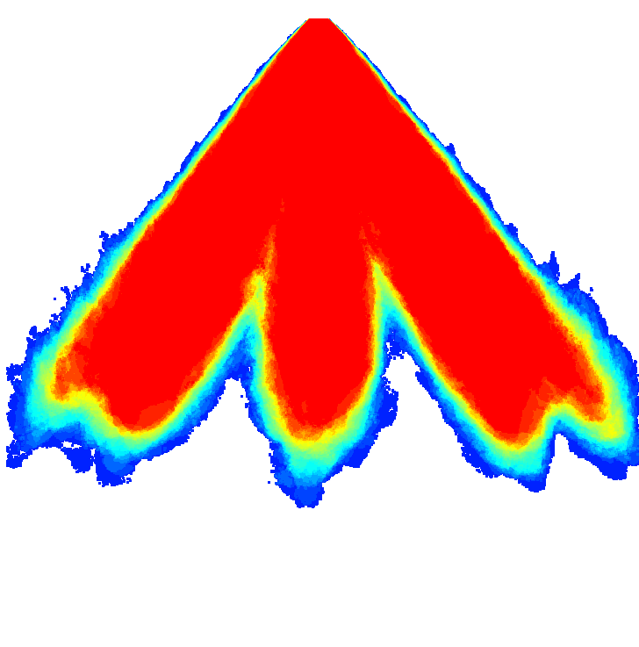
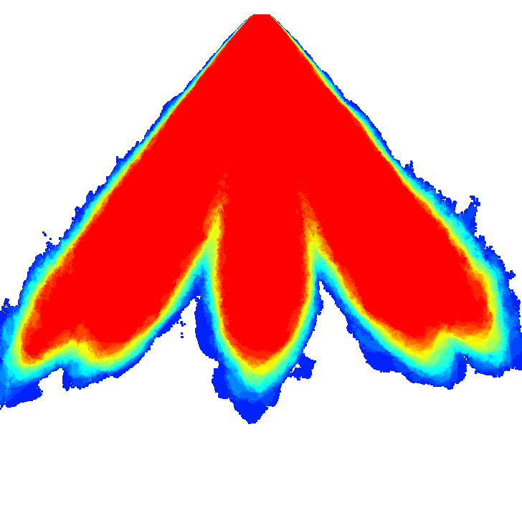
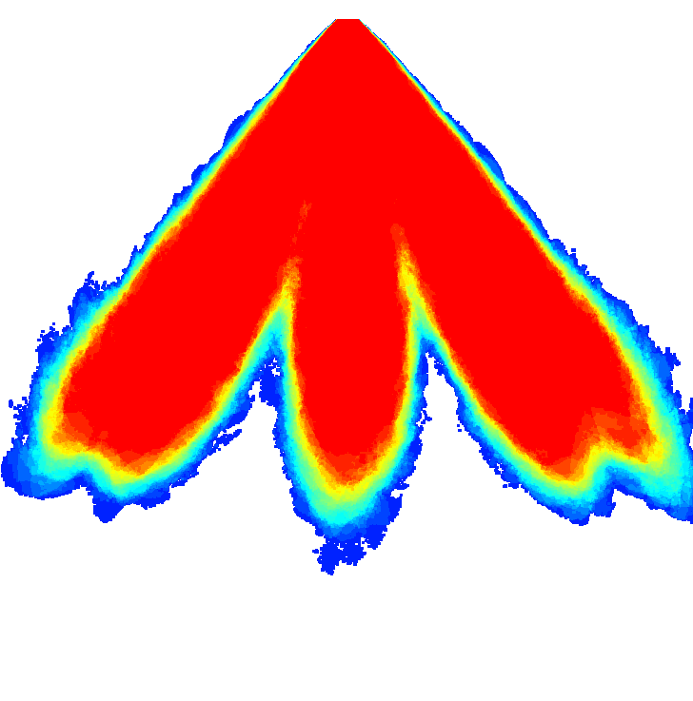
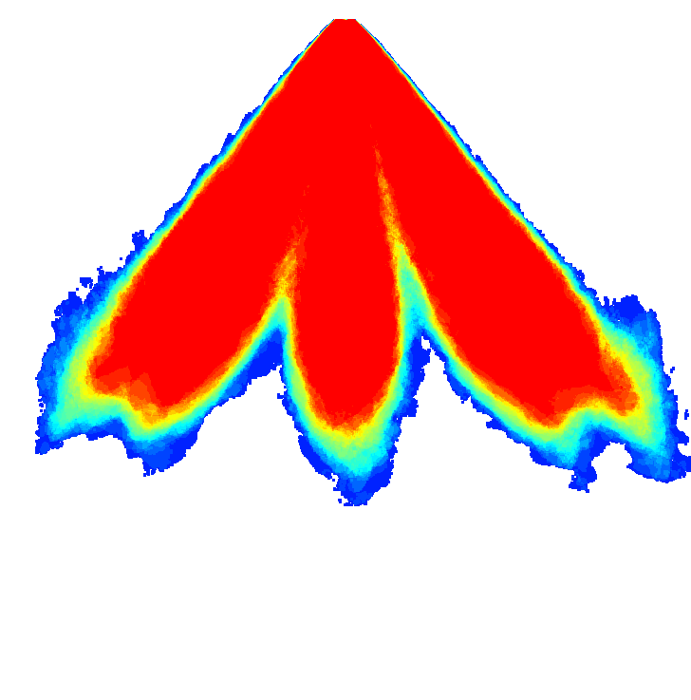
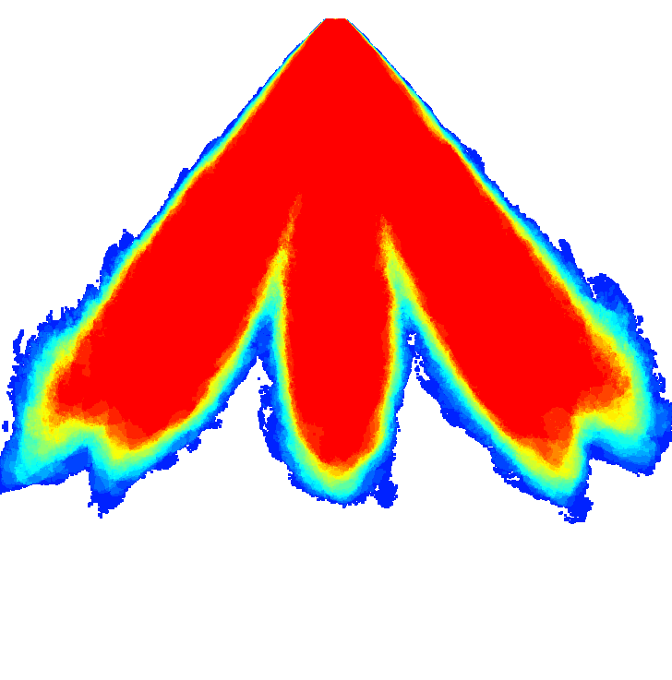
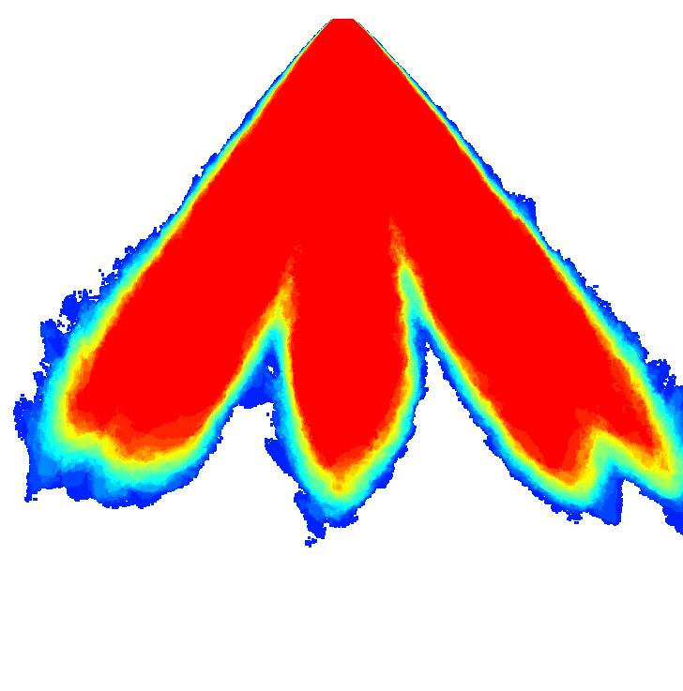
Spray G - Spray Imaging (Delphi)
Injector 16
Injector 17
Injector 18
Injector 22
Injector 24
Injector 28

Slide 15
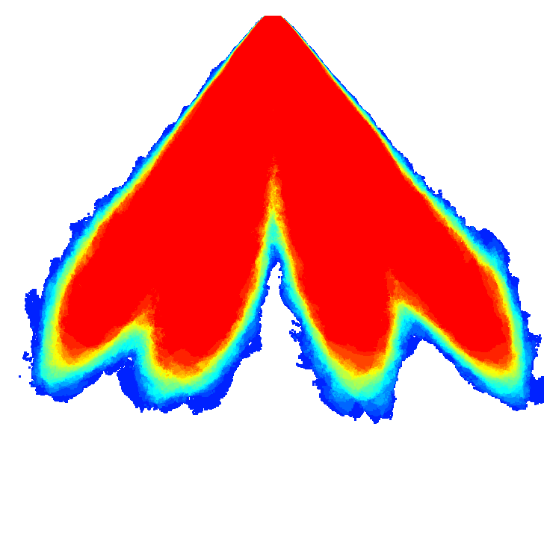
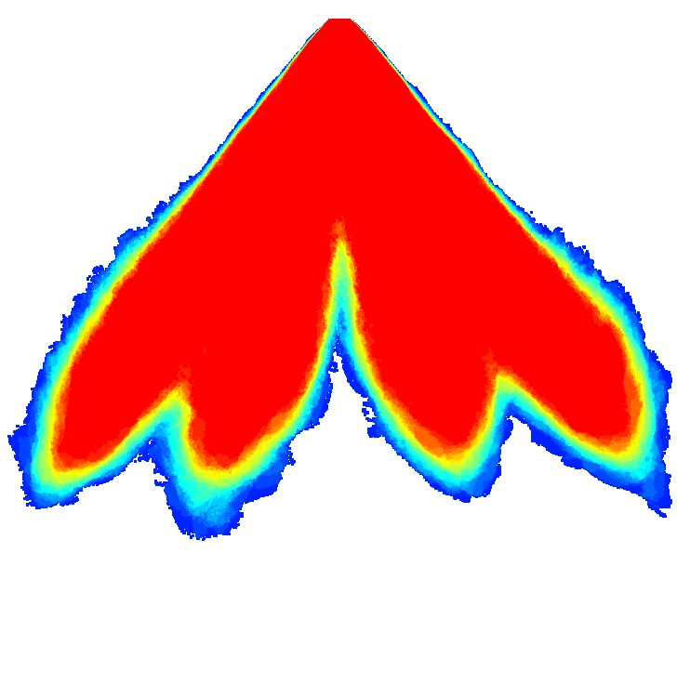
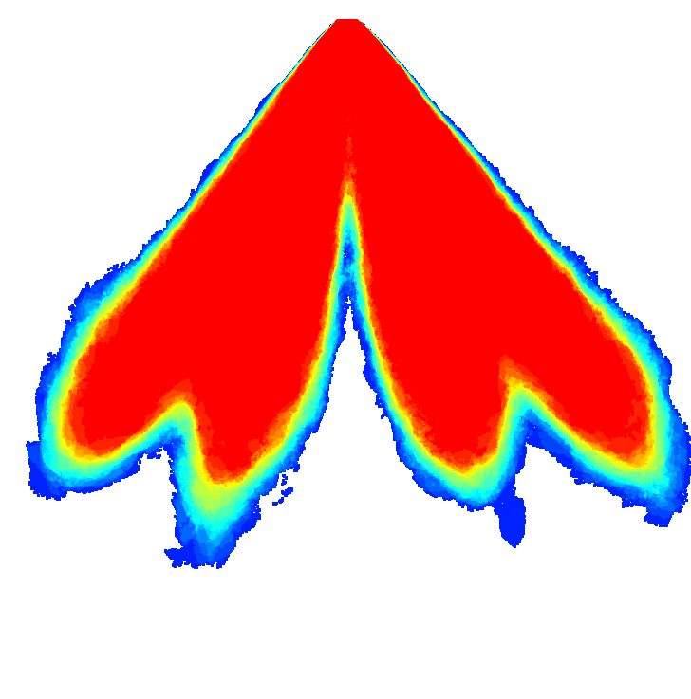
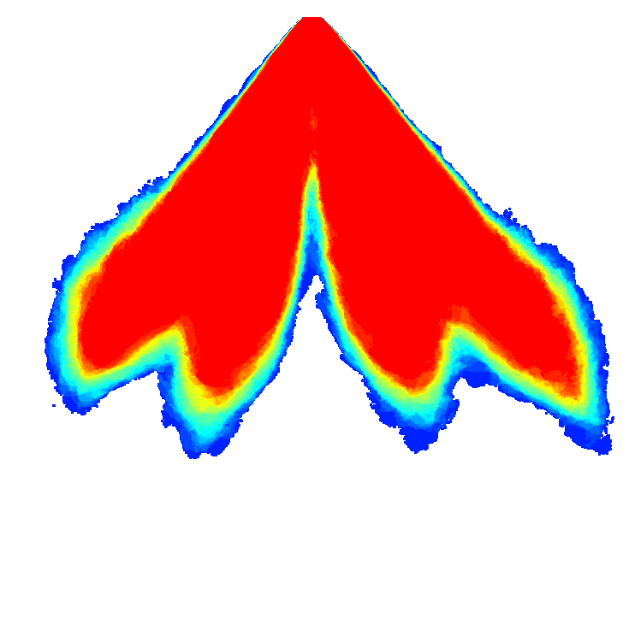
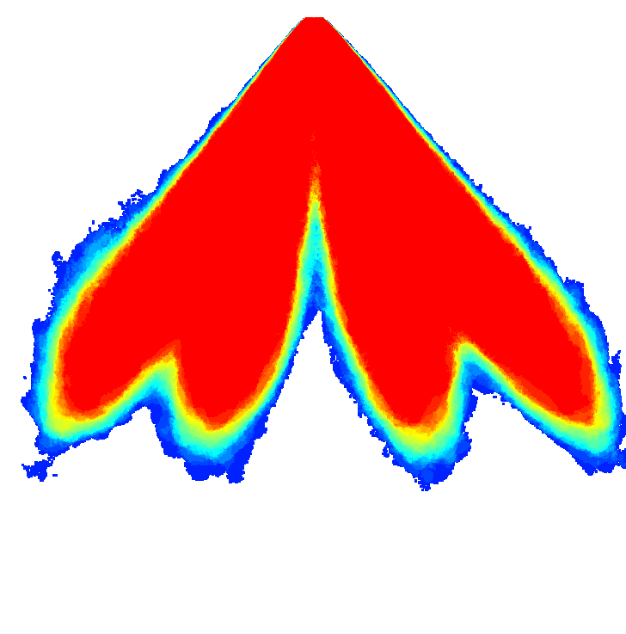
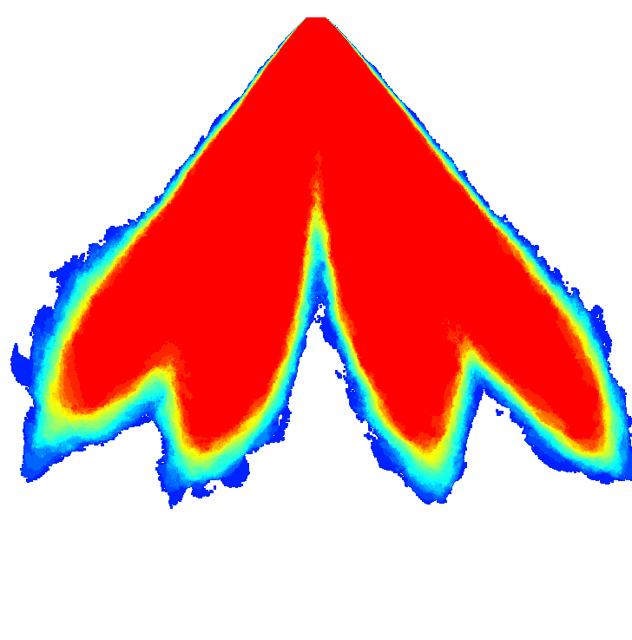
Spray G - Spray Imaging (Delphi)
Injector 16
Injector 17
Injector 18
Injector 22
Injector 24
Injector 28

Slide 16
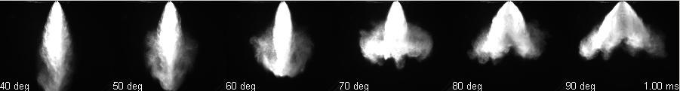
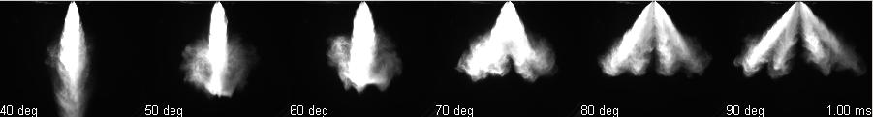
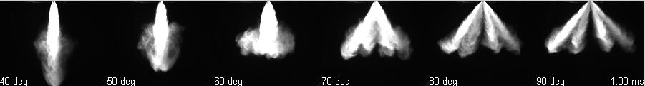
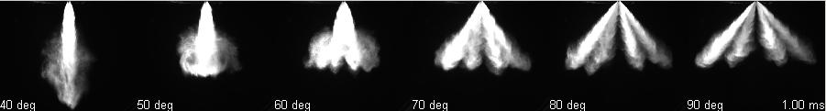
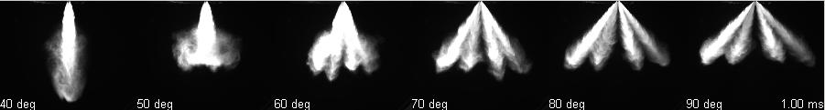
Spray G - Flash Boiling Conditions
40
60
Ambient Pressure (kPa)
80
101
120
40
50
60
70
80
90
Injector Included Spray Angle (º)

Slide 17
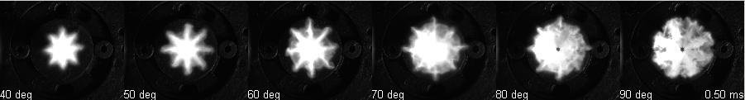
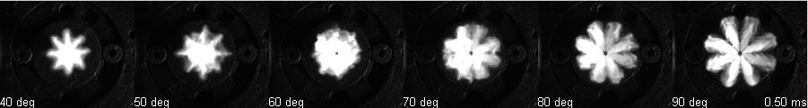
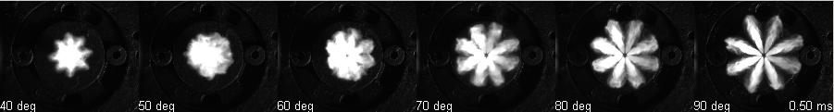
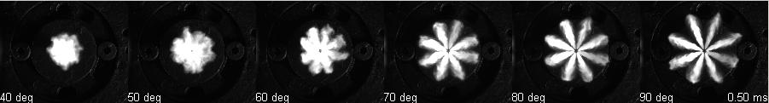
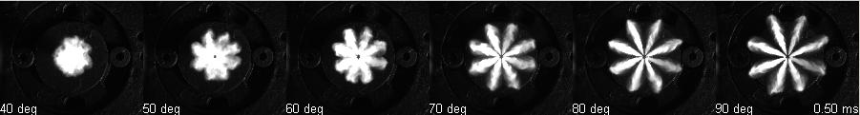
Spray G - Flash Boiling Conditions
40
60
Ambient Pressure (kPa)
80
101
120
40
50
60
70
80
90
Injector Included Spray Angle (º)

Slide 18
Spray G - Axial Penetration, Spray Angle (Delphi)
Injector

Slide 19
Spray G – Mechanical Patternation (Delphi)
Patternation Example
Plume Centroid Locations
10 11 12 13 14 15 16 17 18 19 20 21 22 23 24 25 26 27 28 29
Injector

Slide 20
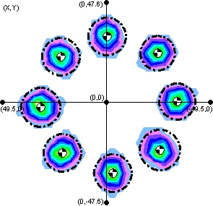
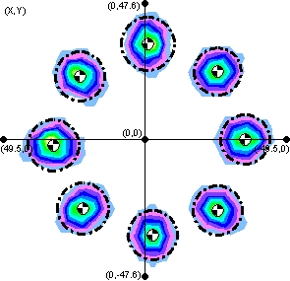
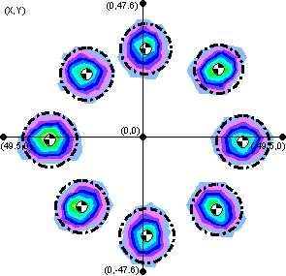
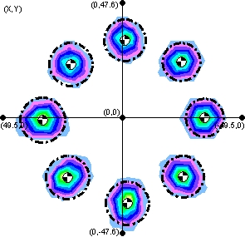
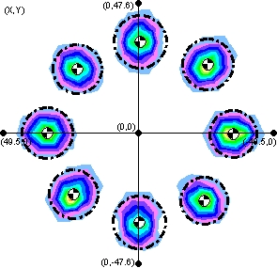
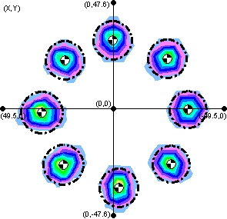
Spray G - Mechanical Patternation (Delphi)
Injector 16
Injector 17
Injector 18
Injector 22
Injector 24
Injector 28

