Slide 1
ECN 5 Future directions: Spray G at flashing conditions Organizer: Joshua Lacey University of Melbourne

Slide 2
GDI flash-boiling overview
As fuel flash-boils in a multi-hole injector, individual spray plumes begin to interact, and in the most severe case, complete collapse occurs, resulting in an elongated jet of fuel
Spray collapse has a substantial impact on the propagation of fuel
$$R_{p}=\frac{p_{sat}\left(T_{fuel, rail}\right)}{p_{chamber}}$$
Source: Zeng et. al., Fuel, 2012

Slide 3
Spray G Flash-boiling
The Spray G topic includes the study of plume interaction due to several sources
Spray cone widening of individual plumes as a consequence of flash-boiling, leading to plume-to-plume interaction (G2)
Plume interaction due to injection into a dense chamber
Study of the G2 condition is well warranted, as a GDI vehicle will spend significant time at part-load, throttled operation (light fractions of gasoline will be heavily flashing)

Slide 4
Propane and iso-octane sprays
The flashing ratio, $R_{p}$, is often used to characterize the severity of plume interaction and spray collapse in multi-hole injectors
Propane is an “extreme case” for liquid-phase direct-injection, as it is severely flashing at all GDI conditions (near its critical point in the fuel rail)
Propane injected into a 10 bar chamber has distinct plumes, and does not display characteristic flashing behavior
Is $R_{p}$ the correct metric to use to quantify the severity of flash-boiling?
All images taken at 20 MPa rail pressure
Source: Lacey et. al, Fuel, 2017

Slide 5
Two-phase sonic velocity
At normal engine operating temperatures, critical fuel flow will arise as a consequence of flash-boiling
Flash-boiling introduces vapor bubbles (flow is two-phase)
Two-phase sonic velocity can be significantly lower than that of the pure liquid or gas phase
We can estimate the velocity of the fuel flow from the rail to the injector nozzle throat, $u_{fuel}=\sqrt{h_{fuel,rail}−h_{throat}}$
This velocity is then compared against the two-phase sonic velocity to determine the chamber pressure required for critical flow at a given $T_{fuel,rail}$ and $p_{fuel,rail}$

Slide 6
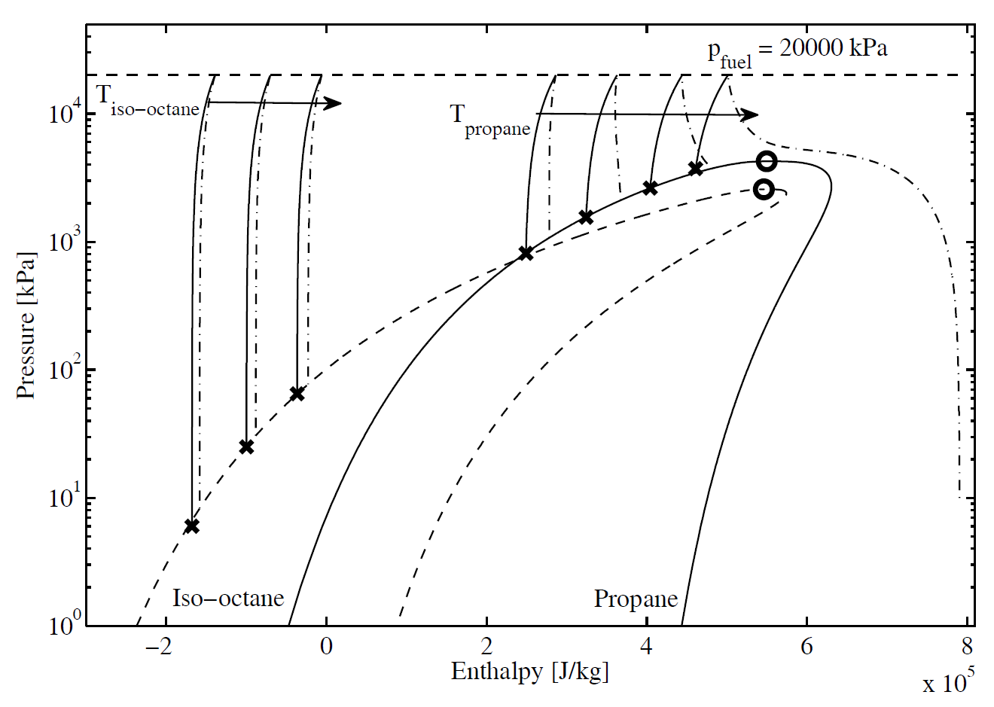
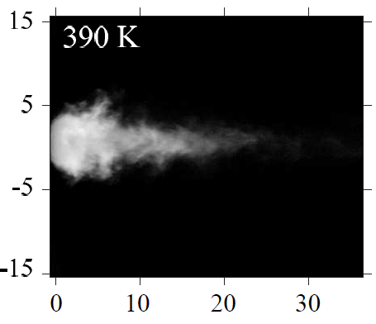
Thermodynamics of fuel injection
700 µs ASOI
p_{CVC} = 1 bar
An isothermal expansion of fuel becomes increasingly invalid for decreasing hydrocarbon molecule size ($R_{p}$ implicitly assumes the fuel expands isothermally from the rail)
Isentropic expansion (until the injector nozzle is choked) is a more accurate representation of the injection process
If chamber pressure is below the pressure required for choking, the fuel entering the chamber is underexpanded and must rapidly expand (potential for plume interaction)

Slide 7
Thermodynamics of fuel injection
A more meaningful pressure ratio than the flashing ratio is the pressure required for critical flow in the nozzle throat compared to the chamber pressure
At sufficiently low chamber pressures, the flow will be underexpanded, resulting in the rapid expansion of individual spray plumes, and the potential for interaction and spray collapse
$${R_{p}}^{∗}<1, fuel flow is unchoked$$
$${R_{p}}^{∗}=\frac{p_{throat,choked}}{p_{chamber}}$$
$${R_{p}}^{∗}=1, fuel flow is choked$$
$${R_{p}}^{∗}>1, fuel flow is underexpanded$$

Slide 8
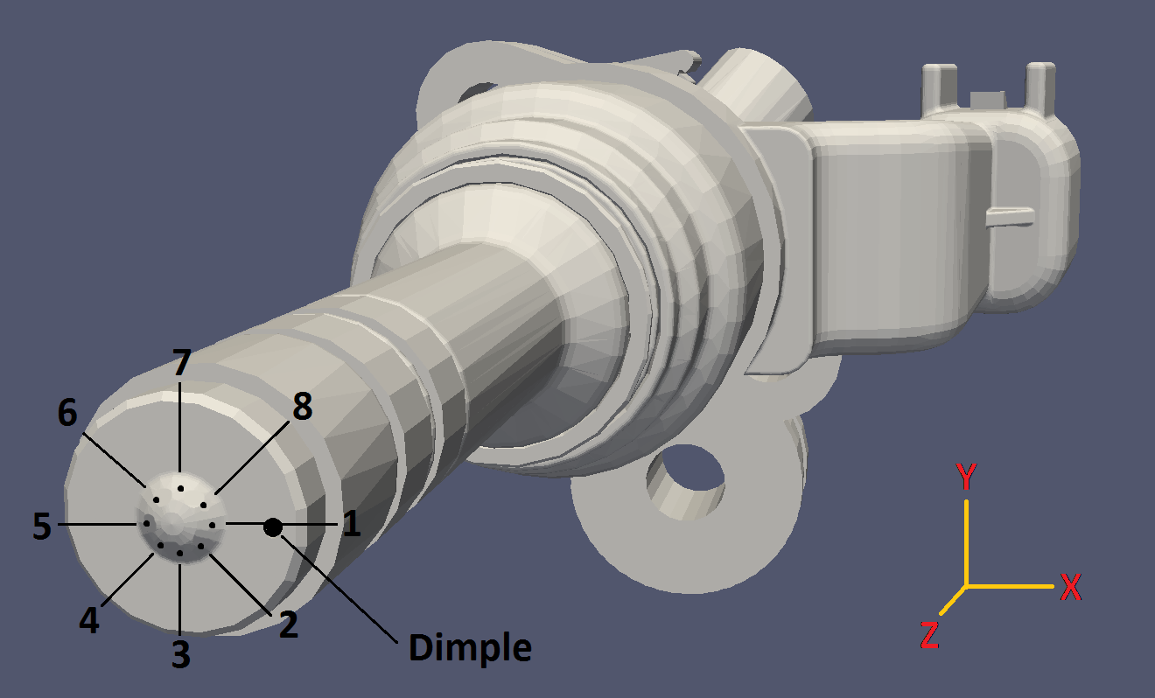
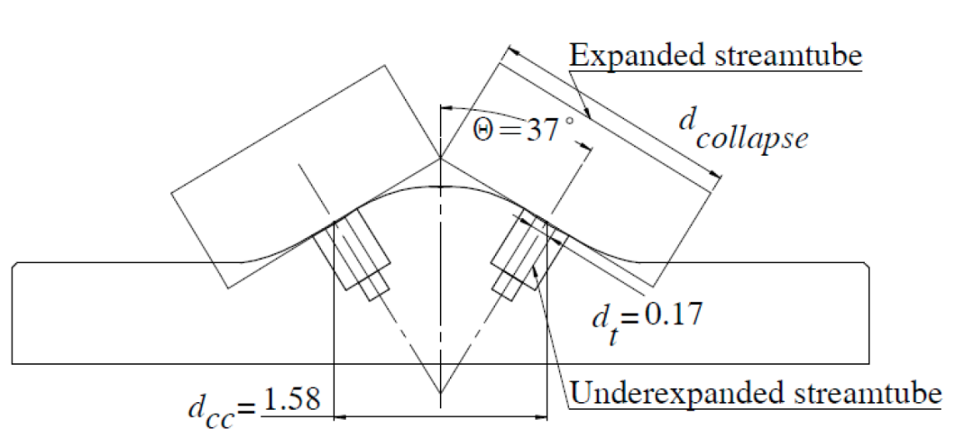
Impact of injector geometry
$R_{p}$ and ${R_{p}}^{∗}$ are purely thermodynamic and contain no geometric information
If injector holes are closer together, plumes can interact with less expansion of the fuel
For a plume interaction/spray collapse metric to be generally useful for any injector hole pattern, it must include some information about hole spacing
The ratio $\frac{d_{collapse}}{d_{t}}$ can be used to predict the onset of severe spray collapse

Slide 9
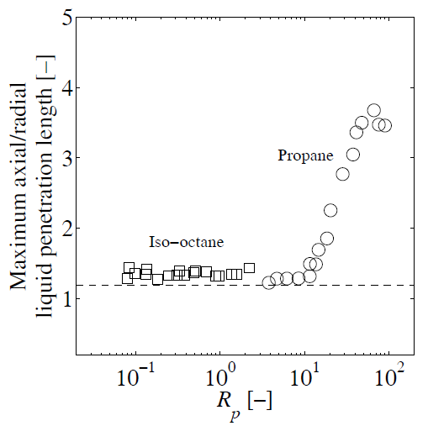
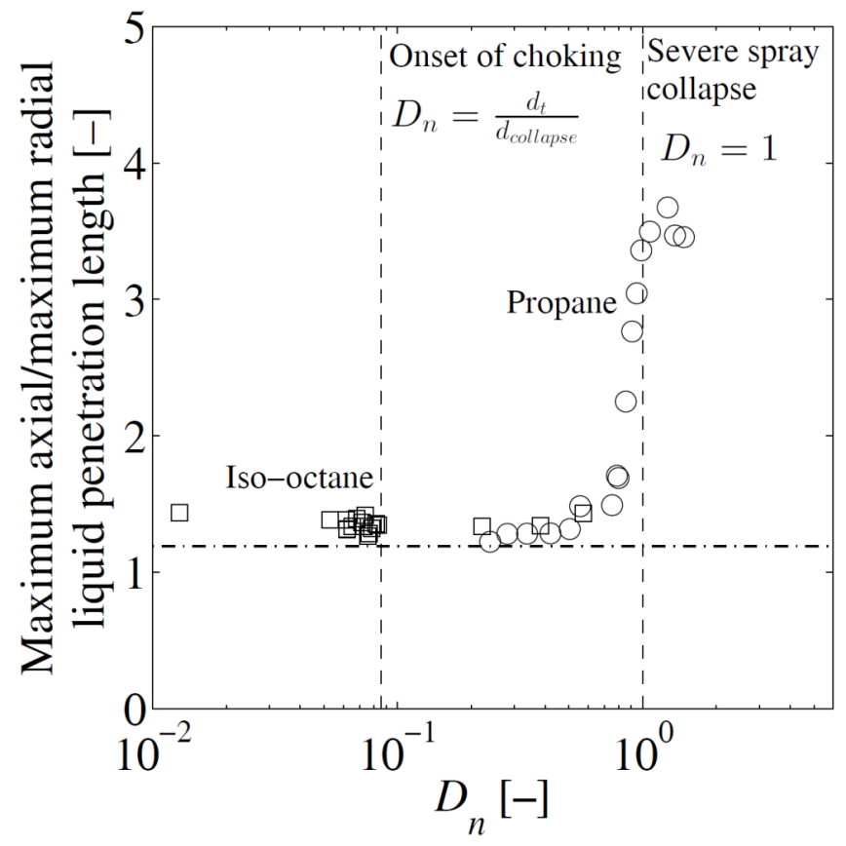
Impact of injector geometry
There is no general threshold for the onset of flash-boiling plume interaction and spray collapse using $R_{p}$ (only injector-specific)
A metric that incorporates injector geometry is better suited to characterizing spray collapse for any multi-hole injector configuration
$$D_{n}=\frac{d_{t}}{d_{collapse}}\sqrt{\frac{v_{c,fuel}}{v_{t}}}$$
Source: Lacey et. al, Fuel, 2017

Slide 10
Key points
The presence of vapour bubbles in flashing, two-phase flow causes a dramatic decrease in the speed of sound compared to either the liquid or gas phase; consequently, fuel flow is highly likely to be choked during flash-boiling
It is more meaningful to use the pressure at which the nozzle throat chokes (past this point plumes can expand and interact), rather than the saturation pressure of the fuel in the rail
Plume widening and interaction is a consequence of choked, underexpanded flow induced by flash-boiling
The onset of flash-boiling spray collapse is strongly tied to both the thermodynamics of the fuel flow as well as the injector geometry

Slide 11
Spray G Future Considerations – Experimental conditions
Use different rail pressures (this will impact the chamber pressure required for critical flow)
Rail temperature also has a significant impact on flash-boiling
Consider lighter fractions of gasoline (i.e. pentane)
Other injector hardware (smaller nominal cone angle; geometry has an impact on plume interaction)

Slide 12
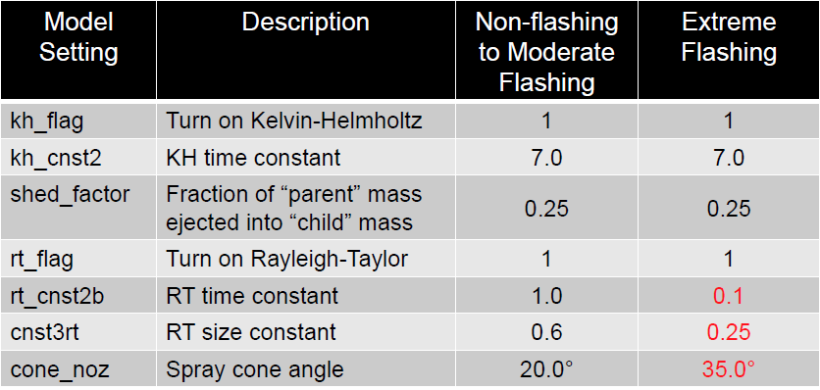
Spray G Future Considerations - Implications for modeling
Directly modeling flash-boiling (nucleation and bubble growth) is generally avoided due to complexity
Using the flashing ratio as a tuning parameter is not generally accurate, particularly for the lighter fractions of gasoline (alternatively use ${R_{p}}^{∗}$)
If the flow is choked, then some boundary conditions can be determined from fundamental theory (e.g. velocity at the injector nozzle throat)

Slide 13
Questions?

Slide 14
Backup
We can estimate the velocity of the fuel flow from the rail to the injector nozzle throat, $u_{fuel}=\sqrt{h_{fuel,rail}−h_{throat}}$
This velocity is then compared against the two-phase sonic velocity to determine the chamber pressure required for critical flow at a given $T_{fuel,rail}$ and $p_{fuel,rail}$
$$c_{t}=\frac{1}{\left(1−α\right)\sqrt{\frac{1−α}{{c_{l}}^{2}}+\frac{αρ_{l}}{{{ρ_{g}c}_{g}}^{2}}}+α\sqrt{\frac{α}{{c_{g}}^{2}}+\frac{(1−α)ρ_{g} }{{{ρ_{l}c}_{l}}^{2}}}}$$
$$α=\frac{xρ_{l}}{xρ_{l}+(1−x)ρ_{g}}$$
Sources: Lacey et. al, Fuel, 2017
Nyugen et. al., Int. J. Multiphase Flow, 1981

Slide 15
Backup
The figure at the right depicts the variation of Ma with chamber pressure for fuel that is at 363 K and 200 bar in the rail
At high chamber pressures propane is sonic in the injector nozzle throat; iso-octane is incompressible until low chamber pressures corresponding to throttled operation
The steep increase in Ma corresponds to the point where the fuel is in a two-phase state, and the presence of vapour bubbles in the flow significantly reduces the speed of sound
Sources: Lacey et. al, Fuel, 2017
Nyugen et. al., Int. J. Multiphase Flow, 1981

Slide 16
Backup
If injector holes are closer together, plumes can interact with less expansion of the fuel
Using conservation of mass through the injector nozzle, we assume that the ratio of fuel densities (or specific volumes) in the nozzle throat and at the expanded state in the chamber is equivalent to the ratio of flow cross-sectional areas
If the fuel flow is modeled as streamtubes (cylinders) of pure fuel we can relate the “expansion ratio” (a ratio of diameters) of the fuel to the ratio of specific volumes in the injector nozzle throat and chamber:
$$\frac{A_{c,fuel}}{A_{t}}=\frac{ρ_{t}}{ρ_{c,fuel}}=\frac{v_{c,fuel}}{v_{t}}$$
$${\left(\frac{d_{c,fuel}}{d_{t}}\right)}^{2}=\frac{v_{c,fuel}}{v_{t}}$$
$c,fuel$ – expanded fuel in the chamber
$t$ – injector nozzle throat

Slide 17
Backup
Comparing the expansion ratio of the fuel streamtubes to the ratio of diameters required for severe spray collapse, we obtain the following:
$$D_{n}=\frac{d_{t}}{d_{collapse}}\sqrt{\frac{v_{c,fuel}}{v_{t}}},where$$
$$D_{n}≤\frac{d_{t}}{d_{collapse}} indicates no plume interaction$$
$$\frac{d_{t}}{d_{collapse}}<D_{n}<1 indicates moderate plume interaction$$
$$D_{n}≥1 indicates severe spray collapse$$

Slide 18
Backup
We plotted the quantity $D_{n}$ against a spray shape (like a spreading angle)
Iso-octane and propane spray structures fall within predicted bounds
Thresholds in this plot have a physical meaning (both thermodynamically and geometrically)
$$D_{n}=\frac{d_{t}}{d_{collapse}}\sqrt{\frac{v_{c,fuel}}{v_{t}}}$$

Slide 19
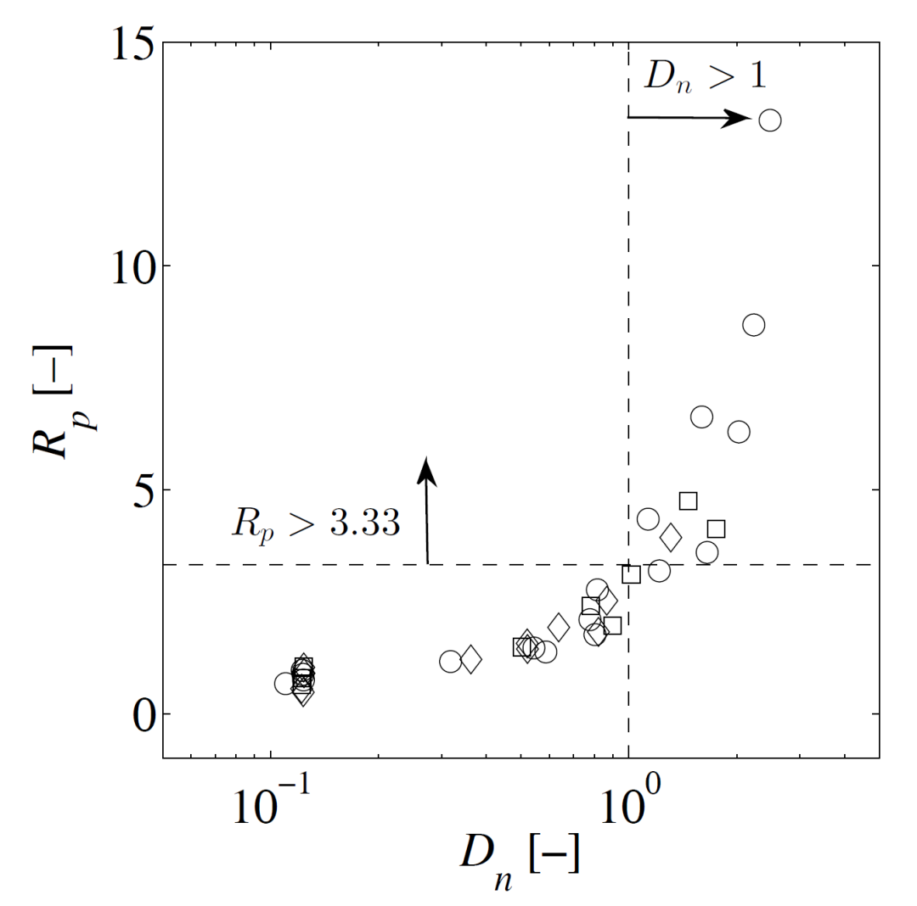
Backup
Circles – methanol
Squares – n-hexane
Diamonds – ethanol
We also used our metric with the data from another study (Zeng et. al., Fuel, 2012), and their injector geometry (60˚ cone angle)
Observations of “flare-flashing” (severe spray collapse) agrees with $D_{n}$

