Slide 1


ECN5 – Diesel Combustion
INTRODUCTION
JM García-Oliver (UPVLC)

Slide 2
DIESEL COMBUSTION EXPERIMENTS
ECN1
SA
ECN2
ECN3
ECN4
Vessels and diagnostics standardization

Slide 3
Combustion
Recommendations
  Use high sensitivity imaging to detect high-T luminosity
    Let soot that forms later saturate your imaging system.
    Operate with high time resolution (high framing rate).
  Use two pressure transducers to resolve spray heat release.
    Time correction for speed of sound is necessary.
  Time average lift-off length during the steady portion of combustion, and provide this profile (maximum at any radial location) to eliminate ambiguity about the “knee” or “leveling-off” value.
  To report a single lift-off length, base it upon 50% of the maximum intensity at the leveling-off value.
    At higher wavelengths, levels may not decline downstream.
    More work is needed to understand leveling-off detection at multiple wavelengths.
  Use this same 50% intensity to determine ignition.

Slide 4
DIESEL COMBUSTION EXPERIMENTS
ECN1
SA
ECN2
SA
ECN3
ECN4
Vessels and diagnostics standardization
ID/LOL
Standardization and comparison among institutions
Soot for SH

Slide 5
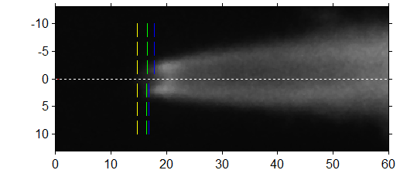
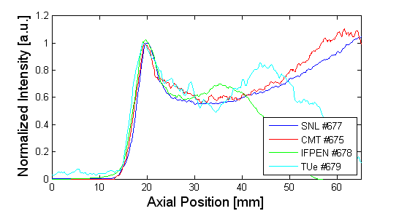
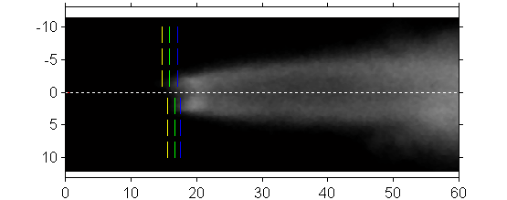
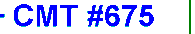
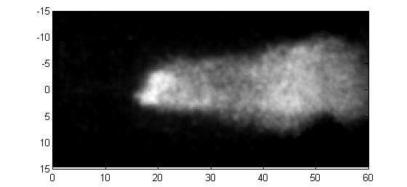
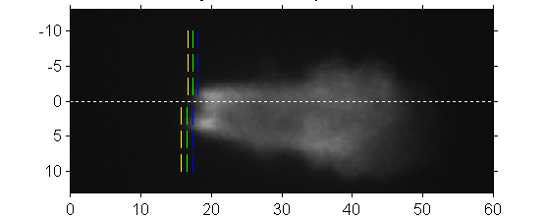
OH* time average
CMT
SNL
SNL #677
TU/e
IFP and TU/e synchronization with injection is different from CMT and SNL.
Noise given by TU/e intensifier is not a problem from the measurement
 | SNL | CMT | TU/e | IFPEN
Start [ms] | 2 | 2 | 1.5 | 0.8
End [ms] | 5 | 5 | 2.0 | 1.3
IFPEN
 | SNL | CMT | TU/e | IFPEN (23.5 kg/m3) | IFPEN 2 (24kg/m3)
Average [mm] | 17.2 | 17.7 | 16.4 | 16.1 | 16.9
Std Dev. [mm] | 0.6 | 0.4 | 1.2 | 0.8 | 0.7

Slide 6
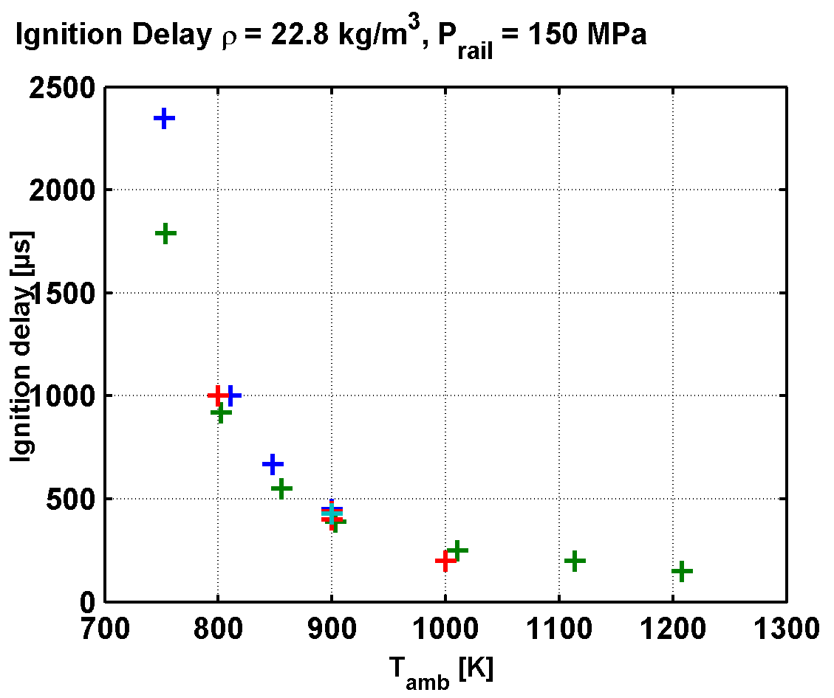
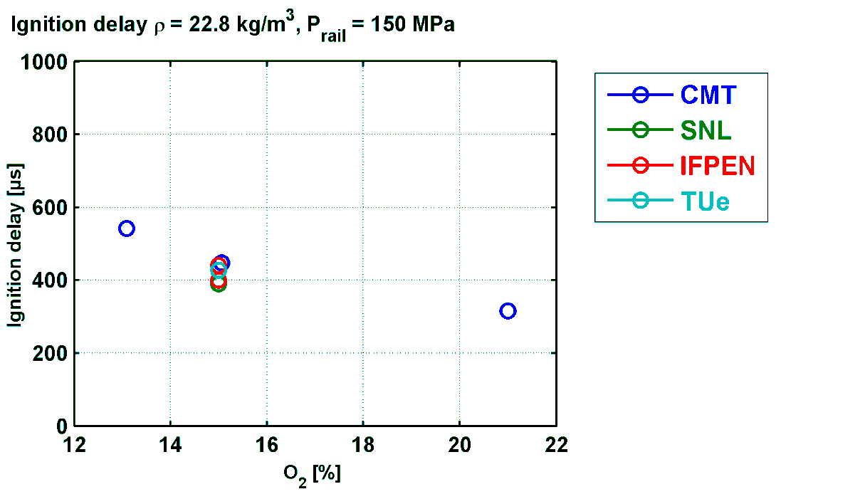
Ignition Delay
Not filtered/ICCD
 | SNL | CMT | TU/e | TU/e | IFPEN1 (23.5kg/m3) | IFPEN2 (24kg/m3)
Average [us] | 400 | 441 | 400 | 410 | 380 | 405
Std Dev. [us] | 10 | 22 | 20
Filtered at 310 nm
First signal detection

Slide 7
DIESEL COMBUSTION EXPERIMENTS
ECN1
SA
ECN2
SA
ECN3
SA
ECN4
Vessels and diagnostics standardization
ID/LOL
Standardization and comparison among institutions
Substantial contributions:
ID/LOL/FP/ HRR/ LIF
Soot SA measurements
Soot for SH

Slide 8
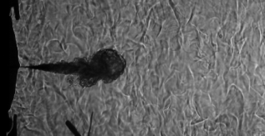


Analysis of flame phases – Spray A
SOC
EOI
I
II
III
FL
FTP
s_{R}
s_{inert}
LOL OH*
LOL(t)
Sources of information
  Shadowgraphy (CMT)
  OH* Chemiluminescence → LOL OH* (CMT)
  Broadband chemiluminescence
    FTP(t) = Flame Tip Penetration (CMT)
    LOL(t) (Sandia)

Slide 9
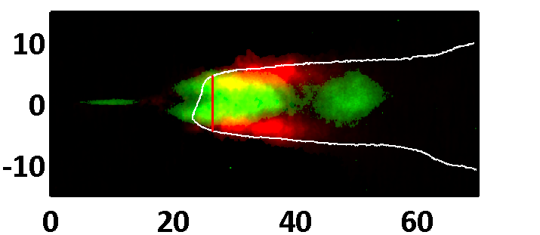
Flame structure – Spray A
Formaldehyde
Reaction zone
PAH
Liquid phase
Hot burnt gases
The formaldehyde structure decreases when increasing tempereature/ [O2]
The PLIF-OH signal start « almost » at LOL (OH*)

Slide 10
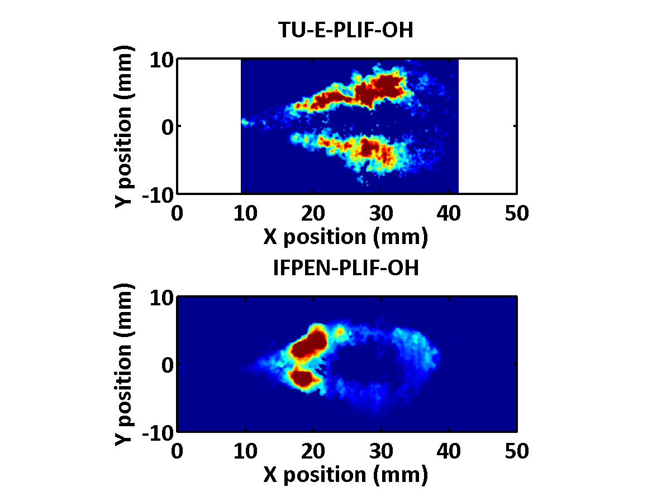
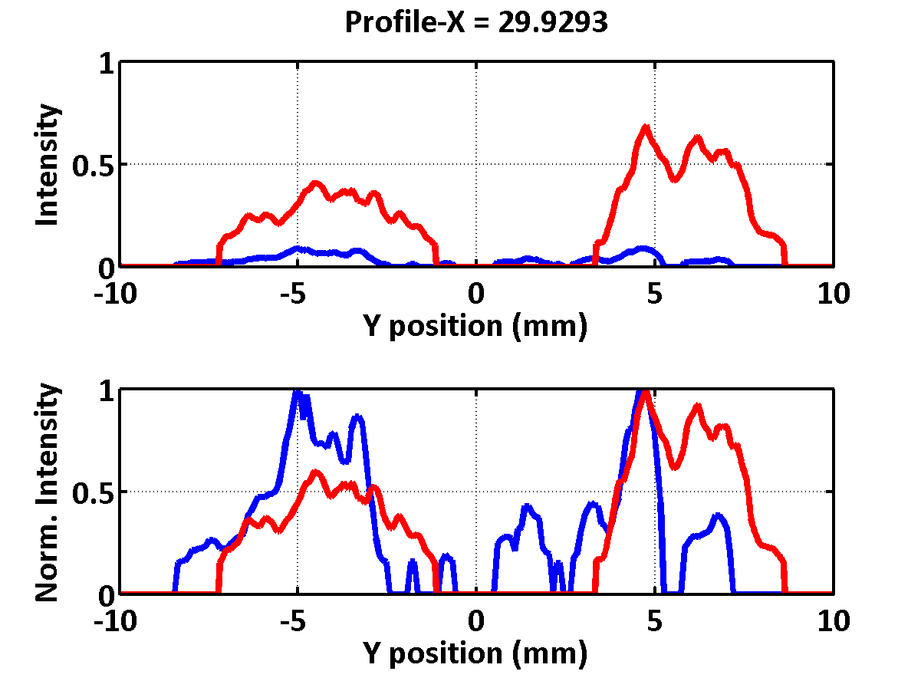
PLIF-OH: 2D comparisons t = 0.7 ms ASOI
Not the same penetration
Ambient conditions ?
Injector to injector variations ?
Hydraulic delay ?
Not the same structure ?
Laser profile correction ?
Timing ?
AI delay differences ?

Slide 11
DIESEL COMBUSTION EXPERIMENTS
ECN1
SA
ECN2
SA
ECN3
SA
ECN4
Vessels and diagnostics standardization
ID/LOL
Standardization and comparison among institutions
Substantial contributions:
ID/LOL/FP/ HRR/ LIF
Soot SA measurements
Soot for SH
SA PIV, mult injections
SB vessels vs engines
SC/SD first measurements

Slide 12
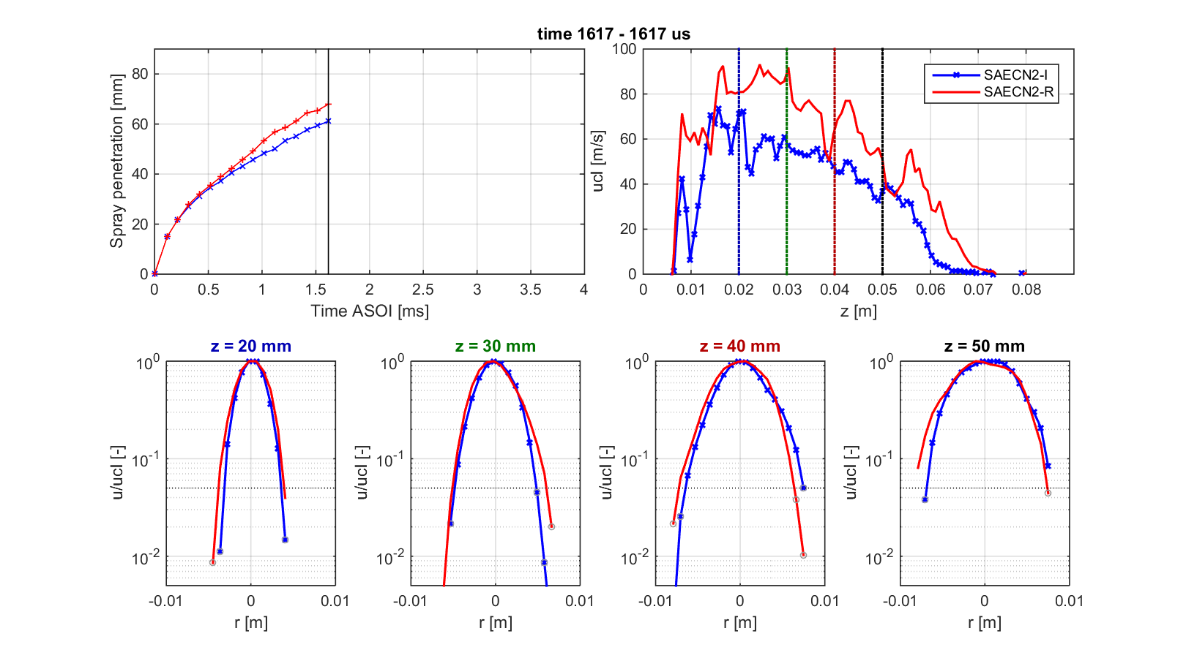
DESCRIPTION OF REACTING FLOW
NOMINAL Spray A
Evidences of:
Increased spray tip penetration
Flow acceleration
Radial dilation

Slide 13
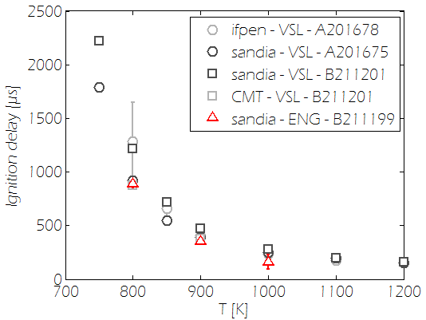
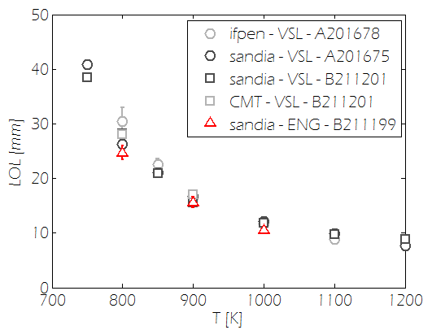
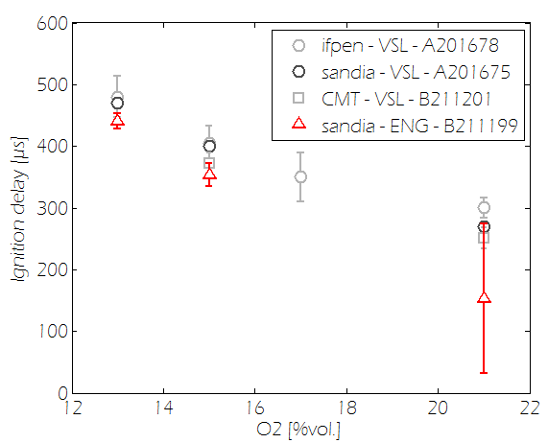
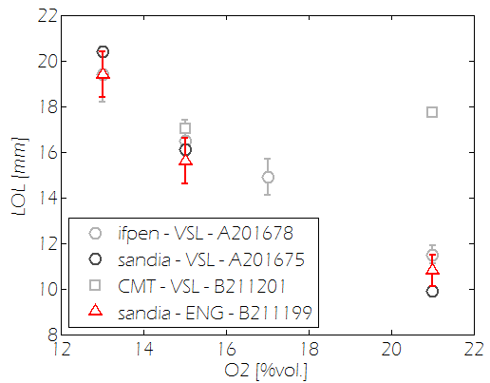
Engine vs Vessel: ID and Lift-off Length
Ignition delay
Lift-off length
B211200
B211200
B211200
Combustion indicators are similar between spray B in vessels and engines

Slide 14
DIESEL COMBUSTION EXPERIMENTS
ECN1
SA
ECN2
SA
ECN3
SA
ECN4
Vessels and diagnostics standardization
ID/LOL
Standardization and comparison among institutions
Substantial contributions:
ID/LOL/FP/ HRR/ LIF
Soot SA measurements
Soot for SH
SA PIV, mult injections
SB vessels vs engines
SC/SD first measurements
ECN5
  Enlarged SC/SD experiment database
  Detailed SA ignition experiments

Slide 15
DIESEL COMBUSTION MODELLING
ECN1
SA/SH
ECN2
SA/ SH
ECN3
First modelling comparison (inert)
Detailed comparison of ID/LOL with different mechs/TCI
ECN4

Slide 16
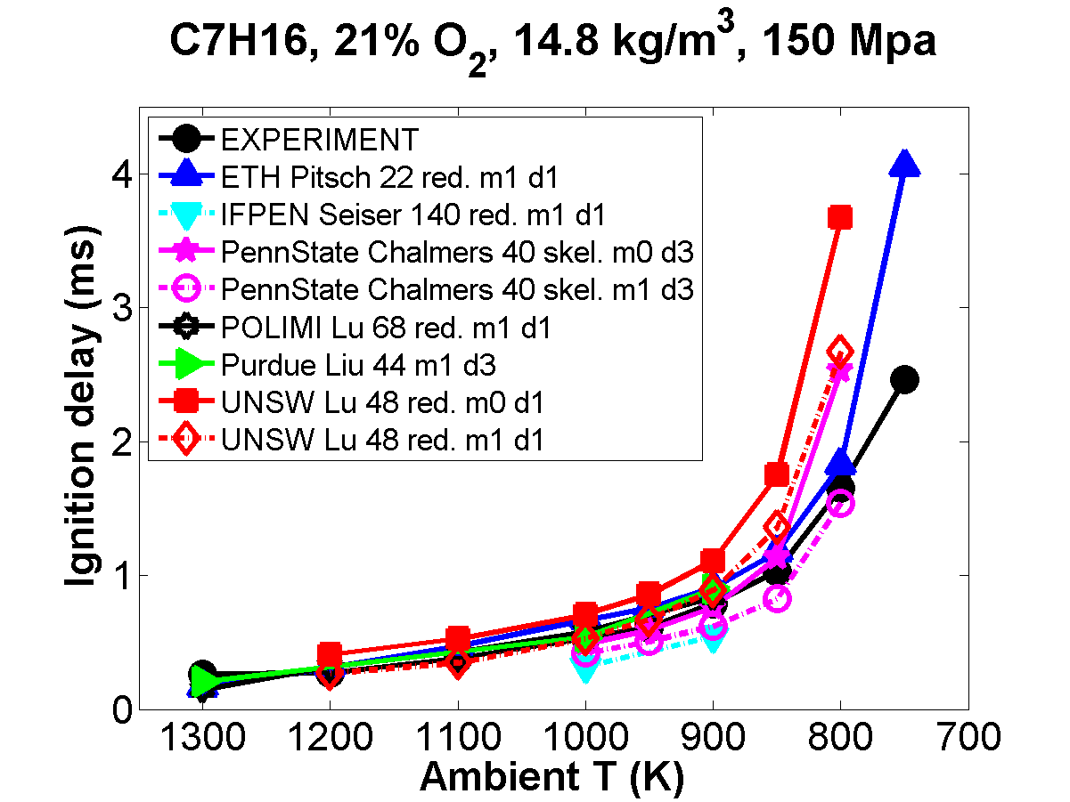
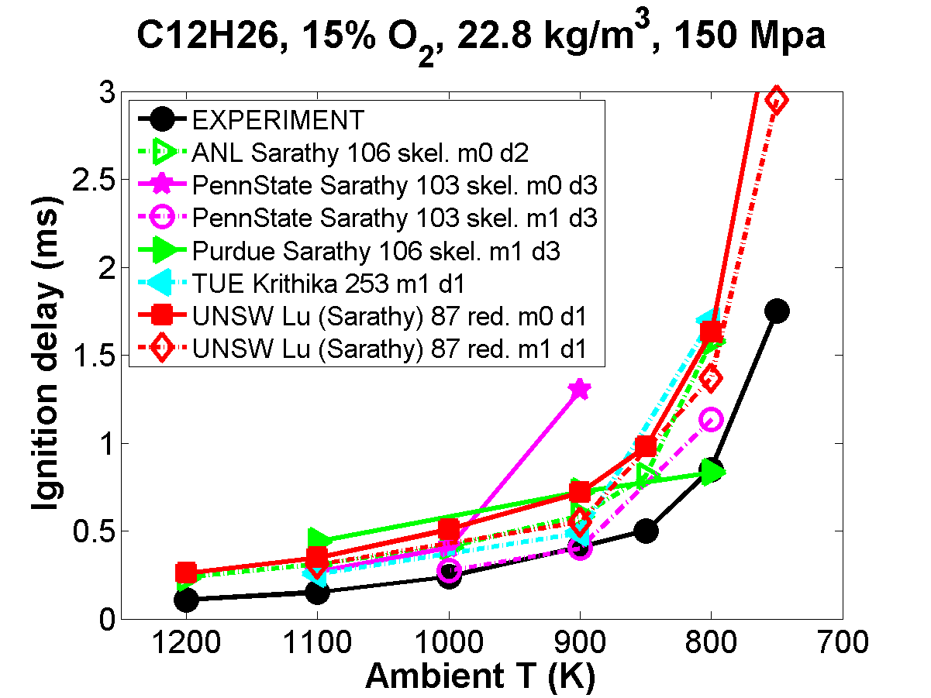
Ignition delay versus T_{a}
Good agreement for qualitative trends with some outliers.
Over-prediction for most models in Spray A, and models straddle spray H.
Absolute agreement generally worse at lower T with over-predicted ignition delay.
Spray H results better than spray A. Lower O₂ in spray A? Or worse chemistry model?

Slide 17
DIESEL COMBUSTION MODELLING
ECN1
SA/SH
ECN2
SA/ SH
ECN3
SA
First modelling comparison (inert)
Detailed comparison of ID/LOL with different mechs/TCI
ECN4
Flame structure analysis
Detailed comparison
ID/LOL/FP/ HRR/ LIF

Slide 18
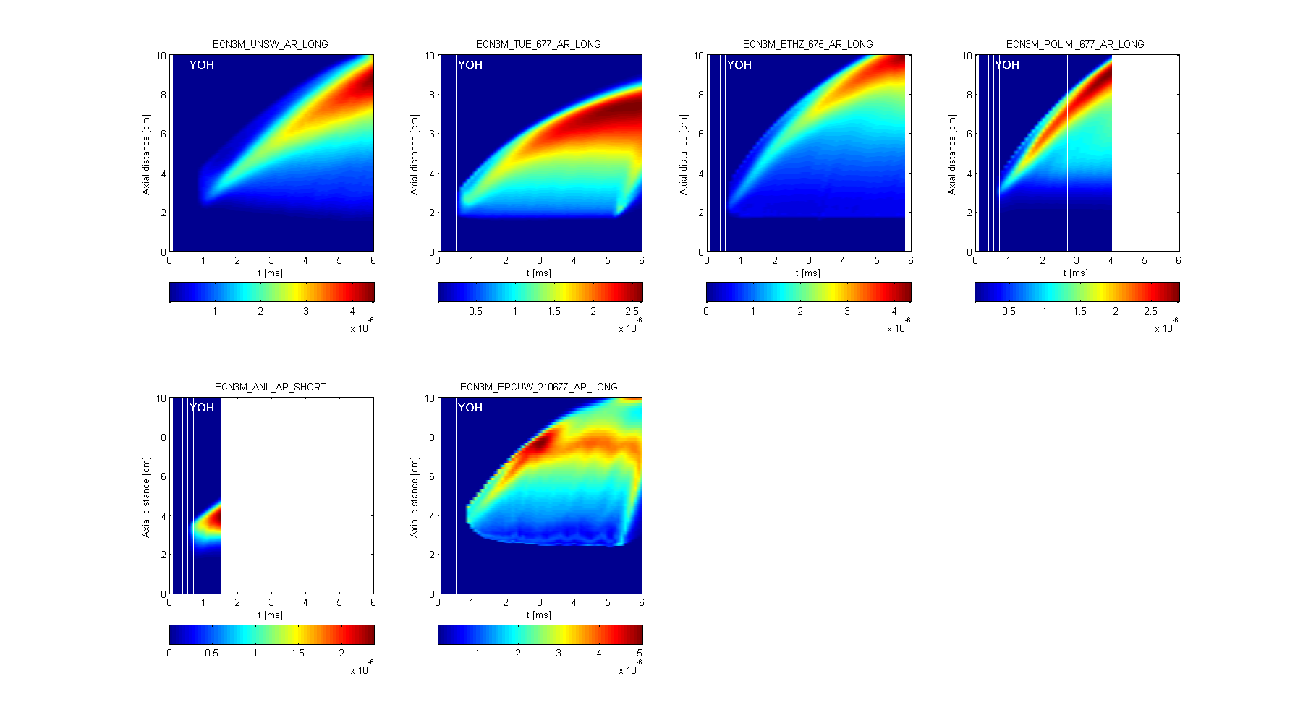
OH

Slide 19
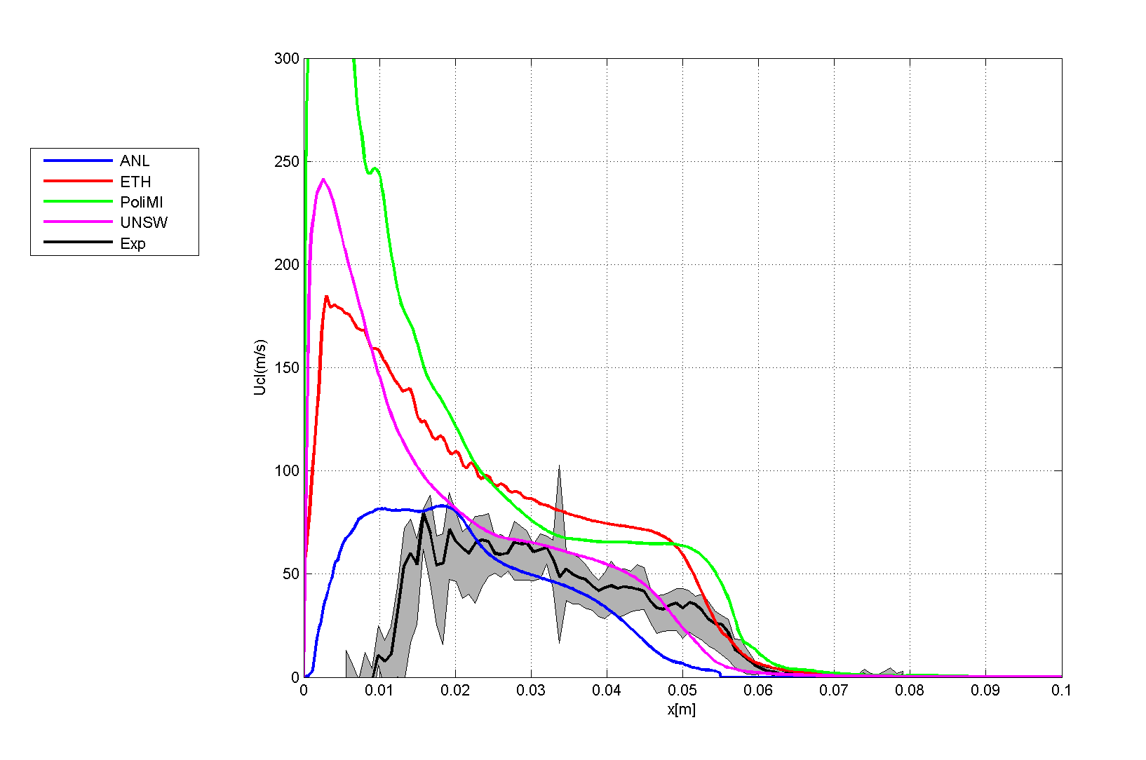
MOTIVATION
Flow analysis @ECN2
  Large scattering in modelling results
    Boundary conditions?
  No analysis of velocity/reactive penetration data

Slide 20
DIESEL COMBUSTION MODELLING
ECN1
SA/SH
ECN2
SA/ SH
ECN3
SA
SA
First modelling comparison (inert)
Detailed comparison of ID/LOL with different mechs/TCI
ECN4
Flame structure analysis
Detailed comparison
ID/LOL/FP/ HRR/ LIF
Detailed comparison Flow+ID
SB engines
Flame structure vs LIF

Slide 21
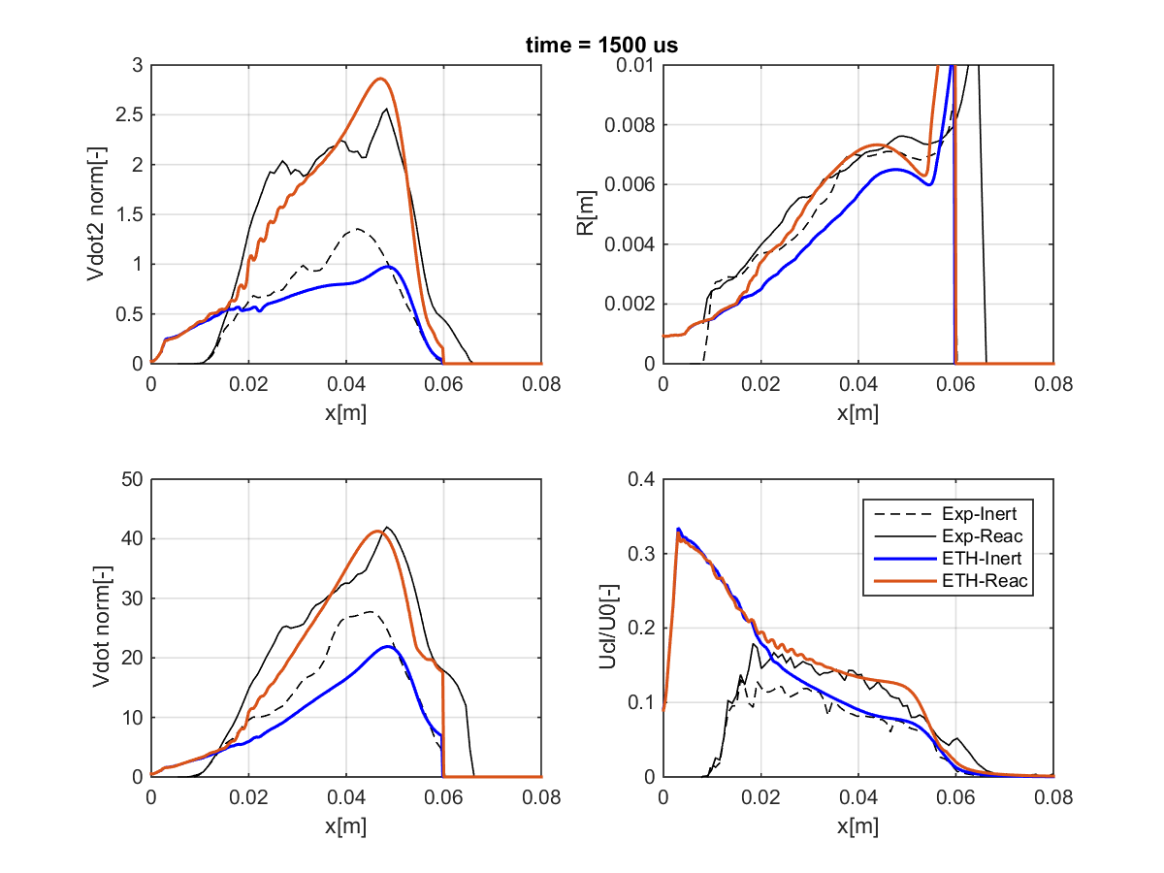
REACTING SPRAY A
ETH
  Good description of
  the flow under reacting
  conditions
  Very high expansion in the
  Inert-to-reacting transition
time = 1500 us
EXP-REACT
EXP-INERT

Slide 22
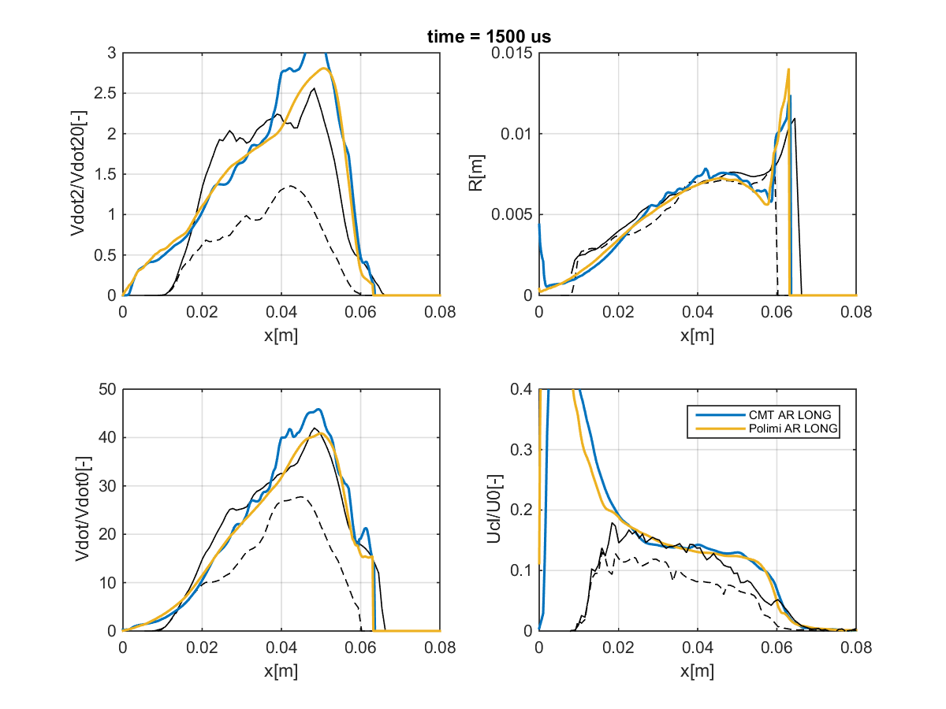
REACTING SPRAY A
CMT/Polimi
  Good overall agreement
time = 1500 us
EXP-REACT
EXP-INERT

Slide 23
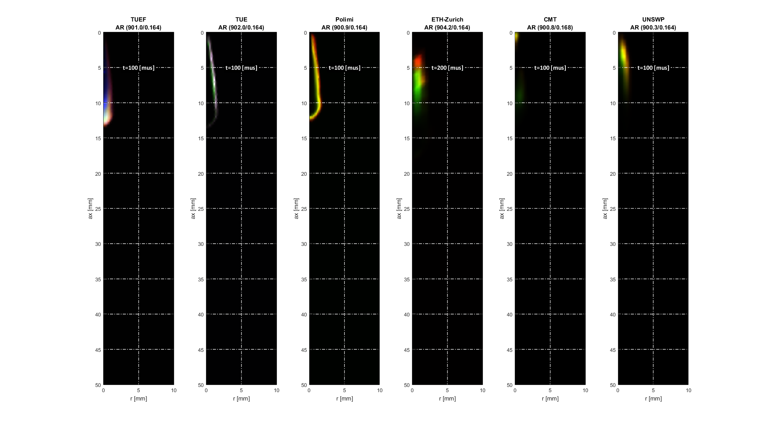
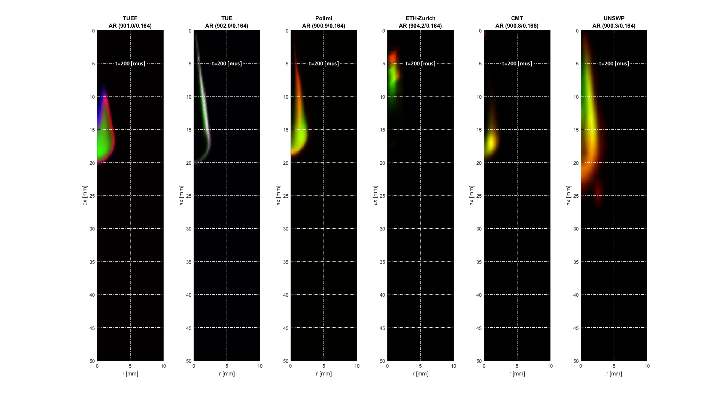
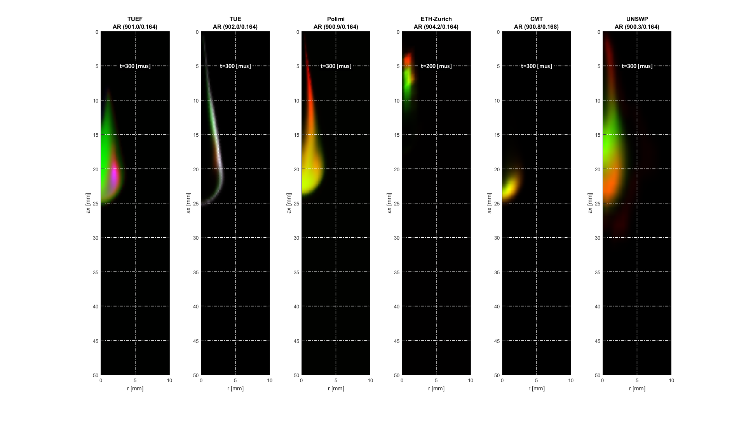
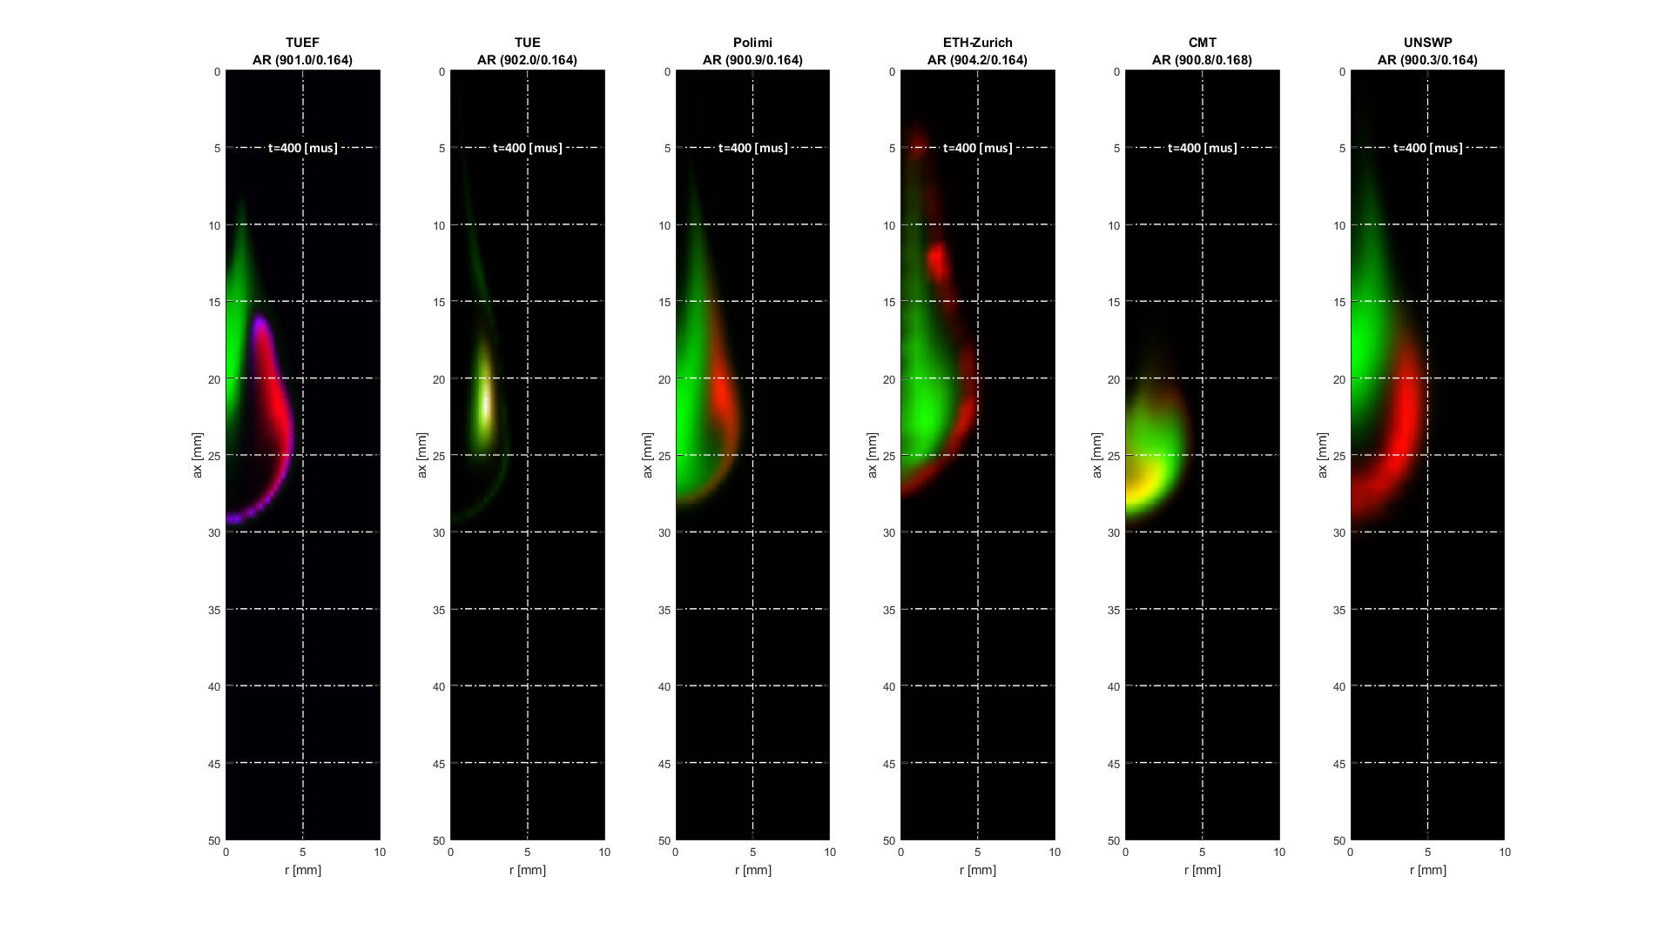
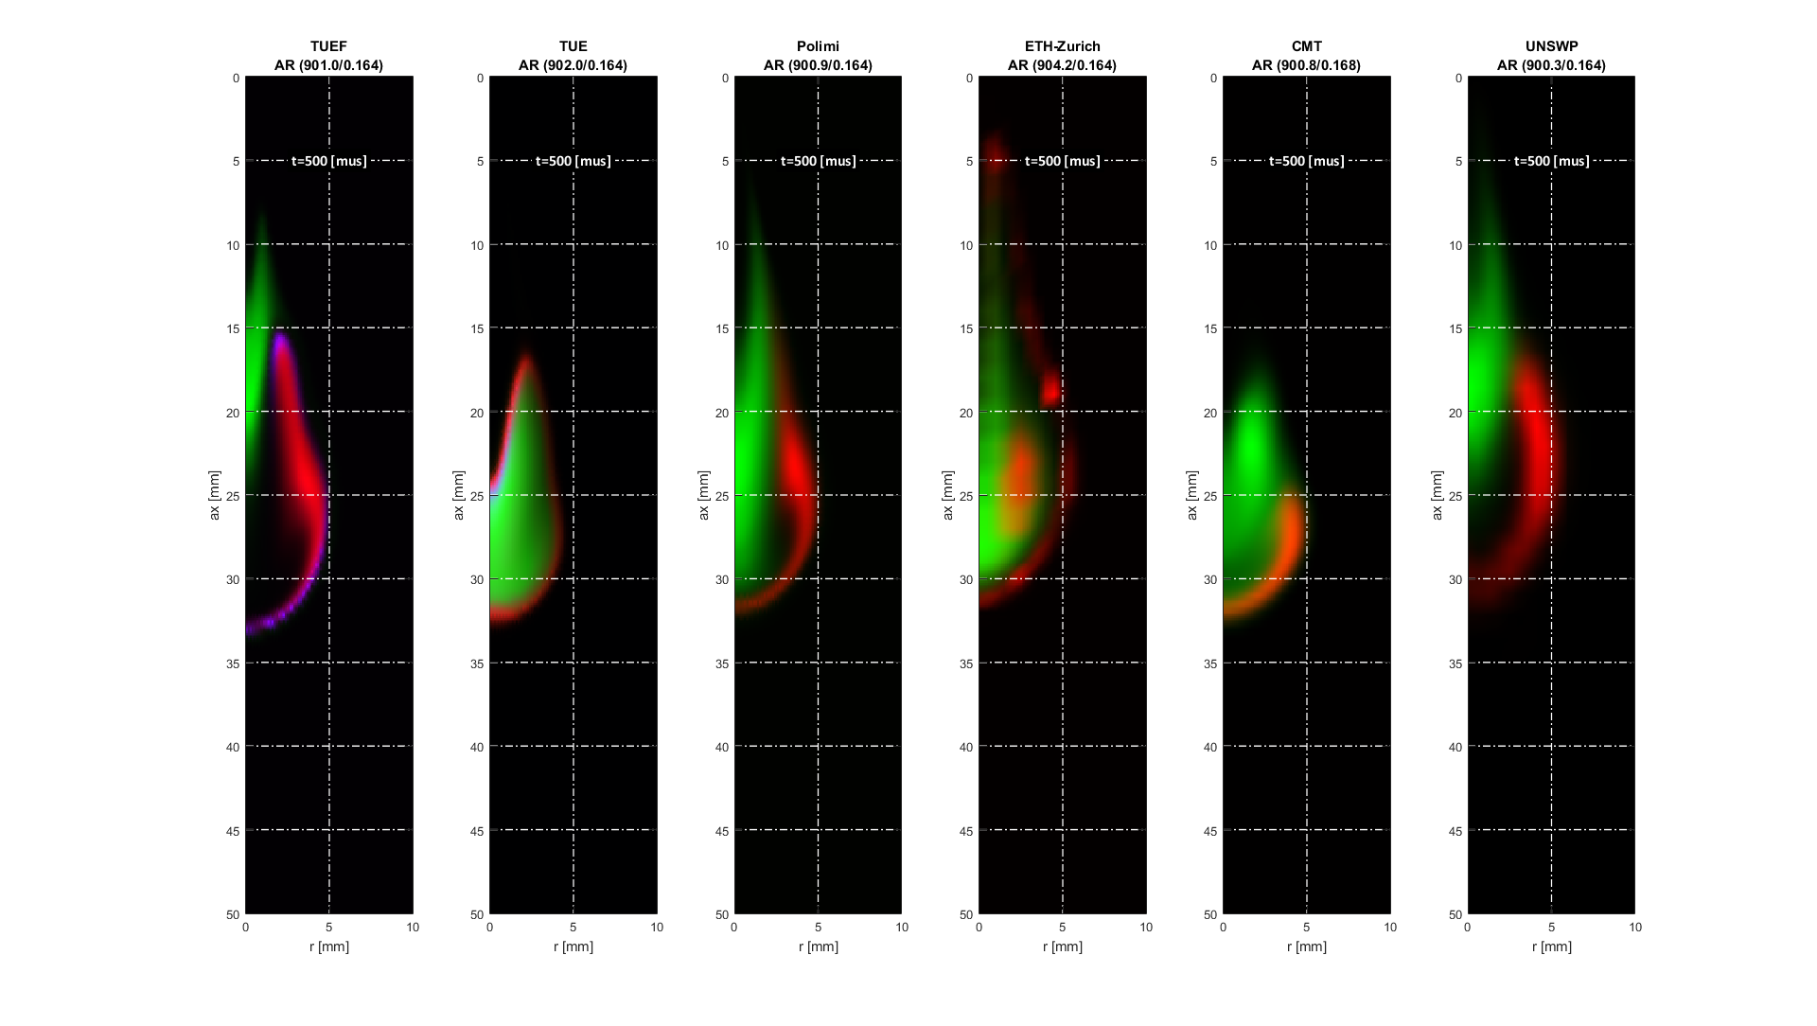
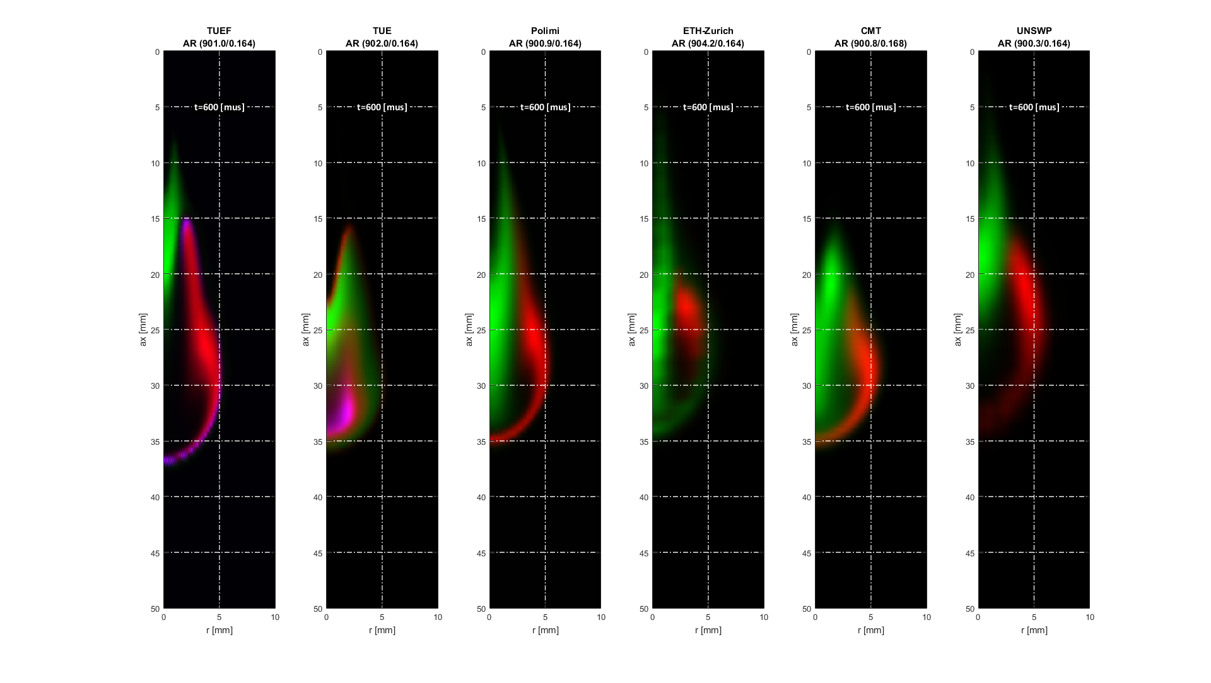
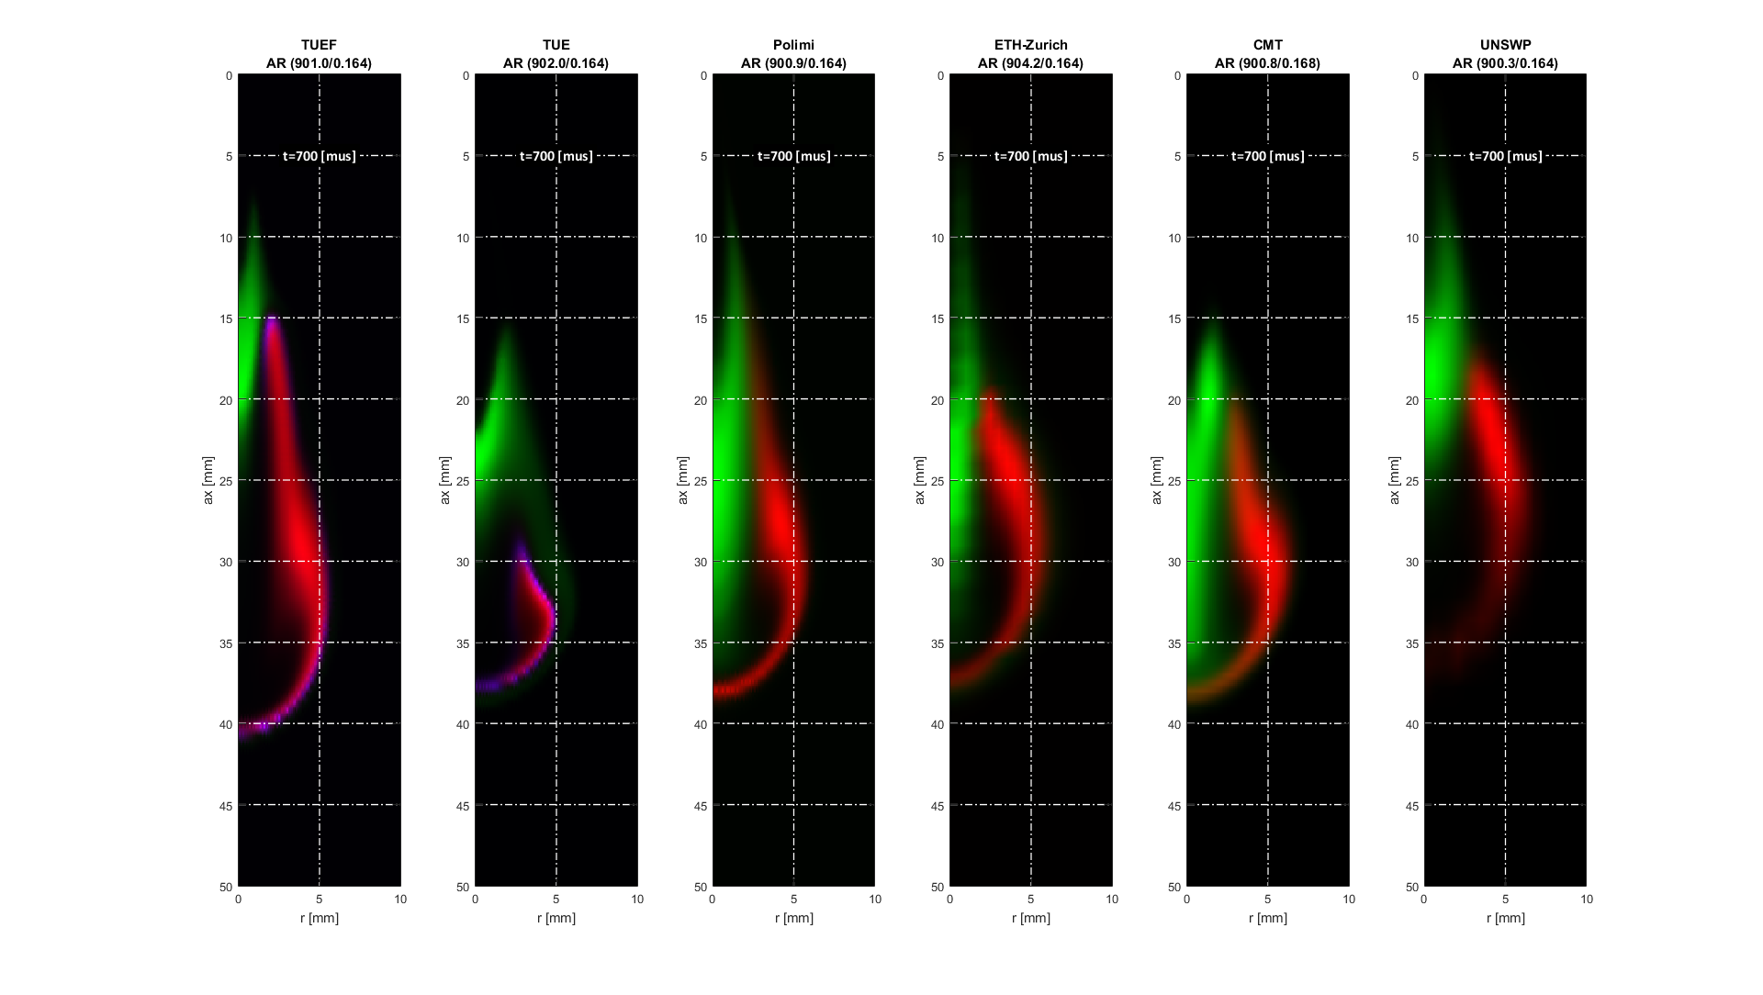
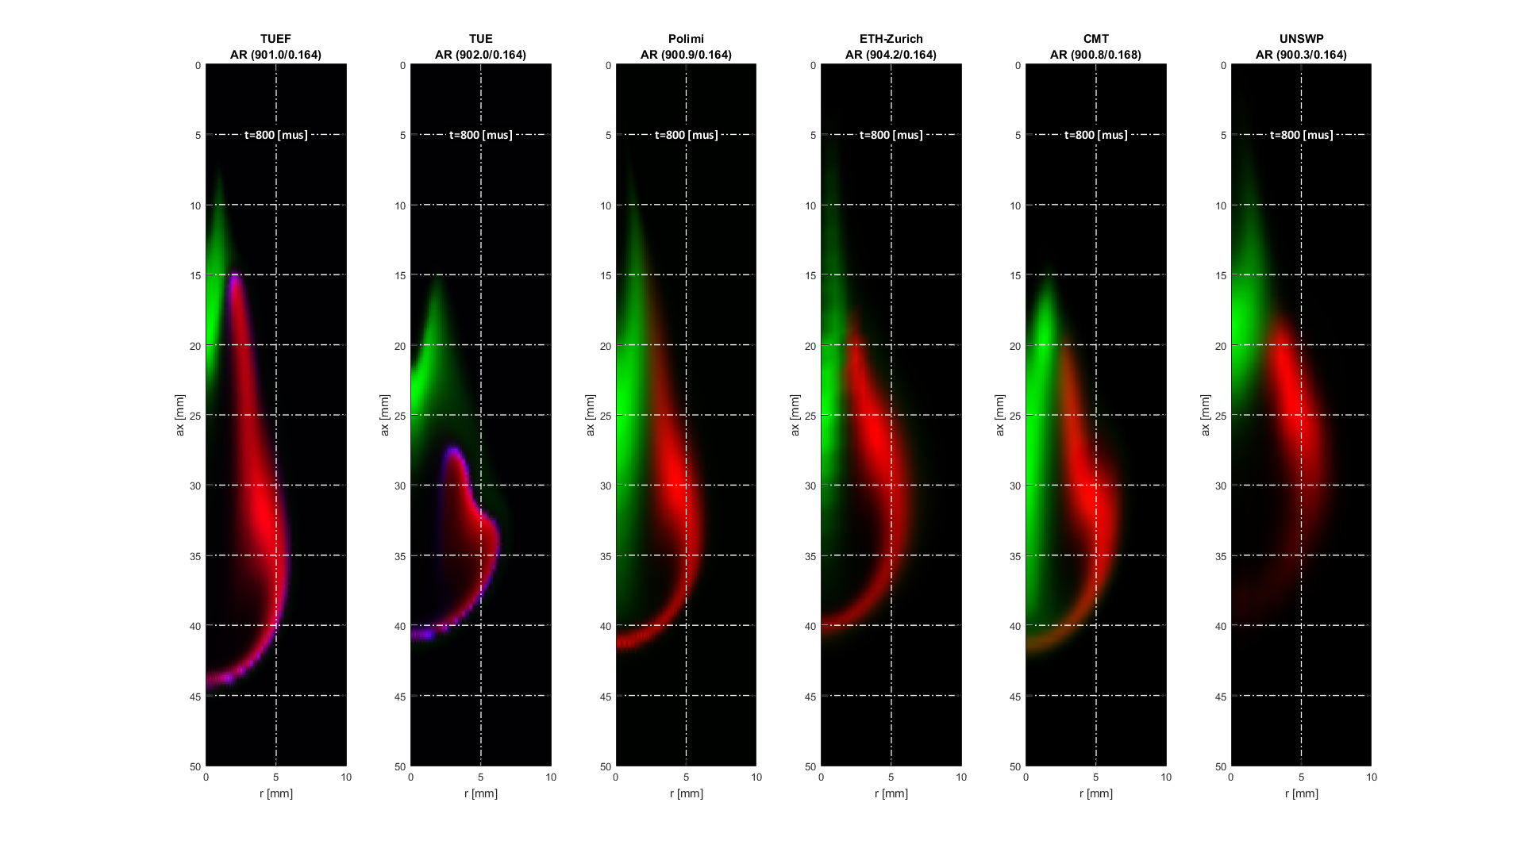
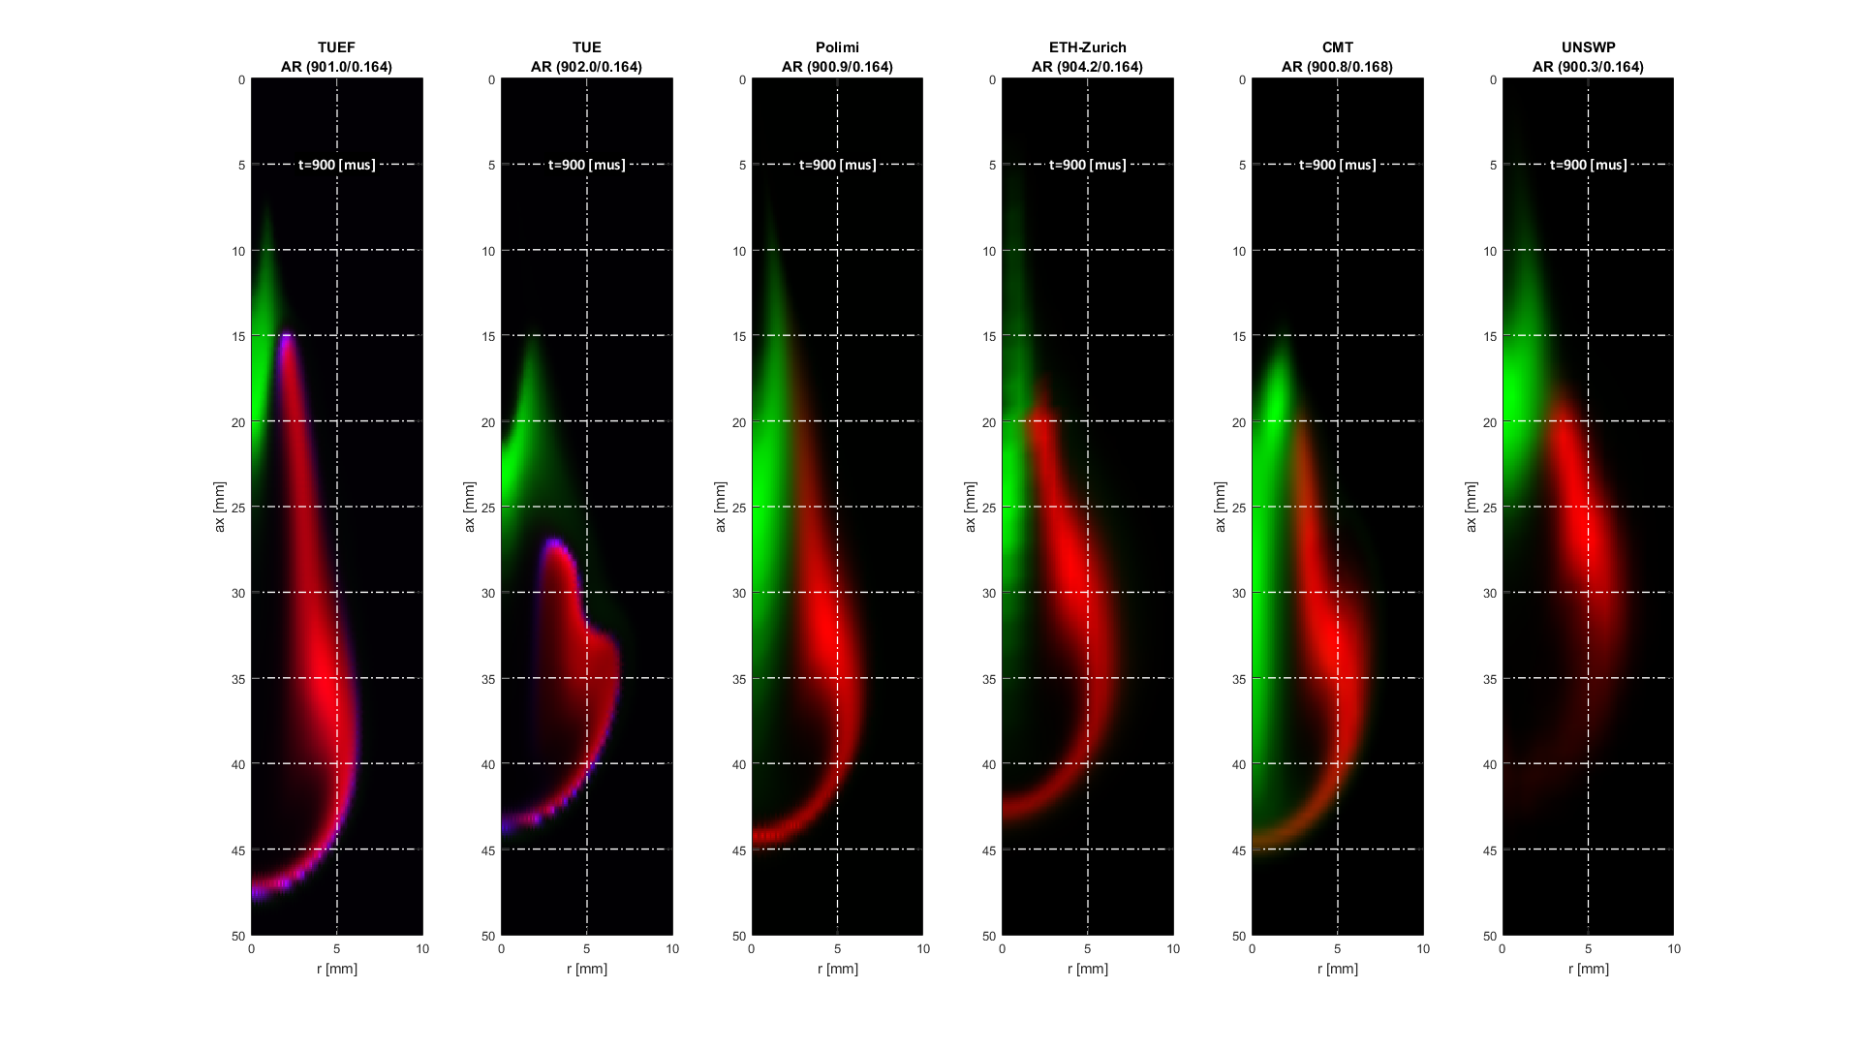
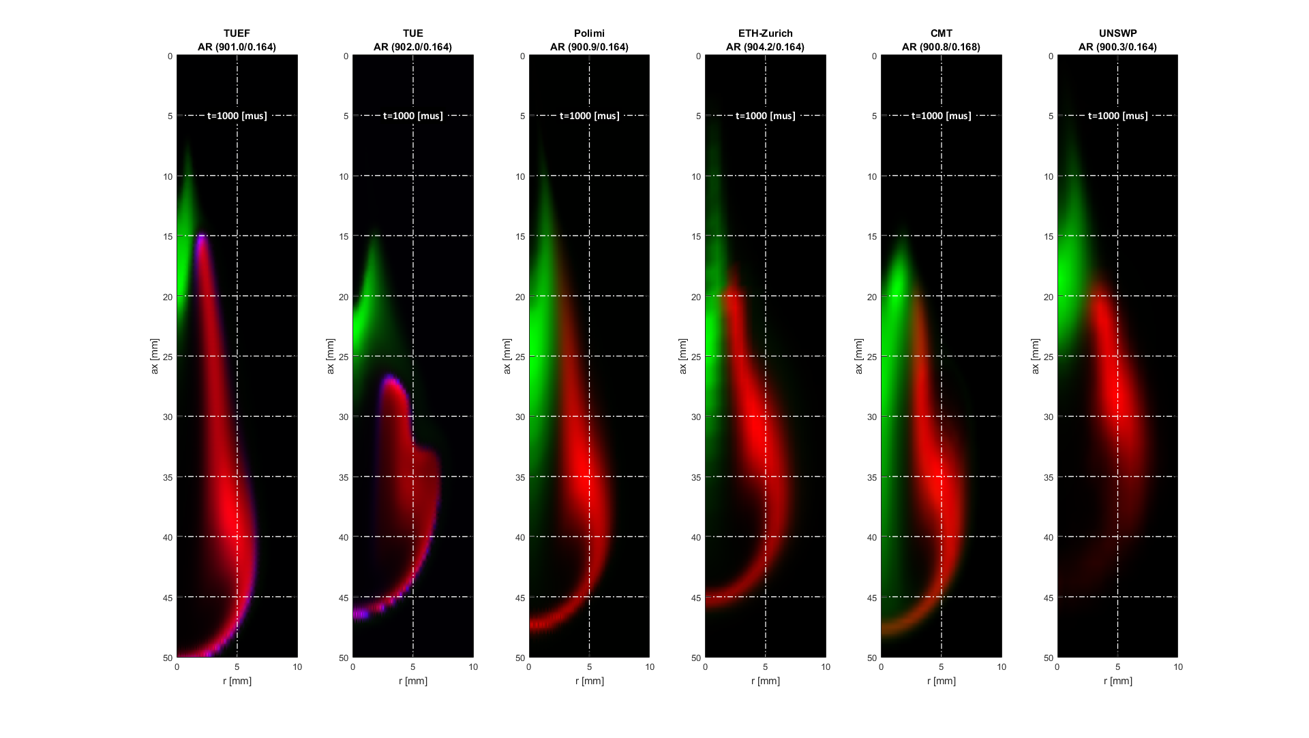
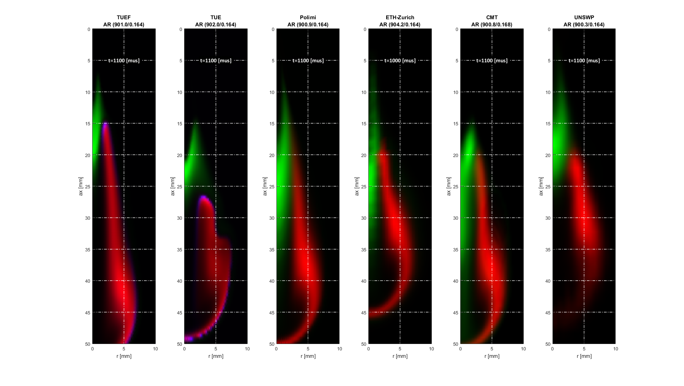
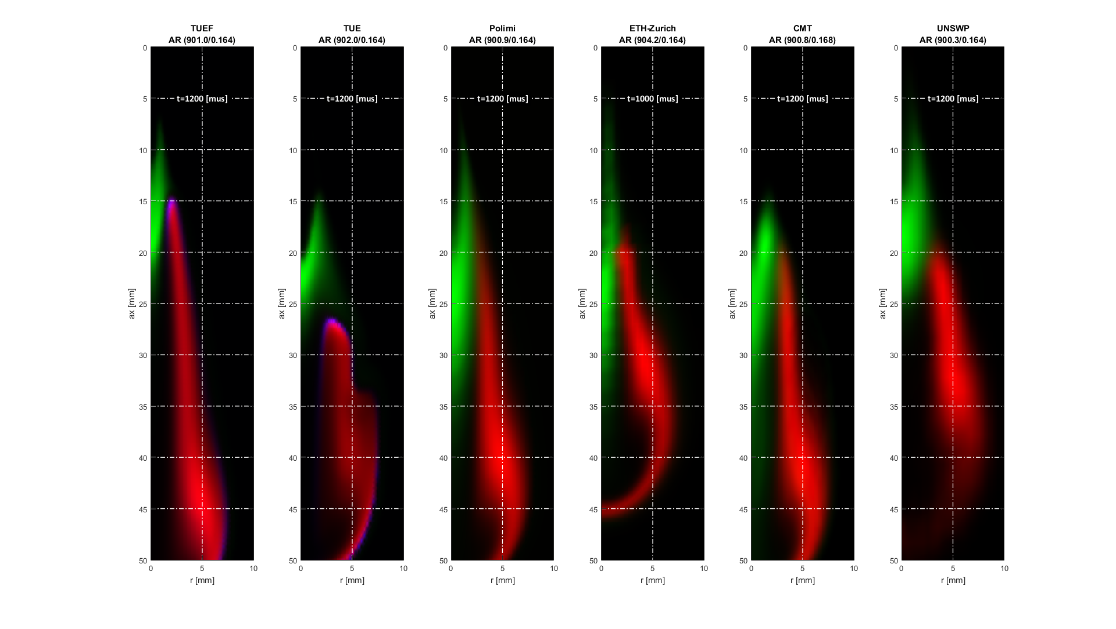
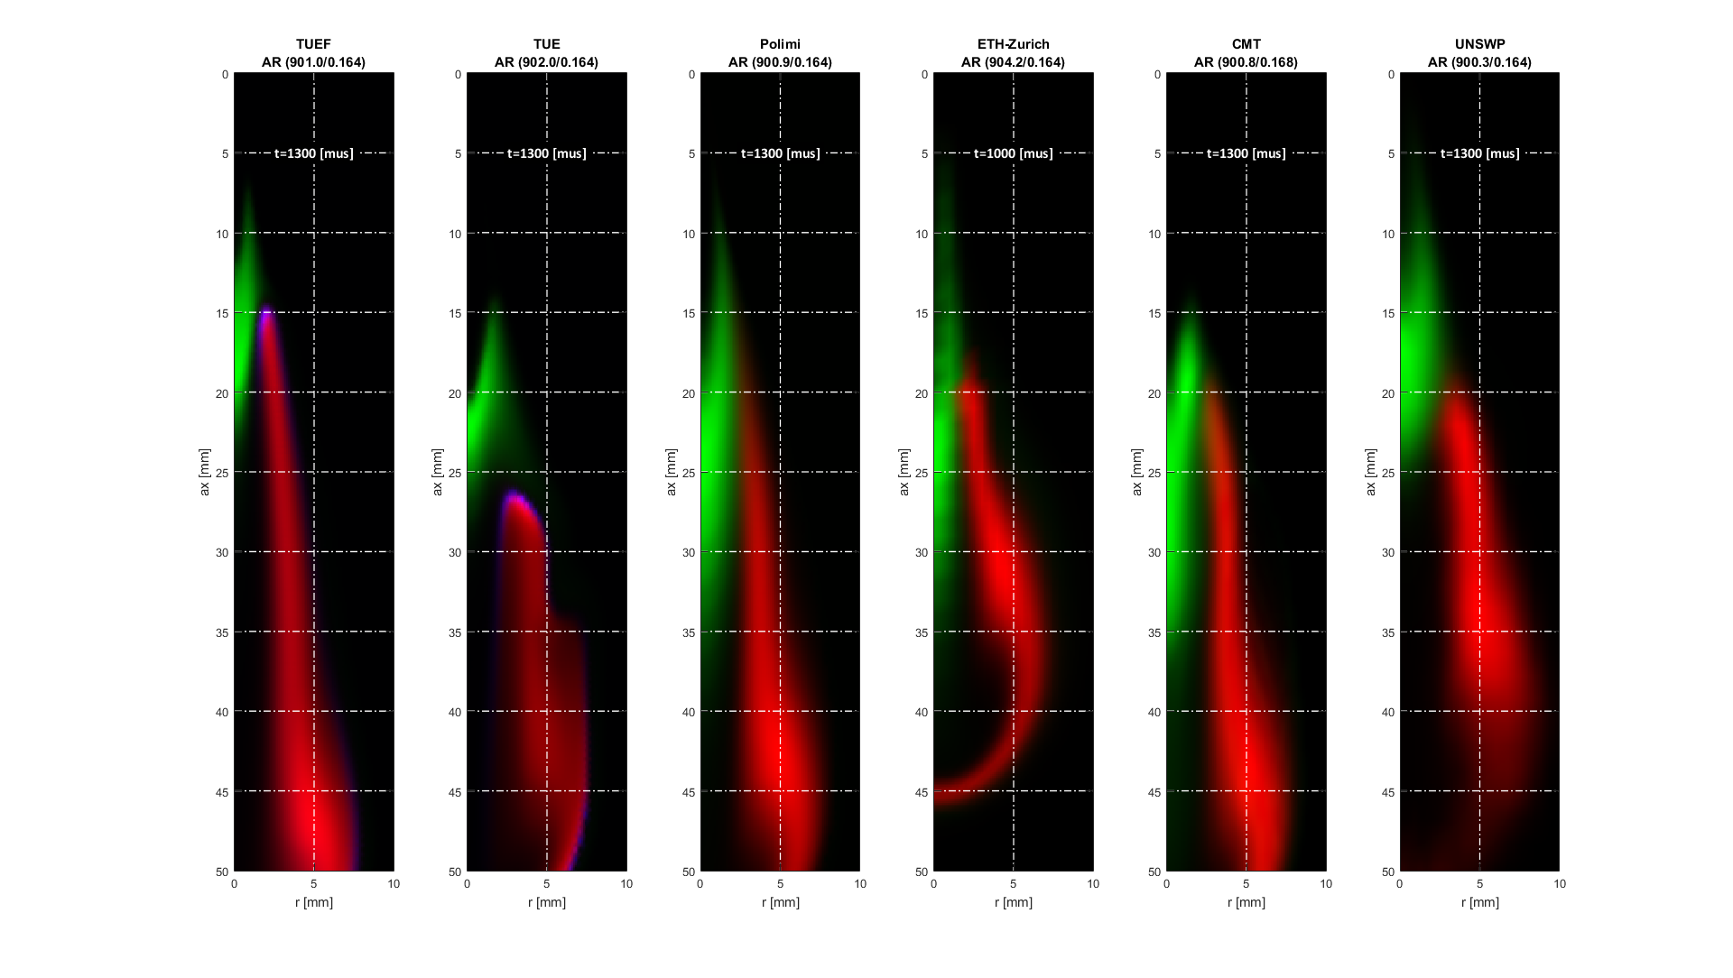
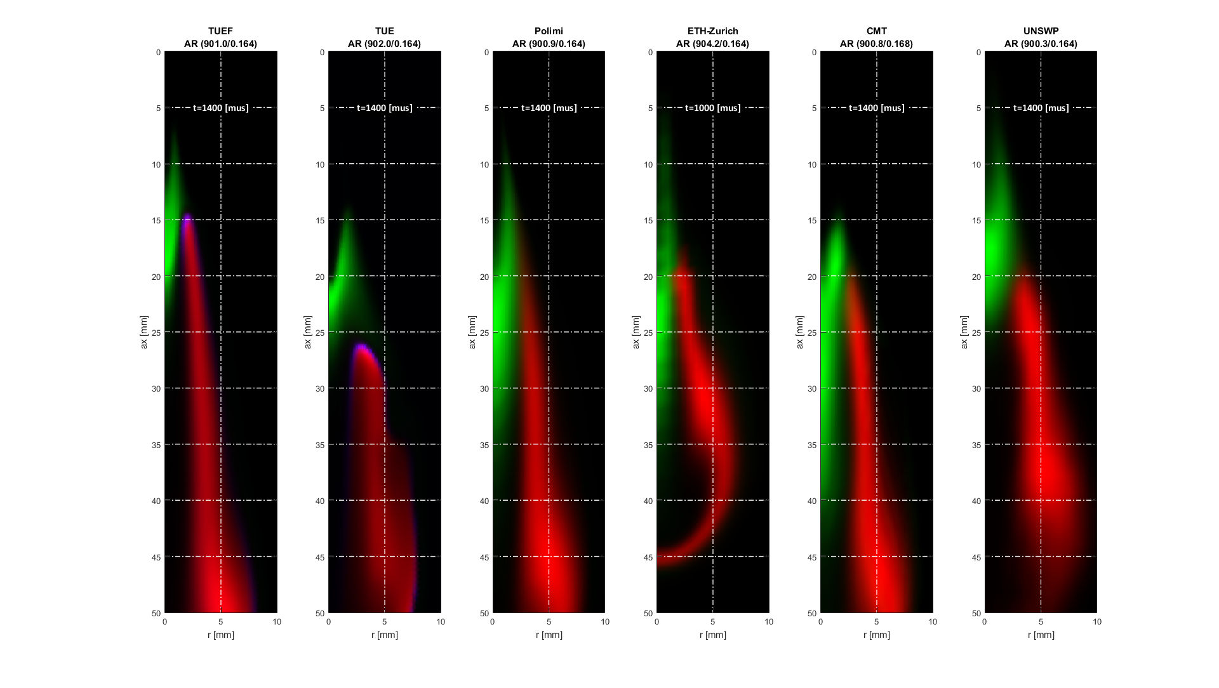
Flame structure
  Early stages clear differences (AR)
OH
CH₂O
OH*
ECN4 Kyoto 2015/Flame Structure

Slide 24
DIESEL COMBUSTION MODELLING
ECN1
SA/SH
ECN2
SA/ SH
ECN3
SA
SA
First modelling comparison (inert)
Detailed comparison of ID/LOL with different mechs/TCI
ECN4
Flame structure analysis
Detailed comparison
ID/LOL/FP/ HRR/ LIF
Detailed comparison Flow+ID
SB engines
Flame structure vs LIF
ECN5
  Improved mechanism
  SA Detailed analysis from SOC till EOI

Slide 25
DIESEL COMBUSTION AGENDA
Summary of ECN 5 plans
  Experiments
    Enlarged SC/SD experiment database
    Detailed SA ignition experiments
  Modelling
    Improved mechanism
    SA Detailed analysis from SOC till EOI

Slide 26
DIESEL COMBUSTION AGENDA
13:00-13:10 DIESEL COMBUSTION TOPICS INTRODUCTION,
Jose Garcia-Oliver (CMT)
13:10-13:40 SPRAY C & D EXPERIMENTAL SUMMARY
Jose Garcia-Oliver (CMT)
13:40-14:20 IGNITION CHEMISTRY
Evatt Hawkes (UNSW)
14:20 15:00 IGNITION PROGRESSION TO LIFT-OFF STABILIZATION AND COMBUSTION RECESSION
Bart Somers (TU/e)
15:30-16:30 SOOT
Noud Maes (TU/e), Scott Skeen (Sandia)
16:30-16:50 SPRAY B: TEST RIGS VERSUS ENGINES
Louis-Marie Malbec (IFPEN)
17:00-17:30 FUTURE DIRECTIONS FOR DIESEL COMBUSTION TOPICS

