Slide 1
Topic 1 – Internal nozzle (Spray D)
Detroit, March 31st, 2017
Presenter: Marco Arienti, Sandia National Laboratories
Contributors:
Michele Battistoni, University of Perugia;
Marco Arienti, Sandia National Laboratories

Slide 2
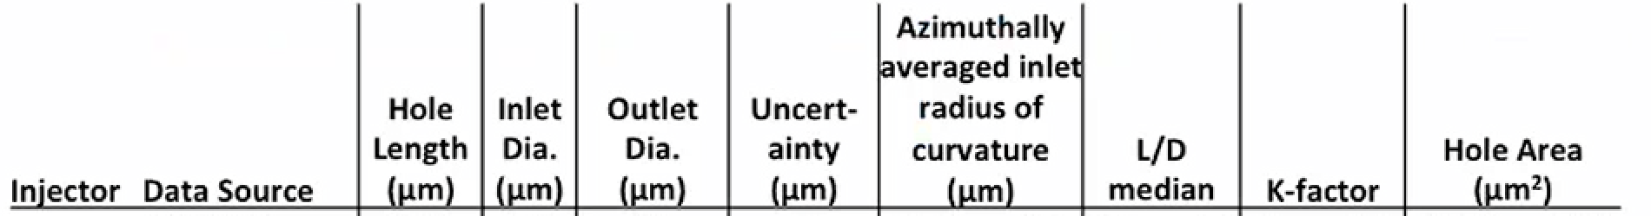
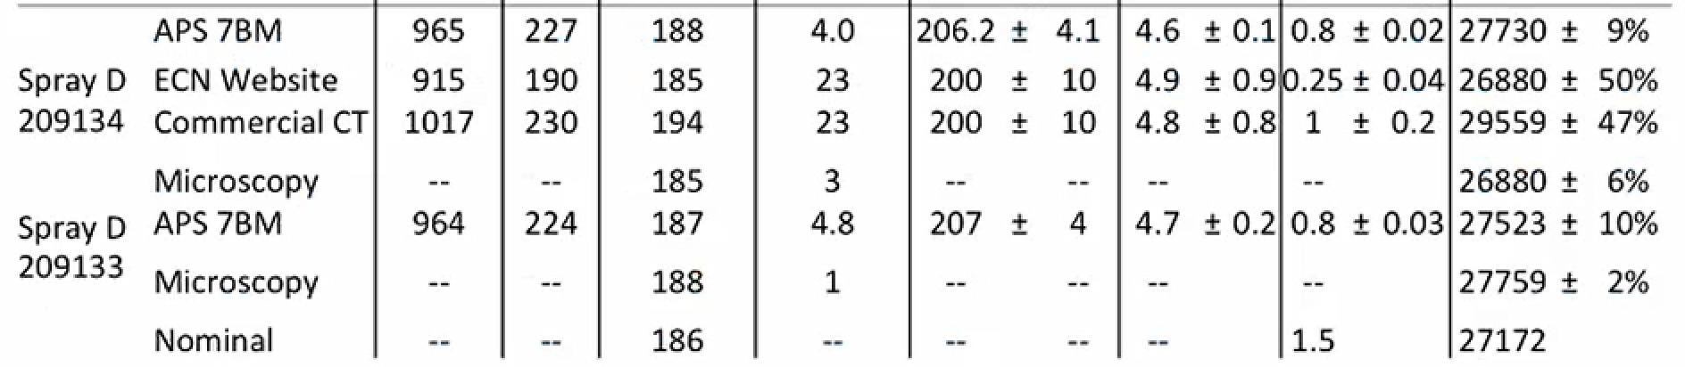
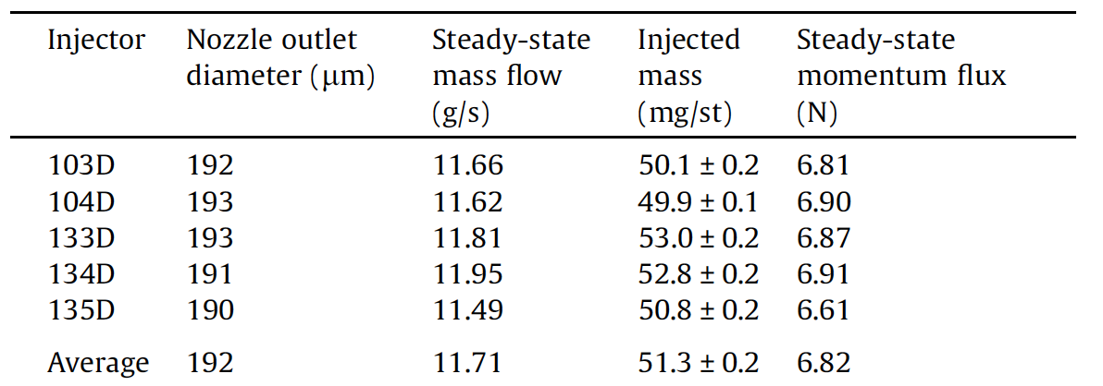
Effort to pin down the exact spray D diameter
D. Duke, ECN webex(2016)
Payri et al., Fuel 180 (2016)
ECN 5 Topic 1 – Internal Nozzle flow - Detroit, March 31st, 2017

Slide 3
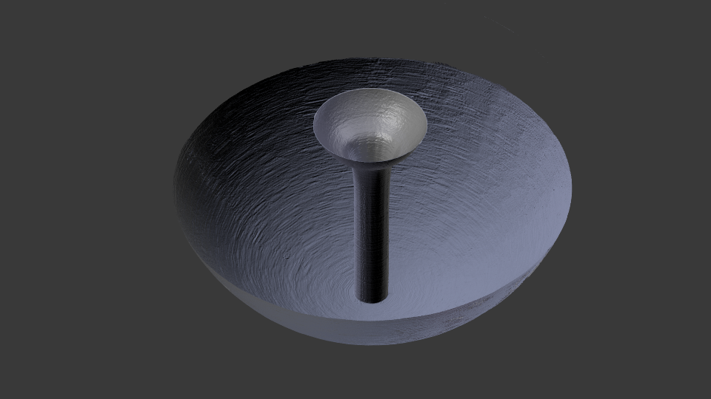
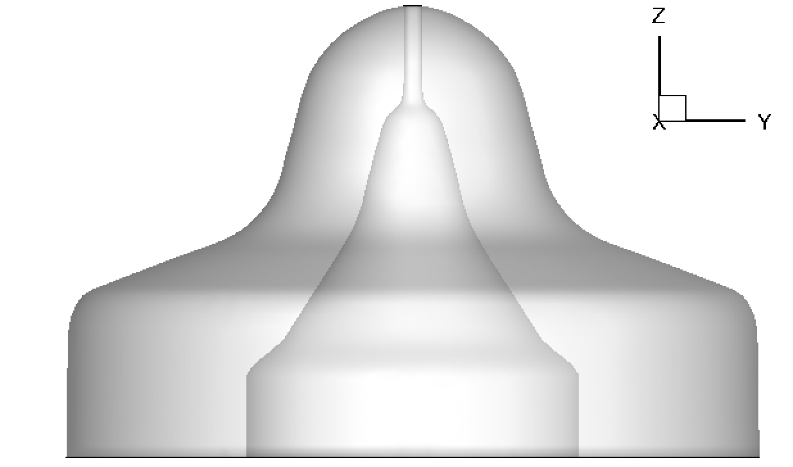
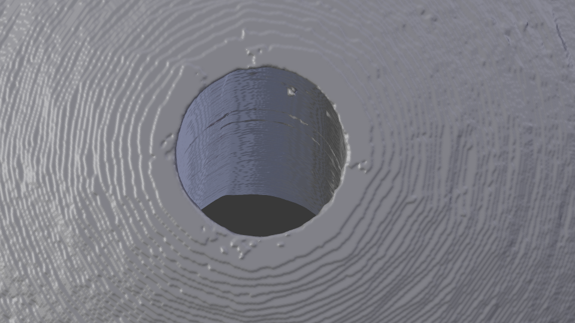
New high-resolution scan by ANL
“SprayD_134_isosurface_smoothed.stl” – 750 Mb
RemeshedLowCount.stl – 11.3MB
(SNL)
surfD_134.stl – 65 MB
(UPG)
Axis-symmetric wireframe
from ECN 4
ECN 5 Topic 1 – Internal Nozzle flow - Detroit, March 31st, 2017

Slide 4
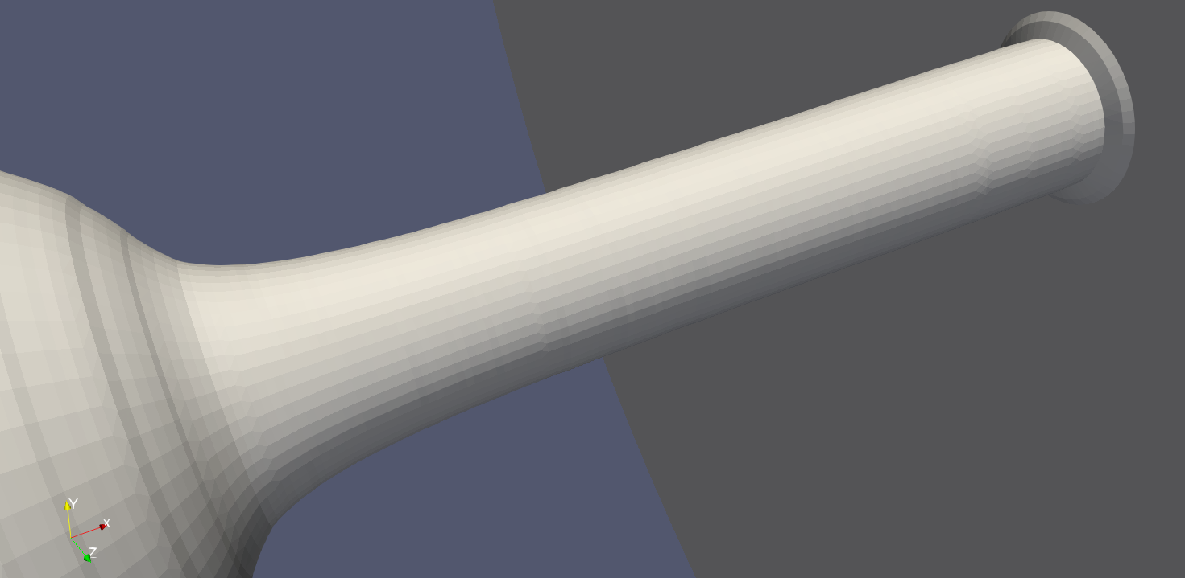
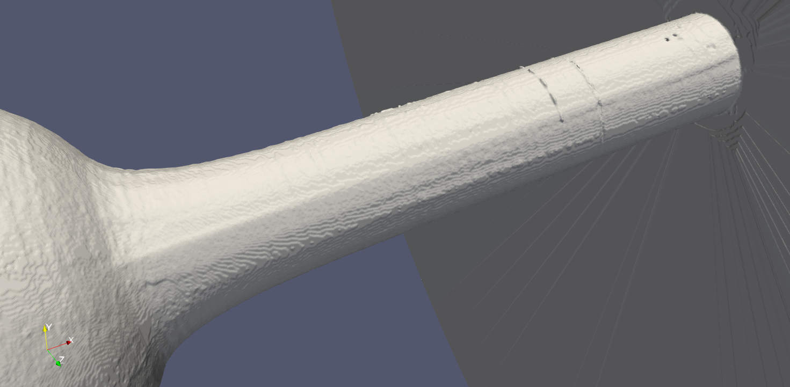
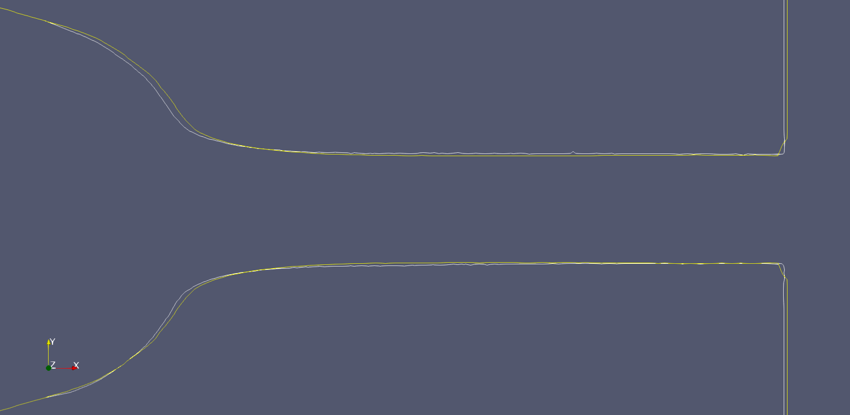
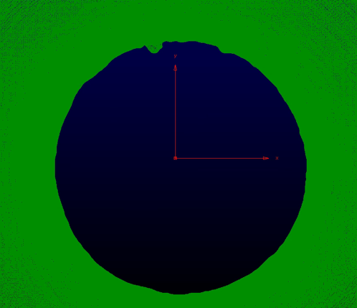
Earlier and new scans spray D
Axis-symmetric model (ECN 4): 5.05 μm/pixel
Surface from high res. scan of (ECN 5):
1.17 μm/pixel
Orifice exit view
axisymmetric model (ECN 4)
ECN 5 Topic 1 – Internal Nozzle flow - Detroit, March 31st, 2017

Slide 5
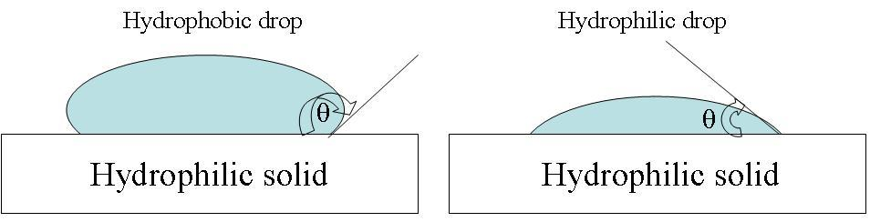
Five available simulations for # 134
Simulation | UPG-ECN4 | UPG-std | UPG-cold | SNL-26deg⁽⁺⁾ | SNL-90deg
Injector model | wireframe description | surfD_134.stl (65 MB) | surfD_134.stl (65 MB) | RemeshedLowCount (11.3MB) | RemeshedLowCount (11.3MB)
Inlet pressure | 1500 bar | 1500 bar | 1500 bar | 1500 bar | 1500 bar
Fuel temperature outlet pressure | 363K 60 bar | 363K 60 bar | 338K 20 bar | 338K 20 bar | 338K 20 bar
(+)
ECN 5 Topic 1 – Internal Nozzle flow - Detroit, March 31st, 2017

Slide 6
Model description
Institution/Group | approach | CFD code | Compressibility and EOS | Cavitation | Turbulence model
U. di Perugia, Michele Battistoni | Single-fluid LES | CONVERGE | barotropic liquid RK EOS gas | Yes | LES – Dynamic Structure
SANDIA, Marco Arienti | DNS | CLSVOF | Calibrated Tait EOS for liquid phase; Ideal gas EOS | No | No model
Institution/Group | Cell type | Total cell count | Spatial discretization | Temporal discretization
U. di Perugia, Michele Battistoni | Hex | 50 M | 2nd order CD for all, except turbulence | 1st Euler
SANDIA, Marco Arienti | Cartesian blocks with embedded boundaries | 625 M | 2nd order upwind (reverts to 1st order near sharp interface) | 1st Euler Δt ~ 1.2 ns

Slide 7
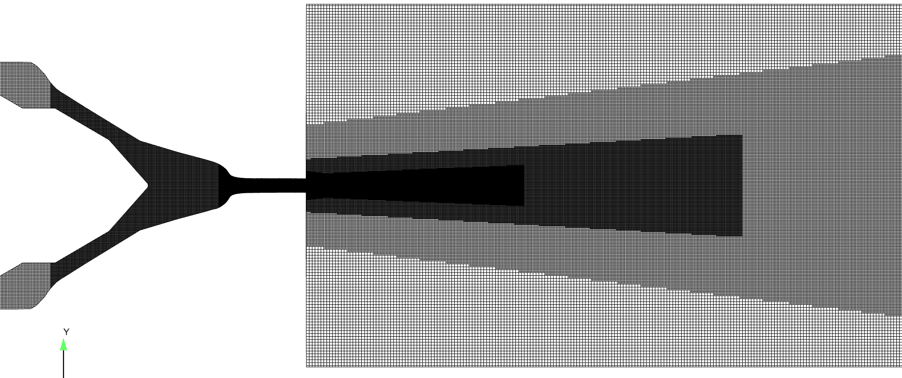
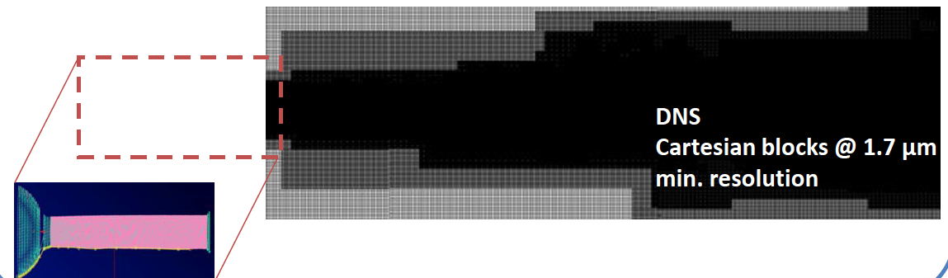
Model description
Institution/Group | min-max mesh resolution (within the 0-10 mm range) | Needle motion | Internal nozzle included | Solid wall
U. di Perugia, Michele Battistoni | 2.5 μm – 10 μm | Fixed – high lift | Modeled seamlessly | Boundary fitted
SANDIA, Marco Arienti | 1.7 μm – 14 μm | Fixed – high lift | Modeled seamlessly | Embedded boundary

Slide 8
Results for spray D
Simulation | UPG-ECN4 | UPG-std | UPG-cold | SNL-26deg | SNL-90deg
Injector model | wireframe description | surfD_134.stl (65 MB) | surfD_134.stl (65 MB) | RemeshedLowCount (11.3MB) | RemeshedLowCount (11.3MB)
Inlet pressure | 1500 bar | 1500 bar | 1500 bar | 1500 bar | 1500 bar
Fuel temperature outlet pressure | 363K 60 bar | 363K 60 bar | 338K 20 bar | 338K 20 bar | 338K 20 bar
STL outlet D* [μm] | 185.2 | 188 | 188 | 189.5 | 189.5
D_eff [μm] | 183.6 | 186 | 186 | 189.7 | 189.7
mass_flux* [g/s] | 10.9 | 11.35 | 11.54 | 11.59±0.31 (std.) | ----
mom_flux* [N] | 6.413 | 6.656 | 6.754 | 6.87±0.36 (std.) | ----
(*) Measured values (Fuel 180 (2016) 357–366): 191 μm
11.95 g/s,
6.91 N
ECN 5 Topic 1 – Internal Nozzle flow - Detroit, March 31st, 2017

Slide 9
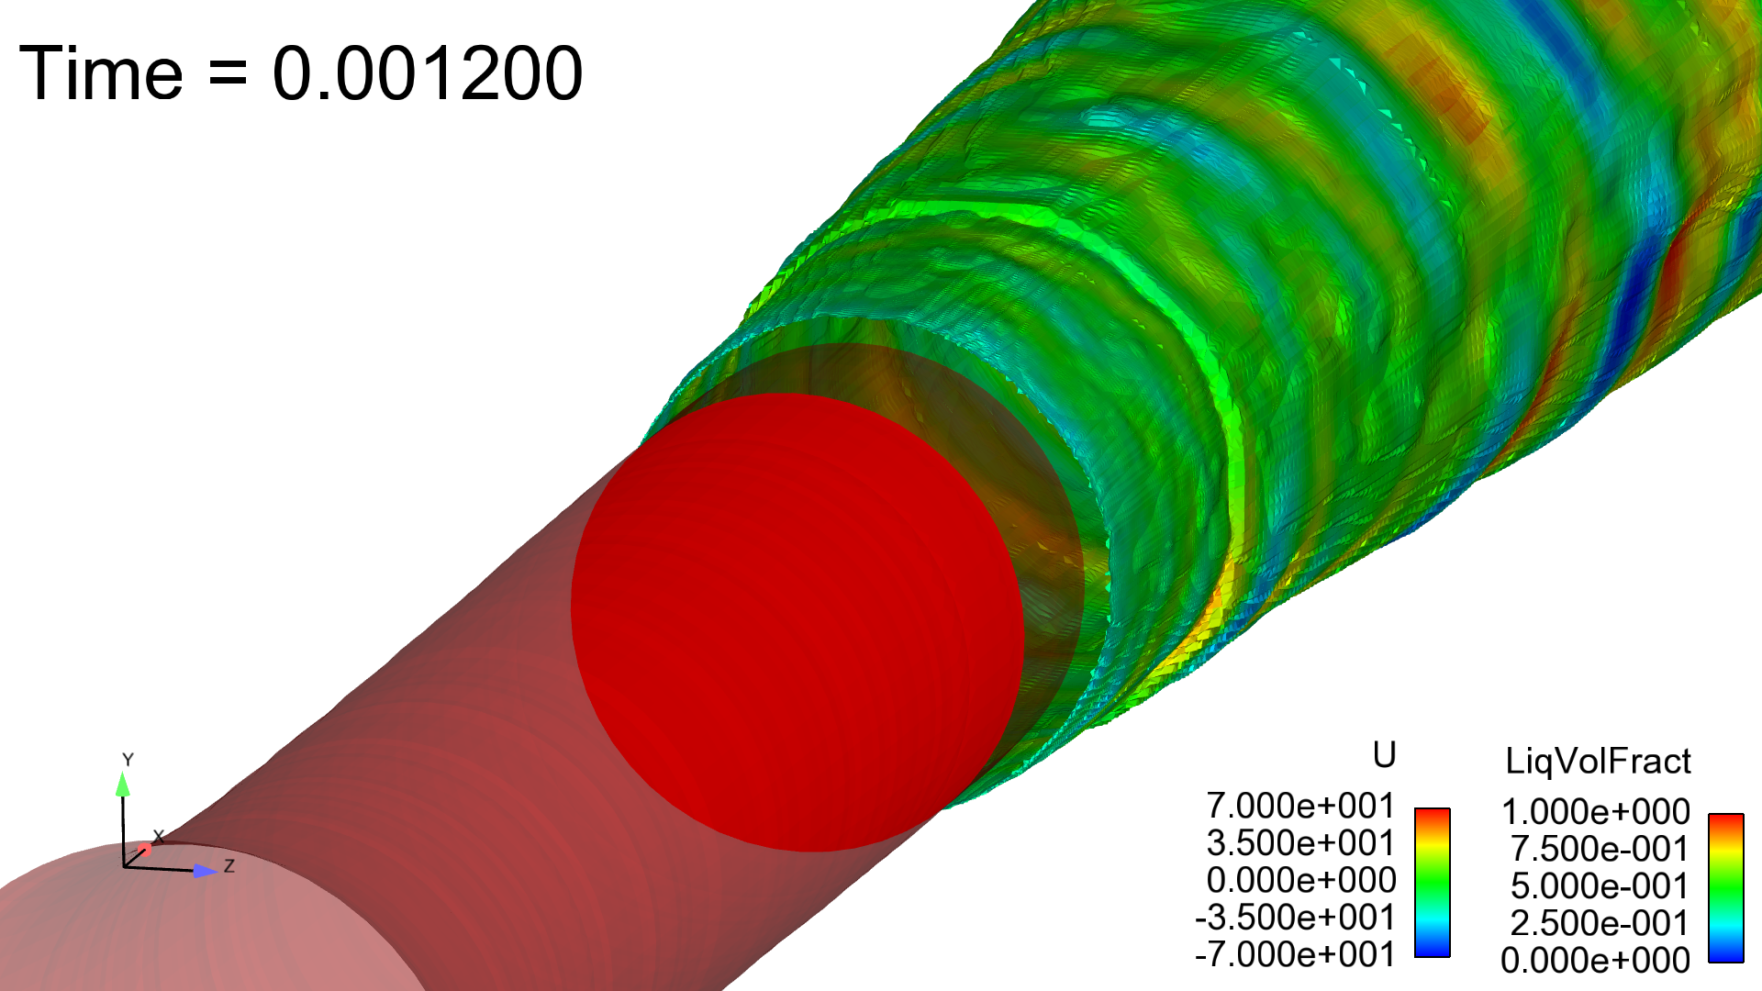
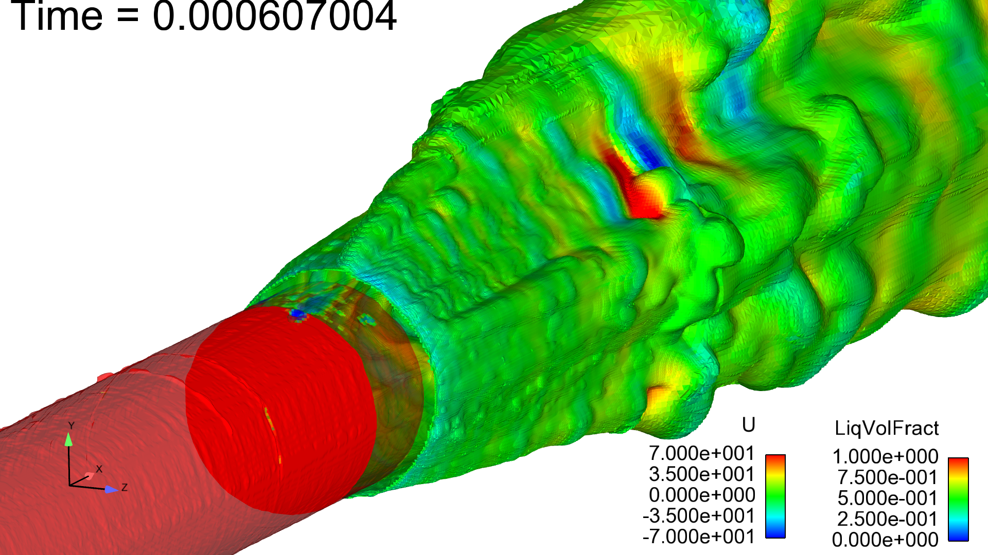
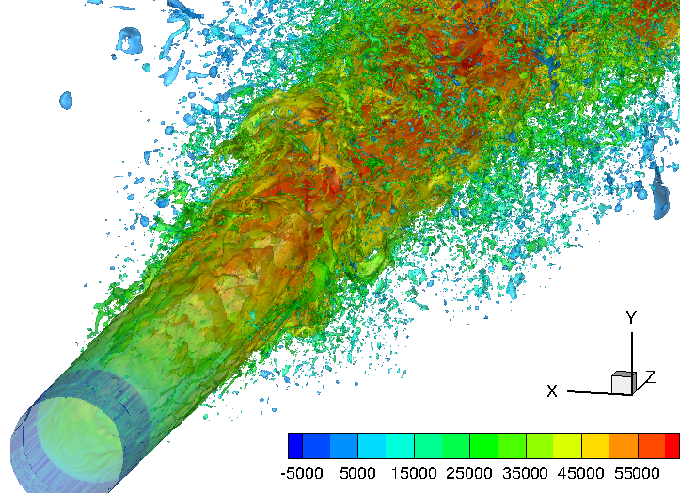
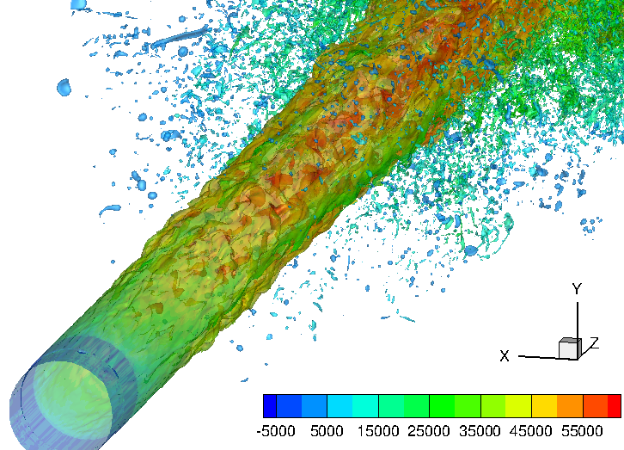
Visual appearance of the jet
UPG-CONVERGE
std. (ECN4)
Smooth interface
UPG-CONVERGE-std. (ECN5)
Caused by cavitation
LVF=0.01 and
colored by the
axial velocity U
SNL-cold
26 deg.
SNL-cold
90 deg.
-50 50 150 250 350 450 550 650 [m/s]
-50 50 150 250 350 450 550 650 [m/s]
ECN 5 Topic 1 – Internal Nozzle flow - Detroit, March 31st, 2017

Slide 10
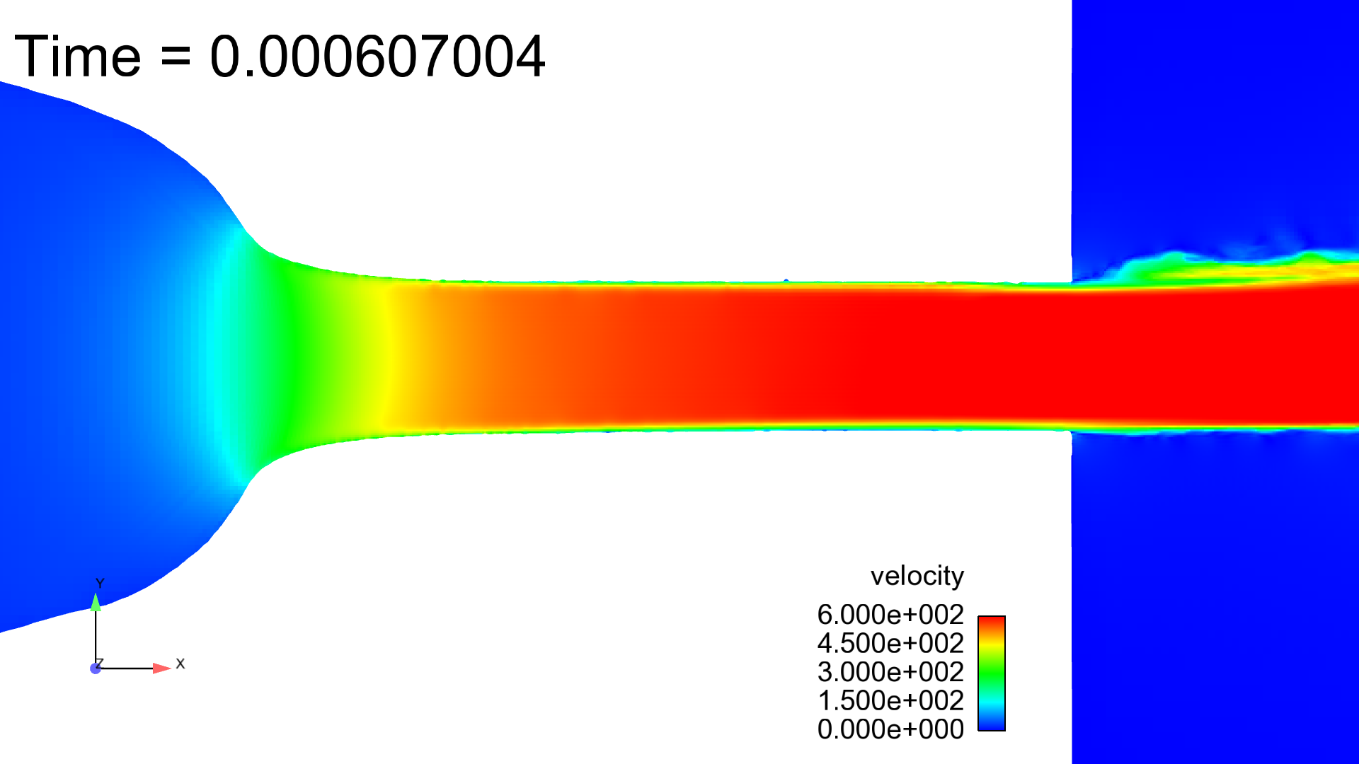
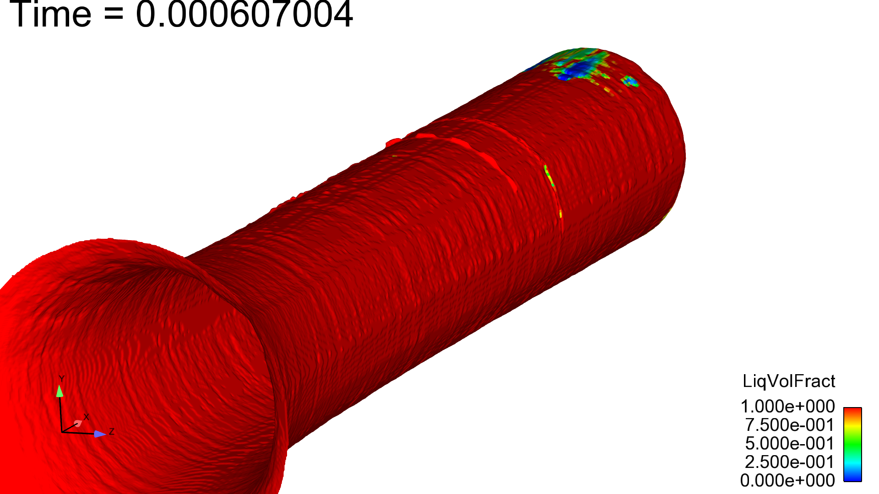
Are there real geometry effects on the jet?
From UPG-CONVERGE-std. (ECN5)
Small “bumps” along the orifice
Occurrence of cavitation
LVF=0.01 and
colored by the
axial velocity U

Slide 11
Axial variation of velocity and pressure
Axial velocity [m/s]
Pressure [Pa]
Recompression in
the sac
ECN 5 Topic 1 – Internal Nozzle flow - Detroit, March 31st, 2017

Slide 12
Axial variation along the orifice
Temperature [K]
Viscosity [Pa s]
Effects of smother inner wall?
ECN 5 Topic 1 – Internal Nozzle flow - Detroit, March 31st, 2017

Slide 13
Radial axial velocity at -1 mm
The sharper axial velocity profile can be attributed to the LES model adopted by UPG
But the SNL – 90 deg. simulation has probably not reached steady state

Slide 14
Summary
Progress in scanning techniques is revealing more and more details of the inner surface of the injector
The size of the injector’s scan files still require engineering judgment to be handled in a feasible simulation. Which features need to be retained?
The actual exit diameter (and departures from nominal geometry) need to be known accurately
Bumps or crevices in the orifice may affect cavitation (more with spray C)
It is unclear how wall surface roughness affects turbulent viscosity & cavitation inception in actual simulations

