Slide 1
ECN5
Spray G Lagrangian Modeling
Presenter:
Lyle M. Pickett*
Sandia National Laboratories
*Sponsor: DOE Office of Vehicle Technologies
Program managers: Gurpreet Singh & Leo Breton

Slide 2
Contributors
Experiment
Modeling
Argonne National Laboratory
  Radiography/tomography measurements: Daniel Duke, Chris Powell, Katie Matusik, Alan Kastengren
General Motors R&D
  Rate of injection &
  Droplet velocity/sizing: Scott Parrish
Delphi
  Patternation: Lee Markle
Sandia National Laboratories
  High-speed PIV gas-phase velocity: Panos Sphicas (visiting from Imperial College), Scott Skeen, Lyle Pickett, Jonathan Frank
Argonne National Lab. (ANL)
  LES & RANS simulation, CONVERGE: Kaushik Saha, Sibendu Som
Politecnico di Milano (PoliMi)
  RANS simulation, Open-FOAM: Tommaso Lucchini, David Sinoir, Davide Paredi, Gianluca d’Errico
KAUST-Hong G. Im, F. E. Hernandez Perez
Wisconsin - Chris Rutland, Hongjiang Li
AramCo - Jihad A. Badra, Jaeheon Sim
  LES simulation, Open-FOAM
ETH-Zurich
  LES simulation, CD-Adapco: Lucas Zeugin, Yuri Wright

Slide 3
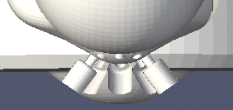
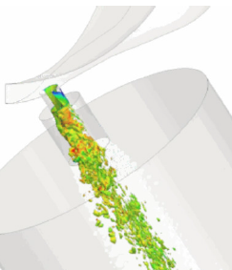
Modeling Spray G via Lagrangian particle tracking is complex/difficult
VOF simulation of internal flow
37° Drill Angle
Plume direction
Full outer spray half angle
~33°
37° drill angle
Plume cone
angle
Major “knobs” of adjustment
  “Plume direction” angle relative to injector
  Individual plume “cone angle”
ECN4: courtesy Bizhan Befrui, Delphi

Slide 4
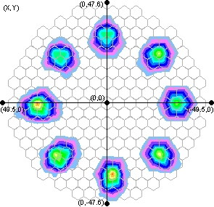
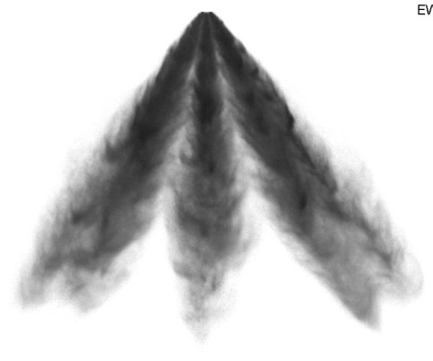
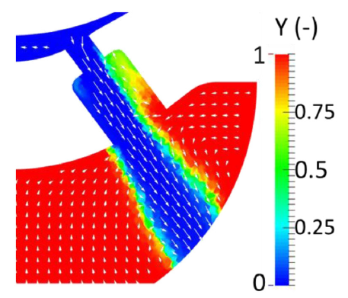
Could/should we use simple measurements to specify plume direction and cone angle?
Delphi patternation at 1 atm:
z = 50 mm, R_{plume}= 33.2 mm
plume direction angle = 33°
plume cone angle, 90% mass = 17°
Plume vector redirection caused by BOTH internal flow and downstream fluid mechanics—patternation experiment at 1 atm not independent of aerodynamics
Plume direction and cone angle depend upon operating conditions
Emerging plume changes direction throughout injection
ECN4: UMass/GM

Slide 5
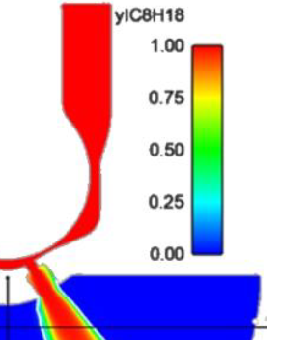
Other challenging ways to get plume cone angle for Lagrangian simulations
Measure it using x-ray radiography
Model it using Eulerian-Eulerian internal flow
Argonne radiography
kg fuel / m³
Simulations at counterbore exit
Argonne, Saha et al. SAE 2017-01-0834
Liquid vol
fraction
Notes:
Copied top from ECN4 presentation. Bottom images straight out of SAE paper

Slide 6
Simulation contributions for ECN5
 | Polimi RANS | Argonne RANS | Argonne LES | KAUST-Aramco-UW LES | ETH-Zurich LES
Domain Dimensions | 169 x 248 mm | 108 x 108 mm | 108 x 108 mm | 100 x 60 x 60mm | 100 x 100 x 100mm
Base Cell Size | 4 mm | 1 mm | 1 mm | 1 mm | 2 mm
Min Cell Size | 1 mm | 0.125 mm | 0.125 mm | 0.5 mm | 0.125 mm
Nozzle tip included | No | No, Yes for one-way | No, Yes for one-way | Yes | Yes
Radial position of droplet parcel | 0.5 mm | 0.79 mm | 0.79 mm | 0.79 mm | 0.79 mm
Adaptive or Static Refinement | Adaptive | Both | Both | Both | Static
Cell Type | Cartesian & oriented | Cartesian cut-cell | Cartesian cut-cell | Cartesian | Cartesian
Total/Maximum Cell Count | 115,000 | 14 million | 14 million @ 1ms; 20 million @ 2ms | 2.2 million | 3.5 million
Number of spray parcels | 20k per plume | 400k per plume | 200k per plume | 200k per plume | 500K per plume
CPU cost | 1 realization 3 processors 40 minutes for 2 ms 2 CPU hrs for 2 ms | ? | 5 realizations 36 processors 10 hours for 1 ms 3600 CPU hrs for 2 ms | 5 realizations 32 processors 10 hours for 2 ms 1800 CPU hrs for 2 ms | 1 realization 96 processors 5 hours for 2 ms 480 CPU hrs for 2 ms
Can less-expensive simulations be used to define bc’s used later for more expensive simulations?

Slide 7
Summary of models and setup
 | Polimi RANS | Argonne RANS | Argonne LES | KAUST-UW-Aramco LES | ETH-Zurich LES
CFD Code | OpenFOAM + Lib-ICE | CONVERGE | CONVERGE | OpenFOAM | Star-CD
Turbulence Model | Standard k-ε | Standard k-ε | LES – dynamic structure | LES dynamic structure with spray source/sink | LES – sub-grid k model
Injection Model | Lagrangian/Huh | Lagrangian/Blob | Lagrangian/Blob | Lagrangian/Blob | Lagrangian/Blob
Primary Break-up Model | Huh-Gosman | Kelvin-Helmholtz (KH) | Kelvin-Helmholtz (KH) | KH (Cb = 1.0, B1= 35) | Kelvin-Helmholtz (KH)
Secondary Break-up | Kelvin Helmholtz (KH) + Rayleigh Taylor (RT) | Rayleigh-Taylor (RT) | Rayleigh-Taylor (RT) | KH/RT competing | Rayleigh-Taylor (RT)
Vaporization | Spalding Number-based (mass-based) |  | Frössling | Frössling | Spalding Number-based (mass-based)
Heat Transfer | Ranz-Marshall |  | O’Rourke | Ranz-Marshall | Ranz-Marshall
Collision | None |  | NTC | None | O’Rourke
Droplet Drag | Dynamic without spherical correction |  | Dynamic | Dynamic without spherical correction | Standard
Initial gas turbulence | u’ = 1 m/s; Li = 2 mm |  | TKE=1.0; EPS=100.0 | TKE=7.9e-3 (35° PD) TKE = 1.6e-4(40° PD) | TKE=7.9e-3
Plume direction | 34°, 37° |  | 35° | 35°, 40° | 33°
Plume cone angle | Calculated from Huh-Gosman as 9° | 25°- 40°, “one-way” | 25°- 40°, “one-way” | 25°, 30°, 35°, 40° | 17°

Slide 8
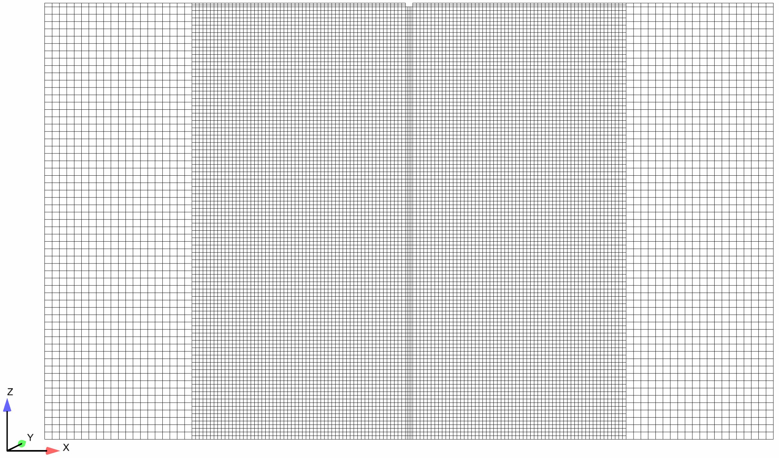
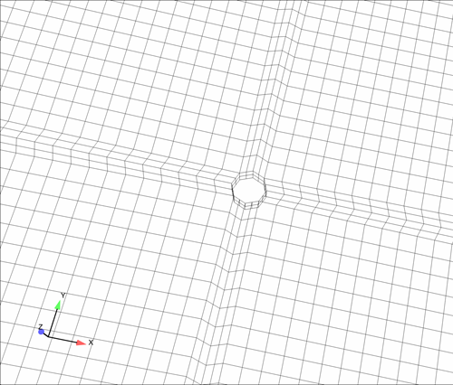
Simulation Setup – KAUST-UW-Aramco Group
CFD platform | Modified OpenFOAM 2.3.x
Fluid solver | sprayFoam (PISO algorithm)
Turbulence model | LES dynamic structure with spray source/sink term
Mesh | 2,111,968 Hexahedron cells (Static mesh refinement)
Typical CPU time | 10 hours using 32 processors
Nozzle cutout
Cross-section: Octagon
60 mm
∆ = 1.0 mm
60 mm
∆ = 0.5 mm
100 mm
The nozzle cutout is able to prevent gas flow entering the middle of spray from above the nozzle exit locations (N.E. Van Dam, Ph.D. Dissertation, University of Wisconsin-Madison, 2015)

Slide 9
Simulation Setup – KAUST-UW-Aramco Group
Injection model | Lagrangian/Blob
Primary breakup | KH (Cb = 1.0, B1= 35)
Secondary breakup | KH/RT competing with each other
Vaporization | Frössling
Heat transfer | Ranz-Marshall
Collision | None
Droplet drag | Dynamic w/o non-spherical correction
Plume direction (°) | 35, 40
Plume cone angle (°) | 25, 30, 35, 40
Number of realizations | 5 (with different random number seed)
Initial TKE (m²/s²) | 7.9E-3 (for 35° PD), 1.6E-4 (for 40° PD)
Initial velocity (m/s) | 0
Injected fuel parcels | 80, 000
Injection velocity profile | Measured ROI
Hydraulic coefficients | C_{A} = 0.69, C_{D} =0.52 (from ECN 3 Topic 3.5)

Slide 10
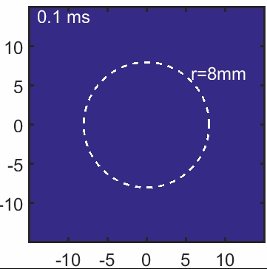
Animation of total mixture density at z=15 mm
ANL LES
35°Plume Direction / 35° Cone Angle
1 realization
KAUST-UW-AramCo LES
35°Plume Direction / 25° Cone Angle
Average of 5 realization
Multiple realizations and average of all plumes used to generate statistics for comparison
Notes:
C:\pickett\ECN\mtgs\ECN5\topics\T9sprayGevap\scripts\argonneDensity15mmVideo.m C:\pickett\ECN\mtgs\ECN5\topics\T9sprayGevap\scripts\kwaDensity15mmVideo.m

Slide 11
To qualify our CFD efforts as “predictive”, what experimental data is necessary (and available)?
Axial vapor penetration
  Schlieren measurements discussed by Daniel Vaquerizo, CMT
Axial liquid penetration
  Extinction imaging discussed by Daniel Vaquerizo, CMT
Plume liquid velocity
  Phase Doppler Interferometry measurements, Scott Parrish (GM)
Droplet size
  Phase Doppler Interferometry measurements, Scott Parrish (GM)
Gas-phase velocity between plumes
  High-speed PIV measurements discussed by Panos Sphicas (Imperial)
Plume direction and mass distribution
  X-ray radiography (z = 2,5,10 mm) as shown by Katie Matusik (ANL)
  Extinction imaging and PDI analysis
Will one simulation consistently “best match” all above?

Slide 12
Start with evaluation of centerline z=15mm axial velocity
Central recirculation zone increases with higher plume direction, but does not meet level of experiment
PoliMi RANS
Plume direction _ Cone Angle
Notes:
C:\share\Panos\Paper4-modelComparison\Tommaso\ECN5_results\extractw15.m.

Slide 13
Almost immediate positive axial velocity with increased plume cone angle
Central recirculation zone increases with higher plume direction, but does not meet level of experiment
PoliMi RANS
Plume direction _ Cone Angle
Notes:
C:\share\Panos\Paper4-modelComparison\Tommaso\ECN5_results\extractw15.m.

Slide 14
KWA LES picks up central recirculation zone and merge of jets at end of injection
35 degree plume direction
Notes:
C:\share\Panos\Paper4-modelComparison\Wisc\ECN5 Topic9 Results Submission-selected\w15plotUW.m

Slide 15
KWA LES: Larger plume direction increases recirculation velocity
40 degree plume direction
Notes:
C:\share\Panos\Paper4-modelComparison\Wisc\ECN5 Topic9 Results Submission-selected\w15plotUW.m

Slide 16
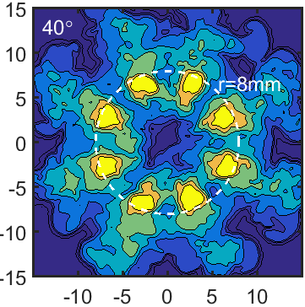
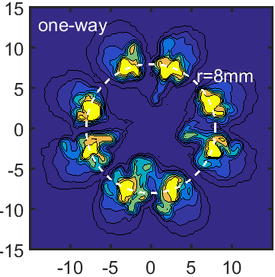
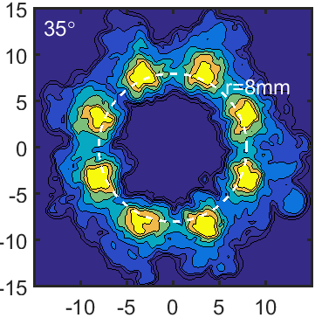
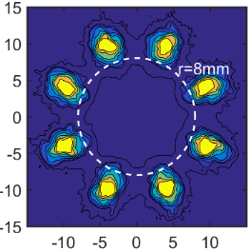
Argonne LES: experiences a toggling/collapse with increased plume cone angle
35 degree plume direction
25° cone
z=15 mm
Mixture density
Notes:
C:\share\Panos\Paper4-modelComparison\ANL\fig6_573.m

Slide 17
ETH Zurich LES shows short-circuited recirculation
Plume direction/cone angle results appear specific to each implementation
Result is for a single LES realization
33° Plume direction, 17° cone angle
Notes:
C:\share\Panos\Paper4-modelComparison\ETH\primaryViewMovie1.m

Slide 18
RANS plume cone angles become more diffuse
ANL LES
35° Plume direction,
25° cone angle
PoliMi RANS
34° Plume direction,
9° cone angle
Total mixture density
kg/m³
Notes:
Straight from paper

Slide 19
RANS with high resolution also shows diffused mixing and probably collapse
Argonne LES
35° Plume direction,
25° cone angle
Argonne RANS simulations
Saha et al. SAE 2017-01-0834
25°
30°
35°
40°
“one-way”
Notes:
Grabbed figure from SAE paper

Slide 20
Total mixture density (fuel + gas)
Argonne simulations at z = 2 mm, 25° plume cone and 35° plume direction
Dashed line is measured plume center by Argonne x-ray (2.3 mm)
kg/m3
Notes:
C:\pickett\ECN\mtgs\ECN5\topics\T9sprayGevap\scripts\mixingat2mm.m

Slide 21
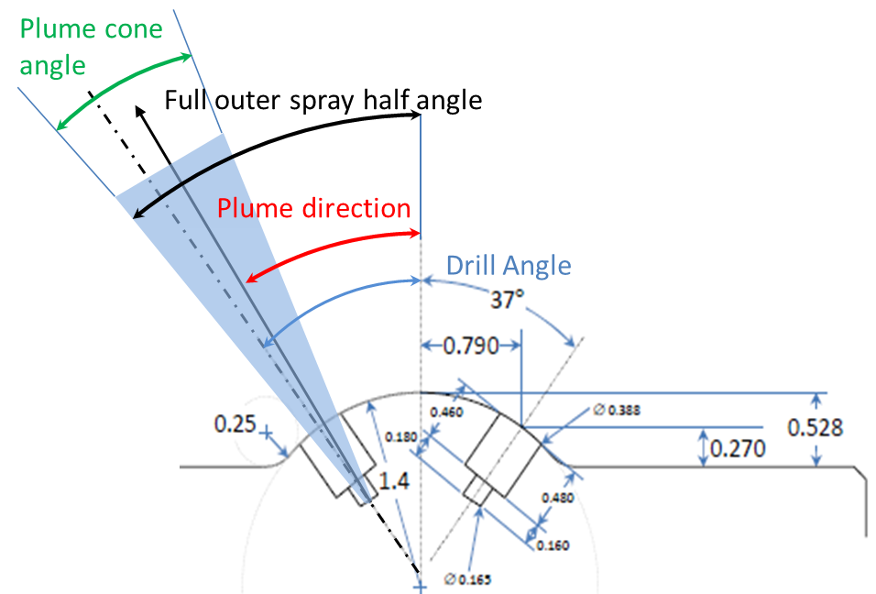
Near-nozzle geometry
Details about the nozzle tip affect simulation setup and axial datum
Notes:
C:\pickett\ECN\mtgs\ECN5\topics\T9sprayGevap\scripts\mixingat2mm.m

Slide 22
Adding axial offset reconciles the matter
Stated hole offset radius in simulation was 0.79 mm
Dashed line is assuming that Argonne used the hole exit as z = 0
Not the tip of the injector, as ECN convention
kg/m3
Notes:
C:\pickett\ECN\mtgs\ECN5\topics\T9sprayGevap\scripts\mixingat2mm.m

Slide 23
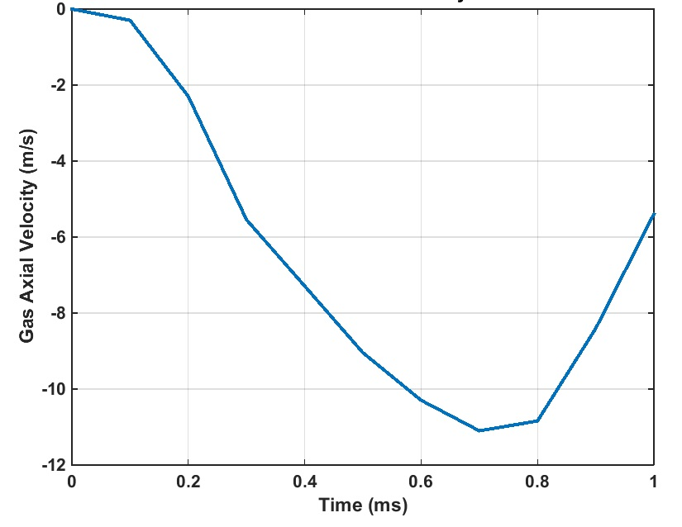
Argonne RANS shows delayed response, but more significant recirculation
Plume direction = 37°, Plume cone angle = 25°

Slide 24
Liquid/gas velocity track together for KWA, not the case for PoliMi
Notes:
C:\pickett\ECN\mtgs\ECN5\topics\T9sprayGevap\scripts\Velocity1.m

Slide 25
ANL 35/35 shows better plume dispersion, but velocity higher than measured
Notes:
C:\pickett\ECN\mtgs\ECN5\topics\T9sprayGevap\scripts\Velocity2.m

Slide 26
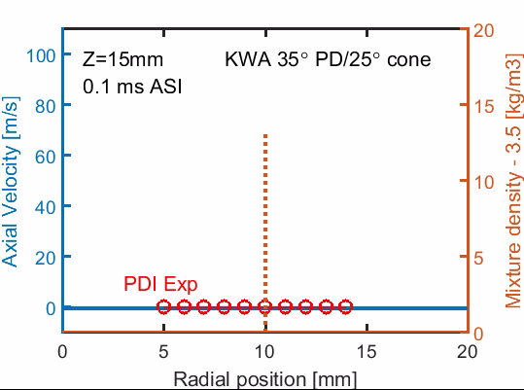
Profiles of velocity, density, mixture fraction used to identify plume center
Nice agreement with measured liquid velocity
Plume center moves towards injector axis during injection
Measured liquid PDI velocity magnitude
Notes:
C:\pickett\ECN\mtgs\ECN5\topics\T9sprayGevap\scripts\plumeMovementKW.m and C:\pickett\ECN\mtgs\ECN4\Topics\T9SprayGVessel\scripts\pdiVmag.m

Slide 27

Larger plume direction is unrealistic
Some combinations of plume direction angle and cone angle provided decent fits to centerline gas velocity or penetration, but this practice cannot be justified when considering plume center
Notes:
C:\pickett\ECN\mtgs\ECN5\topics\T9sprayGevap\scripts\plumeMovementKW40.m and

Slide 28
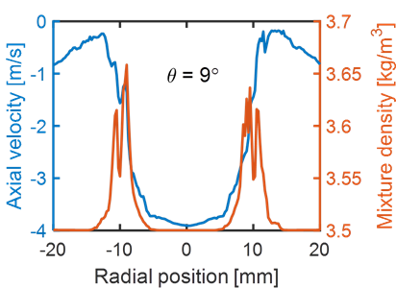
Fuel re-entrainment between neighboring plumes
Total mixture density [kg/m3]
At this 9º rotation, the axial velocity is negative, providing recirculation towards the injector.
573K and 600 µs ASI
Z = 15 mm
ANL LES, 35\25, 600 µs ASI
9°
Mixture densities are significantly greater than the ambient density at this position, indicating that fuel mass is being transported upstream and into the recirculation zones beginning near the edges of the plumes.

Slide 29
Simulated penetration scattered about experiment
Consistency when considering PIV gas-phase and PDI liquid-phase velocity (35\25)
But tuning to penetration yields a different solution (35\35 or 40\30)
Notes:
C:\pickett\ECN\mtgs\ECN5\topics\T9sprayGevap\scripts\vaporKW.m

Slide 30
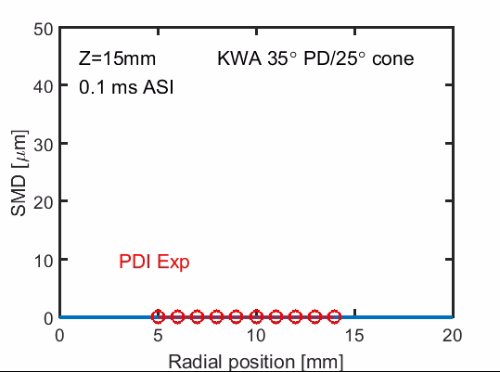
Droplet size (SMD) predictions show radial variance, while the experiment is generally flat
Experiment shows spikes in SMD at EOI—but model does not show this.
Notes:
C:\pickett\ECN\mtgs\ECN5\topics\T9sprayGevap\scripts\smdKW.m

Slide 31
Effect of ambient temperature reveals weakness in current modeling
Sphicas SAE 2017-01-0837, with LES simulations by Argonne and RANS simulations by PoliMi
Trend opposite of experiment

Slide 32
Modeling need-vaporization dynamics
Very different response to increased ambient temperature
Higher total mixture density because of vaporization cooling
ANL LES 35/25, PoliMi 34/9

Slide 33
Current weaknesses
Experiments
  Have not provided quantitative vapor/liquid in “mixed” regions
  Radiography limited to non-vaporizing conditions
CFD (Lagrangian)
  Generally, RANS simulations appear to have difficulties resolving inter-plume fluid mechanics
  Do not consider that plume direction (moving out of the nozzle) changes with time
    consider that small- and multi-injection cycles are common
  Appear to have widely varying vaporization predictions
  Do not predict large SMD at EOI

Slide 34
Overall observations
Will one simulation consistently “best match” all available experimental data?
  Sort of. Good consistency for (1) PDI liquid velocity, (2) PIV gas-phase velocity, (3) plume center identification via extinction imaging
Can I tune model for measured liquid penetration?
  No. Need more clarification about what is measured and modeled
What should I tune, plume direction or plume cone angle?
  Less plume direction, more plume cone angle
  Coupled, or one-way simulations have not shown superiority over simple cone-angle tuning to date
Can RANS or other simulation findings assist other more expensive models?
  Not yet. Plume cone seems to mean a completely different thing for each implementation

Slide 35
END

Slide 36
Analysis of #29 radiography
Also showing 34 degree plume direction
Notes:
C:\pickett\ECN\mtgs\ECN5\topics\T9sprayGevap\scripts\radiography29.m

