Slide 1
Simulations of fuel spray transients in single (spray A & C/D-like) and multi-hole (spray-B) injectors
Michele Battistoni
University of Perugia, Italy
ECN 6.13 – February 6th 2020

Slide 2
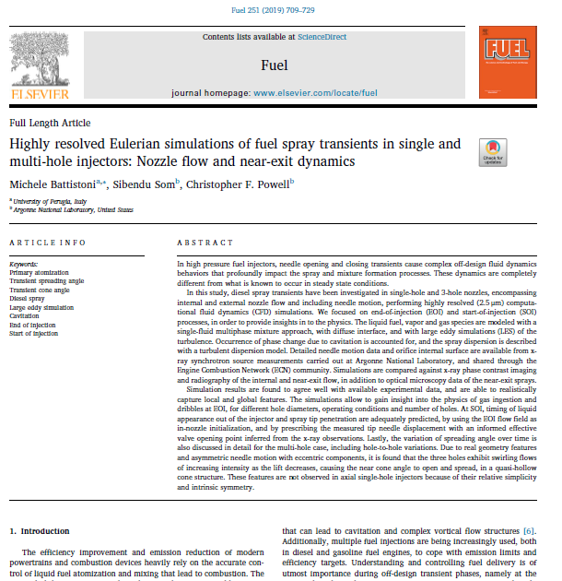

Acknowledgments
Sibendu Som,
Christopher F. Powell

Slide 3
Outline of Presentation
STL files, needle motion and meshes
Observations review regarding nozzle opening/closing
Strategies for mesh handling and sealing
SOI: Spray A opening
EOI: Spray A and D-like closing
Spray B closing and cone-angle variation

Slide 4
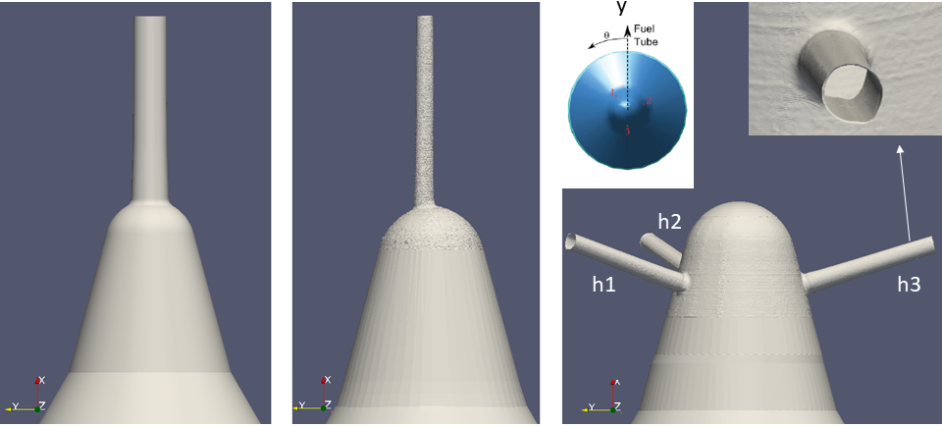
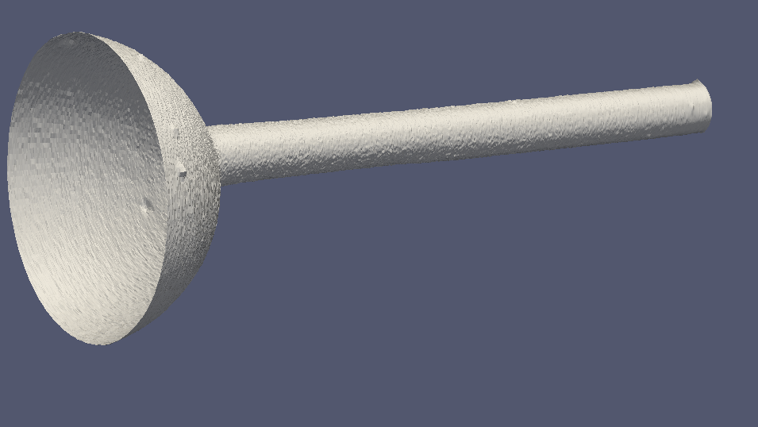
Geometries
smoothed STL files, for CFD, now available on ECN website
A
C
B
D
D-like (180 μm)

Slide 5
Simulation setup
CFD model built in CONVERGE v.2.4
Mixture model (diffuse interface): with 1 compressible (barotropic) liquid and N compressible gaseous species
HRM cavitation model (tabulated properties vs. T) + non-condensable gas
Turbulence: LES, dynamic structure (DS) model
Discretization: Space, 2nd order; Time, 1st Euler
Needle motion according to x-ray data (3 components)
300 K ambient; 343 K fuel
Surface files: smoothed STL obtained from detailed scan
Grids: min cell size = 2.5 μm (max 40 μm); cell count = 16M to 35M
Simulated physical time = up to 700 μs

Slide 6
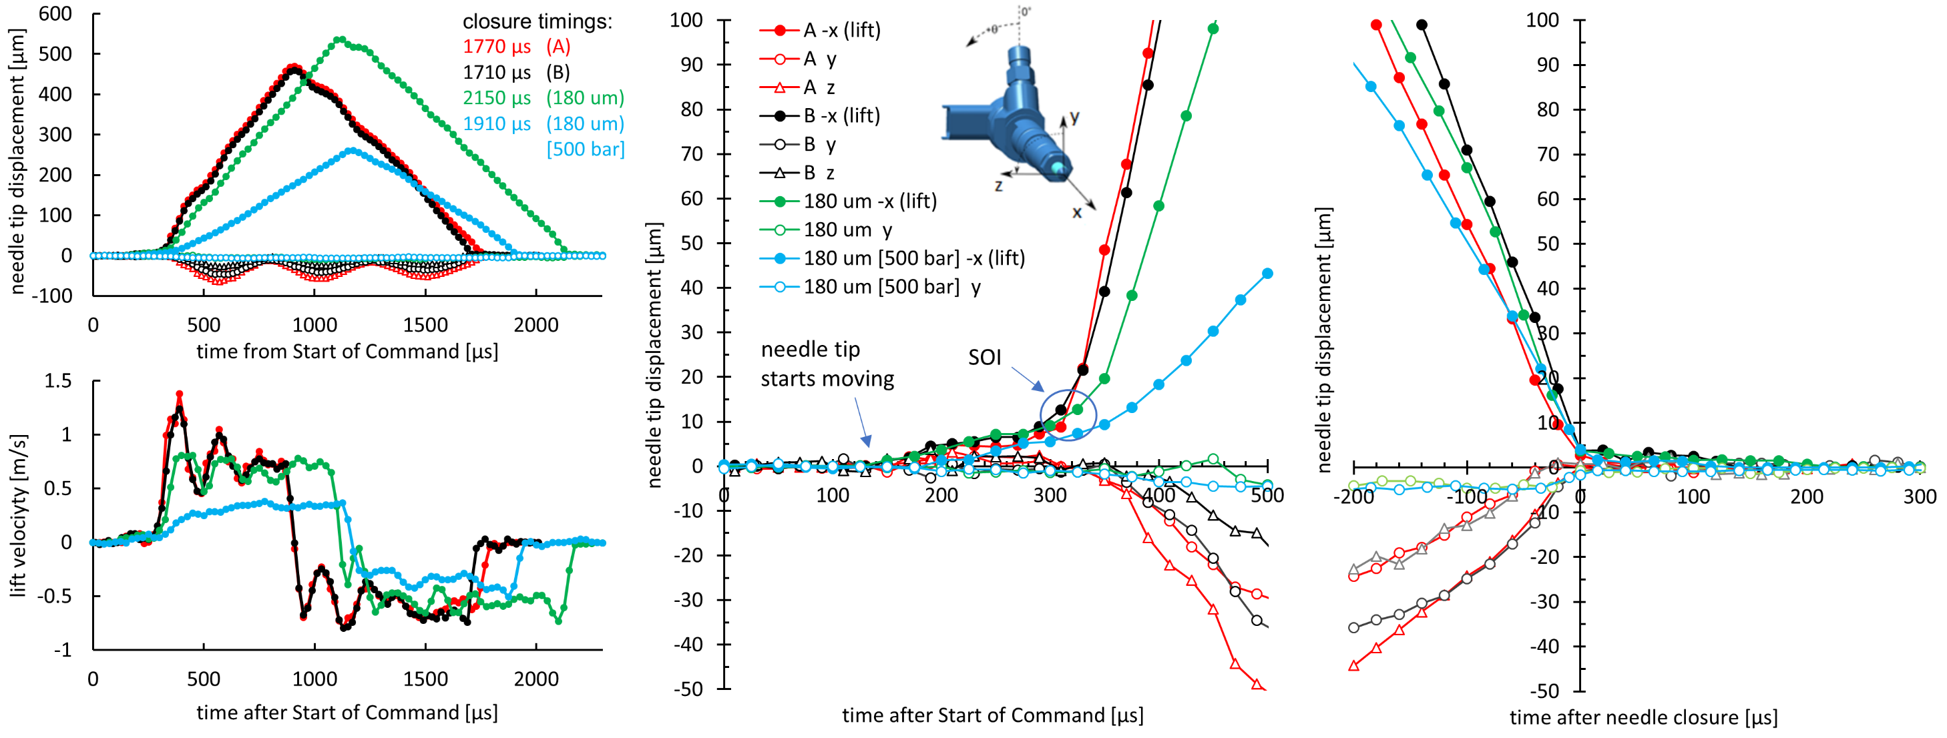
Needle tip displacements (x-ray) at low lift
observed SOI “area”

Slide 7
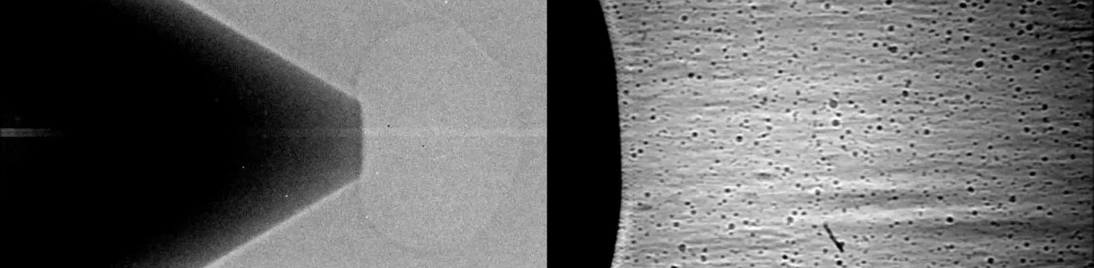
Observations on nozzle opening
D-like (150 MPa into 0.1 MPa)
Powell (ANL)
D-like (150 MPa into 0.1 MPa)
observed SOI “area”
cf. also (SNL paper)
SAE 2019-01-2279
Needle-seat elastic deformation recovery

Slide 8
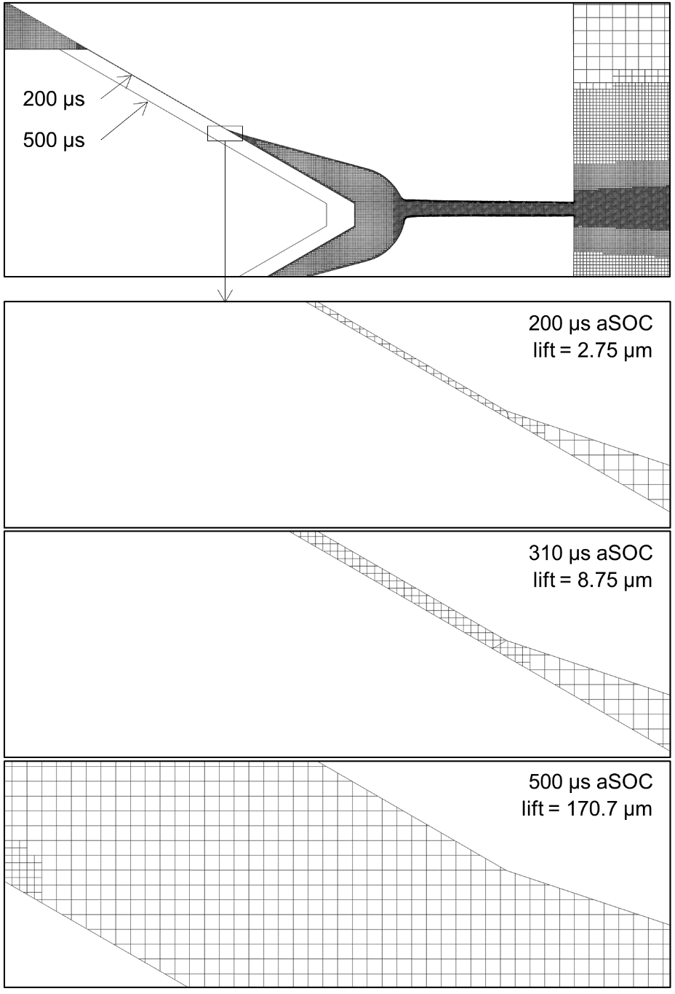
Low lift needle-seat gap mesh
  Options:
  Ignore any problems! ☺
  elasticity-corrected lift (Sandia, SAE 2019-01-2279)
  calibrated flow resistance (AVL, 2009-24-0029; UMASS, ASME FEDSM2017-69309)
  sudden opening at a given point, (informed setup, based on x-ray and lift), but needle also moves below the opening height (so that suction effect can be reproduced)
gap is closed
Flow areas and corresponding needle lifts required to equal hole flow areas.
injector | holes area | seat minimum diameter and inclination | Needle lift of minimum seat-flow area equal to holes area
A | 0.0063 mm² | 1.075 mm × 30° | 4 μm
B | 0.0199 mm² | 1.075 mm × 30° | 12 μm
180 μm | 0.0254 mm² | 0.885 mm × 30° | 18 μm
open
Note that at those lifts, the hydraulic diameter (D_{h}) of the seat-gap is much smaller than the hole D_{h} though
Notes:
This has a drawback: the needle-seat area at that given time is quite high compared to the hole area, however, we note that …

Slide 9
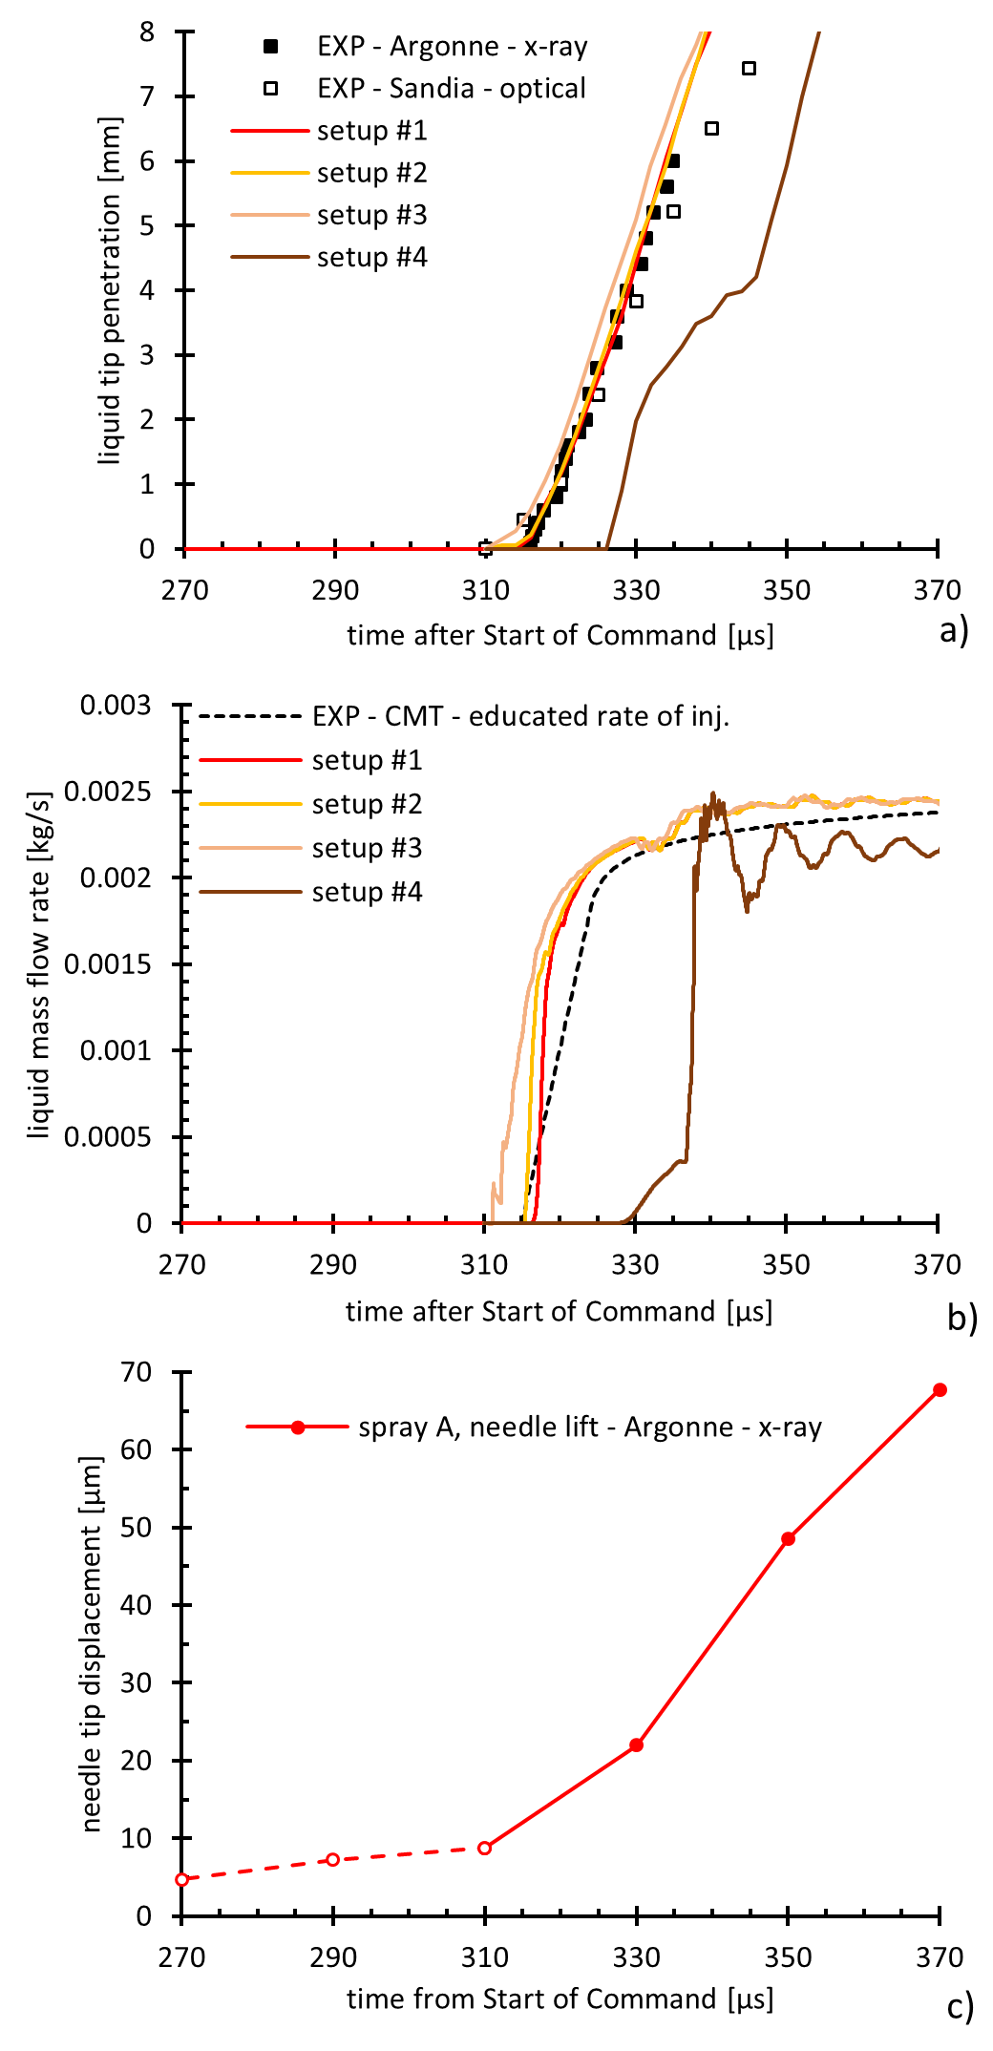
Spray A SOI simulations
From ANL x-ray penetration, SOI is at ~310 μs (Kastengren, A&S, 2012)
Virtual ROI (CMT) and Sandia optical penetration are “positioned” accordingly
Setup #1: flow variables mapped from EOI calculation, simulation starts at 200 μs, valve is initially closed and opens at 310 μs.
Setup #2: like previous, but simulation starts directly at 310 μs.
Setup #3: nozzle full of liquid fuel, simulation starts directly at 310 μs.
Setup #4: nozzle full of residual gas, simulation starts directly at 310 μs.
So, setup #1:
performs adequately “well”
still overpredicts the flow rate ramp wrt virtual ROI
does not show oscillations (are these real?) in the flow rate
predicts suction (gas ingestion), cf. next slide
Combining this with elasticity effects and accurate flow resistance models should further improve ROI and penetration predictions (future work --> ECN7)
Notes:
Combining this with elasticity effects and accurate flow resistance models should further improve ROI and penetration predictions (future work --> ECN7)

Slide 10
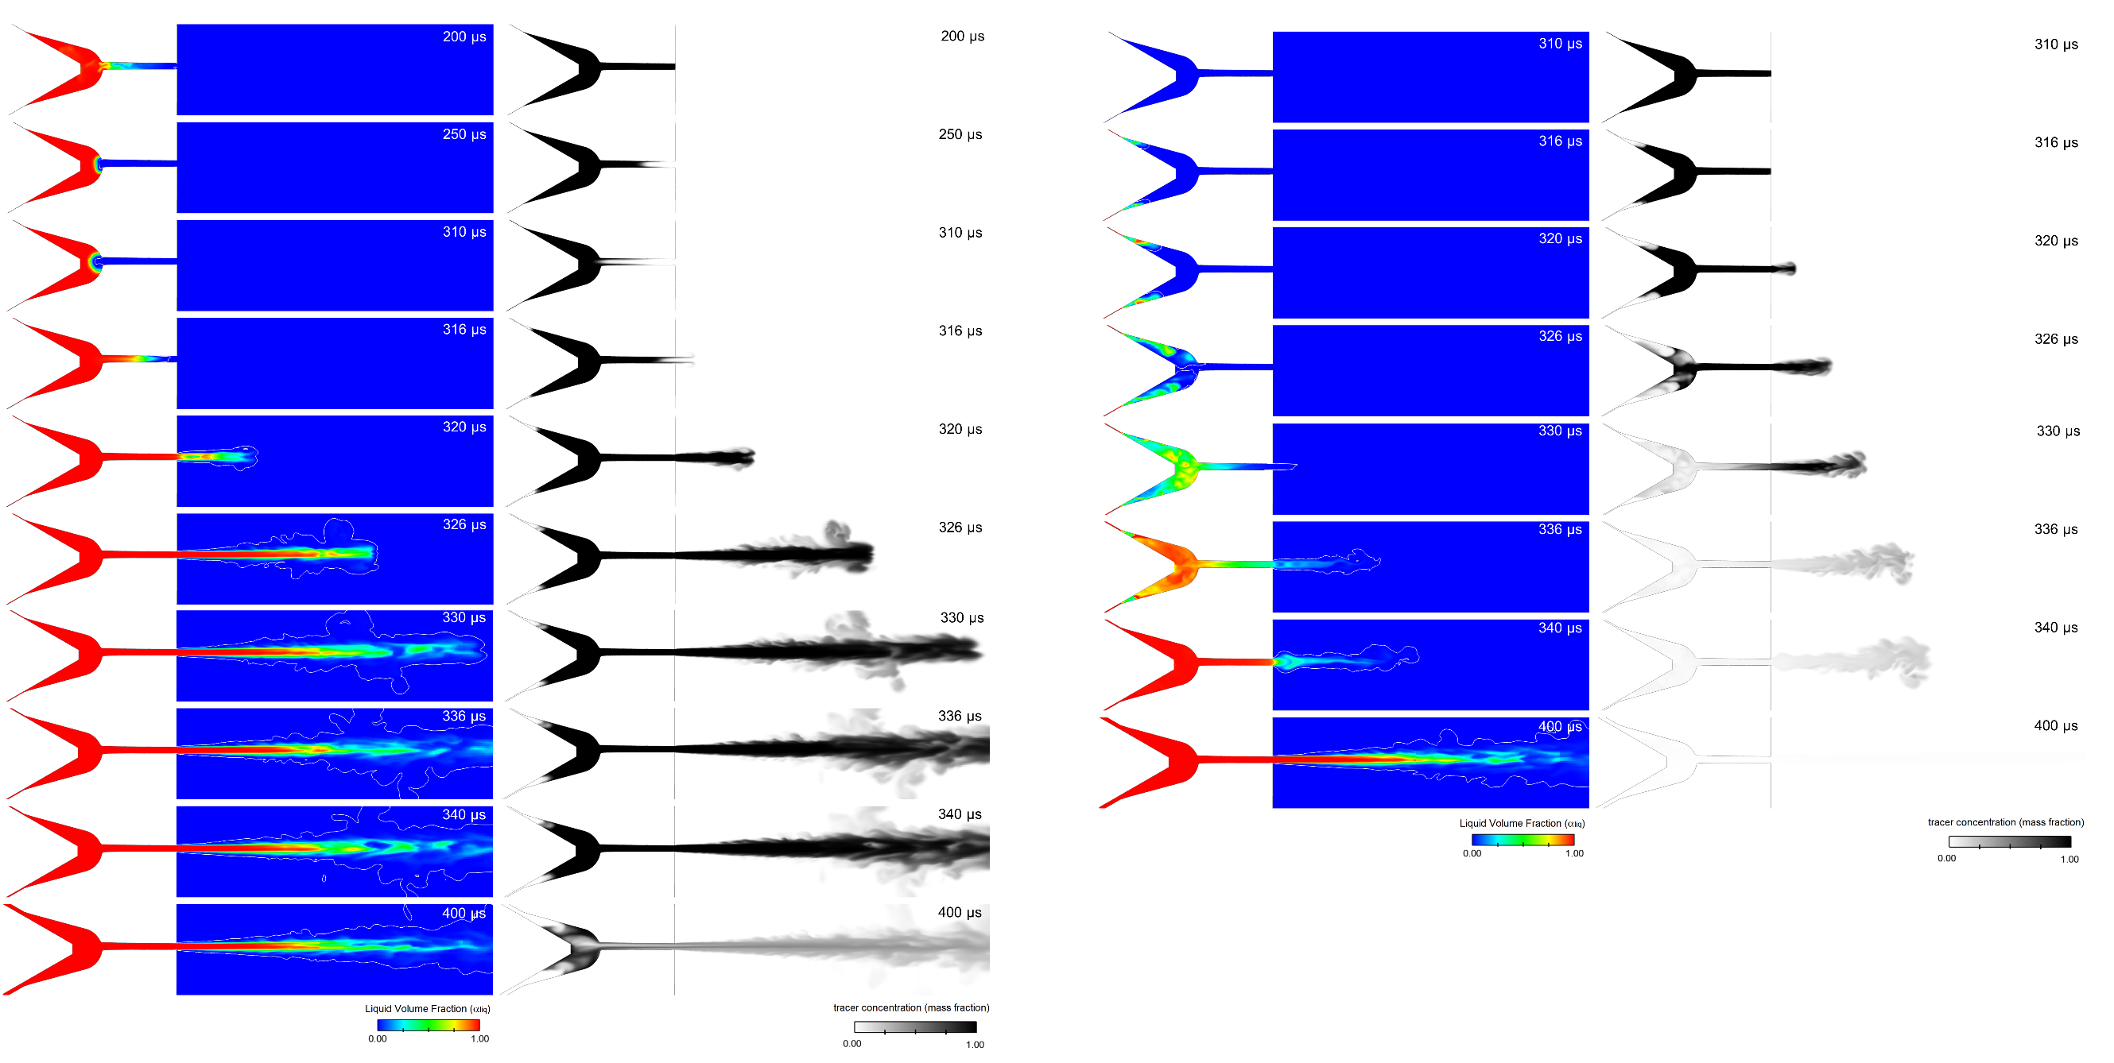
Spray A SOI simulations
Setup #1: flow variables mapped from EOI calculation, simulation starts at 200 μs, valve is initially closed and opens at 310 μs.
Setup #4: nozzle full of residual gas, simulation starts directly at 310 μs.

Slide 11
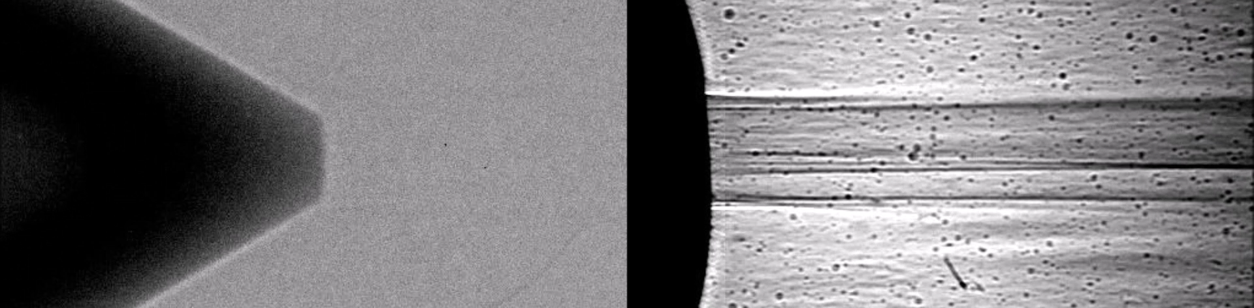
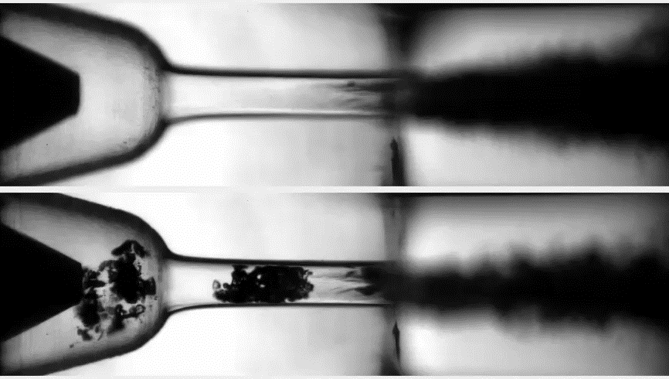
Observations on nozzle closing
D-like (150 MPa into 0.1 MPa)
Powell (ANL)
High inj. pressure, low back-pressure
gas exchange observed (orifice not visible)
D (50 MPa into 2.0 MPa)
High back-pressure
almost no gas exchange is observed;
Quite high inj. pressure, low back-pressure
D (50 MPa into 0.1 MPa)
bulk cavitation and gas exchange observed.
Also, cf.
SNL paper 2019-01-2280
Manin et al. ICLASS 2018
scc.sandia.gov (Spray Combustion Consortium)
Sequences showing the end of injection processes at two chamber conditions.
Notes:
Here the orifice is visible (whole nozzle)

Slide 12
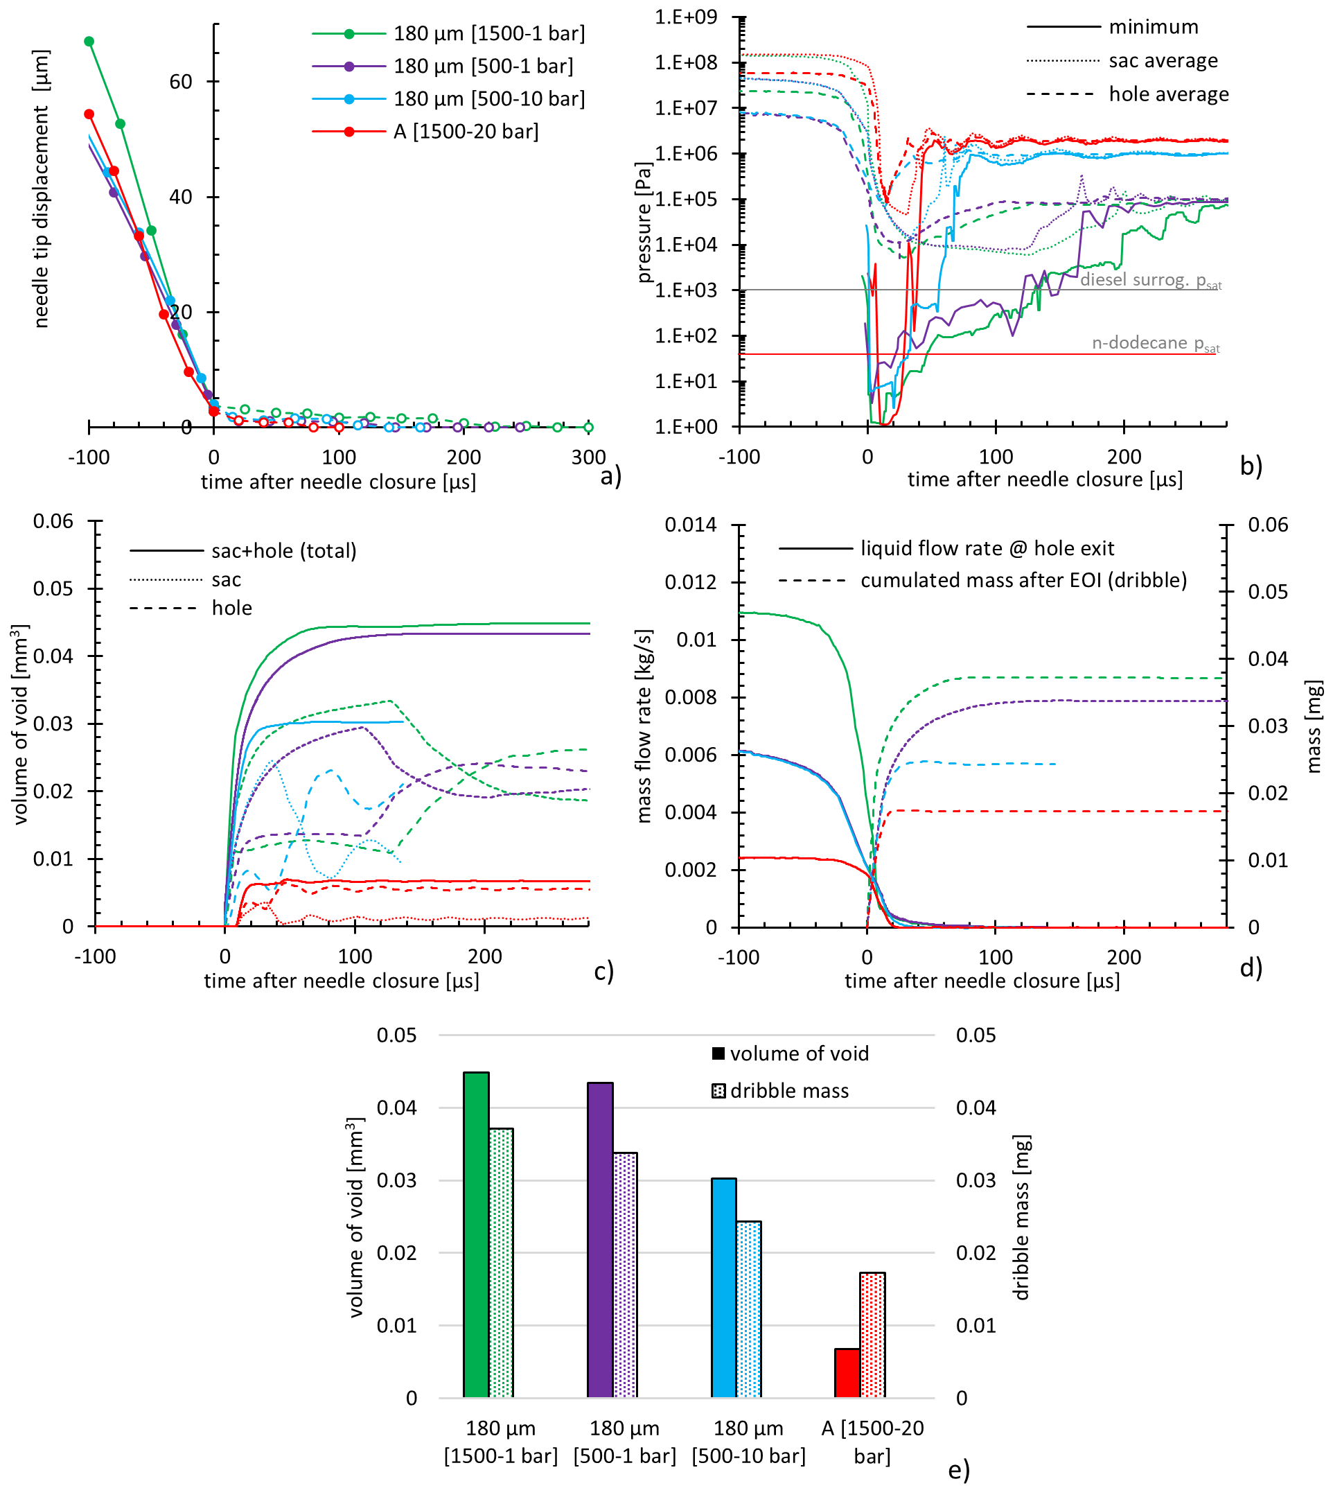
EOI simulations
In line with other observations, we conclude that
Bulk cavitation is easily triggered, but then it collapses. Ambient gas ingestion follows.
the quantity of ingested gas (and undesired dribble) decreases with
  low injection pressure;
  high ambient back-pressure;
  small orifice flow area (i.e., diameter, for single-hole nozzles).
Notes:
I also simulated spray B (shown later, and not included here)

Slide 13
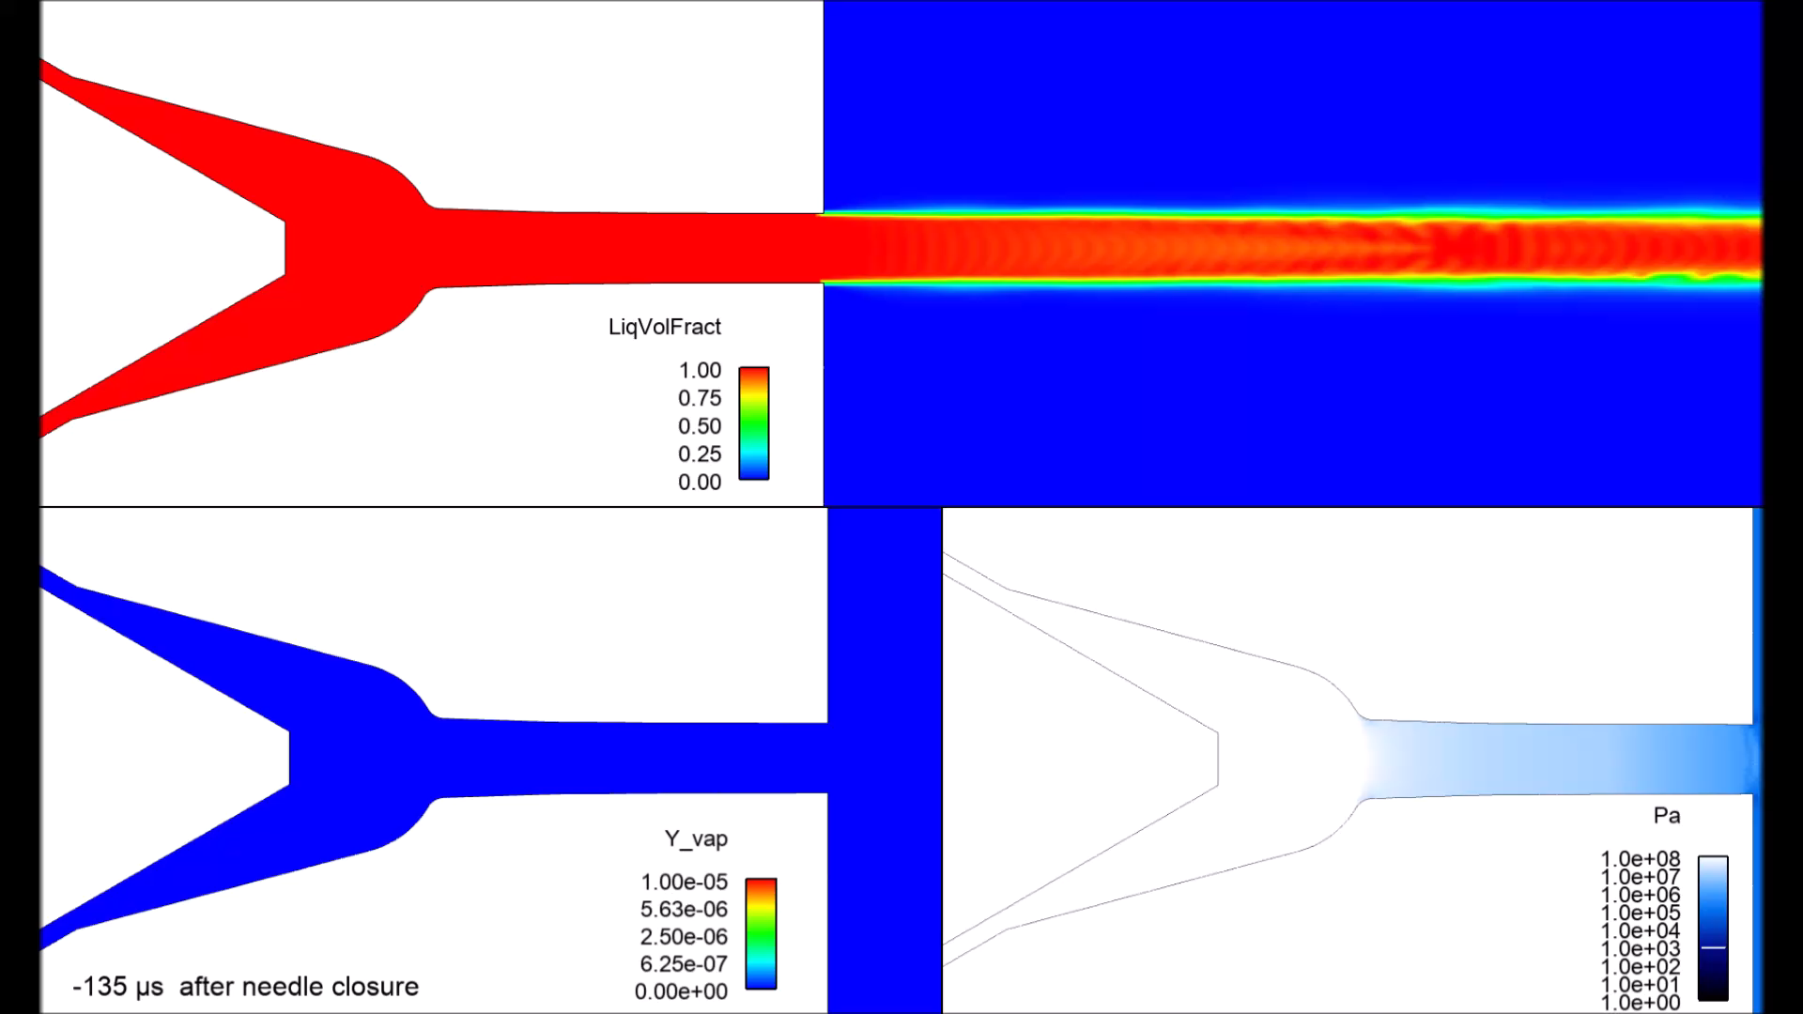
EOI simulations
D-like (150 MPa into 0.1 MPa)
Detection of bulk cavitation in the sac at the end of injection, followed by gas ingestion
D (50 MPa into 0.1 MPa)
scc.sandia.gov (Spray Combustion Consortium)

Slide 14
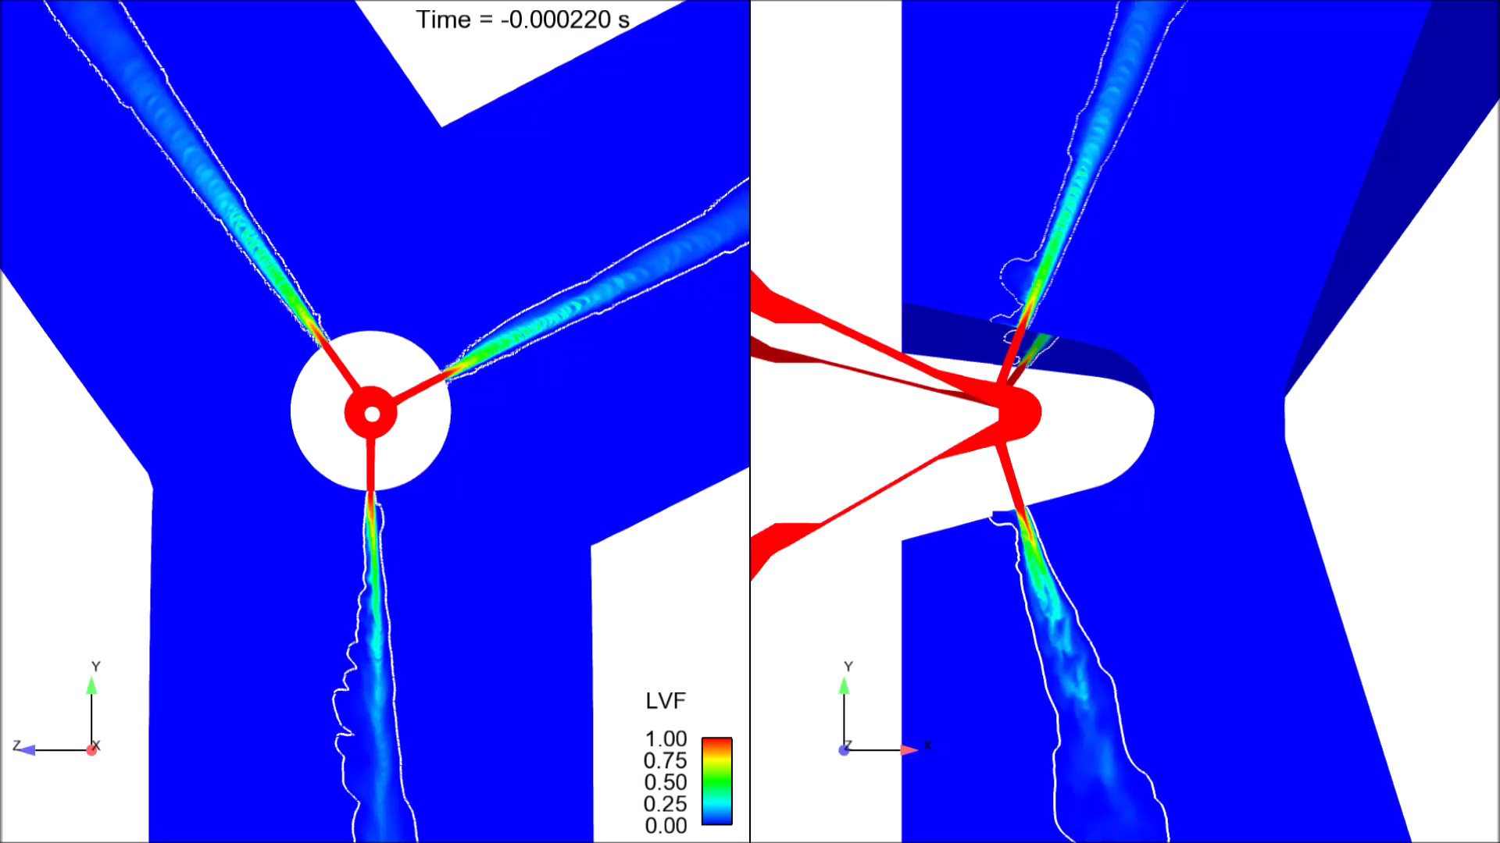
Spray B (multi-hole) – EOI simulation
1
2
3
Grid size = 2.5 μm, 35 Million cells
Simulated time = 0.500 ms (about 3 months on 256 cores)
Notes:
I’ve already discussed about bulk cavitation, followed by gas injection. These things are visible also here.
However, now I want to talk about the spray near-exit cone angle variation.
Spray B is known to exhibit large cone angle variations

Slide 15
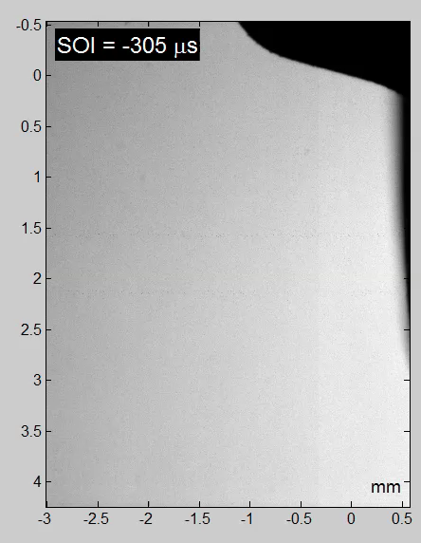
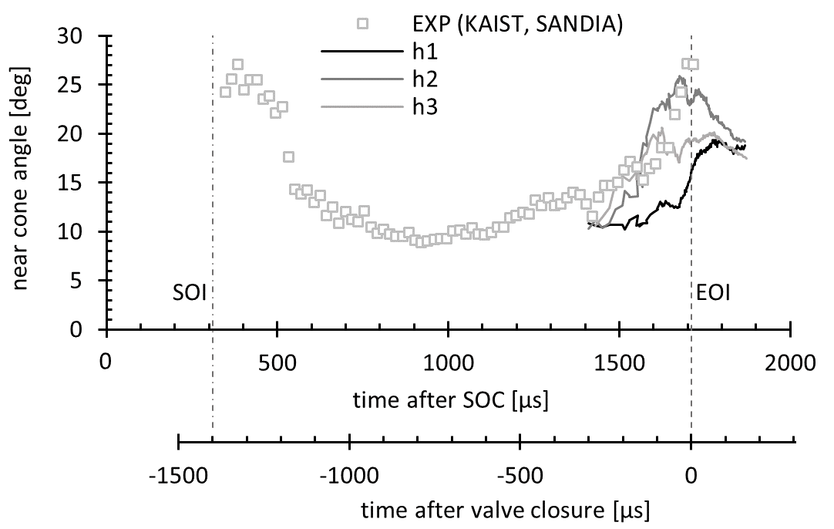
Spray B (multi-hole) – EOI cone angle variation
SAE 2015-01-0946 (Jung et al.)
Sandia LDM movie
Notes:
I’ve already discussed about bulk cavitation, followed by gas injection. These things are visible also here.
However, I want to talk about the spray near-exit cone angle variation.
Spray B is known to exhibit large cone angle variations

Slide 16
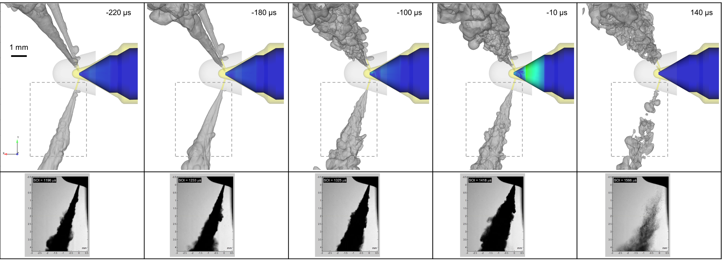
Spray B (multi-hole) – EOI cone angle variation
The spreading increases gradually, from an initially narrow cone at −220 μs to a quite wide and corrugated spray boundary at −10 μs

Slide 17
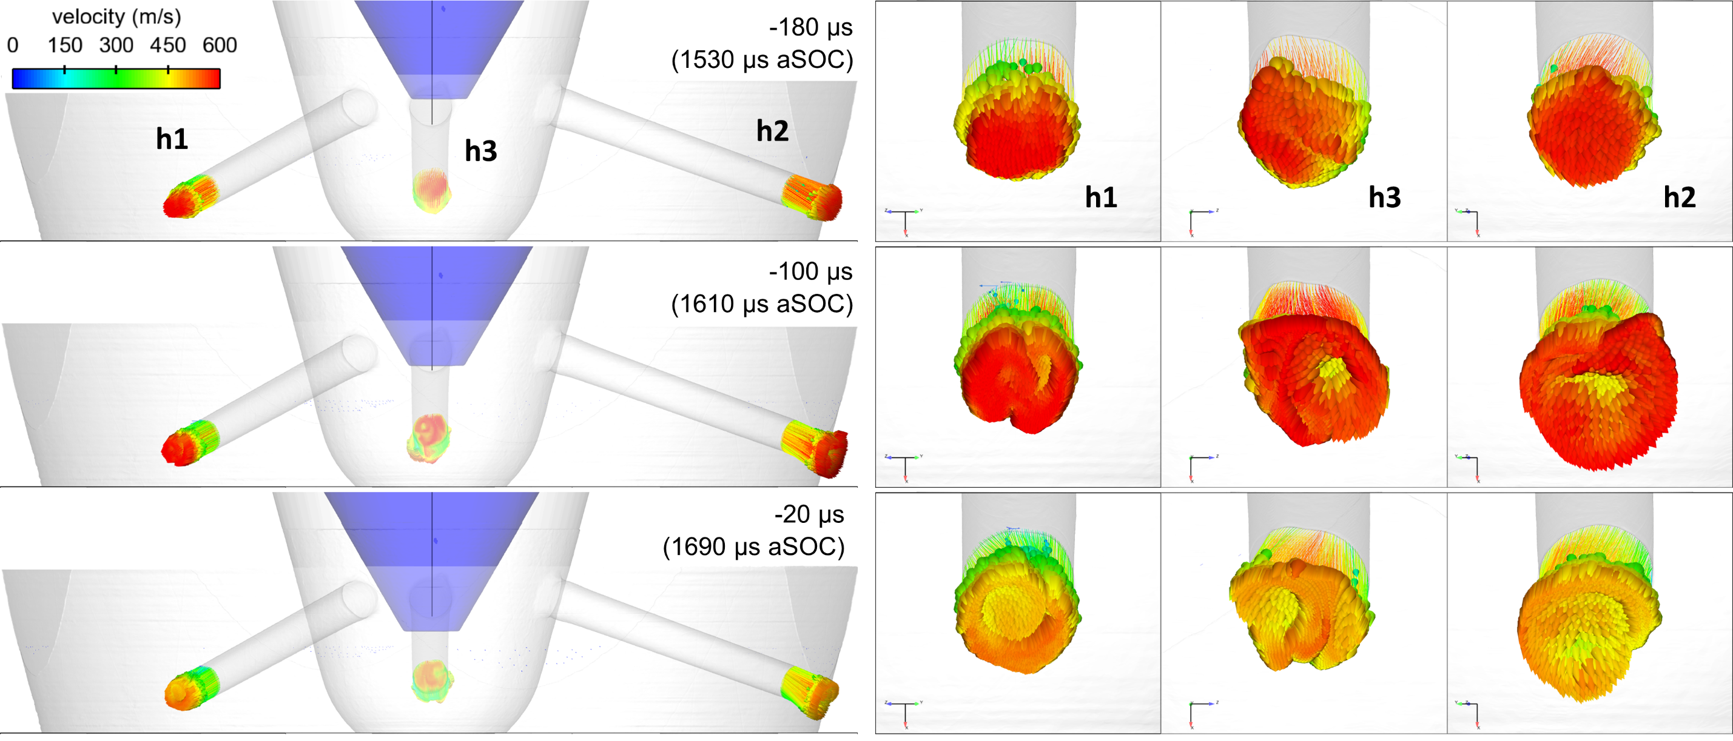
Spray B (multi-hole) – hole swirling flow
Tendency to form a hollow cone, as a result of the swirling flow taking place inside the holes.
This is strictly connected to asymmetries and non-periodicities in the internal flow
Notes:
More work can be done, to decouple surface irregularities and needle wobble effects.
Also, more advanced cone angle variation models can be developed for Lagrangian models.

Slide 18
Conclusions
Simulation results, compared to synchrotron x-ray data and to optical microscopy data, demonstrate the capability of the LES method to comprehensively elucidate the flow physics of injection transients, complementing experimental techniques.
Start-of-injection simulations are almost capable of capturing the timing of liquid appearance and the tip penetration trend. More work still needed for capturing finer details.
Cavitation taking place immediately after the EOI and gas ingestion agrees with ANL, Sandia data.
Cone angle variation in multi-hole nozzle is related to asymmetries of the needle-sac assembly, creating swirling flow inside the holes.

