Slide 1
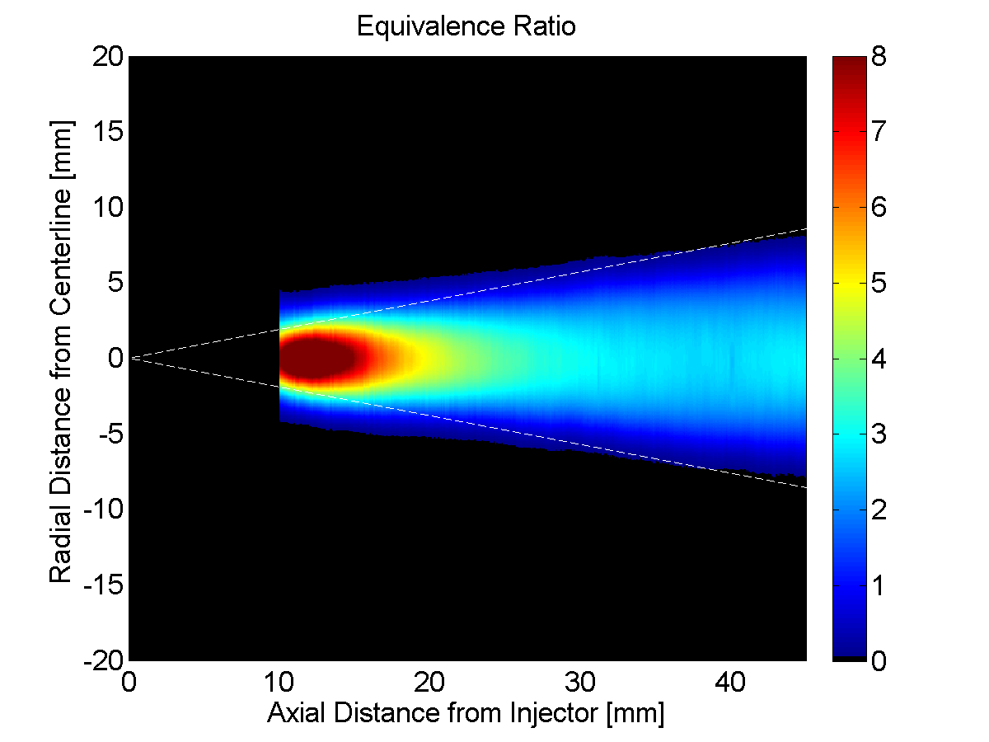

ECN7 Workshop: Diesel Sprays – Mixing of Spray C & D Downstream of the Liquid length
Spray C at Conditions Similar to ECN Target

Slide 2
Contributors
Experiments and Postprocessing
Russ Fitzgerald, Glen Martin, Kenth Svensson, Caterpillar Inc.
Jesús Peraza, CMT/Caterpillar
Michele Bardi, IFPEN
Adam Dempsey, Marquette University
Advisement
Noud Maes, Mark Musculus, Lyle Pickett, Chuck Mueller, Sandia National Laboratories
Sage Kokjohn, University of Wisconsin Engine Research Center
Simulations
Fabien Tagliante, Sandia National Laboratories
Leonardo Pachano, Jose Maria Garcia Oliver, CMT
Hengjie Guo, Emma Zhao, Roberto Torelli, ANL
H. Bao, Bart Somers, Technical University of Eindhoven
Wai Tong Chung, M. Ihme, Stanford University (SU)

Slide 3
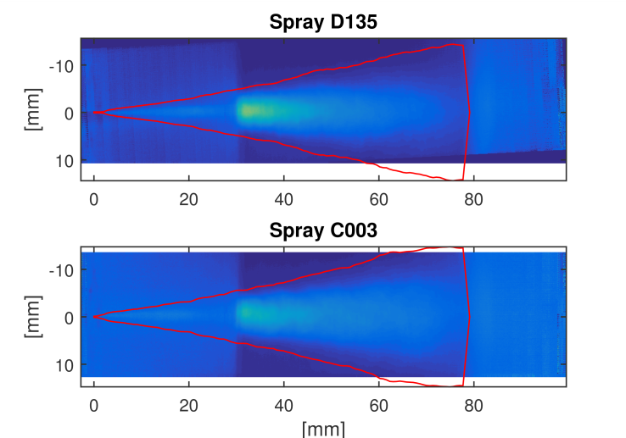
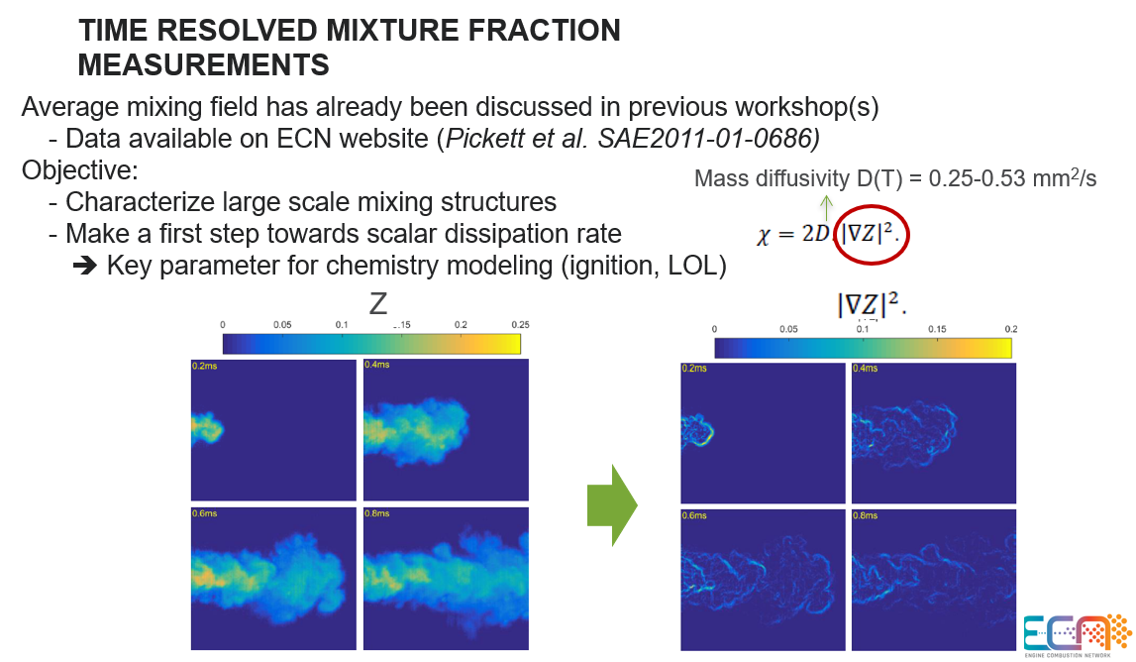
background
From ECN6: Topic 3 – Evaporative Diesel Spray (Michele BARDI)
Mixture fraction measurements desired for Spray C and D
Preliminary DFB LIF by IFP
Mixing field measurement approach has not been formalized.
Previous workshops examined Spray ‘A’ mixing field
Important field data linking diesel injection characteristics and pollutant formation remains unvalidated for large orifice (Spray C/D), heavy-duty injectors.

Slide 4
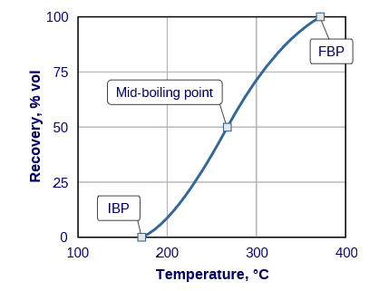
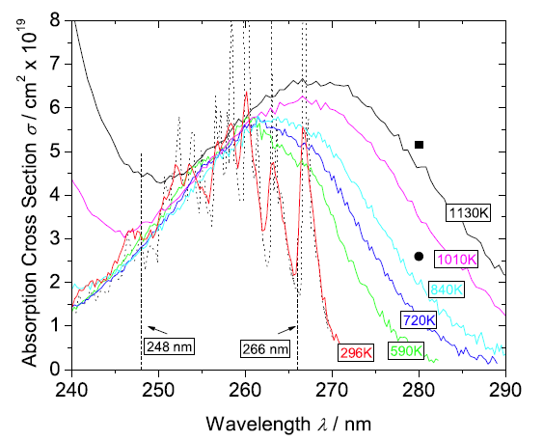
Experimental Approach: Mixture Fraction Measurements via Laser Induced Flourescence
Typical Distillation Curve of Diesel Fuel
Fuel | Boiling Point
dodecane | 216⁰C
n-heptane | 98⁰C
toluene | 111⁰C
Key Considerations
Co-evaporation
Well-characterized photophysics
Accessible excitation
Fuel system campatibility
Quenching
Signal levels and potential trapping
ECN target condition similarity
  Liquid length and evaporation
  Cavitation
Base Fuel: n-heptane
Fuel Tracer: toluene (1% vol)
*1 bar ambient pressure
4
Koch PhD. Thesis, Thermal Sciences Division (TSD-159), Stanford University, p.85

Slide 5
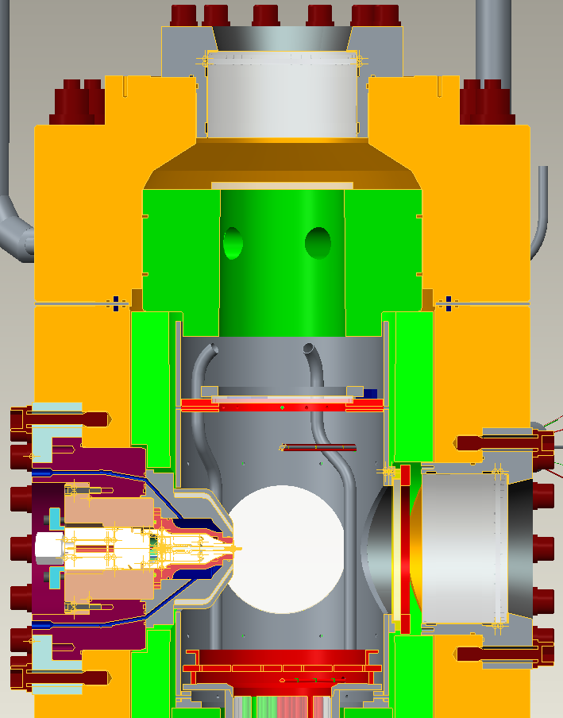
HTPV with Top Window Access Enables Mixture Fraction Measurements for Multiple Injectors and Configurations
Measurement Details
Target Conditions
  ECN similar conditions (23 kg/m³)
  Quasi-steady injection (2000µs aSOI)
Calibration Conditions
  Short (~300µs) known mass
  Fully evaporated
Near-Field Measurements to verify liquid length
Vapor penetration rates inferred by average displacement over elapsed time.
Local mean jet velocity determined from known steady injected mass flux and integrated fuel mass in domain (assumes symmetry)
Test Conditions
Ambient Mixture | N₂ with <0.1% O₂
Vessel Pressures | 4.0, 4.3, 4.6, 8.6MPa
Vessel Temperatures | 600, 650, 700K
Injection Pressures | 100, 150, 200, 250MPa
Injection Duration | 4000µs
Injector | Configuration
ECN Spray C - 037 | Free Jet
ECN Spray D - 134 | Free Jet
5

Slide 6
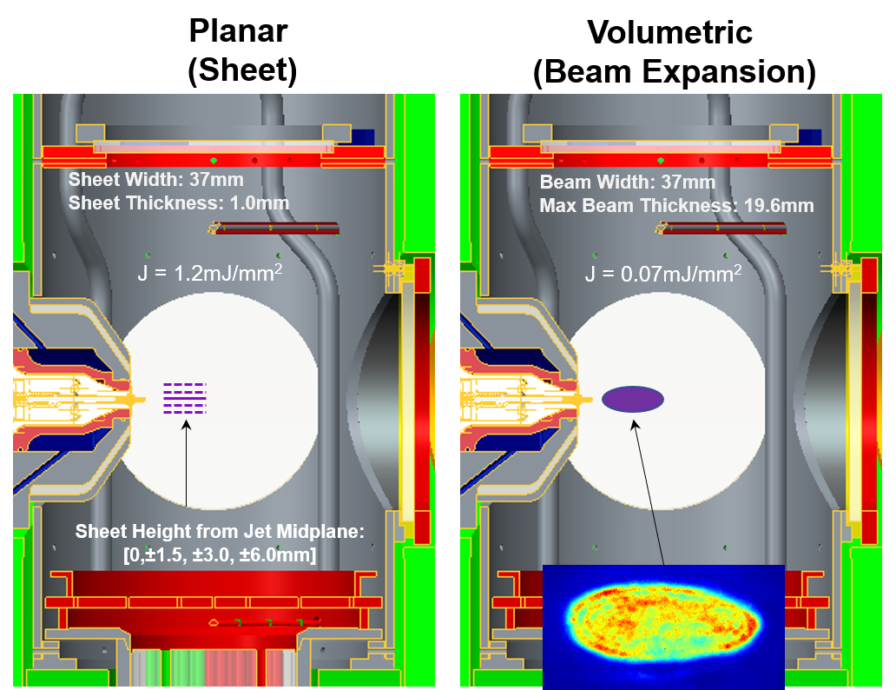
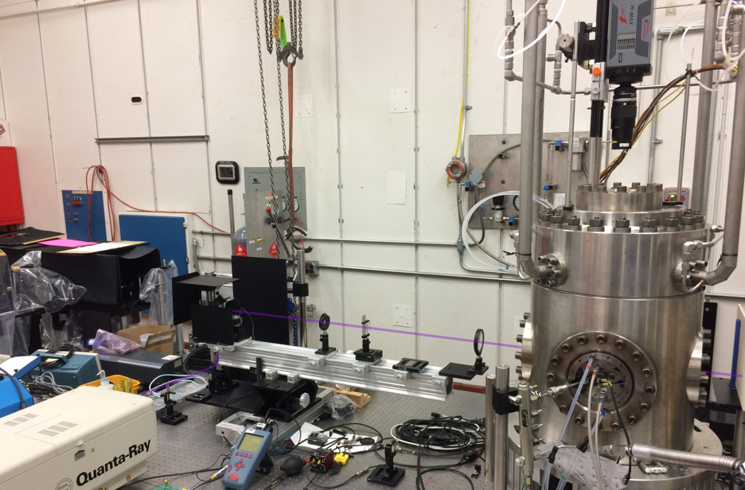
Experimental Approach: Laser Induced Fluorescence Excitation and Detection Scheme
Excitation
Nd:YAG Laser – 4th Harmonic (266nm); 10Hz (single-shot)
Translation stages, optical rails, high-reflectivity optics
Continuous laser power monitoring
Planar (PLIF) and Volumetric (VLIF) excitation
Raster scanning: horizontal-axial and vertical-radial
Beam stops
Detection
ICCD with Nikon UV Lens
  Princeton Instruments emICCD – 512x512 (loaned by Sandia)
  Princeton Instruments ICCD – 1024x1024
Lens aperture: f/# = 4.5 (maximize signal, narrow depth of field)
Filtering: LP295, BP300 40nm FWHM
Princeton Instruments ICCD 105mm Nikon UV Lens
LP295 + BP300 40nm FWHM
Top Access Window
Laser Power Meter
Beam Stop
Nd:YAG 266nm
80mJ/pulse
Optical Rail with Raster Scanning
Sheet Forming Optics
HTPV

Slide 7
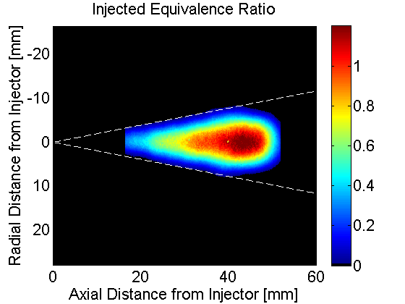

Post Processing: Careful Correction and Calibration Needed to Interpret LIF Signal
Fluorescence Signal Dependence:
$$S_{f}=η_{c}\left(\frac{Ω}{4π}\right)\left(L\right)χ_{tracer}N\left(\frac{E}{hc/λ}\right)σ\left(λ,T\right)φ\left(λ,T,P,\sum_{i}{χ_{i}}\right)$$
Measured signal proportional to tracer mole fraction
Required Corrections
Background subtraction
Local laser fluence
Fluorescence temperature dependence
Misaligned jet axis (image rotation)
Iterative approach required to account for local variations in mixture temperature and fuel concentration
To avoid direct determination of every term, fluorescence signal is calibrated using short injection of known mass.
Interrogation Depth and Collection Efficiency
Excited Molecular Number Density
Fluorescence Quantum Yield
Adiabatic Mixing Calculation:
$$\left(1−χ_{tracer}\right)c_{p,air}\left(T_{air,in}−T_{mix}\right)=χ_{tracer}\left\{c_{p,fuel}\left(T_{mix}−T_{fuel,in}\right)+H_{vap}\right\}$$
Rescaled
CF = .0015 mol – (mJ/mm) / count-m³ @300K
Calibrated Mass: 2.66 mg

Slide 8
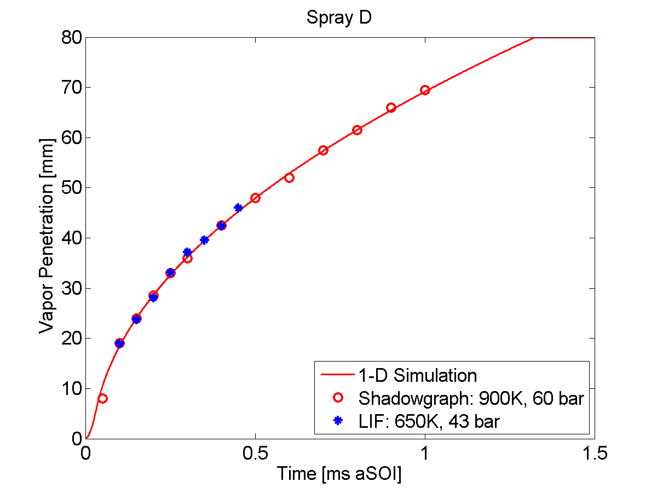

Spray D Measurements are Self Consistent
Spray D
P_{i} = 150 MPa
Naber-Siebers
Musculus-Kattke Mixing Model
Predictions
$$θ=21°$$
LIF penetration measurements at reduced temperature are consistent with shadowgraph measurements at ECN target conditions
1-D mixing model simulations of vapor penetration fit experimental data for assumed spreading angle of 21⁰
Model predictions of local equivalence ratio and bulk jet velocity provide a basis for comparing fuel LIF measurements…
8

Slide 9
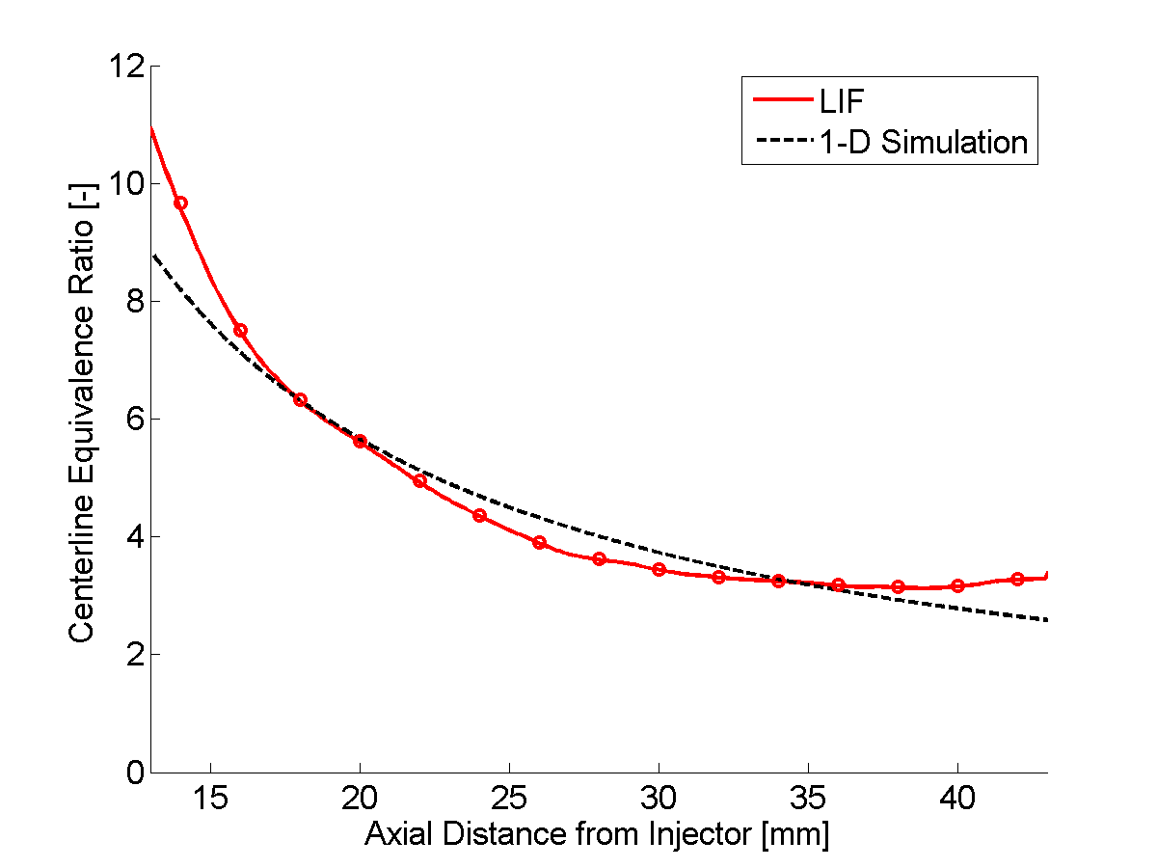

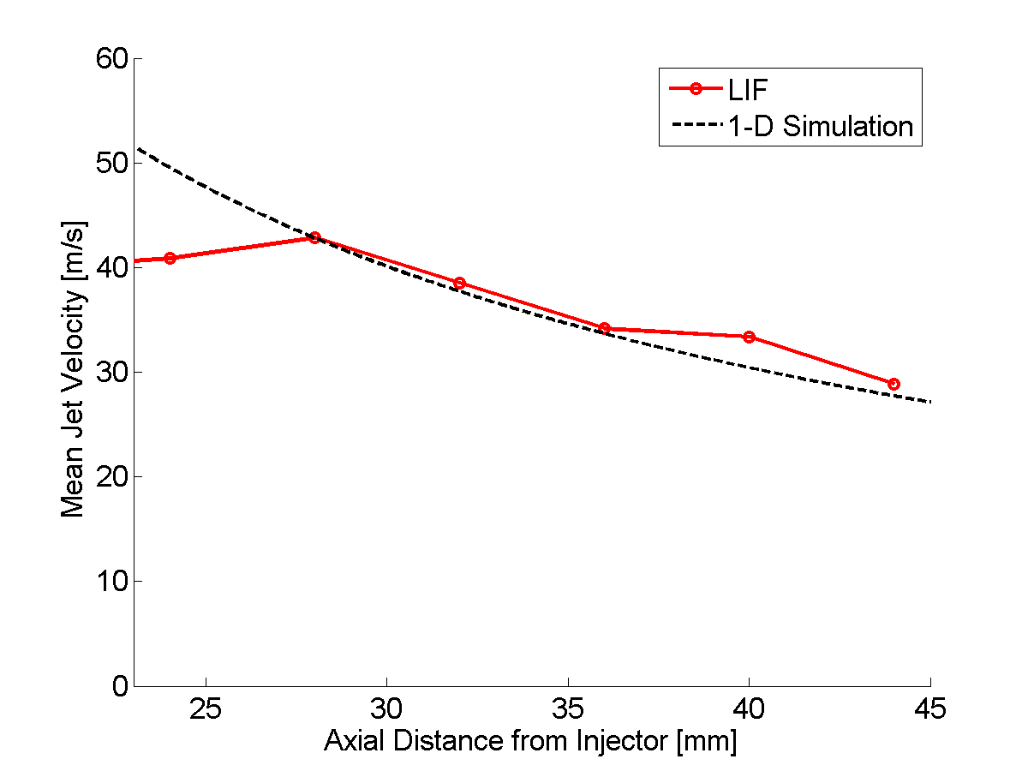

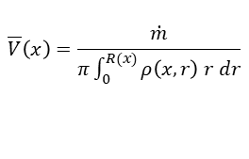
LIF Measurements of Local Equivalence Ratio and Bulk Jet Velocity for Spray D Indicate Reasonable Agreement with 1-D Mixing Predictions
Centerline equivalence ratio decays as 1/x as predicted by model
Despite some expected discrepancies; 1-D mixing model predictions generally consistent with measured equivalence ratios
Inferred average jet velocity agrees with model predictions downstream of the liquid length
Sources of Potential Disagreement:
LIF measurements confounded upstream of liquid length
Spray is only quasi-steady: 1) rail dynamics, 2) rear wall interaction
Beam reflections
Spray D
P_{i} = 150 MPa
T_{a} = 650K
P_{a} = 43 bar
$$θ=21°$$
$$\overline{V}\left(x\right)=\frac{\dot{m}}{π\int_{0}^{R(x)}{ρ\left(x,r\right) r dr}}$$
Strong validation effort paves way for Spray C and D comparisons…
9

Slide 10
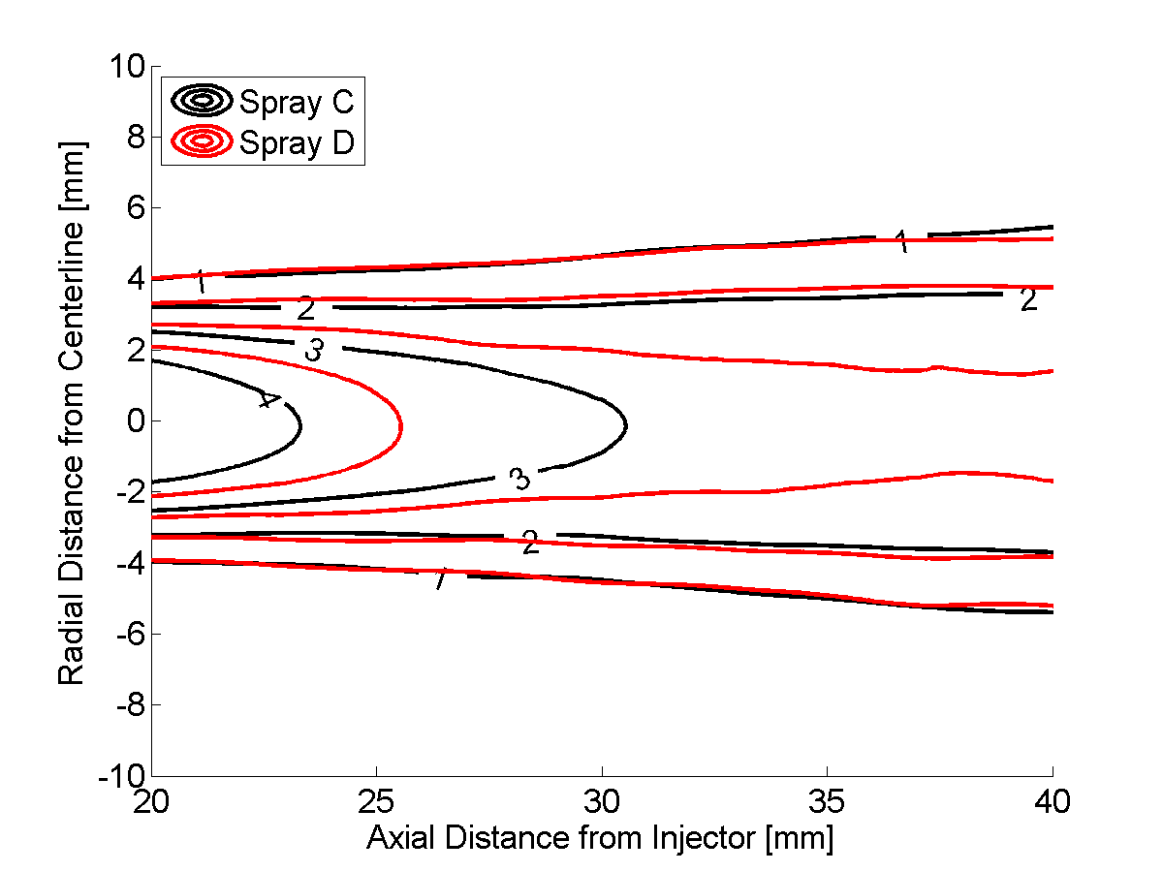
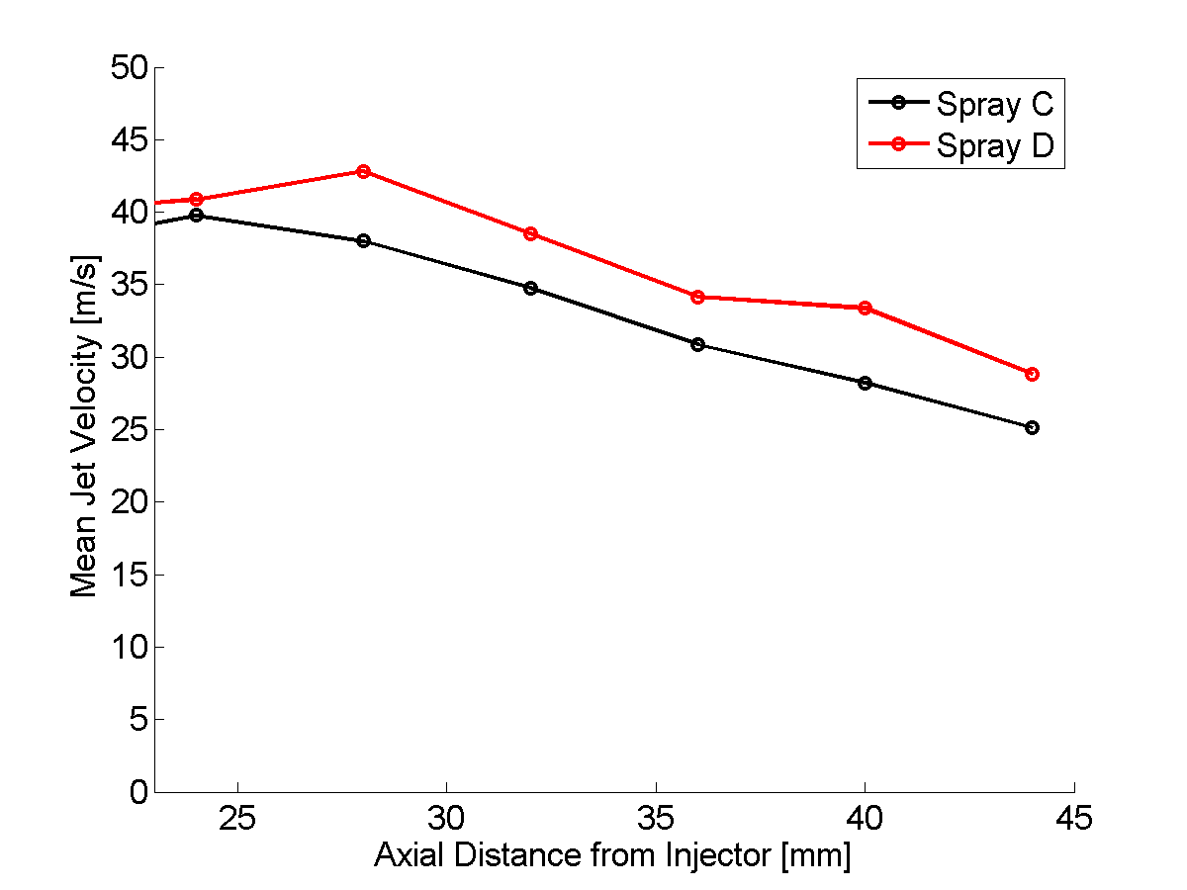

Results: Subtle Injector Differences Revealed by Mixture Fraction Field Comparisons
T_{a} = 650 K
P_{a} = 43 bar
ρ = 22.8 kg/m³
Spray C
Equivalence ratio iso-contours very similar for two jets; spray C core isolines shifted about 2mm upstream
Periphery of jet indicates very similar spreading angles
Mixture fraction measurements support slightly lower air entrainment for Spray D:
  Spray D exhibits comparatively richer core
  Inferred average jet velocity is about 10% higher; consistent with penetration and dispersion measurements
$$θ=21°$$
Spray D
10

Slide 11
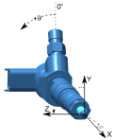
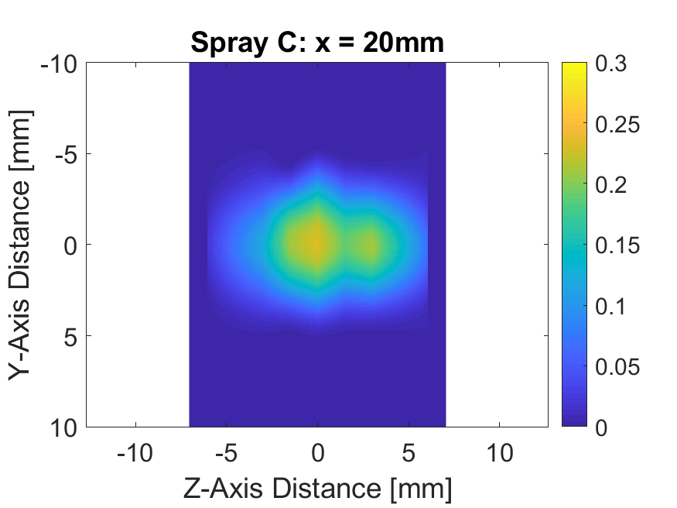
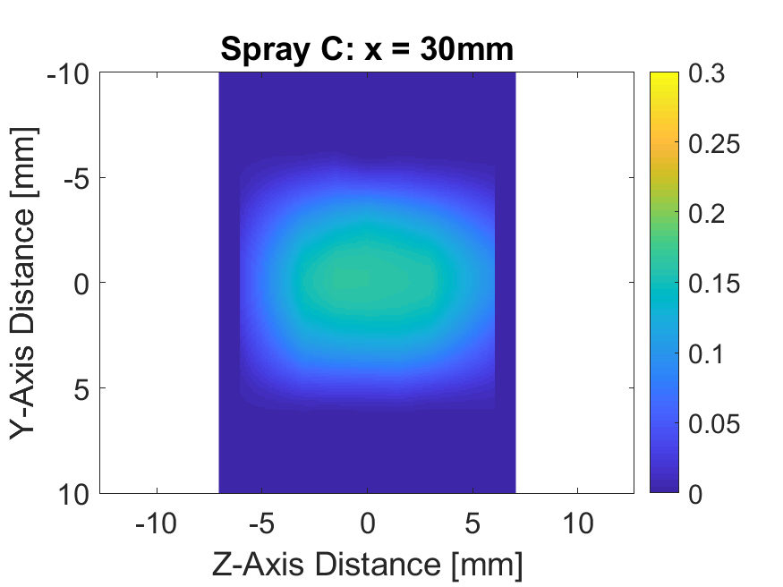
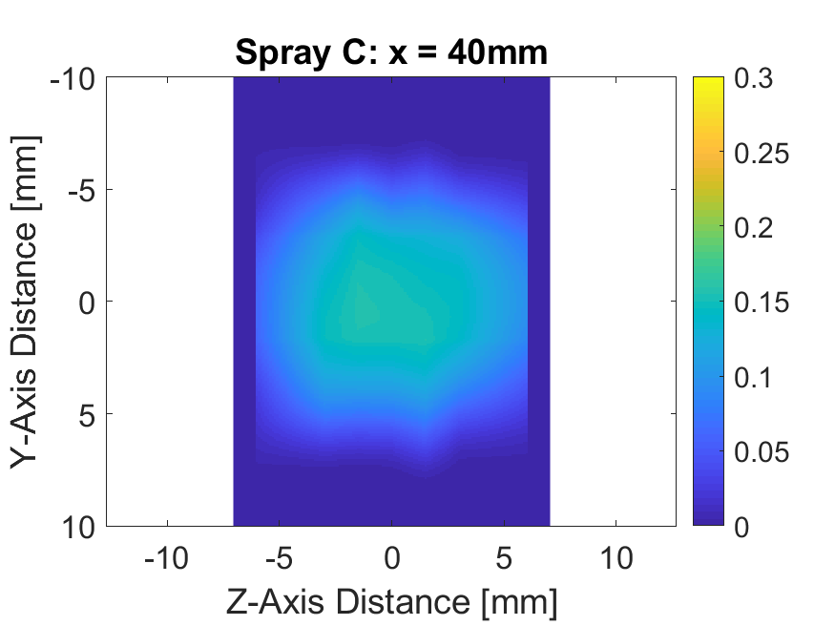
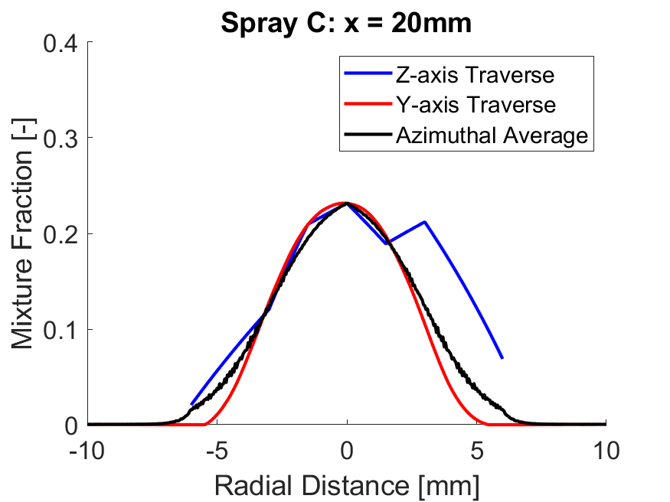
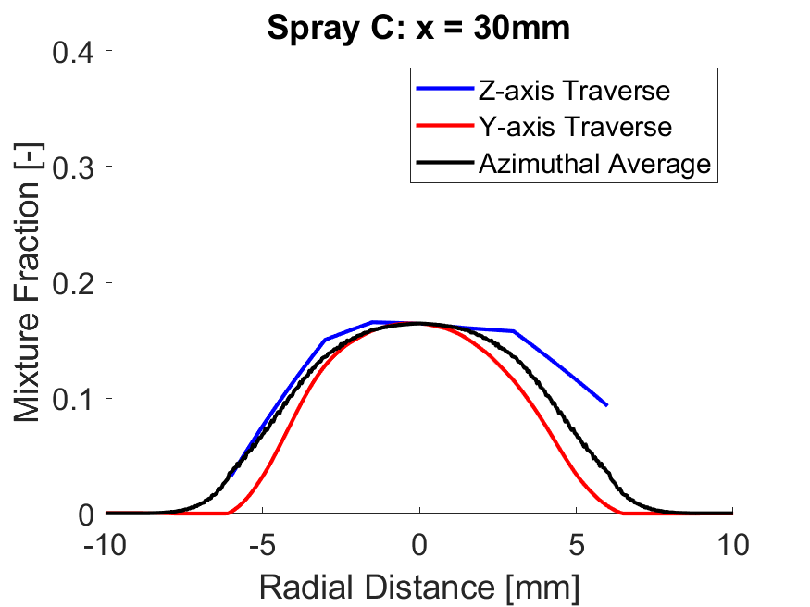
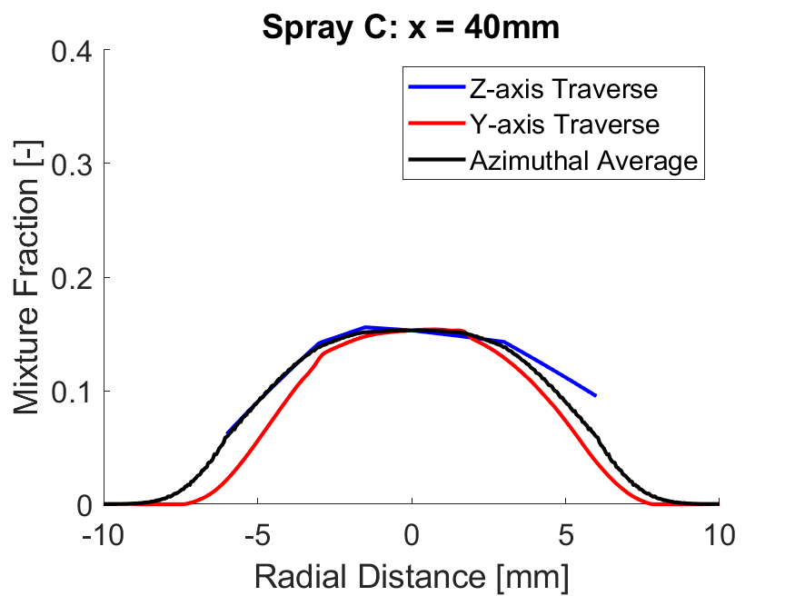
Evaluation of spray C Mixture Fraction asymmetry in FAR Field – LIF Measurements
LIF data indicates wider spray in Z-direction for Spray C; effect diminishes in far field
Spurious effect of reflections for planes closer to camera…

Slide 12
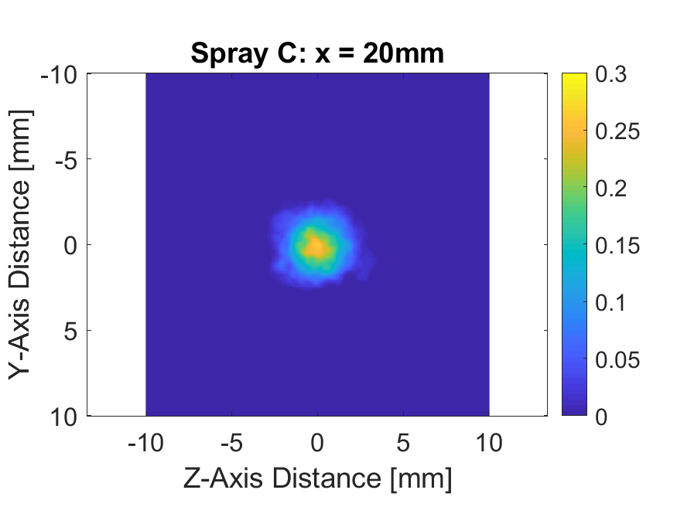
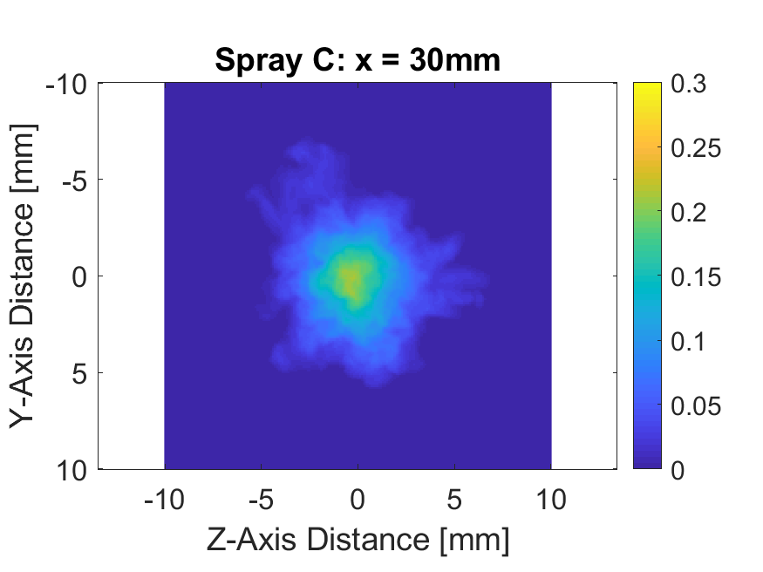
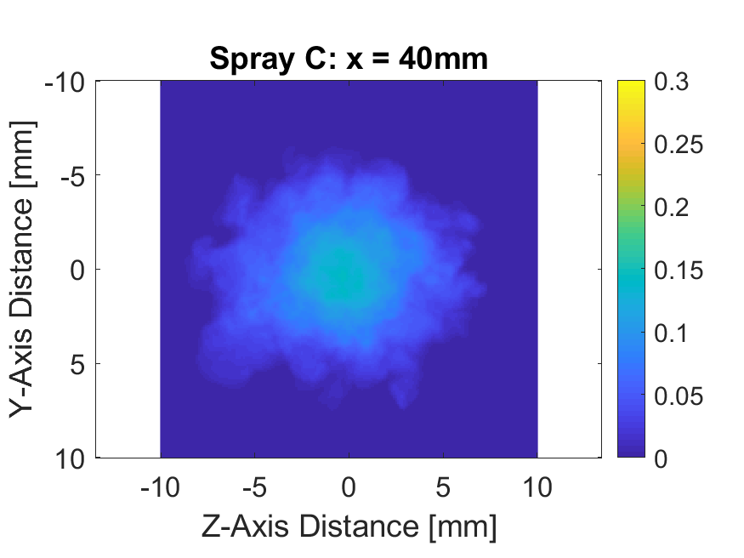
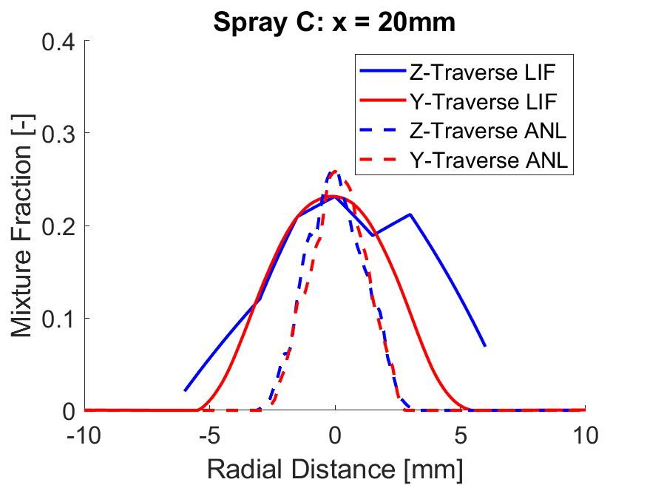
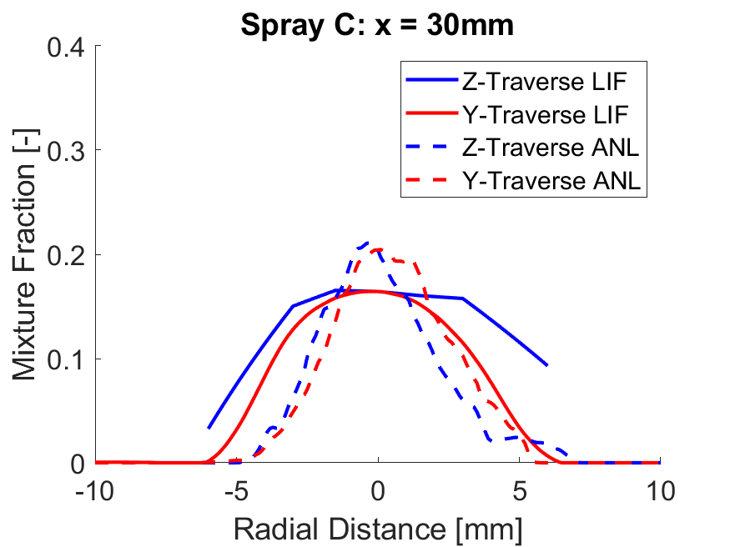
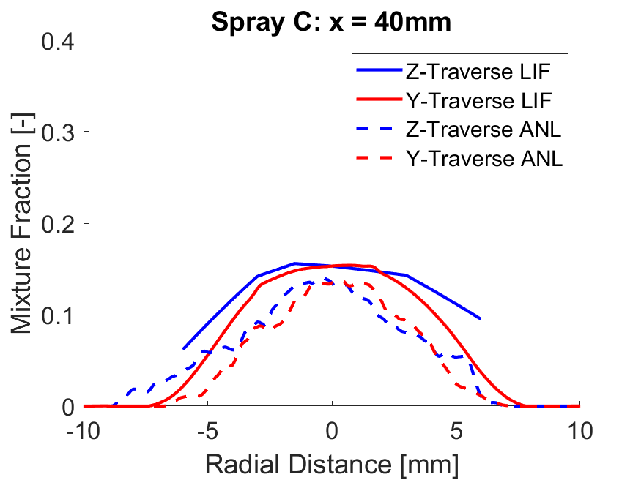
Evaluation of spray C Mixture Fraction asymmetry in FAR Field – ANL Simulations
ANL simulations using real geometry support broadening in z-direction
Reasonable agreement of mixture fraction data in the far field (40mm)

Slide 13
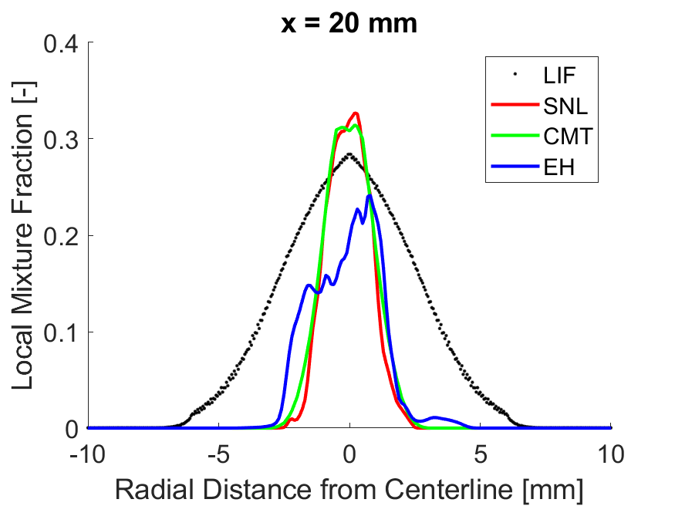
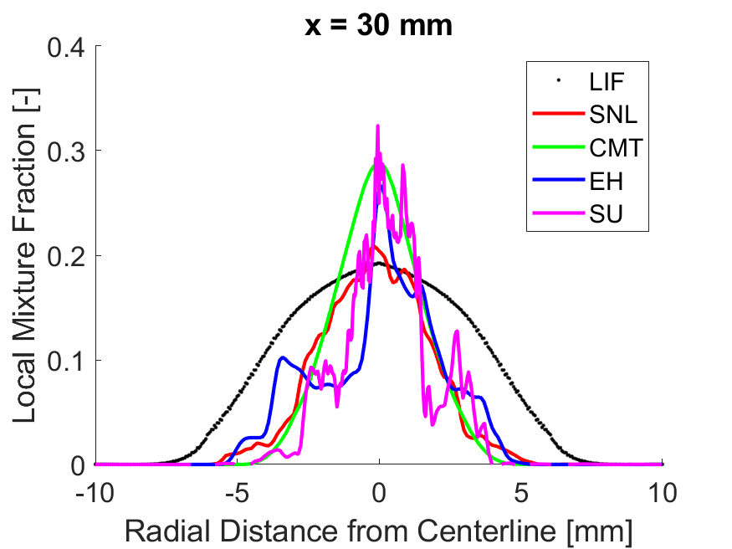
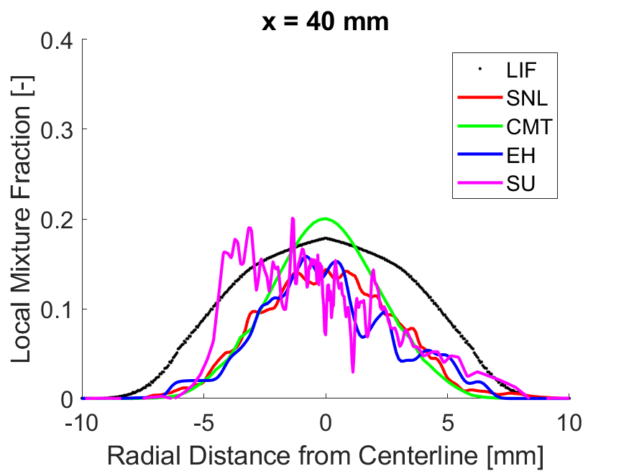
Comparison of Simulated and measured mixture Fraction for spray D in the far field
Near field comparison challenges:
  LIF measurements confounded by liquid droplets
  Simulations report only contribution from vapor
Centerline mixture fraction agrees for two of the simulations
All predictions narrower than measured profile.
Far-field results
Simulations generally capture centerline mixture fraction within 90%.
Location of jet edge (spreading) also better captured in the far-field.
Is there a deficiency in breakup/mixing models that prevents radial profile from being captured?
Do other mixture fraction measurements support similar conclusions?

Slide 14
Summary and Points for discussion
Comparisons of measured and simulated vapor penetration and spreading angle demonstrate that ECN condition similarity can be achieved for a diesel surrogate (heptane) at reduced temperature and matched ambient density.
Measurements of local mixture fraction and local mean spray velocity exhibit satisfactory agreement with 1-D model predictions (Musculus-Kattke)
Mixture fraction field differences between Spray C and D have been quantified; enable broad suite of measurements to be reconciled.
  Spray D exhibits a comparatively richer core, consistent with an upstream shift of 2 mm.
  Spray C exhibits surprising asymmetry in Z-direction (not Y-)
Computational predictions of centerline mixture fraction generally agree with measurements in the far-field (x > 30mm – downstream of liquid length).
Additional measurements and comparisons needed to confirm if model deficiencies are preventing the mixture fraction radial profile from being captured.

Slide 15
Backup Slides

Slide 16
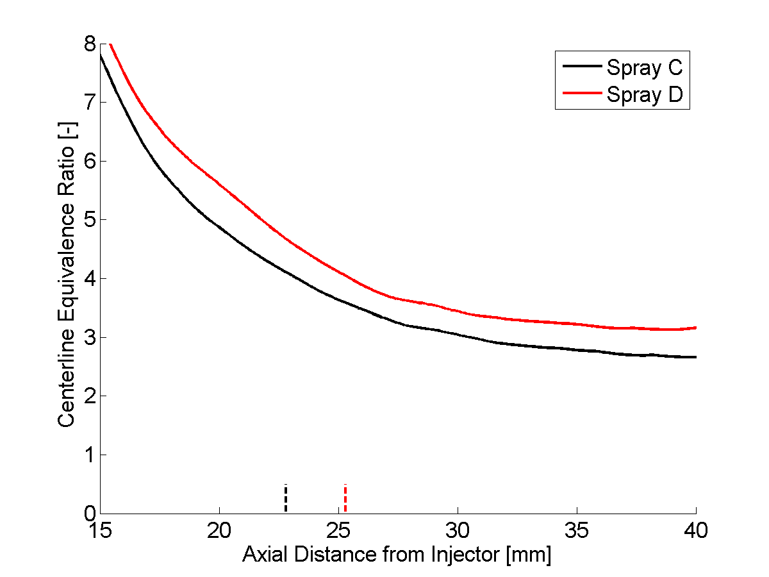
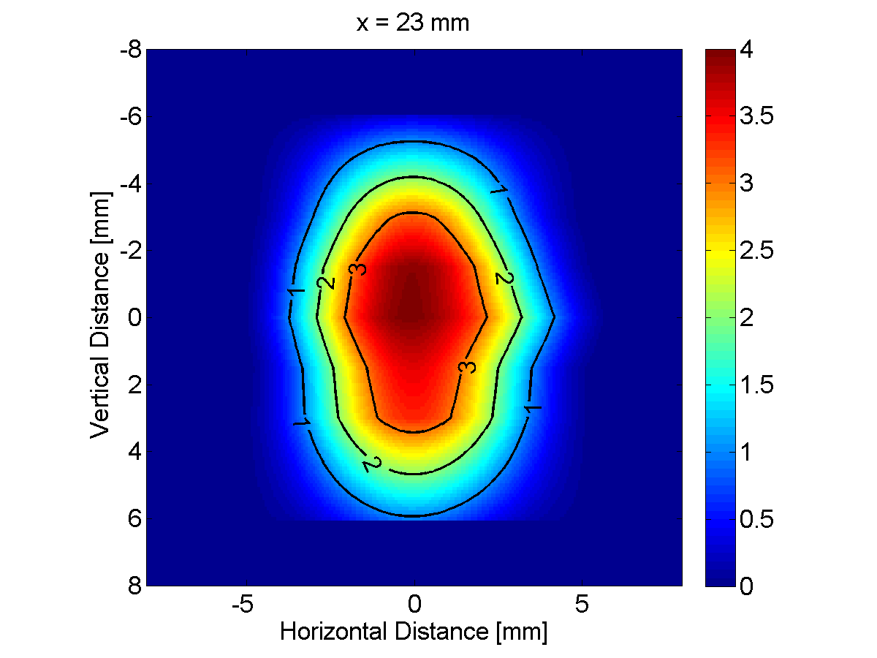
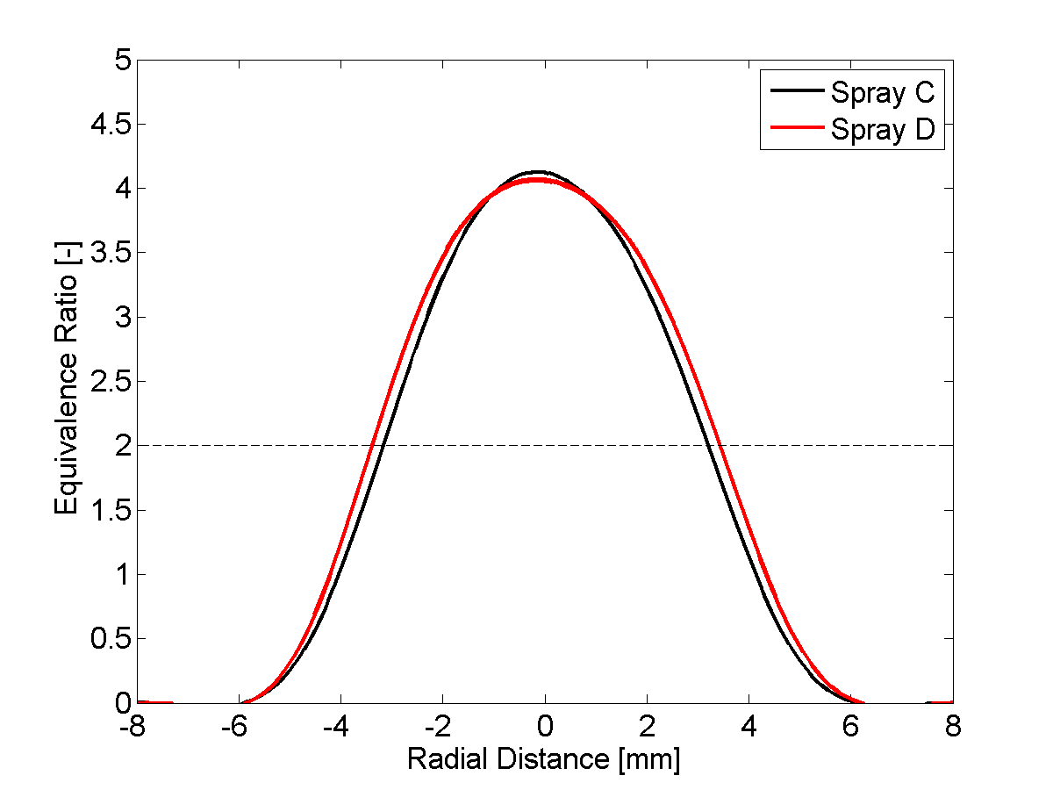
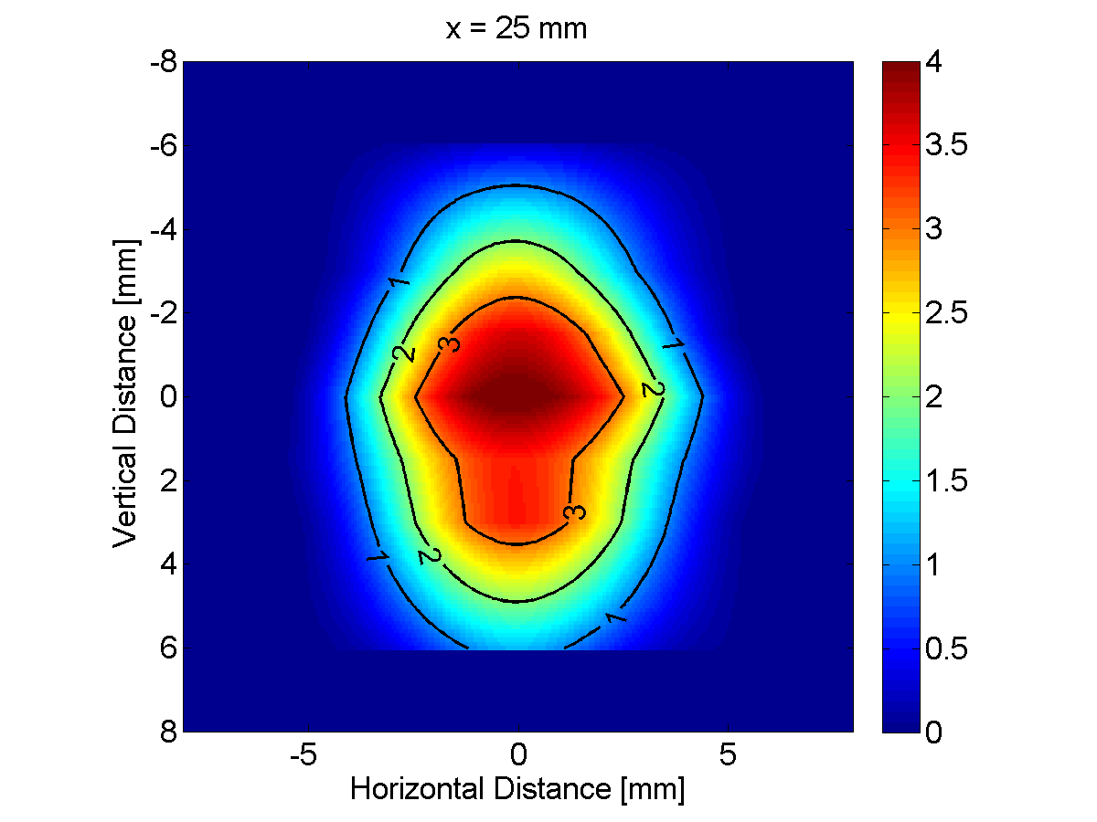
Measurements of Local Mixture Fraction at Corresponding Lift-Off Length Further Aids Interpretation of PM Measurements
Comparatively rich spray ‘D’ core persists more than 40mm downstream of injector tip
Spray C core ‘broken up by cavitation’?
  Known shorter liquid length
  Comparatively wider spray
To anticipate differences in PM emissions, examine equivalence ratio profiles at corresponding LOLs:
Spray C slightly leaner near periphery of jet despite slightly shorter mixing distance
Nevertheless, spray C has nominally higher equivalence ratios in its core near the LOL
From these results, we expect very similar soot fields, but slightly higher soot for spray C
Spray C
Spray D
16

Slide 17
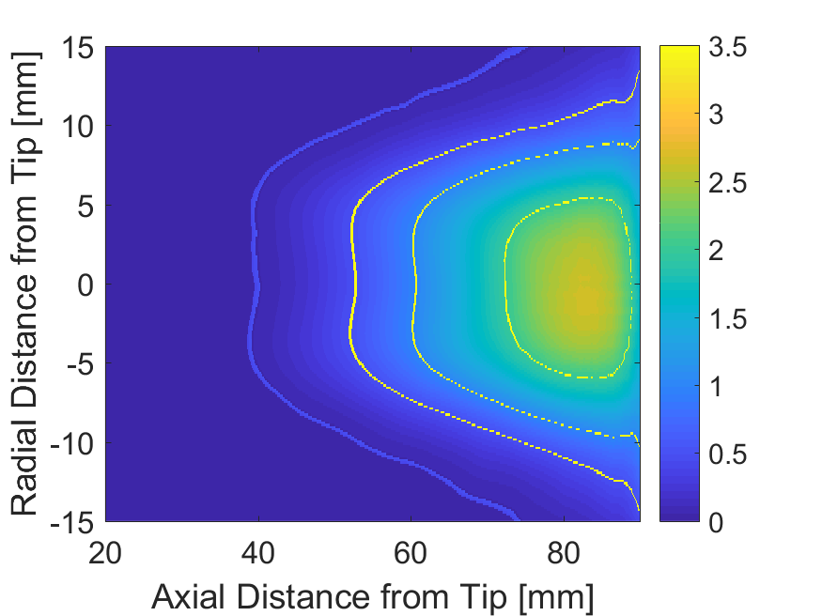

Soot Extinction Trends: Orifice Geometry Effects
Spray C – Diverging Orifice
T_{a} = 900K
P_{a} = 6MPa
P_{i} = 150MPa
0.05
0.5
1
2
Spray C and D produce similar amounts of soot
Soot inception distances and isolines for Spray C are consistently 2-3mm upstream of that for Spray D
Maximum soot KL (optical thickness) is consistently higher for Spray C; consistent with expectations based on previous measurements
Computationally reproducing spatially varying soot profiles and trends like these can be very challenging.
Comprehensive data provide the best chance of unraveling many confounding effects.
Relative locations of soot isolines quantify rates of formation/oxidation, even if maximum soot KL is out view
 | Spray C | Spray D
KL_{max} [-] | 2.6 | 2.5
x@KL_{max} [mm] | 82 | 84
x@KL₂ [mm] | 72 | 75
x@KL₁ [mm] | 60 | 63
x@KL_{0.5} [mm] | 52 | 55
x@KL_{0.05} [mm] | 39 | 41
LOL [mm] | 22.8 | 25.3
Spray D – Converging Orifice
0.05
0.5
1
2

Slide 18
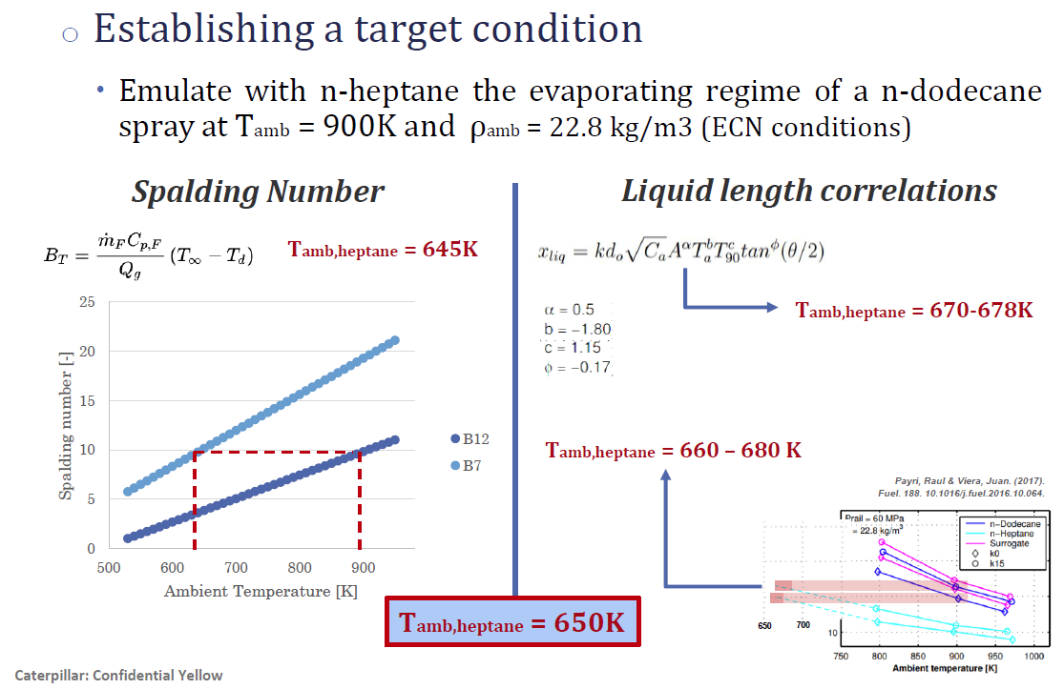
Ambient Temperature for Mixture Fraction Measurements is Reduced to Obtain Vaporization Similar to Target ECN Condition

Slide 19
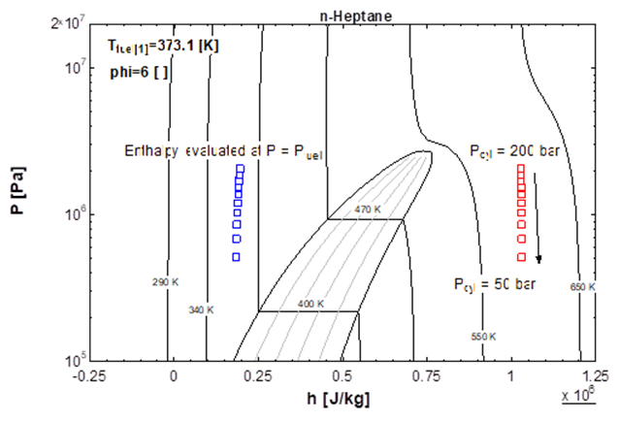
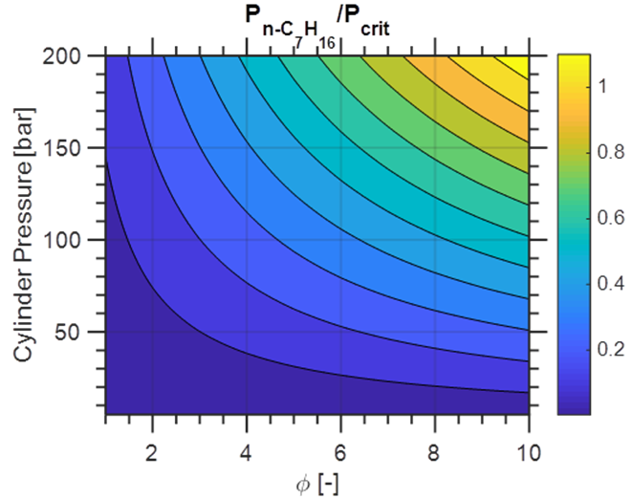
Adiabatic Mixing Calculations Require Thermodynamic Investigation

Slide 20
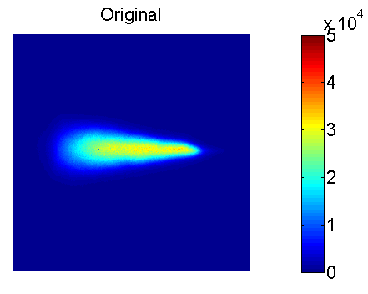
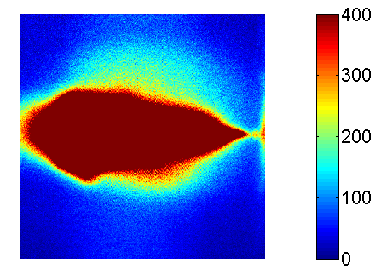
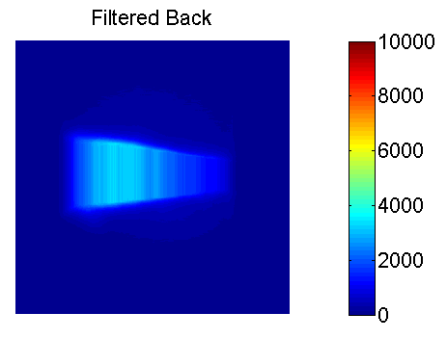
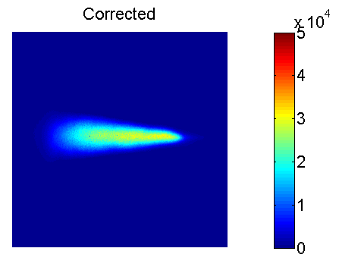
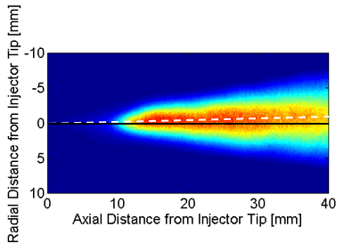
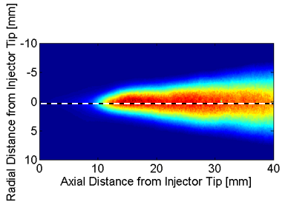
Post Processing: Careful Background Compensation and Image Alignment Needed for Accuracy
Original Rescaled
Potential Sources of Residual Background
Surface flare (unlikely for low fluence)
Toluene excited by beam reflections
LIF reflections (primary/secondary, diffuse/specular)
Residual tracer outside the jet
Correction Approaches
Maintain lower laser fluence
Spatial filtering of known reflections
Background tracer accounting (mixture fraction redefinition)
Image Rotation

Slide 21
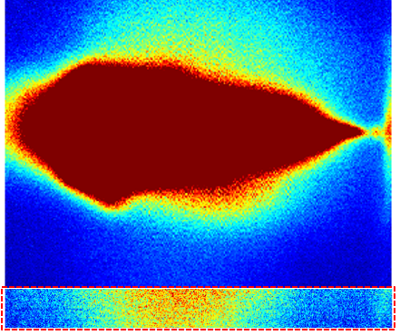
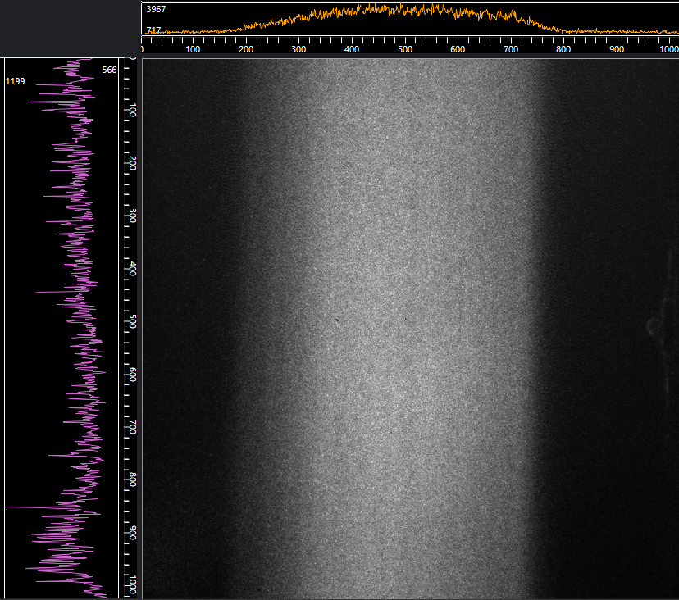
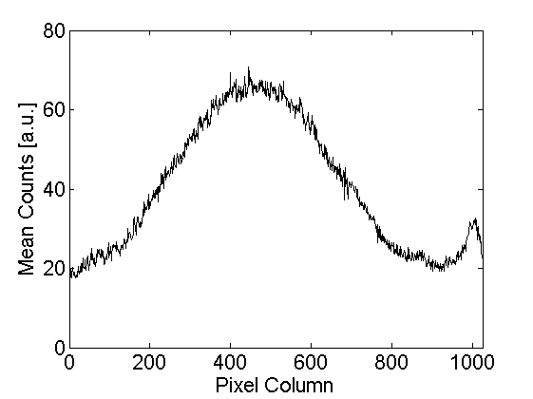
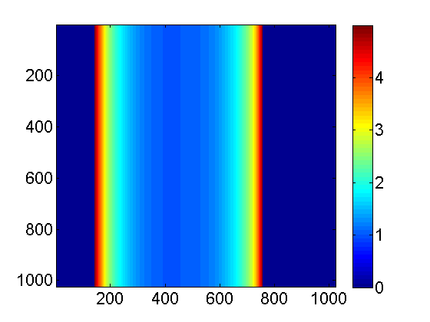

Post Processing: LIF Signal Must Be Corrected for Local Laser Power Variations
Target LIF Measurement
LIF Image of (Assumed) Uniform Acetone Concentration in Stagnant HTPV
Initial Power Correction Approach
Prior to running, let acetone evaporate in stagnant HTPV
Measure spatially varying LIF signal
Approach confounded by laser drift and sheet movement over course of testing
Revised Power Correction Approach
Take advantage of low-level LIF of residual toluene outside of jet (near front window)
Correct measured profile for background (reflections); filter for noise reduction
Shift corrector to account for non-orthogonal beam propagation
Construct final spatial power corrector matrix
Residual Toluene LIF
Apparent for all measurements
Rescaled
Measured Laser Power Profile
(Assumes uniform residual)
Local Minima Subtraction Avoids Overcorrection
Corrector after Subtraction, Filtering, and Shifting
Final Spatial Power Corrector

Slide 22




Strong Toluene LIF Temperature Sensitivity Must Be Corrected for Accurate Measurements
Fluorescence Temperature Sensitivity
Higher local temperature yields lower signal
Measured functions normalized by reference at 600K
Data generally fit between 600-900K; low ambient pressures
Sahoo Miles focusing on lower temperature predicts weaker sensitivity
As local fuel/toluene concentration goes up, mixture temperature is cooler; commensurate increase in fluorescence demands correction to lower concentration.
LIF temperature sensitivity affects:
  Ability to calibrate signal with single value at reference conditions
  Curvature of mixture fraction vs. distance from injector (fuel distribution)
Comparisons of literature correlations
Iterative approach required to reconcile local mixture fraction and temperature.
Poor Convergence
Good Convergence

Slide 23
Overview of Simulation approach
Institution/Group/Injector | CFD code | Turbulence model | Spray modelling approach | Thermodynamics
Sandia – Spray D | CONVERGE V3.0 | LES Dynamic | Blob / KH+RT | Ideal fluid EoS and droplet evaporation
CMT – Spray D | CONVERGE V2.3.12 | RANS standard k-eps | Lagrangian Parcel, KH-RT | Ideal fluid EoS and droplet evaporation
Argonne National Laboratories (ANL) – Spray C | CONVERGE V3.0 | LES Dynamic | HRM informing Lagrangian Parcel (One-way coupling); KH-RT | Ideal fluid EoS and Frossling Droplet Evaporation
Technical University of Eindhoven (EH) – Spray D | OpenFOAM | LES Dynamic | Lagrangian; Rosin-Ramler, KH-RT; Tsang Droplet Dispersion | liquidEvaporationBoil
Stanford University (SU) – Spray D | CHARLESX | LES with Implicit SGS | Plug Flow Profile | Peng Robinson

