Slide 1
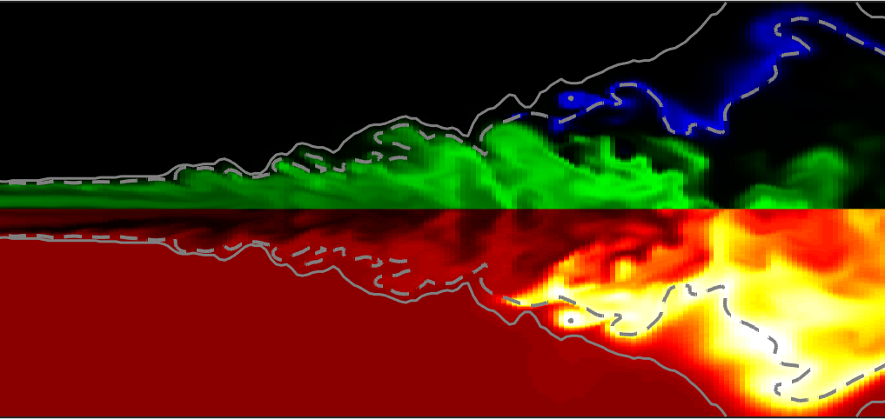
ECN 7: flame structure TOPIC
Leonardo Pachano
CMT-Motores Térmicos
25th June 2020
Valencia, Spain

Slide 2






Contributors
Qiyan Zhou, Tommaso Lucchini, POLIMI
Hesheng Bao, Bart Somers, TU/e
Fabien Tagliante, Noud Maes, Hyung sub, Julien Manin, Lyle Pickett, SNL
Emma Zhao, Muhsin Ameen, ANL
Wai Tong Chung, M. Ihme, SU
Leonardo Pachano, Daiana De Leon, José M Pastor, José M García,CMT

Slide 3
Outline
Introduction
Summary of contributions
Inert mixing field
Assessment of modeling approaches
Transition from Spray A towards Spray D and Spray C
Summary
Future directions

Slide 4
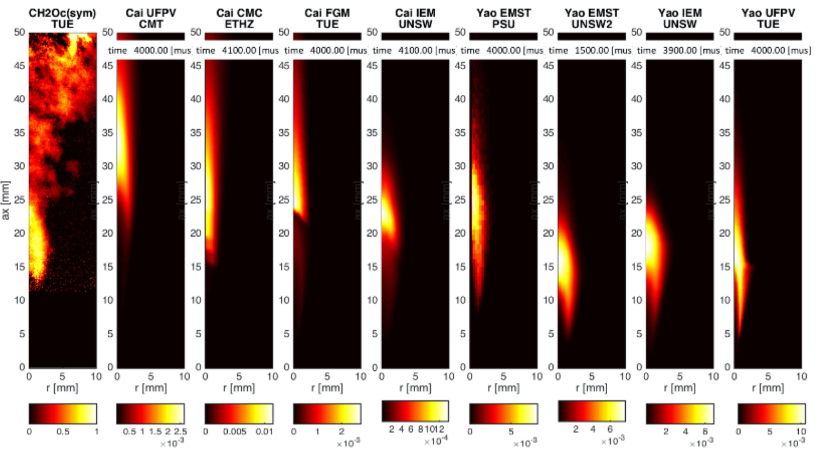
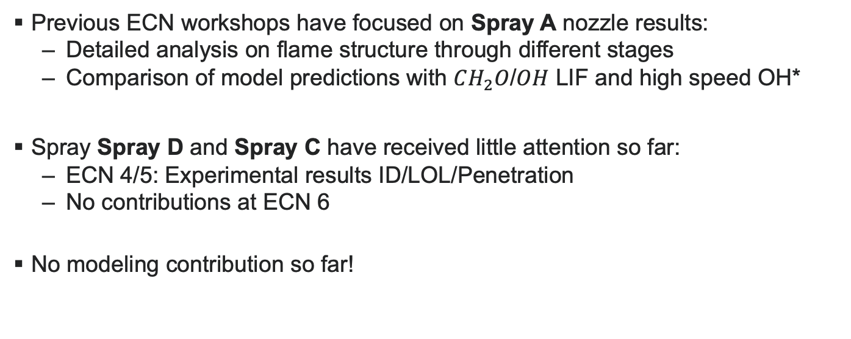
INTRODUCTION
Background
Previous ECN workshops have focused on Spray A nozzle results:
  Detailed analysis on flame structure through different stages
  Comparison of model predictions with $CH_{2}O$/$OH$ LIF and high speed OH*
Spray Spray D and Spray C have received little attention so far:
  ECN 4/5: Experimental results ID/LOL/Penetration
  No contributions at ECN 6
No modeling contribution so far!
Spray A at ECN 5

Slide 5
INTRODUCTION
As from the guidelines
MOTIVATION
  Study of bigger nozzles representative of heavy-duty applications
    Nozzle size transition from Spray A towards Spray C/D
OBJECTIVES
  Assess sub-grid flame structure assumption and turbulence modeling approaches
  Evaluate changes in flame structure: Spray A towards Spray C/D
    Experiments and modeling approaches spatially-resolved

Slide 6
Outline
Introduction
Summary of contributions
Inert mixing field
Assessment of modeling approaches
Transition from Spray A towards Spray D and Spray C
Summary
Future directions

Slide 7
contributions
[1] ECN 6.12 https://ecn.sandia.gov/workshop/ECN7/ECN6.12.mp4
[2] ECN 6.14 https://ecn.sandia.gov/workshop/ECN7/ECN6.14.mp4
[3] https://doi.org/10.1016/j.applthermaleng.2020.115136
[4] https://doi.org/10.4271/2018-01-178
Experimental
 | SNL | CMT
Nozzle | SA#A-3 [1] SD#209134 [2-3] SC#210037 [2-3] | SD#209135 [4]
Techniques | Schlieren imaging Formaldehyde and PAH imaging OH* chemiluminescence | OH* chemiluminescence
Numerical
 |  | Yao |  |  | LLNL-hybrid |  | LLNL-detailed |  | Frassoldati
RANS | WM | ANL CMT POLIMI LLNL | ANL CMT POLIMI LLNL | ANL POLIMI | CMT | LLNL | LLNL | LLNL | POLIMI | POLIMI | POLIMI
 | Flamelet | CMT POLIMI | CMT POLIMI | POLIMI | CMT | CMT | - | - | POLIMI | POLIMI | POLIMI
LES | WM | - | - | - | SNL | SNL | - | - | - | - | -
 | Flamelet | TUe | - | - | - | - | - | - | - | - | -
 |  | SA | SD | SC | SA | SD | SA | SD | SA | SD | SC

Slide 8
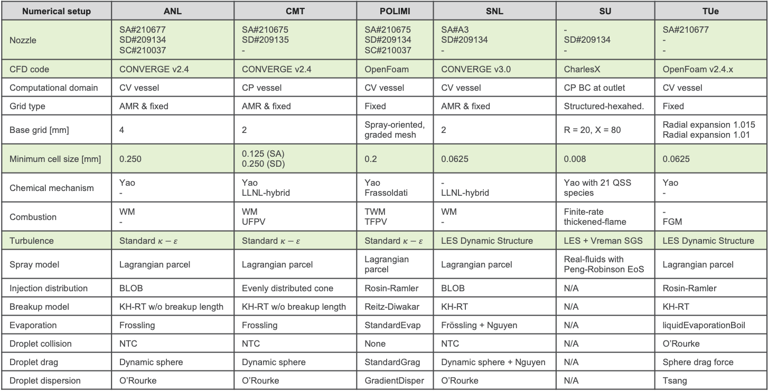
Computational setup
Numerical setup | ANL | CMT | POLIMI | SNL | SU | TUe
Nozzle | SA#210677 SD#209134 SC#210037 | SA#210675 SD#209135 - | SA#210675 SD#209134 SC#210037 | SA#A3 SD#209134 - | - SD#209134 - | SA#210677 - -
CFD code | CONVERGE v2.4 | CONVERGE v2.4 | OpenFoam | CONVERGE v3.0 | CharlesX | OpenFoam v2.4.x
Computational domain | CV vessel | CP vessel | CV vessel | CV vessel | CP BC at outlet | CV vessel
Grid type | AMR & fixed | AMR & fixed | Fixed | AMR & fixed | Structured-hexahed. | Fixed
Base grid [mm] | 4 | 2 | Spray-oriented, graded mesh | 2 | R = 20, X = 80 | Radial expansion 1.015 Radial expansion 1.01
Minimum cell size [mm] | 0.250 | 0.125 (SA) 0.250 (SD) | 0.2 | 0.0625 | 0.008 | 0.0625
Chemical mechanism | Yao - | Yao LLNL-hybrid | Yao Frassoldati | - LLNL-hybrid | Yao with 21 QSS species | Yao -
Combustion | WM - | WM UFPV | TWM TFPV | WM - | Finite-rate thickened-flame | - FGM
Turbulence | Standard $κ−ε$ | Standard $κ−ε$ | Standard $κ−ε$ | LES Dynamic Structure | LES + Vreman SGS | LES Dynamic Structure
Spray model | Lagrangian parcel | Lagrangian parcel | Lagrangian parcel | Lagrangian parcel | Real-fluids with Peng-Robinson EoS | Lagrangian parcel
Injection distribution | BLOB | Evenly distributed cone | Rosin-Ramler | BLOB | N/A | Rosin-Ramler
Breakup model | KH-RT w/o breakup length | KH-RT w/o breakup length | Reitz-Diwakar | KH-RT | N/A | KH-RT
Evaporation | Frossling | Frossling | StandardEvap | Frössling + Nguyen | N/A | liquidEvaporationBoil
Droplet collision | NTC | NTC | None | NTC | N/A | O’Rourke
Droplet drag | Dynamic sphere | Dynamic sphere | StandardGrag | Dynamic sphere + Nguyen | N/A | Sphere drag force
Droplet dispersion | O’Rourke | O’Rourke | GradientDisper | O’Rourke | N/A | Tsang

Slide 9
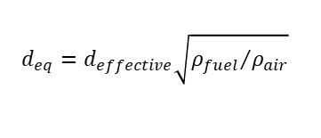
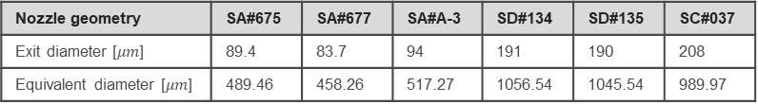
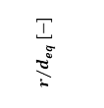
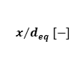
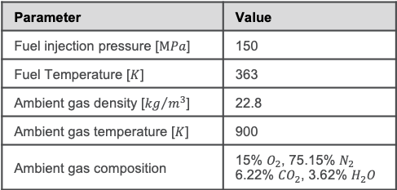

contributions
[1] F.P. Ricou , D.B. Spalding , Measurements of entrainment by axisymmetrical tur- bulent jets, J. Fluid Mech. 11 (1) (1961) 21
Target condition
Parameter | Value
Fuel injection pressure [$MPa$] | 150
Fuel Temperature [$K$] | 363
Ambient gas density [${kg}/{m^{3}}$] | 22.8
Ambient gas temperature [$K$] | 900
Ambient gas composition | 15% $O_{2}$, 75.15% $N_{2}$ 6.22% ${CO}_{2}$, 3.62% $H_{2}O$
Nozzle geometry
Nozzle geometry | SA#675 | SA#677 | SA#A-3 | SD#134 | SD#135 | SC#037
Exit diameter [$μm$] | 89.4 | 83.7 | 94 | 191 | 190 | 208
Equivalent diameter [$μm$] | 489.46 | 458.26 | 517.27 | 1056.54 | 1045.54 | 989.97
$$d_{eq}=d_{effective}\sqrt{{ρ_{fuel}}/{ρ_{air}}}$$
[1]
$$R=1\%Z_{cl}$$
$$r/{d_{eq} [−]}$$
$$x/{d_{eq} [−]}$$

Slide 10
Outline
Introduction
Summary of contributions
Inert mixing field
Assessment of modeling approaches
Transition from Spray A towards Spray D and Spray C
Summary
Future directions

Slide 11


INERT Mixing field
Ideal adiabatic mixing
Do we all start from the same mixing state?
  Some variability around ideal adiabatic mixing
  Points at T > 900 $K$
Reacting case at 0.1 $ms$

Slide 12
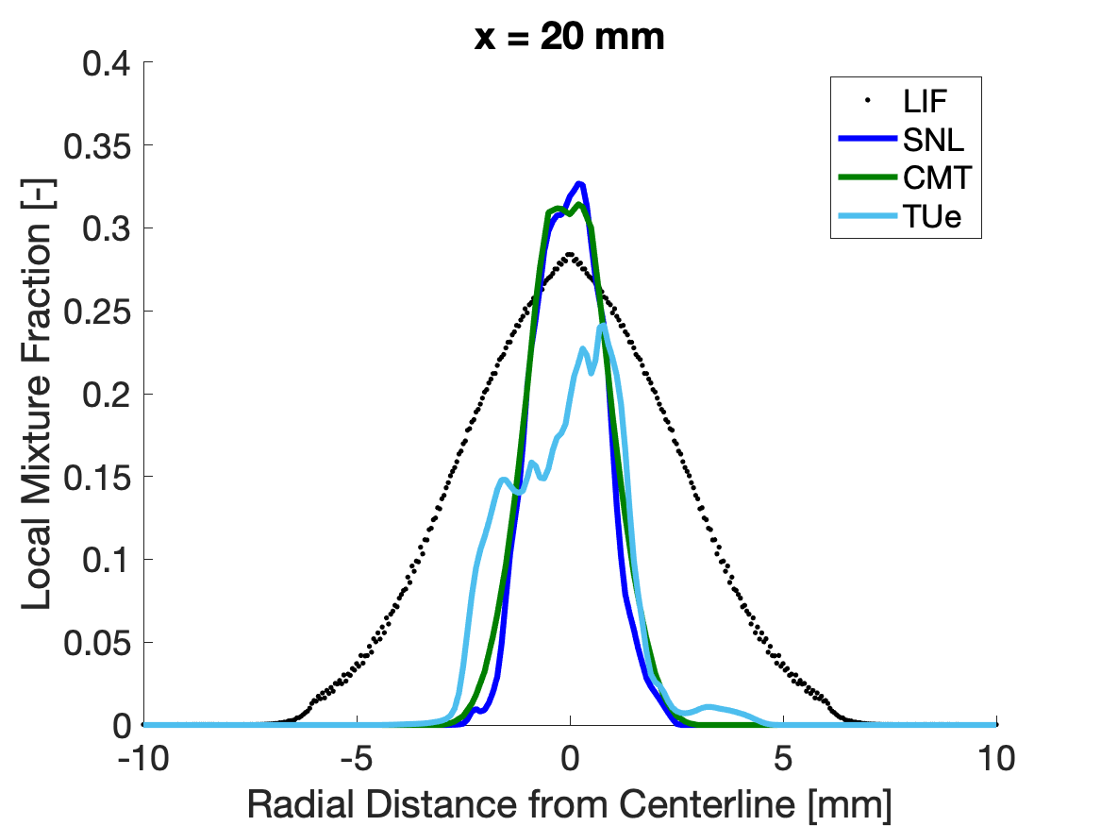
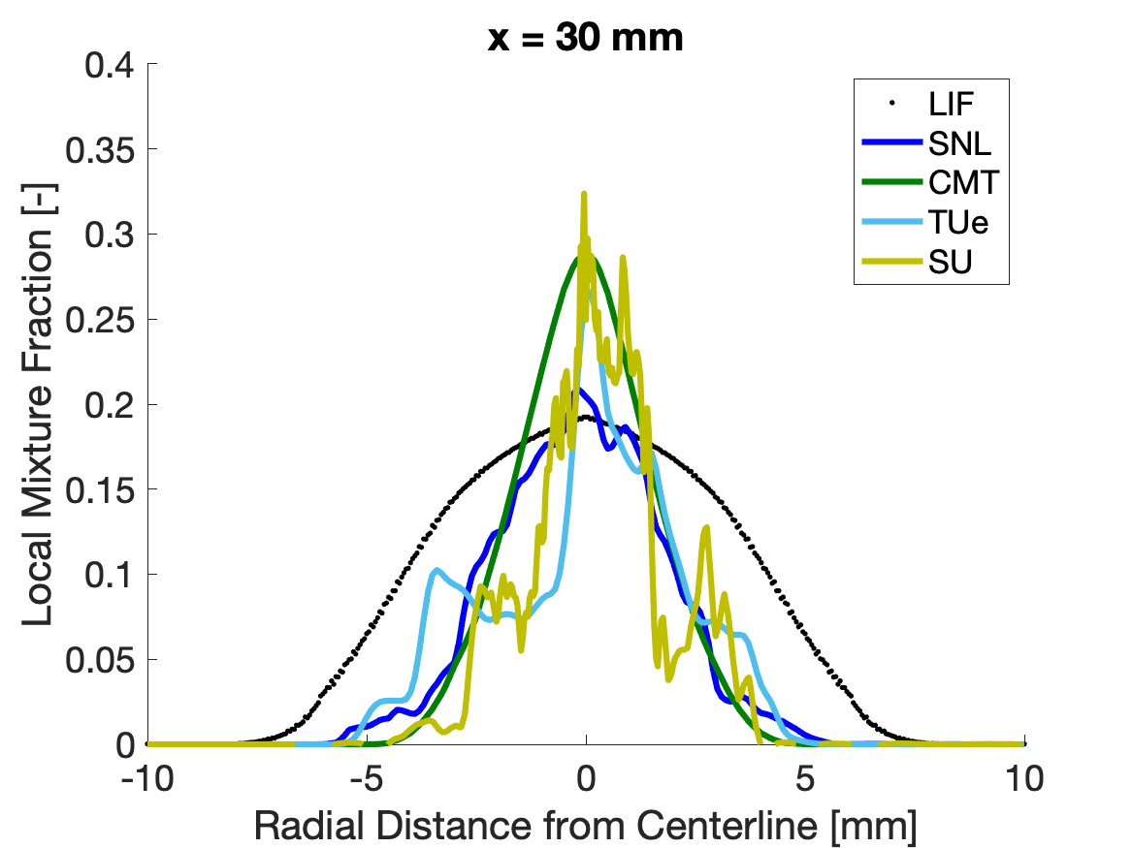
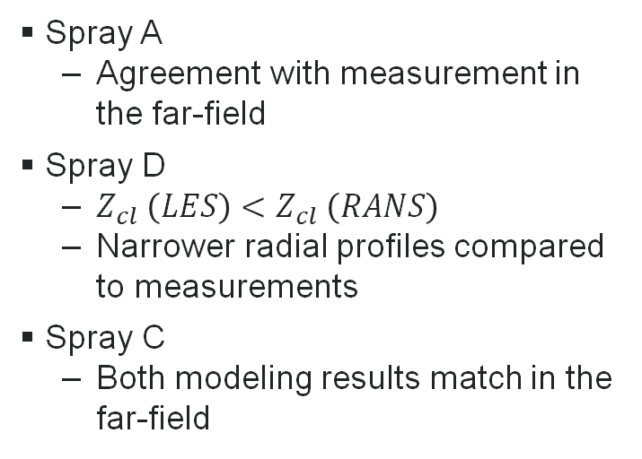
INERT Mixing field
Spray D
SNL LES → reacting case quasi-steady at x < LOL
Adapted from ECN 7 https://ecn.sandia.gov/workshop/ECN7/ECN7.0.2.mp4
Spray A
  Agreement with measurement in the far-field
Spray D
  $Z_{cl} \left(LES\right)<Z_{cl} \left(RANS\right)$
  Narrower radial profiles compared to measurements
Spray C
  Both modeling results match in the far-field
SNL LES

Slide 13
Outline
Introduction
Summary of contributions
Inert mixing field
Assessment of modeling approaches
  RANS sub-grid flame structure assumption
  Turbulence model
Transition from Spray A towards Spray D and Spray C
Summary
Future directions

Slide 14
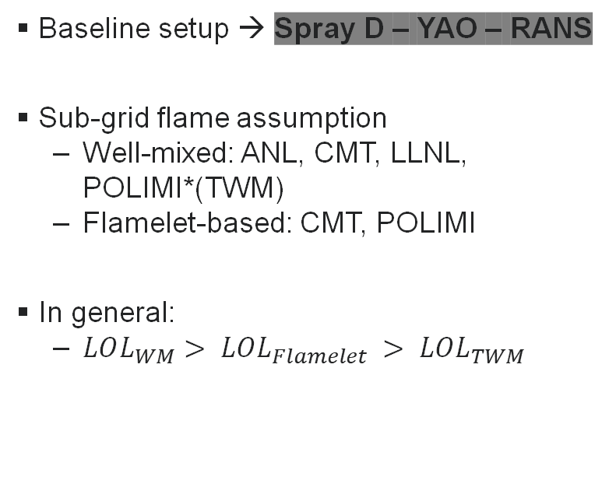

Combustion Modeling approach
Lift-off length: Assessment of sub-grid flame assumption
WM
LLNLWM #135
Baseline setup → Spray D – YAO – RANS
Sub-grid flame assumption
  Well-mixed: ANL, CMT, LLNL, POLIMI*(TWM)
  Flamelet-based: CMT, POLIMI
In general:
  $LOL_{WM}> LOL_{Flamelet} > LOL_{TWM}$
CMT WM #135
ANL WM #134
Exp. CMT #135
CMT UFPV #135
Flamelet
Exp. SNL #134
POLIMI TFPV #134
POLIMI TWM #134
TWM
Definition based on $14\% Y_{OH}^{max}$

Slide 15
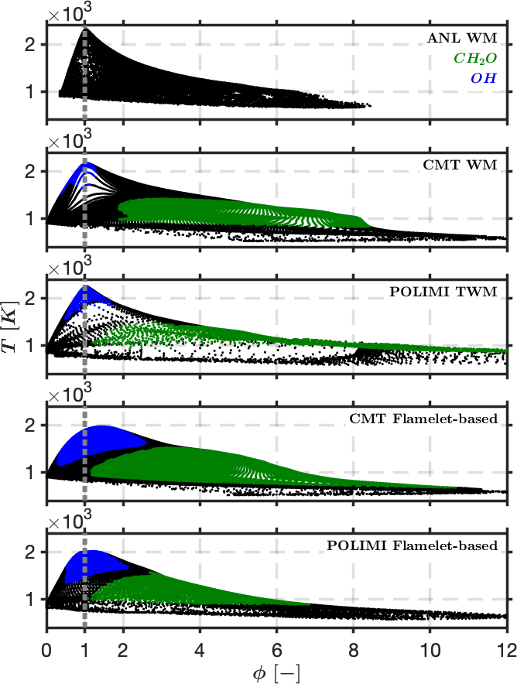


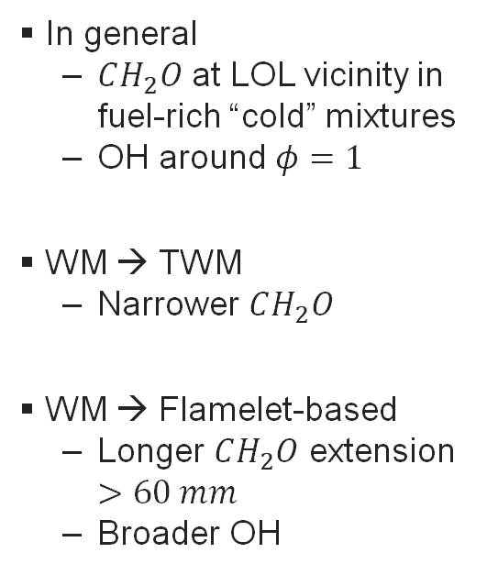
Combustion Modeling approach
Species distribution: Assessment of sub-grid flame assumption
False color images
In general
  $CH_{2}O$ at LOL vicinity in fuel-rich “cold” mixtures
  OH around $φ=1$
WM → TWM
  Narrower $CH_{2}O$
WM → Flamelet-based
  Longer $CH_{2}O$ extension $>60 mm$
  Broader OH
CFD
$$R=1\%Z_{cl}$$
Exp.
$$φ=1$$
WM
Flamelet

Slide 16
Outline
Introduction
Summary of contributions
Inert mixing field
Assessment of modeling approaches
  RANS sub-grid flame structure assumption
  Turbulence model
Transition from Spray A towards Spray D and Spray C
Summary
Future directions

Slide 17
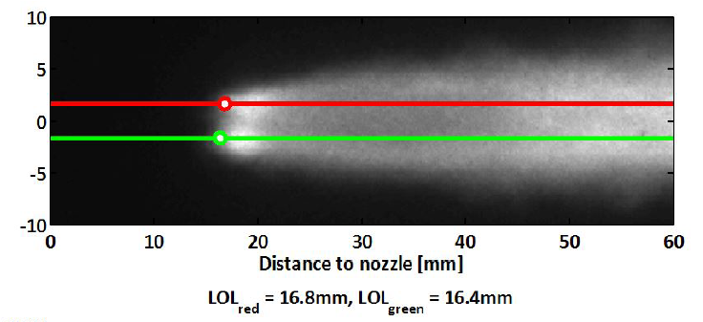
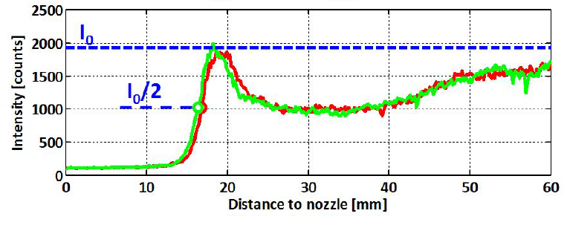



Comb. / Turbulence Modeling approach
Lift-off length
Baseline setup → Spray D – LLNL-h
  WM-LES: SNL
  WM-RANS: CMT, LLNL
  UFPV-RANS: CMT
WM-LES
  $LOL_{WM−LES}<LOL_{WM−RANS}$
  Comparable to UFPV-RANS
$14\% Y_{OH}^{max}$ and $OH^{∗}$ yield similar results
WM-RANS
LLNLWM-RANS #135
CMT WM-RANS #135
Exp. CMT #135
Exp. SNL #134
SNL WM-LES #134
CMT UFPV-RANS #135
Experiments
Definition based on $14\% Y_{OH}^{max}$
Markers → Definition based on $OH^{∗}$
ECN 6.13 Evaluation of hybrid LLNL 65 species mechanism including formaldehyde and OH*, and lift-off length definition

Slide 18
Comb. / Turbulence Modeling approach
Species distribution
Exp
Similar species distributions
  Wider for WM-LES and UFPV-RANS compared to WM-RANS
CFD OH-based
CFD OH*-based

Slide 19
Outline
Introduction
Summary of contributions
Inert mixing field
Assessment of modeling approaches
Transition from Spray A towards Spray D and Spray C
Summary
Future directions

Slide 20
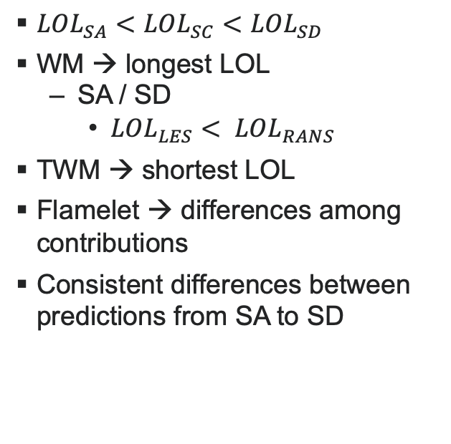
Transition SA → SD/SC
Lift-off length
Exp. CMT #675
$LOL_{SA}<LOL_{SC}<LOL_{SD}$
WM → longest LOL
  SA / SD
    $LOL_{LES}< LOL_{RANS}$
TWM → shortest LOL
Flamelet → differences among contributions
Consistent differences between predictions from SA to SD
Exp. SNL #677
Exp. CMT #135
Exp. SNL #134
Exp. SNL #037

Slide 21
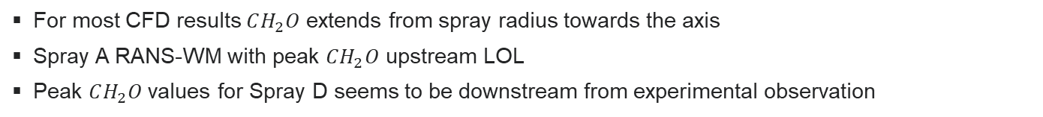

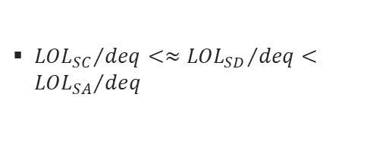
Transition SA → SD/SC
Species distribution: WM
PAH
$$OH$$
$$CH_{2}O$$
${{LOL}_{SC}}/{deq}<≈{{LOL}_{SD}}/{deq}<{{LOL}_{SA}}/{deq}$
For most CFD results $CH_{2}O$ extends from spray radius towards the axis
Spray A RANS-WM with peak $CH_{2}O$ upstream LOL
Peak $CH_{2}O$values for Spray D seems to be downstream from experimental observation

Slide 22
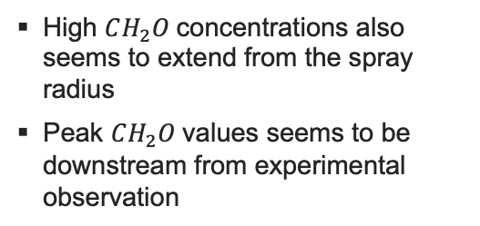

Transition SA → SD/SC
Species distribution: Flamelet-based
PAH
$$OH$$
$$CH_{2}O$$
High $CH_{2}O$concentrations also seems to extend from the spray radius
Peak $CH_{2}O$values seems to be downstream from experimental observation

Slide 23
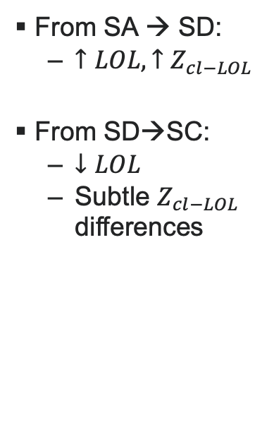
Transition SA → SD/SC
Mixture fraction at LOL
From SA → SD:
  $↑LOL, ↑Z_{cl−LOL}$
From SD→SC:
  $↓LOL$
  Subtle $Z_{cl−LOL}$ differences
Exp. CMT #675
Exp. SNL #037
Exp. CMT #135
Exp. SNL #134
Exp. SNL #677

Slide 24
Outline
Introduction
Summary of contributions
Inert mixing field
Assessment of modeling approaches
Transition from Spray A towards Spray D and Spray C
Summary
Future directions

Slide 25
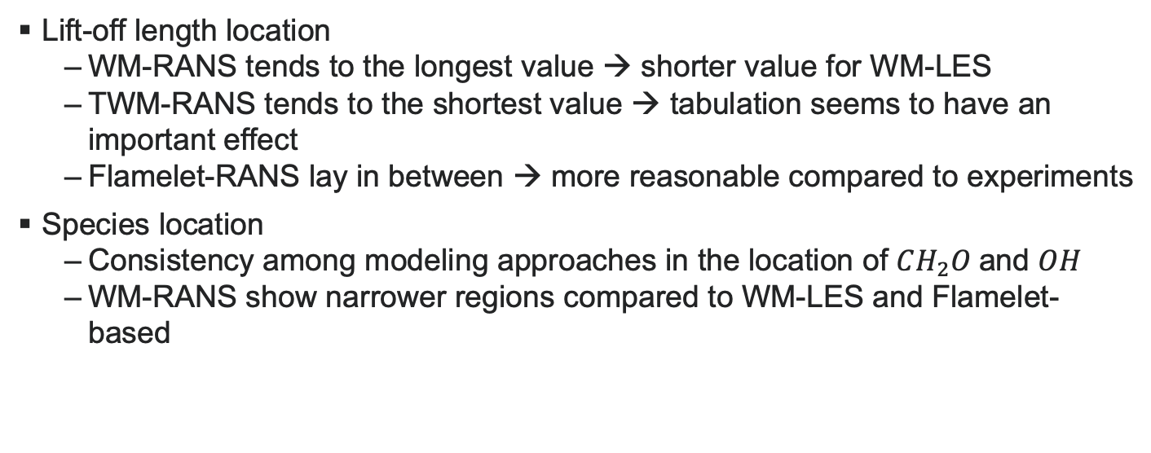
Summary
Modeling approaches
Lift-off length location
  WM-RANS tends to the longest value → shorter value for WM-LES
  TWM-RANS tends to the shortest value → tabulation seems to have an important effect
  Flamelet-RANS lay in between → more reasonable compared to experiments
Species location
  Consistency among modeling approaches in the location of $CH_{2}O$and $OH$
  WM-RANS show narrower regions compared to WM-LES and Flamelet-based

Slide 26


Summary
Nozzle transition
Lift-off length location
  Both experiments and modeling results point at $LOL_{SA}<LOL_{SC}<LOL_{SD}$
  Predicted local mixing conditions at LOL
    $↑Z_{cl−LOL}$from Spray A to Spray D / Spray C
    No clear trend from Spray D to Spray C
Species location
  Good agreement for SA
  Room for improvement for SD
    Maximum $CH_{2}O$ location
    LOL sensitivity to pre-burn?
      Exp. #134 pre-burn
      Exp. #135 $O_{2}$ / $N_{2}$

Slide 27
Outline
Introduction
Summary of contributions
Inert mixing field
Assessment of modeling approaches
Transition from Spray A towards Spray D and Spray C
Summary
Future directions

Slide 28
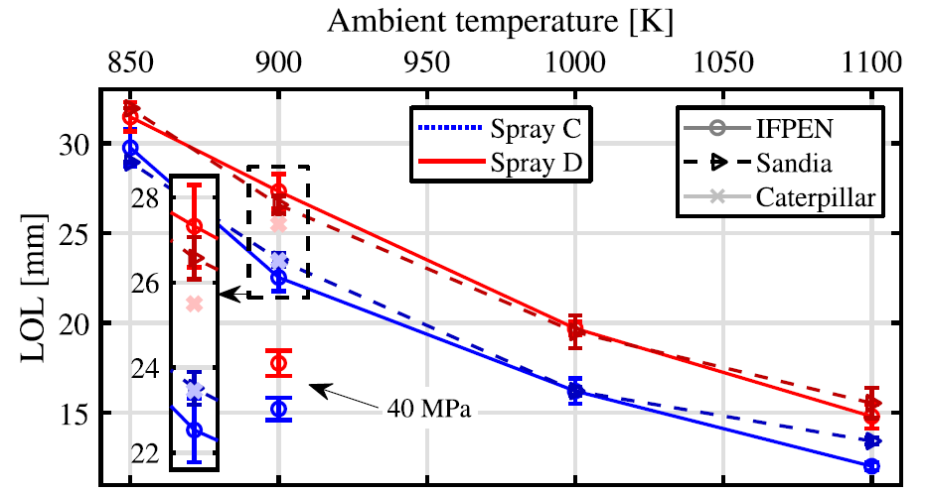
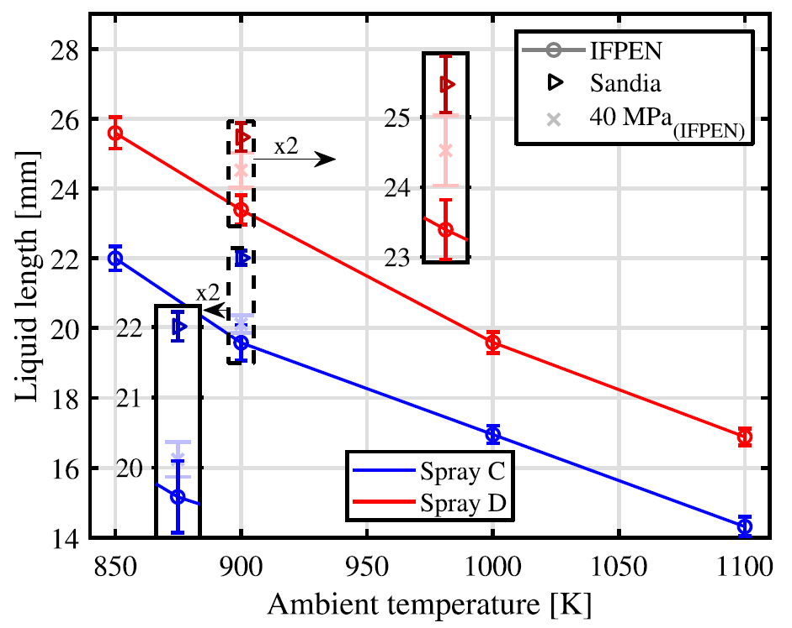
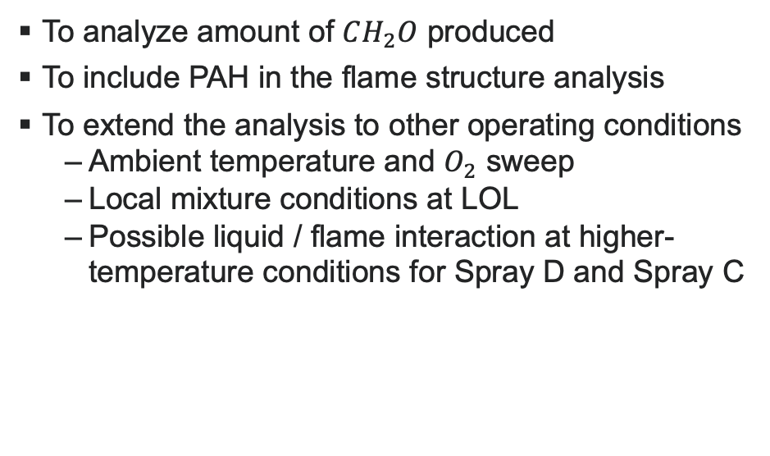
Future directions
To analyze amount of $CH_{2}O$ produced
To include PAH in the flame structure analysis
To extend the analysis to other operating conditions
  Ambient temperature and $O_{2}$ sweep
  Local mixture conditions at LOL
  Possible liquid / flame interaction at higher-temperature conditions for Spray D and Spray C
Source: Maes et al., Applied Thermal Eng. 2020

Slide 29

Future directions
Open topics
Standardization of files to be shared / sharing method
Mixing predictability
For the comparison with PLIF results, the use of $(Y_{k}ρ)$ instead of $Y_{k}$from CFD might be more reasonable
Spray A
Spray D
WM
Flamelet

Slide 30
ACKNOWLEDGEMENTS
CMT-Motores Térmicos greatly acknowledge the financial support the Government of Spain through the CHEST Project (TRA2017-89139-C2-1-R).
Support for the Work conducted at the Combustion Research Facility, Sandia National Laboratories, Livermore, CA, was provided by the U.S. Department of Energy, Office of Vehicle Technologies and by Sandia National Laboratories under the Laboratory-Directed Research and Development (LDRD) program. Sandia National Laboratories is a multi-mission laboratory managed and operated by National Technology and Engineering Solutions of Sandia, LLC., a wholly ownedsubsidiary of Honeywell International, Inc., for the U.S. Department of Energy’s National Nuclear Security Administration under contract DE-NA0003525
Hesheng Bao from TU/e greatly acknowledge the financial support from China Scholarship council

