Slide 1
Internal and near-nozzle synchrotron x-ray diagnostics for spray “c”
ECN7 – Diesel sprays – June 17, 2020
Aniket Tekawade
Postdoctoral Appointee
Energy Systems Division
Brandon Sforzo
Mechanical Engineer
Energy Systems Division
Alan Kastengren
Physicist
X-ray Science Division
Christopher Powell
Principal Scientist
Energy Systems Division

Slide 2
Acknowledgements:
Use of APS 7-BM beamline supported by U.S. Department of Energy (DOE)
Contract No. DE-AC0206CH11357
X-ray fuel spray sponsored by DOE Vehicle Technologies Program
Gurpreet Singh & Michael Weismiller

Slide 3
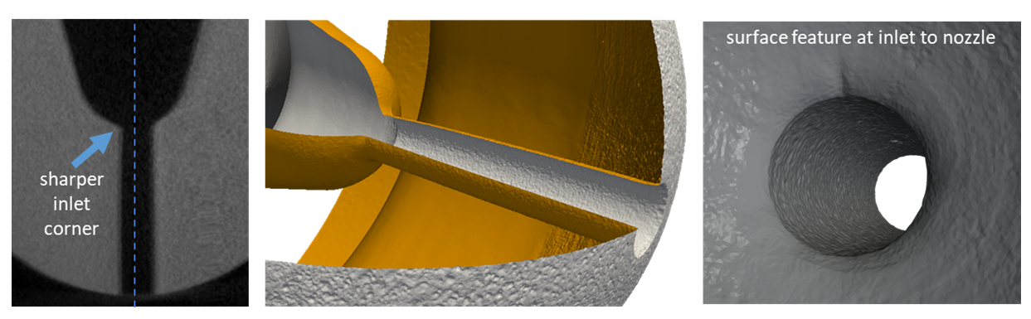
Asymmetric inlet corners are a motivation to study internal flow in Spray C
CFD modeling carried out using real Spray C (#37) extracted from X-ray CT showed asymmetric internal flow due to cavitation from sharper inlet corner.
Without modifications for optical access, could these predictions be validated?
Tekawade et al, Scientific Reports (2020): https://doi.org/10.1038/s41598-020-65701-x
20 um

Slide 4
3D INTERNAL FLOW IMAGING

Slide 5
Synchrotron X-ray imaging setup to visualize high-speed flow through ~ 2 mm steel
Polychromatic X-ray beam used for full-field imaging
Acquire ~ 200 events, then rotate the fuel injector (~ 0.5 deg) to repeat
Exposure time of acquisition: 1 millisecond (during steady-state phase of injection)
Increase sample-detector distance to produce sufficient “phase-contrast”
Tekawade et al, Scientific Reports (2020): https://doi.org/10.1038/s41598-020-65701-x
1500 bar pressure fuel
N₂ gas

Slide 6
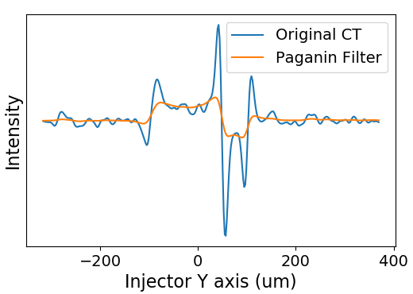
Data-processing pipeline to achieve 3D flow visualization
Computed
Tomography
Paganin filter
Reconstruction by Fourier Transform method
Data is dominated by phase contrast and very weak absorption contrast
A low-pass filter for partially reducing phase contrast edges
Key message: Data can be compared to liquid volume fraction (LVF) from CFD.
Notes:
Get rid of block at lower left or rework

Slide 7
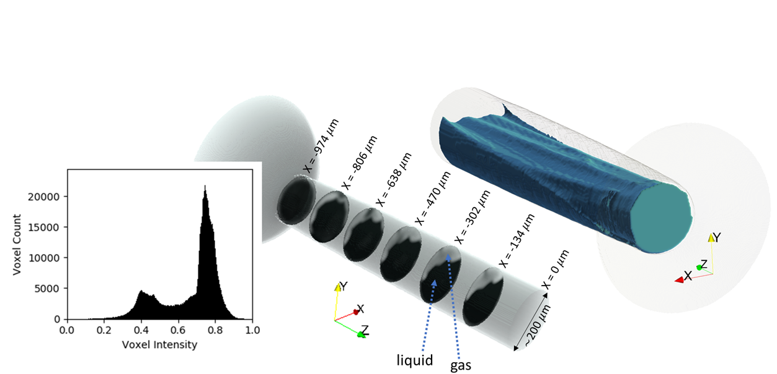
The histogram of the voxel intensity reveals two-phase nature of flow
Voxel intensity does not numerically equate with liquid volume fraction due to presence of extreme values (phase contrast and outliers) and unknown composition of liquid phase (dissolved gas?).
Persistent flow-separation / cavitation is observed from top inlet corner to the exit.
Tekawade et al, Scientific Reports (2020): https://doi.org/10.1038/s41598-020-65701-x
Liquid phase
liquid
gas
Is this hydraulic flip?

Slide 8
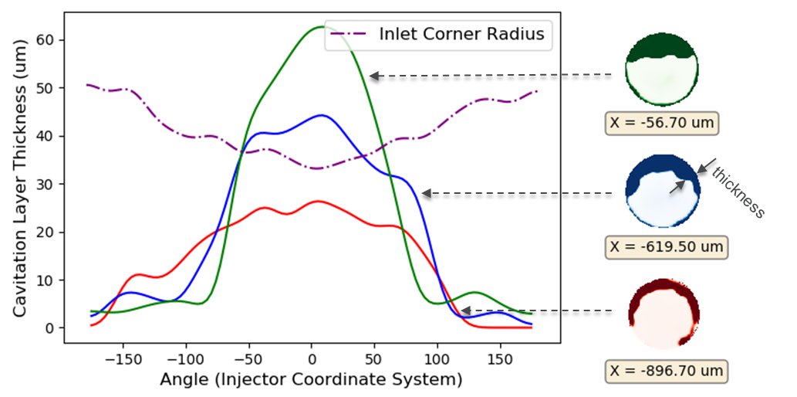
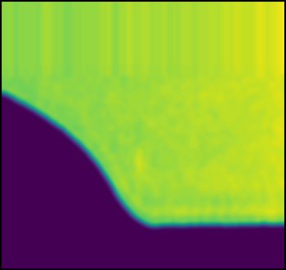
Smaller inlet corner radius causes larger flow separation
The liquid-gas interface is tracked is segmented and its azimuthal location is plotted against inlet radius of curvature (measured on the real geometry)
The interface appears wrinkled due to geometric irregularities at the inlet
Data available at: https://anl.box.com/v/XRaySpray
Inlet corner radius

Slide 9
Additional data at 0.1 ms time resolution shows flow-development timescales
Flow appears fully developed for needle lift over 100 microns
This data is too noisy (SNR ~ 1) for further analysis

Slide 10
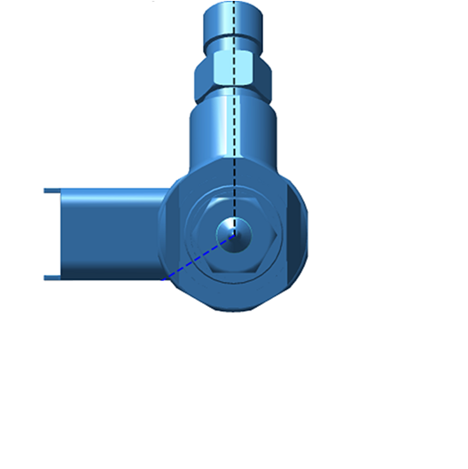
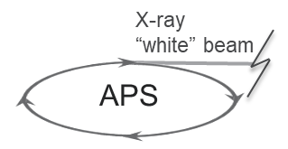
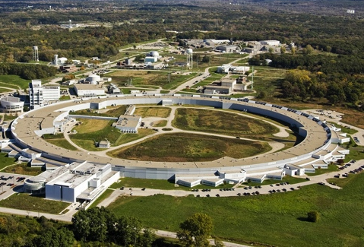
X-ray Spray Tomography with radiographic measurements for near-nozzle density
Incoming beam was focused for time-resolved point measurements
Data processing includes projected mass calculation and tomographic reconstruction
Near-nozzle mass/volume slices obtained for Spray C at 0.1, 2 and 5 mm from nozzle exit
Sample
8 keV beam
(spot-size 4x6 $μm^{2}$)
(spray)
M is the projected mass / unit area
Mass/volume or density field
$$M\left(x,y,θ,t\right)=−\frac{1}{μ}\text{log}\left[\frac{I\left(x,y,θ,t\right)}{I_{0}\left(t\right)}\right]$$
CT reconstruction
$$ρ\left(x,y,t\right)$$

Slide 11
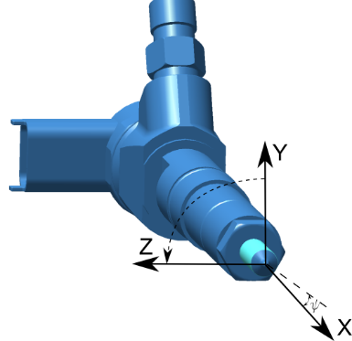
In addition to flow-separation, spray tomography also show transients in the spray
Results acquired at 20 bar ambient, 55 deg C injector
Consistent vapor void at top inlet corner
“donut shaped” void observed within first 0.2 ms from SOI
Sforzo et al, ILASS-Europe (2019), Paris, France: https://pdfs.semanticscholar.org/ae43/b4f8914abff64f1613e09f28ddfbc757660b.pdf

Slide 12
Comparison with Spray D reveals the SOI transient is unique to Spray C
Transient occurs several frames after the SOI and before EOI and is associated with the needle-lift
Recall that EOI is slower than SOI in Spray-C
Spray D
22%
Spray C

Slide 13
In conclusion
Near-nozzle spray tomography shows transient behavior associated with geometric asymmetry and needle-lift.
Internal flow imaging shows evolution of flow-separation and cavitation as it emerges into a spray.
(previously) USAXS data for Spray C & D reports near-nozzle droplet size distribution.
Please check out the following resources:
YouTube channel
https://www.youtube.com/channel/UCCUDfAkHUNXep8FGAG7Lu-w
Data folder
https://anl.app.box.com/v/XraySpray

Slide 14
BACKUP SLIDES

Slide 15
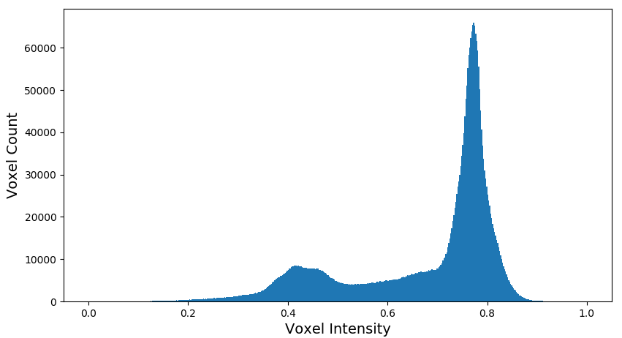
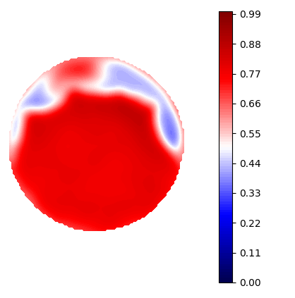
SEGMENTATION of liquid & GAS phase
Histogram of intensities reveals “two-phase” nature of flow
Attempt to fit a Gaussian Mixture Model to capture the intensity range for pixels part of the fluid layer
Note the extreme values are voxels with phase contrast not completely recovered from Paganin filter – low spatial resolution of liquid-gas interface
“liquid” pixels
cavitation layer
phase contrast
“interface”
phase contrast

Slide 16
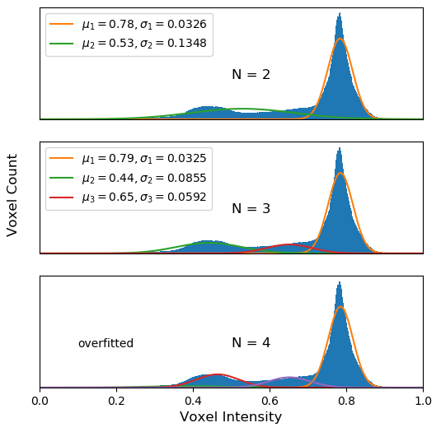
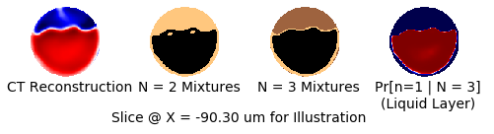
SEGMENTATION – LIQUID from gas
Fit a Gaussian Mixture Model to histogram data
N = 3 is a slightly better choice as the extreme values (phase contrast) are captured in the third component
Interpretation of P(Pixel = Liquid): It’s the posterior probability that a given voxel was drawn from the largest component

Slide 17
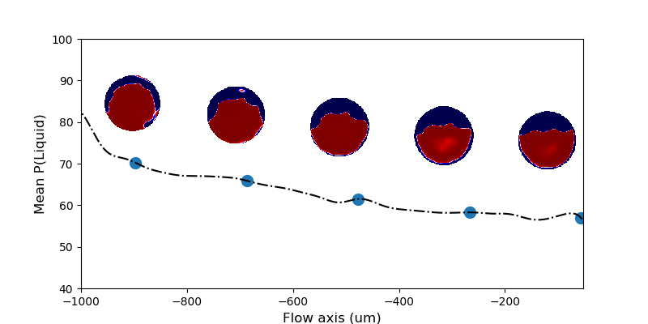
Liquid probability
Intensity map scales with higher liquid fraction
Mean P(liquid) is shown at various cross-sections in the flow
Is this correlated with liquid volume fraction predicted by CFD?

