Slide 1
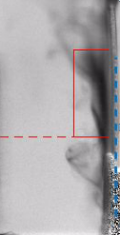
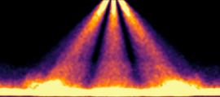
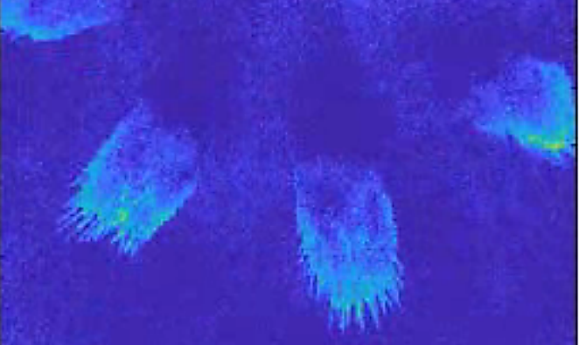
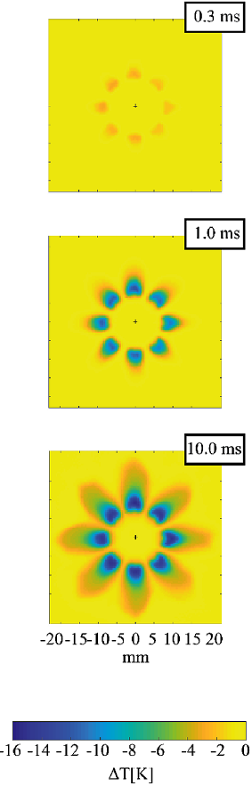
TOPIC 10:
Spray G wall impact and combustion
ECN 7 online workshop
Argonne
X-ray
Sandia
DBI
IFPEN
UV absorption
Federico II
Ist. Motori - IR
Michele BARDI (IFPEN)
michele.bardi@ifpen.fr
Topic Lead
10th June 2020 – Online Presentation

Slide 2
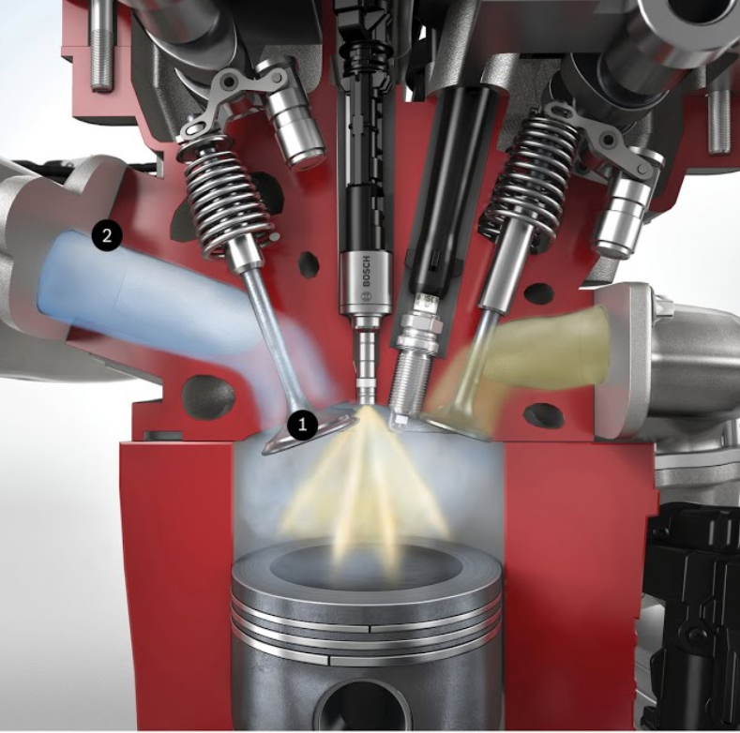
Objectives
Soot formation in GDI is mainly related to fuel wall wetting
The physics/chemistry related to liquid fuel film, its interaction with premixed flame and soot formation is not fully understood yet:
  it is not correctly predicted by current models
  experimental investigations can be found in the literature (growing interest) but results are still sparse
Objective of Topic 10:
  to build a database of consistent data for model validation following the “Spray A” approach
Objective of the current presentation:
  Provide a state of the art of the activities carried out on this topic by ECN community
    ongoing and future activities
    set main challenges for future investigations
From online Bosch press release
https://www.bosch-presse.de/pressportal/de/en/gasoline-injection-systems-42304.html

Slide 3
Topic Contributors
A lot of material has been received… Thanks to the topic contributors!
Argonne: B. Sforzo, R. Torelli, C. Powell, S. Som
Darmstadt University : B. Böhm
Duisburg-Essen Universtiy : N. Jüngst, S. Kaiser
IFPEN: D. Aubagnac-Karkar , K. Shway, M. Chemak
Istituto Motori: L. Allocca, A. Montanaro
Oakland University: Mingyuan Tao, Peng Zhao
ORNL: M. Wissink
Sandia: L. Pickett, S. Skeen, E. Cenker, J. Manin, M. Arienti
Università Federico II: M. Contino, G. Cardone
Wisconsin University: Todd Fansler

Slide 4
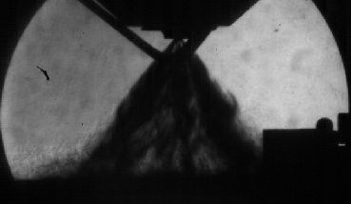
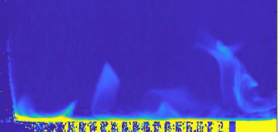
Topic 10: a wide topic
Spray-wall interaction
Fuel film formation/evaporation
Film / Flame interaction / Soot
wall
Istituto Motori* Montanaro et al, SAE 2016-01-2199
Spray Macroscopic parameter measurement
Liquid and Vapor phase
Argonne:
X-ray measurements
3D-CFD simulations
Istituto Motori/Fed. II: Wall Heat-flux (IR)
IFPEN: Film evap. and wall temp. (1D model)
Sandia: spray impact and soot formation (soot extinction / DBI )
IFPEN: film thickness (UV absorption) + Soot extinction (DBI)
Duisburg Essen: Film thickness (LIF) + Soot vol. fraction (LII)* *Jüngst and Kaiser SAE2019-01-0293
Oakland university: film evaporation + flame interaction (1D model)* *Mingyuan Tao et al, IJER 2018
Boundary conditions not consistent yet:
wall distance, fuel, ambient conditions…

Slide 5
Topic 10: a wide topic
Spray-wall interaction
Fuel film formation/evaporation
Film / Flame interaction / Soot
wall
Istituto Motori* Montanaro et al, SAE 2016-01-2199
Spray Macroscopic parameter measurement
Liquid and Vapor phase
Argonne:
X-ray measurements
3D-CFD simulations
Istituto Motori/Fed. II: Wall Heat-flux (IR)
IFPEN: Film evap. and wall temp. (1D model)
Sandia: spray impact and soot formation (soot extinction / DBI )
IFPEN: film thickness (UV absorption) + Soot extinction (DBI)
Duisburg Essen: Film thickness (LIF) + Soot vol. fraction (LII)* *Jüngst and Kaiser SAE2019-01-0293
Oakland university: film evaporation + flame interaction (1D model)* *Mingyuan Tao et al, IJER 2018

Slide 6
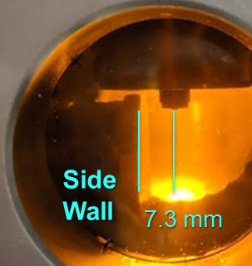
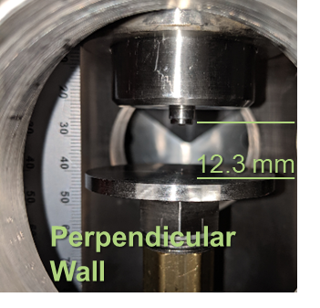
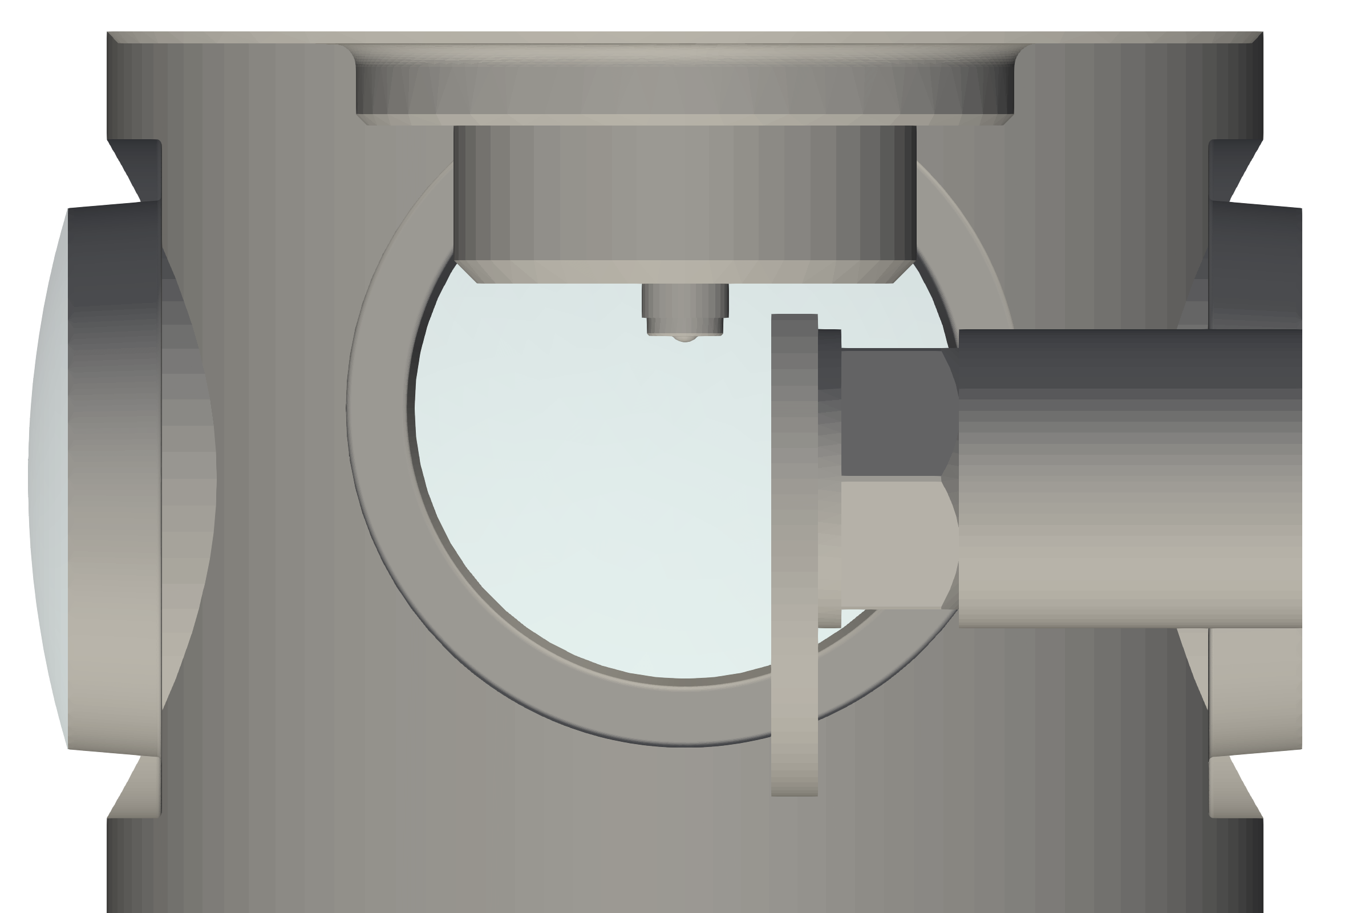
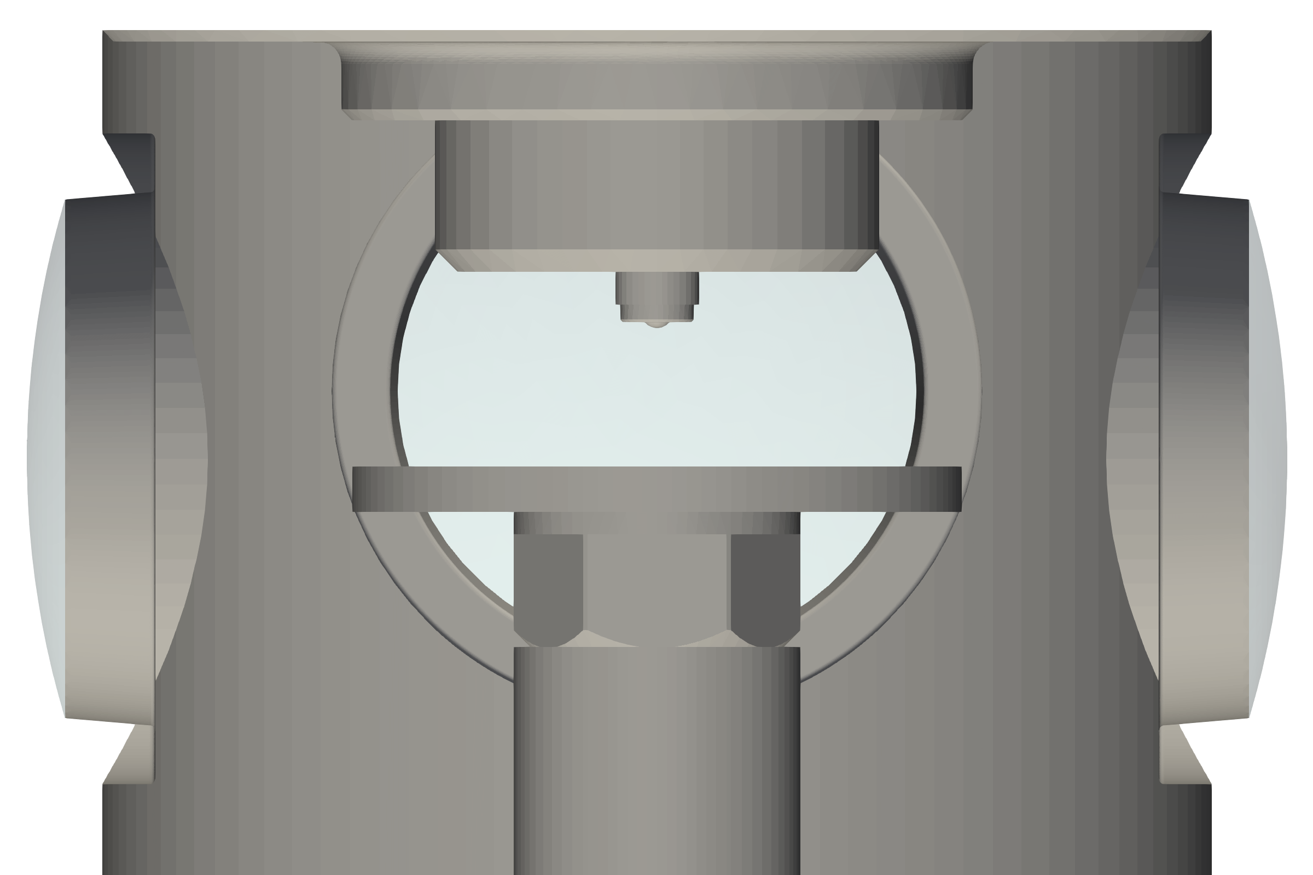
Spray-Wall interaction
Argonne radiography and imaging
Radiography for
  Perpendicular wall
  Side wall
Imaging performed for side-wall
G3 (Pamb= 1 bar, Pinj = 200 bar)
G2 (Pamb= 0.5 bar, Pinj = 200 bar, Tinj = 90 C)
Iso-octane used for all experiments
Wall-distance:
  12.3 mm for perpendicular config.
  7.3 mm wall plane from injector axis in side configuration

Slide 7
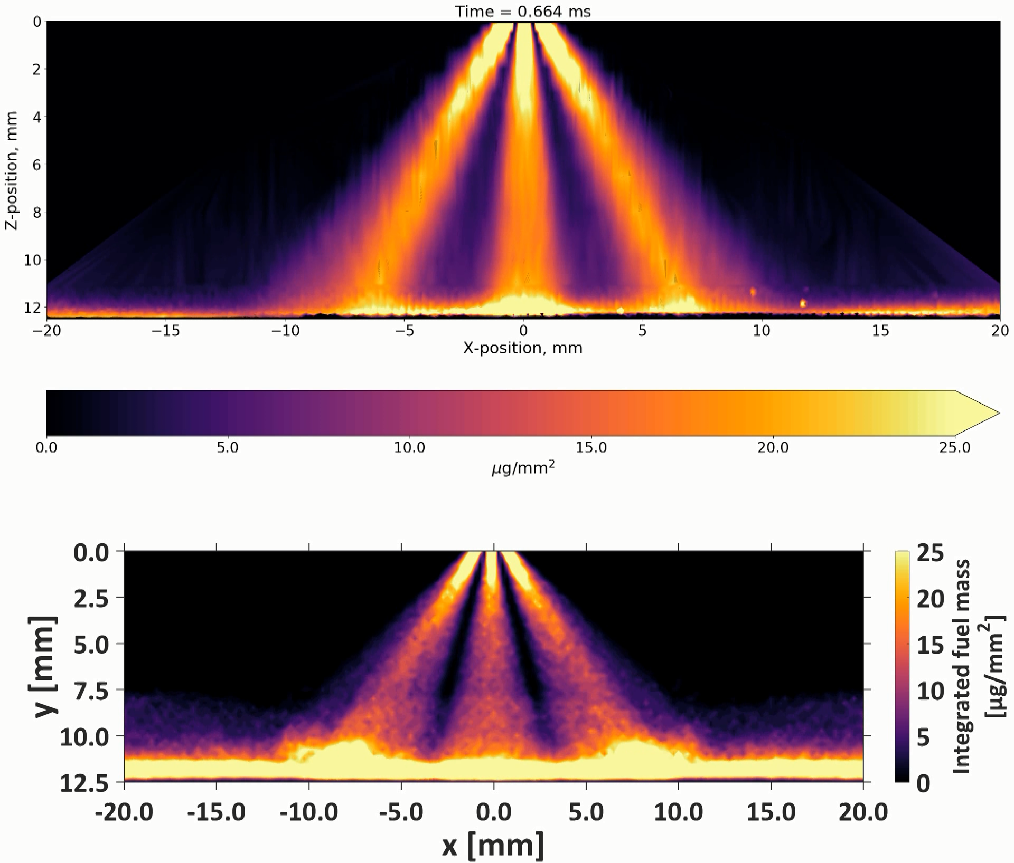
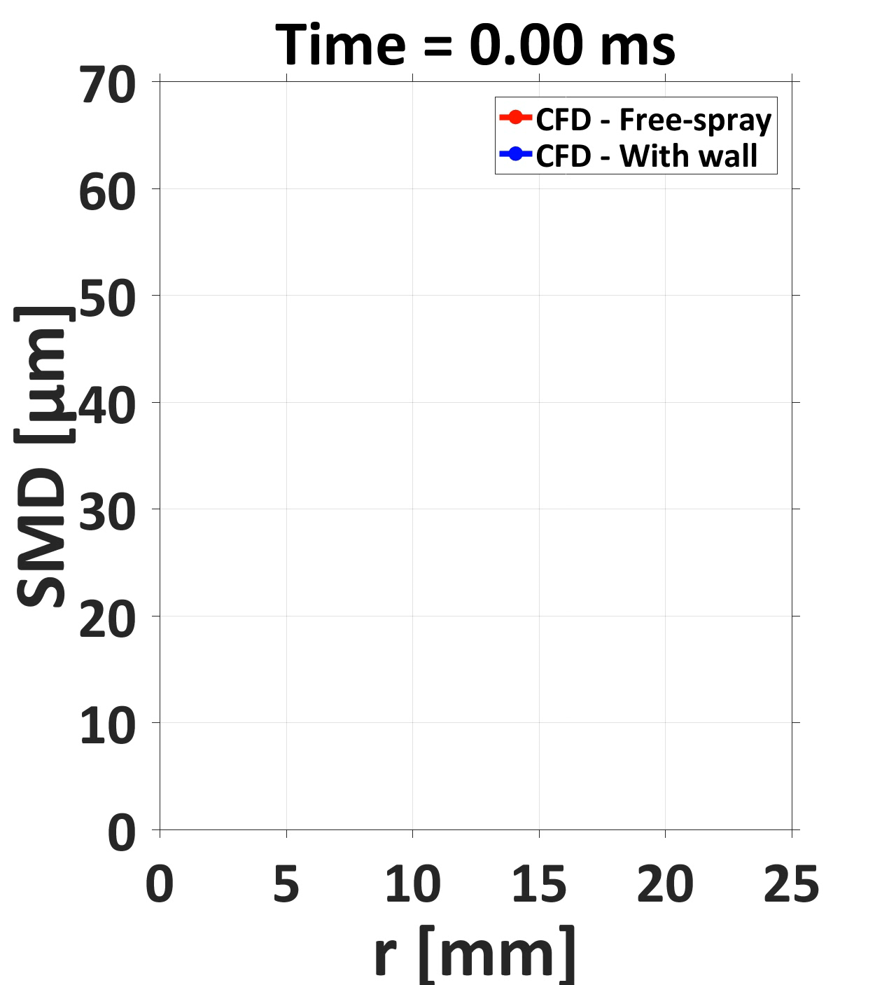
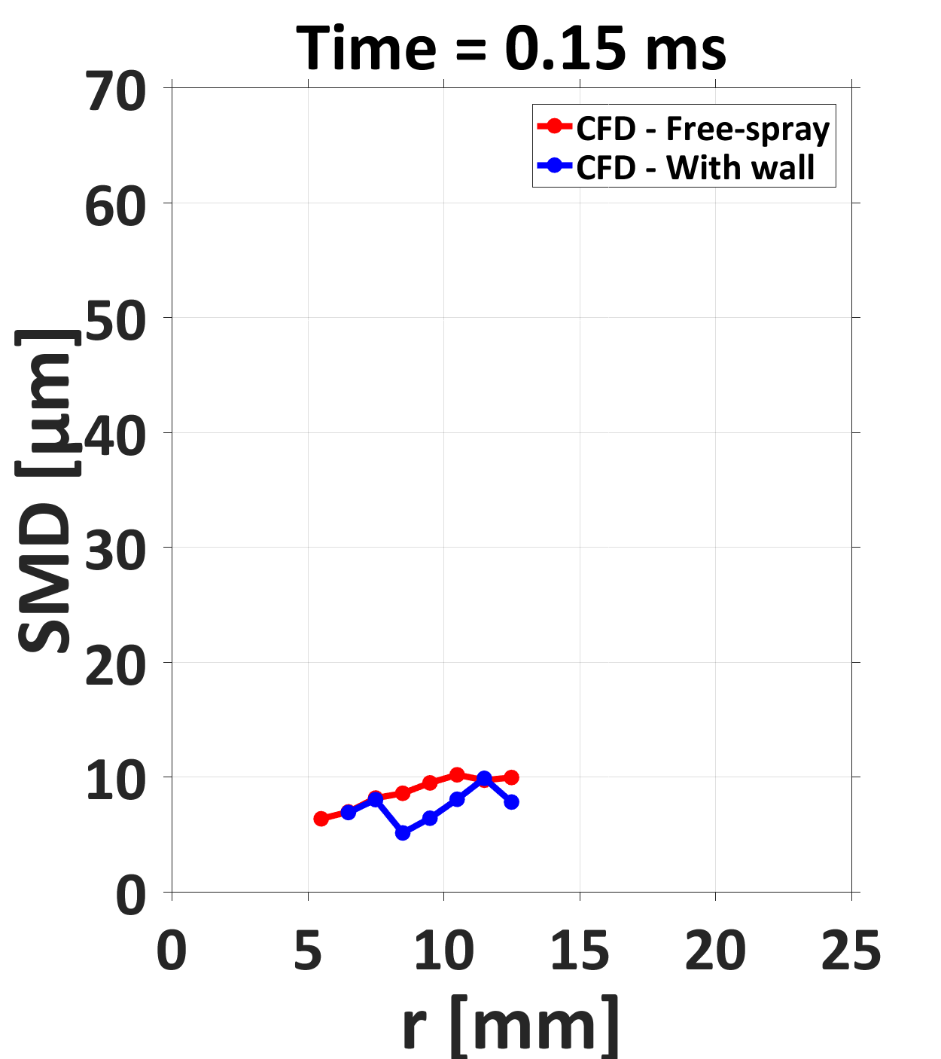
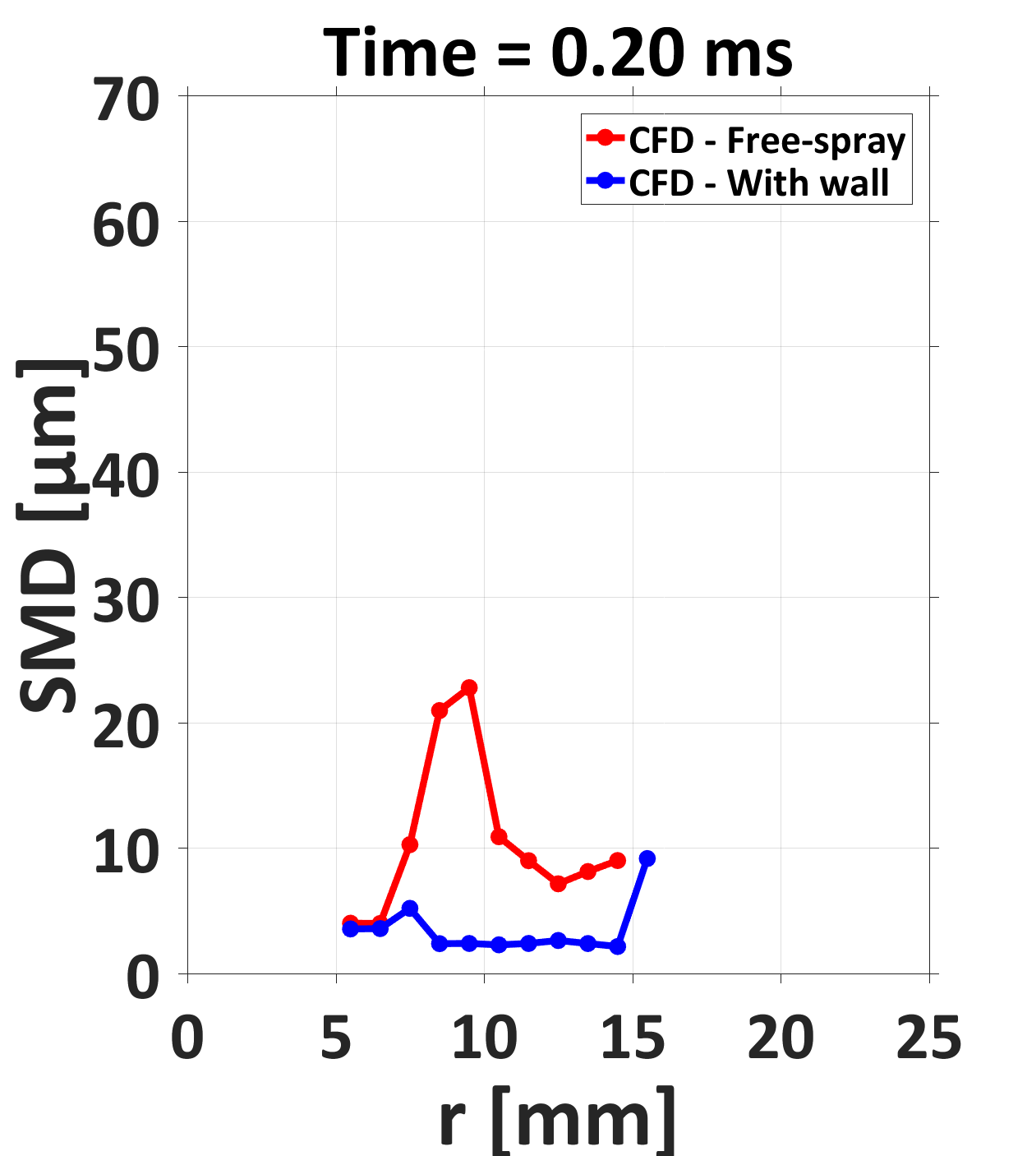
Spray-Wall interaction
CFD 3D simulations at Argonne
Software: CONVERGE v3.0
Wall-film model: O’Rourke and Amsden (SAE 2000-01-0271)
CFD-Argonne
12 mm from injector
X-ray
z [mm]

Slide 8
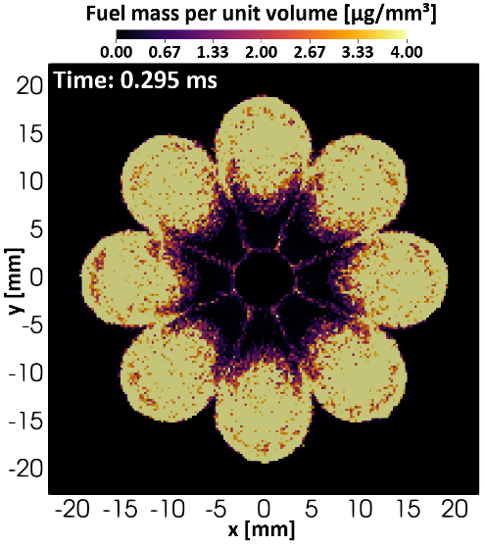
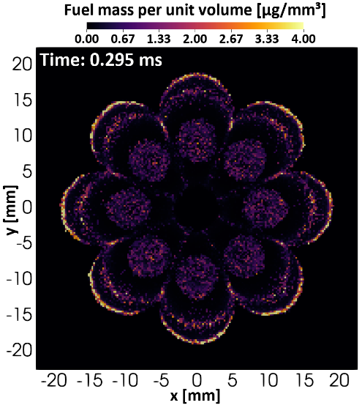
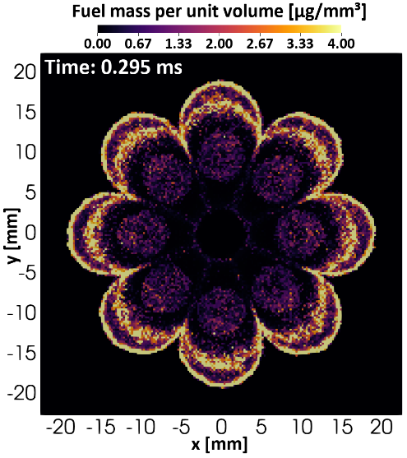
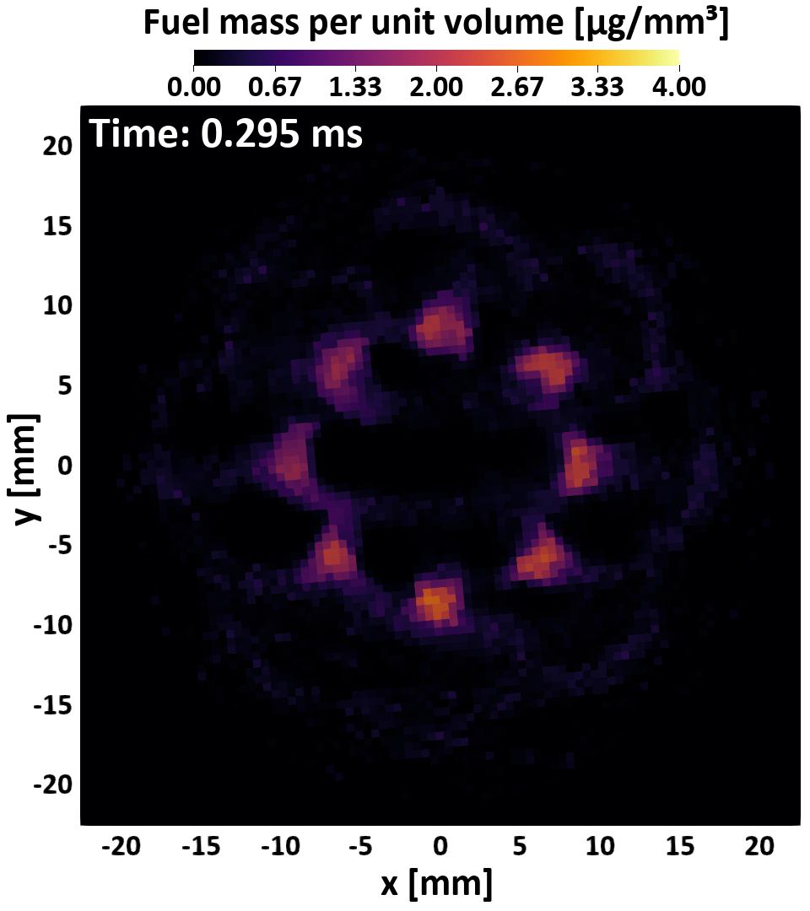
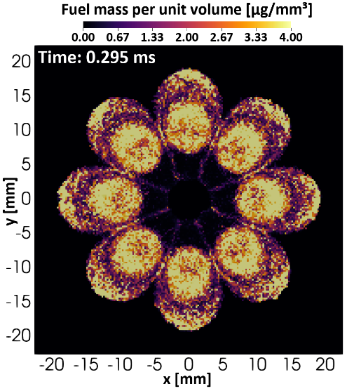
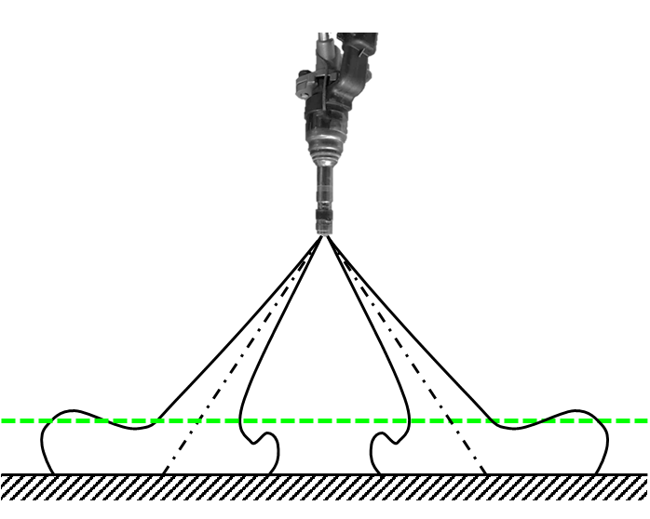
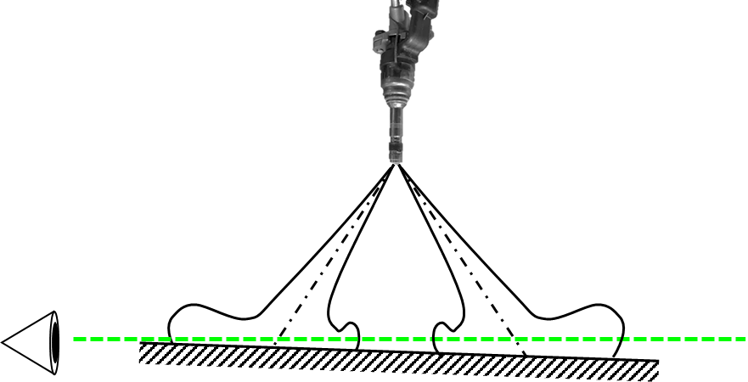
X-ray fuel mass per unit volume
Front wall impingement at 12.3 mm
X-ray tomography enables to compare the spray prints close to the wall
There are uncertainties about where the wall is located with respect to the injector. A 1° rotational uncertainty results into ~500 µm difference
X-ray
CFD-Argonne
Quantitative mixing field data was collected
First 3D impinging SprayG simulations performed
300 µm from wall
50 µm from wall
300 µm from wall
800 µm from wall
550 µm from wall

Slide 9
Topic 10: a wide topic
Spray-wall interaction
Fuel film formation/evaporation
Film / Flame interaction / Soot
wall
Istituto Motori* Montanaro et al, SAE 2016-01-2199
Spray Macroscopic parameter measurement
Liquid and Vapor phase
Argonne:
X-ray measurements
3D-CFD simulations
Istituto Motori/Fed. II: Wall Heat-flux (IR)
IFPEN: Film evap. and wall temp. (1D model)
Sandia: spray impact and soot formation (soot extinction / DBI )
IFPEN: film thickness (UV absorption) + Soot extinction (DBI)
Duisburg Essen: Film thickness (LIF) + Soot vol. fraction (LII)* *Jüngst and Kaiser SAE2019-01-0293
Oakland university: film evaporation + flame interaction (1D model)* *Mingyuan Tao et al, IJER 2018

Slide 10
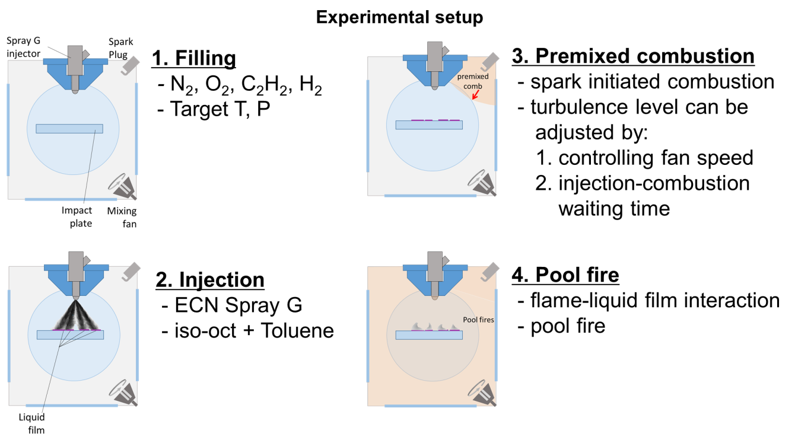
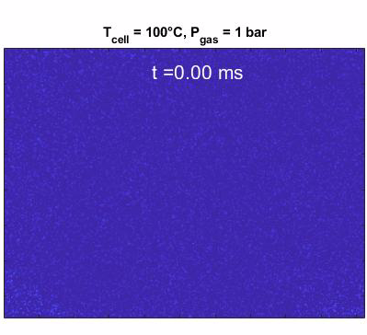
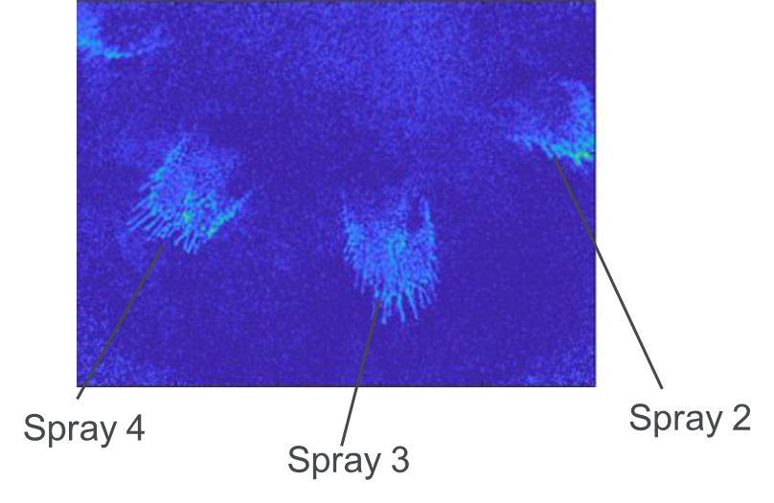
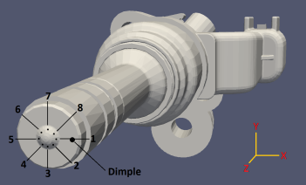

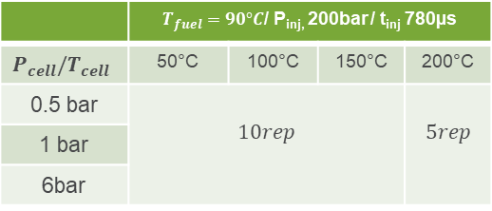
Fuel film formation/evaporation
IFPEN (Kamal Shway, Ongoing PhD thesis)
Constant volume vessel
Twall = Tcell = T gas
Wall distance = 30mm
UV absorption technique
  Fuel: 70% iso-octane / 30% toluene
Wide experimental matrix of quantitative data on liquid film thickness (to be soon published):
 | $T_{fuel}=90°C$/ P_{inj,} 200bar / t_{inj} 780µs
$$P_{cell}/T_{cell}$$ | 50°C | 100°C | 150°C | 200°C
0.5 bar | $$10rep$$ |  |  | $$5rep$$
1 bar
6bar
G2, G3
High speed intensified camera
UV diffused light
(LED ~265nm)

Slide 11
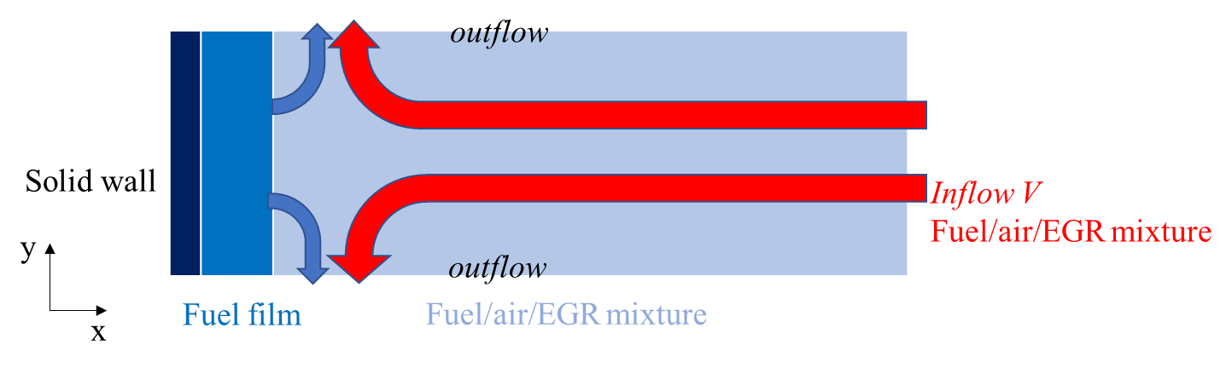
fuel Film and soot formation
Oakland university (Mingyuan Tao et al, IJER 2018)
Application of 2D stagnation flow condition to investigate film evaporation in a 1D model:
  Ambient pressure effect changes depending gas flow (turbulence) level
Low gas flow condition
High gas flow condition
For engine application the model will have to deal to low and high pressure and different turbulence levels
Validation over a wide range of conditions is required

Slide 12
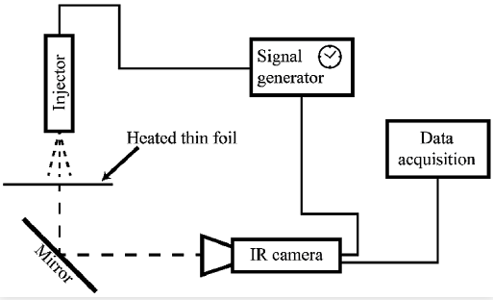
Spray impingement Heat flux
Università Federico II / Istituto Motori (Contino, M. et al. SAE 2019-24-0036)
Spray impact derived wall flux has been measured via infrared
  Thin Invar foil (50 μm in thickness)
  Atmospheric experiment (G3 relevant)
  Control on surface temperature (Ambient - 490 K)
  Nozzle to plate distance: 11mm
  Iso-octane
Time resolved surface temperature has been measured
  Heat flux can be calculated
Spatio-temporal temperature field available for model heat flux validation

Slide 13
Topic 10: a wide topic
Spray-wall interaction
Fuel film formation/evaporation
Film / Flame interaction / Soot
wall
Istituto Motori (Montanaro et al, SAE 2016-01-2199)
Spray Macroscopic parameter measurement
Liquid and Vapor phase
Argonne (Ref?):
X-ray measurements
3D-CFD simulations
IFPEN: film thickness (UV absorption) + Soot extinction (DBI)
Duisburg Essen: Film thickness (LIF) + Soot vol. fraction (LII)
Oakland university: film evaporation + flame interaction (1D model)
Istituto Motori/Fed. II: Wall Heat-flux (IR)
IFPEN: Film evap. and wall temp. (1D model)
Sandia: spray impact and soot formation (soot extinction / DBI )

Slide 14
fuel Film and soot formation
Investigation in CV vessels (IFPEN and Sandia approach)
CV vessels are employed to simulate GDI pre-mixed combustion
compression heating
Fine control on Initial pressure and temperature
Fine control on Residual oxygen content
Pressure rise time, and range determined by reacting gases
isochoric process (no density variation)

Slide 15
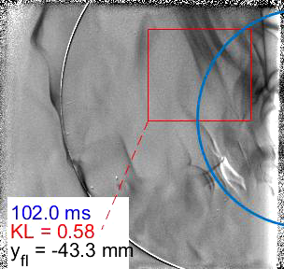
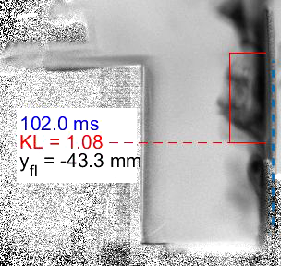
Soot Fuel film and soot formation
Fuel | RD-587
10% ethanol PACE gasoline
Inj Pressure | 350 bar
Wall diameter | 50 mm
Wall Initial T | 102 °C
Sandia (Spray D – wall impact)
Side-view:
  Film clearly remains along wall until after flame passes
  No measureable soot until AFTER flame passes
  Soot forms AWAY from wall (in high T gases)
Wall-view:
  Film texture changes as it vaporizes
  Soot zones concentrated towards the original film at the center
Soot increases as T & P increase in core of vessel, even after film appears to be gone
Soot forms SLOWLY in oxygen-deficient ambient, likely contributing to young (and small) particles
Wall temperature and gas temperature in boundary layer expected to be critical for CFD to capture this problem
Notes:
C:\pickett\papers\emre\wall\extinctionThroughWall_GBIAJD006.m
C:\pickett\papers\emre\wall\compareExtinctionGBIAJD006.m
C:\pickett\papers\emre\wall\extinctionSideWall_GBIAJD006.m

Slide 16
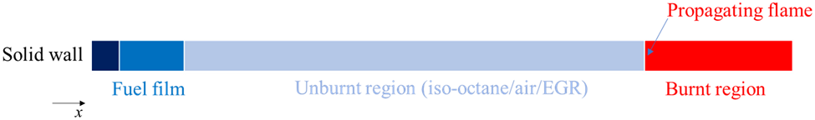
fuel Film and soot formation
Oakland university (Mingyuan Tao et al, IJER 2018)
1D model used to investigate:
  Flame liquid film interaction: quenching distance calculation
  Liquid film increases quenching distance due to rich fuel/air mixture

Slide 17
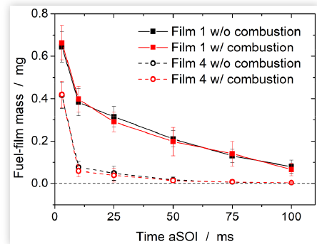
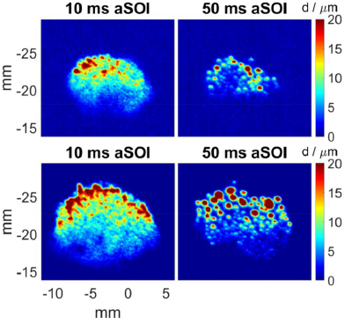
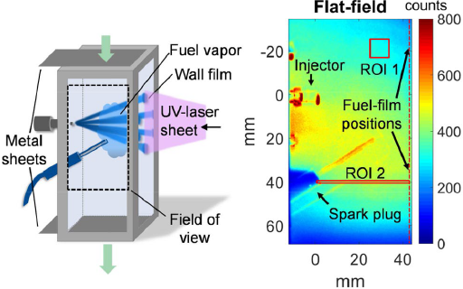
fuel Film and soot formation
Duisburg-Essen University (Jüngst N. and Kaiser S. SAE 2019-01-0293)
  Model experiment in an constant flow cell
  LIF (Iso-octane + 1% toluene)
  GDI injector (Not spray G) / ~30 mm wall distance / perpendicular
  Low ambient pressure (1bar) heterogeneous mixture
  controlled gas flow (air flow 2.23 m/s)
  Premixed combustion does not affect significantly liquid film evaporation
    Wall conduction >> Gas convection
Wall-Heat conduction has a very important impact:
The correct definition of this boundary condition in modeling will be pivotal

Slide 18
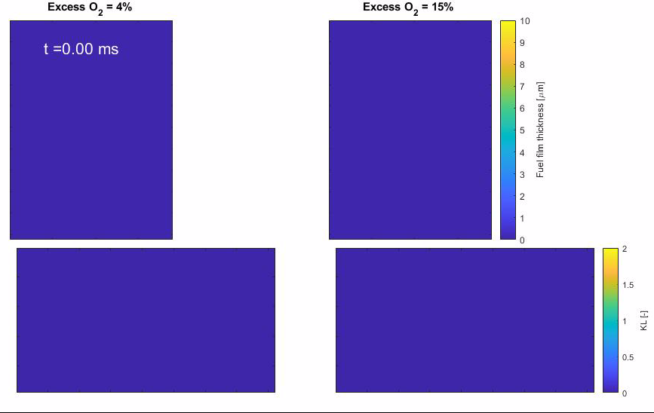
fuel Film and soot formation
IFPEN (Kamal Shway PhD)
Simultaneous liquid film and Soot extinction measurement
Once soot start forming it is impossible to distinguish film from soot on wall view
Liquid persists long time after combustion
Delay between flame arrival and first soot detection ~10ms
Ongoing experiment Oxygen excess impact:
  Timing of soot formation seems similar
  Spatial distribution is different
Wall view (UV absorption)
Side view (DBI)
Artifacts
Artifacts
Impact wall
Impact wall

Slide 19
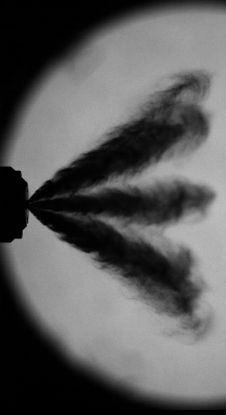
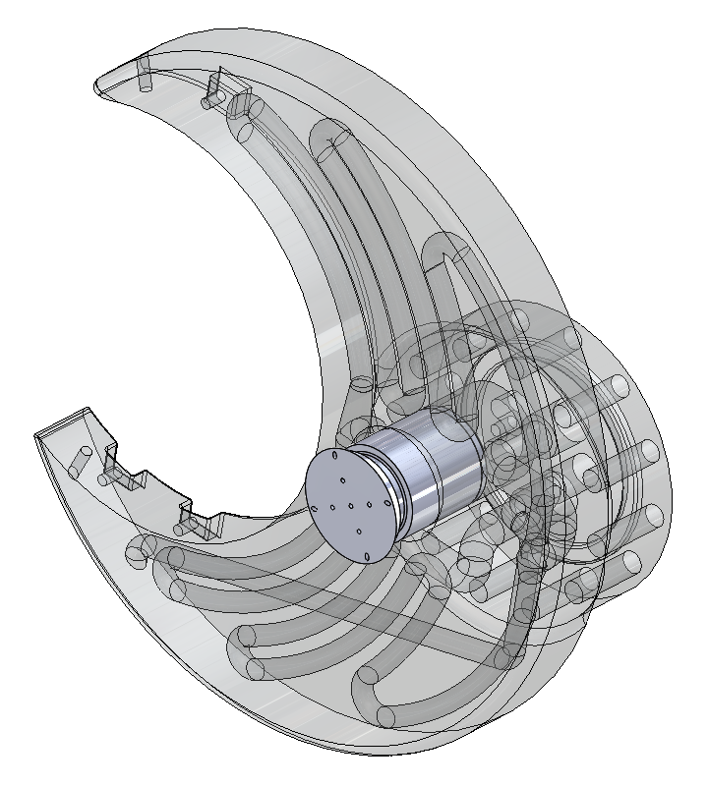
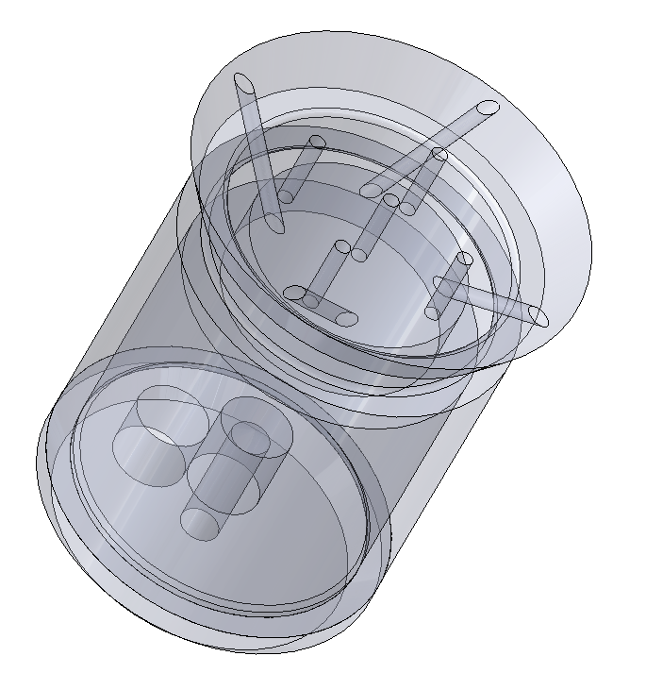
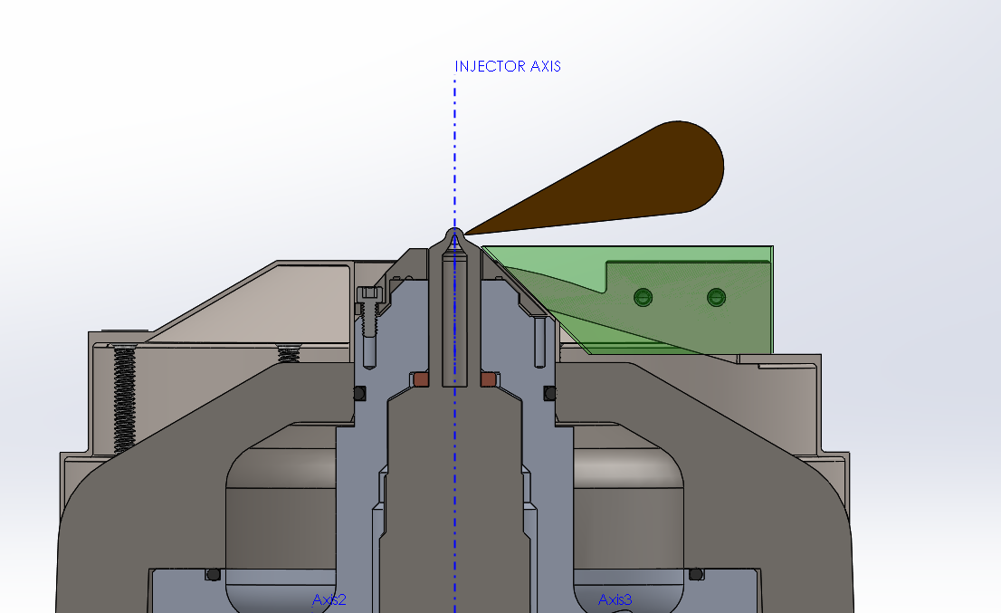
Future activities: Spray G measurements at Sandia and heat flux probe (Sandia and ORNL)
Reconfigurable prism
3D printed wall allows for inner geometry
Optical access
Heat flux probe:
9 surface TC’s (type K)
FKFS custom design
Group order from Sandia and ORNL
Absorption diagnostic
(Optical) insert with retainers and setscrew
Heat flux probe
Air channel – Air-jet nozzle to evaporate left-over fuel & potentially clear soot deposits
Circulating-fluid channels for heating or cooling
Cooling/heating fluid
Diagnostic comparison with IFPEN (UV-Absorption)/CV vessel
Investigation of heat-flux (before and after combustion)
Pressurized air channel
Notes:
C:\pickett\AEC\pace\mtgs\2020AMR\coldHotLVF.m

Slide 20
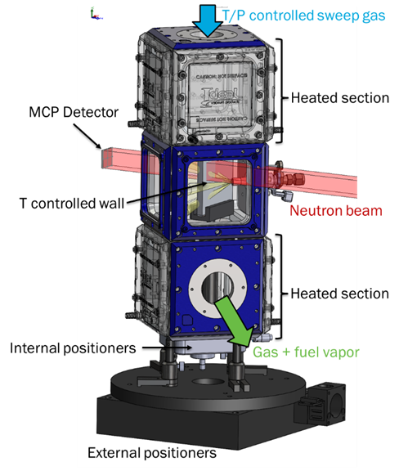
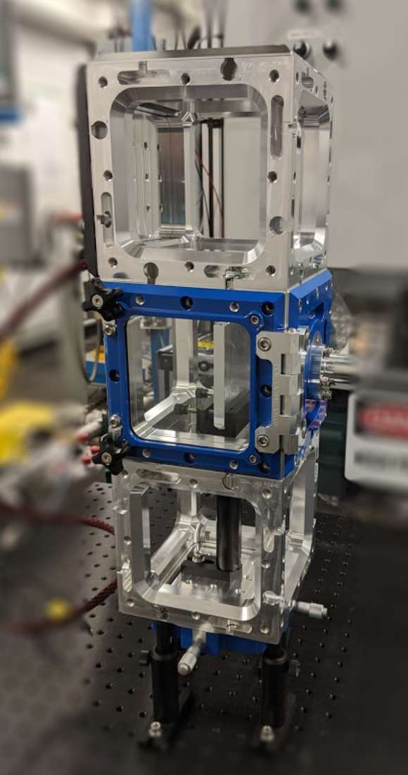
Future activities: new flow chamber and neutron imaging (ORNL)
Design concept
Build progress
Facility features
  Chamber: neutron transparent box, T/P controlled sweep gas
  Wall: temperature-controlled neutron transparent substrate
    Aluminum with thermal control via fluorocarbon coolant
    Option to integrate heat flux probe
Boundary conditions:
  ECN G2 & G3, other “cold” or low-pressure gas conditions
  (-20 to 150 °C, 0 to 2 bar abs.)
  View from almost any angle about the vertical axis
Diagnostics:
  Neutron imaging
    spatiotemporal evolution of the film
    thermally-controlled metal substrate (engine representative thermal properties)
  Heat flux probe
  Important cross check for optical diagnostics film results

Slide 21
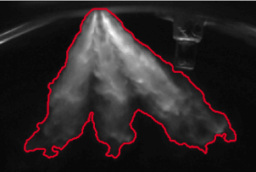
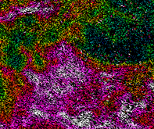
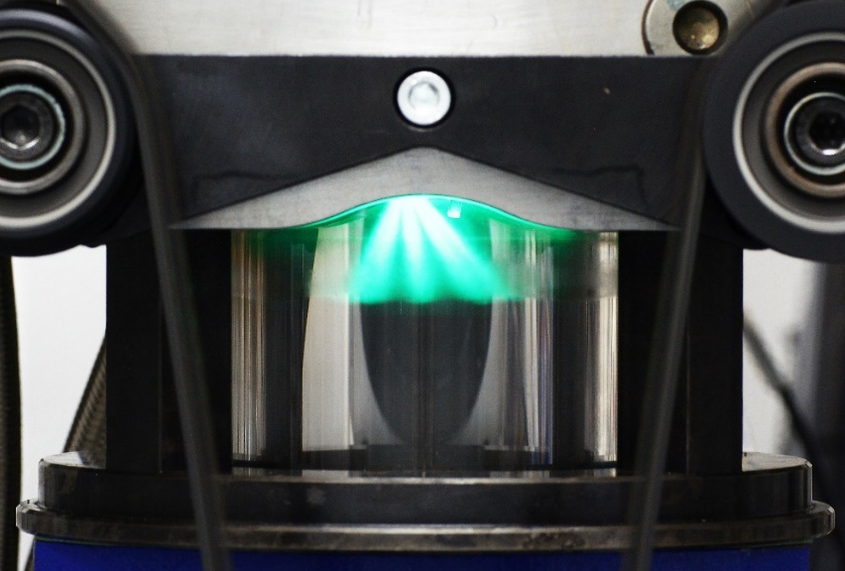
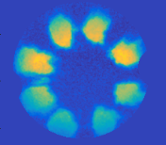
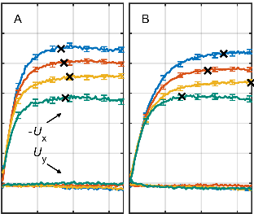
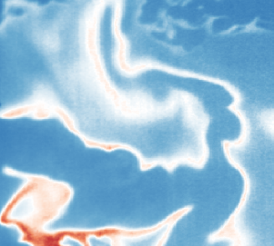


Future activities: engine experiments
Tu/Darmstadt
Optical engine (pent-roof cylinder head, 4 valves, centrally mounted injector, flat piston)
designed for model validation (well-characterized boundary conditions)
Sequence of experiments with increasing complexity: Steady-State Flow-Bench → Single Hole Injector → Spray G (Multi-Hole Injector) → Motored Engine → Fired Engine
Investigations on near-wall flows (ongoing) and spray-wall-interactions (planned 2021)
Fundamental to understand the relevance of model experiment and set new guidelines
Near-wall flow
PIV/PTV
Spray morphology
Mie-scatt./DBI
8° angle
@TDC
13.3mm
Spray foot-print/ Wall wetting
Qualitative RIM
Boundary layer
PIV/PTV
Piston
(near wall)
mixture
LIF
Near-wall flame development
LIF

Slide 22
Conclusions
Significant amount of data is available and important evidences have been showed
  Quantitative data:
    spray impact mixing field
    Liquid film thickness
    film – wall Heat flux
  Persistence of liquid film after flame
  Delay between flame and soot formation
  Distance of soot formation (flame quenching, local temperature, local mixture, etc)
Much more information is needed to understand the process:
  cross check of experiments and creation of a consistent database
  Effect of fuel: The diagnostic employed depends on the fuel, however each process is strongly fuel dependent
  Two main fuel are identified:
    Iso-octane
    70% iso-octane / 30% toluene
Two reference conditions were previously defined based on G3 condition:
  G3 – “Cold start”: $P_{cell}=$1 bar - $T_{cell}=$ 50°C - $T_{fuel}=$ 25 °C – $d_{injector−plate}=$30mm
  G3 – “Cold start – 10 seconds” :$P_{cell}=$1 bar - $T_{cell}=$ 100°C - $T_{fuel}=$ 90 °C – $d_{inj−plate}=$30mm

Slide 23
TOPIC 10:
Spray G wall impact and combustion
Thanks for the attention!!!
ECN 7 online workshop
Argonne
X-ray
Sandia
DBI
IFPEN
UV absorption
Federico II
Ist. Motori - IR
Michele BARDI (IFPEN)
michele.bardi@ifpen.fr
Topic Lead
10th June 2020 – Online Presentation

