Slide 1
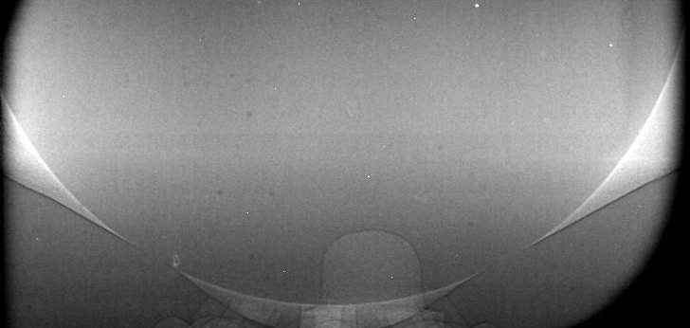
Topic 7: Internal & Near-Nozzle Flow
ECN 7 Online Workshop
erhtjhtyhy
Brandon Sforzo
Lorenzo Nocivelli
Topic Leader
Topic Organizer
June 10, 2020

Slide 2






Contributors
…just the ones that made it into this presentation
Experiments
Martin Wissink - Oak Ridge National Laboratory
Brandon Sforzo, Aniket Tekawade, Christopher Powell – Argonne National Laboratory
Joonsik Hwang*, Lyle Pickett – Sandia National Laboratories
Foivos C. Koukouvinis, Ioannis K. Karathanassis – City, University of London
Simulations
Pedro Martí, María Martínez - CMT-Motores Térmicos
Lorenzo Nocivelli, Sibendu Som – Argonne National Laboratory
Marco Arienti - Sandia National Laboratories
Bejoy Mandumpala Devassy, W. Edelbauer - AVL
*Now at Mississippi State University

Slide 3
ECN 7: Goals of Topic 7
Additional examination in future meetings
Collect internal & near nozzle data for Spray G injector(s)
  Focus on G2 condition (understand flash-boiling behavior)
Simulations to prioritize informed geometry (Gen 3.2)
Explore multi-component fuels
  Many contributions: modeling & experiments
  Focus in future webmeetings
Examine multiple injections
  Available for additional focus
Notes:
QUESTION: What condition is of greatest interest in sprays?

Slide 4
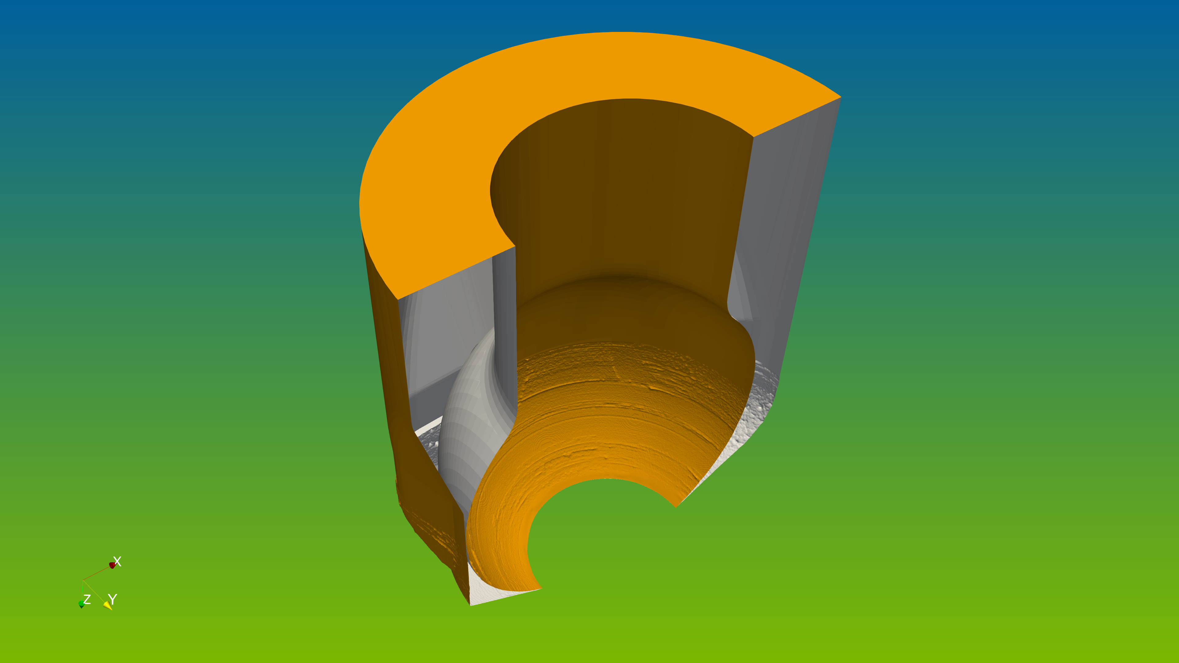
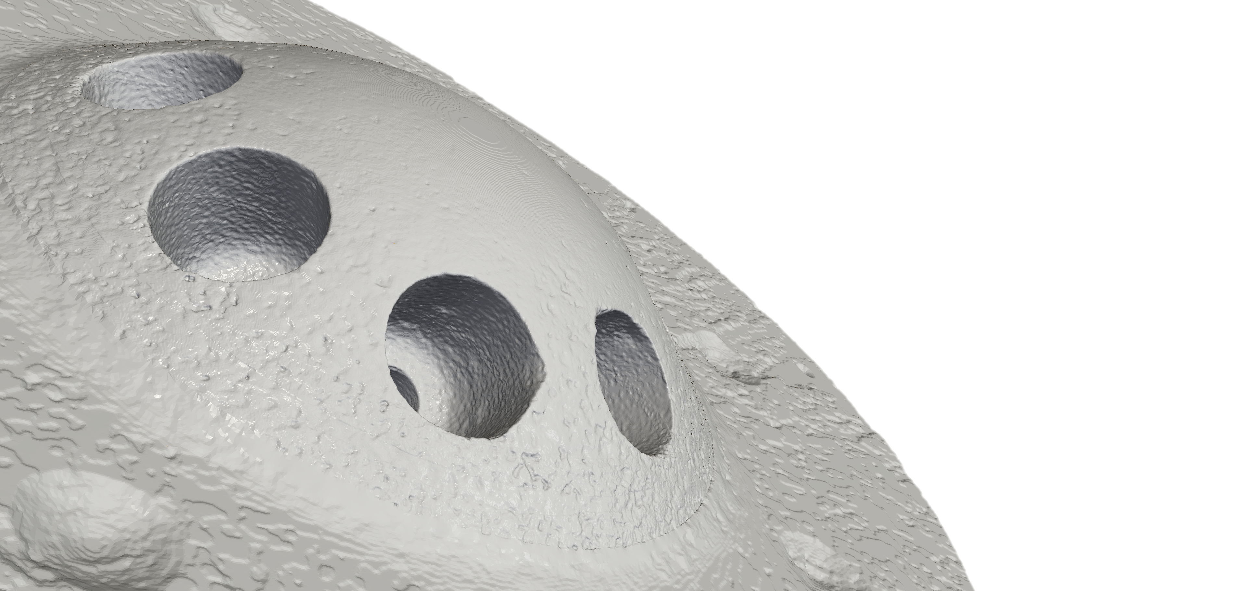
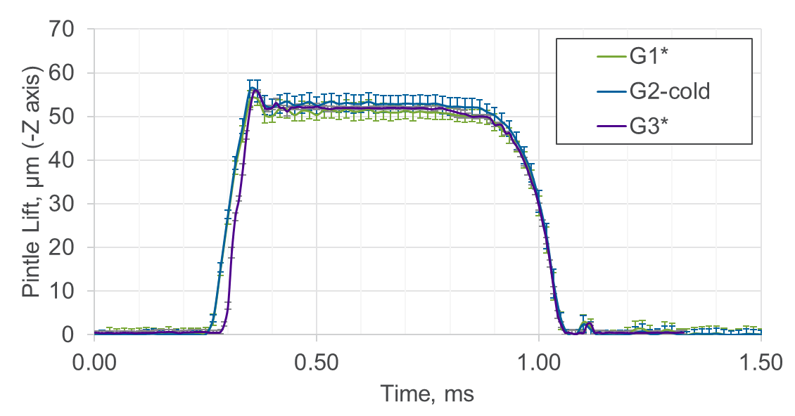
CT Geometry & Pintle Motion
X-ray characterization of Spray G injectors
Detailed geometry of Spray G #28 – ready for CFD: Gen 3.2
Pintle motion at three conditions
Available through ECN, at https://anl.box.com/v/XRaySpray
Notes:
Gen 1: Nominal Geometry
Gen 2: X-ray CT from Northstar (~100 MB) – coarse resolution
Gen 3: “Raw” X-ray CT from Argonne (~1GB) – still required cleanup
Gen 3.1: Prepared by Umass-Amhurst – informed by Gen 3
Gen 3.2: Reprocessed Gen 3, includes inflow from early X-ray CT
QUESTION: Is the Gen 3.2 surface usable? Do you have experience using it?

Slide 5
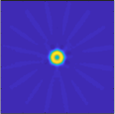
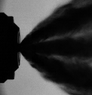

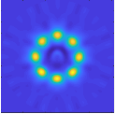

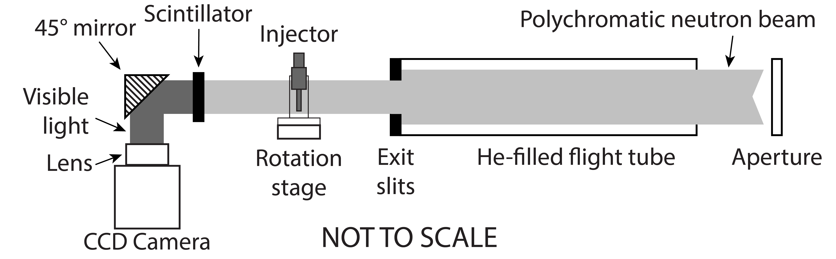
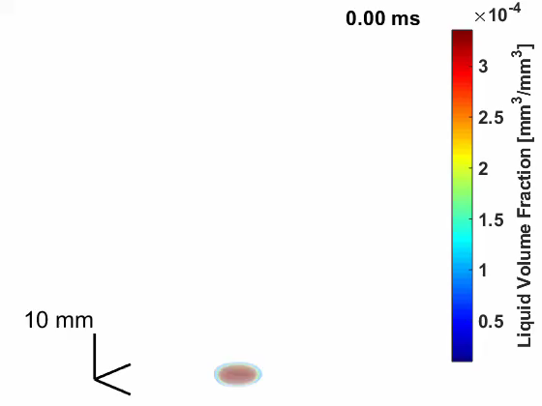
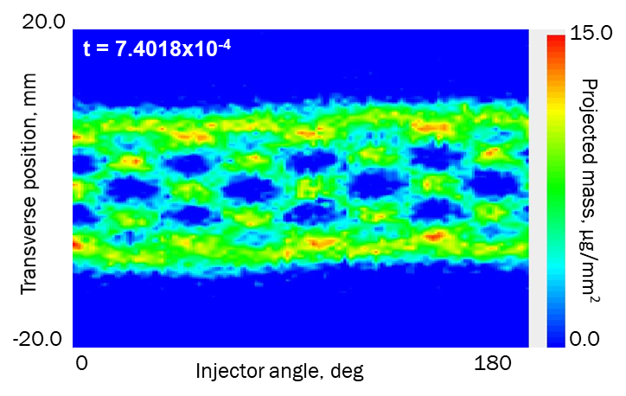
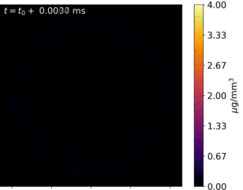
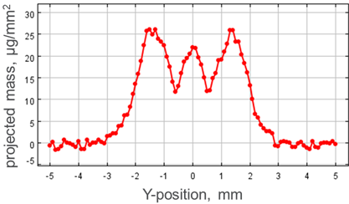

Experimental Methods
LVF*: liquid volume fraction
Example of SNL CT spray
 | Oak Ridge |  | Argonne | Sandia
Beam | Neutron |  | X-rays | LED (diffused)
Theory | Beer-Lambert law (beam attenuation)
Applications | Internal/external flow (Proj. mass), geometry |  |  | External flow (LVF*)
Strength | Very penetrating | Little scattering |  | Far-field sensitivity
Z=5mm
Optical limit
20mm
Optically thick
Z=30mm
Several cutting-edge diagnostics applied to characterize Spray G
Complementary methods
20mm
3D spray
Z=12mm
2mm
Single transverse scan
Full map of projected mass
CT reconstruction

Slide 6
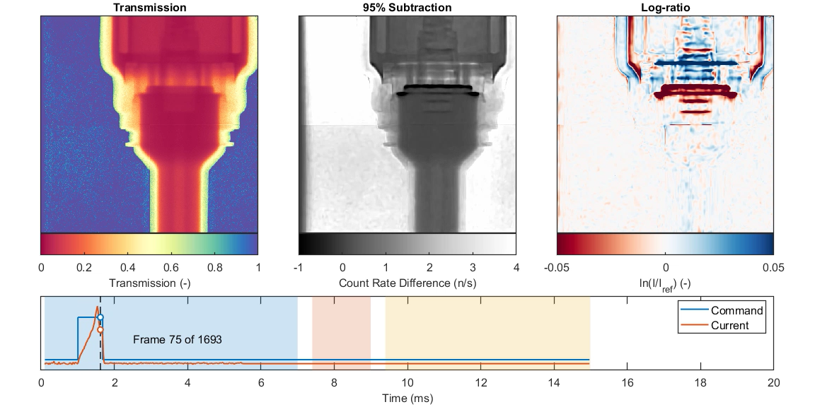
Neutron imaging of Internal flow passages
Armature bounces after injection and takes ~1 ms to settle – predicted by 1D models to be responsible for non-linear injection quantity (SAE 2014-01-1211)
Spring compression visible
Armature impacting the stop causes entire solenoid body to swell outward
Fuel must refill the gap between armature and stop – may have impact on settling time
Valve needle oscillates continuously during injection
Quantitative analysis of actuation dynamics in progress based on previous work to quantify geometric displacement using analytical neutron attenuation model
Notes:
Left panel in movie shows neutron transmission. Low-pass time filtering and spatial Poisson filtering have been performed to improve signal-to-noise. Ensemble of 6.4M injection events. Red areas have low transmission due to attenuation from hydrocarbon fuel (iso-octane). Yellow areas have moderate attenuation from steel injector body. Blue areas are open beam.
Reference frame was constructed by averaging together ~1 ms of frames before SOI where the injector internals are static. Middle panel shows a qualitative normalization in which 95% of the reference frame count rate value is subtracted from the current frame.
Right panel shows quantitative normalization - the natural logarithm of the ratio of the current frame to the reference frame. In this visualization, blue regions have greater neutron count rate than the reference frame, and red regions have lower count rate. Blue region at the top of armature shows that steel armature is occupying a location previously filled with fuel. Red region at bottom of armature shows that fuel is occupying a region previously occupied by steel.

Slide 7
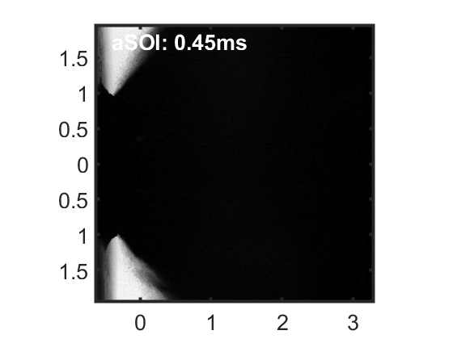
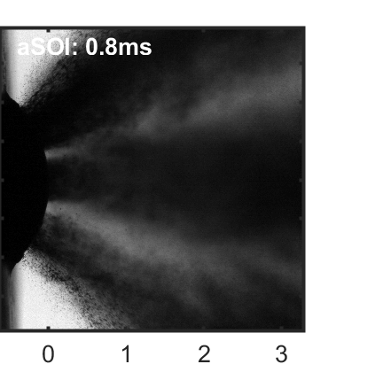
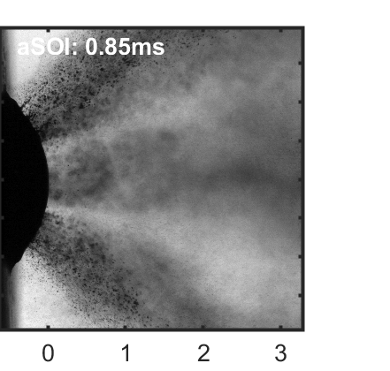
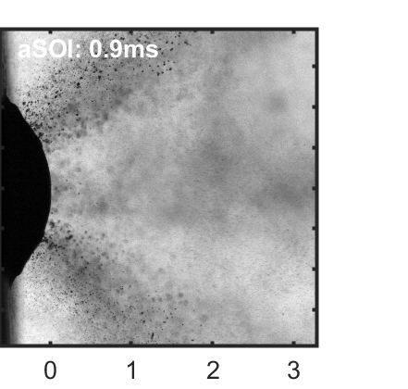
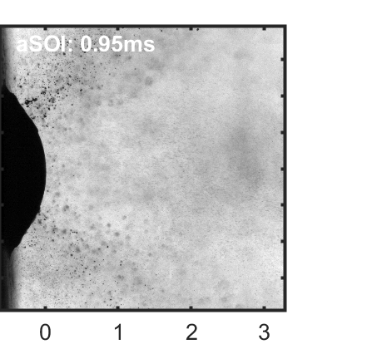
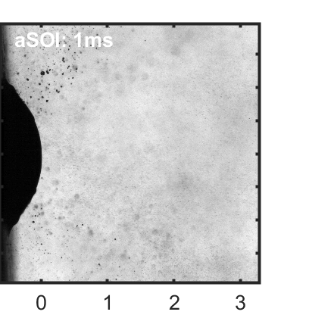
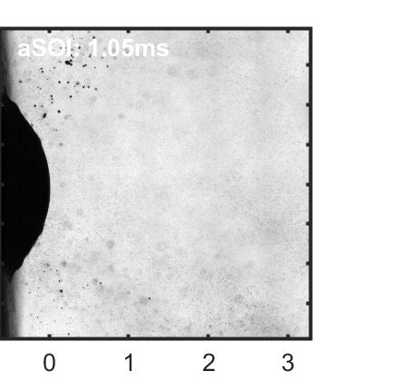
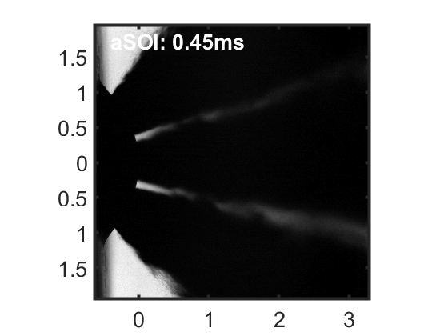
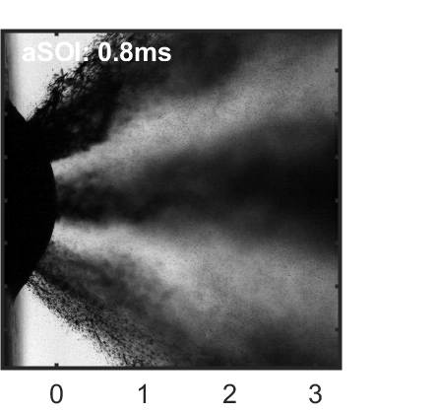
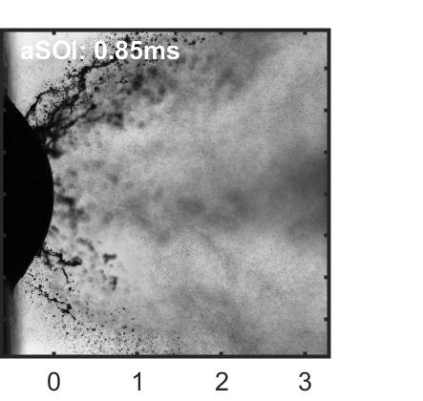
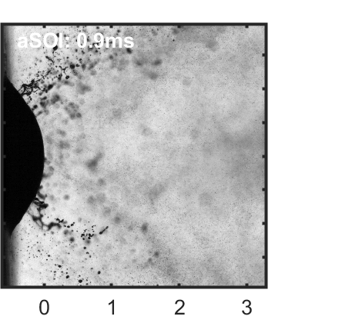
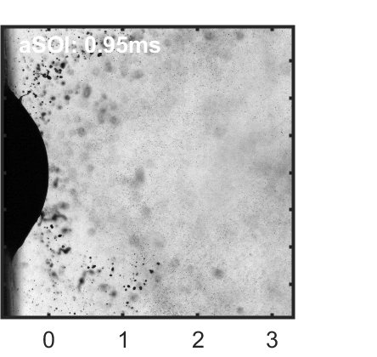
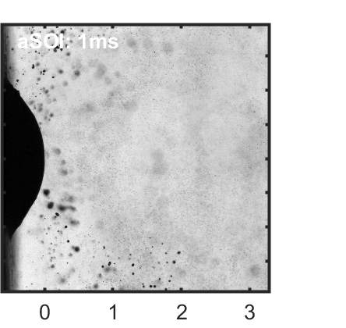
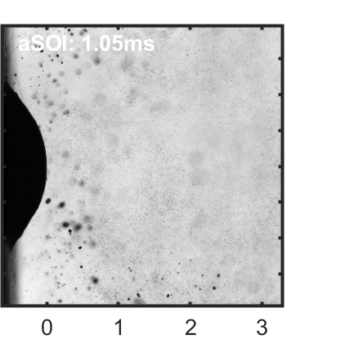
Backlit Microscopy
G2
[mm]
[mm]
G3
[mm]
[mm]
G2 illustrates plume expansion and merging in near-nozzle region
G3 distinction between plumes, different dribble behavior
Influences on tip wetting?
Additional conditions available: E00 fuel

Slide 8
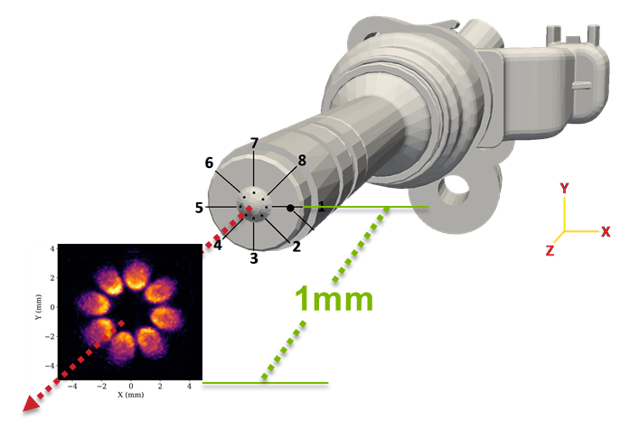
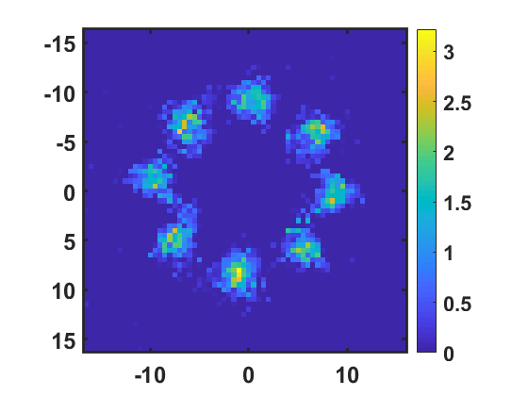
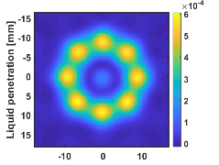
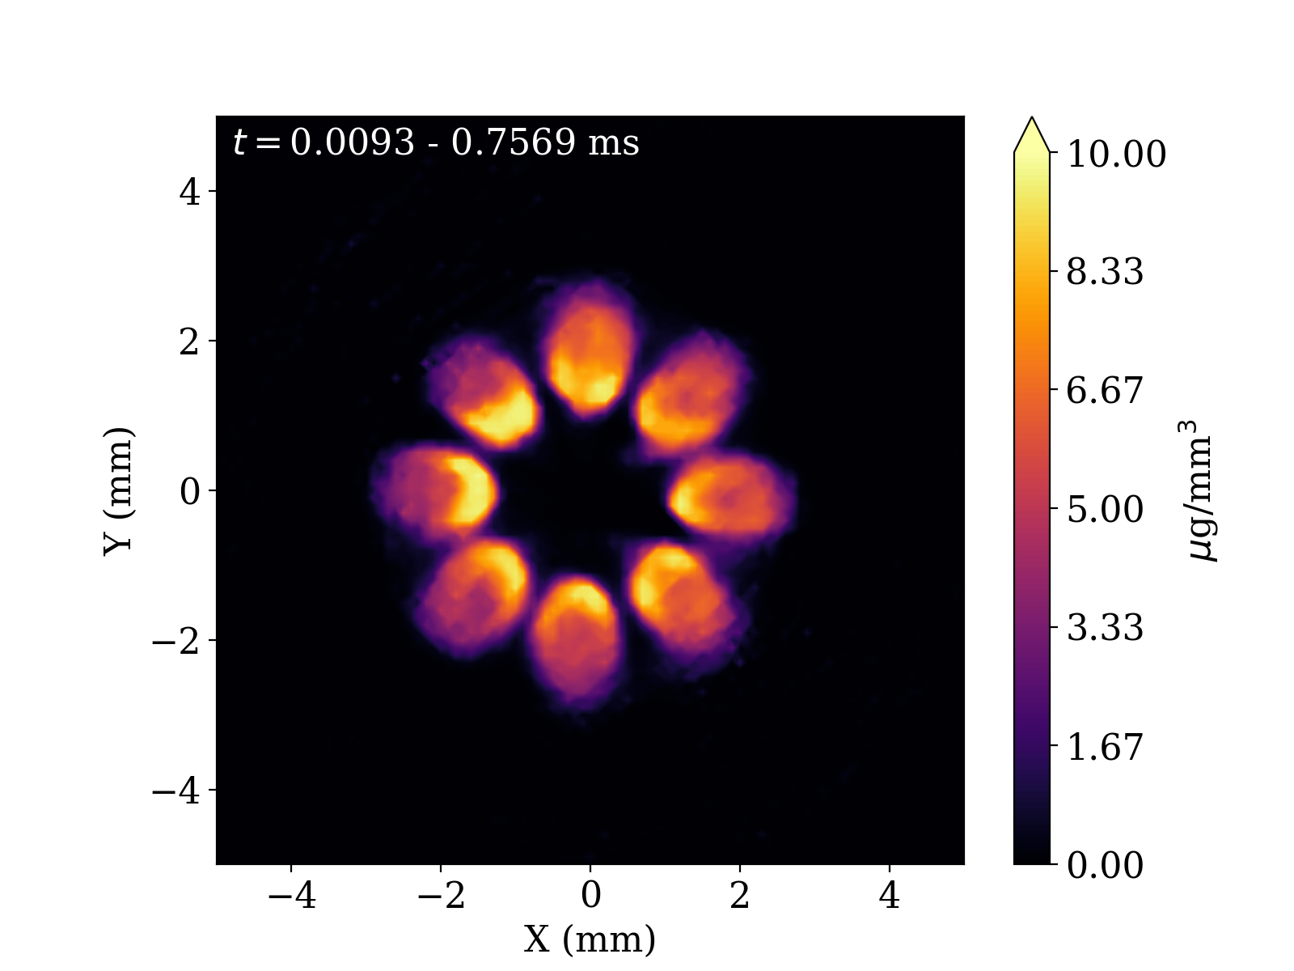
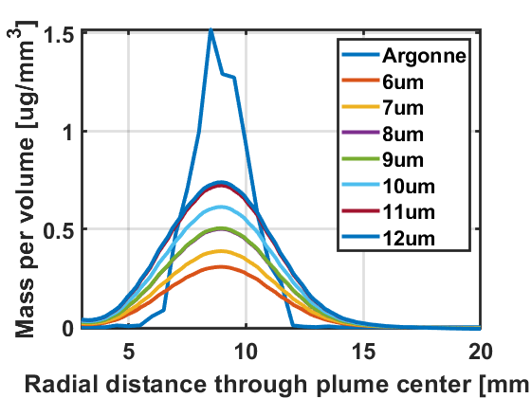
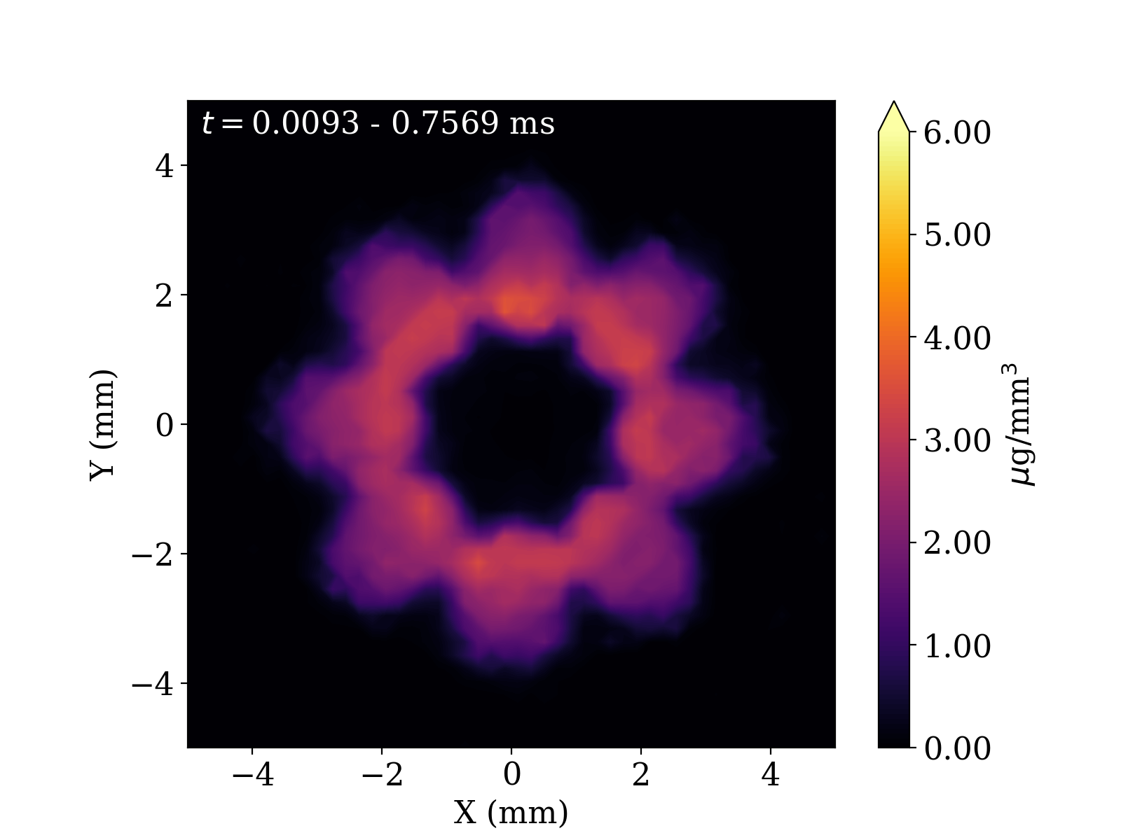
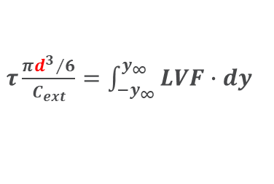

Argonne and Sandia data comparison
Argonne spray
$τ$=4.5
G2
[mm]
[mm]
G3
Z = 12mm
t = 0.5 ms
Sandia LVF
[mm]
[mm]
1 mm
#16
$τ\frac{π{d^{3}}/6}{C_{ext}}=\int_{−y_{∞}}^{y_{∞}}{LVF∙dy}$
2 mm
#28
Notes:
QUESTION: Other diagnostic data for validation?

Slide 9
Modeling Approaches
 | Argonne | CMT | Sandia | AVL
Code | CONVERGE 2.4 / 3.0 | CONVERGE 2.4 | CONVERGE | AVL FIRE
2-phase flow | Eulerian | Eulerian | Eulerian | Eulerian
Geometry | Gen 1 & 3.2 | Gen 1 & 3.2 | Gen 1 | Gen 3.2
Case(s) | G2 | G1, G2, + | G2 | G2
Notes:
+ including E00, G3, & LES Gen 1
QUESTION: What fuels are of interest other than iso-octane?

Slide 10
Modeling Approaches
 | Argonne | CMT | Sandia | AVL
Compressibility | Yes | Yes | Yes
Cavitation | Yes | Yes | Yes | Yes
Phase Change | HRM | HRM | HRM | Hertz-Knudsen
Turbulence | LES, dyn str | k-ε RNG | k-ε | 𝑘−𝜁 –𝑓
Spatial discretization | 2nd order | 1st order, 2nd mom. | 2nd order
Mesh strategy | Hex + AMR | Hex + AMR | Hex + AMR | Hex
Peak cell count | Gen 1: 9 M Gen 3.2: 14 M | Gen 1: 1.5 M Gen 3.2: 2 M | 18 M | 1.1 M

Slide 11
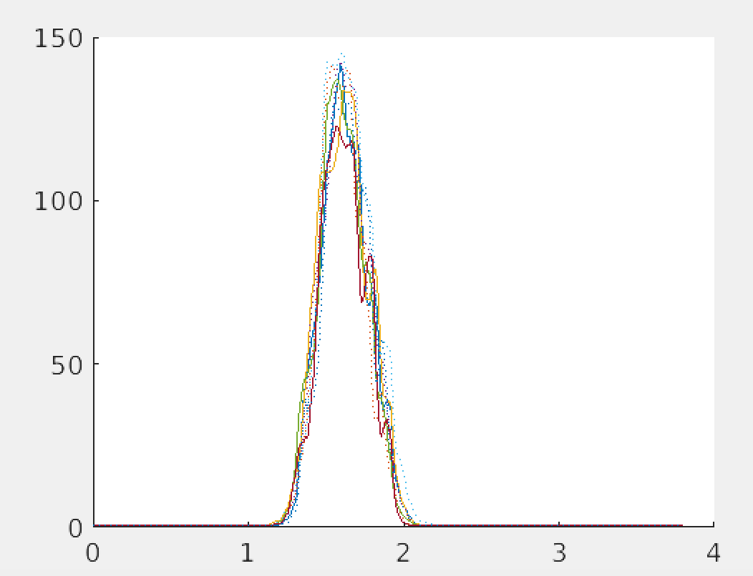
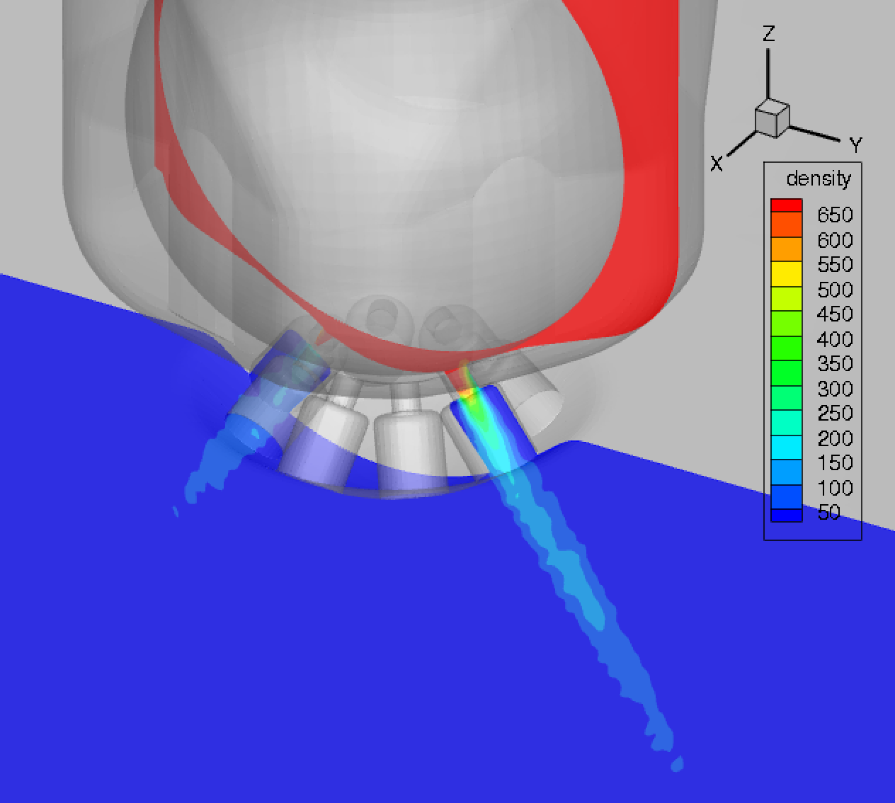
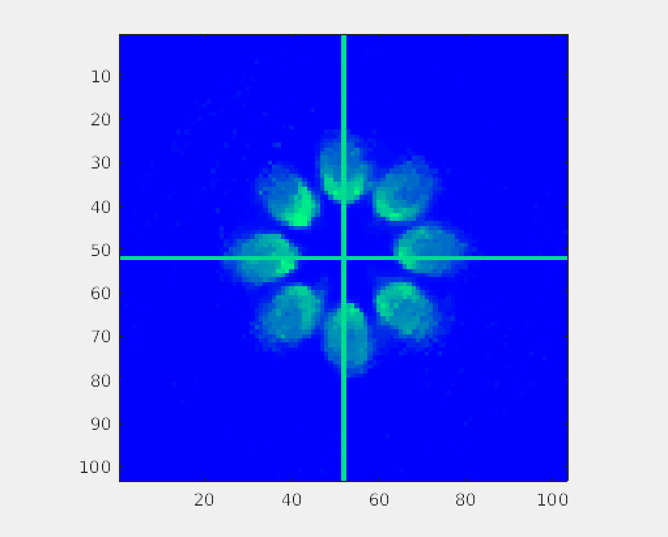
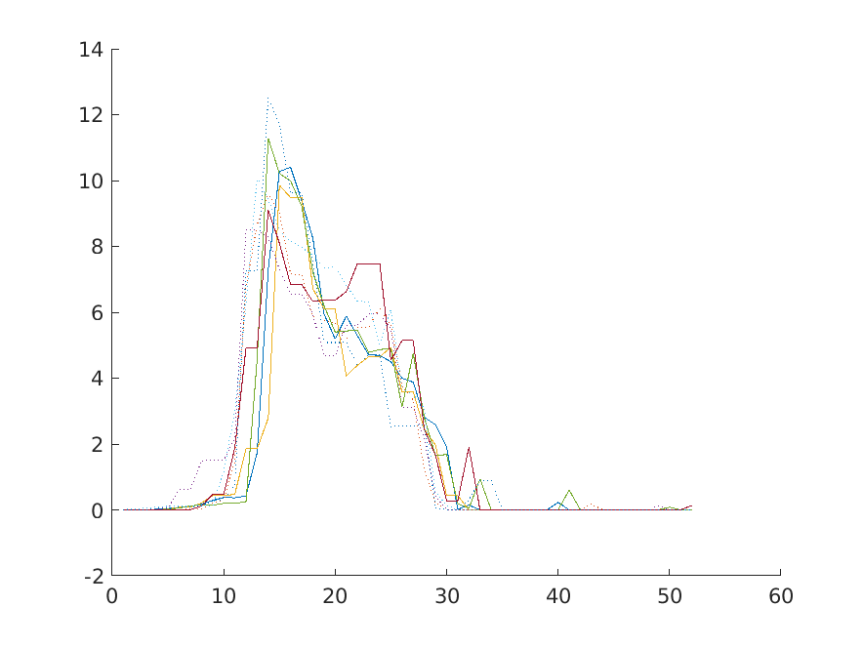
Sandia: Converge G2, Gen 1
Spray mass/volume over-predicted
CONVERGE – density field at 1 mm
Argonne data at 1 mm
µg/mm³
µg/mm³

Slide 12
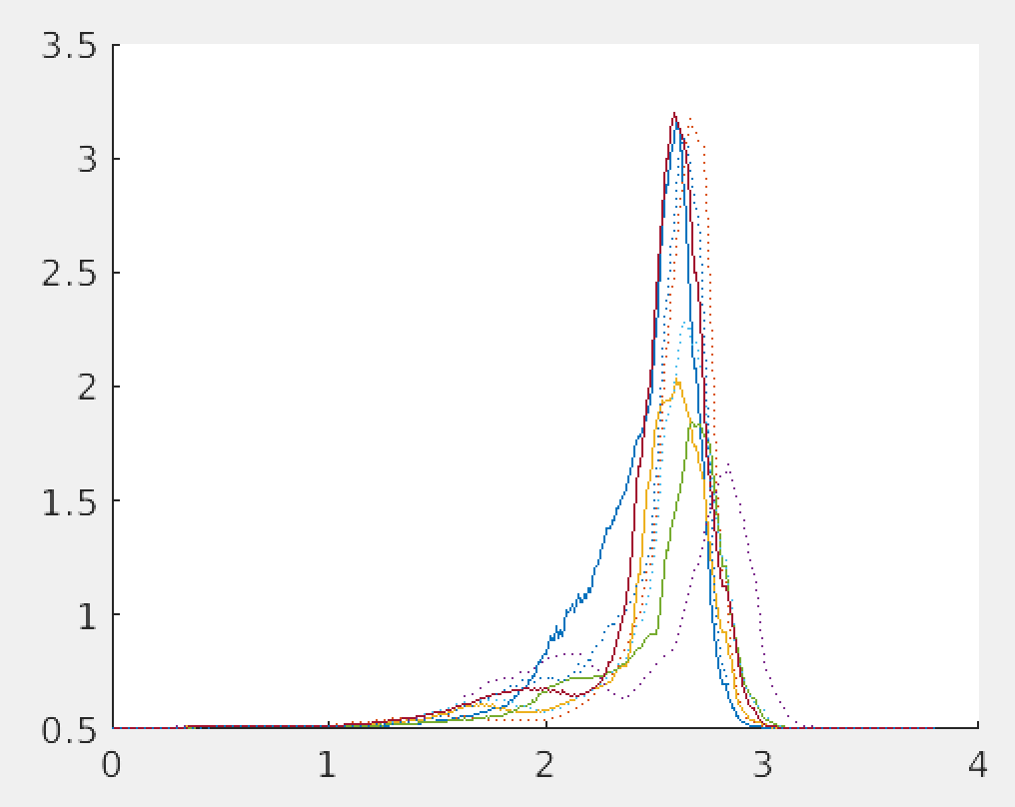
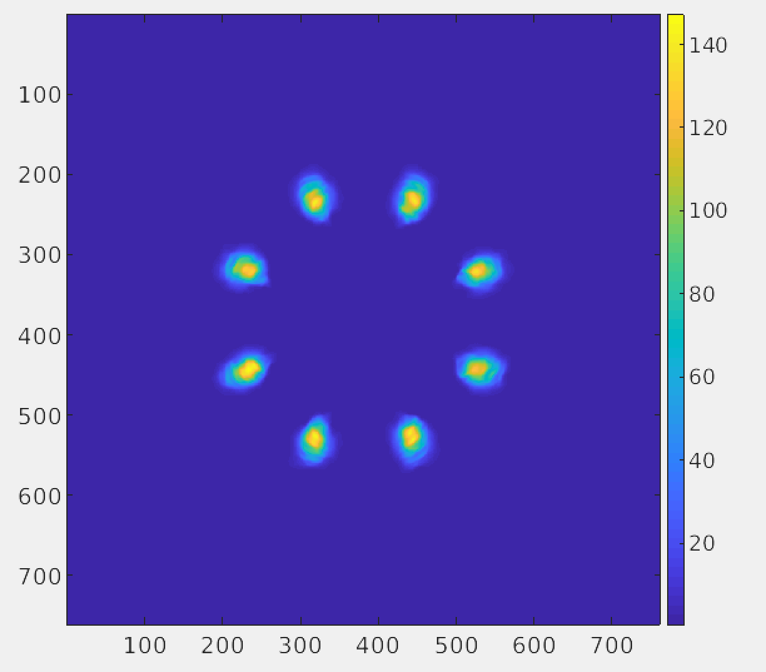
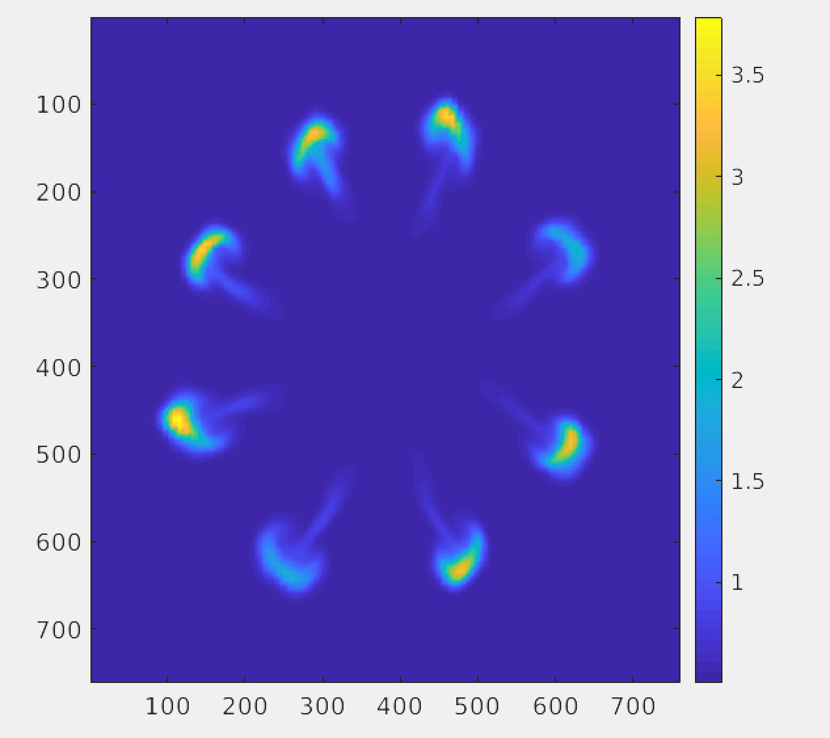
Sandia: Converge
Fully open @ t = 0.79 ms
Closing @ t = 1.15 ms
µg/mm³
µg/mm³

Slide 13
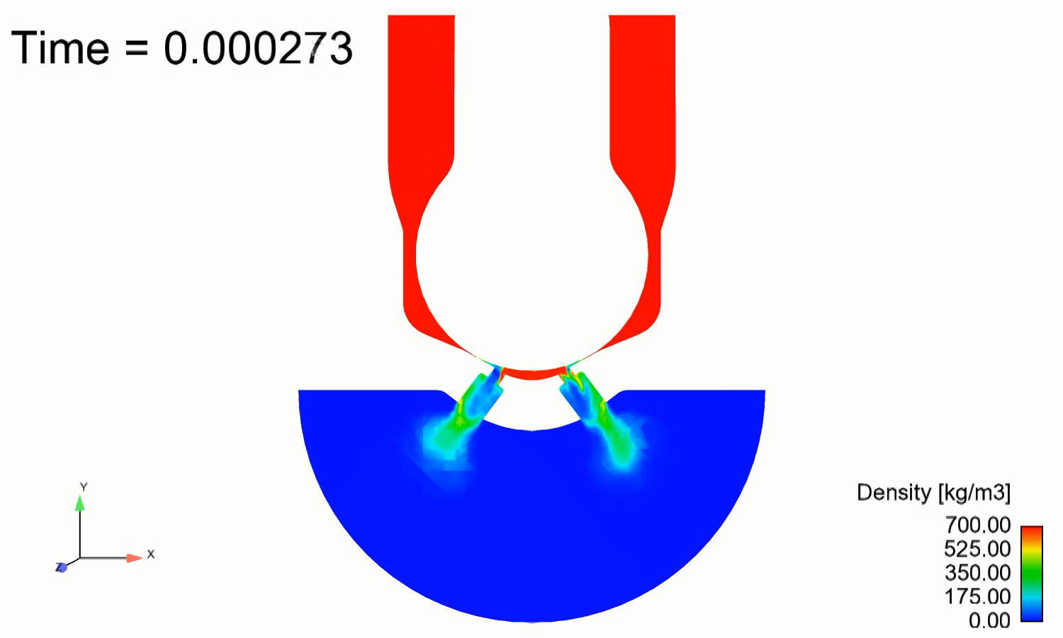
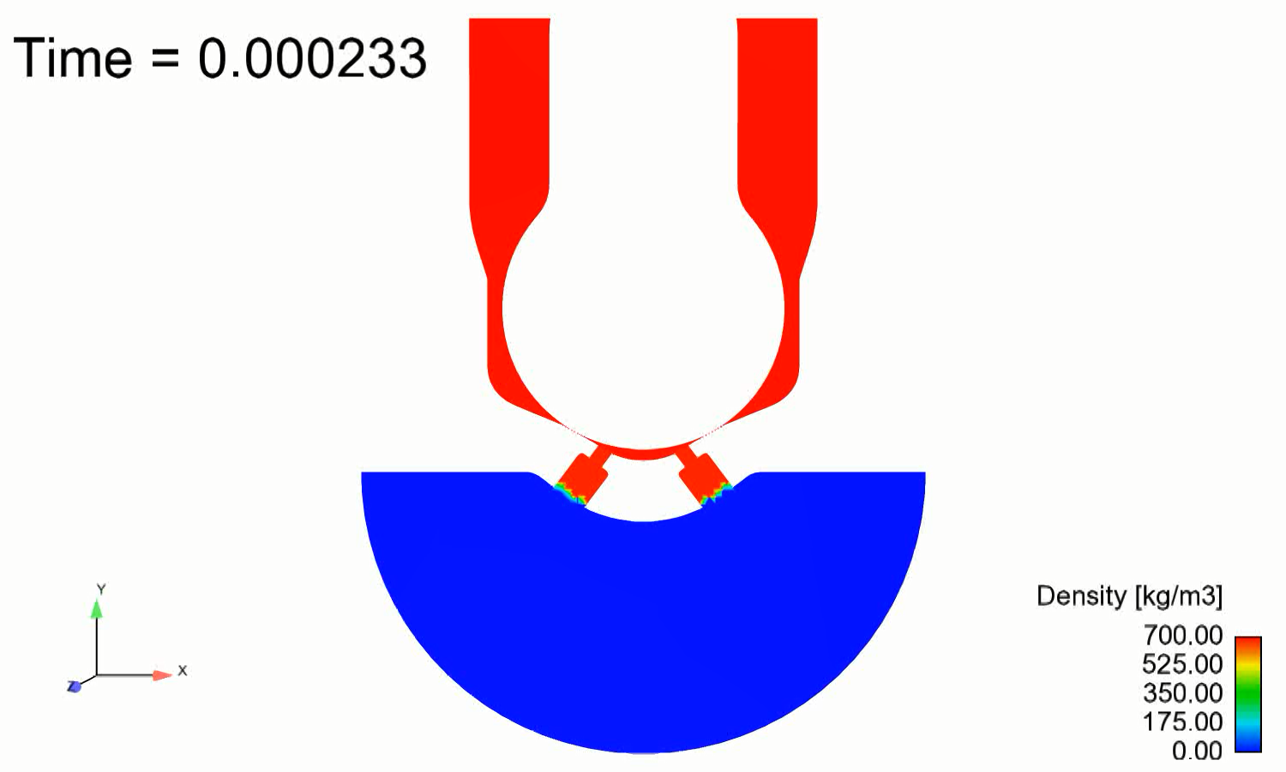
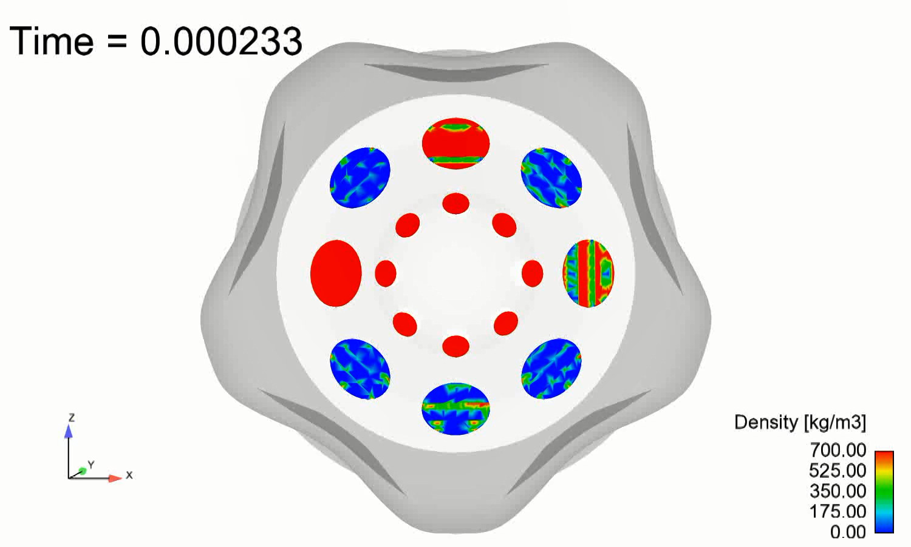
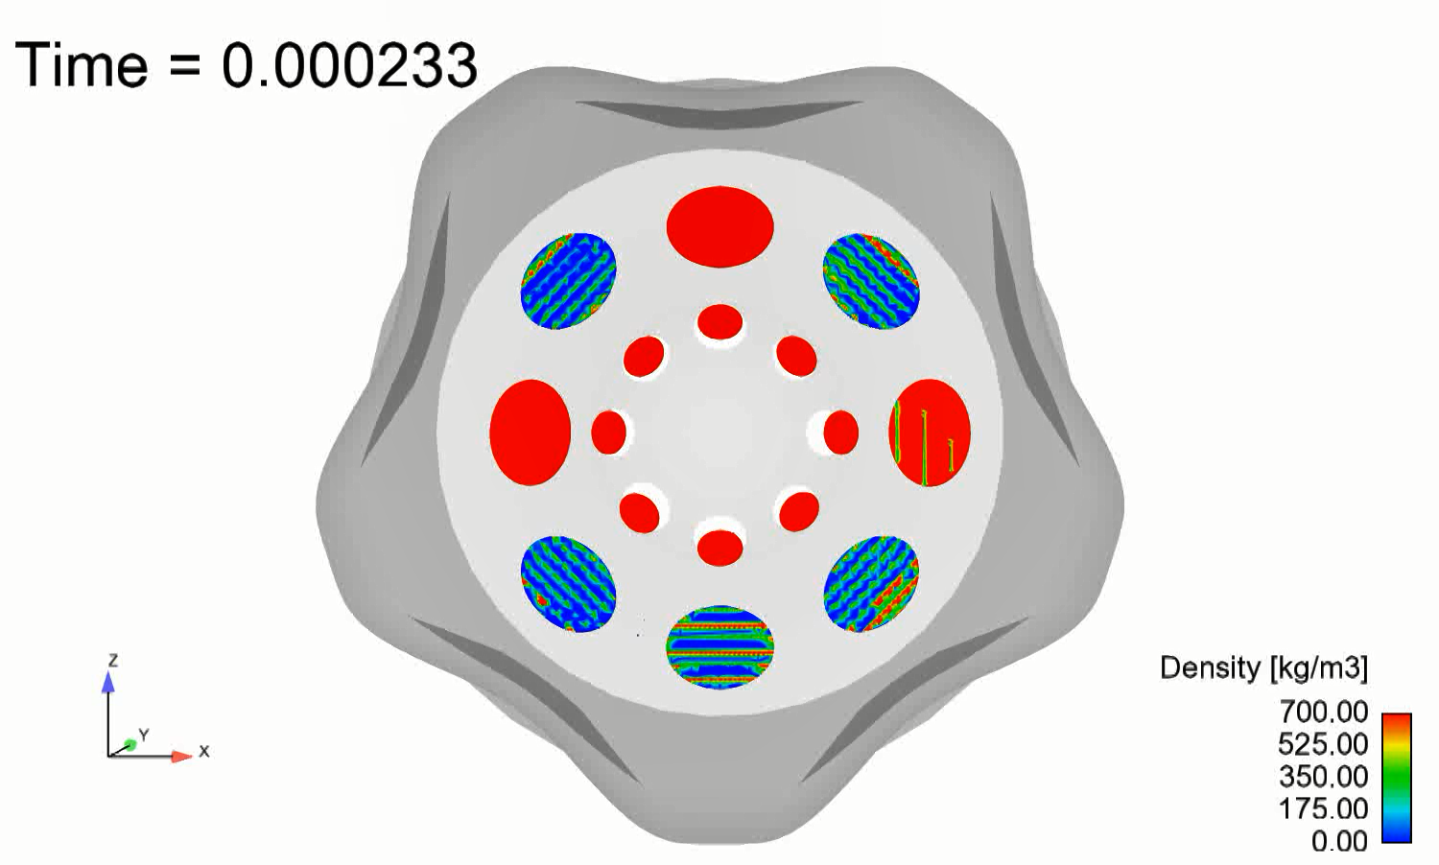
CMT: Spray G2 - Generation 1 & 3.2
Gen 1
Gen 3.2

Slide 14
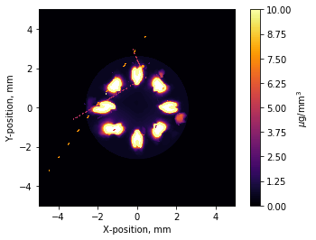
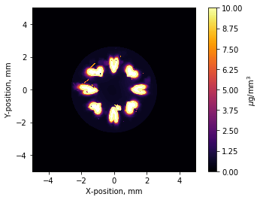
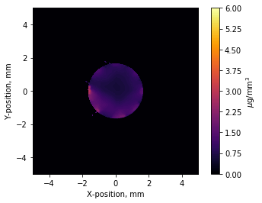
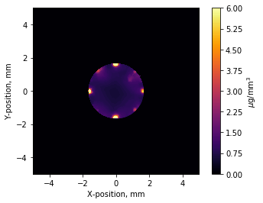
CMT: Spray G2 - Generation 1 & 3.2
Gen 1
Gen 3.2
X-ray spray
Z =
1mm
1 mm
Z =
2mm
2 mm

Slide 15
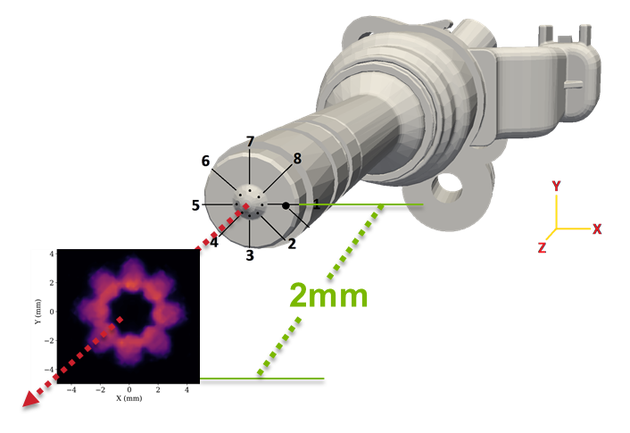





CFD under-predicts plume-plume interactions at full-needle lift conditions
Fuel Density at 2 mm from the injector tip
Gen 1
HRM θ₀ = 3.84E-09 s
Gen 3.2
HRM θ₀ = 3.84E-09 s
The internal-nozzle dynamics derived by the real geometry features improve the representation of the initial jet expansion
X-ray experiments
HRM θ₀ = 3.84E-13 s
HRM θ₀ = 3.84E-13 s
At mild flashing conditions the standard HRM model tends to underestimate the phase change in the near-nozzle region
Simulation at Steady-needle lift
Notes:
QUESTION: HRM model constants…

Slide 16





Influence of the HRM Θ₀ constant in the plume development
Mixture density plot on centerline slice – steady-needle lift condition
Gen 1
Gen 3.2
HRM θ₀ = 3.84E-09 s
The jet fluid-dynamics in the
c-bore determine the initial expansion of the plumes
The reduction of the HRM Θ₀ constant amplified the phase change, generating stronger initial plume expansion
The vapor mass fraction becomes a relevant contribution to the flow of the plumes
HRM θ₀ = 3.84E-13 s

Slide 17






AVL: Flashing Spray G Nozzle Flow
Vapor Volume Fraction Development
Plume-Plume Interaction
Tip Wetting
Fuel density along the radius 2 mm from the nozzle tip
CFD Simulation using AVL FIRETM shows compares well with plume spreading behavior
Sim
Exp
Notes:
CFD_ref: Polimi Lagrangian simulation shared in ECN 6
Question about wall impingement….

Slide 18
Conclusions
What works, next steps….
CFD under-predicts plume expansion/interaction
  Improved with use of real geometry and changes to HRM θ₀
A new Flash-Boiling mass exchange due to pressure difference and degree of superheat based on Hertz-Knudsen model is proposed and implemented in AVL FIRETM
Plume collapse and hole-to-hole interaction observed and can influence tip-wetting
  Upon better prediction of plume expansion, tip wetting phenomena can be approached
Next: Feature contributors from Topic 7 in upcoming webmeetings
Future: Compare CFD to atomization data – USAXS
Future: Opportunity for fluid-structure modeling (Neutron data)
Future: Other/multi-component fuel blends? Multiple injections? Other condtions?

Slide 19
























Notes:
QUESTION: What presentations would you like to hear more from?

Slide 20
Thank You

