Slide 1
Using Reciprocating Engines as a Tool for Chemical Kinetics Studies
Dan DelVescovo, Ph.D.
Assistant Professor, Mechanical Engineering
Oakland University

Slide 2
Introduction
Education
B.S. from Milwaukee School of Engineering (2010)
M.S. and Ph.D. from University of Wisconsin-Madison (2012, 2016)
Thesis: The Effects of Fuel Stratification and Heat Release Rate Shaping in Reactivity Controlled Compression Ignition (RCCI) Combustion
Advisors: Dr. Rolf Reitz and Dr. Sage Kokjohn
Career
Assistant Professor at Oakland University (2016 – Present)
Research Focus: Fuel Chemistry/Engine interactions at conditions relevant to modern and future engines in conventional (SI) and advanced (ACI) combustion strategies
Approach: Combine experimental efforts with fundamental/simplified modeling effort (from 0D to 3D)

Slide 3
Past Research Efforts
Flow Bench Experiments and 3-D CFD Modeling of CFR Cylinder Head (Senior Project/NSF REU Project)
Evaluate flow and swirl predictions compared to experiments
Predictive combustion/chemistry modeling of CFR in GT-Power
Defining boundary conditions/Predicting Octane Number
Modeling Pre-Spark Heat Release in a Boosted SI Engine with Iso-Octane
Mechanism evaluation/tuning

Slide 4
Ongoing Research Efforts
Evaluating Chemical Kinetic Behaviors in IC Engines using Simplified 0-D Models (M.S./Ph.D.)
Compare 3-D CFD with 0-D Chemkin modeling in HCCI combustion for PRFs
Role of thermal stratification?
Genetic Algorithm Optimization of Chemical Kinetic Mechanism for Propane/LPG (M.S. Project)
Optimization of kinetics for 3-D CFD design of high efficiency LPG engine (collaboration with ORNL)

Slide 5
Effect of Chemistry on Sprays
Cool-Flame/LTHR has Compounding Effects
Thermodynamic changes
Compositional changes
Variations between mechs in LTHR timing, mag., speciation
Affects lift-off stabilization
2nd stage ignition delay insufficient
Need tools/data to evaluate 1st stage ignition process/speciation
CHR calculation for Spray A conditions (n-dodecane) at preferred mixture fraction: 𝜙=1.4
2022 (new) LLNL 148
Cai 56
Sarathy 2885
Yao 54
Lapointe 65
Cai det. 1692

Slide 6
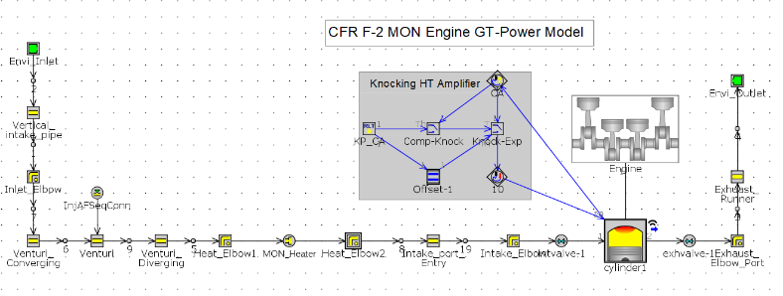
CFR Engine Modeling
0D and 1D Models to Define RON/MON Boundary Conditions
Models validated against exp. Data from Argonne (Chris Kolodziej/Alex Hoth)
Useful for kinetic mechanism development/evaluation/tuning
Salih, S., et al., “Defining the Boundary Conditions of the CFR Engine under RON Conditions…” ASME ICEF2018-9640
Vallapureddy, A., et al., “Defining the Boundary Conditions of the CFR Engine under MON Conditions…”, SAE Technical Paper 2021-01-0469

Slide 7
Pre-Spark Heat Release (LTHR)
Pre-Spark Heat Release Behavior
Fuels with NTC demonstrate PSHR
Late CA50 an high intake Temp
Distinct process from deflagration, and low cyclic variability
DelVescovo, D., et al., “Modeling Pre-Spark Heat Release and Low Temperature Chemistry of Iso-Octane in a Boosted Spark-Ignition Engine”, Combustion and Flame 212 (2020) 39-52

Slide 8
Modeling PSHR
0D Chemkin Simulations
Two-Zone, 0-D Model
Burn rate modeled by Wiebe
Four Kinetic Mechanisms for Gasoline Surrogates
Predicted behavior varies drastically (obvious at high T)
DelVescovo, D., et al., “Modeling Pre-Spark Heat Release and Low Temperature Chemistry of Iso-Octane in a Boosted Spark-Ignition Engine”, Combustion and Flame 212 (2020) 39-52

Slide 9
P-T Trajectories
LTHR magnitude and timing influences end-gas P-T
LTHR increases end-gas temp by ~50-100K
Thermodynamics strongly influenced by chemical kinetics
DelVescovo, D., et al., “Modeling Pre-Spark Heat Release and Low Temperature Chemistry of Iso-Octane in a Boosted Spark-Ignition Engine”, Combustion and Flame 212 (2020) 39-52

Slide 10
Factors Describing Ignition Process
2nd Stage Ignition Delay
(Main Ignition)
1st Stage Ignition Delay
(LTHR timing)
1st Stage Magnitude
(LTHR magnitude/Temp change)
Compositional Changes
(Speciation before, during, and after LTHR)
DelVescovo, D., et al., “Modeling Pre-Spark Heat Release and Low Temperature Chemistry of Iso-Octane in a Boosted Spark-Ignition Engine”, Combustion and Flame 212 (2020) 39-52

Slide 11
0-D RCM vs. CV Simulations
Huge discrepancies between mechanisms
None match RCM data for all cases
Logarithmic scaling
Trends in 2nd Stage Delay are Identical
704K/20bar case is most relevant for this data
RCM LTHR shows similar trend as engine exp.
DelVescovo, D., et al., “Modeling Pre-Spark Heat Release and Low Temperature Chemistry of Iso-Octane in a Boosted Spark-Ignition Engine”, Combustion and Flame 212 (2020) 39-52

Slide 12
Relevance of RCM?
Comparing Engine to RCM on Time Basis
Engine (2000rpm, ~40ºC intake temperature)
t=0 corresponds to TDC
<10ms window of relevance
Faster compression, non-constant conditions
RCM (~36ms comp. time)
t=0 corresponds to EOC
~15ms ignition delay

Slide 13
Propane Ignition/Knock Modeling
SI Combustion has high Cycle-to-Cycle Variability
Advanced phasing cycles are more prone to knock
Insufficient to model only the average cycle
RCM data is limited
ORNL: Long-Stroke High CR Propane
MAPO > 1 Cycles
MAPO > 0.5 Cycles
AVG. Cycle

Slide 14
Using IC Engines to Eval. Kinetics
Must reduce uncertainties and cyclic variability
Reduce/eliminate residual gases or characterize them
Operate with low/no back-pressure
Skip-fired approach?
High speed residual gas sampling
High accuracy pressure data and HRR calculation
Need accurate models for crevice flow/heat transfer
Benefits of this approach
Directly relevant and wide thermodynamic range
Continuous operation -> large data sets

Slide 15
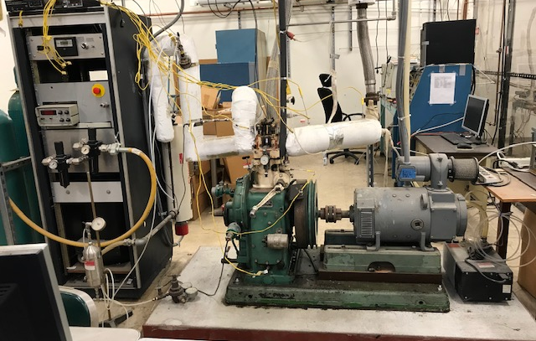
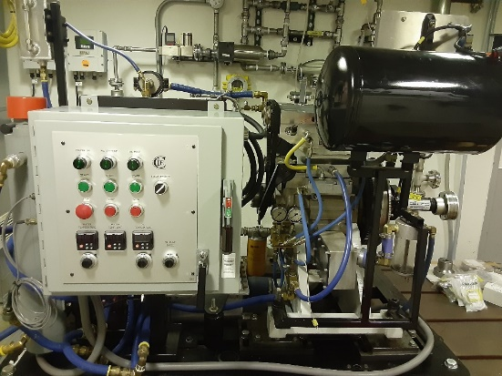
Experimental Facilities at OU
Constructing a Single-Cylinder Engine Dyno Lab at OU
Single-Cylinder FEV engine (DISI) provided by Stellantis
Explore effects of fuel chemistry at conditions relevant for future engines and fuels
Secured donation of CFR Engine from Drexel U.
Variable CR platform ideal for kinetics studies

Slide 16
Role of ECN?
ECN could serve as database for targeted chemistry/kinetics validation cases
Facilities? Conditions? CFR Working Group?
Establish guidelines for validation cases
E.g. what qualifies as “Good Agreement”
Some great resources exist already
Dr. Chih-Jen (Jackie) Sung (UCONN) RCM Database
https://combdiaglab.engr.uconn.edu/database/rcm-database/
Dr. Henry Curran Combustion Chemistry Center (NUI-G)
https://www.nuigalway.ie/combustionchemistrycentre/

