Slide 1



Modeling and LES of high-pressure liquid injection under evaporating and non-evaporating conditions by a real-fluid model and surface density approach
ECN 8.7
2/02/2023
Hesham GABALLA, Chaouki HABCHI, Jean-Charles DE HEMPTINNE
IFP Energies Nouvelles

Slide 2

AGENDA
Introduction
Methodology
Results
Conclusions and perspectives

Slide 3
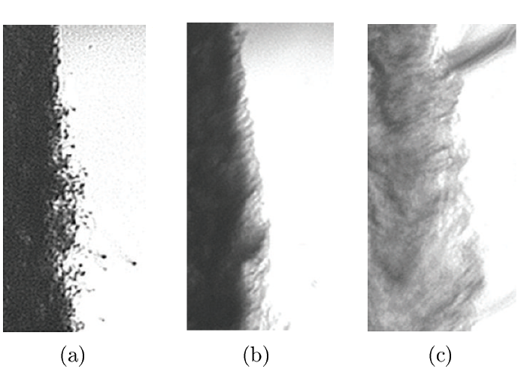

Introduction
Chehroudi et al., 2012
The injected fuel undergoes a continuous change of state from classical two-phase atomization to dense fluid mixing phenomenon.
Predictive CFD model for the fuel injection simulation under various thermodynamic regimes is required.
Spray modeling approaches
  Eulerian –Lagrangian approach
  Discrete Droplet Model (DDM),requires parameter tuning and not suitable for the dense near nozzle region.
  Eulerian-Eulerian approach
    Interface Capturing Methods (ICM) computationally expensive for industrial cases.
    Diffuse interface model (DIM),unresolved interface features are modeled instead of being tracked using a surface density approach.
subcritical
Pr=0.92
Transcritical
Pr=1.22
Supercritical
Pr=2.71
Liquid $N_{2}$ injected into gaseous $N_{2}$
(Single component system)

Slide 4
AGENDA
Introduction
Methodology
Results
Conclusions and perspectives

Slide 5
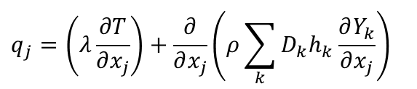
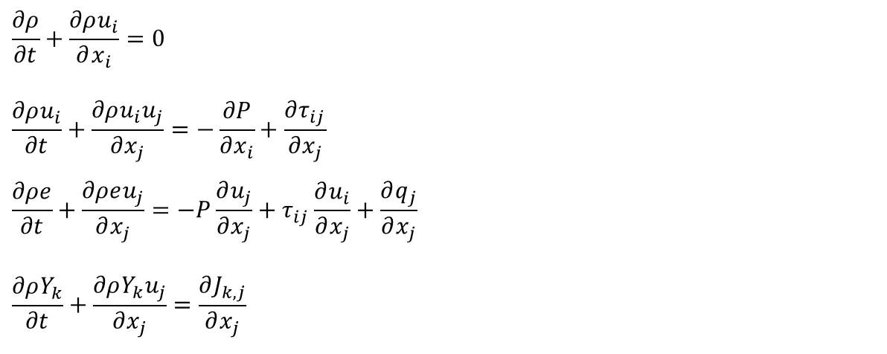
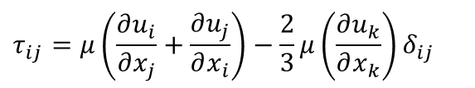
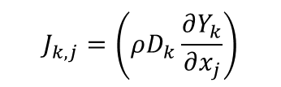
Methodology
Real-fluid model (RFM) description
1-Governing equations (CONVERGE CFD solver)
2- Tabulated thermodynamic closure
$$\frac{∂ρ}{∂t}+\frac{∂ρu_{i}}{∂x_{i}}=0$$
$$\frac{∂ρu_{i}}{∂t}+\frac{∂ρu_{i}u_{j}}{∂x_{j}}=−\frac{∂P}{∂x_{i}}+\frac{∂τ_{ij}}{∂x_{j}}$$
$$\frac{∂ρe}{∂t}+\frac{∂ρeu_{j}}{∂x_{j}}=−P\frac{∂u_{j}}{∂x_{j}}+τ_{ij}\frac{∂u_{i}}{∂x_{j}}+\frac{∂q_{j}}{∂x_{j}}$$
$$\frac{∂ρY_{k}}{∂t}+\frac{∂ρY_{k}u_{j}}{∂x_{j}}=\frac{∂J_{k,j}}{∂x_{j}}$$
Real-fluid EoS and Vapor-liquid equilibrium (VLE) calculations to consider phase change.
VLE coupled with real-fluid EoSs such as (PR, CPA, etc) is computed by in-house Carnot thermodynamic library before the CFD simulation and tabulated.
The tabulated quantities include:
  Thermodynamic & transport properties.
  Phase state & composition.
$$τ_{ij}=μ\left(\frac{∂u_{i}}{∂x_{j}}+\frac{∂u_{j}}{∂x_{i}}\right)−\frac{2}{3}μ\left(\frac{∂u_{k}}{∂x_{k}}\right)δ_{ij}$$
$$q_{j}=\left(λ\frac{∂T}{∂x_{j}}\right)+\frac{∂}{∂x_{j}}\left(ρ\sum_{k}{D_{k}h_{k}}\frac{∂Y_{k}}{∂x_{j}}\right)$$
$$J_{k,j}=\left(ρD_{k}\frac{∂Y_{k}}{∂x_{j}}\right)$$

Slide 6
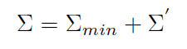
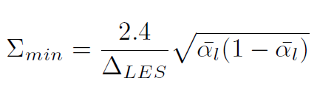

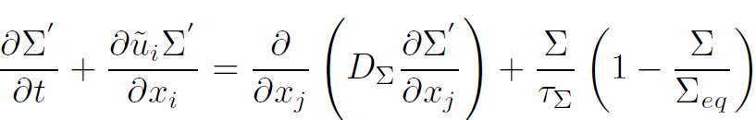

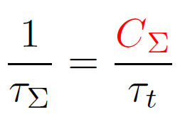

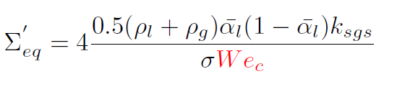
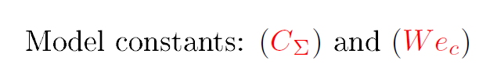
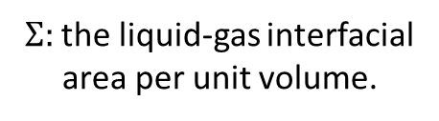
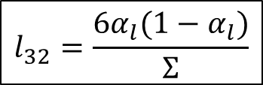
Fuel Atomization (Surface density approach)
${Σ:}_{ }$the liquid-gas interfacial
area per unit volume.
LES postulated model [3]
Coupled with the RFM
(Production/destruction term)
$$l_{32}=\frac{6α_{l}(1−α_{l})}{Σ}$$
(Duret et al. 2013)
(Anez et al, 2018)
$\left[α_{l}, ρ_{l}, ρ_{g}, σ\right]$ are provided by the RFM thermodynamic table as function of $(T,P,Y_{k})$
Phase change effect on the surface density is implicitly considered by $\left[Σ_{min}, Σ_{eq}\right]$ dependent on $\left[α_{l}, ρ_{l}, ρ_{g}, σ\right]$.
[3] Chesnel et al. 2011,
Notes:
*the minimum surface density that can be found for a given value of the resolved liquid volume fraction
*The first term on the RHS represents the turbulent diffusion flux modeled using a gradient law closure,
* The 2nd term on RHS represents the surface production/ destruction, due to turbulent flow stretching
and coalescence effects, which is modeled in a restoration to equilibrium form, where (S_eq)
is an equilibrium surface area density that should be reached within a characteristic time scale (taw).

Slide 7
AGENDA
Introduction
Methodology
Results
Conclusions and perspectives

Slide 8
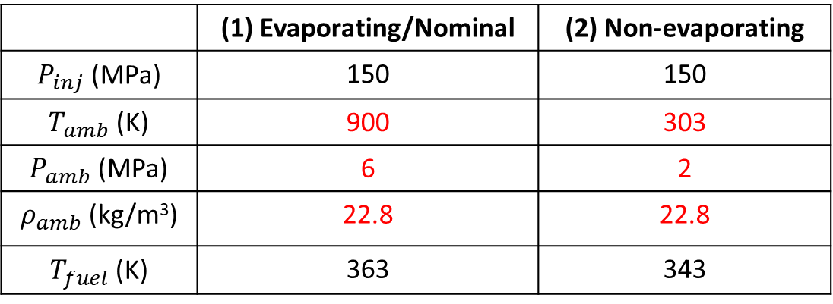
Results
Case study for model validation
ECN spray A:
Fuel: n-dodecane ( C₁₂H₂₆)
Ambient composition: 100% N₂
 | (1) Evaporating/Nominal | (2) Non-evaporating
$P_{inj}$ (MPa) | 150 | 150
$T_{amb}$ (K) | 900 | 303
$P_{amb}$ (MPa) | 6 | 2
$ρ_{amb}$ (kg/m³) | 22.8 | 22.8
$T_{fuel}$ (K) | 363 | 343

Slide 9
Results
Case study for model validation
ECN spray A:
Fuel: n-dodecane ( C₁₂H₂₆)
Ambient composition: 100% N₂
 | (1) Evaporating/Nominal | (2) Non-evaporating
$P_{inj}$ (MPa) | 150 | 150
$T_{amb}$ (K) | 900 | 303
$P_{amb}$ (MPa) | 6 | 2
$ρ_{amb}$ (kg/m³) | 22.8 | 22.8
$T_{fuel}$ (K) | 363 | 343
(2) non-evaporating case: ECN X-ray measurements for spray dispersion.
ECN Ultra small angle X-ray scattering (USAXS) measurements for interfacial area and SMD.

Slide 10
AGENDA
Introduction
Methodology
Results
  Non-evaporating spray A
  Nominal evaporating spray A
Conclusions and perspectives

Slide 11
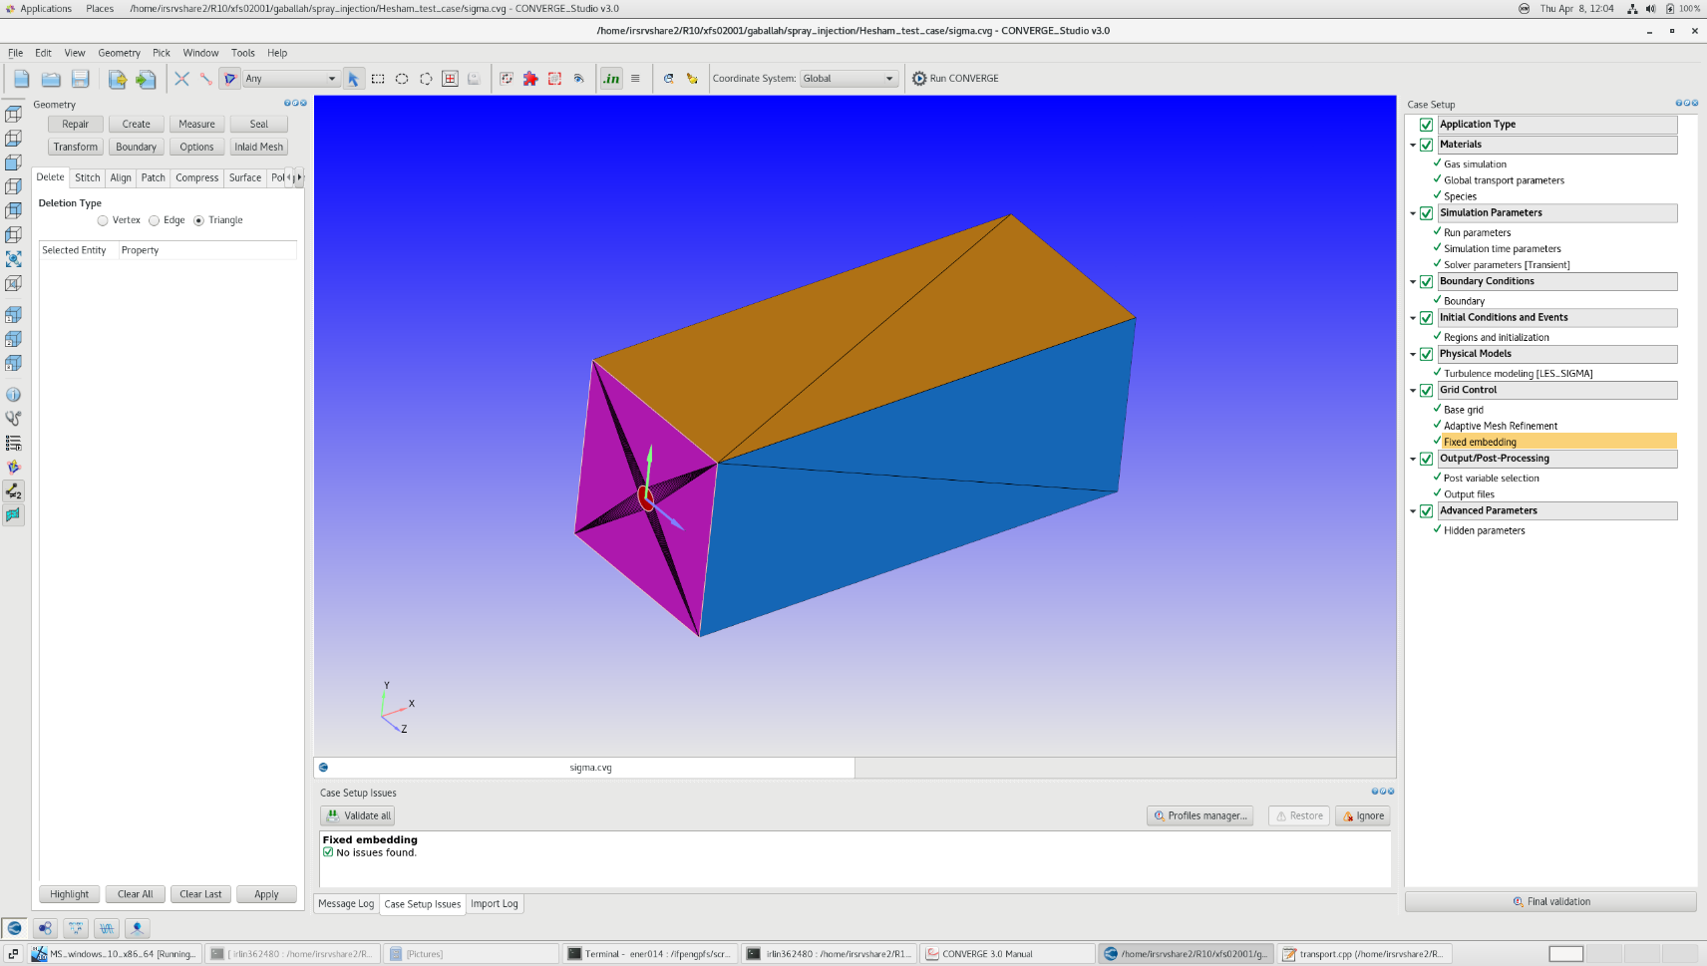
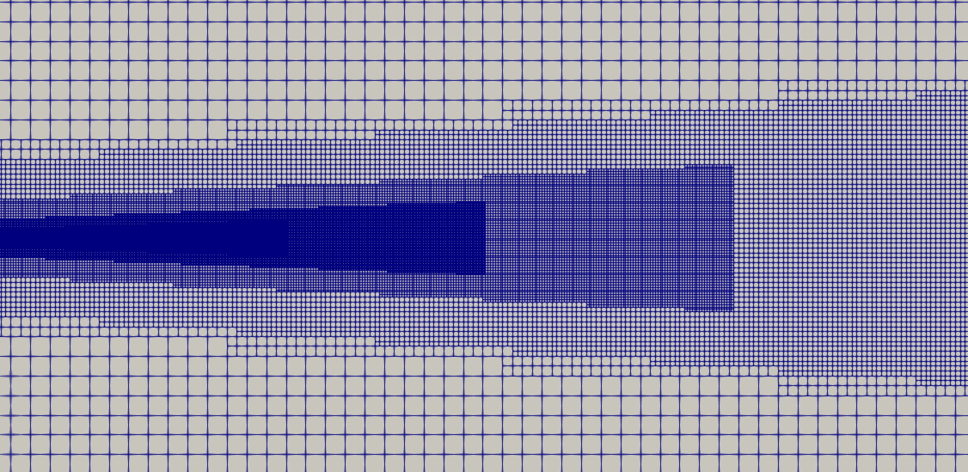
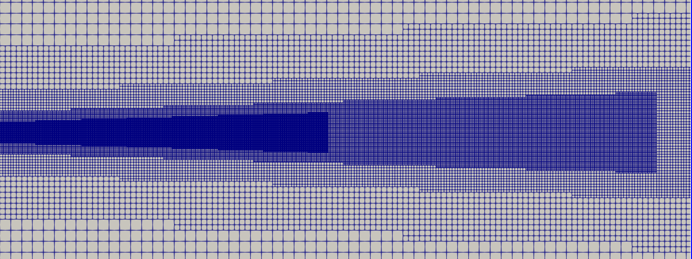
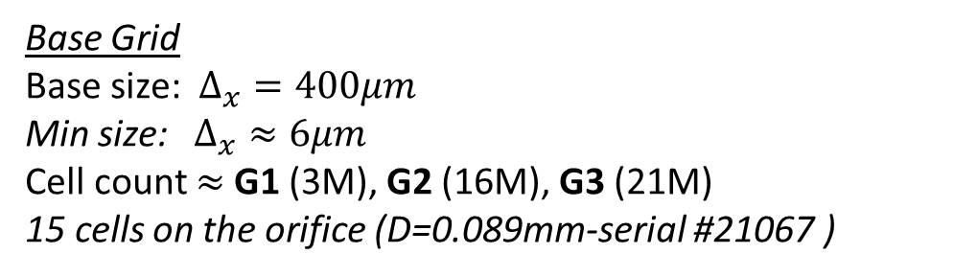
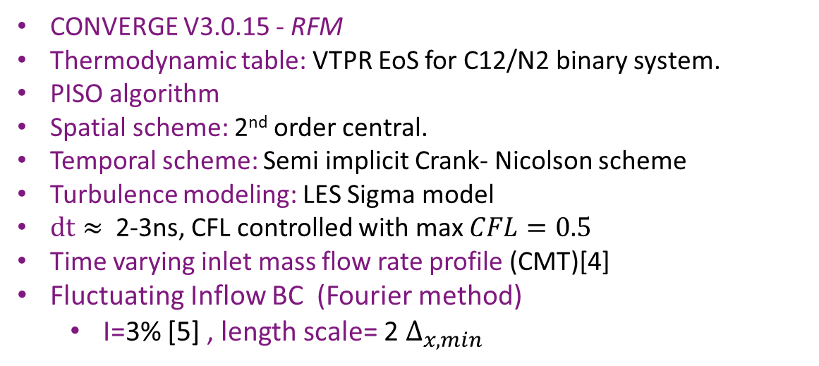

Spray A setup
Base Grid
Base size:$Δ_{x}=400μm$
Min size: $Δ_{x}≈6μm$
Cell count $≈$G1 (3M), G2 (16M), G3 (21M)
15 cells on the orifice (D=0.089mm-serial #21067 )
Lx=20mm, Ly=Lz=10mm
Nozzle exit
CONVERGE V3.0.15 - RFM
Thermodynamic table: VTPR EoS for C12/N2 binary system.
PISO algorithm
Spatial scheme: 2nd order central.
Temporal scheme: Semi implicit Crank- Nicolson scheme
Turbulence modeling: LES Sigma model
$dt≈$ 2-3ns, CFL controlled with max $CFL=0.5$
Time varying inlet mass flow rate profile (CMT)[4]
Fluctuating Inflow BC (Fourier method)
  I=3% [5] , length scale= 2 $Δ_{x,min}$
Inlet
$$Δ_{x,min}$$
[4] CMT. https://www.cmt.upv.es/ECN03.aspx
[5] Desantes et al. (2017, 2020)

Slide 12
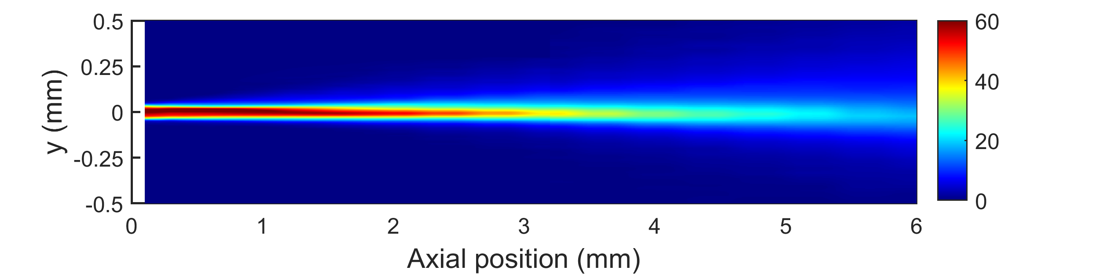
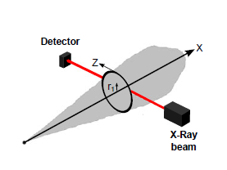
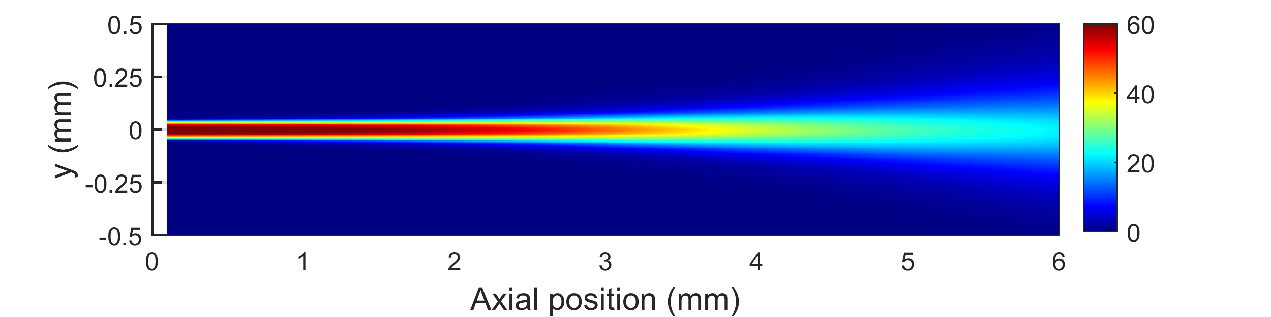
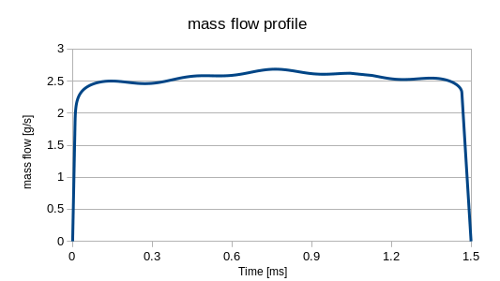
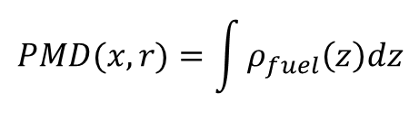
Fuel projected mass density (PMD)
PMD: line of sight integration of fuel density along spray depth
EXP
r
$$PMD(x,r)=\int{ρ_{fuel}\left(z\right)dz}$$
ECN X-ray data[6]
LES time avg
Time- averaged LES- Grid 2
[6]ECN X-ray radiography, https://ecn.sandia.gov/rad675.
Quasi-steady period

Slide 13
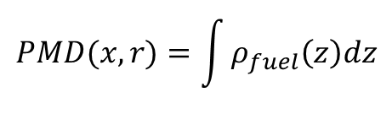
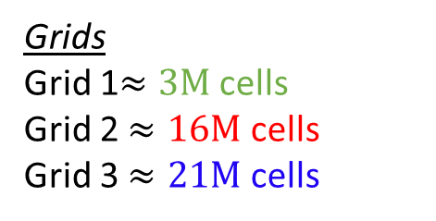
FUEL Dispersion (Projected mass density)
Grids
Grid 1$≈3M$ cells
Grid 2 $≈16M$ cells
Grid 3 $≈21M$ cells
r
Model results are in good agreement with the experimental data, especially using G2 and G3.
$$PMD(x,r)=\int{ρ_{fuel}\left(z\right)dz}$$

Slide 14
FUEL Dispersion (Projected mass density)
Grids
Grid 1$≈3M$ cells
Grid 2 $≈16M$ cells
Grid 3 $≈21M$ cells
r
Model results are in good agreement with the experimental data, especially using G2 and G3.
G2 is used for further calculations .
$$PMD(x,r)=\int{ρ_{fuel}\left(z\right)dz}$$

Slide 15
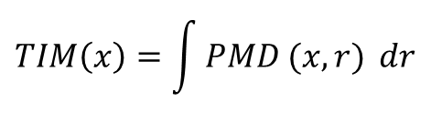
FUEL Dispersion (TIM and LVF)
Transverse integrated mass (TIM)
$$TIM\left(x\right)=\int{PMD (x,r)} dr$$

Slide 16
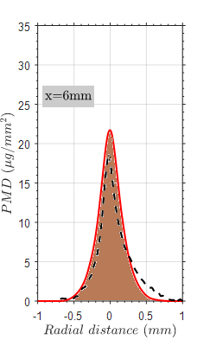
FUEL Dispersion (TIM and LVF)
Transverse integrated mass (TIM)
$$TIM\left(x\right)=\int{PMD (x,r)} dr$$
TIM is well captured until 5mm, then tends to be overestimated.
LVF is matched with great accuracy reproducing intact liquid core and decay along spray centerline.

Slide 17



Atomization model assessment
Ultra small angle X-ray scattering (USAXS) experiments [7]: projected surface area density along the spray centerline.
2 model constants ($C_{Σ}, We_{c}$)
$$C_{Σ}=1,We_{c}=(1.5, 6)$$
$$C_{Σ}=1,We_{c}=1.5$$
Projected surface area density is well reproduced along the spray axis.
SMD falls within the experimental data range.
[8]: Kastengren et al. (2017)
[9]: Desantes et al. (2017,2020)
[10]: Demoulin el al., (2013)

Slide 18
AGENDA
Topic & objectives
Methodology
Description of simulated test case
Results
  Non-evaporating spray A
  Nominal evaporating spray A
Conclusions and perspectives

Slide 19
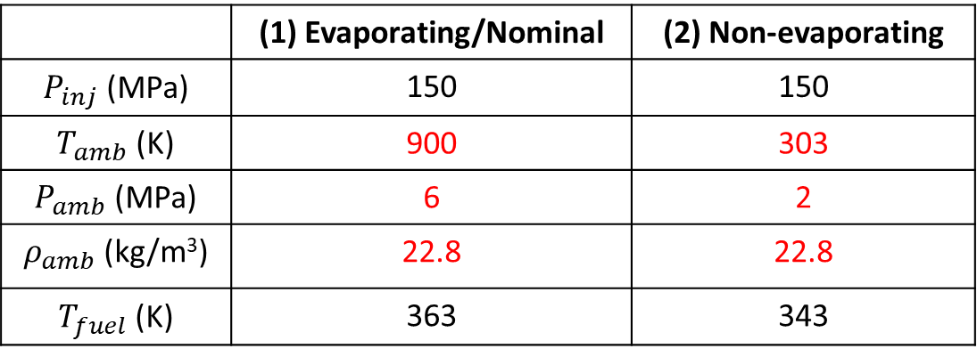
Results
ECN spray A:
Fuel: n-dodecane ( C₁₂H₂₆)
Ambient composition: 100% N₂
 | (1) Evaporating/Nominal | (2) Non-evaporating
$P_{inj}$ (MPa) | 150 | 150
$T_{amb}$ (K) | 900 | 303
$P_{amb}$ (MPa) | 6 | 2
$ρ_{amb}$ (kg/m³) | 22.8 | 22.8
$T_{fuel}$ (K) | 363 | 343

Slide 20
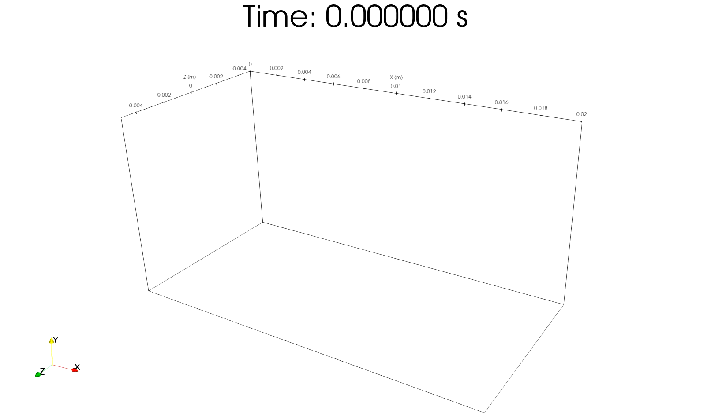
Spray A- evaporating condition
Liquid pen: LVF=0.15%
Vapor pen: Yc12=0.1%
GRID: 16M cells
Inlet mass flow profile (CMT)
without a Fluctuating inflow BC
The Liquid and vapor penetrations match well with the Experiments

Slide 21
Spray A- evaporating condition
Liquid pen: LVF=0.15%
Vapor pen: Yc12=0.1%
GRID: 16M cells
Inlet mass flow profile (CMT)
without a Fluctuating inflow BC
Fuel radial distribution fairly agrees with the Exp.

Slide 22
Droplet SMD- evaporating vs Non-evaporating case
Droplet size reduces under the evaporating condition.
The result show the sensitivity of the surface density model to the phase change, which is automatically provided by the RFM model.

Slide 23
AGENDA
Topic & objectives
Methodology
Description of simulated test case
Results
  Non-evaporating spray A
  Nominal evaporating spray A
Conclusions and perspectives

Slide 24
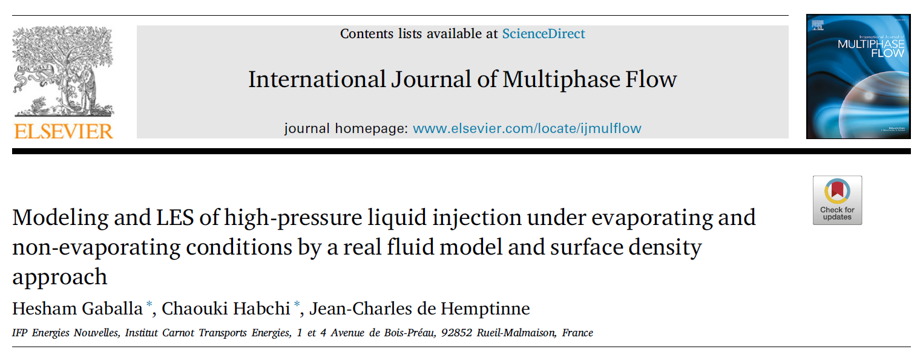
CONCLUSIONS & Perspectives
Conclusions
  RFM model coupled with a SGS atomization model based on a surface density approach for atomization modeling within LES framework.
  Fuel dispersion & atomization are well predicted using (RFM-LES) (non-evaporating Spray A).
  Under (evaporating Spray A) condition, the spray penetrations and fuel distribution are well predicted.
Perspectives
  Investigation of renewable fuels injection such as (Methanol/ammonia) under the Spray A condition.
  Including the in-nozzle flow in the simulation (especially for cavitating injectors)

Slide 25
acknowledgments
This project has received funding from the European Union Horizon 2020 Research and Innovation programme. Grant Agreement No 861002 for the EDEM project.

Slide 26
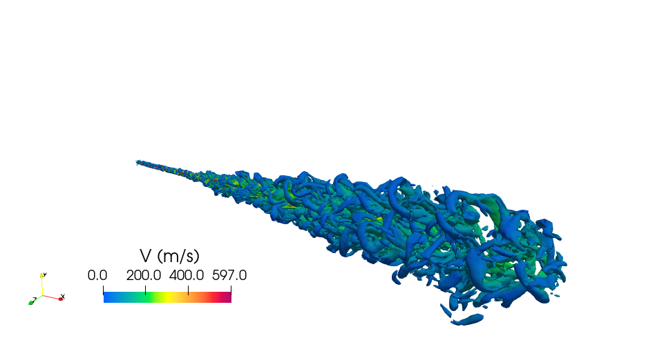
Thank you for your attention
QUESTIONS ?

