Slide 1
ECN9 – diesel-like AMMONIA SPRAYS
José M García-Oliver
ECN 9 Workshop | Naples, Italy on September 8th – 9th, 2023

Slide 2
ECN9 – diesel-like AMMONIA SPRAYS
CONTRIBUTORS
INERT
Gabriela Bracho, Jiawei Cao
REACTING
Andrea Schirru, Tommaso Lucchini
Andrea Di Matteo, Bart Somers

Slide 3
ECN9 – diesel-like AMMONIA SPRAYS
ACKNOWLEDGEMENTS
This research has been partially funded by MCIN/AEI/10.13039/501100011033 and the European Union “NextGenerationEU”/PRTR as part of the projects TED2021-129379A-I00 and SAFLOW TED2021-131618CA-C22
We would like to thank José Enrique del Rey and Omar Huerta for their valuable support during the experimental campaign at CMT
Thanks to Kar Mung Pang from MAN Energy Solutions for fruitful discussion

Slide 4
MOTIVATION
GUIDELINES – WISH LIST ?
Operating conditions
Reference Nozzles
Spray M, single-hole & multi-hole
Spray G, multi-hole
Bosch 7-hole
Spray D, Single-hole
Fuels
Ammonia
Injector type | Name | T fuel [K] | P fuel [bar] | T amb [K] | P amb [bar] | rho amb [kg/m3] | O2 [%] | Injection duration [ms]
M (1,8), G, Bosch7 | Ambient fuel | 293 | 120, 200 | 293 | 0.5, 2, 15 | varies | 0 | > 3
 | Hot fuel | 363 | 200 | 333 | 0.5, 60 | varies | 0 | > 3
 | Hot fuel & air | 363 | 200 | 573 | 6 | 3.5 | 0 | > 3
D | Diesel-like | 363 | 1500 | 1200, 1300 | varies | 22.8 | 0, 21 | > 3

Slide 5
MOTIVATION
… REALITY
Most of the groups are facing difficulties to operate Diesel-like injectors with ammonia
Modelling efforts have been only achieved by groups with traditional activity within ECN
The menu is served
Inert spray: Exp-only by CMT
Reacting sprays: CFD-only by TUe + Polimi

Slide 6
Diesel like ammonia sprays inert

Slide 7
Inert ammonia sprays
THE CONTENTS
Approach
Materials and methods
Experimental facility
Optical setup
Test Conditions
Results and discussion
Spray penetration and spray angle
Effect of chamber conditions and injection pressure

Slide 8
Inert ammonia sprays
APPROACH
This presentation will present a first characterization of ammonia sprays under a Diesel-like configuration using ECN recommendations [1] … except for the injector!!
Vapor phase penetration and cone angle vs time: single-pass Schlieren
Liquid length: diffuse back illumination (DBI)
Parametric study:
Ambient gas density, ambient gas temperature
Rail pressure conditions
[1] García-Oliver JM, Bracho G, de la Morena J, Cao J, 2nd Symposium on Ammonia Energy, 2023

Slide 9
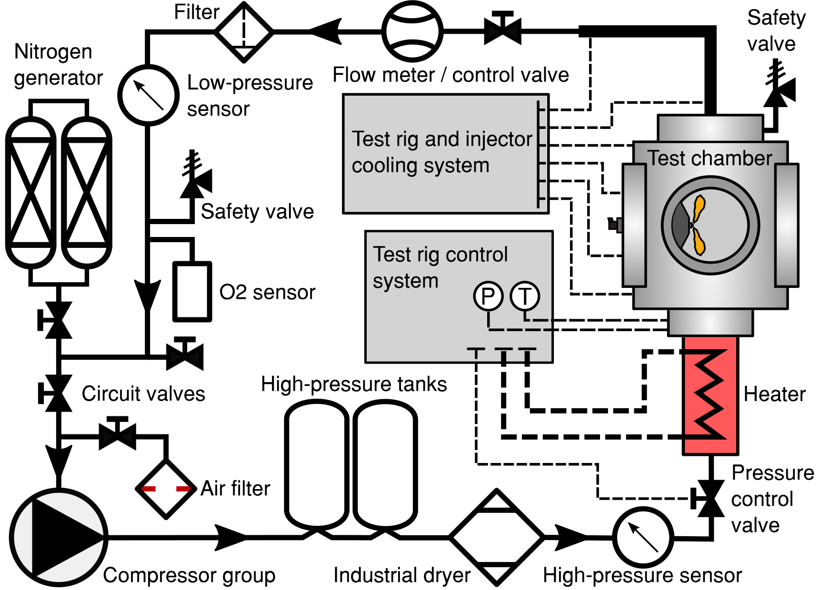
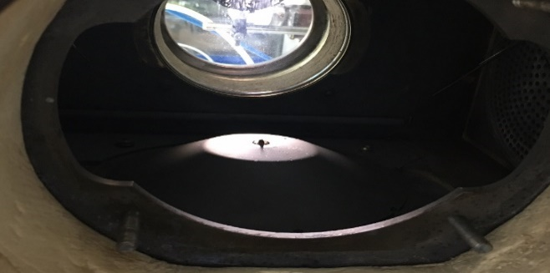
Materials and Methods
Experimental Facility: High Pressure High Temperature Test rig
Continuous flow operation
Wide range of operating conditions:
Gas: [N₂] or [N₂+O₂]
Temperature up to 1100K
Pressure: up to 150 bar
Wide testing section: Ø200mm
Injector holder with a cooling adaptor
Nozzle
9

Slide 10
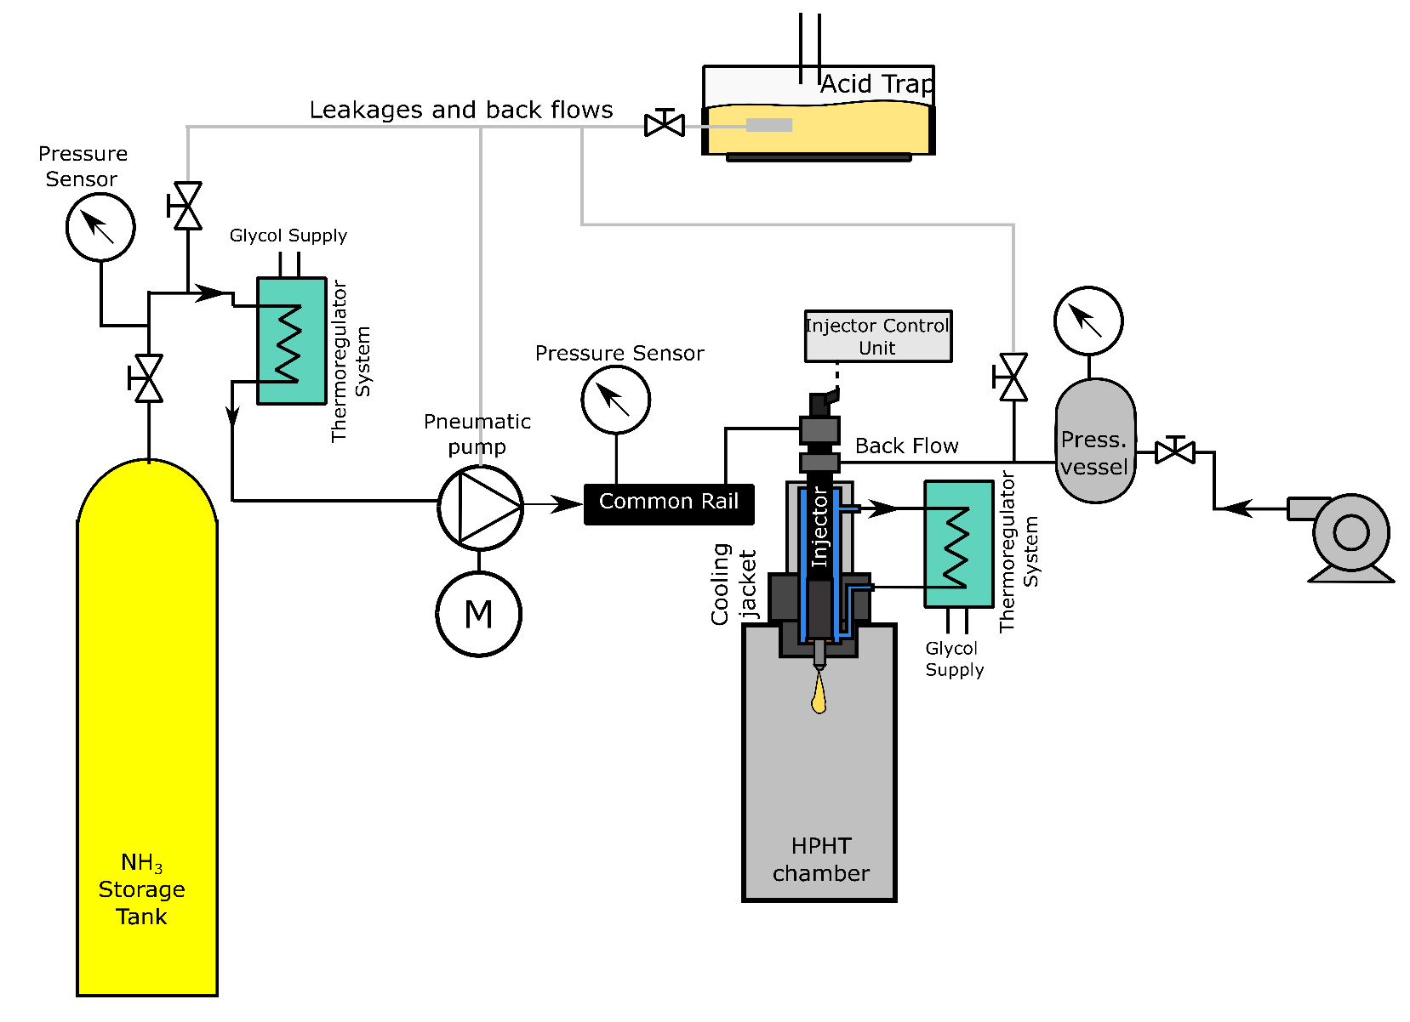
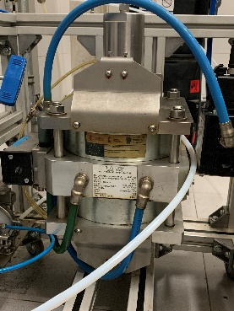
Materials and Methods
Experimental facility: Common Rail Injection system description
Liquid ammonia was supplied from a storage tank → NH₃ Cooled down to prevent cavitation in the pump
A pneumatic pump was used
To prevent phase change in the injector:
Return-leakage line was pressurized [10 bar]
Adjustable injector cooling temperature [15ºC]
All the return lines were collected → acid trap
15-18 bar
Heating blankets
[50ºC]
The system operated in stabilized conditions up to P_{inj} 800 bar
10
Notes:
Around 40ºC in storage

Slide 11
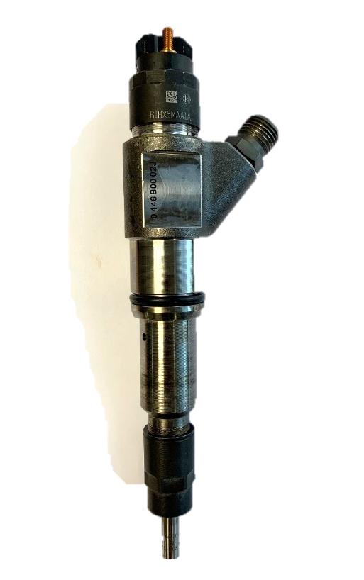
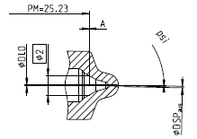
Materials and Methods
Test Conditions:
Bosch Spray D-like Injector
Gas Temp. [K] | Pinj [bar] | Oxygen [%] | Density [kg/m3]
800 900 | 600 800 | 0 | 22.8 30.4
- Single hole nozzle, convergent
Nozzle | Diameter
Solenoid – Bosch | 300 µm
Injection frequency: every 4 sec.
Energizing Time: 2 ms -> Injection duration 3 ms
Sample size: 20 injection cycles
11

Slide 12
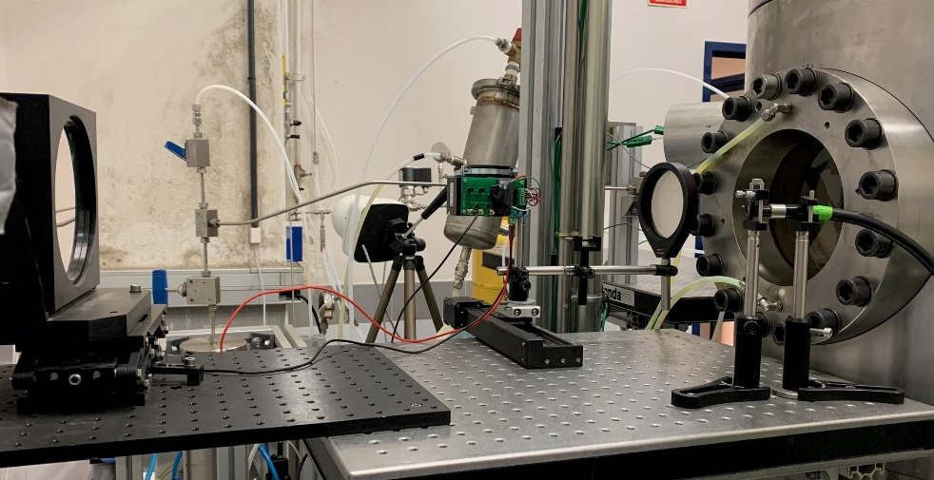
Materials and Methods
Optical setup:
Vapor phase penetration: Conventional single-pass Schlieren
Image size: 768x272 pix
Spatial resolution: 4.2 pix/mm
Image acquisition: 60 kfps
Exposure time: 0.6 µs
Lens
Iris
Parabolic mirror
Light source
12

Slide 13
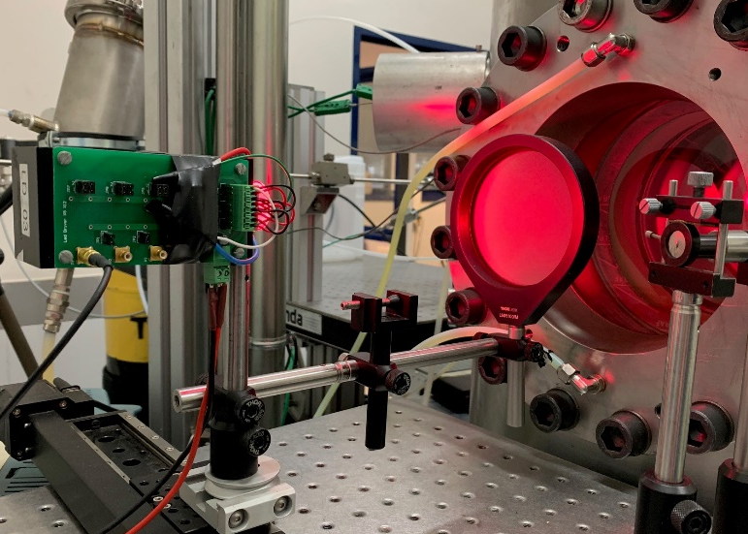
Materials and Methods
Optical setup:
Liquid length: Diffuse Back Illumination (DBI)
Image size: 768x272 pix
Spatial resolution: 4.2 pix/mm
Image acquisition: 60 kfps
Exposure time: 15 µs
LED @ 660nm
Lens
LED
Diffuser
13

Slide 14
Materials and methods
EXAMPLE OF RAW IMAGES
T=900 K – rho=22.8 kg/m3 – Pinj = 600 bar
14

Slide 15
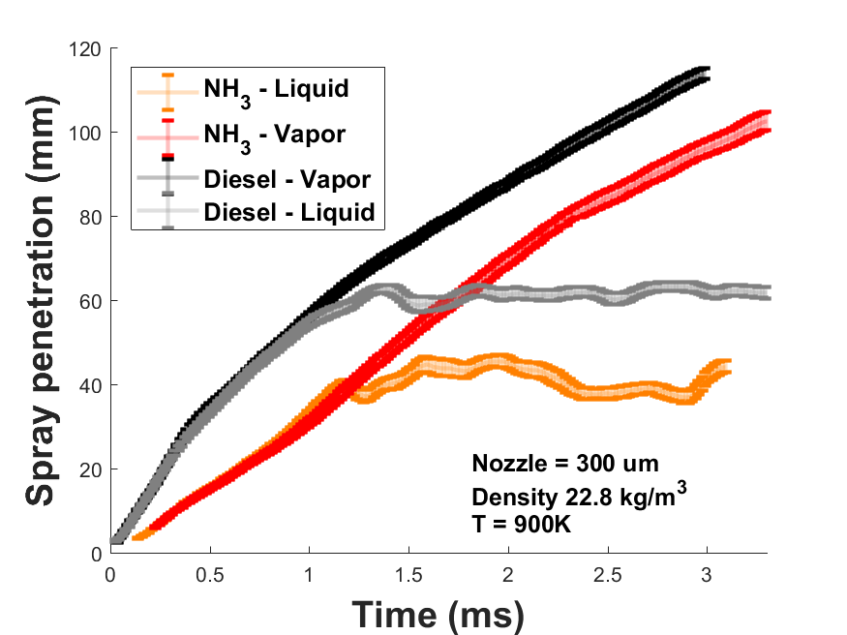
Results
COMPARISON WITH CONVENTIONAL DIESEL
NH3 Overall behaviour similar to Diesel BUT
Initial phase of the injection is slower in the NH3 spray
Stabilized LL of NH3 is shorter
Open points
Different density, lower viscosity
Internal nozzle flow and dynamic operation of the injector?
Needle lift? Actual injection rate differences?
Injection Pressure: 600 bar
15
Notes:
La densidad es 22.8

Slide 16
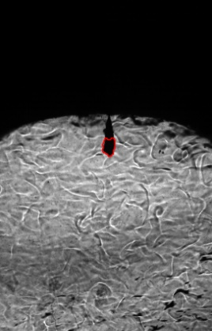
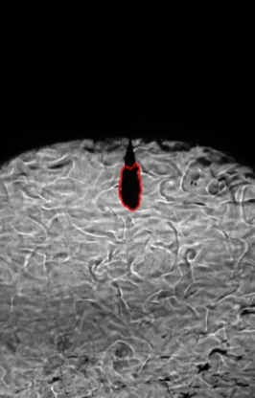
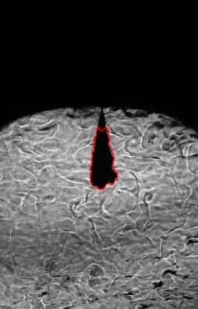
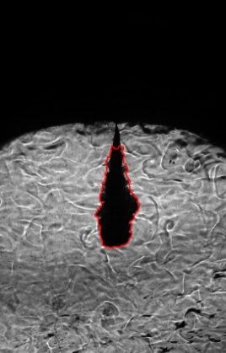
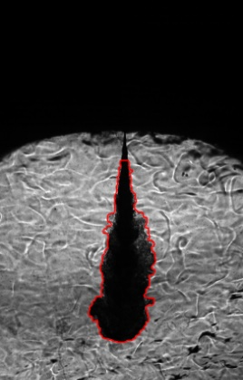
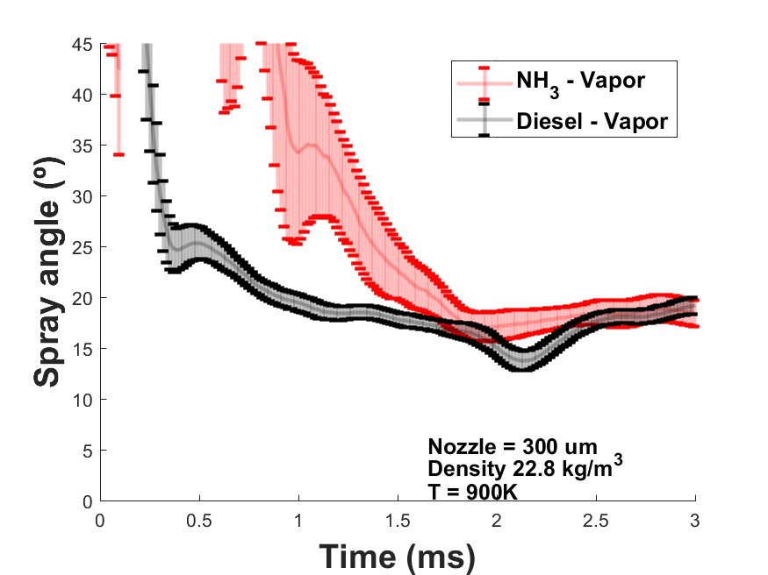
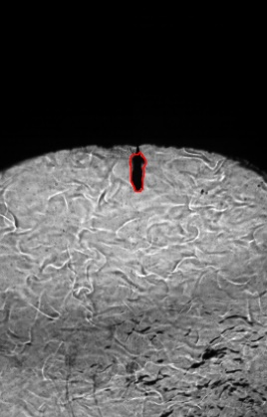
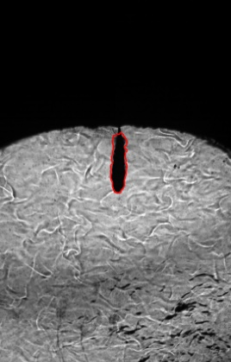
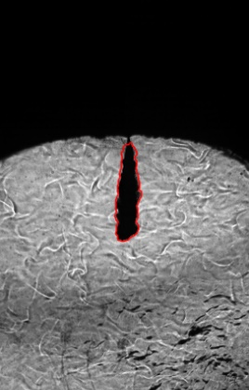
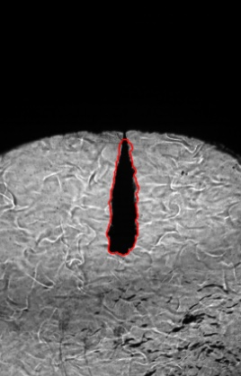
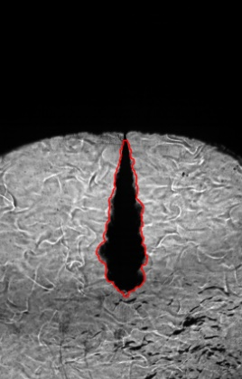
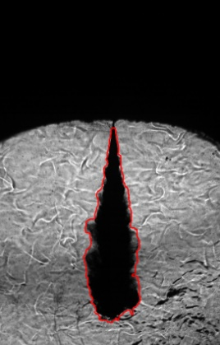
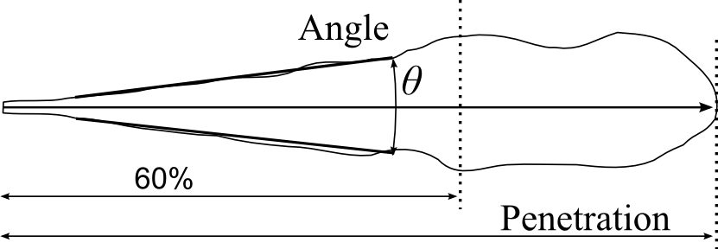
Results
COMPARISON WITH CONVENTIONAL DIESEL
SPRAY ANGLE EVOLUTION
NH₃
Injection Pressure: 600 bar
Diesel
S
Angle criteria: Angle fitted between 10% - 60% spray region
Wider spray angle for NH3 at the start of injection → later behaviour is pretty similar
16
Notes:
La densidad es 22.8

Slide 17
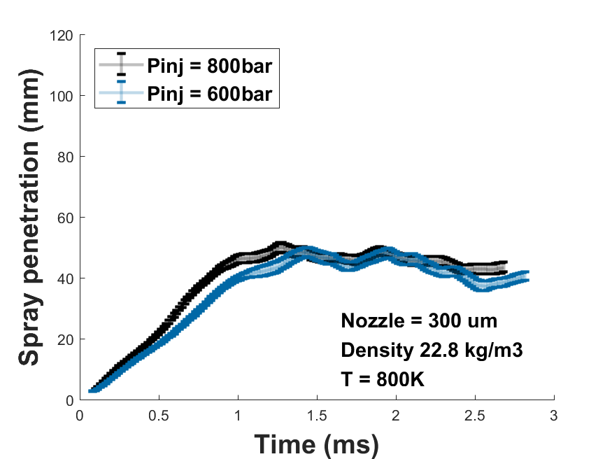
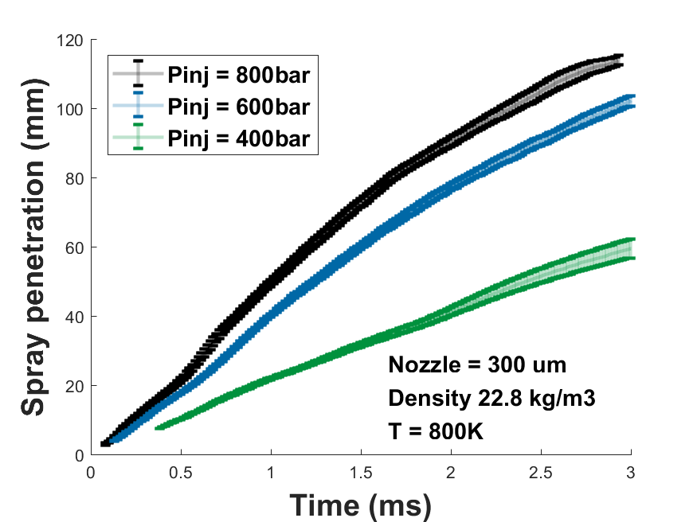
Results
PARAMETRIC VARIATIONS
Effect of injection rail pressure
Gas density: 22.8 kg/m³
Temp 800K
VAPOR PHASE
LIQUID PHASE
Mixing-controlled LL
17

Slide 18
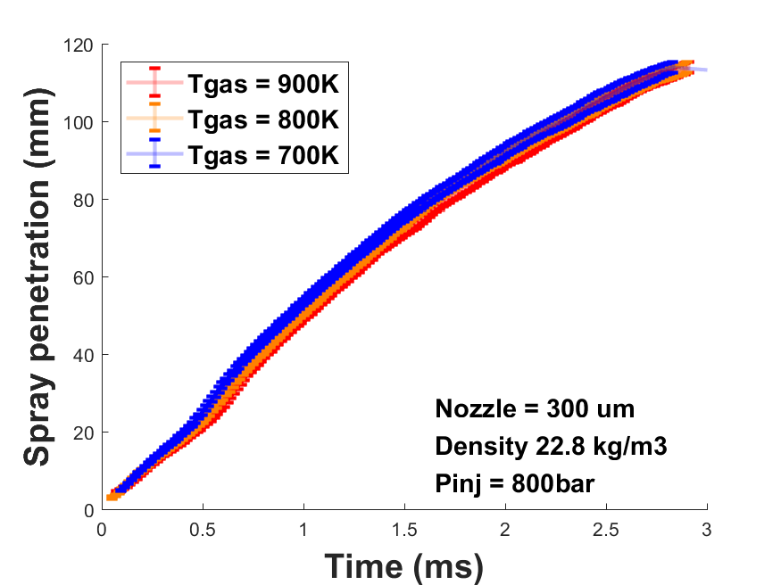
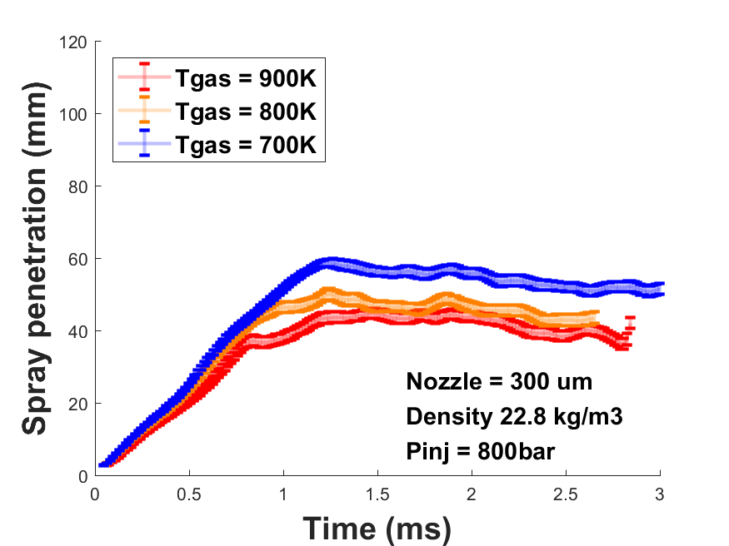
Results
PARAMETRIC VARIATIONS
Effect of chamber temperature
Gas density: 22.8 kg/m³
Injection pressure 800 bar
VAPOR PHASE
LIQUID PHASE
18
Notes:
Añadir barras de error

Slide 19
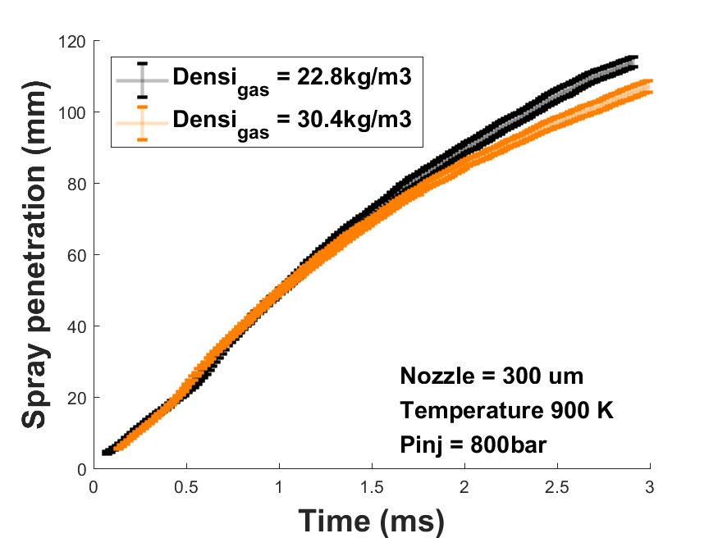
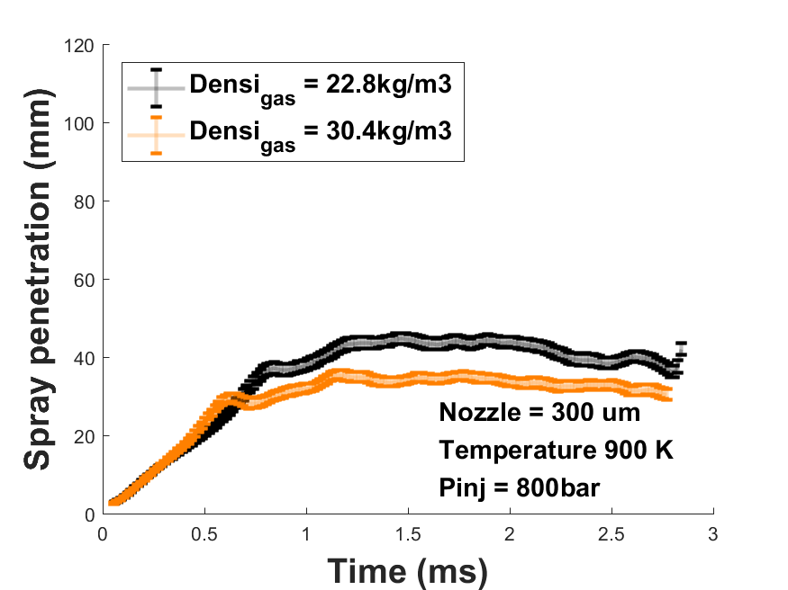
Results
PARAMETRIC VARIATIONS
Effect of chamber density
Gas Temperature: 900K
Injection pressure 800 bar
VAPOR PHASE
LIQUID PHASE
19
Notes:
Añadir barras de error

Slide 20
Conclusions – inert
Inert ammonia sprays were investigated for a 300µm nozzle
A common-rail type system has been employed. Needed adaptations:
Return-leakage line was pressurized [10 bar]
Adjustable injector cooling temperature [15ºC]
Spray penetration results showed significant differences between NH3 and conventional diesel during the initial transient phase of the process
Later evolution becomes similar to that of Diesel
Trends in parametric variationssimilar behaviour as Diesel sprays
Injection pressure, ambient temperature, density variations hint at mixing-controlled, gas-jet behaviour
20

Slide 21
Diesel like ammonia sprays reacting

Slide 22
reacting AMMONIA SPRAYS
CONTENTS
Introduction & Motivation
Numerical setup
Domain/Mesh
Turbulence model
Spray
Combustion
Spray mixing characteristics
Combustion results
ID/Tmax
Flame stabilization
Combustion – Flamelet behaviour

Slide 23
INTRODUCTION
ECN CONTEXT
PROPOSED EXPLORATORY STUDY
Numerical analysis (‘blind experiment’) of ammonia spray combustion under diesel-like environment
Evaluation of potential future research within ECN
FOCUS OF ANALYSIS
Ammonia ignition sequence / potential
NOx formation

Slide 24
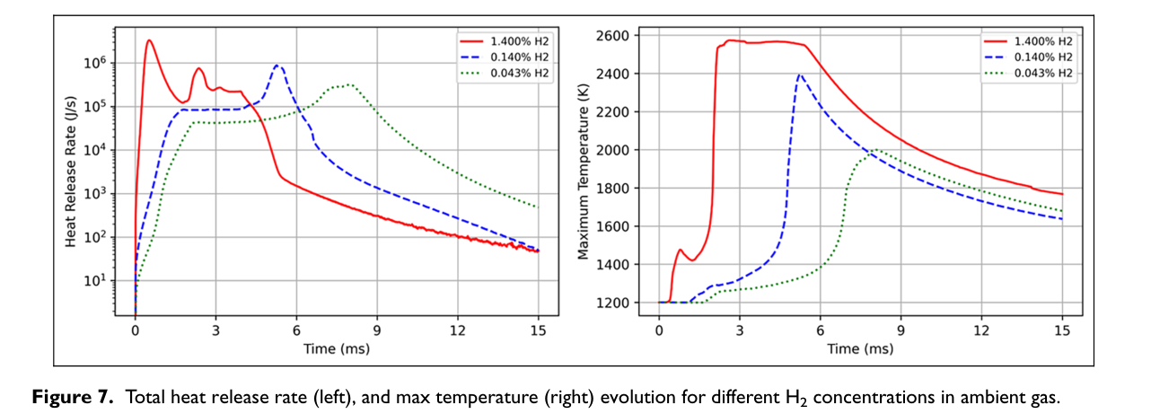
introduction
AS OF GUIDELINES
Idea ‘borrowed’ from presentation by Bakir et al [1]
[1] Bakir, A. H., Ge, H., Zhang, Z., & Zhao, P. (2023). International Journal of Engine Research, 146808742311773. https://doi.org/10.1177/14680874231177361

Slide 25
introduction
AS OF GUIDELINES
Idea ‘borrowed’ from presentation by Bakir et al [1]
[1] Bakir, A. H., Ge, H., Zhang, Z., & Zhao, P. (2023). International Journal of Engine Research, 146808742311773. https://doi.org/10.1177/14680874231177361

Slide 26
MOTIVATION
GUIDELINES – WISH LIST
Operating conditions
Reference Nozzles
Spray M, single-hole & multi-hole
Spray G, multi-hole
Bosch 7-hole
Spray D, Single-hole
Fuels
Ammonia
Injector type | Name | T fuel [K] | P fuel [bar] | T amb [K] | P amb [bar] | rho amb [kg/m3] | O2 [%] | Injection duration [ms]
M (1,8), G, Bosch7 | Ambient fuel | 293 | 120, 200 | 293 | 0.5, 2, 15 | varies | 0 | > 3
 | Hot fuel | 363 | 200 | 333 | 0.5, 60 | varies | 0 | > 3
 | Hot fuel & air | 363 | 200 | 573 | 6 | 3.5 | 0 | > 3
D | Diesel-like | 363 | 1500 | 1200, 1300 | varies | 22.8 | 0, 21 | > 3
Ref chemical mechanism: Otomo et al. Int J Hydrogen Energy 2018; 43: 3004–3014 32 species / 211 reactions

Slide 27
COMPUTATIONAL SETUP
MESH | TU/e | PoliMi
Type | 3D Cylindrical | 2D Wedge
# Cells | 2.85 M | 50 K
Min. Cell Size | 200 μm | 400 μm
Length | 0.24 m | 0.5 m
Radius | 35 mm | 100 mm
SPRAY Reitz KHRT | TU/e (Modified) | PoliMi
B0 | 0.1 | 0.61
B1 | 40 | 40
Ctau | 1 | 1
CRT | 0.1 | 0.1
Cone Angle | 19° | 14°
ROSIN-RAMLER | TU/e (RR) | PoliMi (uniform)
min | 30 μm | 186 μm
max | 186 μm | 186 μm
SMD | 50 μm | 186 μm
For PoliMi the standard evaporation model of OpenFOAM was used. A modified version is used for TU/e

Slide 28
COMPUTATIONAL SETUP
k - ε | TU/e (RR) | PoliMi (uniform)
C1 | 1.59 | 1.55
Cmu | 0.09 | 0.09
C2 | 1.92 | 1.92
C3 | -0.33 | 0
Sigma k | 1 | 1
Sigma ε | 1.3 | 1.3
TCI models
TUe:
FGM: Tabulation, progress variable in terms of species
PoliMi
DETAILED KINETICS: Well-mixed with dynamic load balancing
TRIF: Tabulation, progress variable in terms of enthalpy

Slide 29
Overall mixing comparison
PENETRATION + EVAPORATION
Slightly faster penetration in FGM

Slide 30
OVERALL MIXING COMPARISON
AXIAL VELOCITY DISTRIBUTION BEFORE IGNITION
Slightly faster penetration in FGM -> Higher velocity

Slide 31
Overall mixing comparison
MIXTURE FRACTION BEFORE IGNITION
Slightly faster penetration in FGM -> Slower mixing

Slide 32
Overall mixing comparison
Differences among models in mixing behaviour due to
Mesh
Turbulence model (small)
Not likely to spray calibration

Slide 33
Ignition – 1200 K
ID based upon Tair+400K
ID [ms] | D-K | TRIF | FGM
1200 K | 9.48 | 9.3 | 5.91
1300 K | 2.05 | 3.64 | 1.91
Ignition after EOI, spray dilution

Slide 34
Ignition – 1300 K
ID based upon Tair+400K
ID [ms] | D-K | TRIF | FGM
1200 K | 9.48 | 9.3 | 5.91
1300 K | 2.05 | 3.64 | 1.91
Ignition in a sustained spray

Slide 35
IGNITION SEQUENCE
Temperature maps
FGM
TRIF
DK

Slide 36
Ignition sequence
Side ignition– only captured for FGM due to saving discretization
Fuel age calculation for a n-heptane jet
0.002 s
FGM
TRIF
DK
Side ignition as a result of ‘oldest’ fuel?

Slide 37
Flame stabilization
SUSTAINED FLAME?
0.005 s
FGM
Lean
TRIF
DK
Full reaction zone under lean conditions
Peak temperature correlates with leanest mixtures

Slide 38
Flamelet analysis
1200 K - Strain rate 50 1/s
Consistency with CFD spray results
Late ignition
Progress from lean towards rich
Lean branch always on the steady flamelet

Slide 39
Reacting penetration
Ignition amplifies inert differences

Slide 40
CONCLUSIONS – reacting
First trials hint at
Ignition at around end of injection (5 ms!!) for 1200K
Igniting sprays before end of Injection at 1300 K
Side ignition due to extreme low ignitability, role of fuel age
Stabilized flame seems to occur?
Higher temperatures could further decrease ID and lead to a very similar Diesel like combustion
Combustion always under lean conditions
Combustion regime?
Vast need of experimental validation

Slide 41
Future directions
A LONGER WISH LIST?
Nozzle flow analysis
Injection rate measurements?
CFD Simulations
41

Slide 42
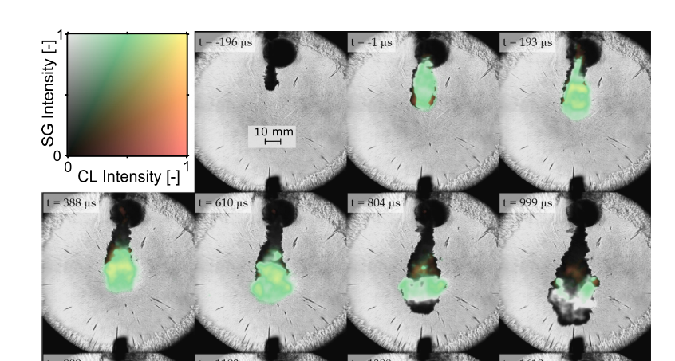
FUTURE DIRECTIONS
POTENTIAL PATHS FOR REFERENCE STUDIES
More reactive conditions
Adding H2 in the ambient air, following the simulation work by Bakir et al that inspired the ECN9 proposal.
Not feasible for constant-pressure vesseIs, more feasible in constant-volume ones with a second injector
Using a pilot spray with a more reactive fuel: Recent work by the group at TU Munich by Scharl et al, Fuel 333 (2023) 126454
Reference experiment with two injectors, at an angle to allow spray intersection

Slide 43
Thank you, questions?

Slide 44
Backup slides

Slide 45
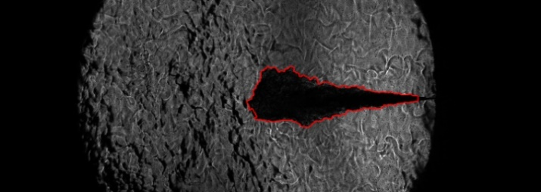
Materials and Methods
Data processing:
The images have been processed following the procedure developed at CMT from previous works [1,2]*
Steps:
Background Correction
Spray boundaries detection
Contour analysis
Penetration (S)
Liquid Spray Angle (θ)
Example of raw images
Example of contour detection
NH₃ Vapor phase
Nozzle tip
Nozzle tip
NH₃ Liquid phase (LL)
Nozzle tip
Nozzle tip
[1] | R. Payri, J. M. García-Oliver, M. Bardi and J. Manin, “Fuel temperature influence on diesel sprays in inert and reacting conditions,” Applied Thermal Engineering, vol. 35, pp. 185-195, 2012.
[2] | R. Payri, F. Salvador, J. Gimeno and L. Zapata, “Diesel nozzle geometry influence on spray liquid-phase fuel penetration in evaporative conditions,” Fuel, vol. 87, pp. 1165-1176, 2008.
45

Slide 46
CONCLUSIONS
Non-reacting sprays of ammonia were investigated to obtain the LL and vapor tip penetration at high injection pressure condition
A common-rail type system has been employed. To prevent phase change in the injector:
Return-leakage line was pressurized [10 bar]
Adjustable injector cooling temperature [15ºC]
Spray penetration results showed significant differences between NH₃ and conventional diesel (used as reference), especially in the transient phase of the process.

Slide 47
Computational setup
Numerical setup | POLIMI | TUe
CFD code | OpenFoam | OpenFoam v2.4.x
Computational domain | CV vessel | CV vessel
Grid type | Fixed | Fixed
Base grid [mm] | Spray-oriented, graded mesh | Radial expansion 1.015 Radial expansion 1.01
Minimum cell size [mm] | 0.2 | 0.0625
Chemical mechanism | Yao | Yao -
Combustion | TWM TFPV | FGM
Turbulence | Standard $κ−ε$ | LES Dynamic Structure
Spray model | Lagrangian parcel | Lagrangian parcel
Injection distribution | Rosin-Ramler | Rosin-Ramler
Breakup model | Reitz-Diwakar | KH-RT
Evaporation | StandardEvap | liquidEvaporationBoil
Droplet collision | None | O’Rourke
Droplet drag | StandardGrag | Sphere drag force
Droplet dispersion | GradientDisper | Tsang

