Slide 1
ECN9 AMMONIA sprays and combustion
Ammonia agenda
GDI Spray simulations and experiments
Combustion in SI engines
Diesel-like sprays
Open discussion
Topic LEADS
M Battistoni, UNIPG
J M García-Oliver, CMT
NAPLES, September 8, 2023

Slide 2
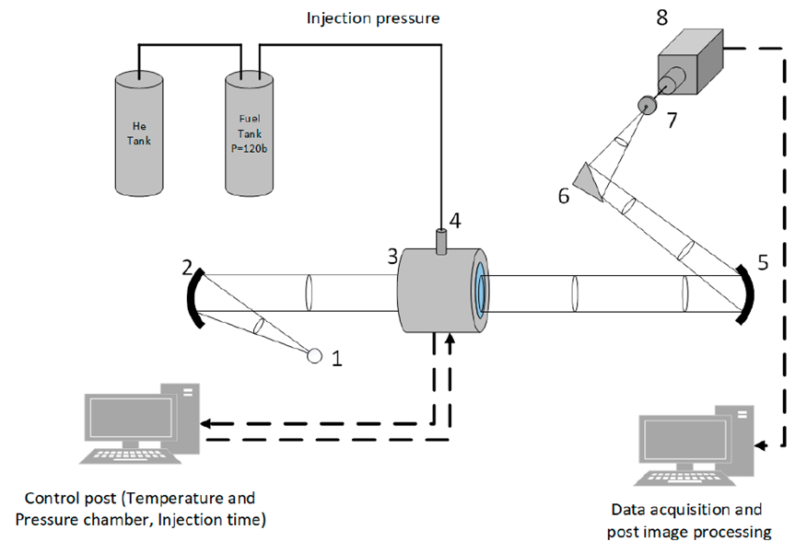
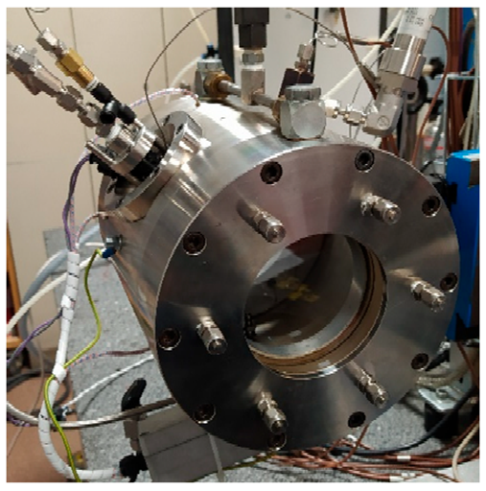
Contributors – experiments
Group | Spray |  |  |  | Techniques & Conditions
 | Bosch (7 holes) | G (8 holes) | M (8 holes) | M (single-hole)
U-ORLEANS Christine Rousselle Ronan Pele Camille Hespel Pierre Brequigny |  |  |  |  | High-speed imaging Schlieren to track the liquid and vapor phases Malvern droplet size analyzer Thermocouple “point” measurements
constant volume 2.5 l chamber
Pele, R.; Mounaïm-Rousselle, C.; Bréquigny, P.; Hespel, C.; Bellettre, J.; First Study on Ammonia Spray Characteristics with a Current GDI Engine Injector. Fuels, 2021, 2, 253–271

Slide 3
proposed operating conditions for ammonia
Operating conditions
Reference Nozzles
Spray M, single-hole & multi-hole
Spray G, multi-hole
Bosch 7-hole
Spray D, Single-hole
Injector type | Name | T fuel [K] | P fuel [bar] | T amb [K] | P amb [bar] | rho amb [kg/m3] | O2 [%] | Injection duration [ms]
M (1,8), G, Bosch7 | Ambient fuel | 293 | 70, 120, 200 | 293 | 0.5, 2, 15 | varies | 0 | > 3
 | Hot fuel | 363 | 200 | 333 | 0.5, 60 | varies | 0 | > 3
 | Hot fuel & air (spray G cond.) | 363 | 200 | 573 | 6 | 3.5 | 0 | > 3
D | Diesel-like | 363 | 1500 | 1200, 1300 | varies | 22.8 | 0, 21 | > 3
From ECN3-8:
Spray G, operating up to 200 bar injection pressure for SI engines
Spray D of interest for combustion systems based on diesel hardware
Highlights for ECN9:
New GDI type injector: spray M, capable of up to 350 bar injection pressure
Single-hole & 8-hole nozzles
Extra: GDI Bosch 7-hole injector

Slide 4
Contributors – CFD Modelers
Institution/Group | Injectors |  |  |  | Conditions
 | Bosch (7 holes) | G (8 holes) | M (8 holes) | M (single-hole)
U-Perugia, Michele Battistoni Jacopo Zembi |  |  |  |  | M (single hole) – all conditions Bosch (7 holes) – all conditions
IFP-EN, Chaouki Habchi Al-Hassan Afailal |  |  |  |  | M (single hole) – selected conditions (Rp=0.5, Rp=4, Rp=9, and Rp=19)
U-Mass/U-Stuttgart Sampath Rachakonda Daniel Götte David P Schmidt |  |  |  |  | G (8 holes) – G condition – selected conditions (ammonia / methanol)
U-L’Aquila Francesco Duronio Angelo De Vita |  |  |  |  | M (single hole) – selected conditions Bosch (7 holes) – selected conditions
U-Oviedo Adrian Pandal |  |  |  |  | Bosch (7 holes) – all conditions
PoliMI Andrea Schirru Tommaso Lucchini, Gianluca D'Errico |  |  |  |  | M (single hole) – selected conditions M (8 holes)

Slide 5
Model description 1/3
Institution/Group | Approach | CFD code | Compressibility and EOS | Turbulence model
U-Perugia, Michele Battistoni Jacopo Zembi | Eulerian single-fluid diffuse interface + phase change (HRM), non-equilibrium | CONVERGE | Liquid: barotropic Gas: Ideal-gas | RANS RNG k-ε
 | Lagrangian spray | CONVERGE | Liquid: incom. tabulated vs. T Gas: Ideal-gas | RANS RNG k-ε
IFP-EN, Chaouki Habchi Al-Hassan Afailal | Diffuse interface (mixture) + Real Fluid Model (RFM) under equilibrium | CONVERGE | Fully compressible homogeneous mixture of liquid and gas Peng Robinson EOS Tabulated VLE properties | LES Sigma sgs model
U-Mass/U-Stuttgart Sampath Rachakonda Daniel Götte David P Schmidt | Eulerian single-fluid diffuse interface + phase change (HRM), non-equilibrium | OpenFOAM (HRMFoam solver) | Compressibility and REFPROP fluid properties | RANS 𝜅-𝜔 SST
U-L’Aquila Francesco Duronio Angelo De Vita | Lagrangian spray, with “fbBreakup” break-up model | CONVERGE | Liquid: incom. tabulated vs. T Gas: Ideal-gas | RANS RNG κ−ε
U-Oviedo Adrian Pandal | Lagrangian spray | OpenFOAM | Incompressible (liquid) + compressible with ideal gas law (gas) | RANS κ−ε (C_{ε1}=1.6)
PoliMI Andrea Schirru Tommaso Lucchini, Gianluca D'Errico | Lagrangian Spray | OpenFOAM + LibICE | Liquid: incompressible Gas: Ideal-gas | RANS k-ε (C_{ε1} = 1.5)
Notes:
Eulerian HMR vs RFM
Lagrangian: RANS, fbBreakup, correlations,
OpenFOAM, CONVERGE
all RANS, one LES

Slide 6
Model description 2/3
Institution/Group | min-max mesh resolution | Cell type | Cell count | Needle motion | Internal nozzle | Dimensionality and domain extension
U-Perugia, Michele Battistoni Jacopo Zembi | 6.25 μm – 100 μm (with embeddings and AMR) | Hex + cut cell | 10 M | Fixed, high-lift Fixed pressure BC | included | 3D, up to 20 mm
 | 0.250 mm – 2 mm | Hex + cut cell | 2 M | no | no | 3D, full bomb
IFP-EN, Chaouki Habchi Al-Hassan Afailal | 8.5 μm – 544 μm (Embeddings + AMR based on NH3 mass fraction) | Hex + cut cell | from 2.5 M to 15 M | Fixed lift, 50 μm Pressure ramp BC, for 100 us | included | 3D, up to 60 mm
U-Mass/U-Stuttgart Sampath Rachakonda Daniel Götte David P Schmidt | 7 μm (nozzle) 10 μm (sac) | Hex | 1.4 M | Moving Needle | Included | 3D up to 4.5 mm
U-L’Aquila Francesco Duronio Angelo De Vita | 0.250 mm – 1 mm (with embeddings) | Hex + cut cell | 1 M | no | no | 3D, full bomb
U-Oviedo Adrian Pandal | 610 μm | Hex (structured Cartesian) | 4.4 M | no | no | 3D, full bomb
PoliMI Andrea Schirru Tommaso Lucchini, Gianluca D'Errico | 400 μm – 2 mm 140 μm – 2 mm | Hex (structured Cartesian) | 50 K 1.4 M | no | no | 2D wedge (axisymmetric) 3D, up to 10 mm
Notes:
Eulerian with internal flow
Lagrangian

Slide 7
Model description 3/3
Institution/Group | Nozzle surface geometry | Spatial discretization | Temporal discretization
U-Perugia, Michele Battistoni Jacopo Zembi | M single-hole surface mesh (by Marco Arienti, Sandia) | 2nd order CD (with flux limiter), except for turbulence 1st upwind | Euler implicit Δt ~ 1E-9 s
 |  | 2nd order CD (with flux limiter), except for turbulence 1st upwind | Euler implicit Δt ~ 1E-6 s
IFP-EN, Chaouki Habchi Al-Hassan Afailal | M single-hole surface mesh (by Marco Arienti, Sandia) | 1st order upwind scheme (Rp=4 uses 2nd order upwind scheme for spatial) | Euler implicit Δt ~ 1E-9 s (Rp=4 uses 2nd order Crank Nicholson scheme with Δt ~ 1E-9 s)
U-Mass/U-Stuttgart Sampath Rachakonda Daniel Götte David P Schmidt | G 8-hole (Gen 1 Nominal, ECN) | 2nd order with flux limiter | Euler implicit, adaptive Δt
U-L’Aquila Francesco Duronio Angelo De Vita |  | 2nd order | Euler implicit Δt ~ 1E-6 s
U-Oviedo Adrian Pandal |  | 2nd order with flux limiter | Euler implicit, Δt ~ 3E-6 s
PoliMI Andrea Schirru Tommaso Lucchini, Gianluca D'Errico |  | 2nd order | Euler implicit Δt ~ 1E-7 s
Notes:
Just for reference
2nd space, 1st order in time, except Crank Nicholson IFPEN

Slide 8
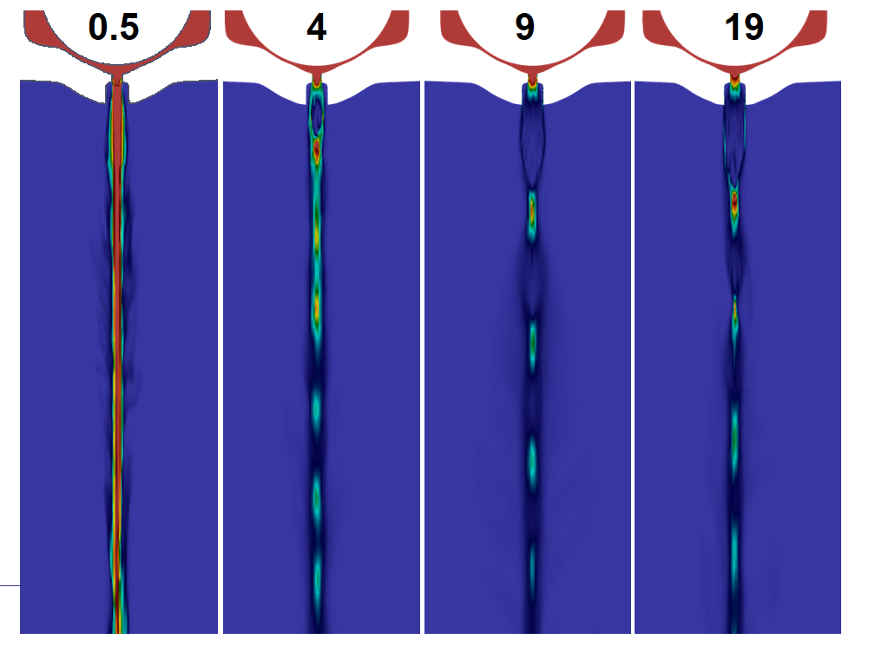
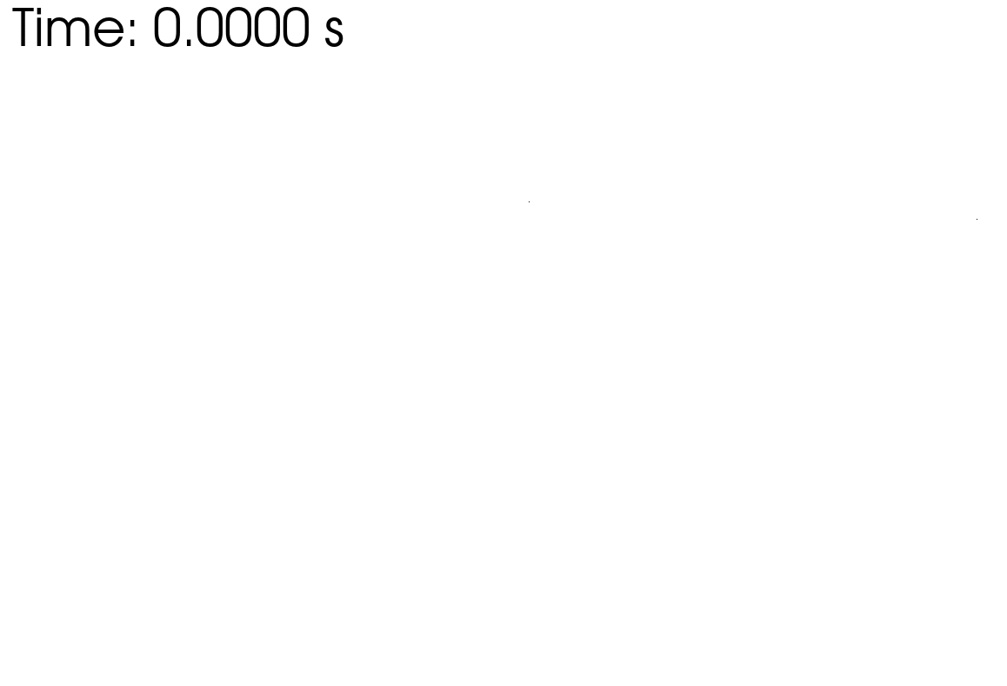
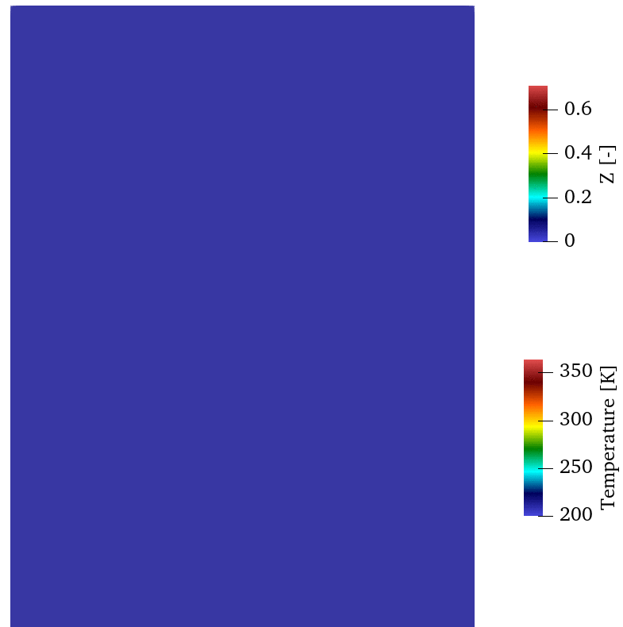
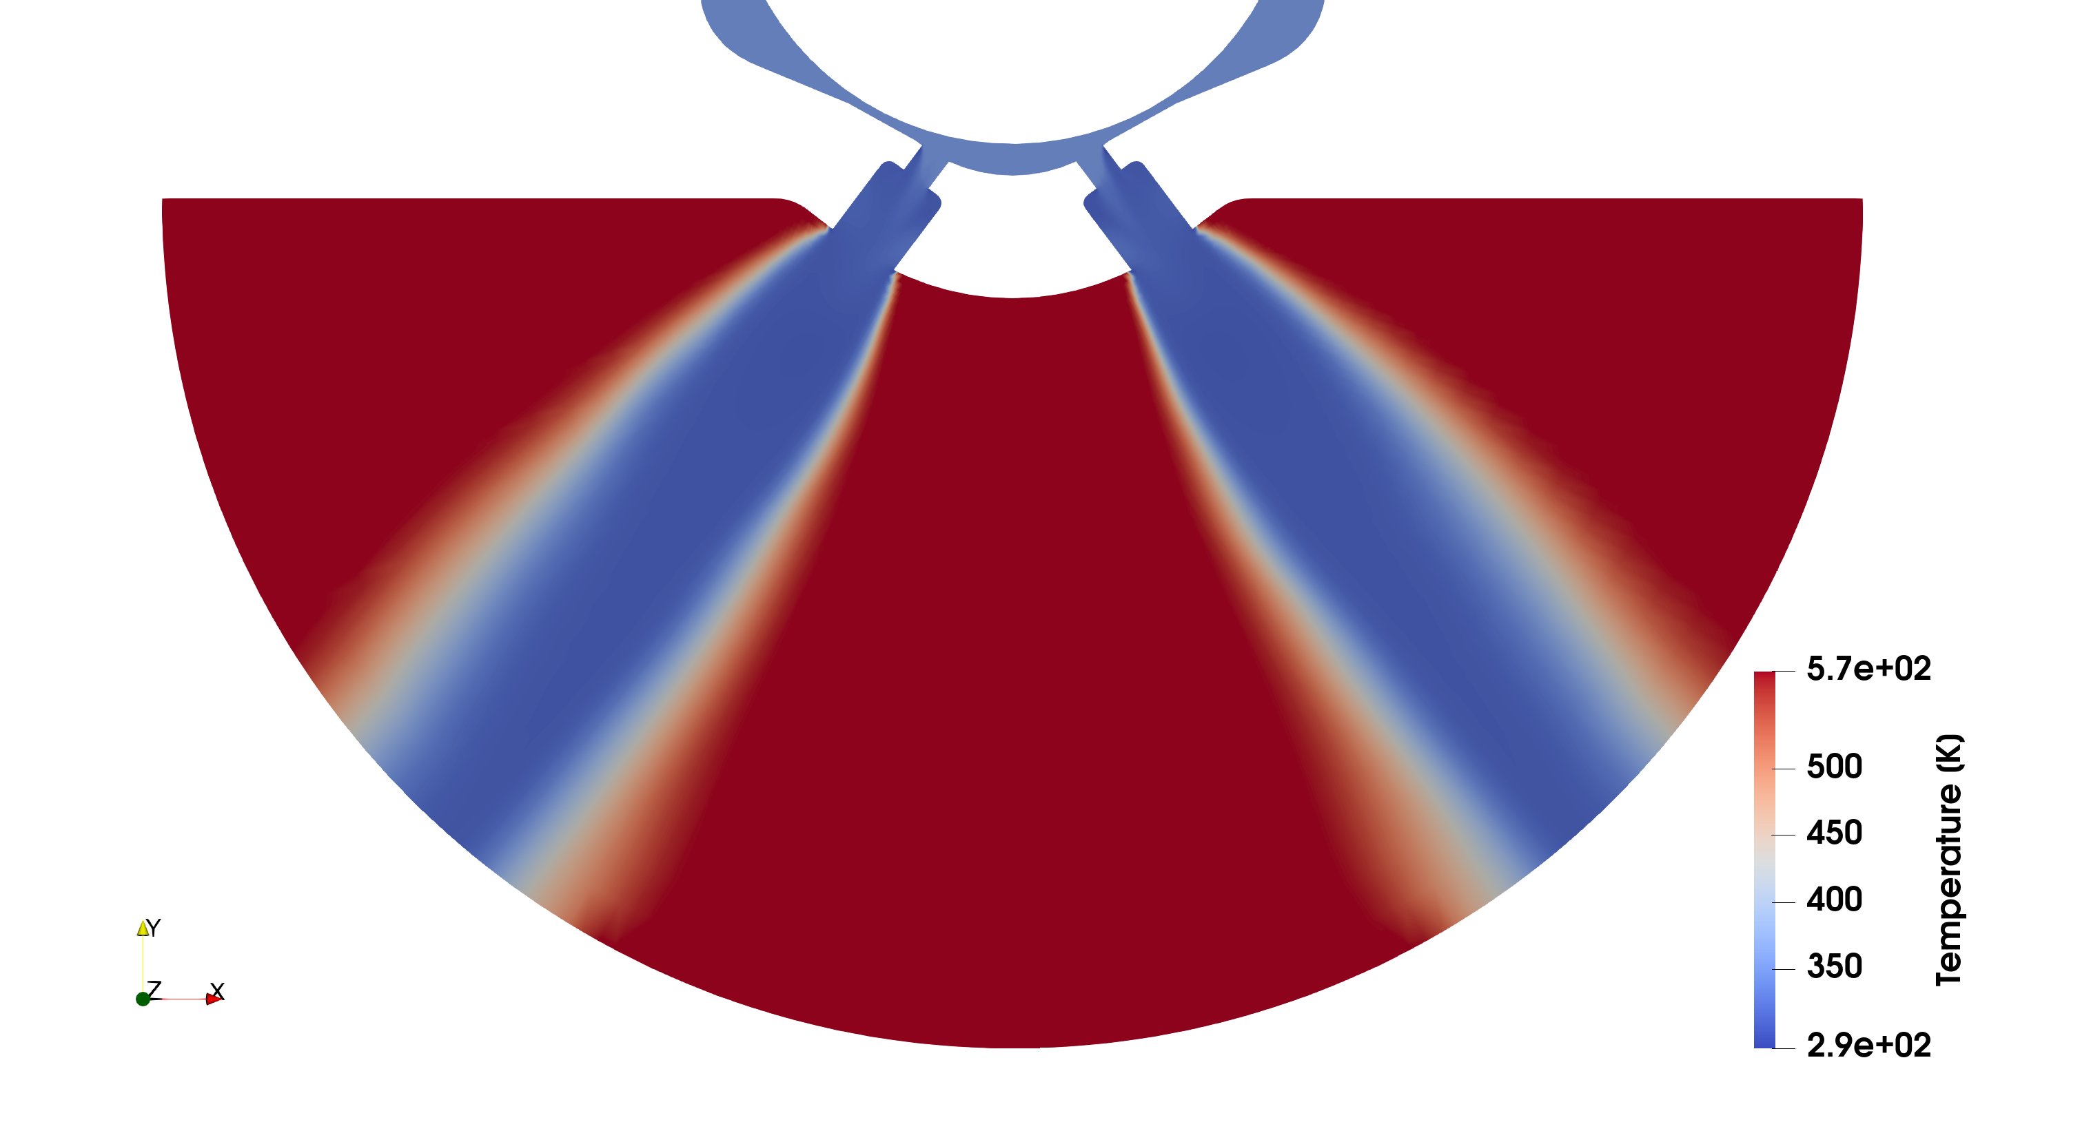
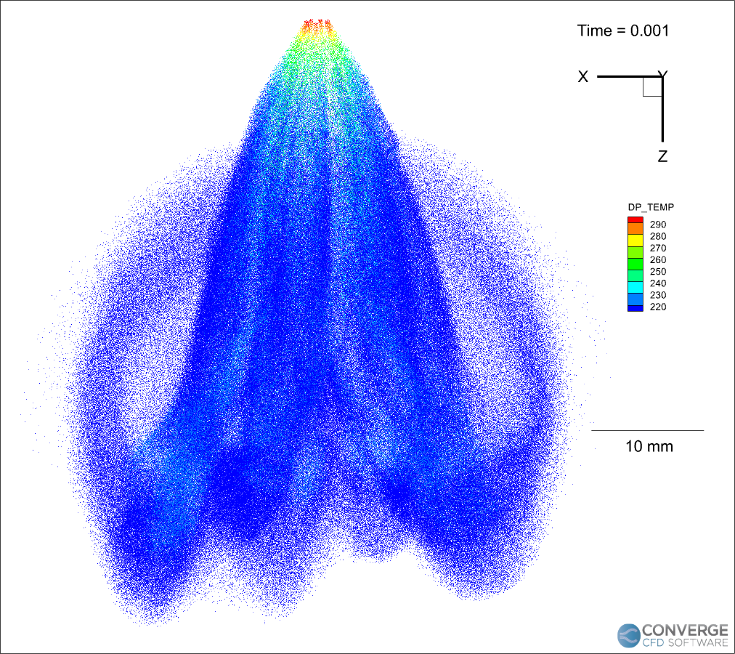
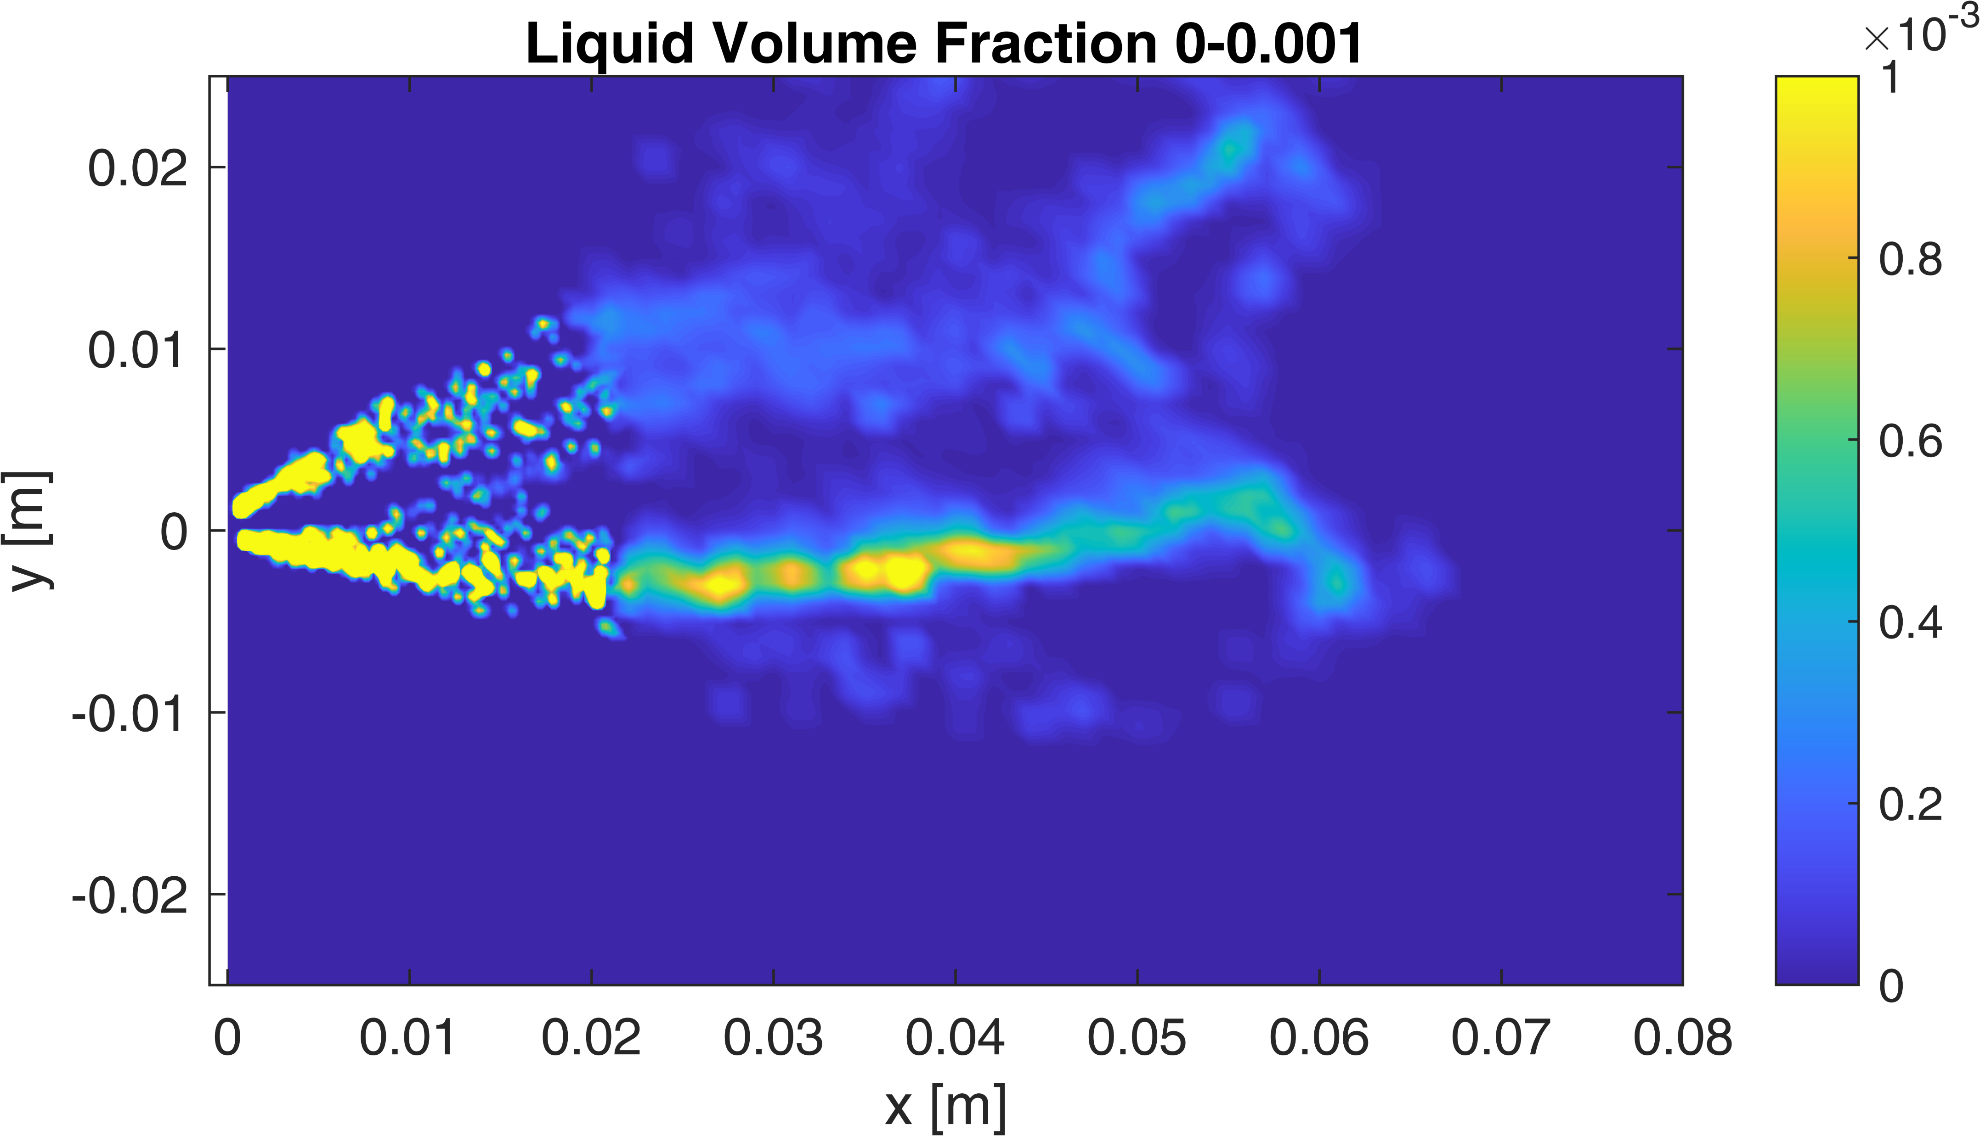
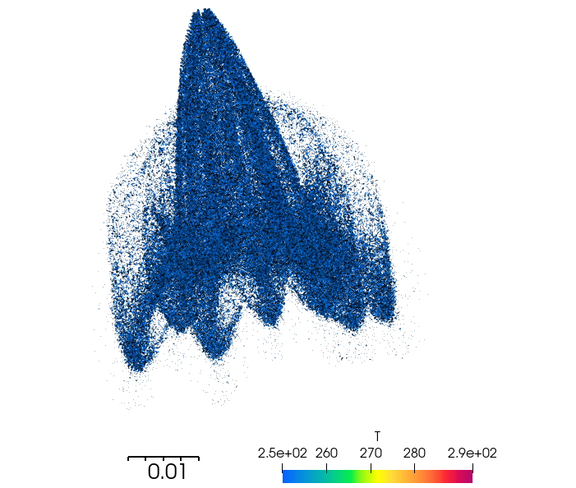
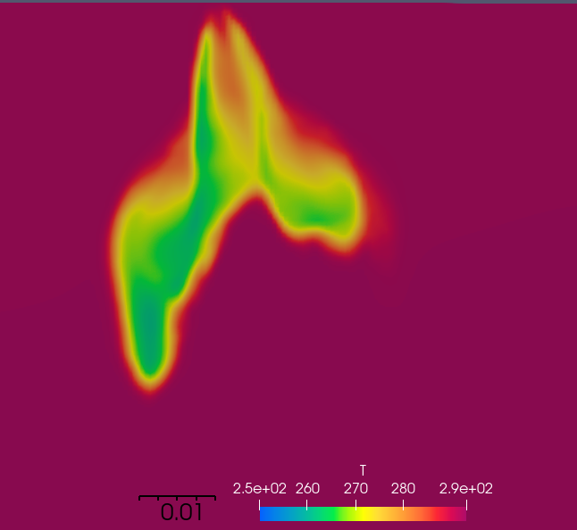
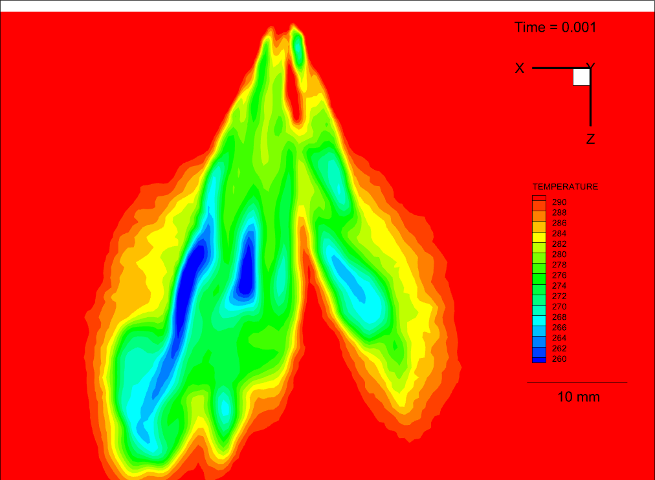
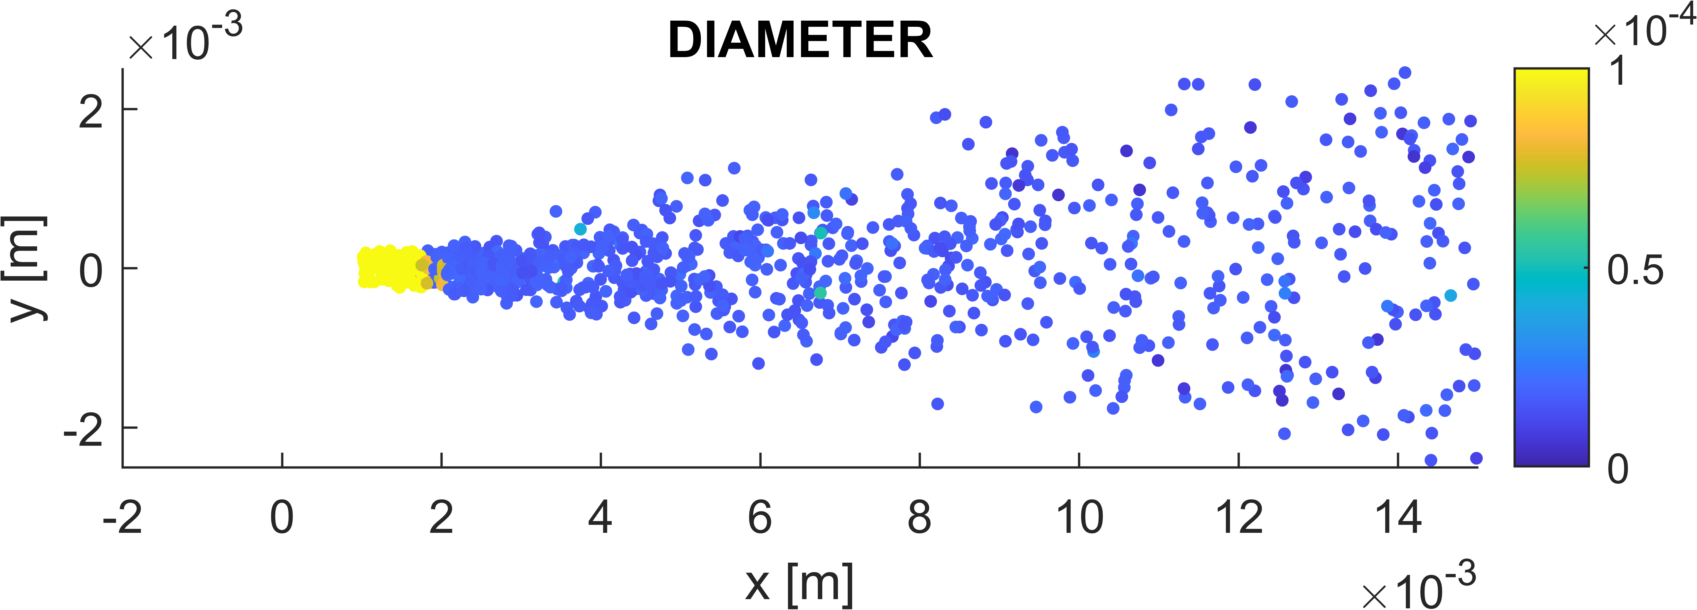
Spray views
IFP-EN (Converge, LES)
U-MASS/U-STUTTGART
(OpenFOAM, HRMFoam)
POLIMI
(OpenFOAM+LibICE, RANS)
U-PERUGIA (Converge)
U-OVIEDO
(OpenFOAM, RANS)
U-L’AQUILA
(Converge)
Eulerian, RANS
Lagrangian, RANS

Slide 9
Result types
Internal-flow and Near nozzle
Hydraulics: mass flow rates
Near-exit flow structure (flash boiling) vs Rp
Global results
Penetration (L and V)
S1/2 cone-angle
2D maps
Liquid volume and mass fraction Vapor mass fraction
Liquid temperature Gas phase temperature
Liquid velocity gas phase velocity
Droplet diameters
Projected fuel mass (liquid+volume)
Droplet PDFs and SMD

Slide 10
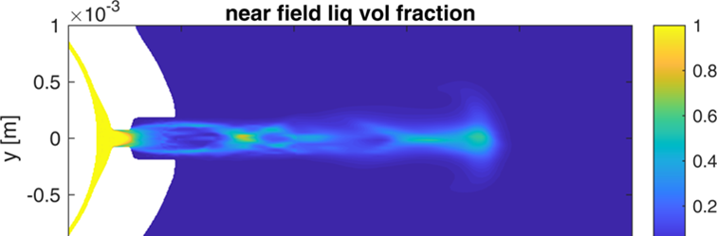
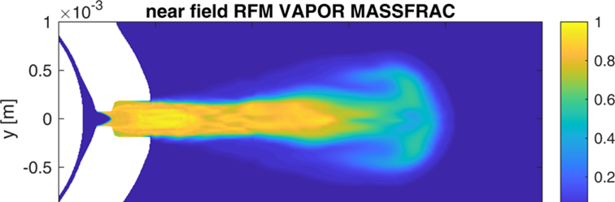
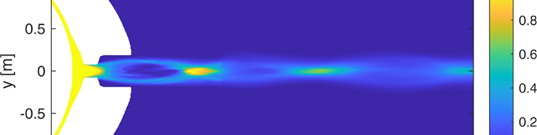
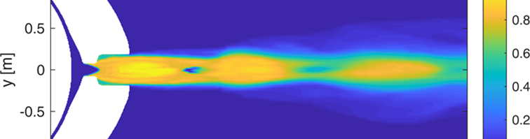
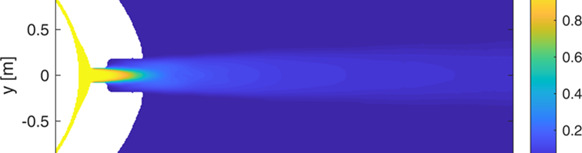
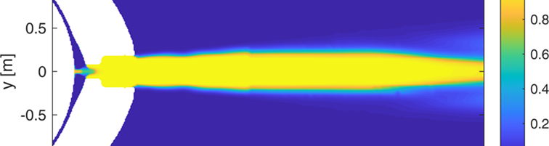
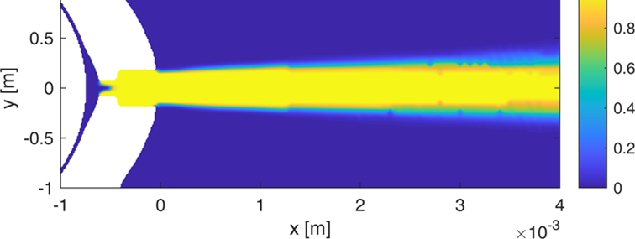
M SH – 2D SLICES: NEAR NOZZLE
70-2 bar
Ambient fuel
50 us
IFP-EN – REAL FLUID MODEL
(Eulerian, LES)
200 us
50 us
U-PERUGIA – HRM MODEL
(Eulerian, RANS)
200 us
Notes:
LES vs RANS
RFM vs HRM
Two timesteps. Perugia ahead for fixed BC
Cavitation inside the nozzle, then (FRM) transition to supersonic two-phase flow

Slide 11
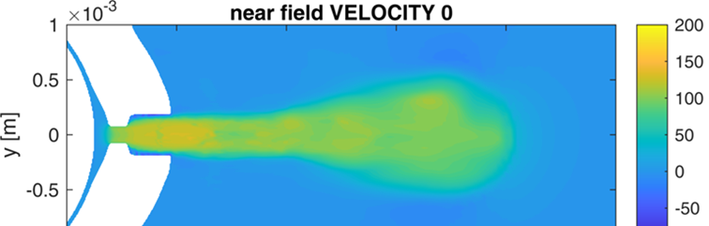
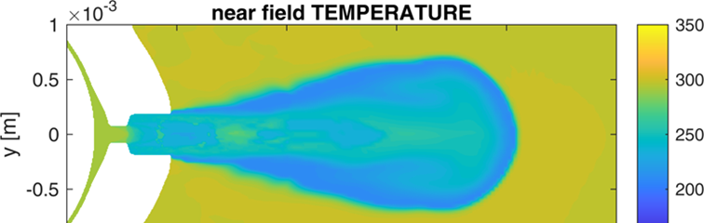
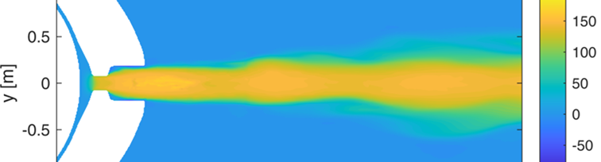
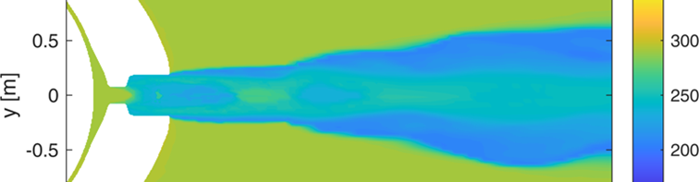
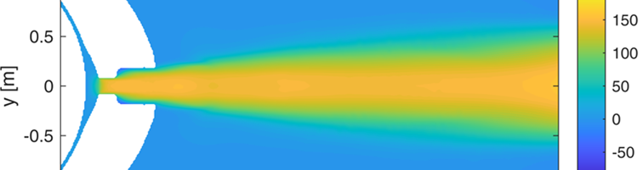
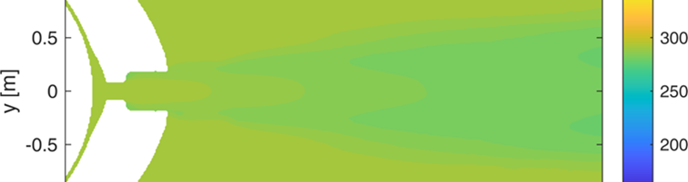
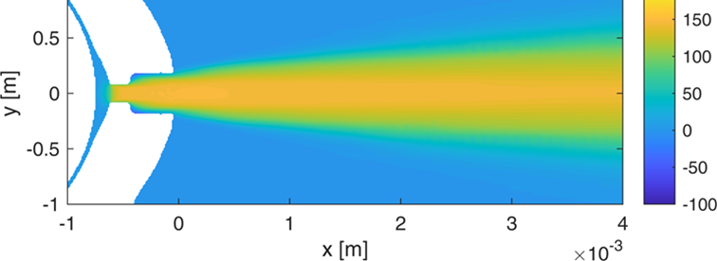
M SH – 2D SLICES: NEAR NOZZLE
70-2 bar
Ambient fuel
50 us
IFP-EN – REAL FLUID MODEL
(Eulerian, LES)
200 us
50 us
U-PERUGIA – HRM MODEL
(Eulerian, RANS)
200 us

Slide 12
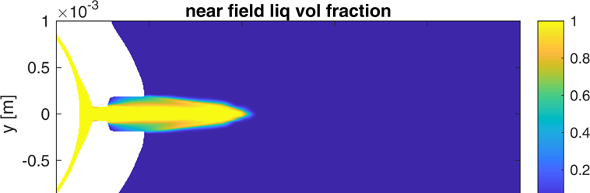
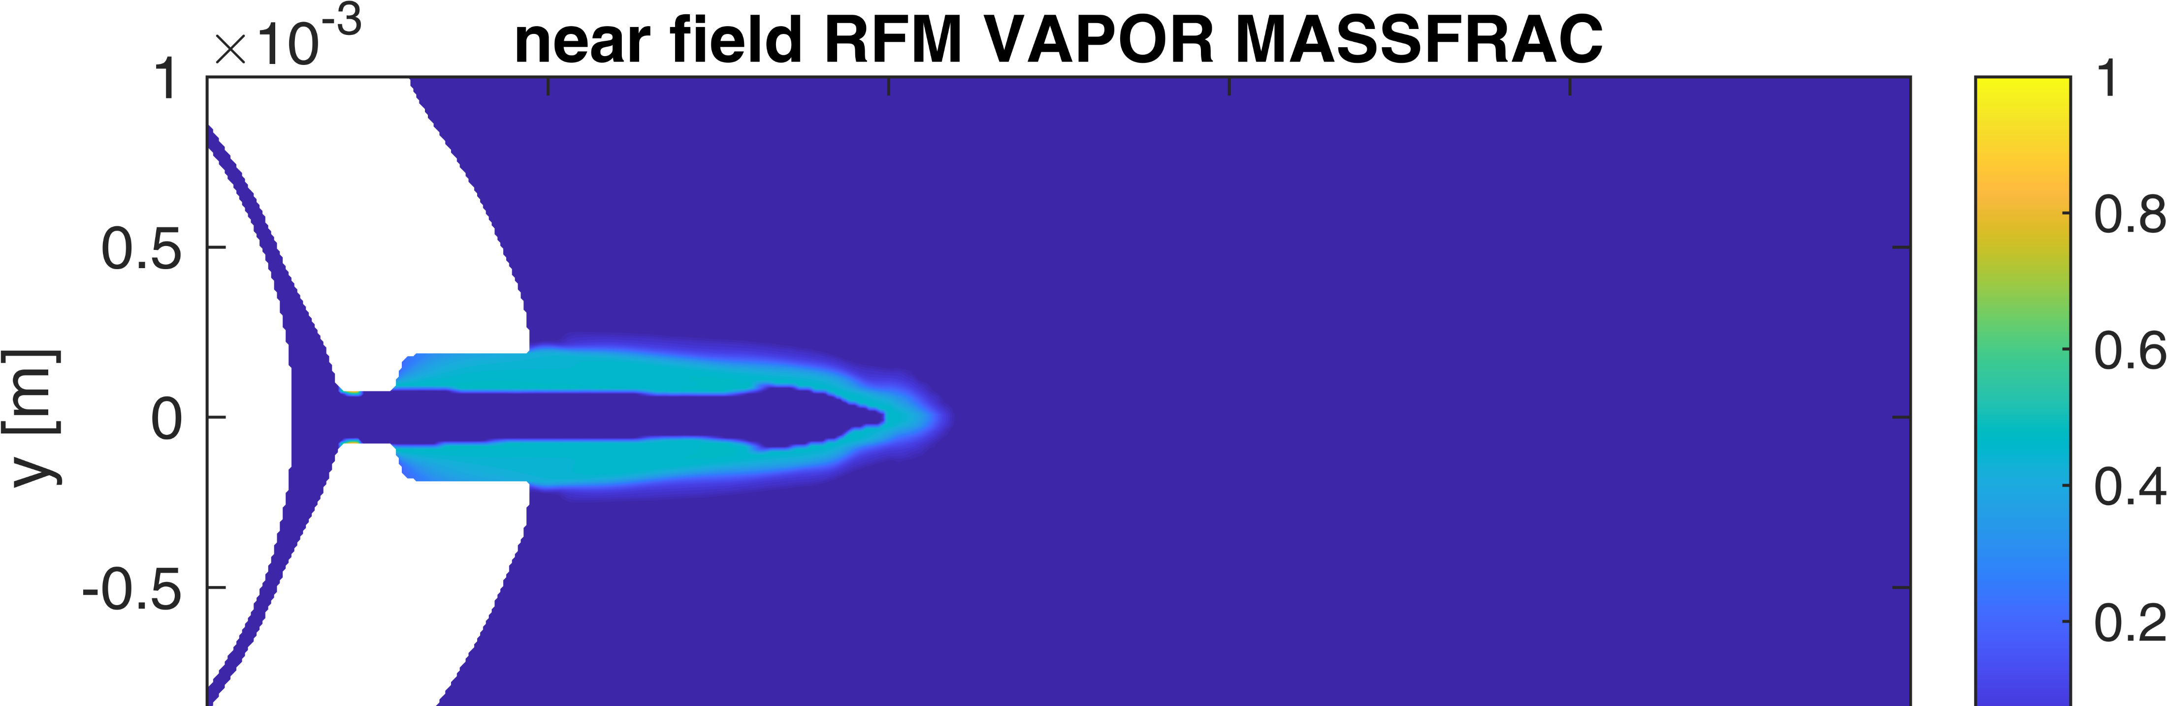
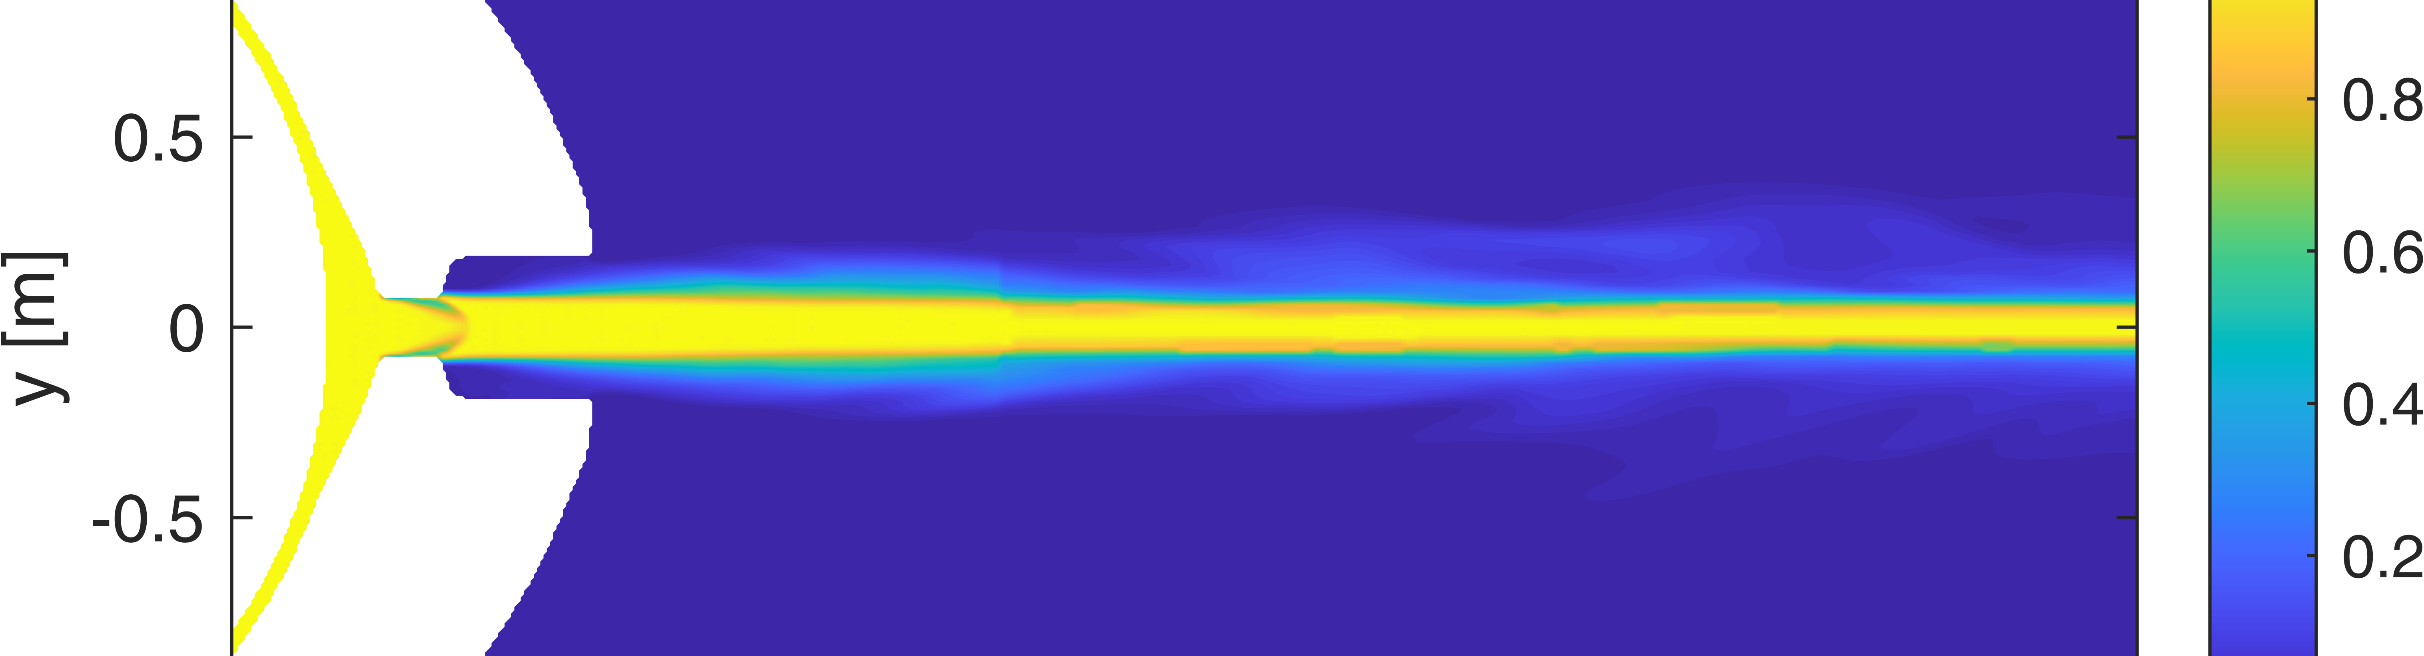
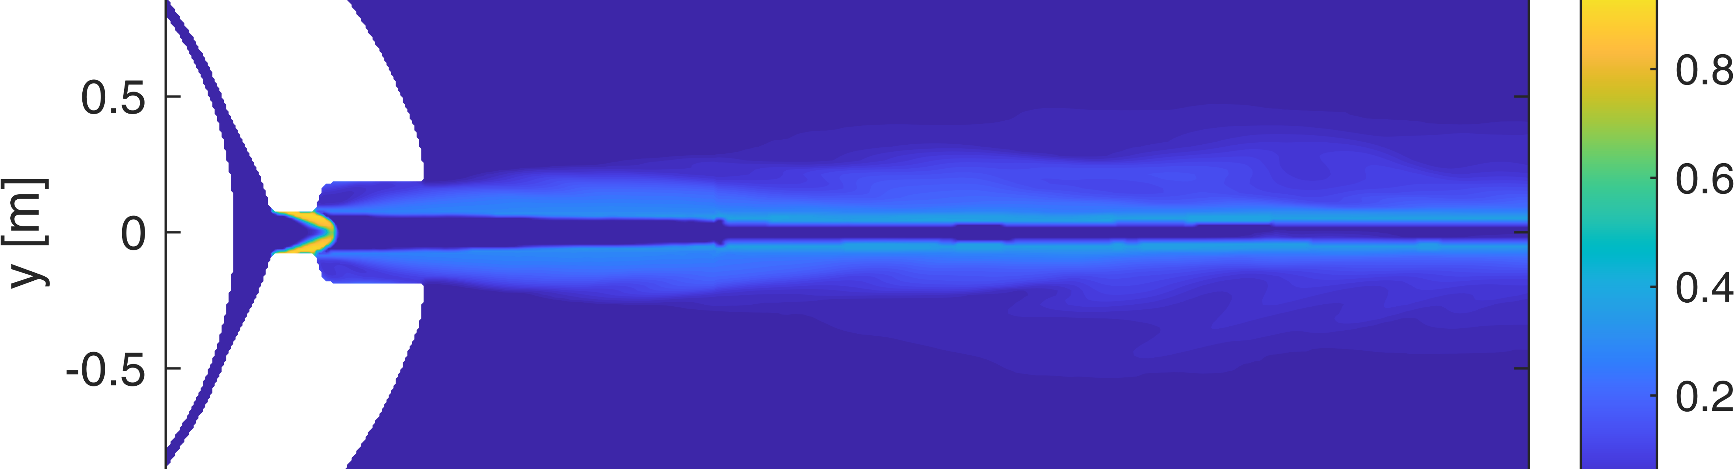
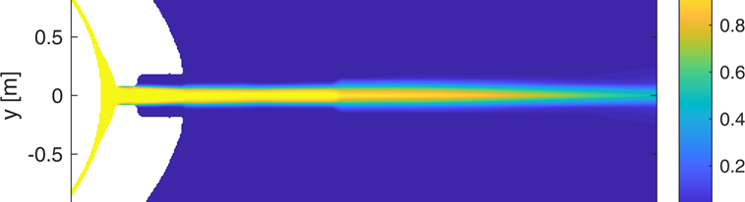
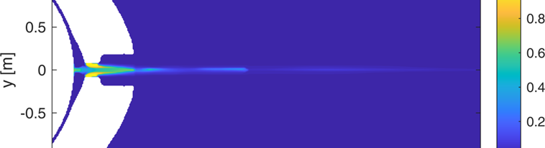
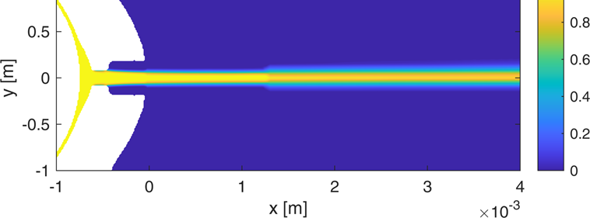
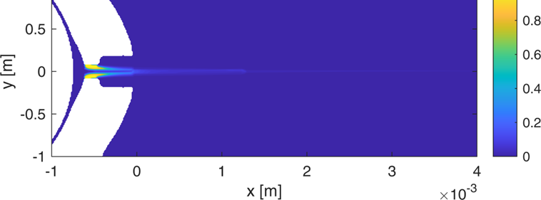
M SH – 2D SLICES: NEAR NOZZLE
70-15 bar
Ambient fuel
50 us
IFP-EN – REAL FLUID MODEL
(Eulerian, LES)
200 us
50 us
U-PERUGIA – HRM MODEL
(Eulerian, RANS)
200 us
Notes:
We start with single hole M, Eulerian Near Nozzle (up to 4 mm) for hydraulics, ROI, etc…
IFP-EN and Perugia
50 us, 200 us

Slide 13
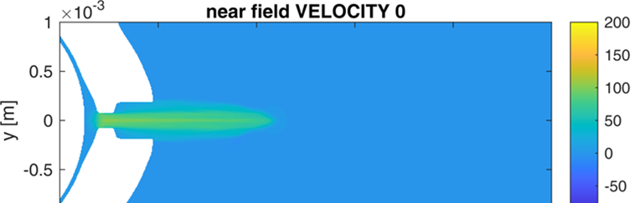
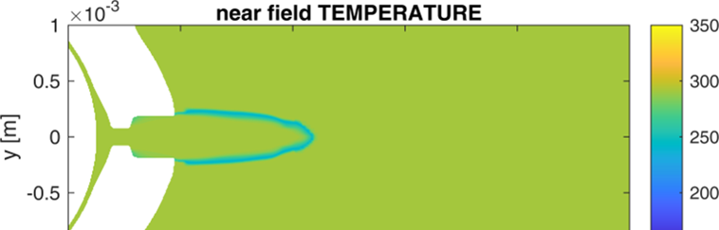
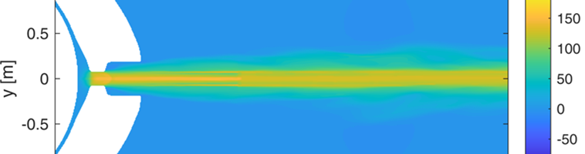
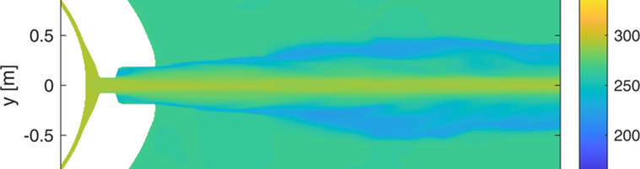
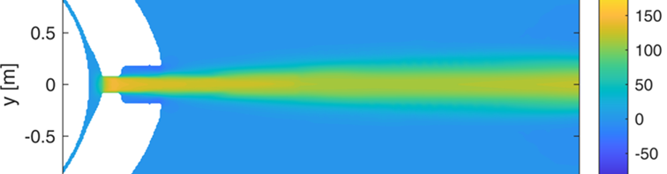
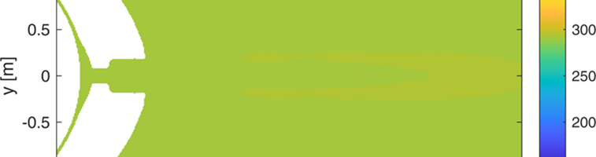
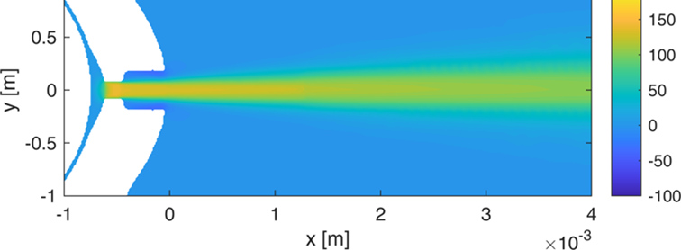
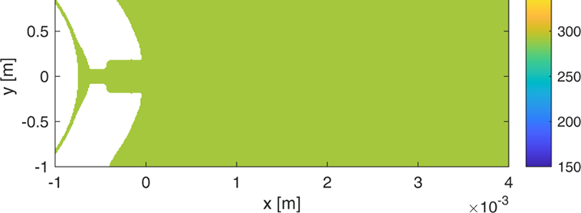
M SH – 2D SLICES: NEAR NOZZLE
70-15 bar
Ambient fuel
50 us
IFP-EN – REAL FLUID MODEL
(Eulerian, LES)
200 us
50 us
U-PERUGIA – HRM MODEL
(Eulerian, RANS)
200 us

Slide 14
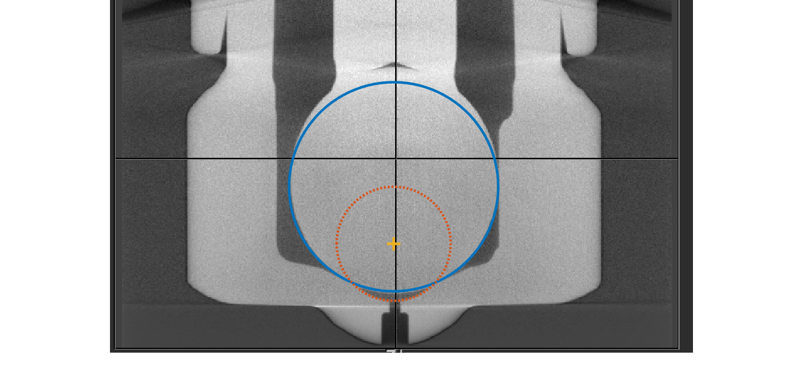
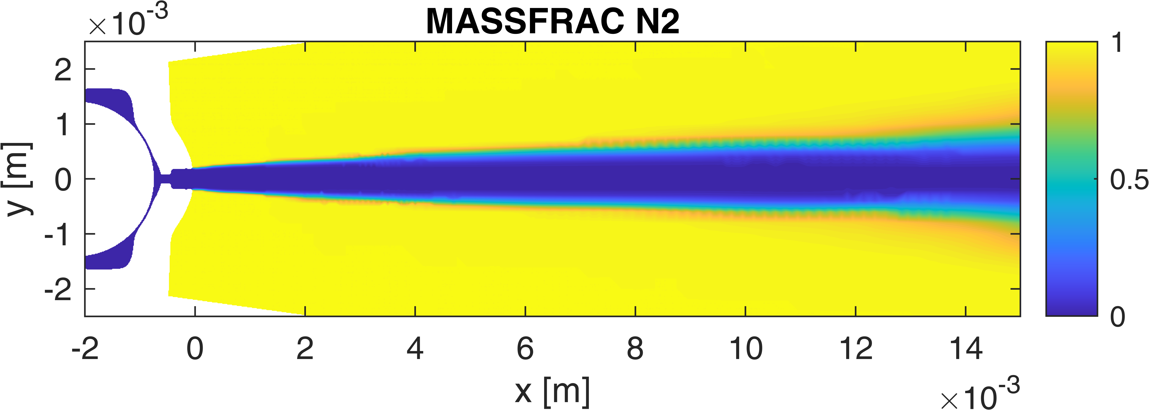
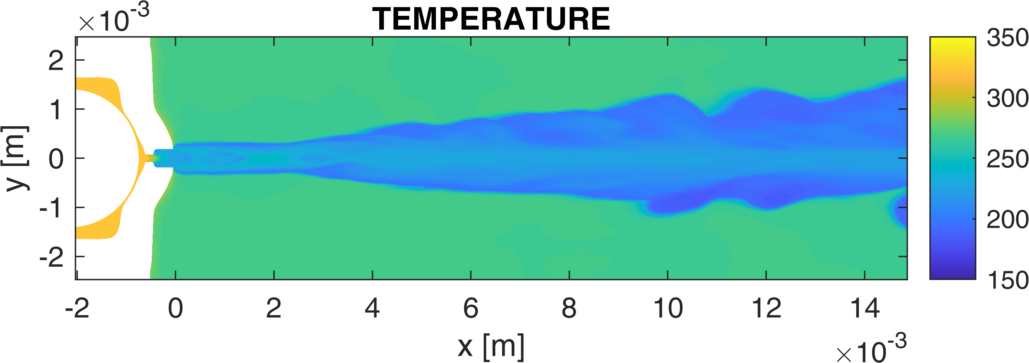
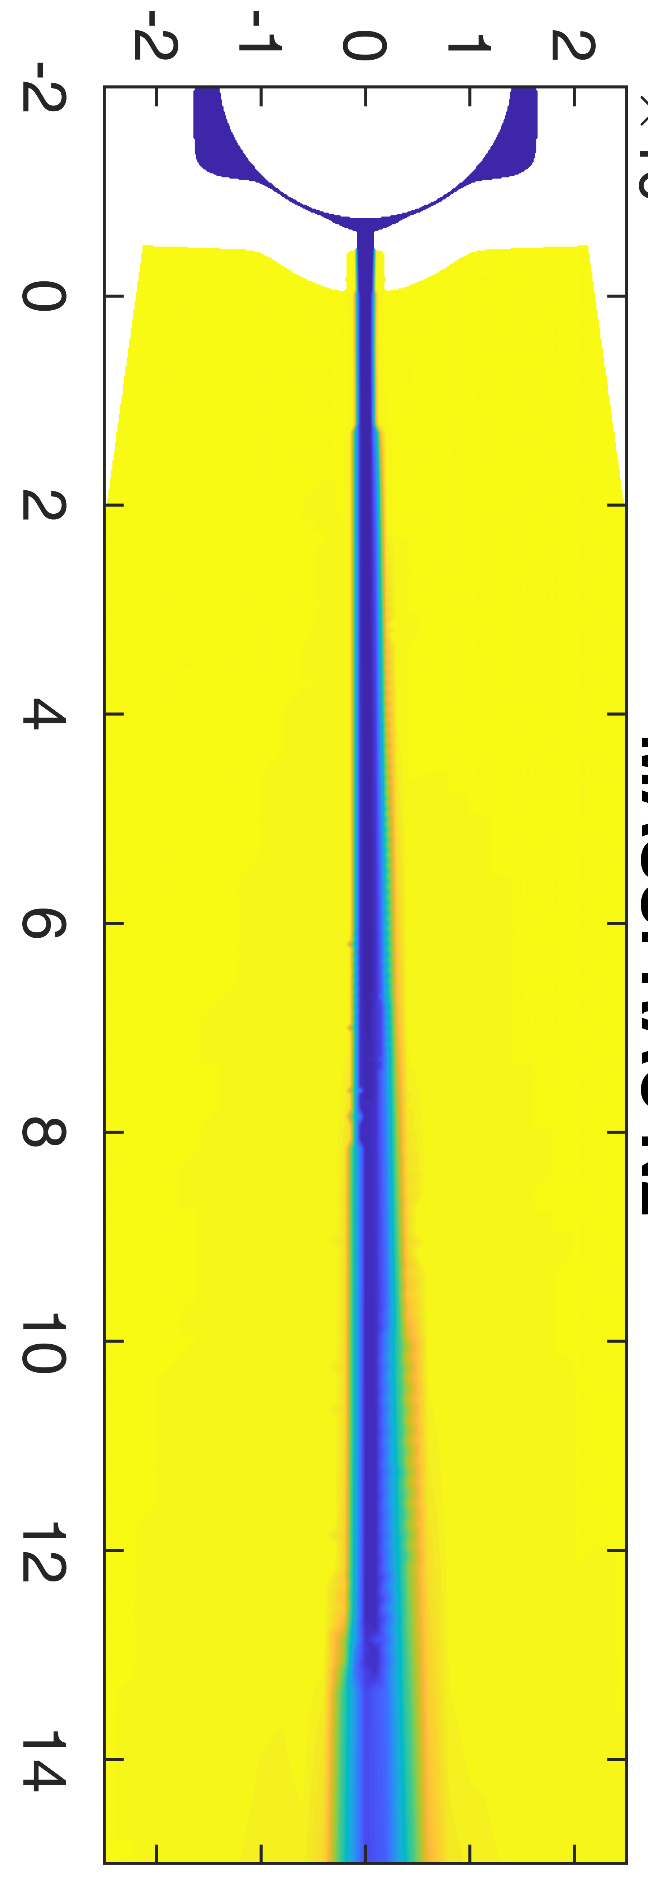
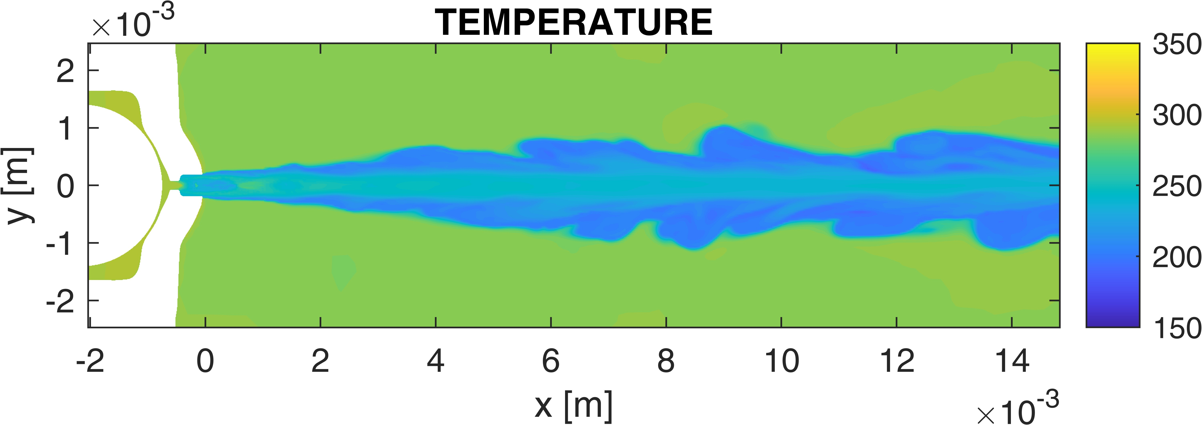
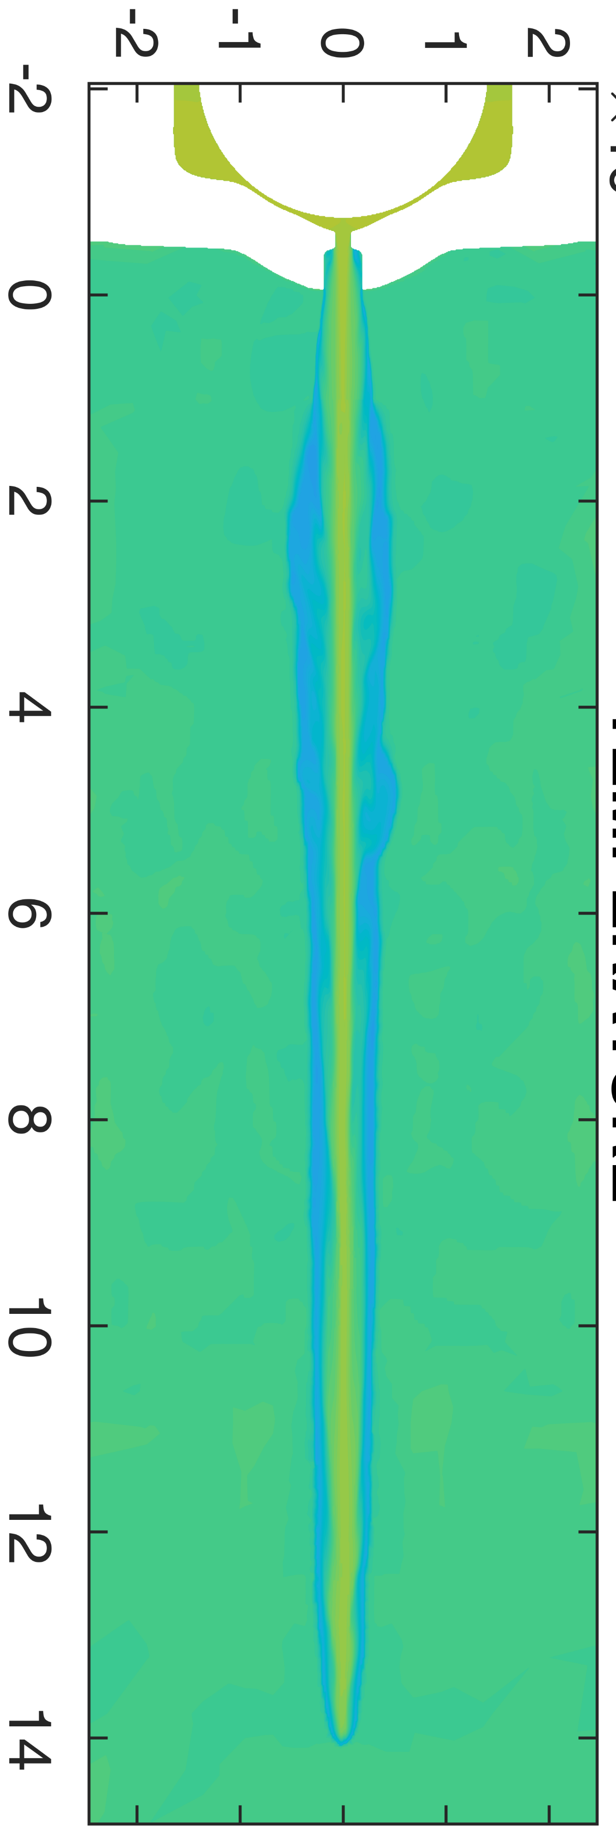
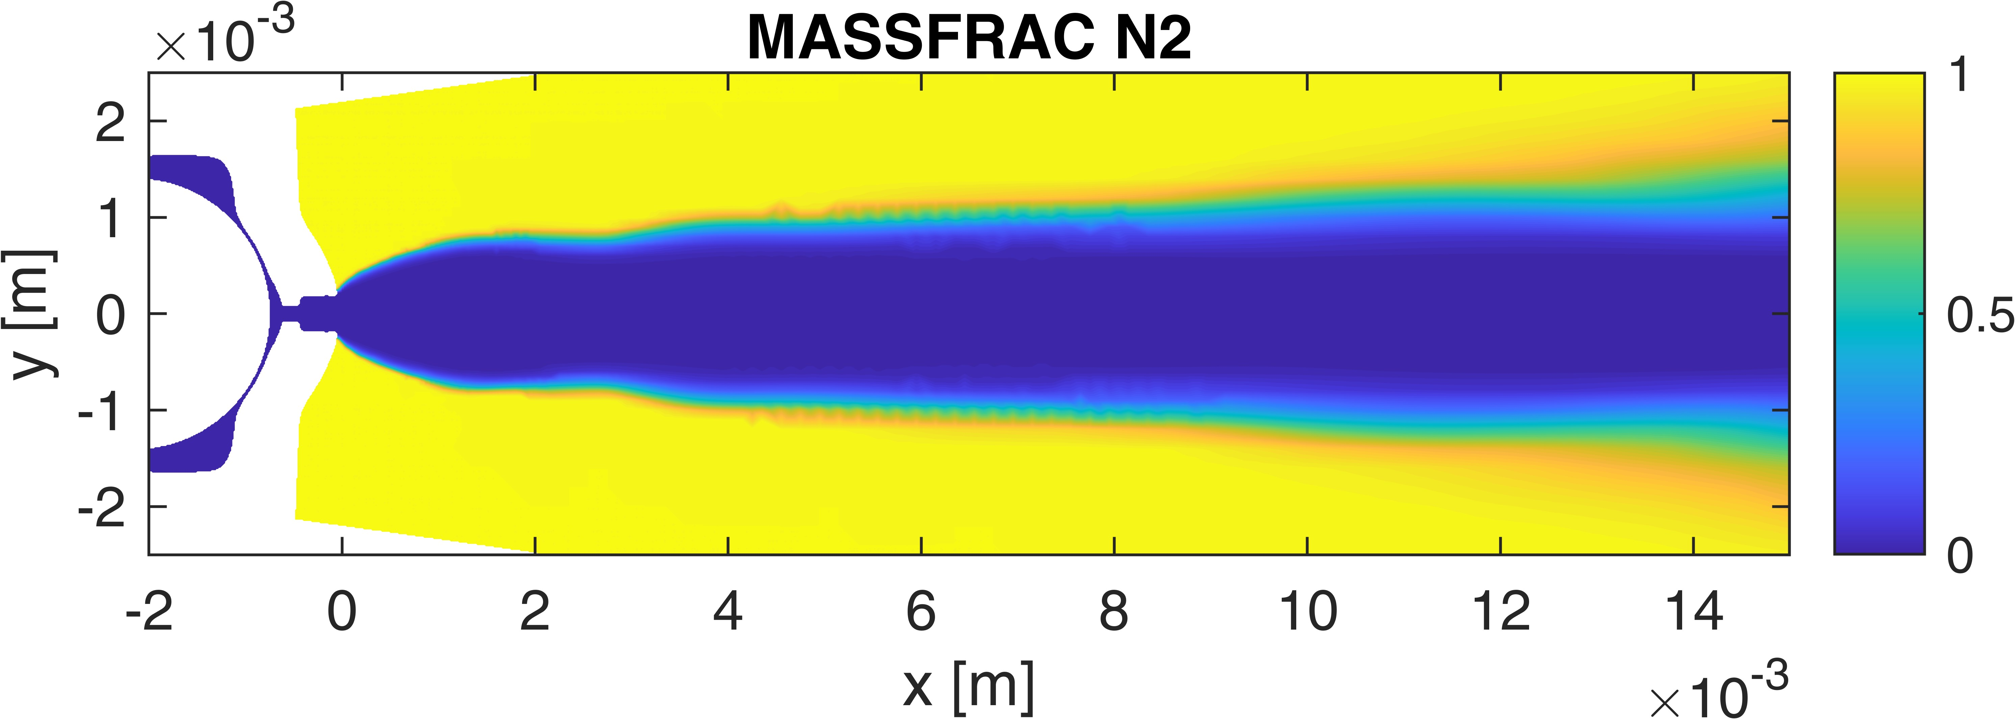
NEAR NOZZLE exp vs SIM
N.A.
N.A.
N.A.
*
50 mm
70bar-15bar (Rp=0.5)
Ambient fuel
70bar-4bar (Rp=2)
Ambient fuel
70bar-2bar (Rp=4)
Ambient fuel
70bar-1bar (Rp=19)
50°C fuel

Slide 15
NEAR NOZZLE exp vs SIM
70bar-4bar (Rp=2)
Ambient fuel
70bar-2bar (Rp=4)
Ambient fuel
70bar-1bar (Rp=19)
50°C fuel
N.A.
N.A.
*
* 70-0.5 ambient

Slide 16
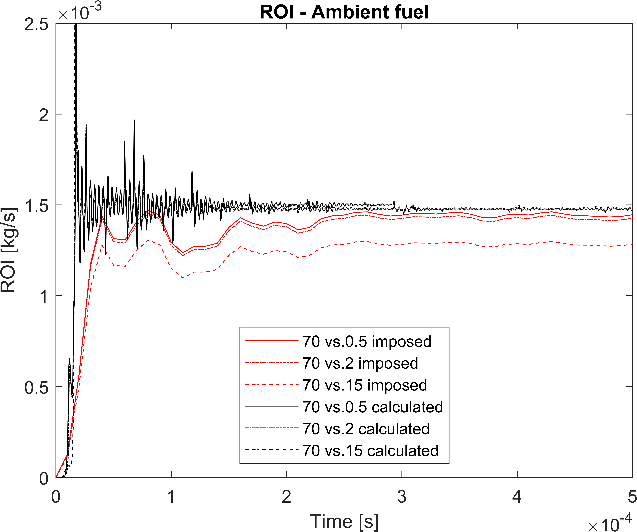
M sh – Hydraulics (ROI)
Case | Ca
70 vs. 0.5 | 0.628
70 vs. 2 | 0.625
70 vs. 15 | 0.738
Curves that were suggested for Lagrangian simulations (shape from spray G)
Eulerian calculations
Notes:
We start with single-hole M
No measurements for ROI → Eularian calculation on M as first data

Slide 17
M sh – EXTRAPOLATED ROI
Notes:
And ROI extrapolation to all conditions for Lagrangian input

Slide 18
M sh – 2D SLICES: Liquid AND VAPOR mass fraction
70-2 bar
Ambient fuel
100 us
IFP-EN
(Eulerian, LES)
U-PERUGIA
(Eulerian, RANS)
U-PERUGIA
U-L’AQUILA
POLIMI

Slide 19
M sh – 2D SLICES: TEMPERATURE
70-2 bar
Ambient fuel
100 us
IFP-EN
(Eulerian, LES)
mixture
mixture
U-PERUGIA
(Eulerian, RANS)
U-PERUGIA
gas
liquid
gas
liquid
U-L’AQUILA
gas
POLIMI

Slide 20
M sh – 2D SLICES: AXIAL VELOCITY
70-2 bar
Ambient fuel
100 us
IFP-EN
(Eulerian, LES)
mixture
mixture
U-PERUGIA
(Eulerian, RANS)
U-PERUGIA
gas
liquid
gas
liquid
U-L’AQUILA
gas
POLIMI

Slide 21
M sh – 2D SLICES: DROPLET DIAMETERS
70-2 bar
Ambient fuel
100 us
IFP-EN
(Eulerian, LES)
U-PERUGIA
(Eulerian, RANS)
U-PERUGIA
SMD_{average}=12.5 um
SMD_{average}=13.8 um
U-L’AQUILA
POLIMI

Slide 22
M SH – 2D SLICES: Liquid AND VAPOR mass fraction
70-2 bar
Ambient fuel
500 us
IFP-EN
(Eulerian, LES)
U-PERUGIA
(Eulerian, RANS)
U-PERUGIA
U-L’AQUILA
POLIMI

Slide 23
M SH – 2D SLICES: TEMPERATURE
70-2 bar
Ambient fuel
500 us
IFP-EN
(Eulerian, LES)
mixture
mixture
U-PERUGIA
(Eulerian, RANS)
U-PERUGIA
gas
liquid
gas
liquid
U-L’AQUILA
gas
POLIMI
Notes:
? T peak Univ AQUILA ?

Slide 24
M SH – 2D SLICES: AXIAL VELOCITY
70-2 bar
Ambient fuel
500 us
IFP-EN
(Eulerian, LES)
mixture
mixture
U-PERUGIA
(Eulerian, RANS)
U-PERUGIA
gas
liquid
gas
liquid
U-L’AQUILA
gas
POLIMI

Slide 25
M SH – 2D SLICES: SMD
70-2 bar
Ambient fuel
500 us
IFP-EN
(Eulerian, LES)
U-PERUGIA
(Eulerian, RANS)
U-PERUGIA
SMD_{average}=12.5 um
SMD_{average}=13.8 um
U-L’AQUILA
POLIMI

Slide 26
M SH – 2D SLICES: Liquid AND VAPOR mass fraction
70-15 bar
Ambient fuel
500 us
IFP-EN
(Eulerian, LES)
U-PERUGIA
(Eulerian, RANS)
U-PERUGIA
U-L’AQUILA
POLIMI

Slide 27
M SH – 2D SLICES: TEMPERATURE
70-15 bar
Ambient fuel
500 us
IFP-EN
(Eulerian, LES)
mixture
300 us
mixture
U-PERUGIA
(Eulerian, RANS)
U-PERUGIA
gas
liquid
gas
liquid
U-L’AQUILA
gas
POLIMI

Slide 28
M SH – 2D SLICES: AXIAL VELOCITY
70-15 bar
Ambient fuel
500 us
IFP-EN
(Eulerian, LES)
mixture
300 us
mixture
U-PERUGIA
(Eulerian, RANS)
U-PERUGIA
gas
liquid
gas
liquid
U-L’AQUILA
gas
POLIMI

Slide 29
M SH – 2D SLICES: SMD
70-15 bar
Ambient fuel
500 us
IFP-EN
(Eulerian, LES)
300 us
U-PERUGIA
(Eulerian, RANS)
U-PERUGIA
SMD_{average}=39.4 um
SMD_{average}=64.8 um
U-L’Aquila
POLIMI

Slide 30
M sh – Penetrations & ANGLE data (U-ORLEANS)
Rp = P/Psat(T)
One dataset within ECN9 proposed conditions (70-2 bar, ambient fuel)

Slide 31
M sh – Penetrations & validation case
70-2 bar
Ambient fuel
Only one dataset available within ECN9 conditions

Slide 32
M sh – Effect of ambient pressure
70 bar
Ambient fuel

Slide 33
M sh – Effect of injection pressure
2,15 bar back
Ambient fuel

Slide 34
M sh – hot fuel
200 bar
Hot fuel 363 K
Notes:
Strong fb at 0.5 bar (363 K fuel), but not much evaporation later

Slide 35
M sh – hot fuel & air (G)
200-6 bar
Hot fuel 363 K – Hot air 573 K
Notes:
In addition to strong fb (363 K at 6 bar), there is also strong evaporation of small droplets at 573 K
Discrepancies between models (no data): truth in the middle?

Slide 36
M sh – Droplet PDFs – ambient fuel
Ambient fuel
Notes:
Log scale shows some effects of PDF and SMD. Note two peaks in UniPG PDF for evaporating cases

Slide 37
Bosch 7h – CONDITIONS
120-2,15 bar
Ambient fuel
Condition | T_{fuel} [K] | T_{a} [K] | r_{a} [kg/m³] | p_{a} [bar] | p_{a}/p_{sat}
1 | 293 | 293 | 29.75 | 25 | 3.125
2 | 293 | 293 | 26.99 | 22.68 | 2.835
3 | 293 | 293 | 17.82 | 15 | 1.875
4 | 293 | 293 | 11.88 | 10 | 1.25
5 | 293 | 293 | 8.32 | 7 | 0.875
6 | 293 | 293 | 4.76 | 4 | 0.5
7 | 293 | 293 | 2.38 | 2 | 0.25
EVAPORATING
FLASHING
“Numerical Study of Ammonia Spray with a GDI Engine Injector”, Zembi , J., Battistoni, M., Pandal, A.,et al, Journal of Ammonia Energy, volume 1, issue 1, 2023, E-ISSN: 2752-7735, Published by Cardiff University Press
“GDI Ammonia Spray Numerical Simulation by Means of OpenFOAM”, Pandal, A., Zembi, J., Battistoni, M., Hespel, C. et al, SAE Technical Paper 2023-01-0311, 2023, https://doi.org/10.4271/2023-01-0311.

Slide 38
Bosch 7h – Penetration, SMD, Morphology
120-2,15 bar
Ambient fuel
U-PERUGIA uses RT model constant correlation
U-L'AQUILA uses with fbBreakup model
U-ORLEANS Schlieren
U-ORLEANS Malvern
U-L'AQUILA has very similar results,
Only U-PERUGIA shown
Notes:
Collapse at 2 bar
…

Slide 39
Bosch 7h – droplet and gas temperatures
120-2,15 bar
Ambient fuel
Droplet temperature
Gas temperature
120 vs. 2
Flashing spray
120 vs. 15
Evaporating spray
U-PERUGIA
Notes:
Collapse at 2 bar
High heat of vaporization
Strong cooling for 2 bar, T tends to Tvap(2bar)=250 K

Slide 40
Bosch 7h – Morphology
120-2,15 bar
Ambient fuel
10 mm plane
20 mm plane
30 mm plane
120 vs. 2
Flashing spray
120 vs. 15
Evaporating spray
U-PERUGIA
Notes:
Collapse at 2 bar; jet merging

Slide 41
Bosch 7h – RT model constant correlation
120 bar
Ambient fuel
U-PERUGIA
Notes:
We determined RT parameters needed to cover all conditions
(KH has no effect)
RT size constant changes crossing Psat

Slide 42
Bosch 7h – back-pressure EFFECT (U-L’aquila, fb-breakup)
120 bar
Ambient fuel
0.5 bar
gas
gas
2 bar
gas
gas
2 bar
15 bar
gas
gas
15 bar
U-L'AQUILA: obtained with fbBreakup model

Slide 43
Bosch 7h – Penetration (U-OVIEDO)
Ambient fuel
Validation
U-OVIEDO: obtained with breakup model calibration

Slide 44
Bosch 7h – SMD (U-OVIEDO)
Ambient fuel
@ 3.9 ms aSOI
@ 3.9 ms aSOI
U-OVIEDO: obtained with breakup model calibration
@ 1.0 ms aSOI

Slide 45
8H – Hot fuel & air
200-6 bar
Hot fuel 363 K – Hot air 573 K
Umass/U-STUTTGART
POLIMI
spray G geometry, Eulerian
spray M injector, Lagrangian

Slide 46
G – velocity
200-6 bar
Hot fuel 363 K – Hot air 573 K
2 mm
high maximum velocity of around $≈550\frac{m}{s}$ due to intense flash-boiling
”bell-shaped” velocity contour → shock structure as velocity exceeds speed of sound?
U-MASS/U-STUTTGART

Slide 47
G – temperature & n2 mass fraction
200-6 bar
Hot fuel 363 K – Hot air 573 K
2 mm
large temperature drop due to high rate of vaporization and high latent heat of vaporization
asymmetry could be caused by numerical diffusion
strong plume interaction, merging of the sprays and consequent spray collapse due to rapid expansion caused by severe flash-boiling
U-MASS/U-STUTTGART

Slide 48
G – vapor mass fraction
200-6 bar
Hot fuel 363 K – Hot air 573 K
2 mm
$$x$$
$$\overline{x}$$
Instantaneous: $x≡\frac{m_{fuel,v}}{m_{fuel}}$ : current fraction of fuel vapor divided by fuel mass (has no significance where there is no fuel)
Equilibrium: $\overline{x}≡\frac{m_{fuel,v,equil}}{m_{fuel}}$ represents the fraction of fuel vapor at equilibrium divided by fuel mass
ammonia reaches equilibrium very near to the counterbore exit (see $x$vs. $\overline{x}$)
comparatively high equilibrium vapor mass fraction indicates strong flash-boiling potential
high resemblance to instantaneous vapor mass fraction of ammonia G injection indicating rapid vaporization due to intense flash-boiling
U-MASS/U-STUTTGART
Notes:
ammonia reaches equilibrium very near to the counterbore exit (see $x$vs. $\overline{x}$) ---> strong flash boiling

Slide 49
M 8h – 2D SLICES: gas phase (POLIMI)
200-6 bar
Hot fuel 363 K – Hot air 573 K
500 us
gas
gas
gas
1000 us
gas
gas
gas
3000 ms
gas
gas
gas
POLIMI

Slide 50
M 8h – 2D SLICES: liquid phase (POLIMI)
200-6 bar
Hot fuel 363 K – Hot air 573 K
500 us
plv
1000 us
plv
gas
3000 ms
plv
POLIMI

Slide 51
Conclusion and outlook
First attempt to compare and analyze spray data from different institutions
We need ROI measurements
Ammonia easily undergoes flash-boiling: predicting its effects at engine combustion chamber scale is the challenge
Temperature measurements could be useful for detailed model validation, not attempted so far, but checking timescales
More work on multi-hole
Need to standardize
injectors (only M, multi-hole and single-hole ?)
conditions (agree on BASE CONDITION, and parametric variations)

Slide 52
THANK YOU

