Slide 1
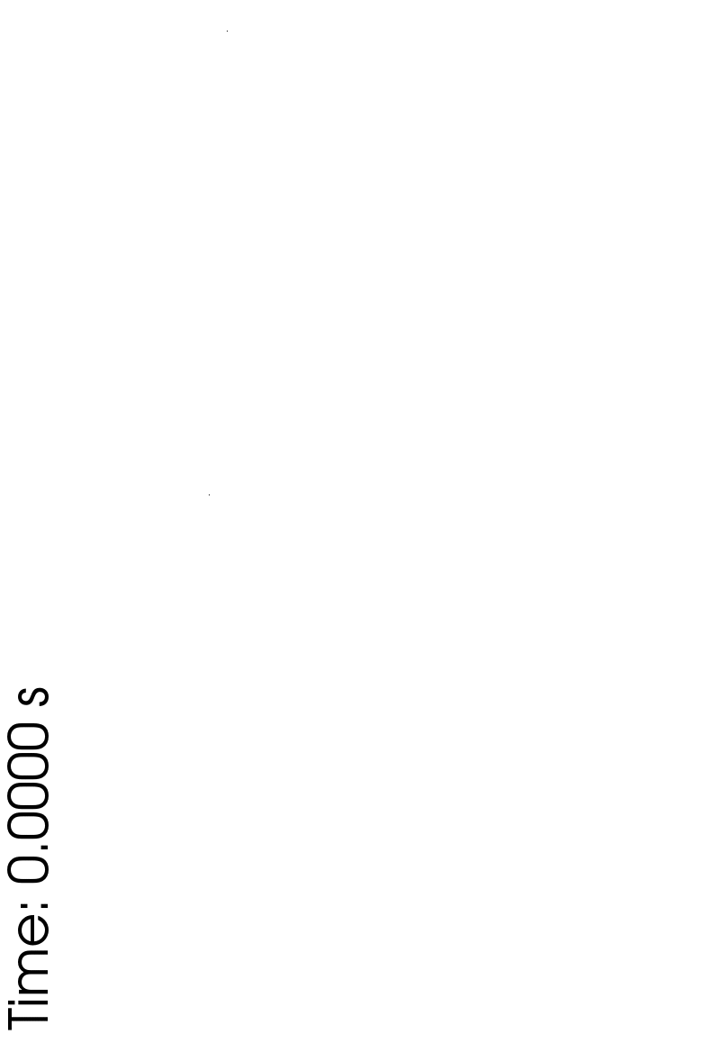
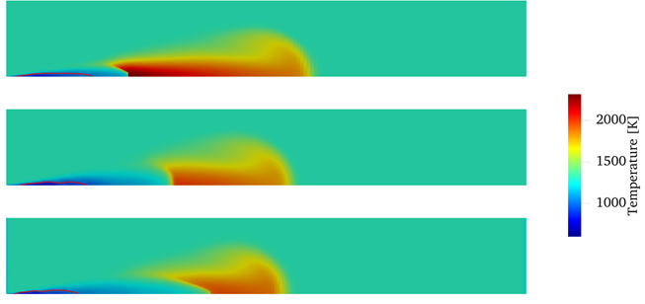
ECN9: AMMONIA
sprays and combustion
Topic LEADS
M Battistoni, UNIPG
J M García-Oliver, CMT
NAPLES, September 8, 2023

Slide 2
AMMONIA: WHY?
Availability of ammonia as chemical → ammonia as fuel for power
Hydrogen carrier: zero-carbon fuel for transportation and power
Ammonia properties are not optimal for combustion ☹
But combustion can be achieved through ☺
High compression ratios
High-energy discharge spark-ignition in near-stoichiometric/lean conditions
Pilot-ignition in lean and very lean conditions
Booster/enhancer, like H2 from reforming

Slide 3
detailed agenda
10:00 – 10:05​ | Intro​ | ​
​ | ​ | ​
10:05 – 10:40​ 10:40 – 11:10 ​ | GDI Spray simulation and experiments​ Combustion in SI engines​ | Michele​ Christine​
​ | ​ | ​
11:10 – 11:40 ​ | Coffee break​ | ​
​ | ​ | ​
11:40 – 12:15​ 12:15 – 12:30​ | Diesel-like sprays​ Open discussion​ | José​ All​

