Slide 1
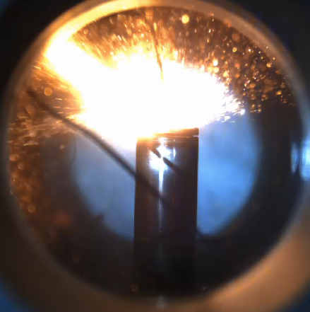
Li-ion Battery thermal runaway ECN topic
ECN 9 workshop
September 9th 2023, Napoli
Michele BARDI (IFPEN)
Antonio Garcia (CMT)

Slide 2
Li-ion Battery thermal runaway ECN Topic
ECN 9 workshop
September 9th 2023, Napoli
Michele BARDI (IFPEN)
Antonio Garcia (CMT)

Slide 3
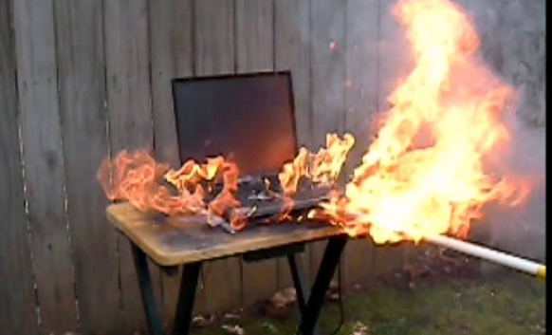
Thermal runaway topic
Li-ion battery thermal runaway is a challenging safety issue for mobility electrification
Why ECN is dealing with batteries?
It concerns mobility
It involves several phenomena that we know and we have the tools to study:
Combustion
Di- (or tri-) phasic jets
Heat transfer
Challenging condition testing (high temperature, short time scales)

Slide 4
Thermal runaway topic
Li-ion battery thermal runaway is a challenging safety issue for mobility electrification
Why ECN is dealing with batteries?
It concerns mobility
It involves several phenomena that we know and we have the tools to study :
Combustion : different and partially unknown fuels
Di- (or tri-) phasic jets : fluid composition not constant, nozzle geometry “not cylindrical”
Heat transfer: convection, radiation, conduction, flame propagation and runaway propagation
Challenging condition testing (high temperature, short time scales): relevant boundary condition and parametric variation to be understood

Slide 5
Thermal runaway topic
Combustion community is starting to study Li-ion thermal runaway
Experimentally and numerically
The topic objectives:
Apply the “Spray A” approach to the test currently performed
optical characterization of thermal abuse
Start investigating results “dispersion” / lab to lab bias
To form a “peloton” on the subject
Share good experimental / modeling practice
It seems to be a wide world to explore (much more parameters to investigate / much more boundary conditions to explore)
Generate a virtuous exchange between combustion and battery communities

Slide 6
Thermal runaway topic
A reference case has been defined
Reference battery + reference abuse test
5 lab volunteered to perform tests (CMT, IFPEN, KAUST, University of Tennessee, KIT)
Only two labs managed to perform experiment due to shipping / schedule issue
Comparison of results to reference test approach
Hints on possible optical analysis
A community is forming around the topic
2 pre-workshop meetings / technical exchanges
Possibility to start the discussion on future direction
Discussion of practical issue (e.g. battery shipment issues..)
Identification of possible way of participating to the topic

Slide 7
Thanks to all Contributors!

Slide 8
Agenda
Experimental activities Reference case description and discussion of the available data
Abuse test description
Abuse test comparison
Complementary analysis on reference cells
ARC for battery thermal runaway investigation (KIT)
Lessons from recent studies on battery thermal runaway (University of Tennessee)
Numerical results:
3-D approach (Converge)
0-D/1D numerical Approach(CMT / IFPEN)
In parallel please fill in the Beekast Survey:
Which are the key measurement that we should / could add to reference battery cell case?
On which aspect of our results, we should be focusing on the most?
How should reference case evolve?
Battery cell Geometry
Abuse test
Ageing process
…
How to investigate to cell-to-cell propagation?

Slide 9
Reference case
Common battery chosen
LG M50LT from the same production lot
120 battery cells purchased and shared by IFPEN
Reference Running-in
3 charge / discharge cycles
CC/CV ref cycle from manufacturer
Test Definition:
Thermal Abuse
“Slow cooking mode”
Heating with a controlled heating ramp at constant gradient
Reference case : 1.5 °C/min
Parametric Variation: 0.5 °C/min ; 0.2 °C/min
BC state of charge (SOC):
Ref Case: 100%
Parametric variations: 50% ; 25% ; 75%

Slide 10
Experimental campaign
IFPEN / CMT |  | SOC
 |  | 25% | 50% | 75% | 100%
Heating Ramp | 0,5°C/min | 0 / 0 | 3 / 3 | 0 / 0 | 3 / 3
 | 1,5°C/min | 3 / 0 | 3 / 3 | 3 / 0 | 7 / 4
ARC | HWS : 5°C – 30min - 0.02 °C/min |  | 3 | 2 | 5
Experimental campaign on ARC at IFPEN HWS using the reference battery used for comparison (SAE 2023-24-160)

Slide 11
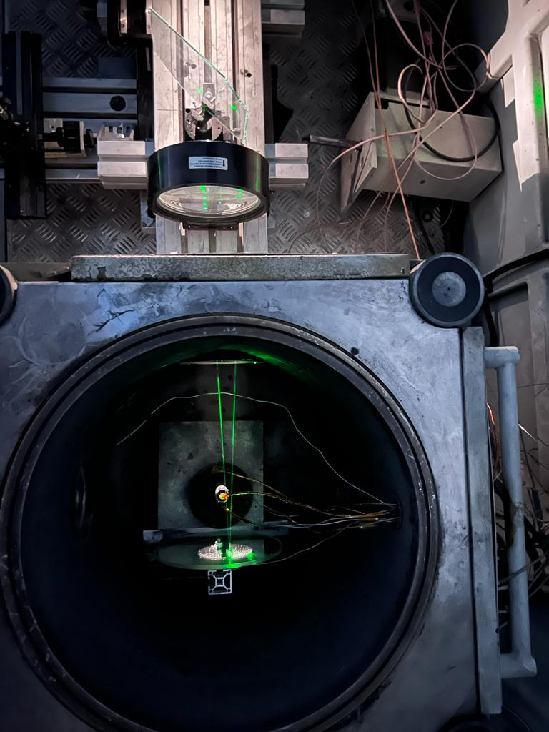
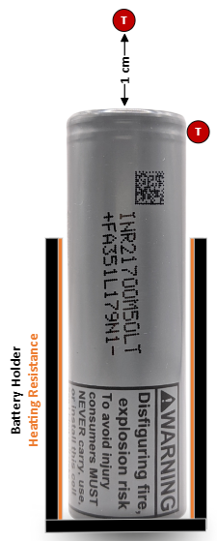
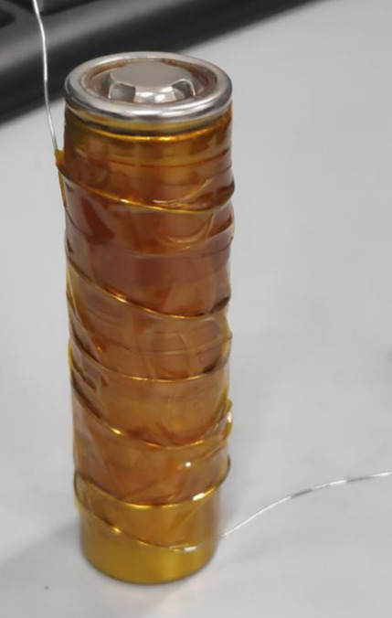
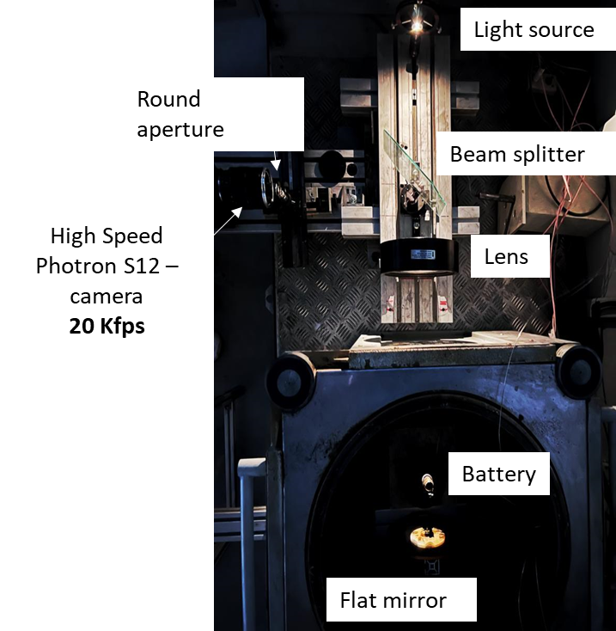
Setup Description: CMT setup
Trigger system with laser
Adapted ARC
Double heating system:
Electrical resistance in contact with the cell
ARC resistance in « Exothermic mode » to keep ambient air at skin temperature
Temperature measurement at
Skin temperature
Gas temperature 1 cm over the cap
Laser triggered camera

Slide 12
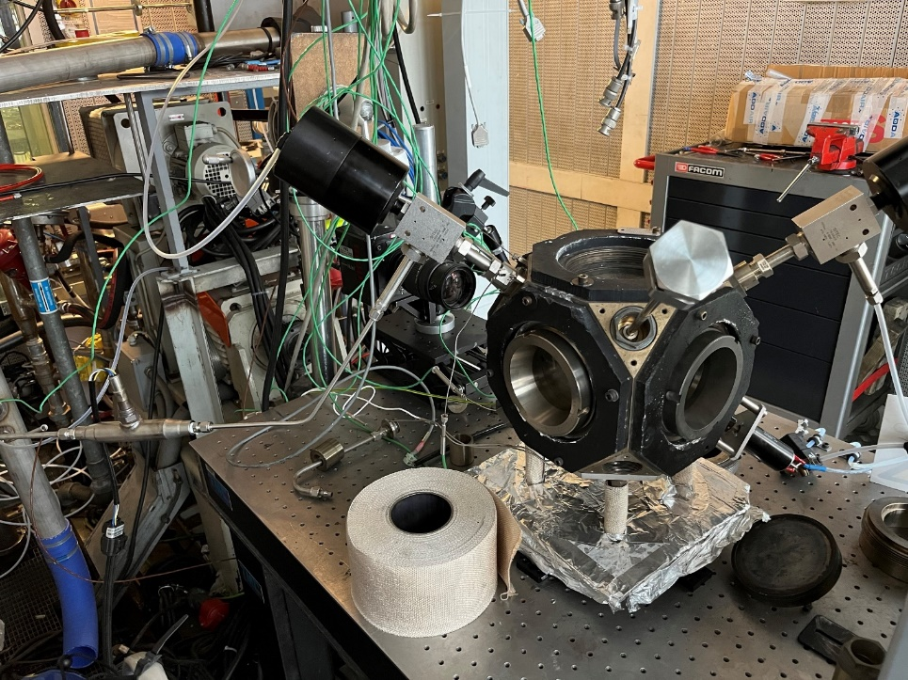
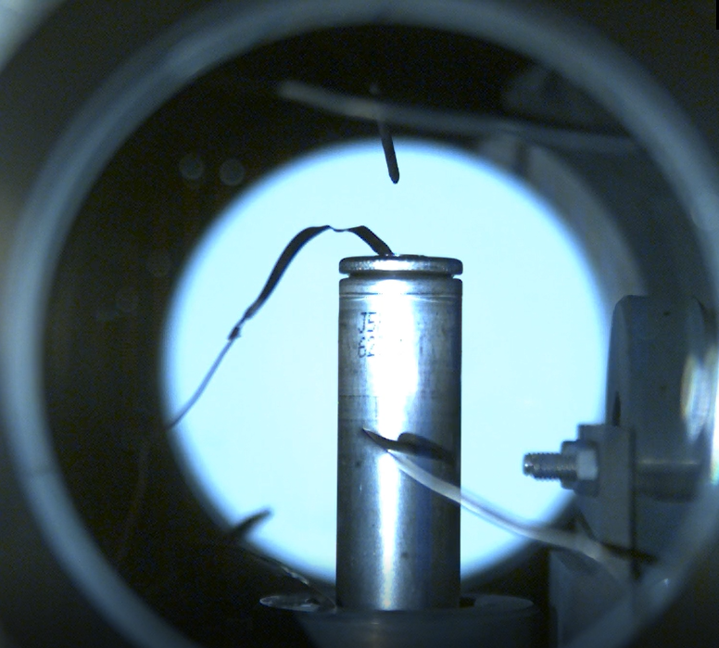
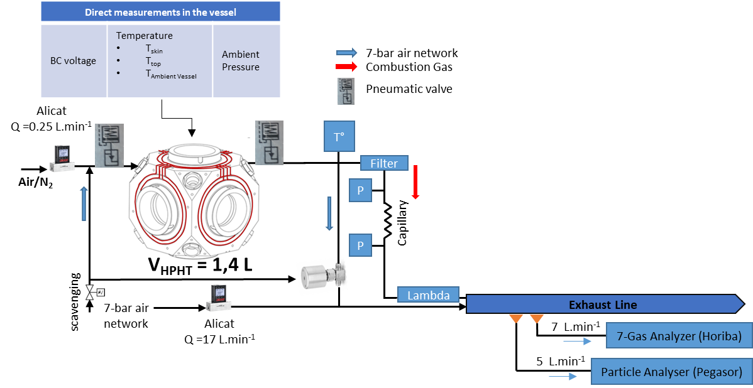
Setup description : IFPEN setup
Adapted CV vessel
Electrical heating of the vessel body
Air temperature homogenized by a fan
Cell heating by convection
Constant air flux for gas analysis
0.25 l/min to have low impact on temperature
Capillary system at the outlet to detect cell gas emissions
High speed cameras
Simultaneous Schlieren + natural luminosity

Slide 13
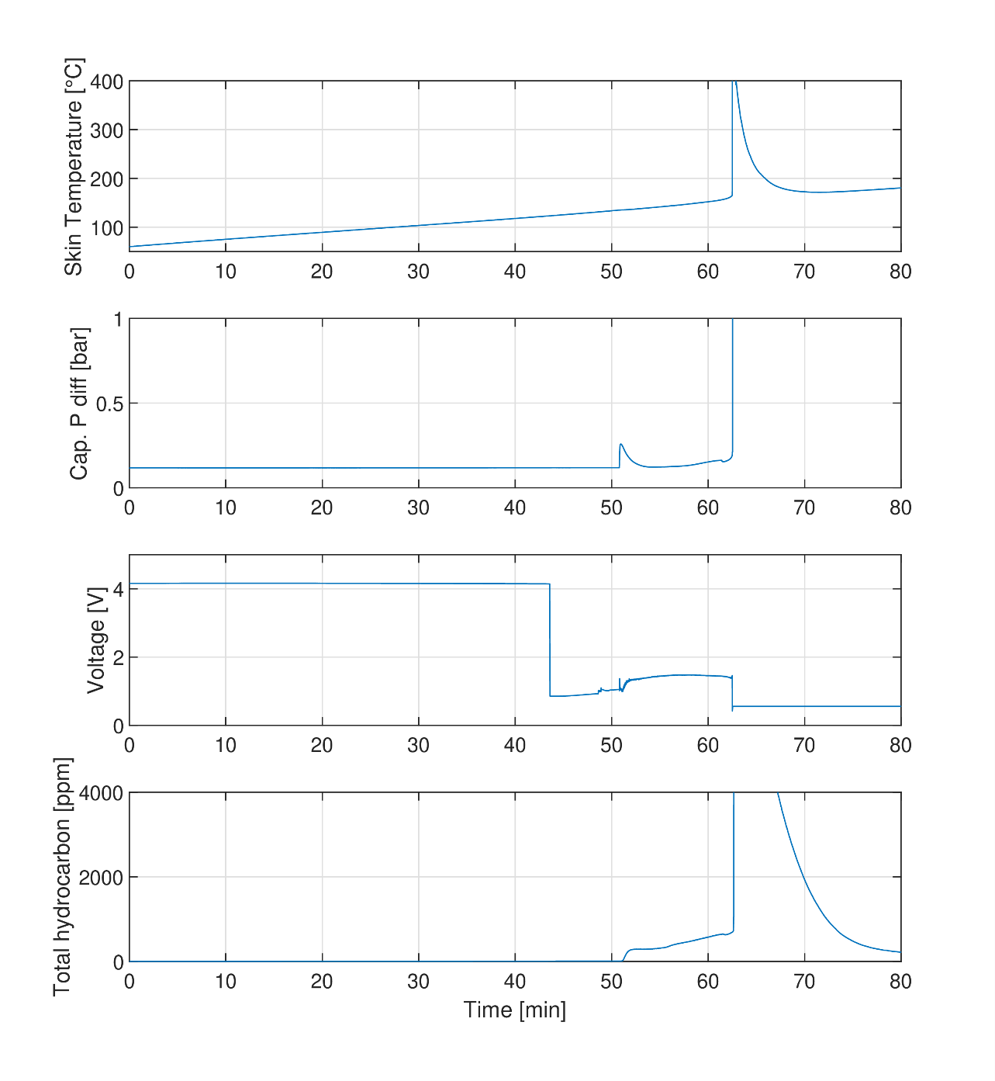
Sample Test results
Exothermic
onset
Voltage Drop
Gas Venting
Global runaway description measurement :
Richardet et al, SAE 2023-04-0165
García, et al., Energy Conversion and Management 2021
The following main events are in general described during TR in a thermal abuse case
1. Exothermic reaction onset
-Observed mainly with HWS method
2. Voltage drop : CID (current interrupting device) stop battery form charge/decharge (non reversible)
3. Gas Venting
- Temperature variation
- Pressure increase
-Gas Analysis

Slide 14
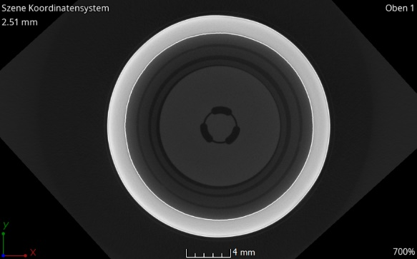
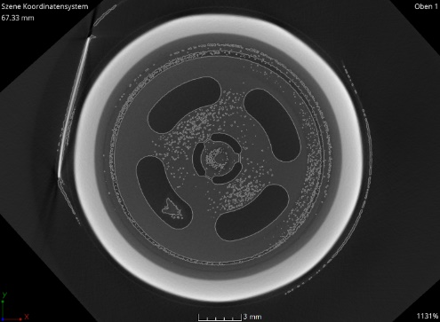
Sample Test results
Gas Venting
M50 / SOC 50% / 1.5°C/min
Di-(Tri) phasic jet
Complex nozzle
~100 ms duration
Global runaway description measurement :
Richardet et al, SAE 2023-04-0165
García, et al., Energy Conversion and Management 2021
The following main events are in general described during TR in a thermal abuse case
1. Exothermic reaction onset
-Observed mainly with HWS method
2. Voltage drop : CID (current interrupting device) stop battery form charge/decharge (non reversible)
3. Gas Venting
- Temperature variation
- Pressure increase
-Gas Analysis
-Video Analysis
M50 2018
M50 2019
S. Ohneseit, P. Finster, C. Floras, N. Lubenau, N. Uhlmann, H.J. Seifert, C. Ziebert, Batteries 2023, 9, 237, https://doi.org/10.3390/batteries9050237

Slide 15
Sample Test results
Exothermic
onset
Gas Venting
TR onset
Global runaway description measurement :
Richardet et al, SAE 2023-04-0165
García, et al., Energy Conversion and Management 2021
The following main events are in general described during TR in a thermal abuse case
1. Exothermic reaction onset
-Observed mainly with HWS method
2. Voltage drop : CID (current interrupting device) stop battery form charge/decharge (non reversible)
3. Gas Venting
4. Thermal Runaway

Slide 16
Sample Test results
M50 / SOC 100% / 1.5°C/min
~1 second duration
Global runaway description measurement :
Richardet et al, SAE 2023-04-0165
García, et al., Energy Conversion and Management 2021
The following main events are in general described during TR in a thermal abuse case
1. Exothermic reaction onset
-Observed mainly with HWS method
2. Voltage drop : CID (current interrupting device) stop battery form charge/decharge (non reversible)
3. Gas Venting
4. Thermal Runaway
Gas emission
Ignition
Incandescent particles
Optical thick gas/dust

Slide 17
Sample Test results
Global runaway description measurement :
Richardet et al, SAE 2023-04-0165
García, et al., Energy Conversion and Management 2021
The following main events are in general described during TR in a thermal abuse case
1. Exothermic reaction onset
-Observed mainly with HWS method
2. Voltage drop : CID (current interrupting device) stop battery form charge/decharge (non reversible)
3. Gas Venting
4. Thermal Runaway
Gas emission
Ignition
Incandescent particles
Optical thick gas/dust

Slide 18
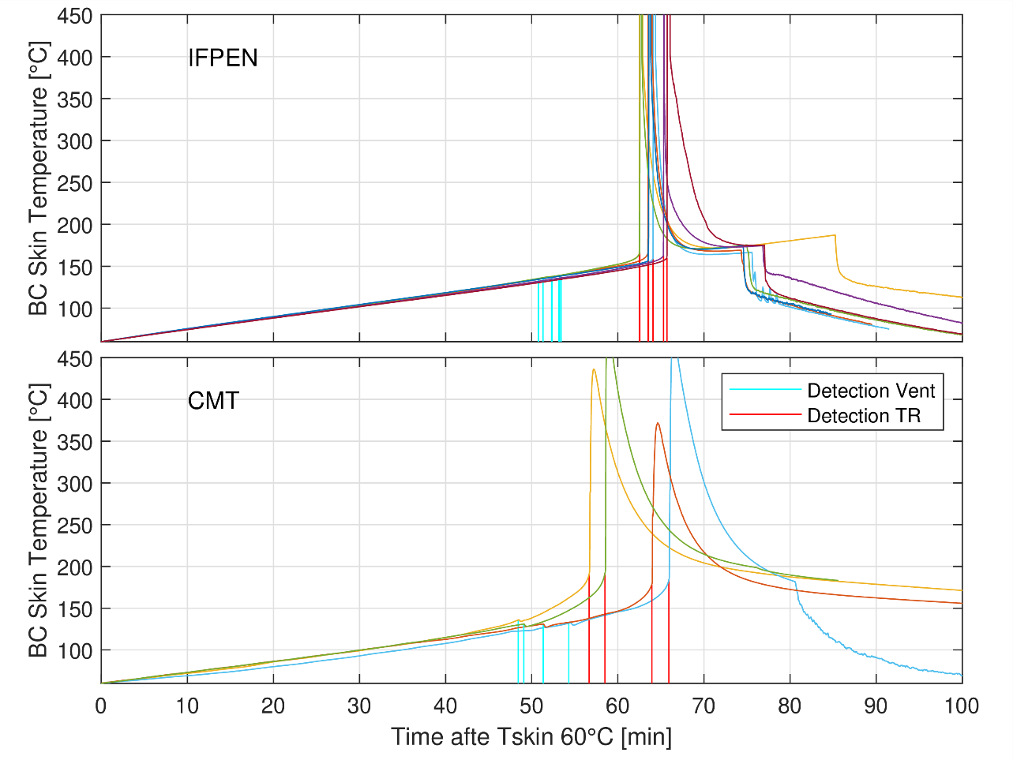
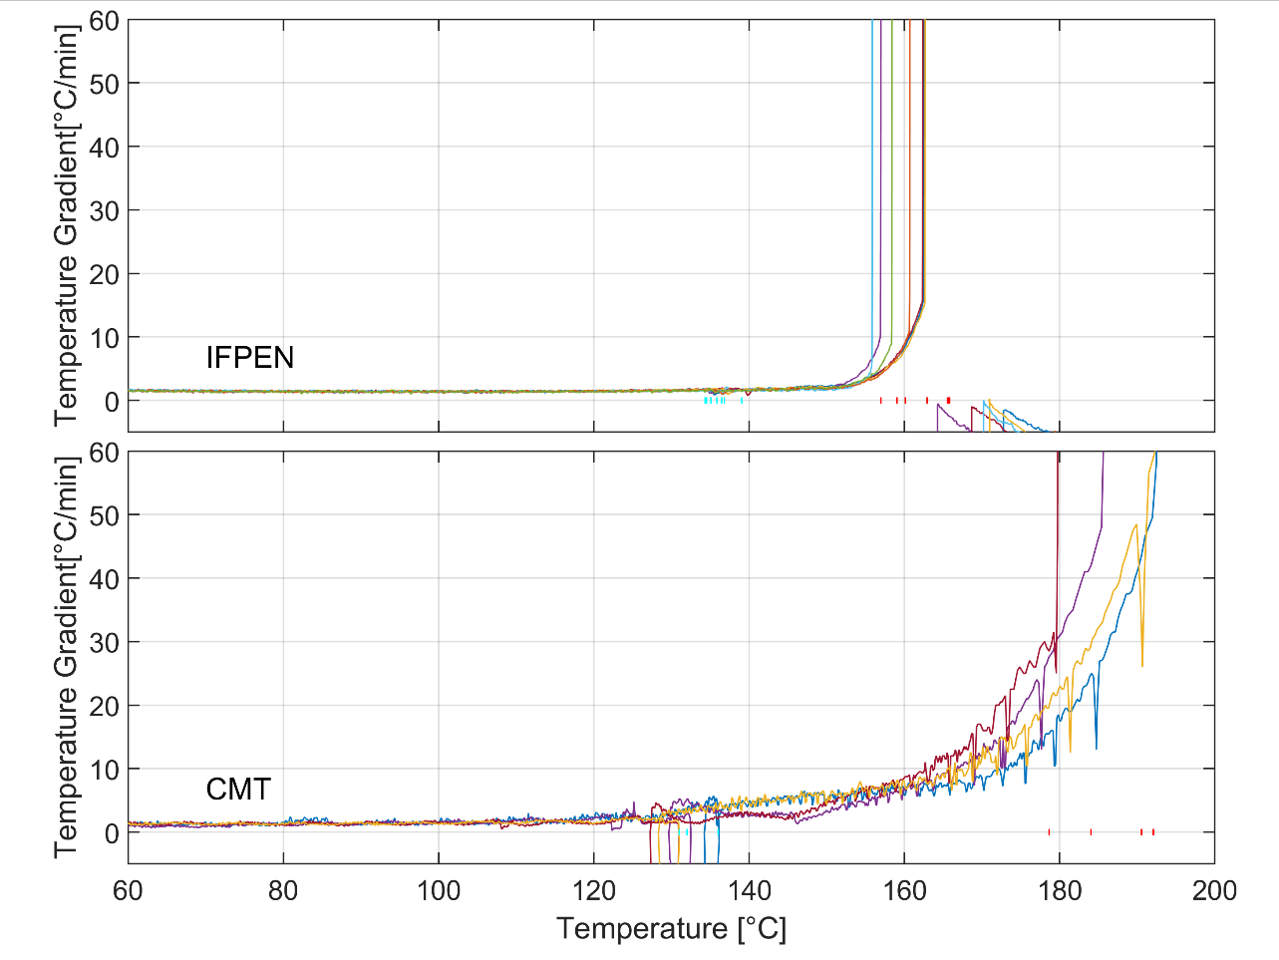
Reference case
Skin temperature
T gradient vs Temperature
IFPEN
7 tests repetitions
venting
4 tests repetitions
CMT
At venting an important temperature reduction is observed by CMT
TC position : IFPEN at mid height / CMT at upper part (no contact with jet)
TR gradient behavior is clearly different
The transition to thermal runaway significantly different in the two cases
In CMT experiments the battery cell-air heat exchange is limited (holder + heating mode)
The TR temperatures at IFPEN are lower ➔air might have a cooling effect on battery skin

Slide 19
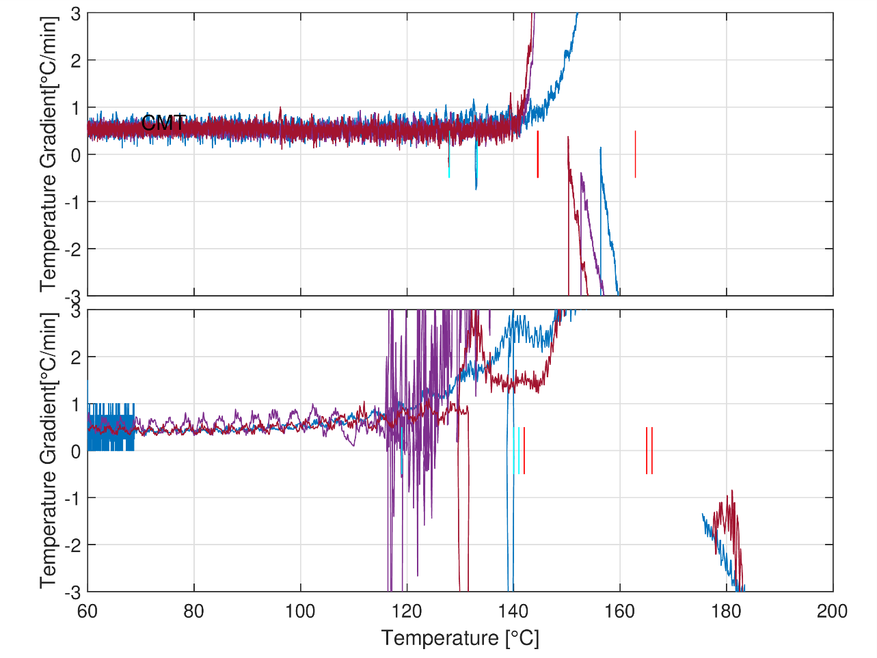
Heating ramp and heating control
Heating ramp: 1.5 °C/min
Heating ramp: 0.5 °C/min
IFPEN
CMT
Heating ramps are reasonably close to the target ramps
However, for both cases a deviation from the target is observed starting at 120°C
Evident for CMT, but detectable also in IFPEN data
Potential interesting measurement for future
ARC results detects exothermic reaction onset at T >70°C

Slide 20
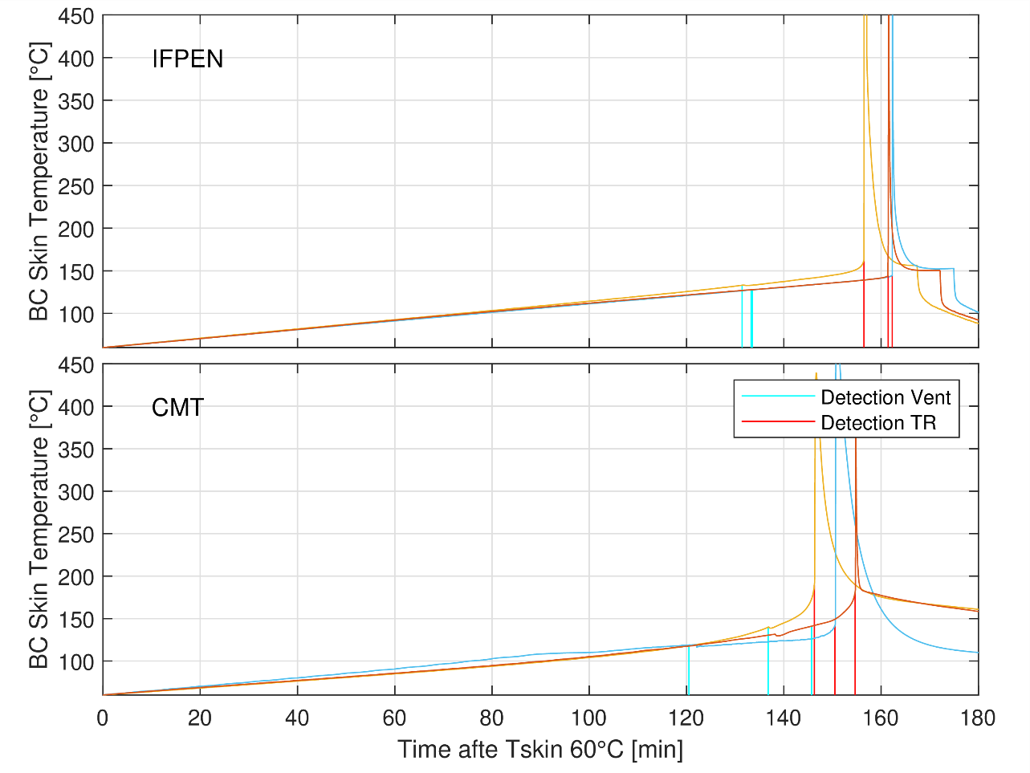
SOC 100 comparison: skin temperature measurement
Heating ramp: 1.5 °C/min
Heating ramp: 0.5 °C/min
IFPEN
7 tests repetitions
4 tests repetitions
CMT
The reduction in heating ramp slope has an obvious effect on venting and TR time
Delay between Venting and TR increases more for IFPEN
In both case is less than 3 times longer (3 times lower heating ramp)
Combination of heating ramp and chemical reactions time

Slide 21
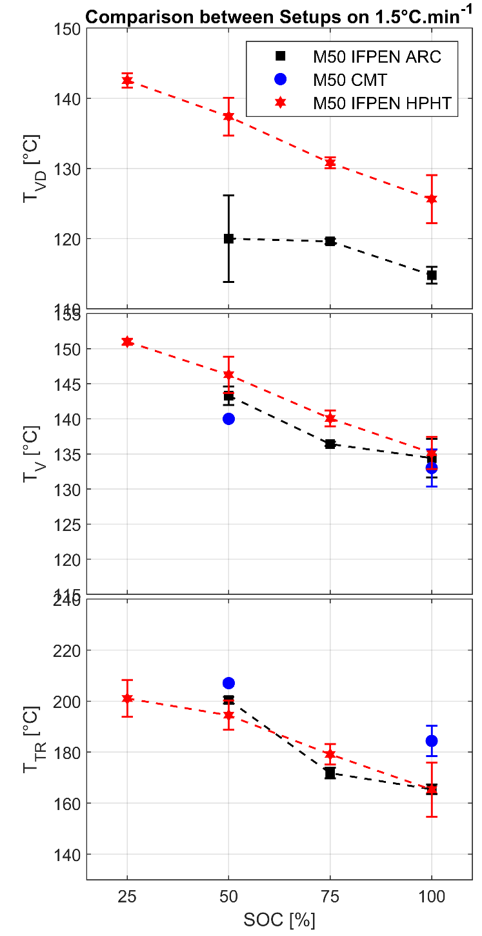
Venting and runaway temperatures
Consistent deviation Voltage drop temperature between ref ARC and IFP – HPHT
Related to the CID design
Venting and runaway temperatures are often evaluated to describe Thermal runaway behavior
Variability observed is acceptable and enable to identify clear trends (effect of SOC)
Agreement with reference method (ARC HWS mode)
At lower heating rate
Results variability increases significantly
Impact of heating strategy become bigger at slow heating rate
Minor impact on the characteristic temperatures

Slide 22
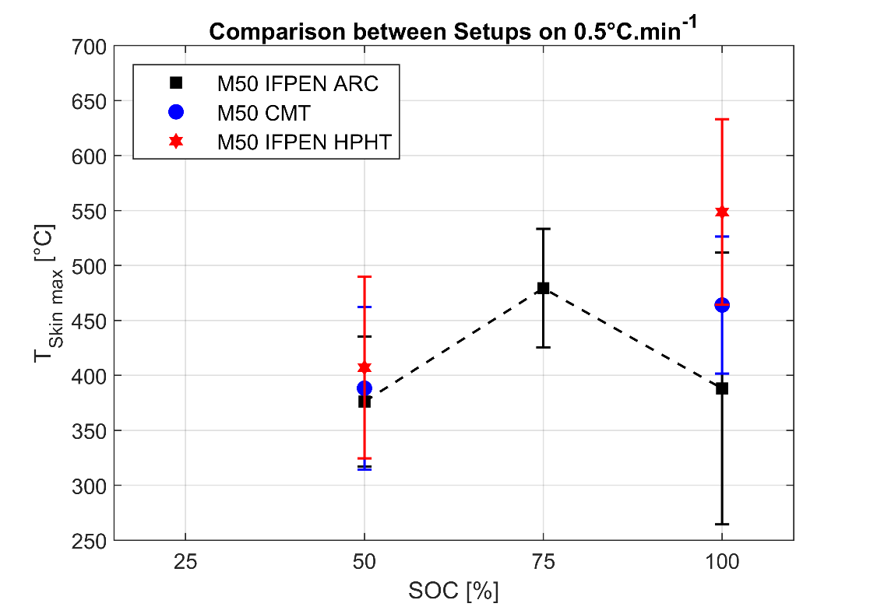
Max skin temperature
Max skin temperature measurement can provide information on the intensity of the TR event
Dispersion obtained is very large
Need to find more responsive sensors
Could this be an effective variability of temperature?

Slide 23
Venting video observation
Venting jet penetration is very fast
High sampling rate: in 300µs is out of field of view
Larger field of view is needed
Liquid and vapor could provide different answers
1.5 °C/ min heating ramp / 100 SOC
IFPEN NL / Mie scattering

Slide 24
Venting video observation
Effect of SOC on venting seems to be affected by SOC
statistical analysis is needed
The way in which safety valve brakes can affect jet development
0 us
200 us
400 us
600 us
800 us
1000 us
1200 us
1400 us
1600 us
1800 us
SOC50%
SOC100%

Slide 25
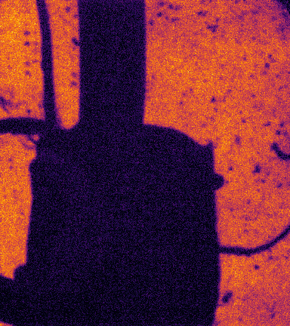
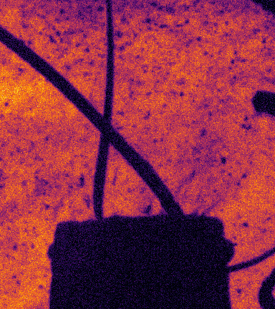
SOC effect on videos
CMT 1.5 °C/ min heating ramp
SOC 100%
SOC 50%
At 100% SOC ignition takes place immediately after the gas ejection (~0.3 ms)
At 50% SOC it take longer (~ 10 ms)
The ignition position might change significantly
In IFPEN movies no ignition is detected at 25% SOC

Slide 26
Reference case experiment Conclusions 1/2
Temperature ramp abuse test was carried out in two different optically accessible facility
Heating strategy was not the same and it has an important effect on the transient before TR
Characteristic temperatures can be characterized via different techniques, are compared to ARC reference HWS results
Exothermic onset temperature is still missed “T ramp” case
VD temperature is consistently higher in “T ramp” case
Venting and TR onset temperature are comparable (in absolute values and trend)
Results variability is acceptable:
SOC trend could be identified
T ramp slope affect the variability of the results
Important to perform test repetitions
Important information about heat release can be studied via pressure analysis (not presented / not ready)

Slide 27
Reference case experiment Conclusions 2/2
High speed videos provide important information to understand the process
Venting
Complex jet shape strongly depending on battery type: which are the key measurement to perform?
“venting valve” to be characterized for the current battery
Orientation of battery should be clarified
Larger field of view would be beneficial to characterize the process
TR
A continuous gas emission could be observed from venting until TR
Via NL jet ignition is shown to take place in different ways (directly at the vent cap in a ”diffusive” outlet or far from it followed by a “flame propagation”)
OH* images, combined with high-speed pressure measurement could clarify the ignition process
SOC affect significantly TR and the ignition detection
Optical thick Smoke make it difficult the visualization of the event

Slide 28
Agenda
Experimental activities Reference case description and discussion of the available data
Abuse test description
Abuse test comparison
Complementary information and analysis on reference cells
ARC for battery thermal runaway investigation (KIT)
Lessons from recent studies on battery thermal runaway (University of Tennessee)
Numerical results:
3-D approach (Converge)
0-D/1D numerical Approach(CMT / IFPEN)
In parallel please fill in the Beekast Survey:
Which are the key measurement that we should / could add to reference battery cell case?
On which aspect of our results, we should be focusing on the most?
How should reference case evolve?
Battery cell Geometry
Abuse test
Ageing process
…
How to investigate to cell-to-cell propagation?

Slide 29
Battery cells tested
LG INR21700LT M50 => « M50 »
C_{nom} = 4,85 Ah
Energy density = 263 Wh/kg
70 cm
2,1 cm
/ 3.69V
2,1 cm
Notes:
21700 format cylindrical
Capacity of almost 5Ah
Energy density of 263 Wh/kg

Slide 30
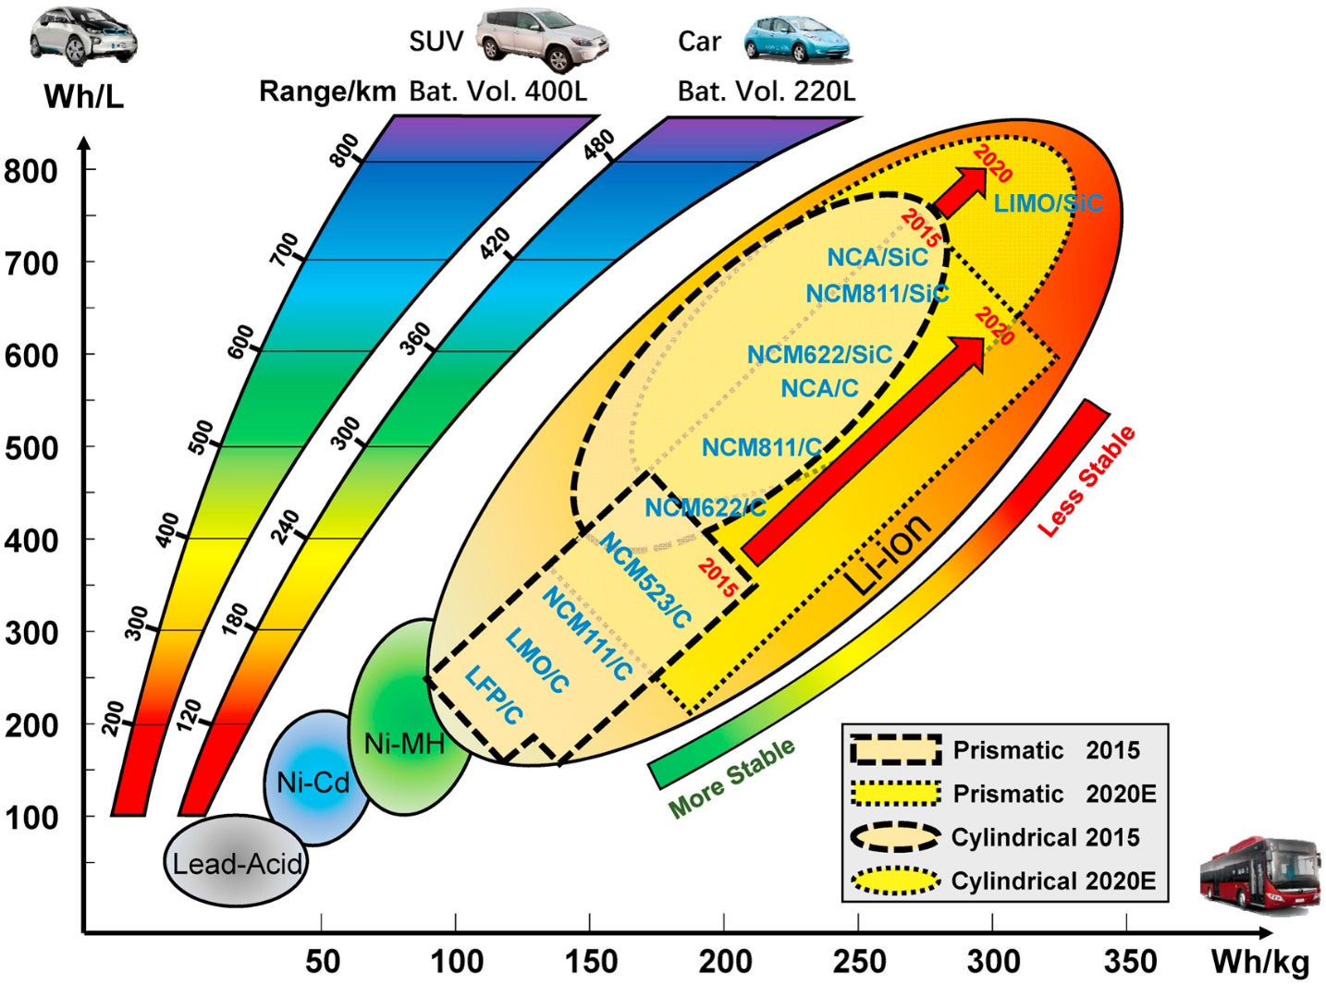
Battery cells tested
LG INR21700LT M50 => « M50 »
70 cm
2,1 cm
2,1 cm
X. Feng, M. Ouyang, X. Liu, L. Lu, Y. Xia, X. He, Thermal runaway mechanism of lithium ion battery for electric vehicles: A review, Energy Storage Materials 10 (2018) 246–267.
State of the art cylindrical battery cell
263 Wh/kg
Notes:
That kind of energy density => state of the art battery
Lead to specific electrode chemistry

Slide 31
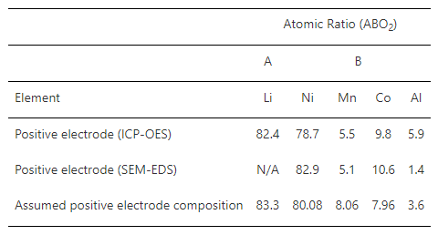
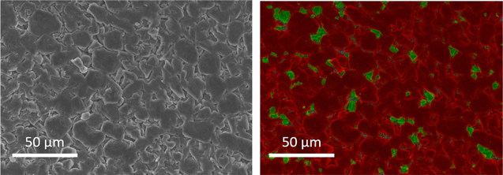
Composition
Electrodes
Positive Electrode
NMC 811 (not specific to M50)
Negative Electrode
Graphite/Silicon
Weight percentage of graphite and silicon oxide is 90% and 10% by weight (Chen, 2020)
Si 1% in weight of the battery cell mass (Popp, 2021)
Chen, 2020
Chen, 2020
Top-view EDS images of the negative electrode extracted from LGM50 displaying graphite (red) and silicon oxide (green) content.
Notes:
NMC 811 => 80% Nickel 10% Manganese 10% Cobalt
Ni-rich
Silicon at the anode to boost the capacity of the battery
NE Active material is around 7g ~10% of total mass of BC

Slide 32
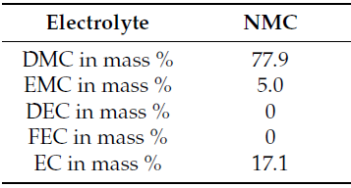
Composition
Electrolyte + Solvant
LiPF₆ (Catenaro, 2021)
Organic solvent (Ohneseit, 2023, KIT)
Important to perform the same kind of analysis for our generation of M50 (2022)
M50 : generation 2018
Notes:
Lithium salts LiPF6 similar to most of LIB
Organic Solvant
DMC, EMC and EC according to KIT work
Keep in mind it is a 2018 generation and we have a 2022 one

Slide 33
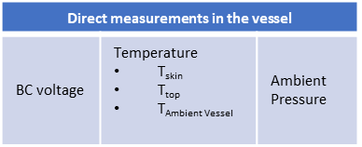
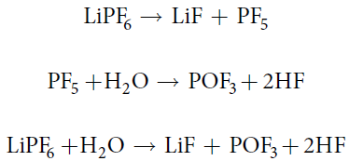
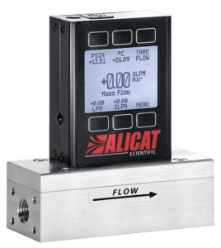
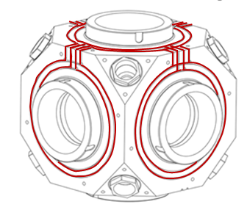
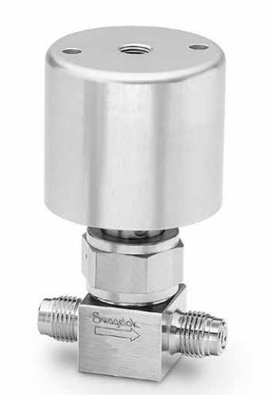
Advanced gas analysis at IFPEN
Experimental setup – ongoing activity
Some gas emitted can be really hazardous
HF can be formed
Quantify these emissions
Trap them to avoid damaging analyzers
7-bar air network
Combustion Gas
PUMP
PUMP
Pneumatic valve
Alicat
Q =0.25 L.min⁻¹
T°
Mass flow
Mass flow
Air/N₂
Filter
P
Exhaust
Capillary
P
Bubblers
V_{HPHT} = 1,4 L
Runaway
Venting
scavenging
7-bar air network
Lambda
Exhaust Line
Alicat
Q =17 L.min⁻¹
7 L.min⁻¹
7-Gas Analyzer (Horiba)
5 L.min⁻¹
Particle Analyser (Pegasor)
Use of Bubblers
Yang, 2006
Kawamura, 2006
Notes:
Toxic gases can be found, harmful for health or also for some analyzers
Especially Hydrogen Fluoride
Need to quantify the risks and try to trap them => bublers to dissolve the HF into it

Slide 34
Experimental Set up
Detect hazardous gases
Results
100% SOC M50 battery cells were tested (Ionic Chromatography)
No trace of HF have been detected
7-bar air network
Combustion Gas
PUMP
PUMP
Pneumatic valve
Alicat
Q =0.25 L.min⁻¹
T°
Mass flow
Mass flow
Air/N₂
Filter
P
Exhaust
Capillary
P
Bubblers
V_{HPHT} = 1,4 L
Runaway
Venting
scavenging
7-bar air network
Lambda
Exhaust Line
Alicat
Q =17 L.min⁻¹
7 L.min⁻¹
7-Gas Analyzer (Horiba)
5 L.min⁻¹
Particle Analyser (Pegasor)
Bubblers were removed
Notes:
100% SOC M50 tested and no trace of HF found in Ionic Chromatography =>so we removed the bublers

Slide 35
Experimental Set up
Collect gases
Gas collection
100% SOC M50
during 1 min after Venting and Thermal Runaway
Collected from exhaust line at 2 L.min⁻¹
Dilution of the vent gases via mass flowmeter 17 L.min⁻¹
Dilution of the vent gases via mass flowmeter 2 L.min⁻¹
Venting Bag
TR Bag
7-bar air network
Combustion Gas
PUMP
PUMP
Pneumatic valve
Alicat
Q =0.25 L.min⁻¹
T°
Mass flow
Mass flow
Air/N₂
Filter
P
Exhaust
Capillary
V_{HPHT} = 1,4 L
P
Runaway
Venting
scavenging
7-bar air network
Lambda
Exhaust Line
Alicat
Q =17 L.min⁻¹
7 L.min⁻¹
7-Gas Analyzer (Horiba)
Q =2 L.min⁻¹
5 L.min⁻¹
Particle Analyser (Pegasor)
Notes:
We Tested LIB in same condition 100% SOC
Collection 1 min after Venting for 1 bag and 1 min after TR in a second bag
We regulated on the second and third test our dilution of exhaust gases

Slide 36
GAS collected analysis
GC-MS
Qualitative detection of many species
3 tests were conducted on 100% SOC
Thermal Runaway Bag
Echantillon : | 23-03498-2 | 23-03498-4 | 23-03498-6
Peak Name |  | Relative Area (%)
Ethane | 3.57 | 1.56 | 1.29
Water | 6.05 | 0.69 | 0.76
Propyne | 0.06 | 0.04 | 0.03
Silane, difluorodimethyl- | 0.04 | 0.05 | 0.03
Acetaldehyde | 0.11 | 0.04 | 0.09
Methyl Alcohol | 0.1 | 0.06 | 0.15
1-Propene, 2-methyl- | 0.31 | 0.19 | 0.22
1,3-Butadiene | 1.72 | 1.34 | 0.92
2-Butene | 0.13 | 0.07 | 0.09
Trimethylsilyl fluoride | 1.17 | 0.75 | 0.76
2-Butene, (Z)- | 0.1 | 0.07 | 0.07
1-Pentene | 0.05 | 0.02 | 0.02
Acetic acid, methyl ester | 0.05 | 0.1 | 0.06
1,3-Cyclopentadiene | 0.26 | 0.15 | 0.2
Silanol, trimethyl- | 0.37 | 0.03 | 0.4
1-Hexene | 0.06 | 0.02 | 0.02
Carbonic acid, dimethyl ester | 63.19 | 82.56 | 71.09
Tetrahydrofuran | 0.19 | 0.19 | 0.17
Dimethyl-(allyl)-silyloxybenzene | 0.07 | 0.03 | 0.08
Benzene | 15.93 | 5.02 | 15.12
Carbonic acid, ethyl-, methyl ester | 4.05 | 4.75 | 4.44
Disiloxane, hexamethyl- | 0.66 | 0.3 | 0.96
Toluene | 0.31 | 0.06 | 0.26
Cyclotrisiloxane, hexamethyl- | 1.07 | 0.24 | 1.12
Trisiloxane, octamethyl- | 0.06 | 0.02 | 0.08
Cyclotetrasiloxane, octamethyl- | 0.08 | 0.02 | 0.04
Venting Bag
Echantillon : | 23-03498-1 | 23-03498-4 | 23-03498-3 | 23-03498-6 | 23-03498-5
Peak Name | Relative Area (%) | Relative Area (%)
Water | 87.74 | 80.65 |  | 79.99
Carbonic acid, dimethyl ester | 11.91 | 19.35 |  | 17.17
Benzene | 0 | 0 |  | 0.76
Carbonic acid, ethyl-, methyl ester | 0.35 | 0 |  | 2.08
DMC
EMC
Silicon based gases
Notes:
Give data that are quite repetable over the 3 tests
Mostly water during Venting
3 intersting point in TR
DMC, EMC and silicon based gases

Slide 37
GAS collected analysis
GC-MS
DMC and EMC are components of the electrolyte
Also found in Abbott et al. work (2022)
No trace of EC which was detect on ante mortem analysis (Ohneseit, 2023, KIT)
Silicon based gases probably coming from Negative electrode decomposition
Thermal Runaway Bag
Echantillon : | 23-03498-2 | 23-03498-4 | 23-03498-6
Peak Name |  | Relative Area (%)
Ethane | 3.57 | 1.56 | 1.29
Water | 6.05 | 0.69 | 0.76
Propyne | 0.06 | 0.04 | 0.03
Silane, difluorodimethyl- | 0.04 | 0.05 | 0.03
Acetaldehyde | 0.11 | 0.04 | 0.09
Methyl Alcohol | 0.1 | 0.06 | 0.15
1-Propene, 2-methyl- | 0.31 | 0.19 | 0.22
1,3-Butadiene | 1.72 | 1.34 | 0.92
2-Butene | 0.13 | 0.07 | 0.09
Trimethylsilyl fluoride | 1.17 | 0.75 | 0.76
2-Butene, (Z)- | 0.1 | 0.07 | 0.07
1-Pentene | 0.05 | 0.02 | 0.02
Acetic acid, methyl ester | 0.05 | 0.1 | 0.06
1,3-Cyclopentadiene | 0.26 | 0.15 | 0.2
Silanol, trimethyl- | 0.37 | 0.03 | 0.4
1-Hexene | 0.06 | 0.02 | 0.02
Carbonic acid, dimethyl ester | 63.19 | 82.56 | 71.09
Tetrahydrofuran | 0.19 | 0.19 | 0.17
Dimethyl-(allyl)-silyloxybenzene | 0.07 | 0.03 | 0.08
Benzene | 15.93 | 5.02 | 15.12
Carbonic acid, ethyl-, methyl ester | 4.05 | 4.75 | 4.44
Disiloxane, hexamethyl- | 0.66 | 0.3 | 0.96
Toluene | 0.31 | 0.06 | 0.26
Cyclotrisiloxane, hexamethyl- | 1.07 | 0.24 | 1.12
Trisiloxane, octamethyl- | 0.06 | 0.02 | 0.08
Cyclotetrasiloxane, octamethyl- | 0.08 | 0.02 | 0.04
This is a step forward, but need to quantify the emissions
DMC
EMC
Silicon based gases
Notes:
DMC and EMC are found also in Abbott M50 gas analysis in thermal abuse
Similar to KIT ante mortem analysis , laking EC
Silicon from Negative electrode
Now we lack quantification

Slide 38
Perspectives
Some data in the literature
BUT really chemistry dependent AND probably generation dependent
So we are aiming for a set up to characterize the emission over time with FTIR analyzer
Need for others to join the efforts
7-bar air network
FTIR
Measurement
Combustion Gas
Pneumatic valve
Alicat
Q =0.25 L.min⁻¹
T°
Air/N₂
Filter
P
3.8 L/min
Capillary
V_{HPHT} = 1,4 L
P
scavenging
7-bar air network
Lambda
Exhaust Line
Alicat
Q =17 L.min⁻¹
7 L.min⁻¹
7-Gas Analyzer (Horiba)
5 L.min⁻¹
Particle Analyser (Pegasor)

