Slide 1
welcome to ECN9!
We thank Alessandro Montanaro and staff at STEMS for this wonderful opportunity
Congratulations and best wishes to Luigi Allocca on your retirement!
Thank you for traveling to be with us
Welcome to those joining online -- we will record (using MS Teams) and post all proceedings

Slide 2
ECN Directions
Lyle Pickett (Sandia)
Gilles Bruneax (IFPEn)
Raúl Payri (CMT)
ECN9 Sept 2023 – Napoli
Credit: Els Maes-Verdonschot IJER ECN special issue

Slide 3
Low-lifecycle-carbon fuels + batteries are topics for ECN9
Ideas chosen at ECN8
While young, we have seen significant growth in each topic
Working groups becoming more active
Prospects look good for future growth
We three ECN leads wish to provide perspective that we hope may be used to foster growth after the spirit of the ECN
Topic | Lead(s)
Hydrogen injection & combustion | Noud Maes, TU/e Max Peters, TU/e
Methanol early direct injection | Paul Lien, Darmstadt Rafa Clemente, FAU
OME, methanol (and renewable) diesel combustion | Julien Manin, Sandia Frederik Wiesmann, TU Vienna
Ammonia injection and combustion | Michele Battistoni, Perugia Jose Maria Garcia Oliver, CMT
Battery safety and thermal runaway | Michele Bardi, IFPEN; Antonio Garcia, CMT
3

Slide 4
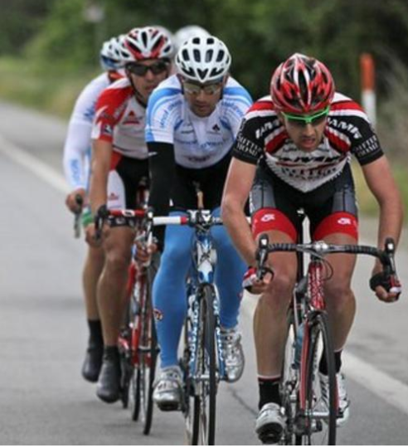
we suggested at ECN8 that we could form smaller ___________ for research on low lifecycle carbon fuels, with lower grade and headwinds
Why is the ECN a good place for this research?
ECN topics
Not afraid to talk about what doesn’t work, to air “dirty laundry”
Success is not a typical conference presentation where experiments and simulations “show good agreement”
Seek to break down barriers for quantitative comparison of CFD and experiments, including uncertainty quantification of both
We help each other
We share injectors, geometries, grids, knowledge about uncertainties, experimental knowhow, means of characterizing boundary conditions,…
We learn about “hidden biases” inherent to our own experiment or code and make ties to others
We have fun together!
4

Slide 5
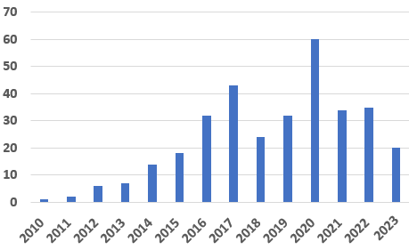
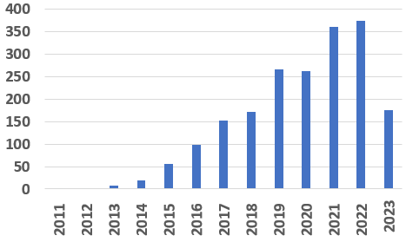
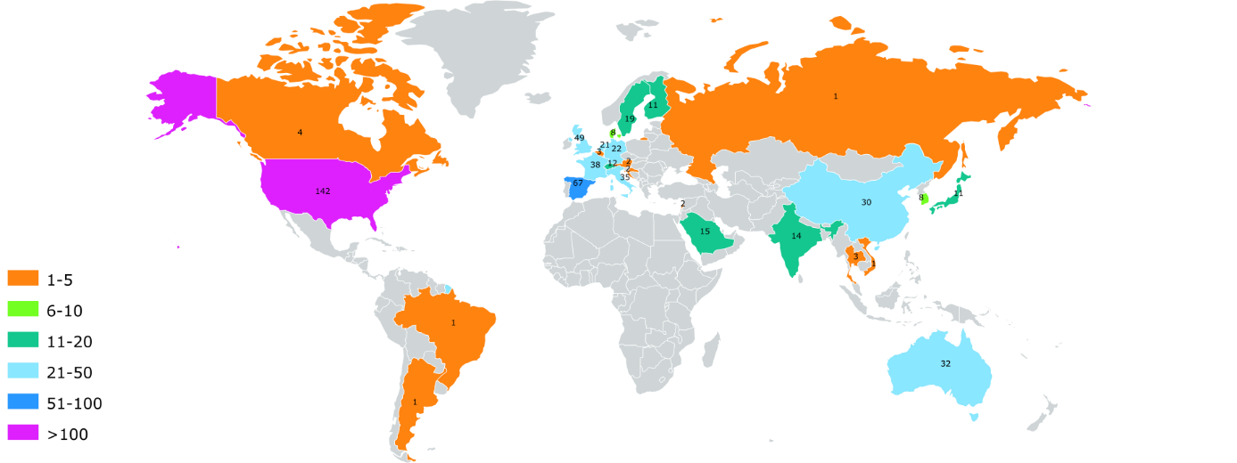
Proof that the peloton works
IJER
special
Issue
ECN7
180 laboratories actively involved (publishing ECN related work)
329 WOS publication (2010-2023)
800 laboratories using the ECN work (citing the ECN related work)
ECN production is stable since 2016 (30-40 publications/year) but its visibility (number of citations) continues to increase
h index: 40 (36 in 2022, 23 in 2019, 20 in 2018)
2019 study shows that ECN articles have 40% higher impact factor than papers on comparable subjects!
Number of ECN
publications/year
Number of ECN
citations/year
ECN publishing countries
5

Slide 6
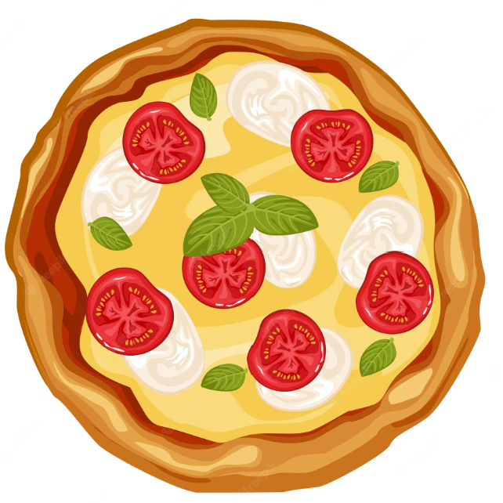
How do all of these research topics fit together?
Are there overlaps and synergistic activities between topics?
Yes, like a pizza ! ?
Perfect combination of ingredients from new world (tomatoes) and old world (dough cooked on a hot stone)
6

Slide 7
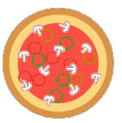
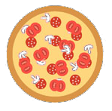
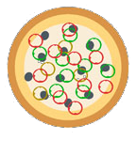
Who makes the best pizza in the world?
Methanol
Hydrogen
Great pizza is found all over!
No ECN vehicle technology topic clearly has the edge over another
Helpful combinations may exist, even if ingredients aren’t completely mixed
We believe that the interdependencies of the ECN technical topics still offer “Network” benefits
Ammonia
Batteries
OME/
DME/RD
7

Slide 8
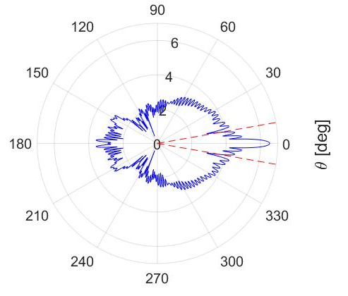
Maybe it is just being in napoli, but I am starting to see pizzas everywhere within the ECN!
8

Slide 9
Question
At ECN8 we know what happened when you said the word “peloton”, what do you think will happen if you say the word “pizza” at ECN9?

Slide 10
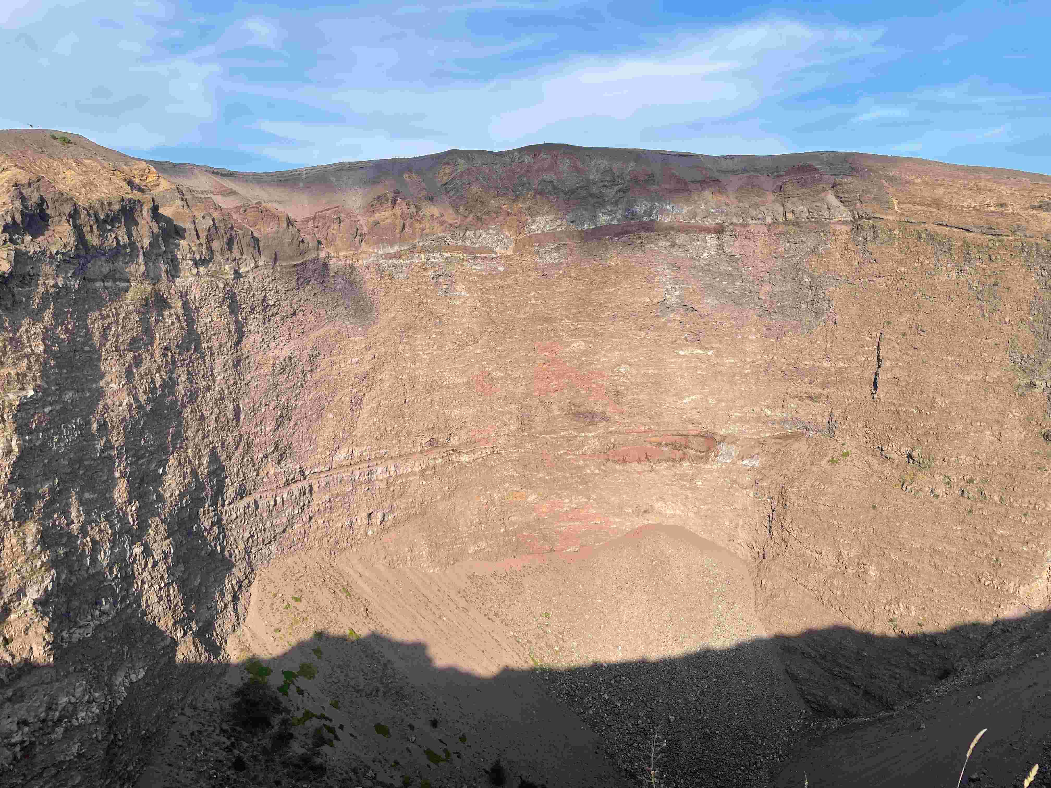
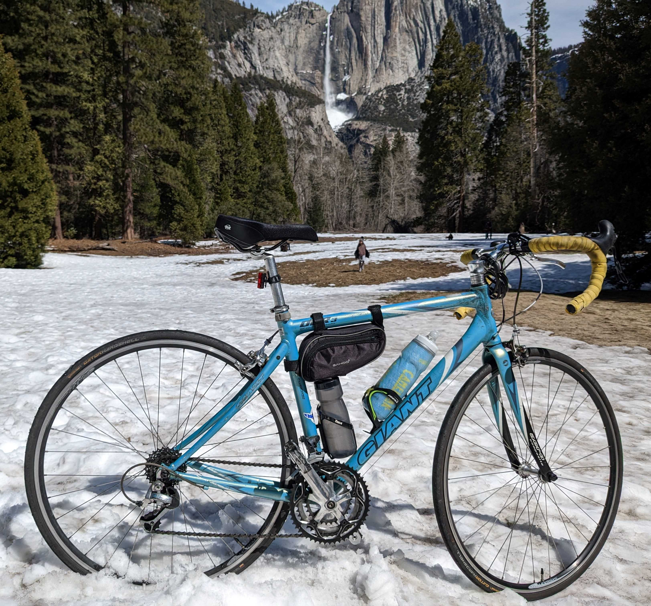
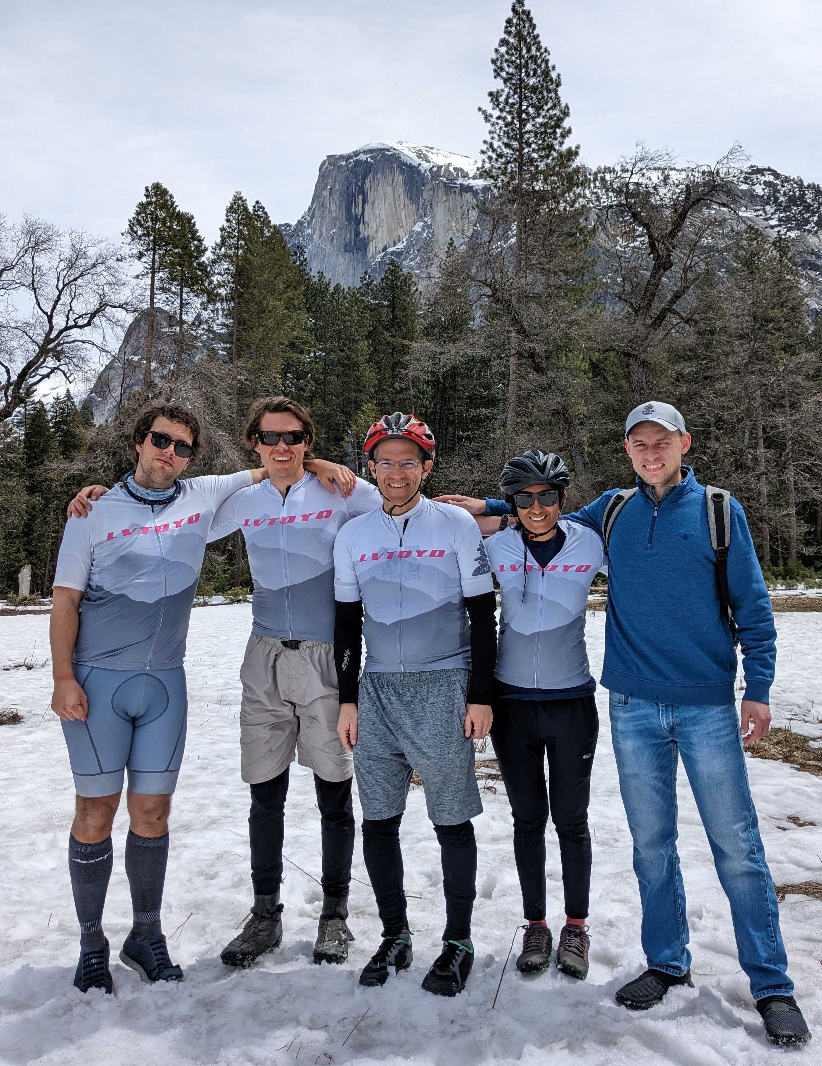
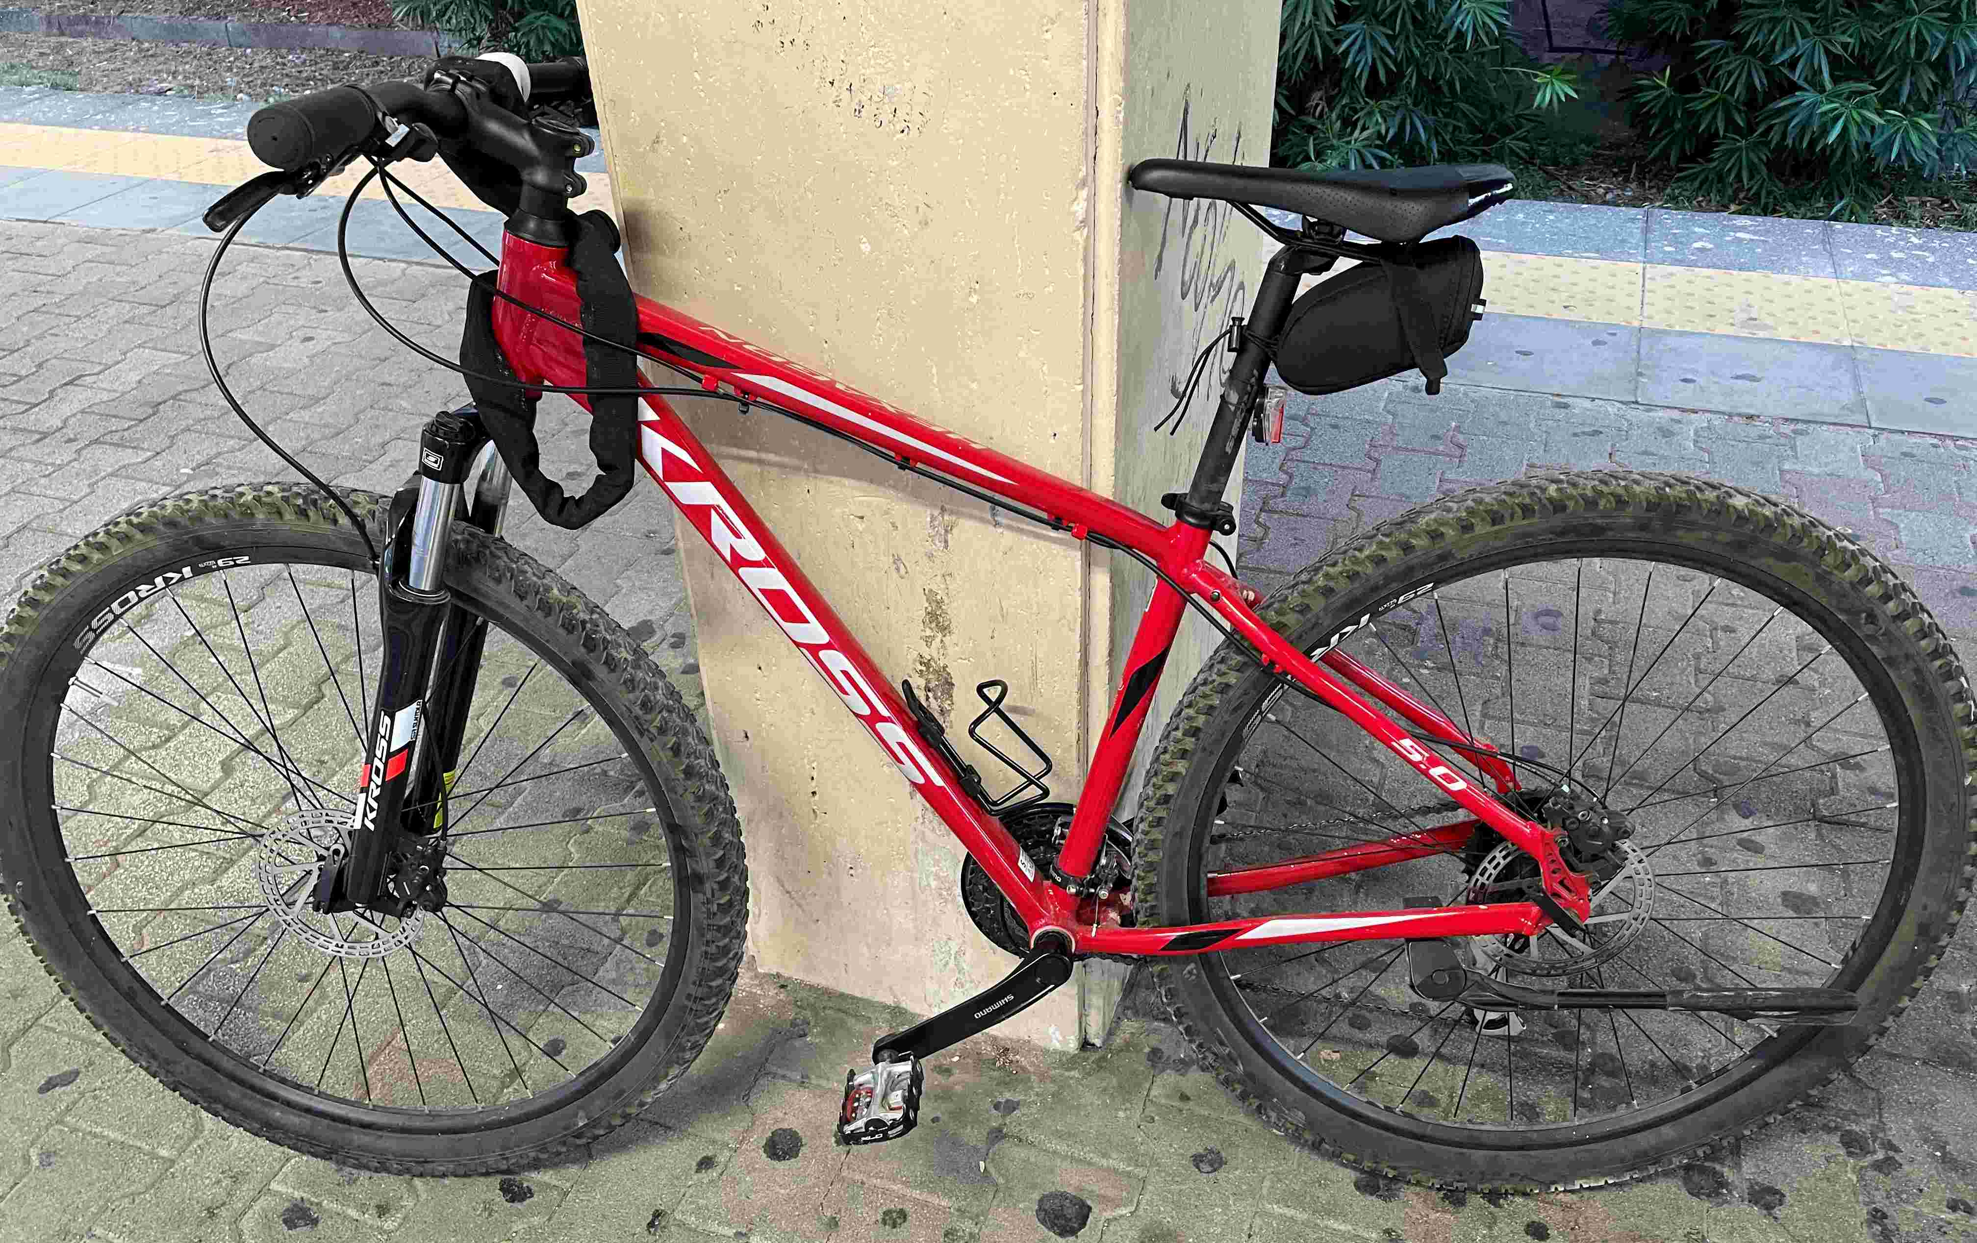
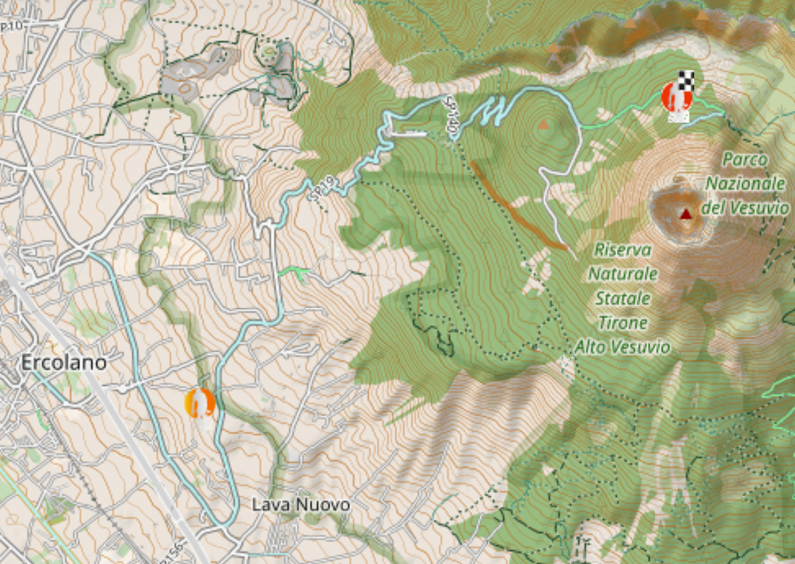
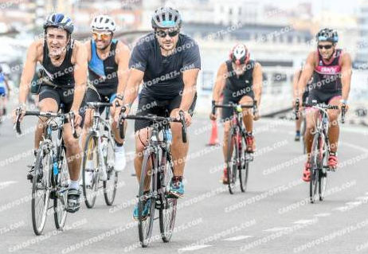
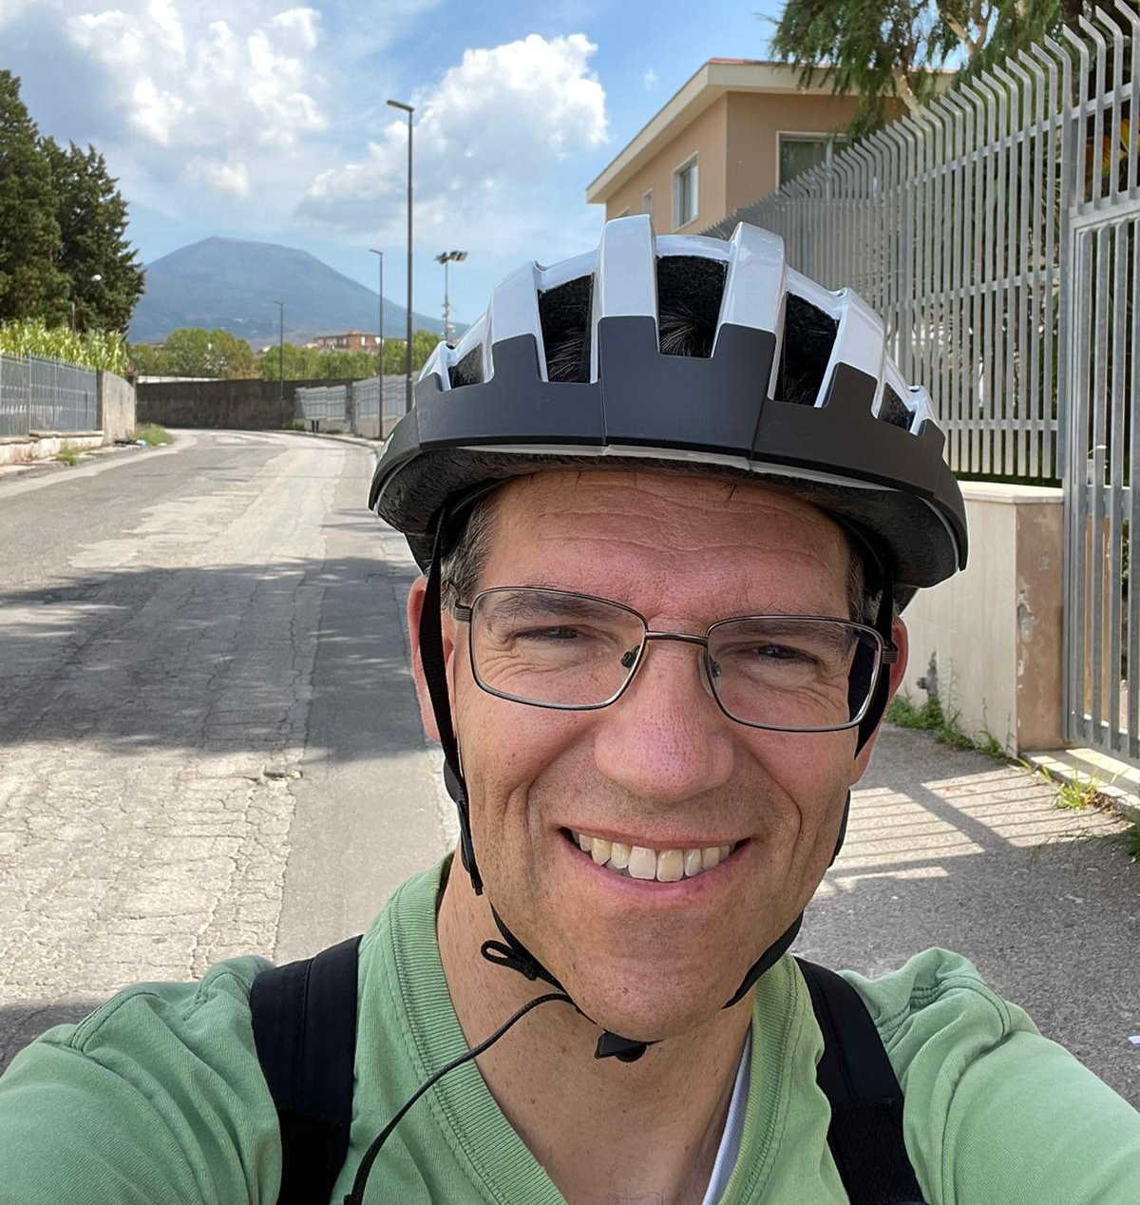
I am also seeing them in the peloton
Livermore to Yosemite Sandia Team
Apr 2023
Lyle
Rafa Clemente
Meghna Dhanji
Tyler Strickland
Logan White
Valencia Tri 2018
To Vesuvius
Sept 2023
JM Garcia Oliver
Gilles Bruneaux

Slide 11
Friday 8 Sept 2023 AGenda
10:00--12:30 Ammonia injection and combustion, Michele Battistoni (Perugia)& Jose Maria Garcia (CMT)
(11:00-11:30 Coffee break)
12:30-14:00 Lunch
14:00-16:00 Spray G and Spray M research (intake injection) using methanol and PACE-20, Paul Lien (Darmstadt) & Rafael Clemente (FAU) & Lyle Pickett (Sandia)
16:00-17:00 OME and methanol diesel combustion, Julien Manin (Sandia) and Frederik Wiesmann (TU Vienna)
18:00 Reception/Dinner

Slide 12
SATUrday 9 Sept AGenda
08:00-09:00 Welcome / breakfast
09:00-11:00 Hydrogen Injection, Noud Maes, Max Peters (Eindhoven)
(10:00-10:30 Coffee break)
11:00-12:30 Battery safety and thermal runaway, Michele Bardi (IFPEN)& Antonio Garcia Martinez (CMT)
12:30-14:00 Lunch
14:00-16:00 Future directions (all)
16:00-20:00 ECN fun activity

