Slide 1
ECN2 Future Direction
Continue
Spray A baseline
Soot
New
Large, single-hole nozzle.
Spray B
GDI injector
Transparent nozzle
Engine flows
Address physical problems
Internal flow/near nozzle
Supercritical
Turbulence/chemistry interaction at engine conditions

Slide 2
ECN2 Future Direction
Continue
Spray A baseline
Soot
New
Large, single-hole nozzle.
Spray B
GDI injector
Transparent nozzle
Engine flows
Address physical problems
Internal flow/near nozzle
Supercritical
Turbulence/chemistry interaction at engine conditions
Carried out
Started
Coming soon

Slide 3
ECN2 : Physical problem challenges
Carried out
Started
Coming soon
Understanding internal nozzle flow, nozzle geometry, and its connection to the near field spray
Suggested hardware
Spray B, transparent nozzle (large nozzle), sharp-edged axial single-hole nozzle
Potential experiments
Phase-contrast, radiography, high-res. x-ray tomography, transparent visualization, momentum and mass flow rate, near-field long-distance microscopy, L2FV, ballistic imaging
Potential modeling projects
Internal flow CFD with cavitation
Effects of grid size and surface roughness and “imperfections”
Primary atomization
B.C.s that include nozzle gas in the sac and initial wall temperature distribution
Hydraulic model of injector, (e.g. AMESIM)

Slide 4
ECN2: Physical problem challenges
Carried out
Started
Coming soon
Is Spray A "supercritical"? (a dense fluid)
Potential experiments
long-distance microscopy high speed imaging, PDA near LL, Ballistic imaging, others (Raman spectroscopy?)
Potential modeling projects
models that treats dense fluid
Develop a light model for photons interacting with dense fluids

Slide 5
ECN2: Physical problem challenges
Carried out
Started
Coming soon
Turbulence/chemistry interaction at "engine type conditions"
Hardware
Multiple injections, wall impingement (liquid or vapor?), large nozzles, fuels, RCM
Potential experiments
OH/CH2O, PIV, transient lift off, chemiluminescence, schlieren, Temperature (Raman), LIF, Rayleigh, other species? (NO…)
Potential modeling projects
Chemistry mechanisms
Continuation of model comparisons
Modeling experimental measurements (OH LIF…)

Slide 6
Topic 2: Recommendation for Simulations
EE models need a primary breakup model, since the turbulence mixing based models only capture mixing but not spray breakup
Simulations with high needle lifts need to reduce the initial lift values, otherwise they run the risk of completely missing the initial transients. At 20 μm min. lift, injection velocity is already quite high for Spray A
Is Spray A supercritical?
Yes/No/Unsure
What are the implications to modeling these sprays if they are indeed supercritical?
Simulations need to account of liquid compressibility and temperature variations
There is a clear evidence of the gas in the sac. Sub-merged nozzle flow simulations are not accurate
Need more Grid resolution!
2-D results are good and computationally cheap, needle off-axis motion and geometric asymmetries necessitate 3-D simulations

Slide 7
Topic2: Recommendation for Experiments
Data not reliable in some cases due to injector coking issues. Some guidelines developed on how to handle the injectors under the reacting environments.
ECN requirement is to measure flow rate before and after tests
There are also other storage and handling requirements
Radial mixture fraction and velocity distributions were available beyond 20 mm. Possible to perform these measurements in the near nozzle region using optical techniques?
Simulations predict significant temperature drop as the fuel exits the nozzle. Density reconstruction at the nozzle exit possible?
Similar to Spray A: (1) quantification of differences between Spray B injectors, (2) Robust parametric variations

Slide 8
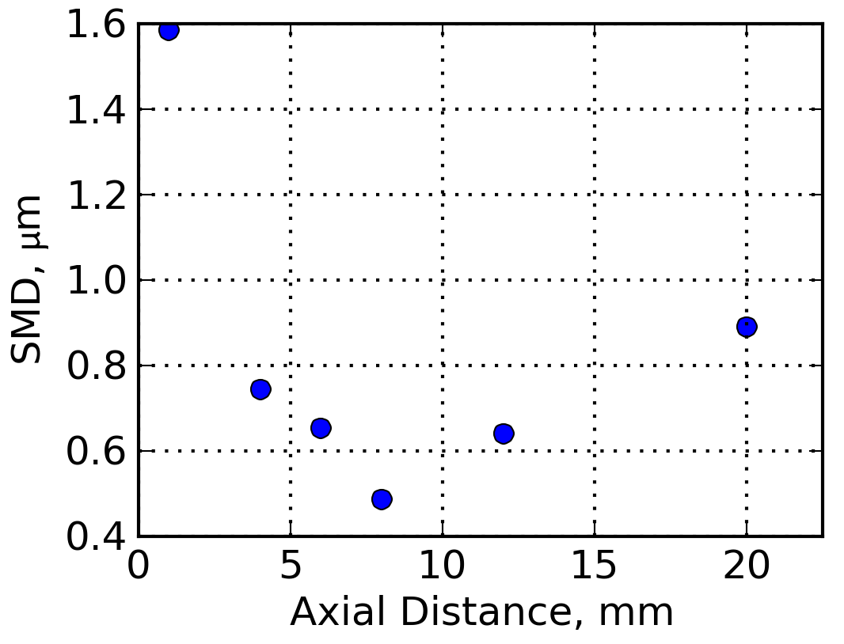
Topic 2: ECN 4: Grand Challenge
Experiments and simulations to work together and identify means to transition from EE to LE models (since topic 1.3 and topic 2 were mostly LE)
This is not a new problem, researchers have attempted these transitions before, but the transitions seem rather empirical in nature and lose fidelity from the EE calculations
Perhaps long-distance microscopy and droplet size measurements can aid in the development of such models
IFPEN Calculation
Argonne X-ray experiments

Slide 9
Topic 2: RECOMMENDATIONS FOR ECN≥3
SIMULATIONS
A more accurate chemistry model is needed
Subtopic for ECN4?
Why not testing spray A with a fuel with a better known chemistry, e.g. n-heptane?
Well-mixed model issue less accurate predictions of ID/LOL than TCI ones
BUT more validation is needed to fully discern prediction capabilities regarding
Velocity field (PIV), FL, Penetration

Slide 10
Topic2: RECOMMENDATIONS FOR ECN≥3
SIMULATIONS
Inert vs reacting spray
Always simulate an inert case as a baseline upon which the reacting case can be compared
This can rule out differences due to spray mixing
Soot models need to be investigated with a closer look at the combustion model
LES contributions are welcome
NOZZLE FLOW
NEAR NOZZLE
EVAPORATIVE SPRAY
COMBUSTION
SOOT

Slide 11
Topic 2: RECOMMENDATIONS FOR ECN≥3
EXPERIMENTS
Any technique that delivers information on local temperature/composition under reacting condition is welcome!
More 2D Information is essential
More extensive radiation measurements
Closer look into soot-radiation link
ANALYSIS FROM EXPERIMENTS+MODELLING
Are we able to describe the spray flow time evolution?

Slide 12
Topic 2: RECOMMENDATIONS FOR ECN≥3
ADDITIONAL IDEAS
After EOI flame dynamics
DB extension with multiple injections/larger orifice size

Slide 13
Topic 2: future directions?
Multiple injections
Spray A 0.3/0.5/1.2 (4)

Slide 14
Topic 2: future directions?
Multiple injections
IFPEN 2009

