Slide 1
ECN3: Spray G Geometry
Yongjin Jung (KAIST)
Peter Hutchins (Infineum)
Third Workshop of the Engine Combustion Network,
Ann Arbor, Michigan, Apirl 2014

Slide 2
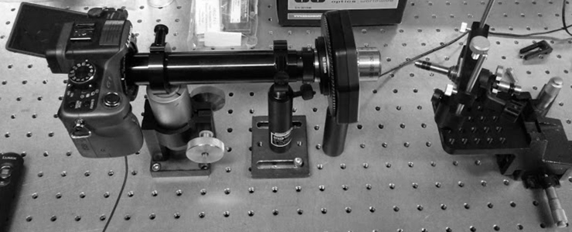
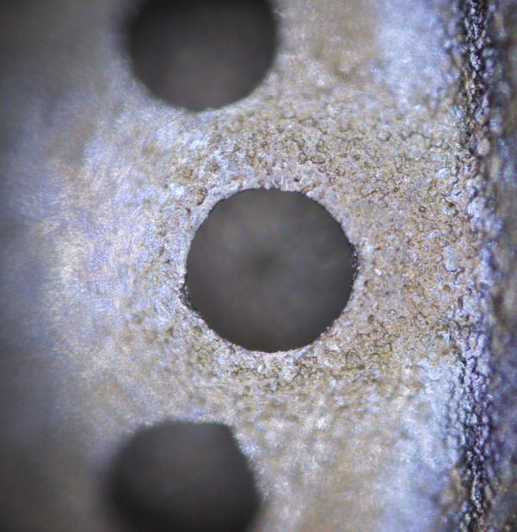
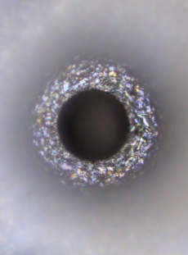
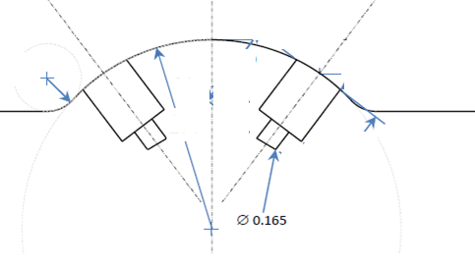
Microscopy installation and Images
Setup for Microscopy
Microscope objective
Lens: Plan Apochromat Objective (Edmund), 10X
Entire Image size: 4000x3000
Spatial resolution
: ≈ 2.34 pixel/μm
Injector
spray G
Digital
camera
(4000x3000)
LED
light
Inner hole
Outer
hole
Schematic of cross sectional area

Slide 3
Inner diameters
Φ 0.165
Inner
diameter
in specification

Slide 4
Outer diameters
Φ 0.388
Out
diameter
in specification

Slide 5
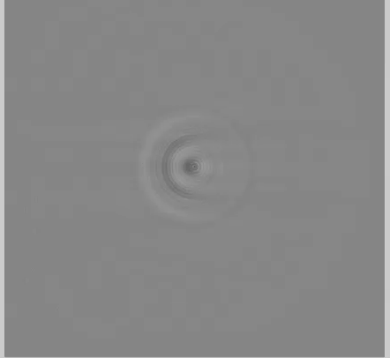
X-ray Phase contrast images
1.
2.
2.
Higher
Lower
Peter Hutchins
1 deg. rotation (counterclockwise)
Median filter (3,3)
Reconstruction

Slide 6
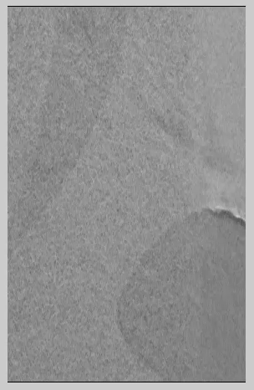
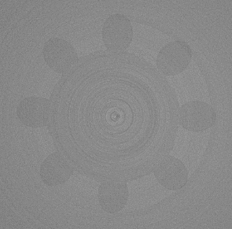
Cylindrical inner orifice
Perspective from top to bottom right-inner orifice
The inner orifice is almost cylindrical. (little reverse k-factor)
Calculation of the diameter based on the images will be performed.
Orientation, and voxel size are required to know.
sac
Top
Middle
Bottom
Inner
orifice
Inner
orifice
Inner
orifice
Notes:
Pictures of the different facilities

Slide 7
