Slide 1

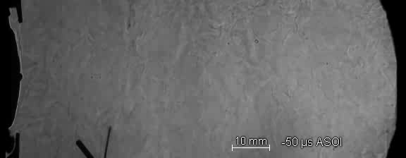
ECN3
Introduction
Lyle Pickett (Sandia), Gilles Bruneaux (IFPEN), Raúl Payri (CMT)
4-5 April 2014
University of Michigan

Slide 2
We sincerely thank our sponsors and organizers
University of Michigan
  Dave Reuss, Volker Sick, Kathy Owens and many other UM staff
Session coordinators
  Sibendu Som (Argonne), Diesel Topic 1: Internal Flow, Near-Nozzle Break-up, Mixing, and Evaporation
  Jóse M. García-Oliver (CMT), Diesel Topic 2: Mixing/chemistry interaction
  Scott Parrish (GM), Gasoline Spray G
  Dave Reuss (UM), Engine Flows and Combustion
You (and your sponsor)!
Your participation and expert analysis, most of it during many weeks before this meeting, will make the workshop worthwhile.

Slide 3
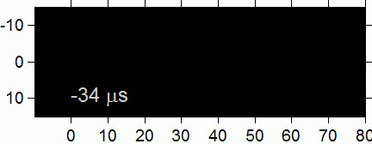
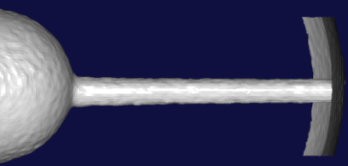


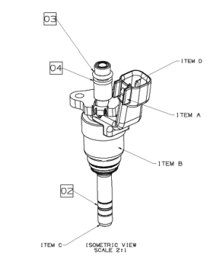
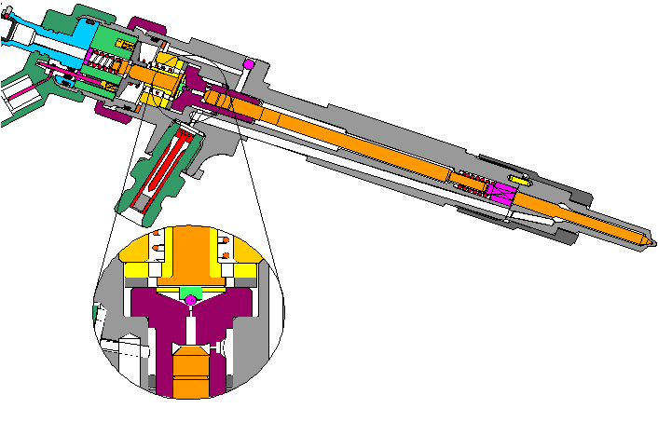
What is the Engine Combustion Network?
ECN collaborative research at engine-relevant
target conditions → predictive modeling
Other Targets:
Injector
Ambient
Spray A
900 K, 60 bar
Spray B (3-hole version of Spray A).
Gasoline (Spray G) and engine flows (Spray G).
Spray H (baseline n-heptane)
Spray C with cavitation (in progress)
90° C, 1500 bar
Internal nozzle
geometry
Leverages the development of quantitative, complete datasets.
  New (unique) diagnostics build upon past understanding, rather than starting over.
  Moves from “qualitative” to “quantitative”.
  Sharing results/meshes/code/methods saves time and effort.
Pathway towards predictive spray and engine CFD
Notes:
3
C:\pickett\ECN\sprayA\schlierenMovie.m jklda035.avi We have the world’s experts in sprays sitting here amongst us, but we won’t talk about individual research in a vacuum. The strength of the ECN is to connect it with joint modeling and experimentation.

Slide 4
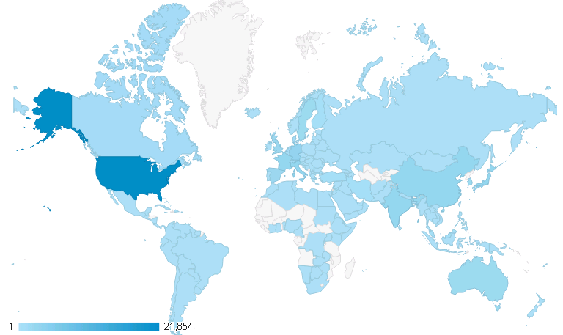
A truly international research effort
Contributed experimental data at ECN target conditions (15)
Will contribute soon
Eindhoven
Infineum
Chalmers
Aachen
MTU
IFPEn
GM
SNU
Sandia
Argonne
CMT
Top 10
CAT
KAIST
Ga Tech
Ist. Motori
United States
Germany
Italy India China Japan France United Kingdom Spain Australia
Meiji
SJTU
UNSW
Melbourne
ECN website visits since 2010 by country
(www.sandia.gov/ECN)

Slide 5
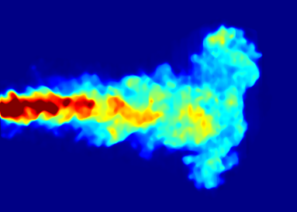
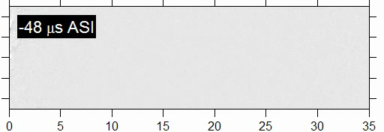

Leveraging target conditions greatly accelerates research
Spray A experiment: >30 different measurements by >10 different institutions
  ~15 years of research performed in ~3 years
Simulations for Diesel Spray Topic 1 at ECN3 using DNS, LES, RANS
  Internal Flow, Near-Nozzle Break-up, Mixing, and Evaporation
  Collective expense > 1 Million CPU hrs
Soot fv, size
LII, TEM
IFPEN, Sandia, Meiji
Nozzle geometry
Sandia/CAT/Argonne/Infineum/ESRF
Combustion structure
CH₂O & OH LIF
IFPEN, TU/e, Sandia
Needle lift motion
Xray, Argonne
Temperature
Liquid size
Liquid vol. fraction, dense spray structure
Radiography, ballistic imaging, microscopy
Argonne/Chalmers/
Sandia
Other species
Fuel concentration
Rayleigh
Sandia
Already available on the website
Velocity
PIV, IFPEN
Exp. Done, to be published
In progress
Considered
Standard: liq & vap penetration, lift off, AI
Mie/Shadowgraphy/Schlieren
Sandia/IFPEN/CAT/CMT/TUe
Notes:
5

Slide 6
What is the spirit of ECN?
A forum for open discussion and synthesis of modeling and experimental results, not usually found at conferences.
  Synthesis creates expert reviews on topics.
  We want to know what does NOT work, what is broken.
  Airing our dirty laundry….so that it can be cleaned!
  Policy is to not duplicate conference (SAE) presentations.
  Not highlighting individual laboratories or groups, but rather, common research problems.
ECN

Slide 7
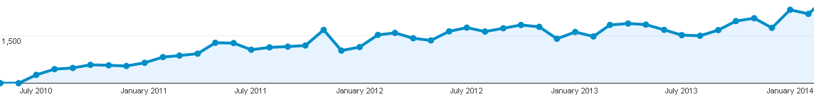
History of the ECN
ECN3: Apr 2014
120 participants
Website
visits/month
ECN2: Sept 2012
104 participants
ECN1: May 2011
53 participants
ECN1: Provide a standardized configuration
  Facility temperature distribution of gases and fuel is critical.
  Ignition and lift-off length measurements are consistent with different types of HP-HT facilities—datasets can be linked.
ECN2: Leveraging of advanced diagnostics
  Internal geometry characterizations/microscopic near field visualizations/Argonne liquid mass characterizations are consistent
  Sandia mixture and IFPEN velocity provide a consistent database
  Main scientific challenges identified, new organization of ECN Topics
Will ECN3 make significant progress towards our understanding of engine spray combustion?

Slide 8
ECN has met many objectives for new quantitative datasets at engine conditions
A few examples of world-first experiments at difficult conditions representative of engine spray combustion:
  Nozzle internal geometry and needle-valve movement
  Near-nozzle mixture fraction or liquid volume fraction
  Vapor-phase mixture fraction and velocity
  Radical species formation visualization
  Extinction imaging and LII for soot volume fraction
Intensive experimental and modeling comparisons are underway
  Standardized combustion indicators as well as detailed structure
  State of the art CFD approaches with research codes and commercial software

Slide 9
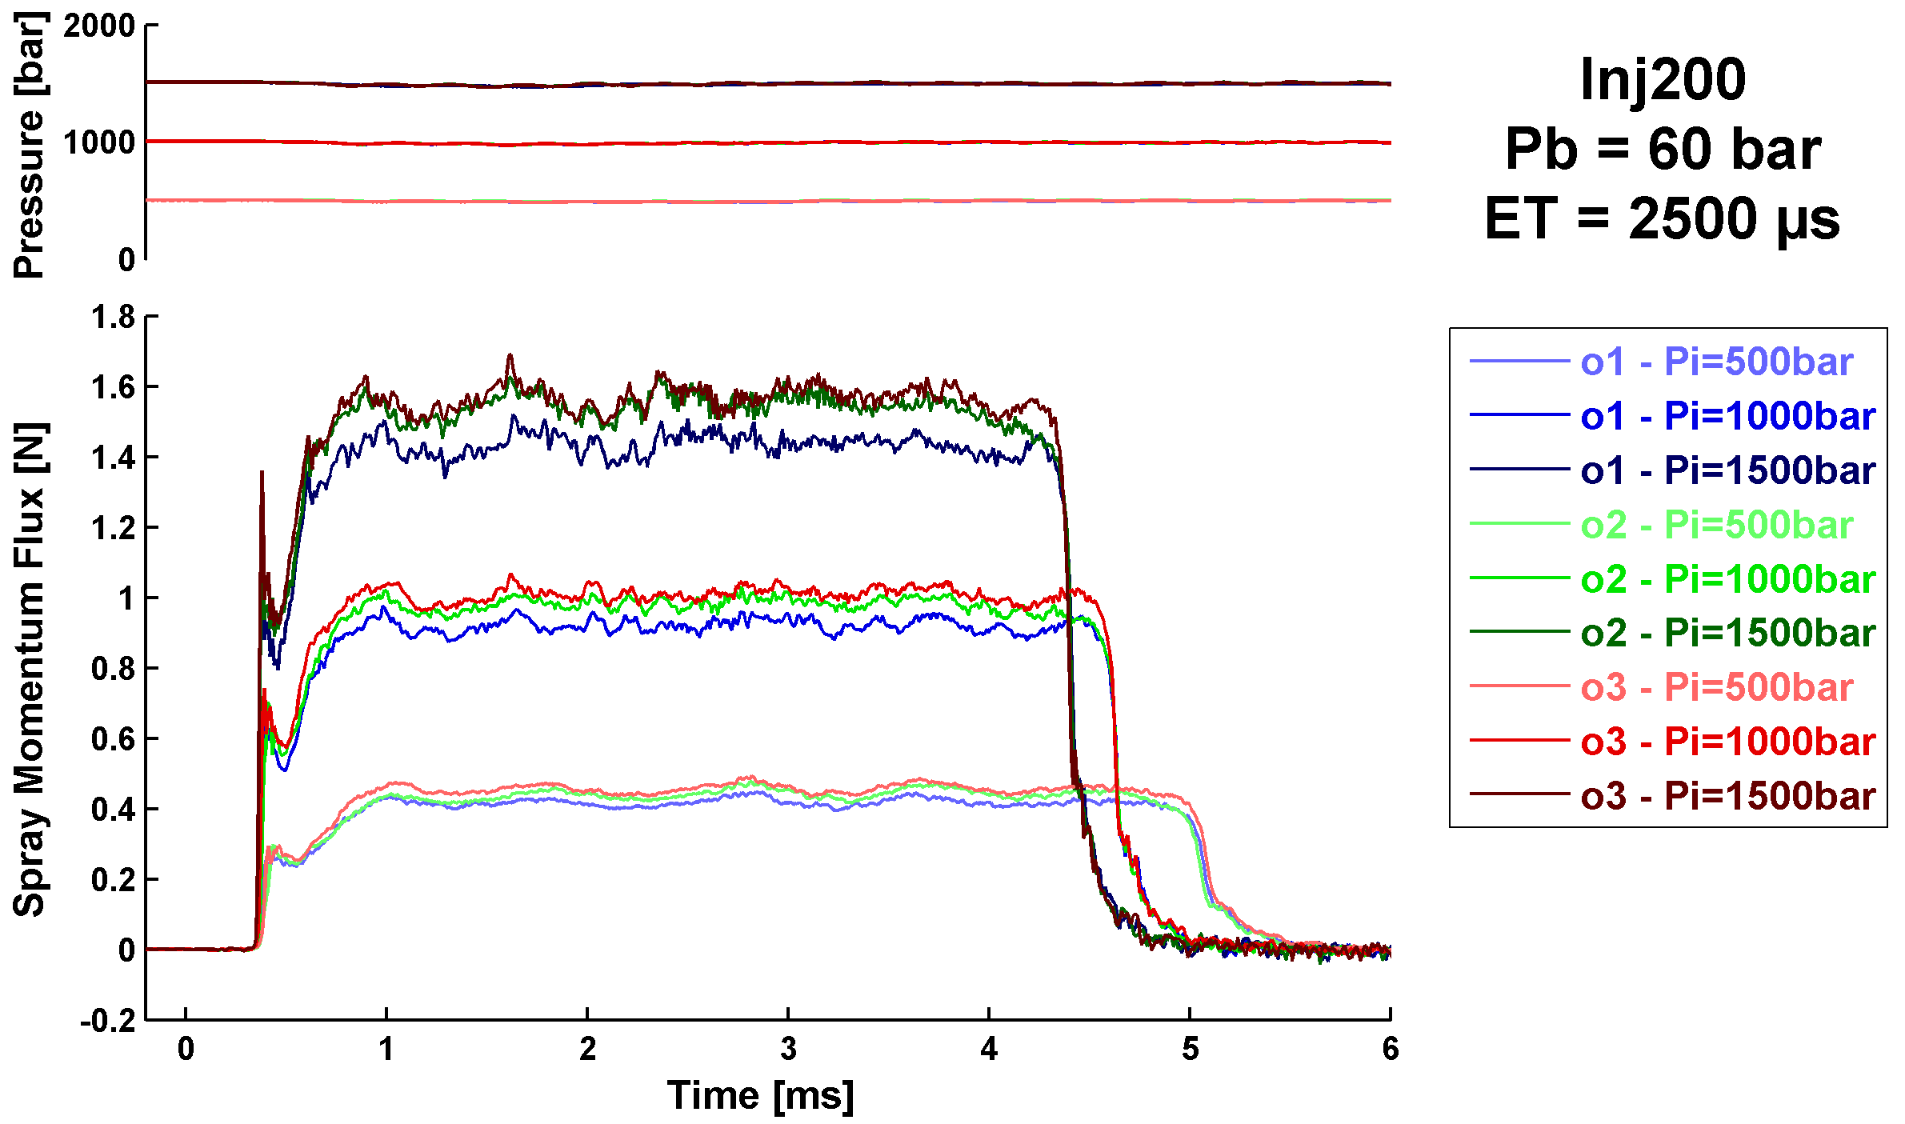
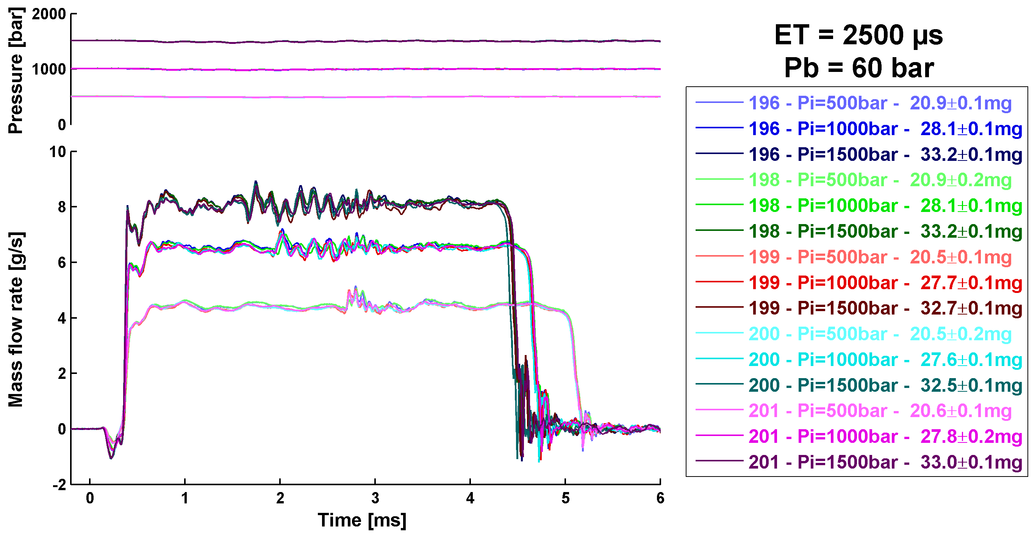
ECN Hydraulic characterization
At ECN2 we discovered that our injectors were not “equal”
For ECN3 we want to understand the subtle differences between injectors so that exact geometry and hydraulic characterization is done in advance for all the injector samples (spray “B” and Spray “G”)
Common injection rate for all modelers (virtual injection rate generator)

Slide 10
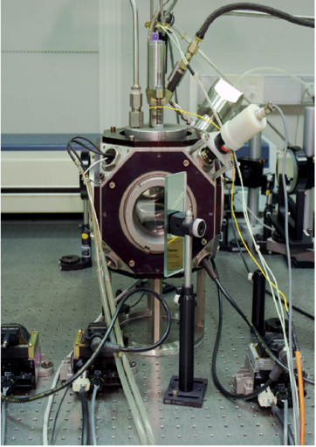
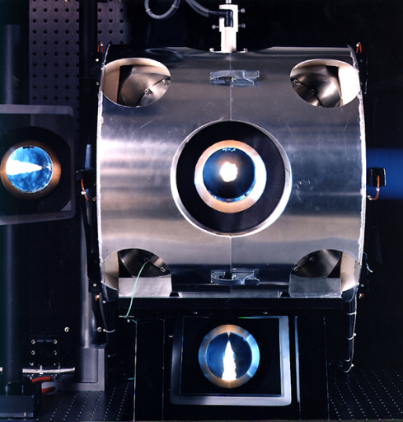
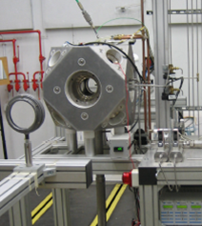
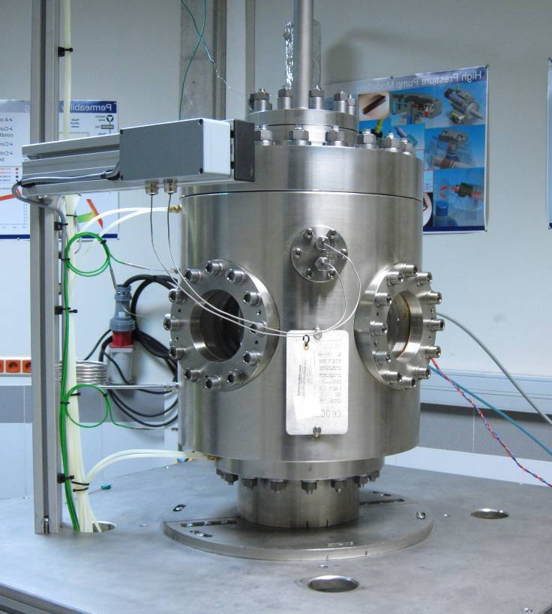
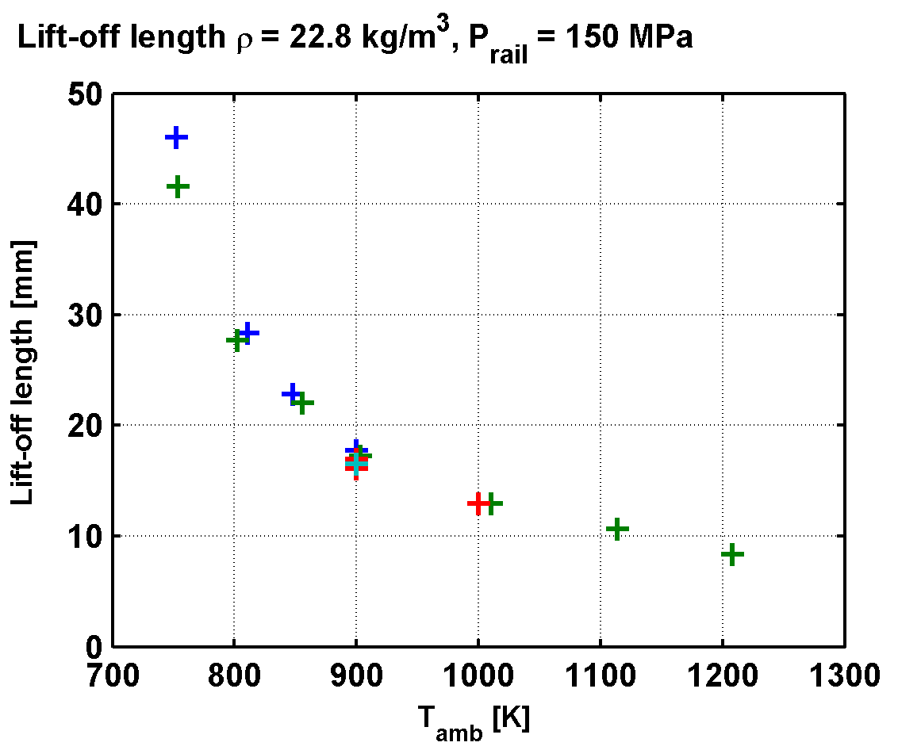
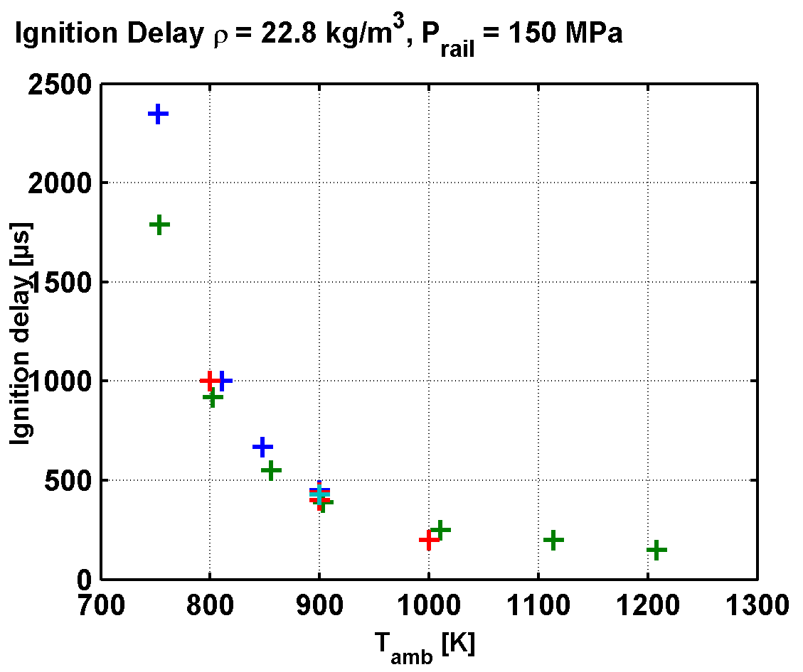
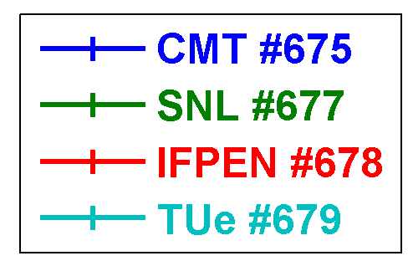
Ignition and lift-off length measurements are consistent for different types of HP-HT facilities.
IFPEn
SNL
TU/e
CMT

Slide 11
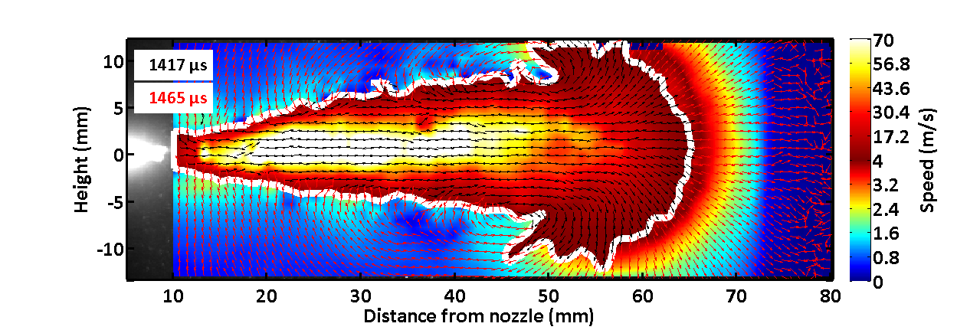

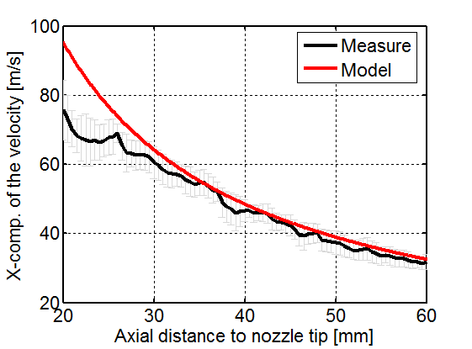
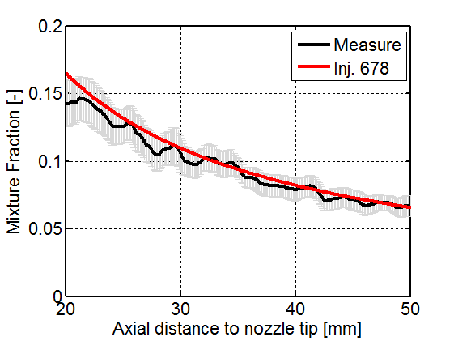
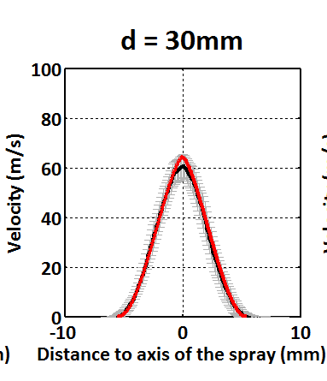
Consistency of mixture and velocity measurements
PIV: Velocity (IFPEN)
Rayleigh: mixture fraction (Sandia)
Boundary Conditions
+
Vapor angle
from ECN Spray A
Spray Model

Slide 12
An analytic model highlights the importance of the spray spreading (dispersion) angle on penetration and mixing
Spreading-angle impact on penetration
compared to experimental data.
Spreading-angle impact on mixture fraction compared with Rayleigh measurements in vapor phase region.
Bottom line: In current CFD codes, the effective spreading angle is not predictable and usually requires substantial tuning of model constants.
Future emphasis:
  How can this dispersion be made more predictive?
  What happens inside the nozzle and in the near field?
Notes:
First time that penetration, spreading angle, mixture fraction connection has been demonstrated.

Slide 13
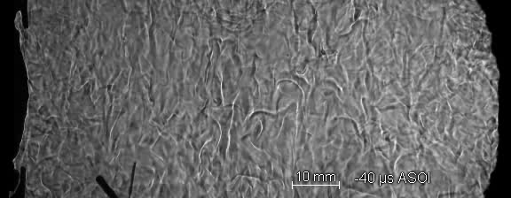
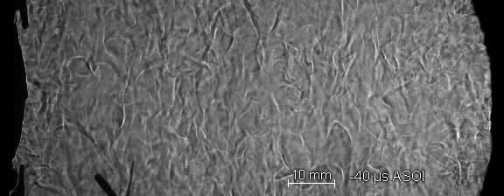
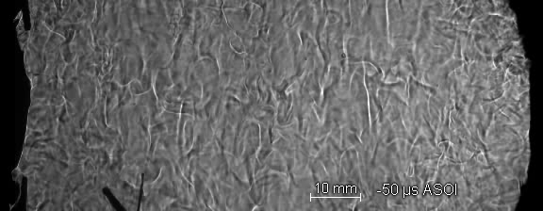
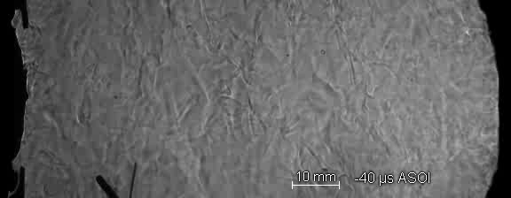
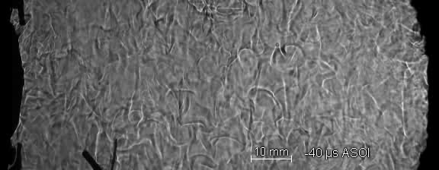
Models are compared against parametric variations about Spray A dataset (CMT)
“low-sensitivity” schlieren
900 K, 60 bar, 15% O₂
Injector 210675
1500 bar
Inj. P
Amb. P
300 bar
60 bar
750 bar
40 bar
1250 bar
20 bar
Benajes J., Payri R., Bardi M., and Martí-Aldaraví P., ATE 2013
www.sandia.gov/ECN, download movies at www.cmt.upv.es/ECN10.aspx
Notes:
Purposely adjust size of light source and large schlieren stop.

Slide 14
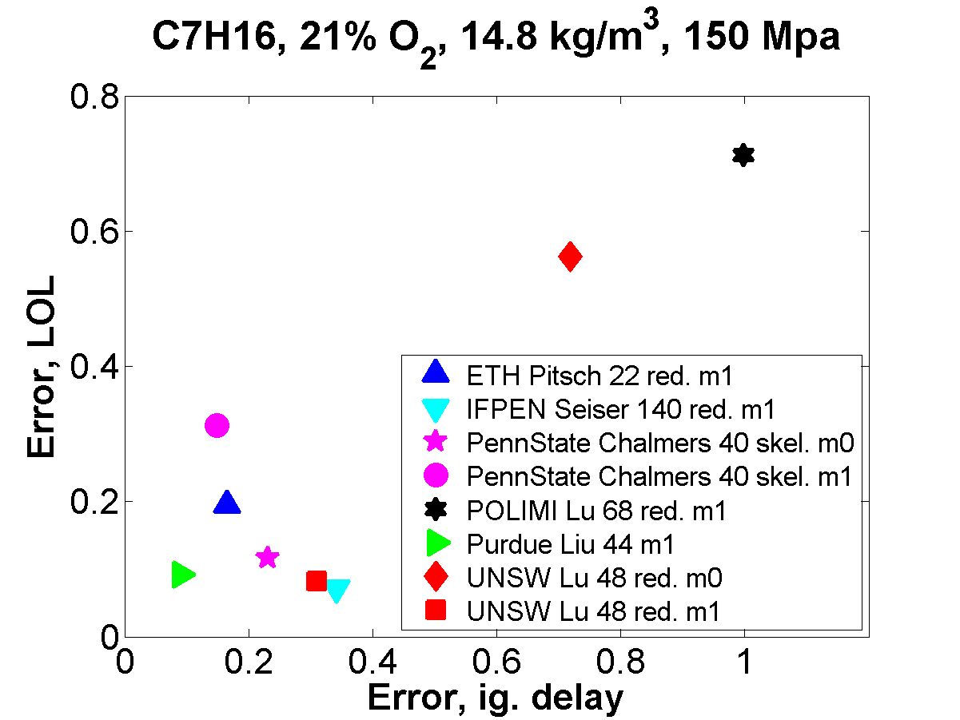
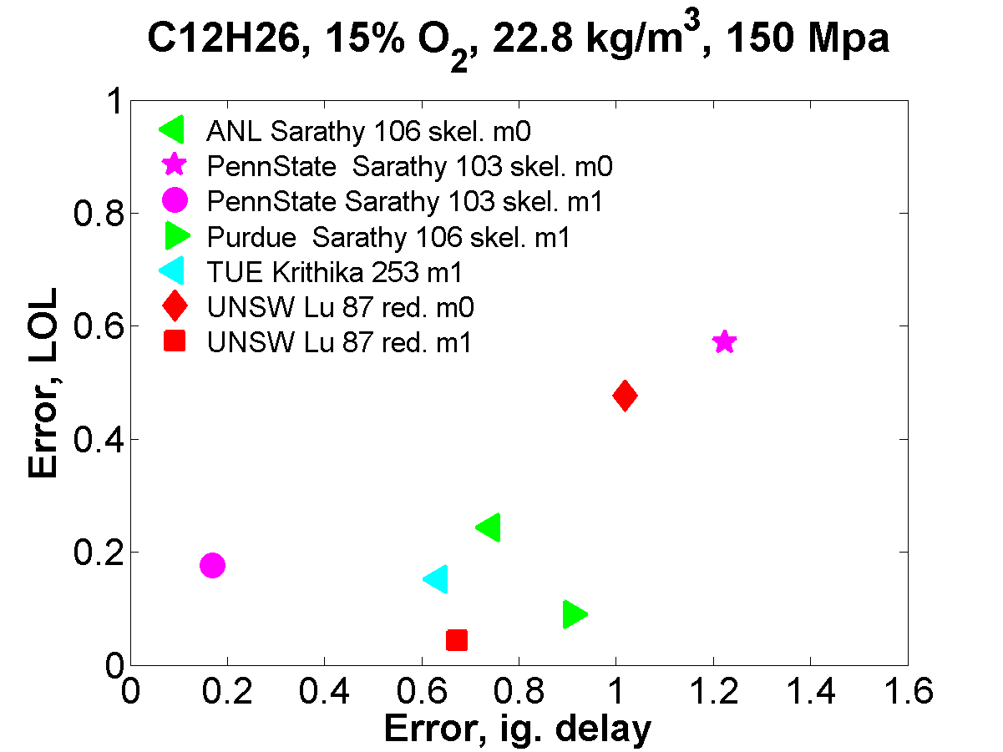
ECN2 parametric variations show modeling improvement, but no superior combustion model.
Well-mixed
Well-mixed
pdf
pdf
Difficult to achieve predictive ignition delay and lift-off length.
  Lift-off length predictions better than ignition delay.
  Predictions better for n-heptane than n-dodecane.
Serious questions remain about the chemical mechanisms and combustion models.
  More advanced combustion models (pdf) show improvements for one set of data, but not others.
  Errors of 20-40% could easily translate to sooting vs non-sooting sprays.
No ignition at 900 K at ECN1 !

Slide 15
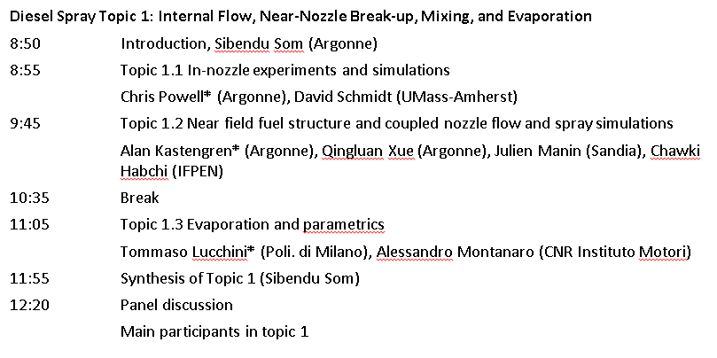
ECN3 objectives and program
How does internal flow, near-nozzle break-up, mixing, and evaporation, ultimately affect mixture preparation?

Slide 16
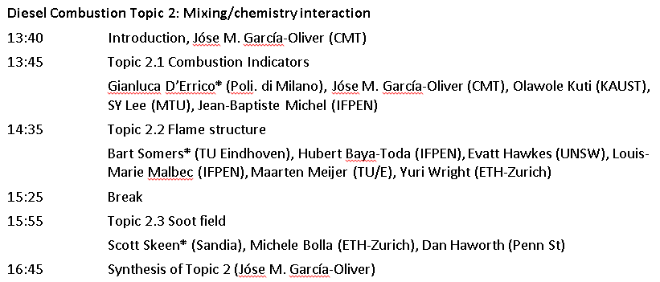
ECN3 objectives and program
How do mixing/chemistry interactions affect ignition, flame lift-off, flame structure, and soot processes?

Slide 17
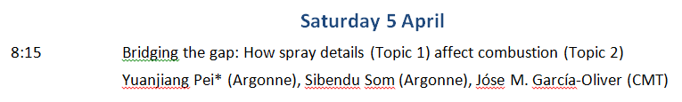
ECN3 objectives and program
What details of the spray preparation actually affect combustion?
ECN Methodology
Look back!
Nozzle flow
Near Nozzle
Evaporative sprays
Combustion

Slide 18
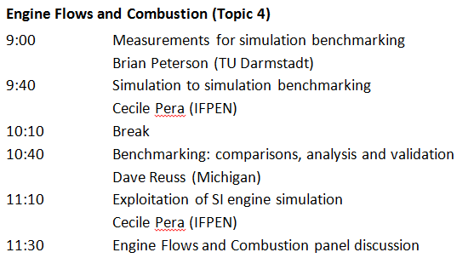
Putting the “engine” into the ECN
Spray B and Spray G will both go into engines.
Results in stationary spray vessels will be compared to that in engines.
What minimum information is needed/required for useful (to CFD) engine experiments?
Can we explain the real sources for cycle to cycle variability?

Slide 19
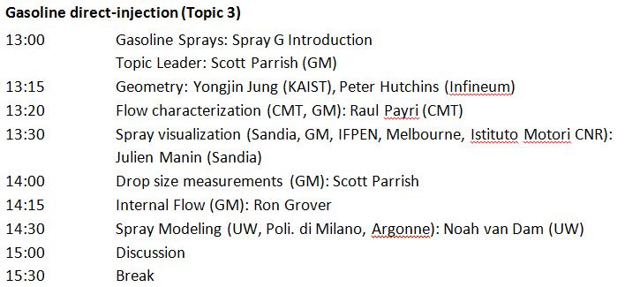
An inaugural event for Spray G!
Complexity of multi-hole gasoline sprays is challenging, requiring significant advances in modeling capability.

Slide 20
Message to all
ECN3 preparation involved a tremendous amount of work, hours of data analysis…
Collection of the data for presentation on the same graph is a major accomplishment, but identifying reasons for the differences is the key to progress.
Our message to session coordinators and co-organizers
  Let’s use ECN3 to look back at the original objectives and perspectives
  Provide a review and synthesis including past work before ECN3
  Draw conclusions comparing the achievements with the initial objectives
  Identify the most significant weaknesses in current modeling and experiment, and provide recommendations about how these weaknesses can be addressed.

Slide 21

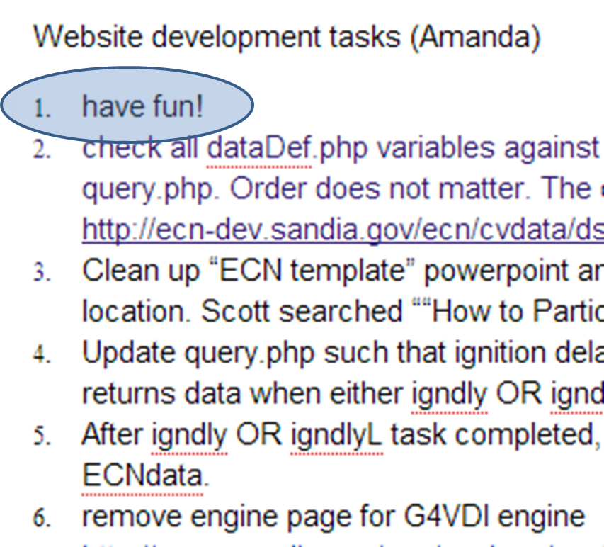
Other goals of the ECN: To have fun!

Slide 22
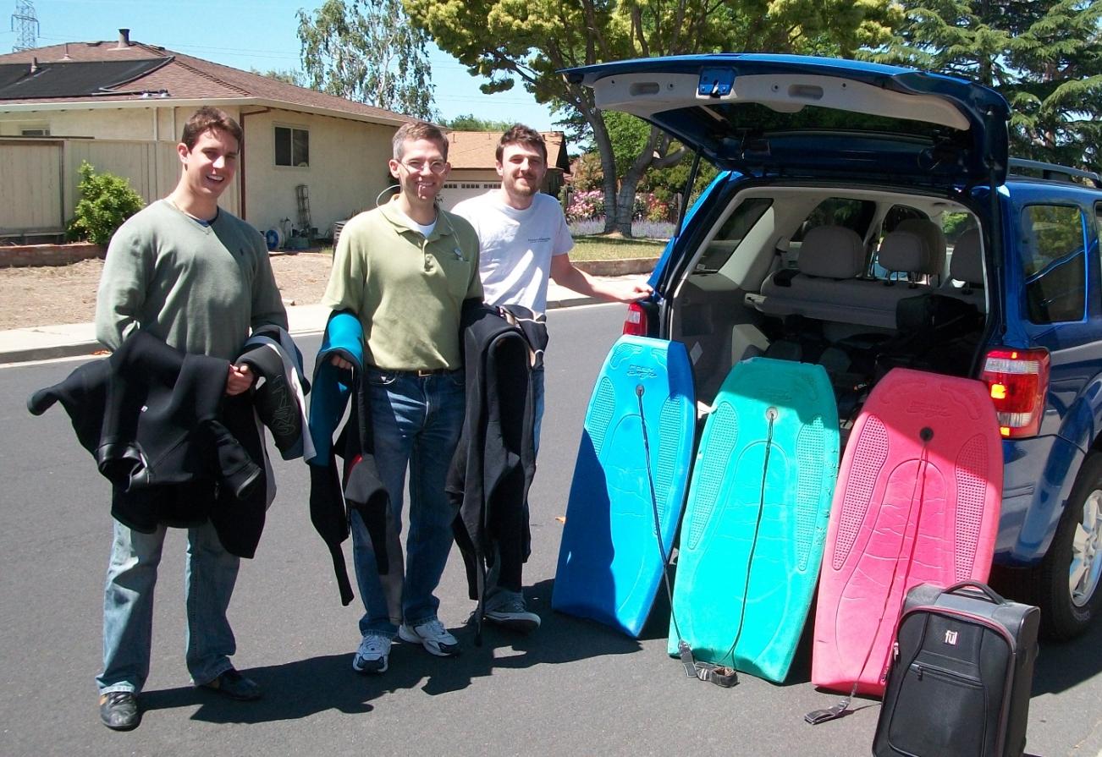
ECN OFFICIAL activities
ECN1: “Study of droplet breakup theory” on the beach!
  “Wind sensors” (volleyballs) needed to analyze shear flow and droplet stripping during wave roll-up
  Conclusion: more research is needed!

Slide 23
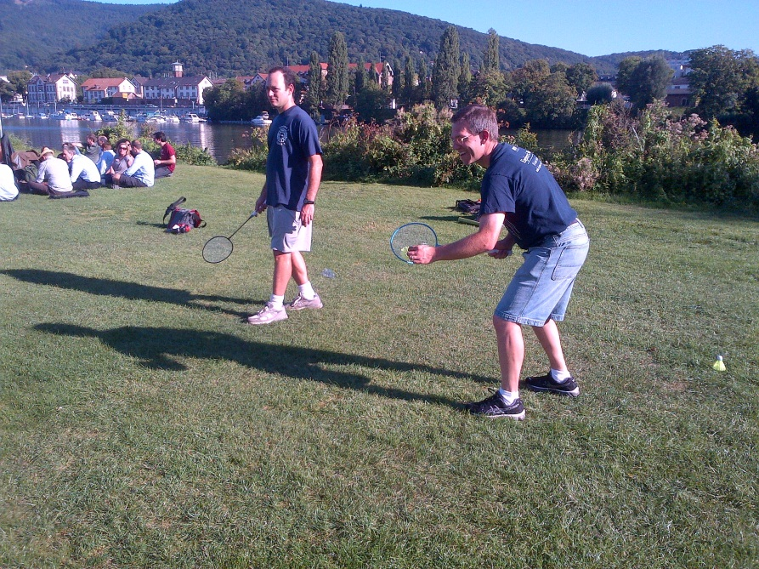
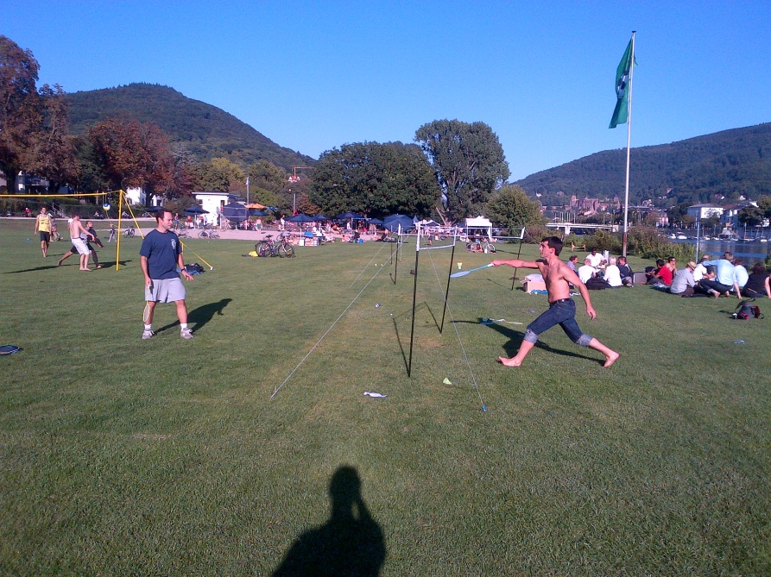
ECN OFFICIAL activities
ECN2: “Birdie/vortex interaction” on the river shore!
  Winner used to determine which facility was the “true” standard for Spray A research.
  IFPEN triumphed over Sandia
  Conclusion: Rematch challenge has been issued!

Slide 24
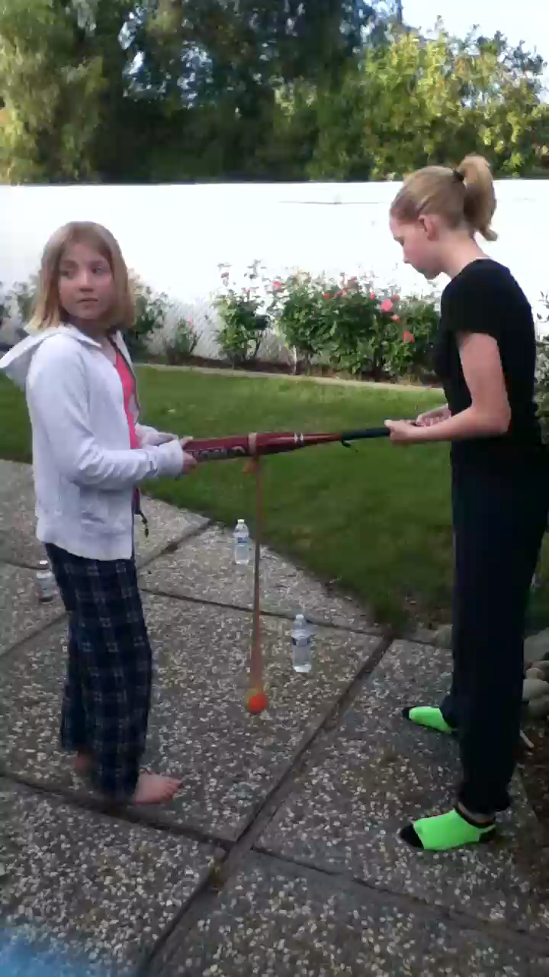
ECN OFFICIAL activities
ECN3: “ECN game theory” is last event on Saturday at 5 pm
  Baseball season just resumed in the U.S.
    precluded by Spring Training
  Don’t miss our version of “Spring Training”
  Designated as the way to settle any differences in opinion
  Winner takes ECN bragging rights, as well as an official UM baseball bat

Slide 25
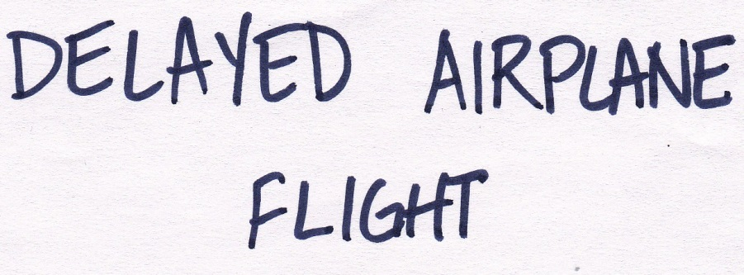
More fun at ECN3 “Game Theory”
Introducing “Telestrations”

Slide 26
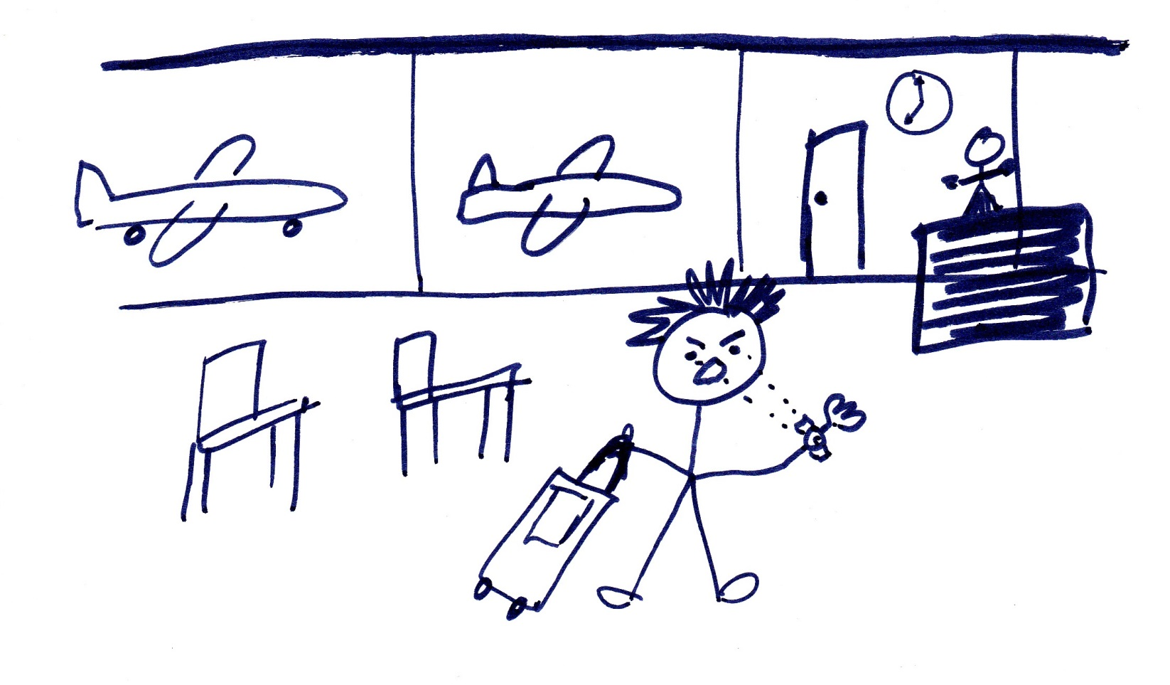
More fun at ECN3 “Game Theory”

Slide 27
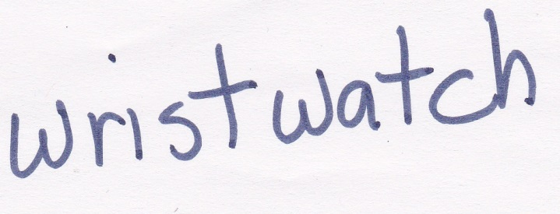
More fun at ECN3 “Game Theory”

Slide 28
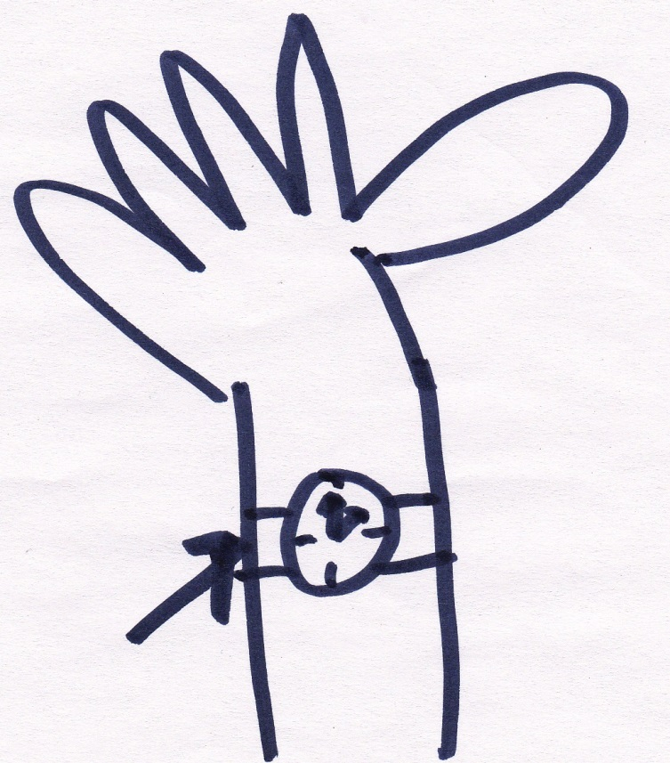
More fun at ECN3 “Game Theory”

Slide 29
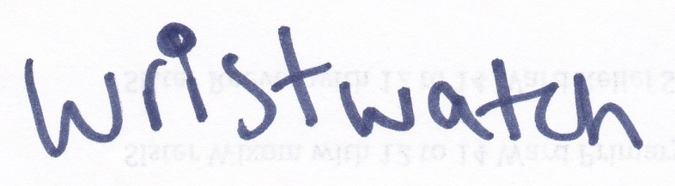
More fun at ECN3 “Game Theory”

Slide 30
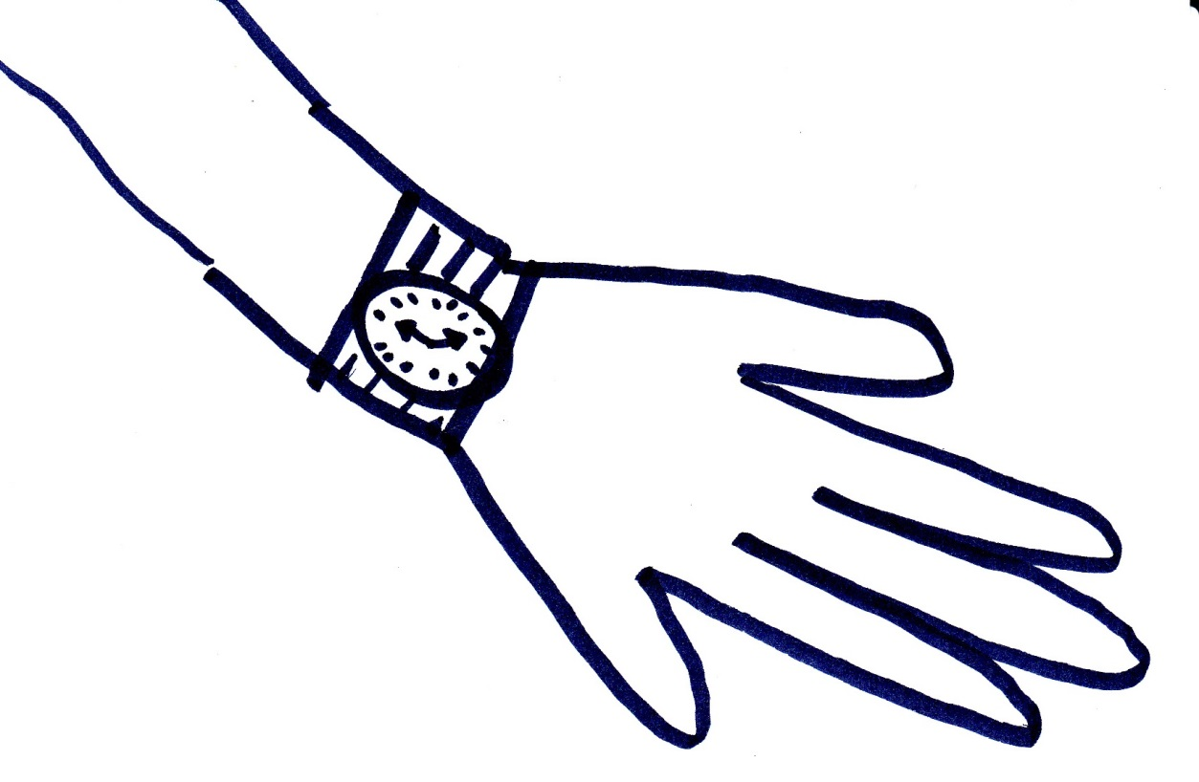
More fun at ECN3 “Game Theory”

Slide 31
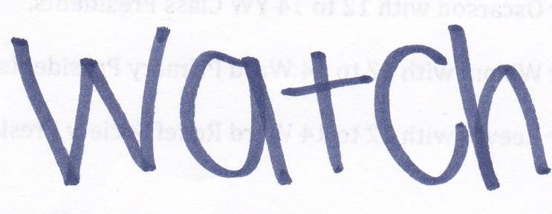
More fun at ECN3 “Game Theory”

Slide 32
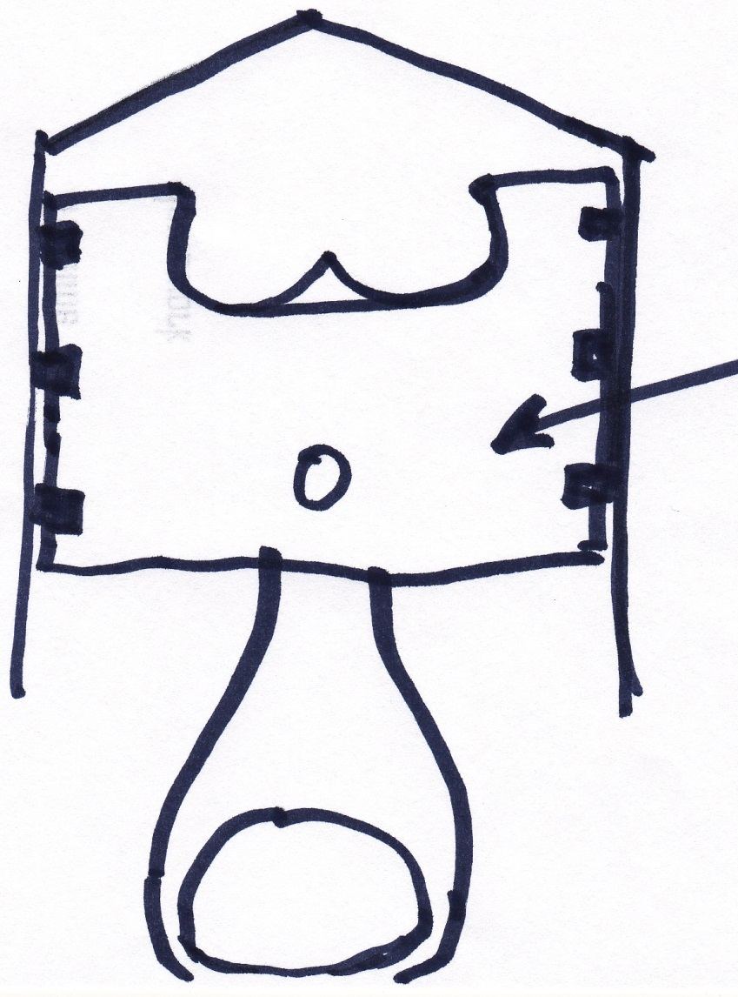
More fun at ECN3 “Game Theory”
Your turn:
What do you see?
Gilles Bruneaux:
  “A person wearing a Vietnamese hat”
  or “a piston”
My daughter:
  “Indoor goal”

Slide 33
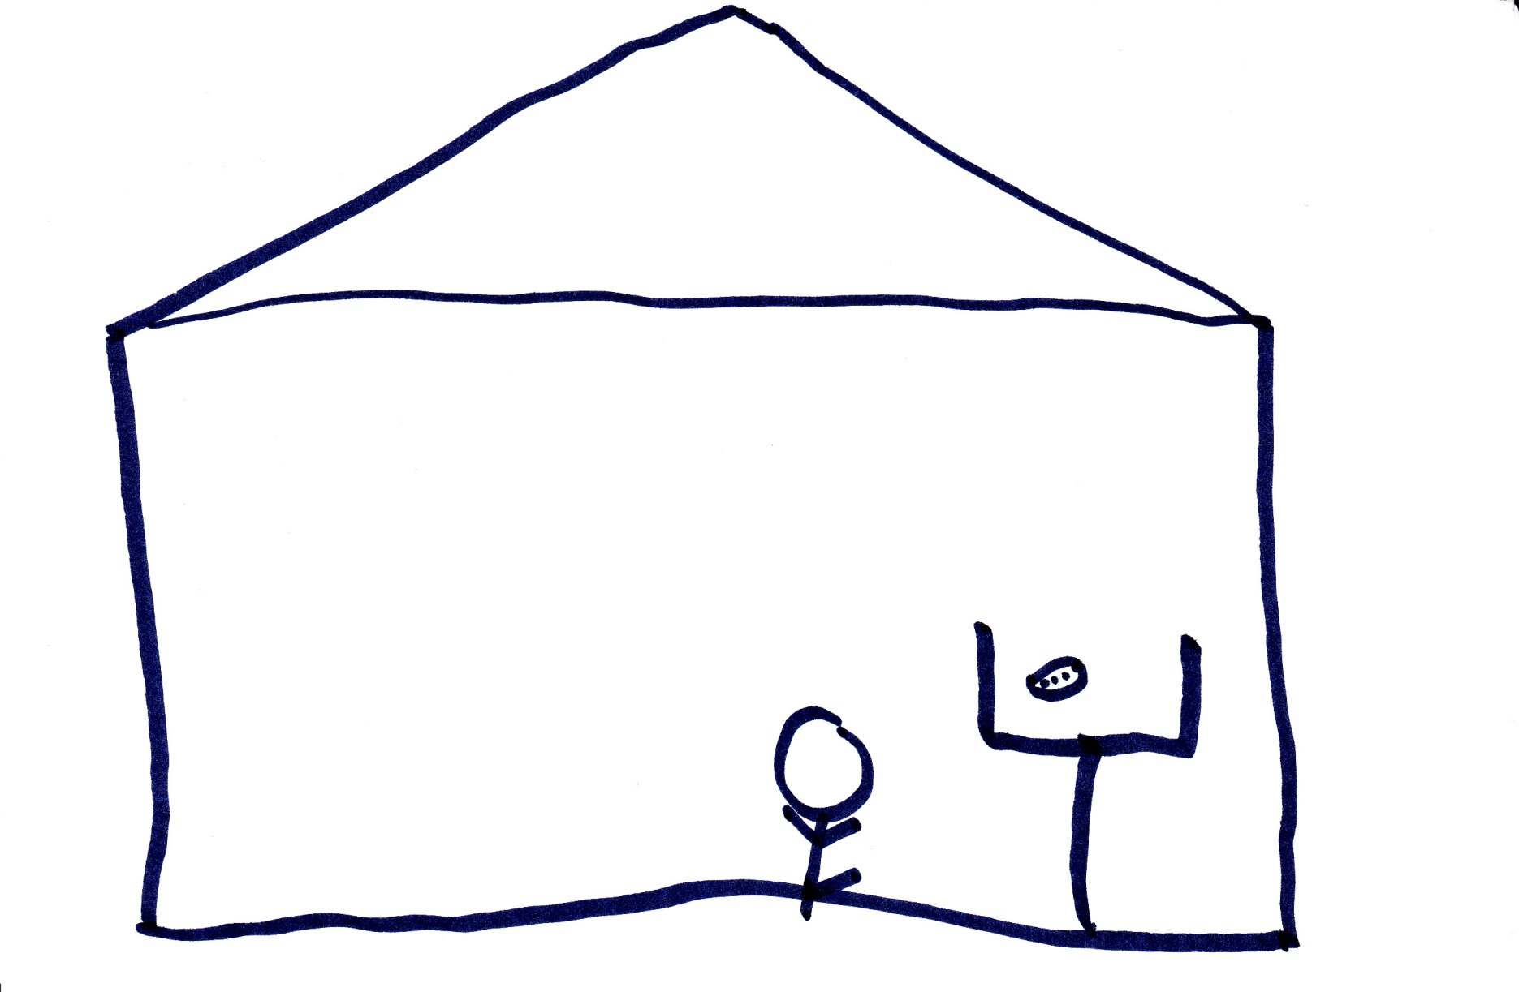
More fun at ECN3 “Game Theory”

Slide 34
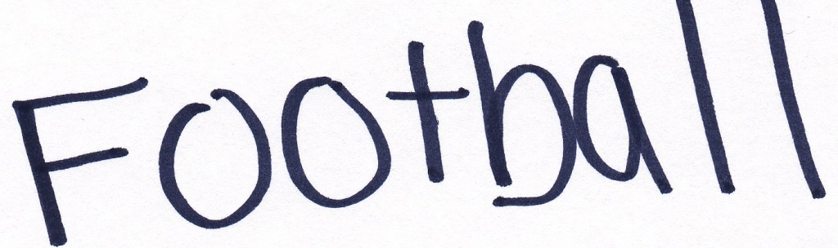
More fun at ECN3 “Game Theory”

Slide 35
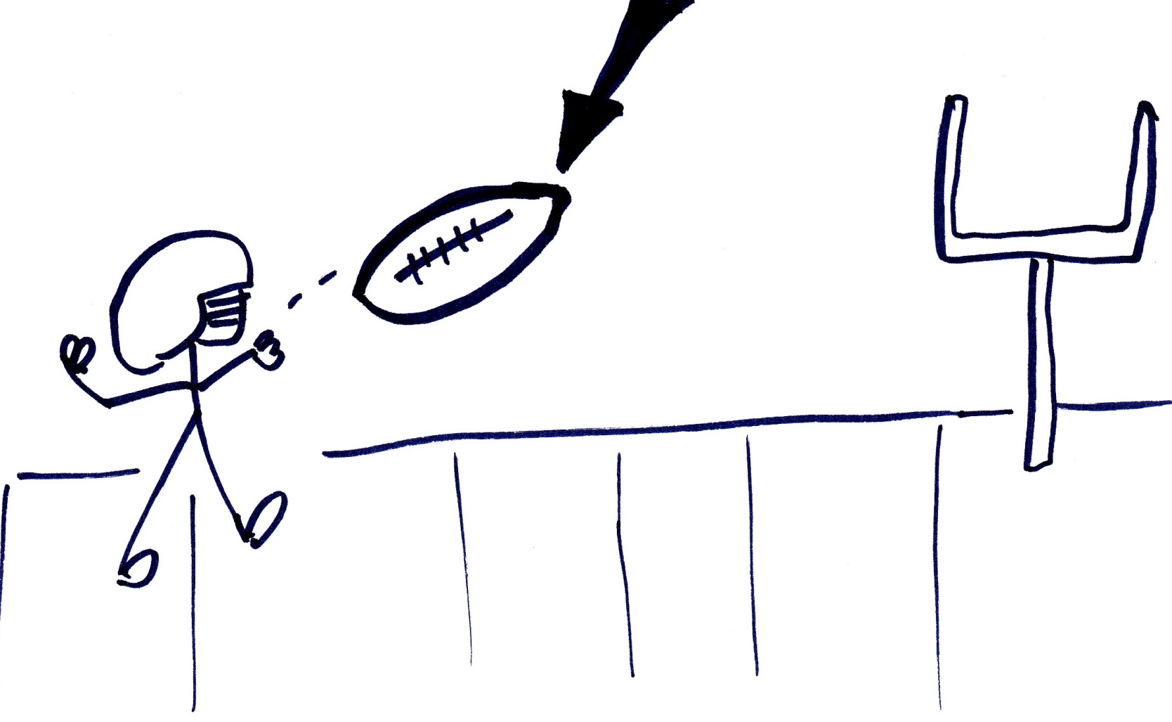
More fun at ECN3 “Game Theory”

Slide 36

More fun at ECN3 “Game Theory”

