Slide 1
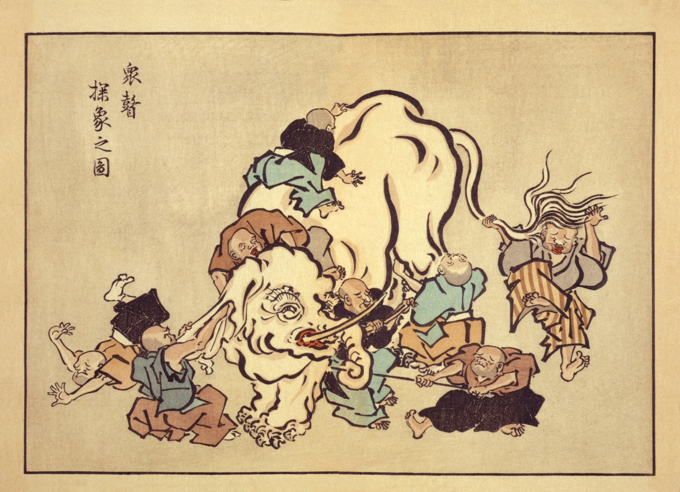
ECN Topic 1.1 Modeling Results
Compiled by David P. Schmidt
UMass Amherst
*Hanabusa Itchō (1652–1724)

Slide 2
Organization
Techniques
Spray A Early Injection
Spray A Main Injection
Spray B

Slide 3
Internal Modeling Codes
Institution | ANL | UMass | CMT | IFPEN | Sandia
Code | Converge | HRMFoam | Eulerian Spray Atomization | IFP-C3D | CLSVOF
Origin | Convergent Science | In-house | In-house | In-house | In-house
External Coupling | No for A, Yes for B | Yes | Yes | Yes | Yes
* Also included a few results from M. Bode, Aachen RWTH for a simplified geometry and lower Reynolds number

Slide 4
Approaches
Institution/Code | ANL Converge | UMass HRMFoam | CMT ESA | IFP C3D | Sandia
Liquid fuel | n-dodecane | n-dodecane | n-dodecane | n-dodecane | n-dodecane
Equation of State | Incomp. | Const. compressibility (input error!), perfect gas | Non-linear function of p,T, perfect gas | Stiffened gas EOS, ideal gas | Non-linear function of p,T, perfect gas
Cavitation Enabled? | Yes | No for A, Yes for B | No | Yes | No
Cavitation Model | Homogenous Relaxation | Homogenous Relaxation | -- | GERM | -
Inclusion of turbulent viscous energy generation? | N | N | Y | Y | N
Turbulence | RANS k-epsilon | LES one-eq. eddy | RANS SST k-ω | LES Smagorinksy | None
Spatial Discretization | 2nd order | 2nd / 1st order | 1st order | 2nd order | Cell-integrated semi-Lagrangian

Slide 5
Computational Domain
Institution/Code | ANL Converge | UMass HRMFoam | CMT ESA | IFP C3D | Sandia CLSVOF
Dimensionality | 3 | 3 | 2 | 3 | 3
Cell Type | Hex cut cell | Hex, polyhedral | Quad, polyhedral | Hex | Embedded boundary
Cell count (total interior and exterior) | 2.5M early, 0.8M main | 2.8M | 64K | 1M | 74M
Needle motion? | Yes | No | No | Yes (lift, no wobble) | Yes
Geometry | CNRS yearly, Same as last year for main | Same as last year | Last year(2D) | CNRS scan | Based on description

Slide 6
Boundary Conditions
Institution/Code | ANL Converge | UMass HRMFoam | CMT ESA | IFP C3D | Sandia CLSVOF
Time Accurate ROI Profile? | Yes | Yes | Yes | Yes | Yes
Inlet | Time varying total pressure | Time varying velocity | Time varying static pressure | Time varying static pressure | Fixed static pressure
Wall BCs | L.O.W. | Slip | No-slip | Slip | No-slip
Needle motion? | Yes | No | No | Yes (lift, no wobble) | Yes

Slide 7
Spray A Early Injection
Submissions by
Sandia, Marco Arienti
ANL, Michele Battistoni, Qingluan Xue, Sibendu Som
IFP, Chawki Habchi, Rajesh Kumar

Slide 8
Early Injection
A subset of the contributors submitted results that focused on the details of:
early needle lift
air ingestion
the start of fuel flow
trapped air

Slide 9
Needle-Filling Movies by IFP
Noted how fuel follows the needle surface into the sac

Slide 10
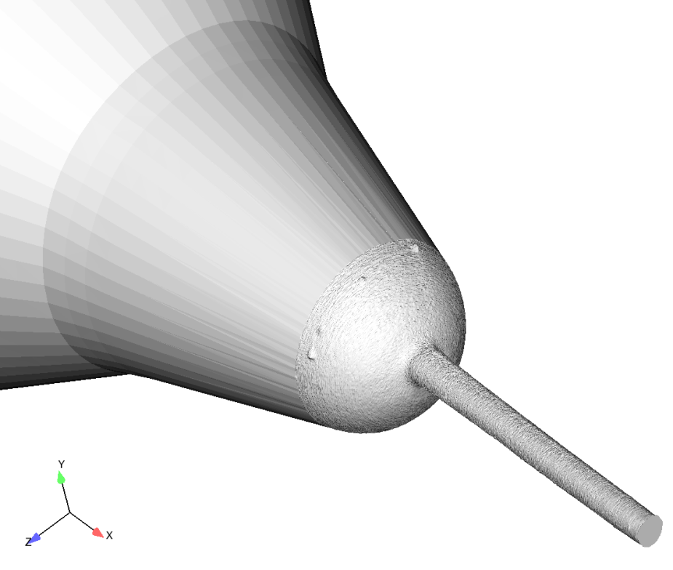
ANL Results
LIFT
CNRS stl file for sac and nozzle
210675
Simulation starts at 200 µs (4 µm lift)
Ends at 400 µs

Slide 11
Notes:
ANL Results
Based on End-of-Injection studies, the sac is likely to be filled with ambient gas, resulting from a previous injection event.
Spray A penetration starts at ~310 µs after command
Needle rises slowly until ~310 µs after command; afterwards steep rise

Slide 12
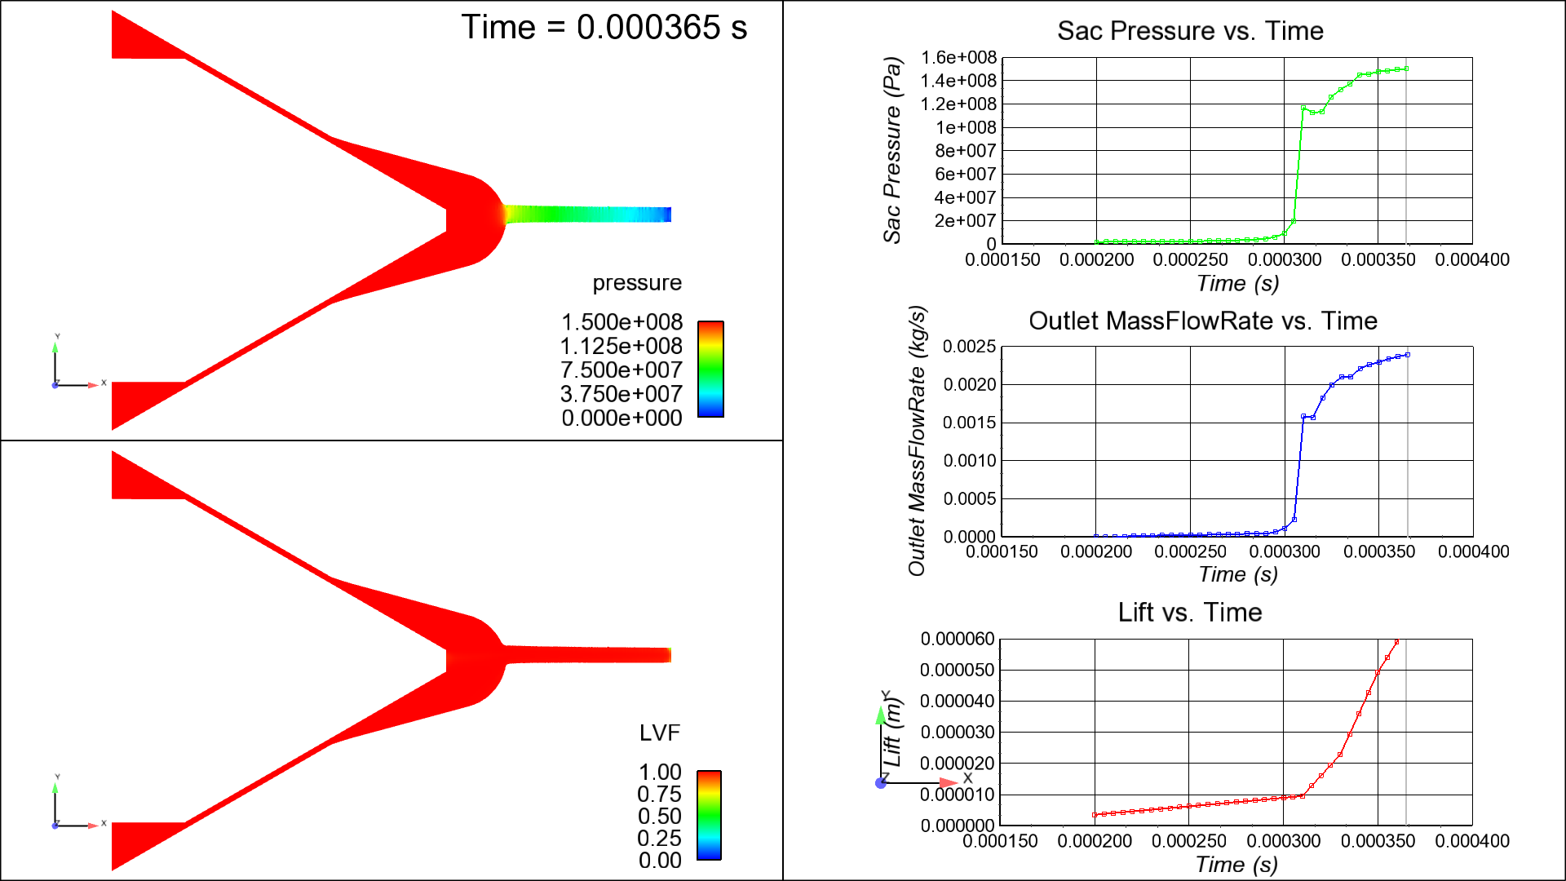
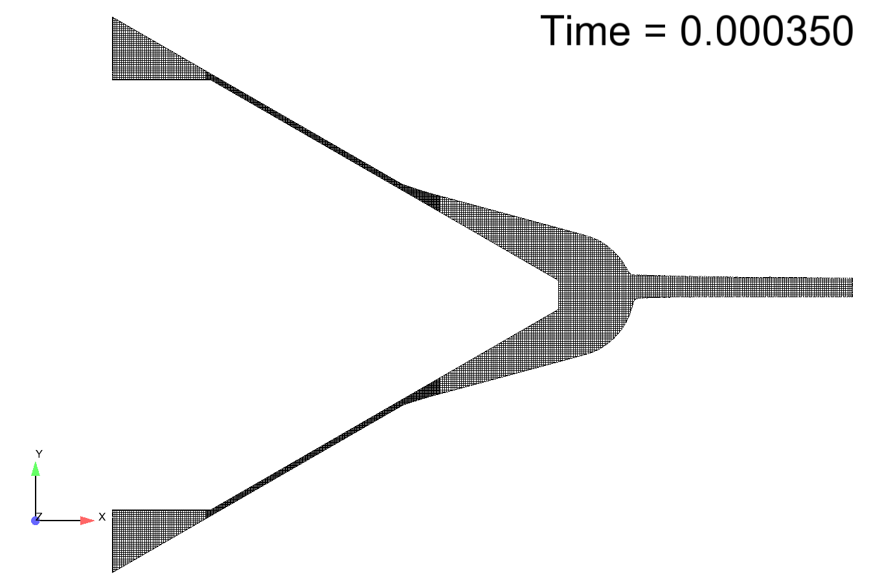
ANL Results

Slide 13
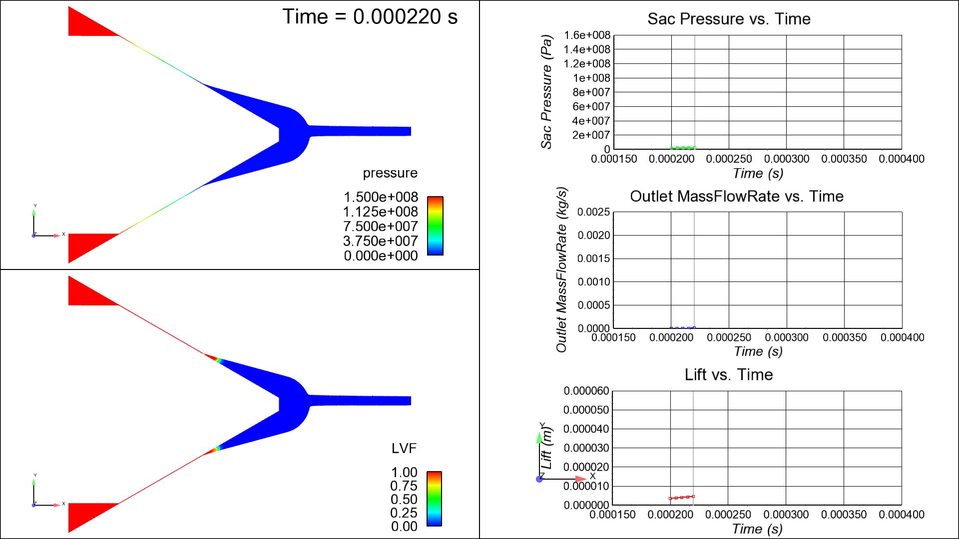
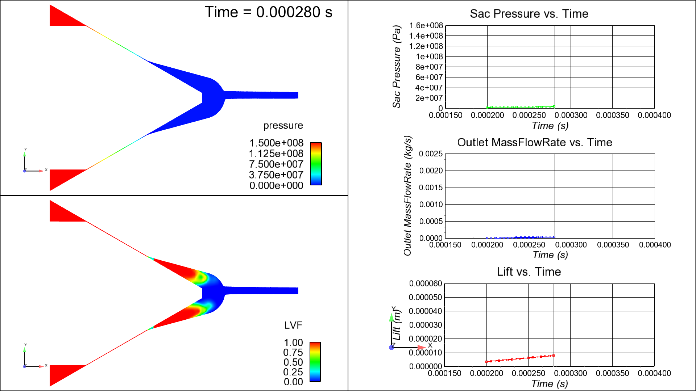
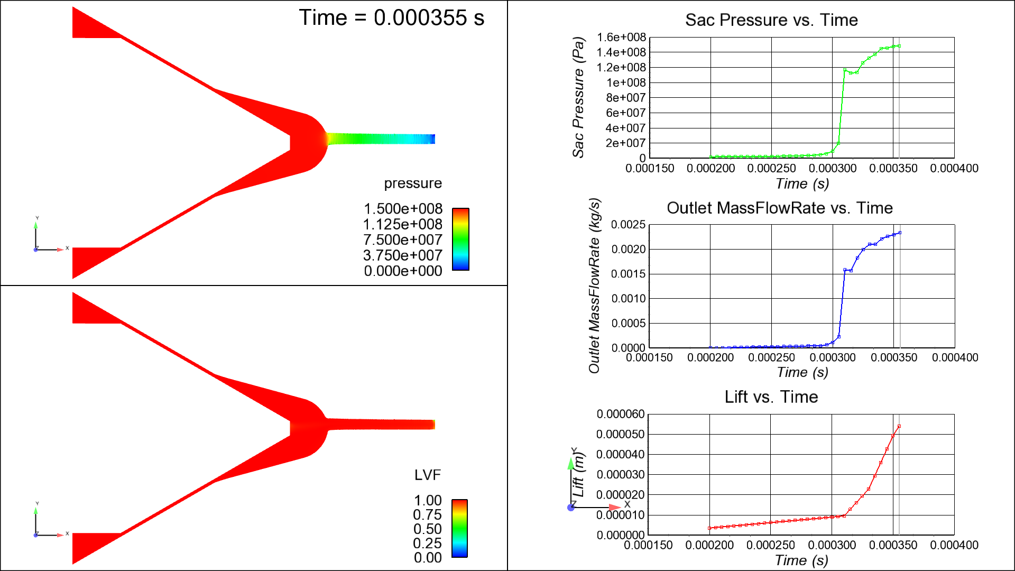
ANL Results:
Mostly dissolved gas, very little vapor

Slide 14
ANL Results:

Slide 15
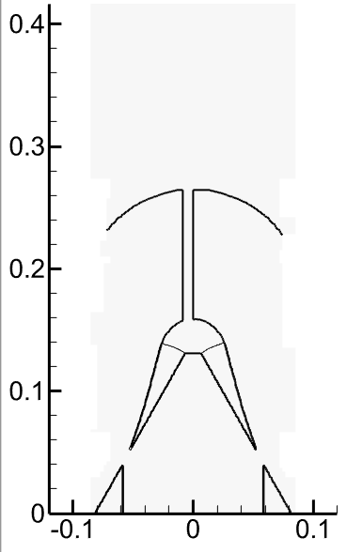
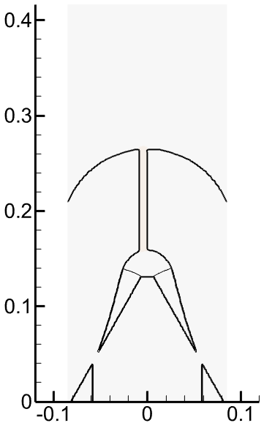
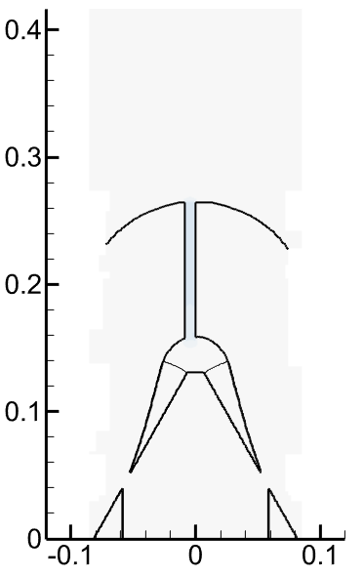
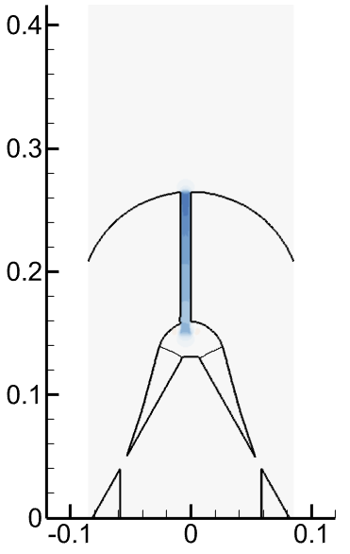
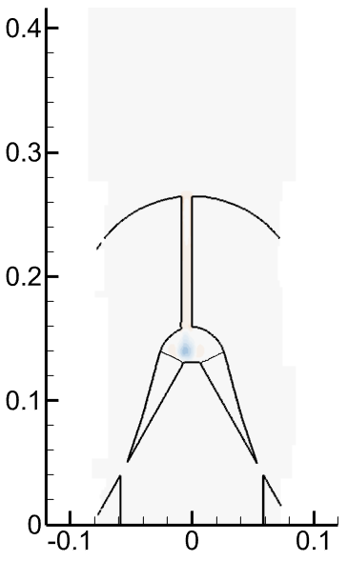
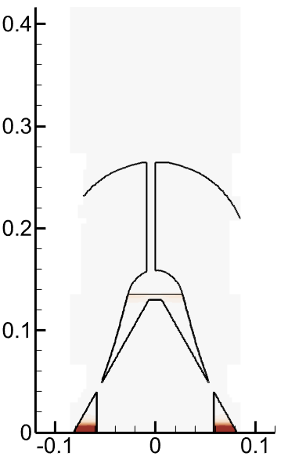
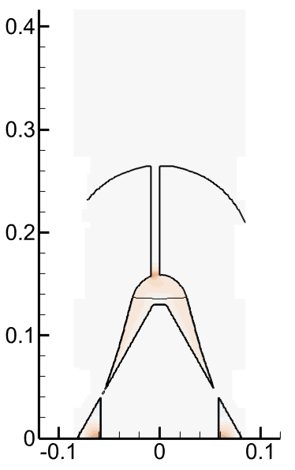
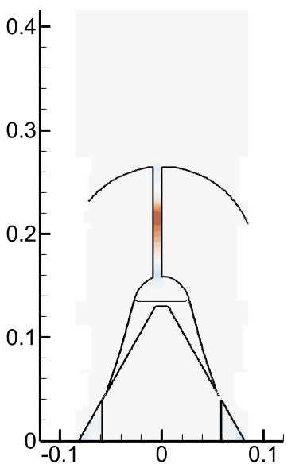
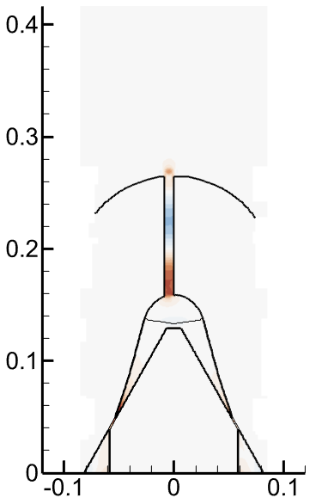
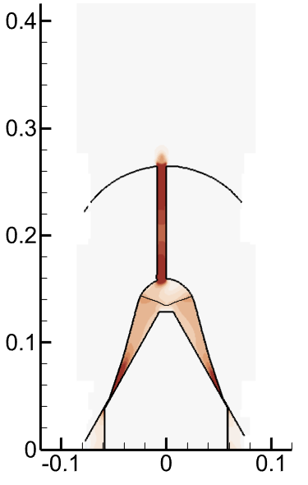
Axial velocity – early opening transient
t = 2.6 μs
t = 76.5 μs
t = 158.8 μs
t = 173.3 μs
t = 187.6 μs
t = 235.5 μs
t = 315.5 μs
t = 317.5 μs
t = 320.0 μs
t = 325.0 μs
t = 330.0 μs
Axial velocity
40 m/s
0m/s
-40 m/s
Sandia Results

Slide 16
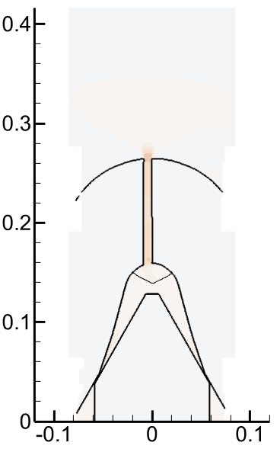
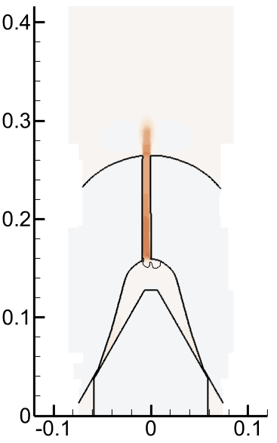
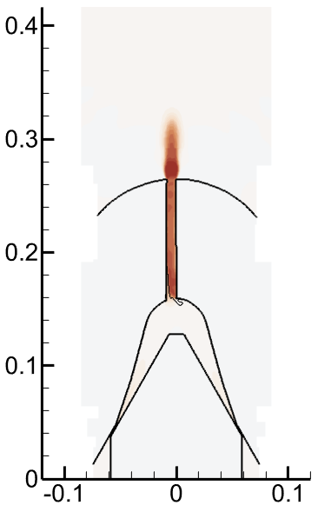
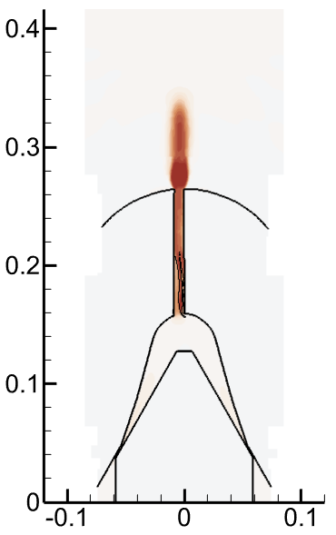
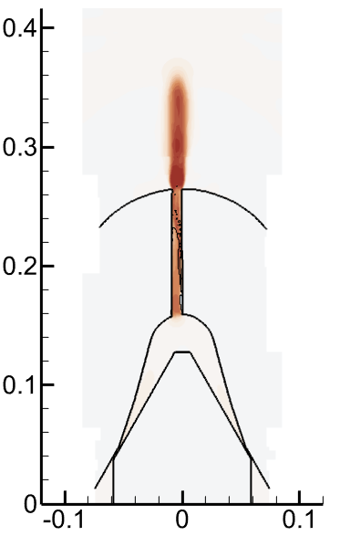
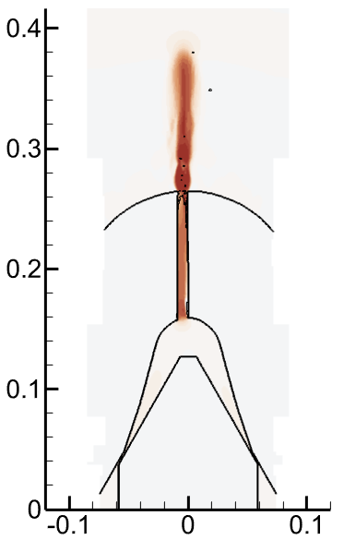
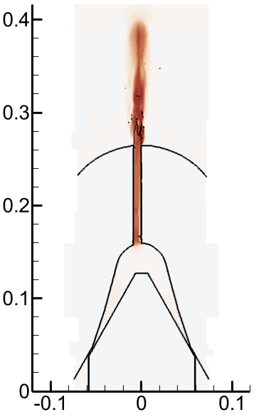
Axial velocity – opening transient
t = 332.7 μs
t = 334.8 μs
t = 336.2 μs
t = 337.2 μs
under-expanded jet
t = 338.6 μs
t = 390.0 μs
t = 390.7 μs
Axial velocity
520 m/s
trapped gas
0m/s
Sandia Results

Slide 17
Mass flows – opening transient
time [ms] | mass flow – AIR [g/s] | mass flow – FUEL [g/s]
0.00255753 | 2.40E-06 | 0
0.1587736 | -1.23E-03 | 0
0.1732709 | -3.82E-03 | 0
0.187601 | 1.08E-03 | 0
0.19837 | 2.05E-03 | 0
0.235546 | 1.42E-03 | 0
0.280205 | -2.83E-03 | 0
0.315518687 | 9.29E-07 | 0
0.317500687 | -6.54E-06 | 0
0.319629 | -8.46E-04 | 0
0.324989 | 1.12E-03 | 0
0.329654 | 7.11E-03 | 0
0.3326556 | 2.71E-02 | 0
0.334792 | 4.90E-02 | 0
0.3361497 | 1.41E-01 | 0
0.33717 | 2.00E-01 | 0
0.33806 | 1.69E-01 | 0
0.339021 | 1.34E-01 | 1.37E-01
0.3397494 | 3.73E-03 | 1.442248
time [ms]
The flows are calculated by integration of the axial flux over a cross-section of the orifice located just before the exit
Sandia Results

Slide 18
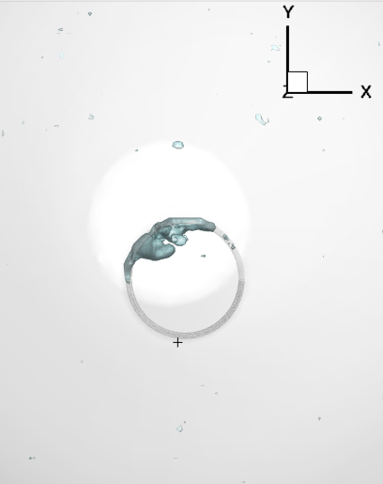
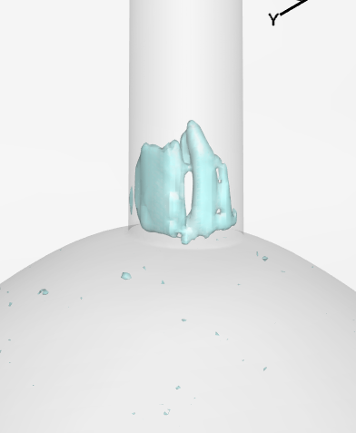
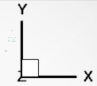
Trapped gas at t = 390.7 μs
Z
Y
Estimated gas volume ~ 3 10⁻⁷ cm³ = 0.0015 V_{sac}
The average density of the gas inside the bubble is ~ 0.2 g/cm³
The estimated residual gas mass is therefore 6 10⁻⁸ g
Sandia Results

Slide 19
Observations
Computationally, we can predict air ingestion and delay due to sac filling
Unresolved: Is fuel filling the sac as a quasi one-dimensional process or does the fuel follow the needle?
Prediction of under-expanded jet
Unresolved: Prediction of trapped air

Slide 20
Spray A Main Injection
Submissions by
ANL, Qingluan Xue, Michele Battistoni, Sibendu Som
UMass, Maryam Moulai, David Schmidt
CMT, Pedro Marti Gomez-Aldaravi, Raul Payri
IFP, Chawki Habchi

Slide 21
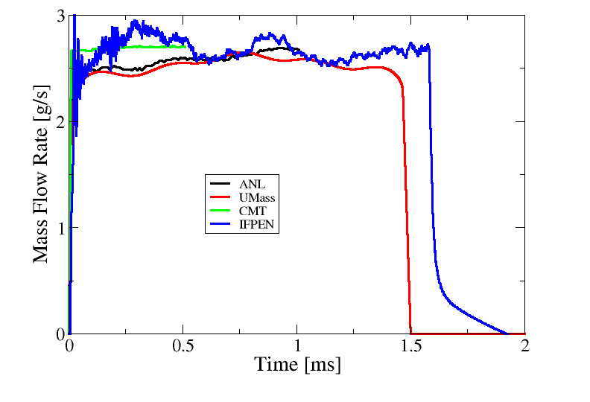
Mass Flow Rate

Slide 22
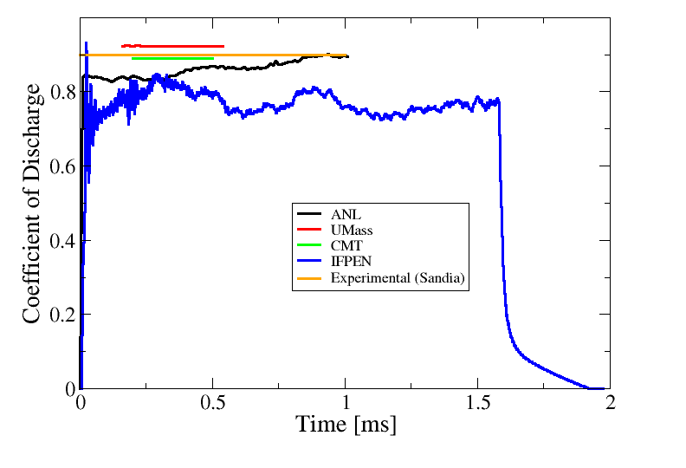
Coefficient of Discharge
Notes:
What are the latest experimental values of discharge coefficients?

Slide 23
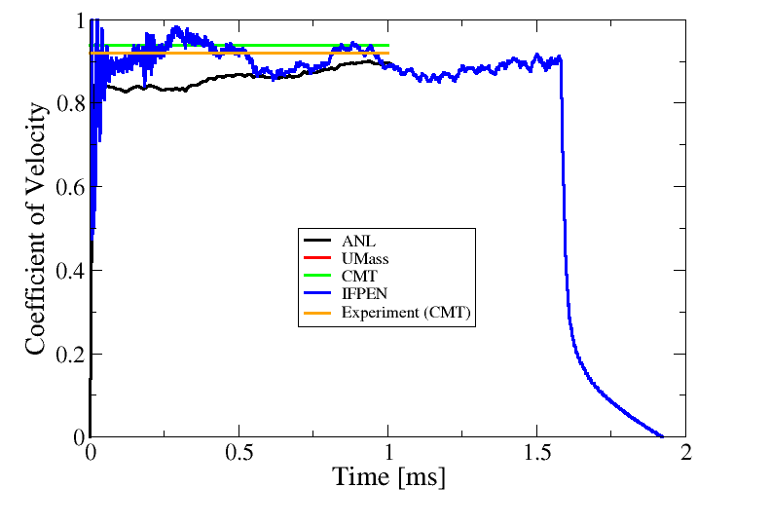
Coefficient of Velocity

Slide 24
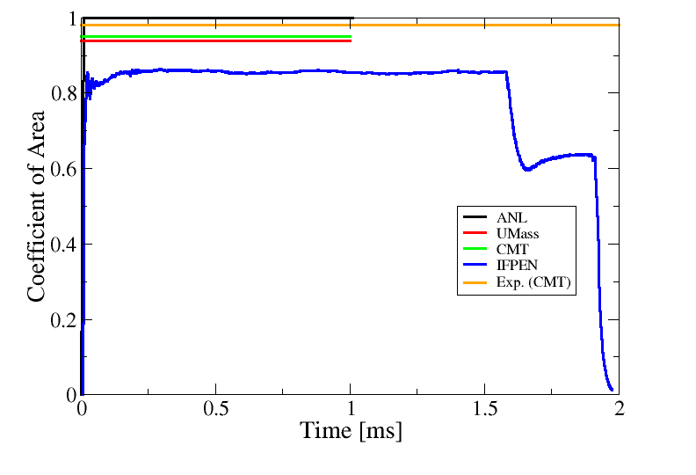
Coefficient of Area

Slide 25
Spray A Snapshots
All taken at t = 0.75 ms

Slide 26
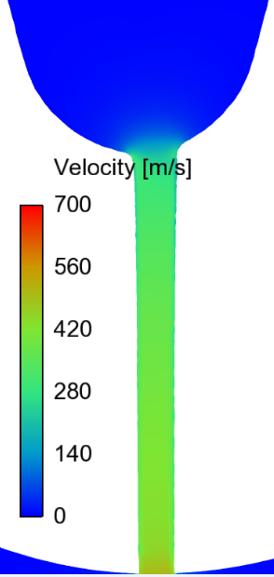
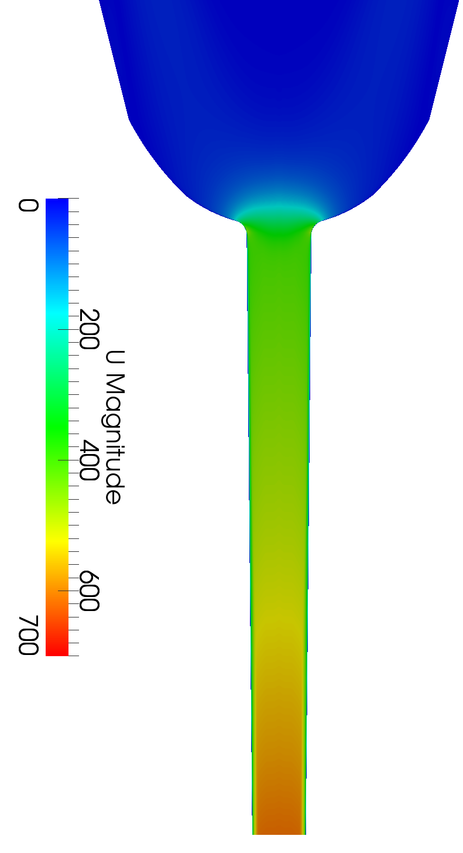
Velocity, Transverse (x-y) View
ANL
UMass
CMT
IFPEN

Slide 27
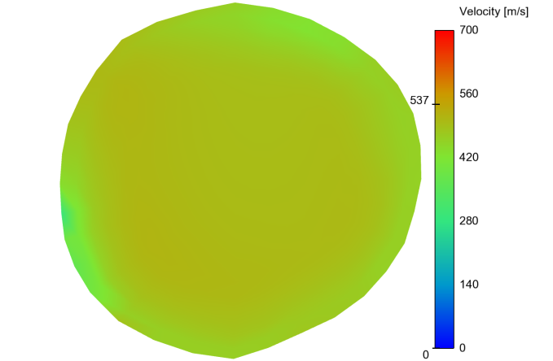
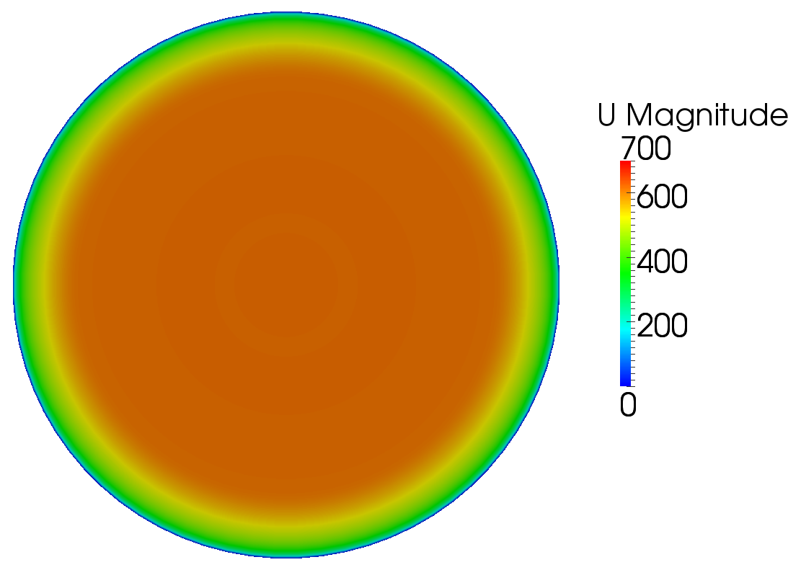
Velocity at the Exit
UMass
ANL
Aachen
IFPEN
CMT

Slide 28
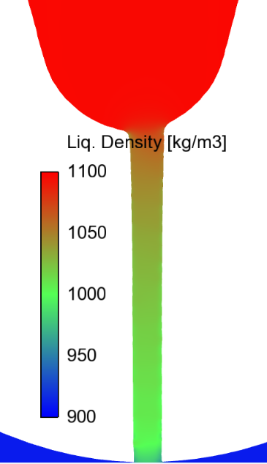
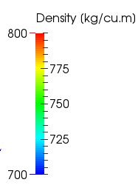
Density, Transverse (x-y) View
ANL
UMass
CMT
IFPEN
* Due to input error, the UMass density was too low.

Slide 29
Idea from Pedro Marti
Perhaps viscous dissipation in the turbulent boundary layer raises the temperature and decreases the density of the liquid near the wall

Slide 30
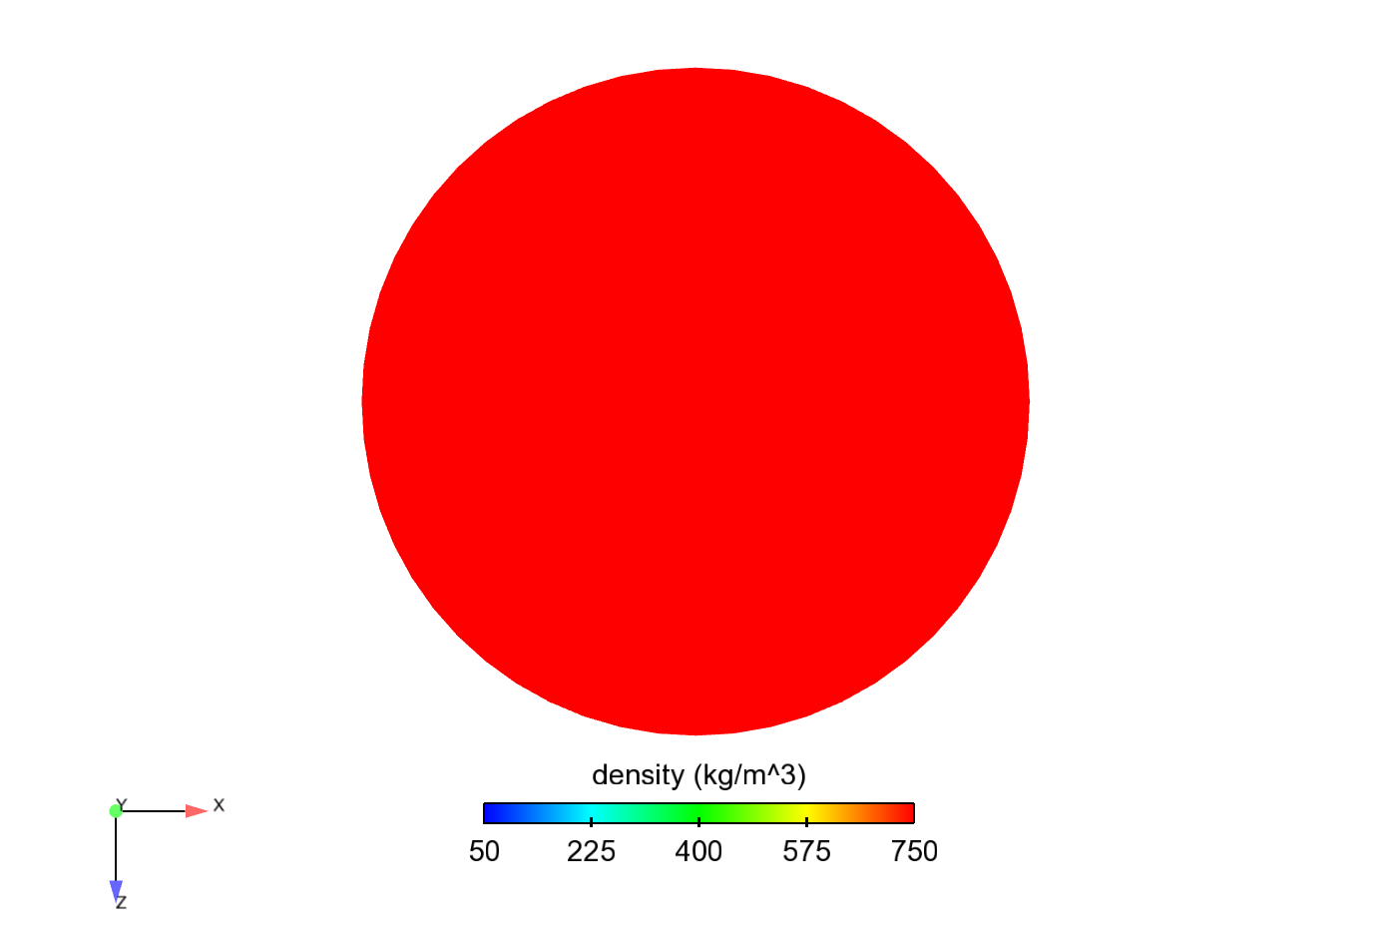
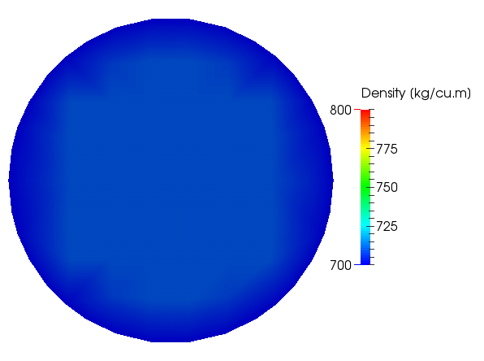
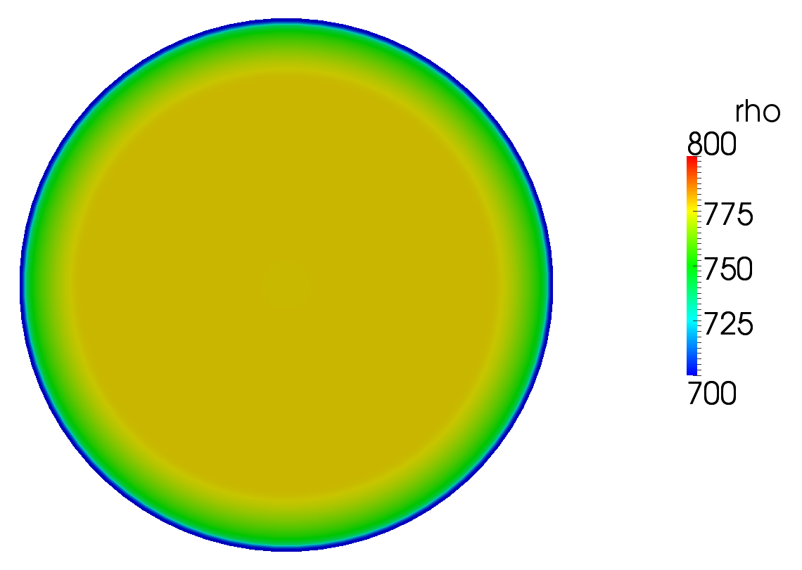
Density at the Exit
UMass
ANL
Density at nominal
exit t,p : 741 kg/m³
CMT
IFPEN
* Due to input error, the UMass density was too low.

Slide 31
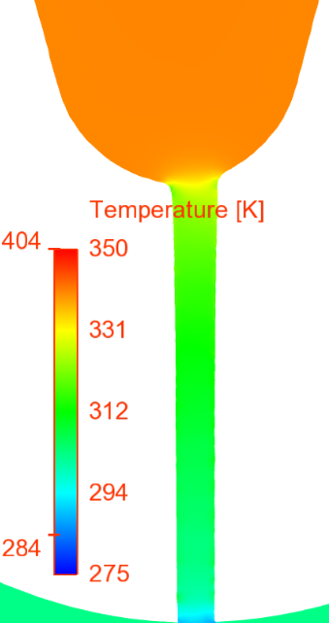
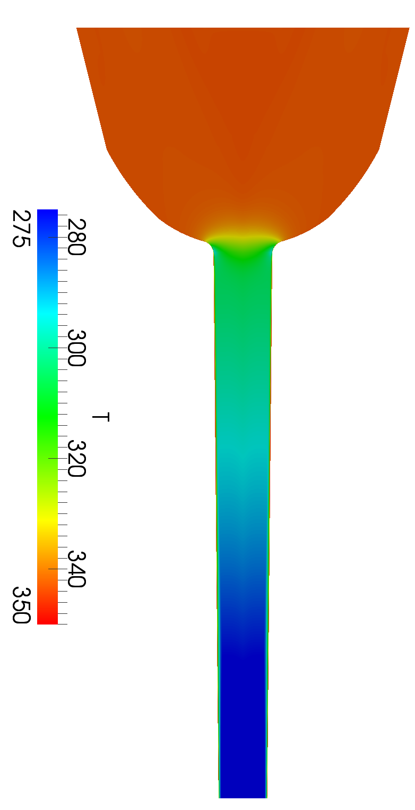
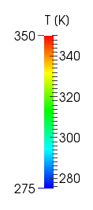
Temperature, Transverse (x-y) View
ANL
UMass
CMT
IFPEN

Slide 32
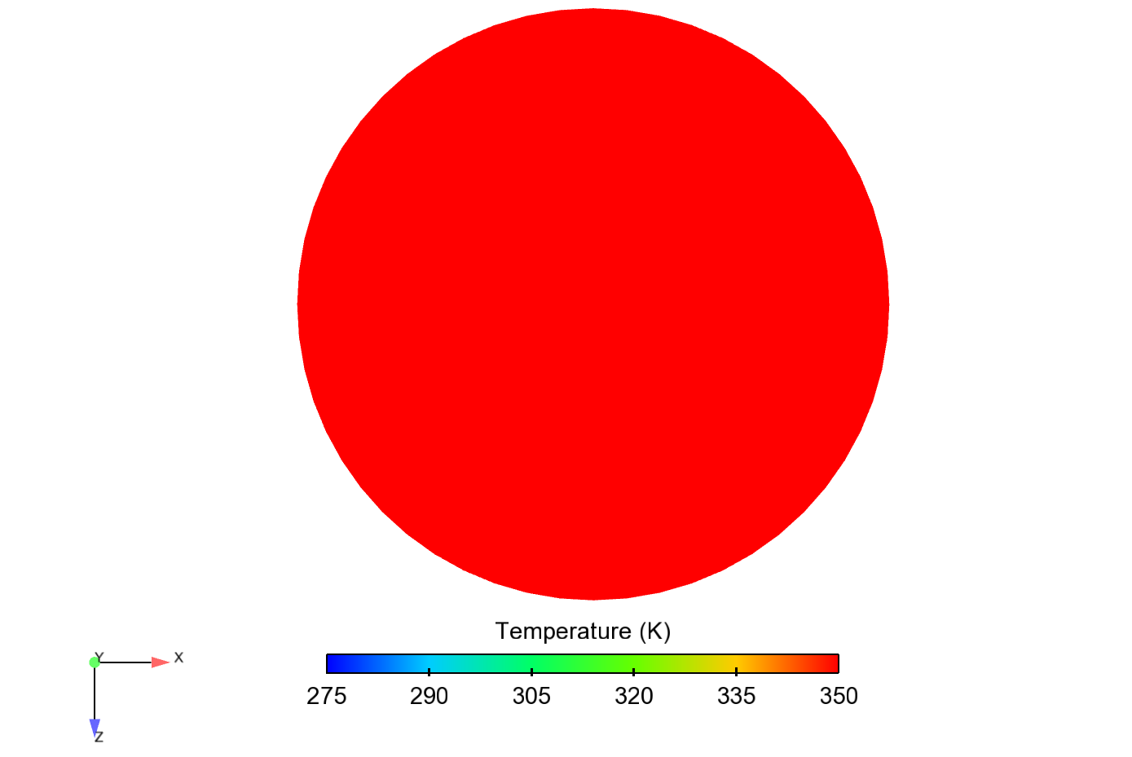
Temperature at the Exit
UMass
ANL
CMT
IFPEN

Slide 33
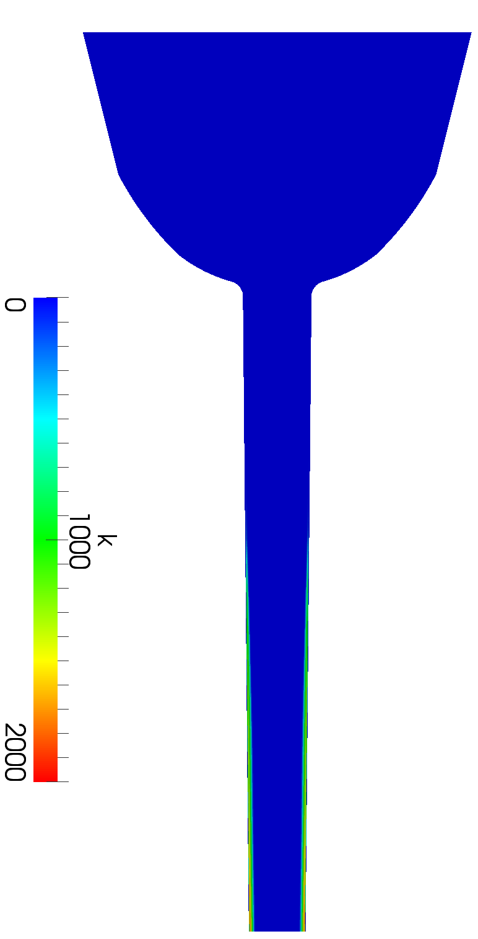
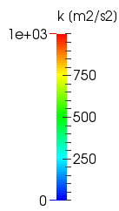
Turbulence, Transverse (x-y) View
ANL
UMass
CMT
IFPEN

Slide 34
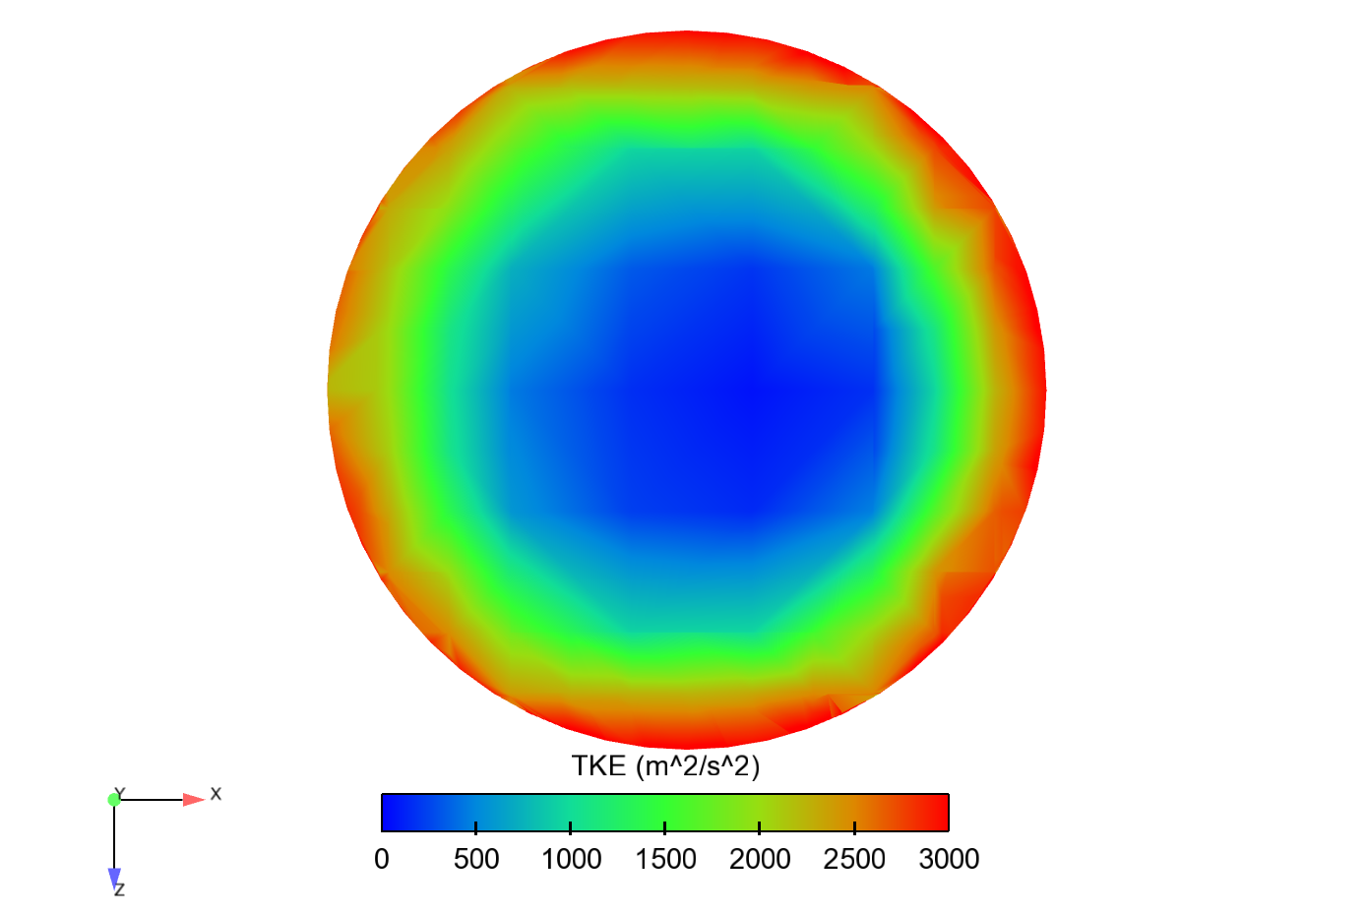
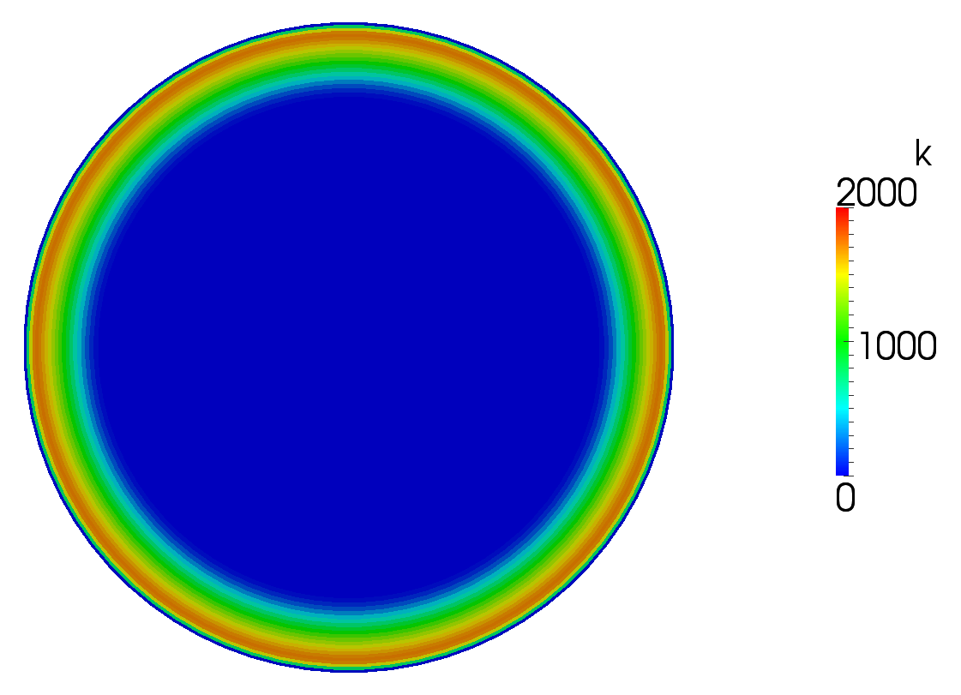
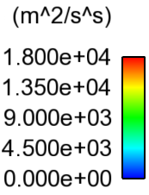
Turbulence at the Exit
UMass
ANL
Aachen
CMT
IFPEN

Slide 35
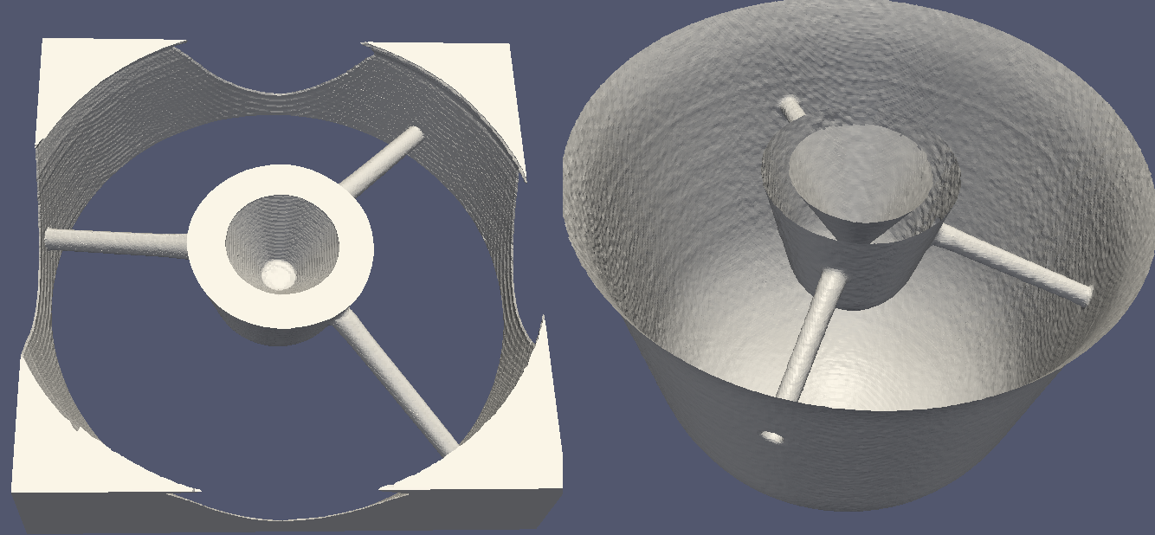
Spray B
ESRF geometry is incomplete, but more accurate
Initial simulation with the Phoenix tomography
ESRF
Phoenix

Slide 36
Contributions
Institutions | UMass | ANL
People | Maryam Moulai, David Schmidt | Michele Battistoni, Qingluan Xue, Sibendu Som
Approach | Eulerian cavitation, spray development | Adaptive mesh Eulerian-Eulerian
Code | In-house | Converge
Needle motion | none | yes
Geometry | Reduces ESRF | Phoenix

Slide 37
ANL Contribution

Slide 38
ANL Contribution
Spray B: Hole slices of liquid volume fraction and velocity
Hole 1
Hole 2
Hole 3

Slide 39
ANL Contribution
A closer examination of hole 3
t = 100 μs ASOI

Slide 40
Spray B
UMass contribution
Hole 1
Hole 2
Hole 3
Rough geometry from Phoenix STL is smoothed, slightly
Roughness causes large spatial pressure fluctuations in nozzle, especially near exit
Hole 3 produces a wider spray than the other holes

Slide 41
Connecting internal flow to external spray
UMass contribution
Hole 1
Hole 2
Hole 3
Mass fraction of gas

Slide 42
Cavitation?
UMass contribution
Hole 1
Hole 2
Hole 3
Volume fraction of fuel vapor
As the holes diverge near the exit, trace amounts of vapor appear
No cavitation predicted at nozzle inlets

Slide 43
Main Injection Conclusions
Some differences between results with new and old 675 geometries
With no slip walls, temperature variation due to viscous energy generation
Stiffened gas EOS is overly compressible, UMass results included incorrect density input
Mostly, matched experimental Cv,Ca, Cd
Roughness effects in Phoneix spray B geometry
Matched mass flow trends with CSI spray B geometry
Wide spray from hole 3, with perhaps, a little cavitation, just at the exit

