Slide 1
Spray G Modeling
ECN 3.0
April 5th, 2014

Slide 2
Participating Institution | Abbreviation | Researcher(s)
Argonne National Lab | ANL | Zihan Wang, Sibendu Som
Politecnico di Milano | Polimi | Tommaso Lucchini, Tarcisio Cerri
University of Wisconsin – Madison | UW | Noah Van Dam

Slide 3
Modeling Outline
Case description
Modeling approaches
CFD Measurement definitions
Modeling results
Liquid and vapor penetration
Spray visualization
Mixture fraction and drop size (SMD) profiles
Summary

Slide 4
Spray G Nominal Baseline Data/Conditions
Fuel | Isooctane
Injection Pressure | 20 MPa
Fuel Temperature | 90° C (363.15 K)
Ambient Temperature | 300° C (573.15 K)
Ambient Density | 3.5 kg/m³
- Ambient Pressure | 5.97 bar (N₂); 5.77 bar (Air)
Injected Quantity | 10 mg
Injection Duration | 780 µs
Number of Nozzle Holes | 8
Hole Diameter | 165 µm
Fully Included Angle | 80°

Slide 5
Rate of Injection

Slide 6
Modeling Approaches
 | ANL | Polimi | UW
CFD Code | Converge 2.1.0 | OpenFOAM + Lib-ICE | KIVA3V-r2-ERC
Turbulence Model | Standard k-ε | Standard k-ε | RNG k-ε
Injection Model | Lagrangian/Blob | Lagrangian/Huh | Lagrangian/Blob
Primary Break-up Model | KH-RT (B1 7; RT Length 0.0) | Huh-Gosman | KH-RT (B1 40; RT Length 1.0)
Secondary Break-up |  | Wave
Vaporization | Frössling | Spalding Number-based (mass-based) | Frössling
Heat Transfer | O’Rourke | Ranz-Marshall | Ranz-Marshall
Collision | NTC | None
Turbulent Dispersion | O’Rourke | None | Gaussian Distribution
Droplet Drag | Dynamic | Dynamic w/ non-spherical correction | Dynamic w/ non-spherical correction

Slide 7
Mesh Details
 | ANL | Polimi | UW
Domain Dimensions | 108 Ø x 108 mm | 169 x 248 mm | 100 x 100 x 60 mm
Base Cell Size | 2 mm | 4 mm | 1 mm
Min Cell Size | 0.25 mm | 1 mm | -
Adaptive or Static Refinement | Both | Adaptive | Uniform
Cell Type | Cartesian | Cartesian | Cartesian Hexahedron
Total/Maximum Cell Count | 1.53 Million | 115,000 | 600,000

Slide 8
CFD Penetration Measurement Details
Liquid Penetration
0.1 % Liquid volume fraction threshold
Vapor Penetration
0.1 % Mixture fraction threshold
Measured along injector axis
Zero point at injector tip
Penetration
Length
Side View

Slide 9
Mixture Fraction and SMD Profile Locations
Spray Axis
Along centerline of a spray jet
Injector Axis
Along the injector axis
Radial
Radially through spray jet center point in a plane 15 mm downstream
Transverse
Perpendicular to radial profile through spray jet center point in a plane 15 mm downstream
Dual-plume
On a line connecting the center points of two neighboring spray jets in a plane 15 mm downstream

Slide 10
Profile Location – Spray Axis
Along the centerline of an individual spray jet
Distanced measure along the spray axis
Zero at injection location, positive towards spray tip
Profile Line
Profile Line
Top View
Side View

Slide 11
Profile Location – Injector Axis
Along the injector axis
Distance measure along the injector axis
Zero at nozzle tip, positive towards leading edge
Profile Line
Top View
Side View

Slide 12
Cross-section Plane
Plane normal to injector axis
Located 15 mm downstream of injector tip measured along injector axis
15 mm
Side View
Top View

Slide 13
Radial Cross-section
Along a radial line through the spray axis center point
Zero at injector axis, positive outward
Radial Line
15 mm
Side View
Top View

Slide 14
Transverse Cross-section
Across the spray perpendicular to the radial line
Zero at spray center point
Experiments put this at 10 mm radial distance
Positive direction clockwise as viewed from injector
10 mm
Spray Plume Center
15 mm
Transverse Line
Side View
Top View

Slide 15
Dual-plume Cross-section
Taken along a line connecting the center-points of two neighboring spray plumes
Zero at center of counter-clockwise-most (as viewed from injector) plume
Positive towards second plume (clockwise as viewed from injector)
15 mm
Dual-plume Line
Side View
Top View

Slide 16
Image View Orientations
Camera/Viewing Position
Position 1 (Widest Spray)
Position 2 (Narrowest Spray)

Slide 17
Spray Penetration
Liquid Penetration
Vapor Penetration

Slide 18
Spray Penetration (Initial Transient)
Liquid Penetration
Vapor Penetration

Slide 19
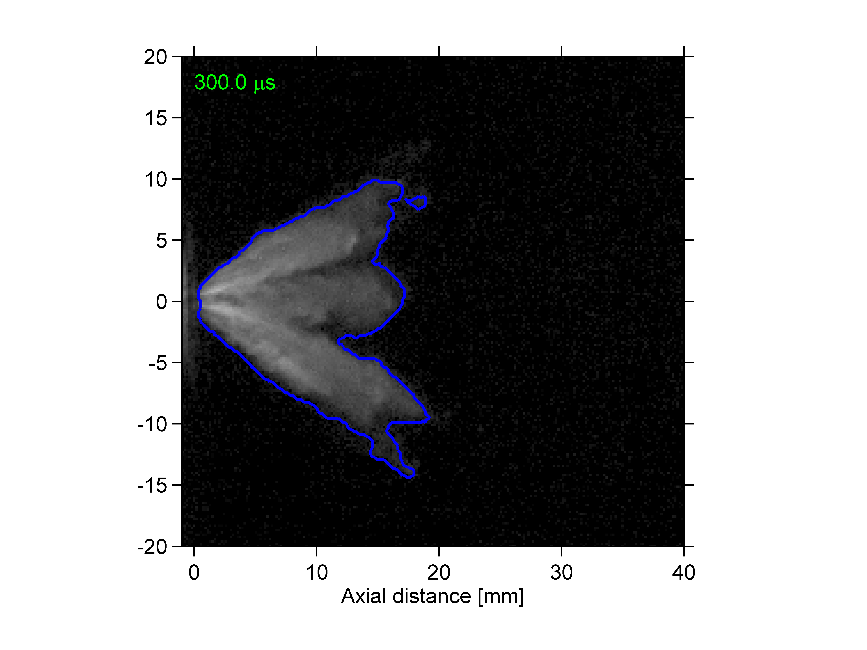
Liquid Images – View 1
0.3 ms ASOI
Experiment
ANL
UW
Polimi

Slide 20
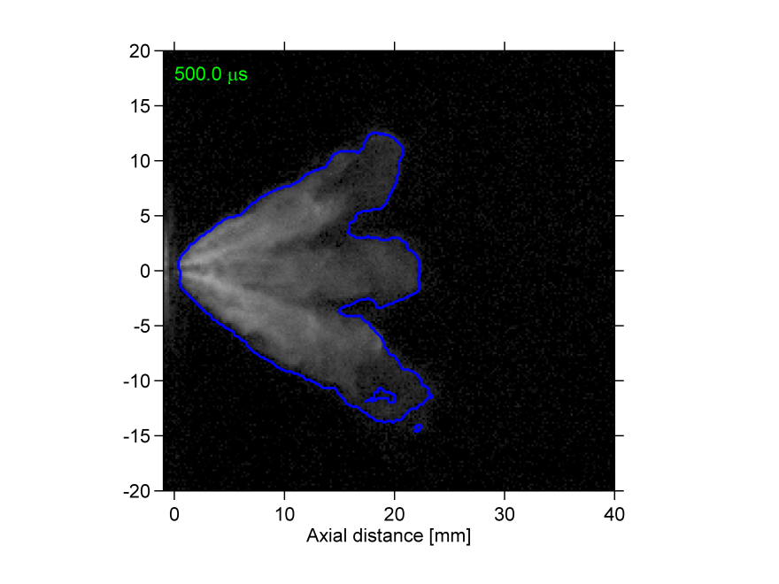
Liquid Images – View 1
0.5 ms ASOI
Experiment
ANL
UW
Polimi

Slide 21
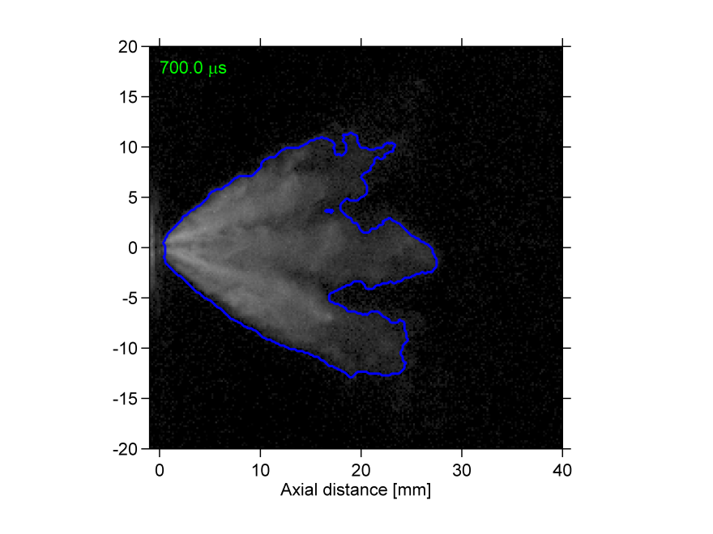
Liquid Images – View 1
0.7 ms ASOI
Experiment
ANL
UW
Polimi

Slide 22
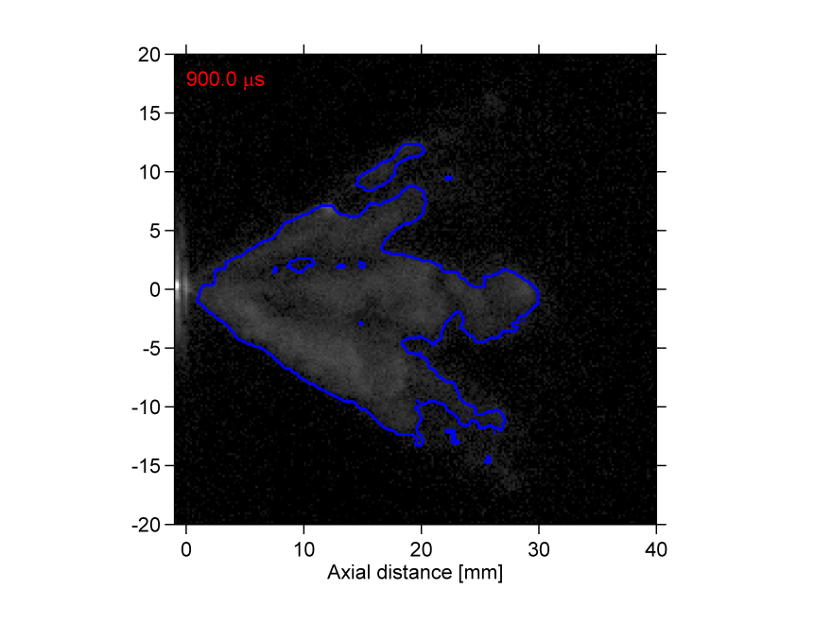
Liquid Images – View 1
0.9 ms ASOI
Experiment
ANL
UW
Polimi

Slide 23
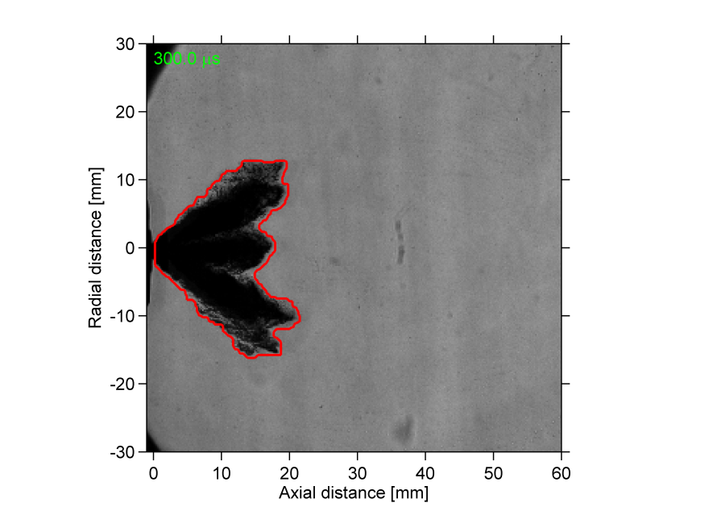
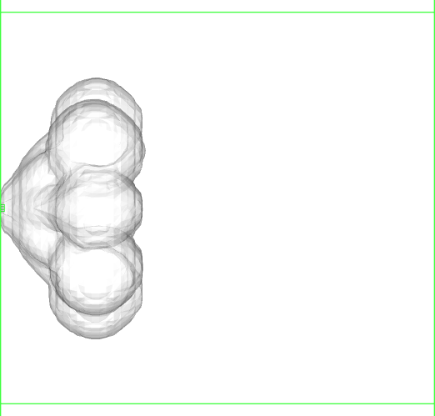
Vapor Images – View 1
0.3 ms ASOI
Experiment
ANL
UW
Polimi

Slide 24
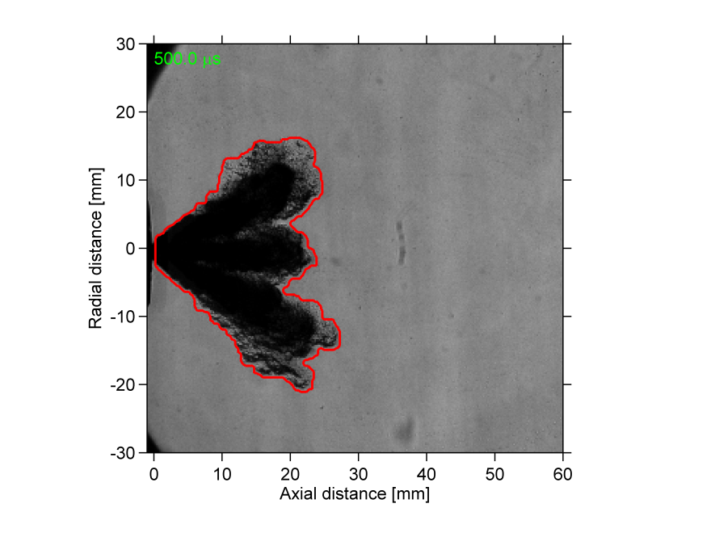
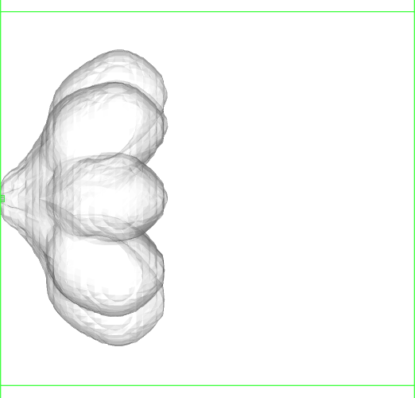
Vapor Images – View 1
0.5 ms ASOI
Experiment
ANL
UW
Polimi

Slide 25
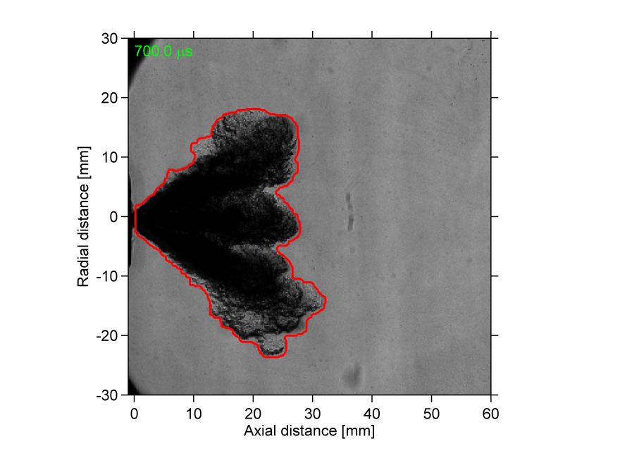
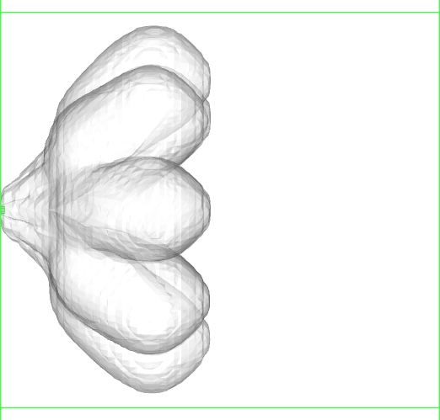
Vapor Images – View 1
0.7 ms ASOI
Experiment
ANL
UW
Polimi

Slide 26
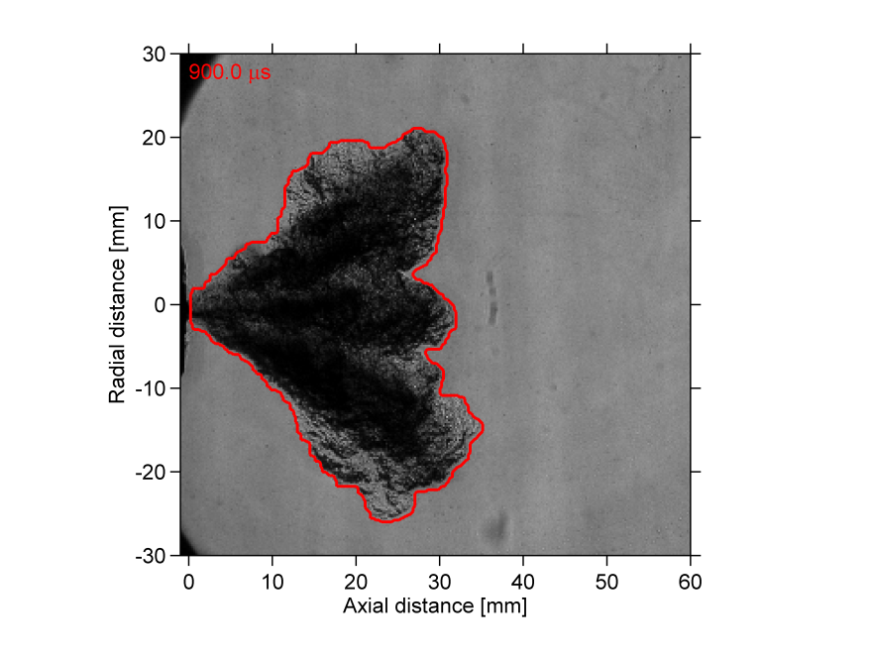
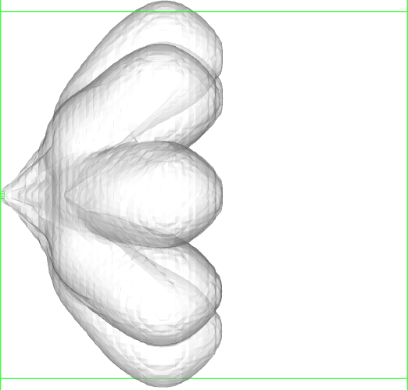
Vapor Images – View 1
0.9 ms ASOI
Experiment
ANL
UW
Polimi

Slide 27
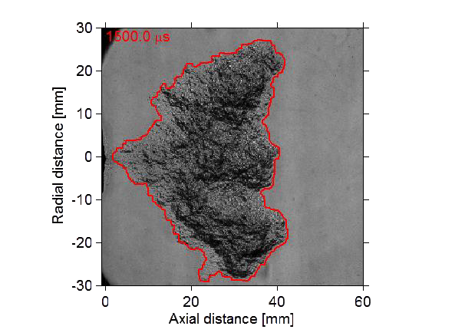
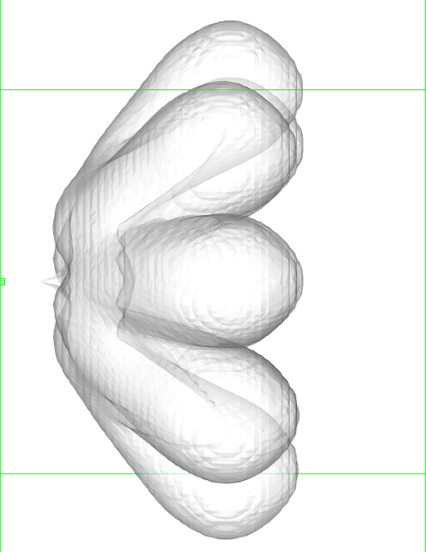
Vapor Images – View 1
1.5 ms ASOI
Experiment
ANL
UW
Polimi

Slide 28
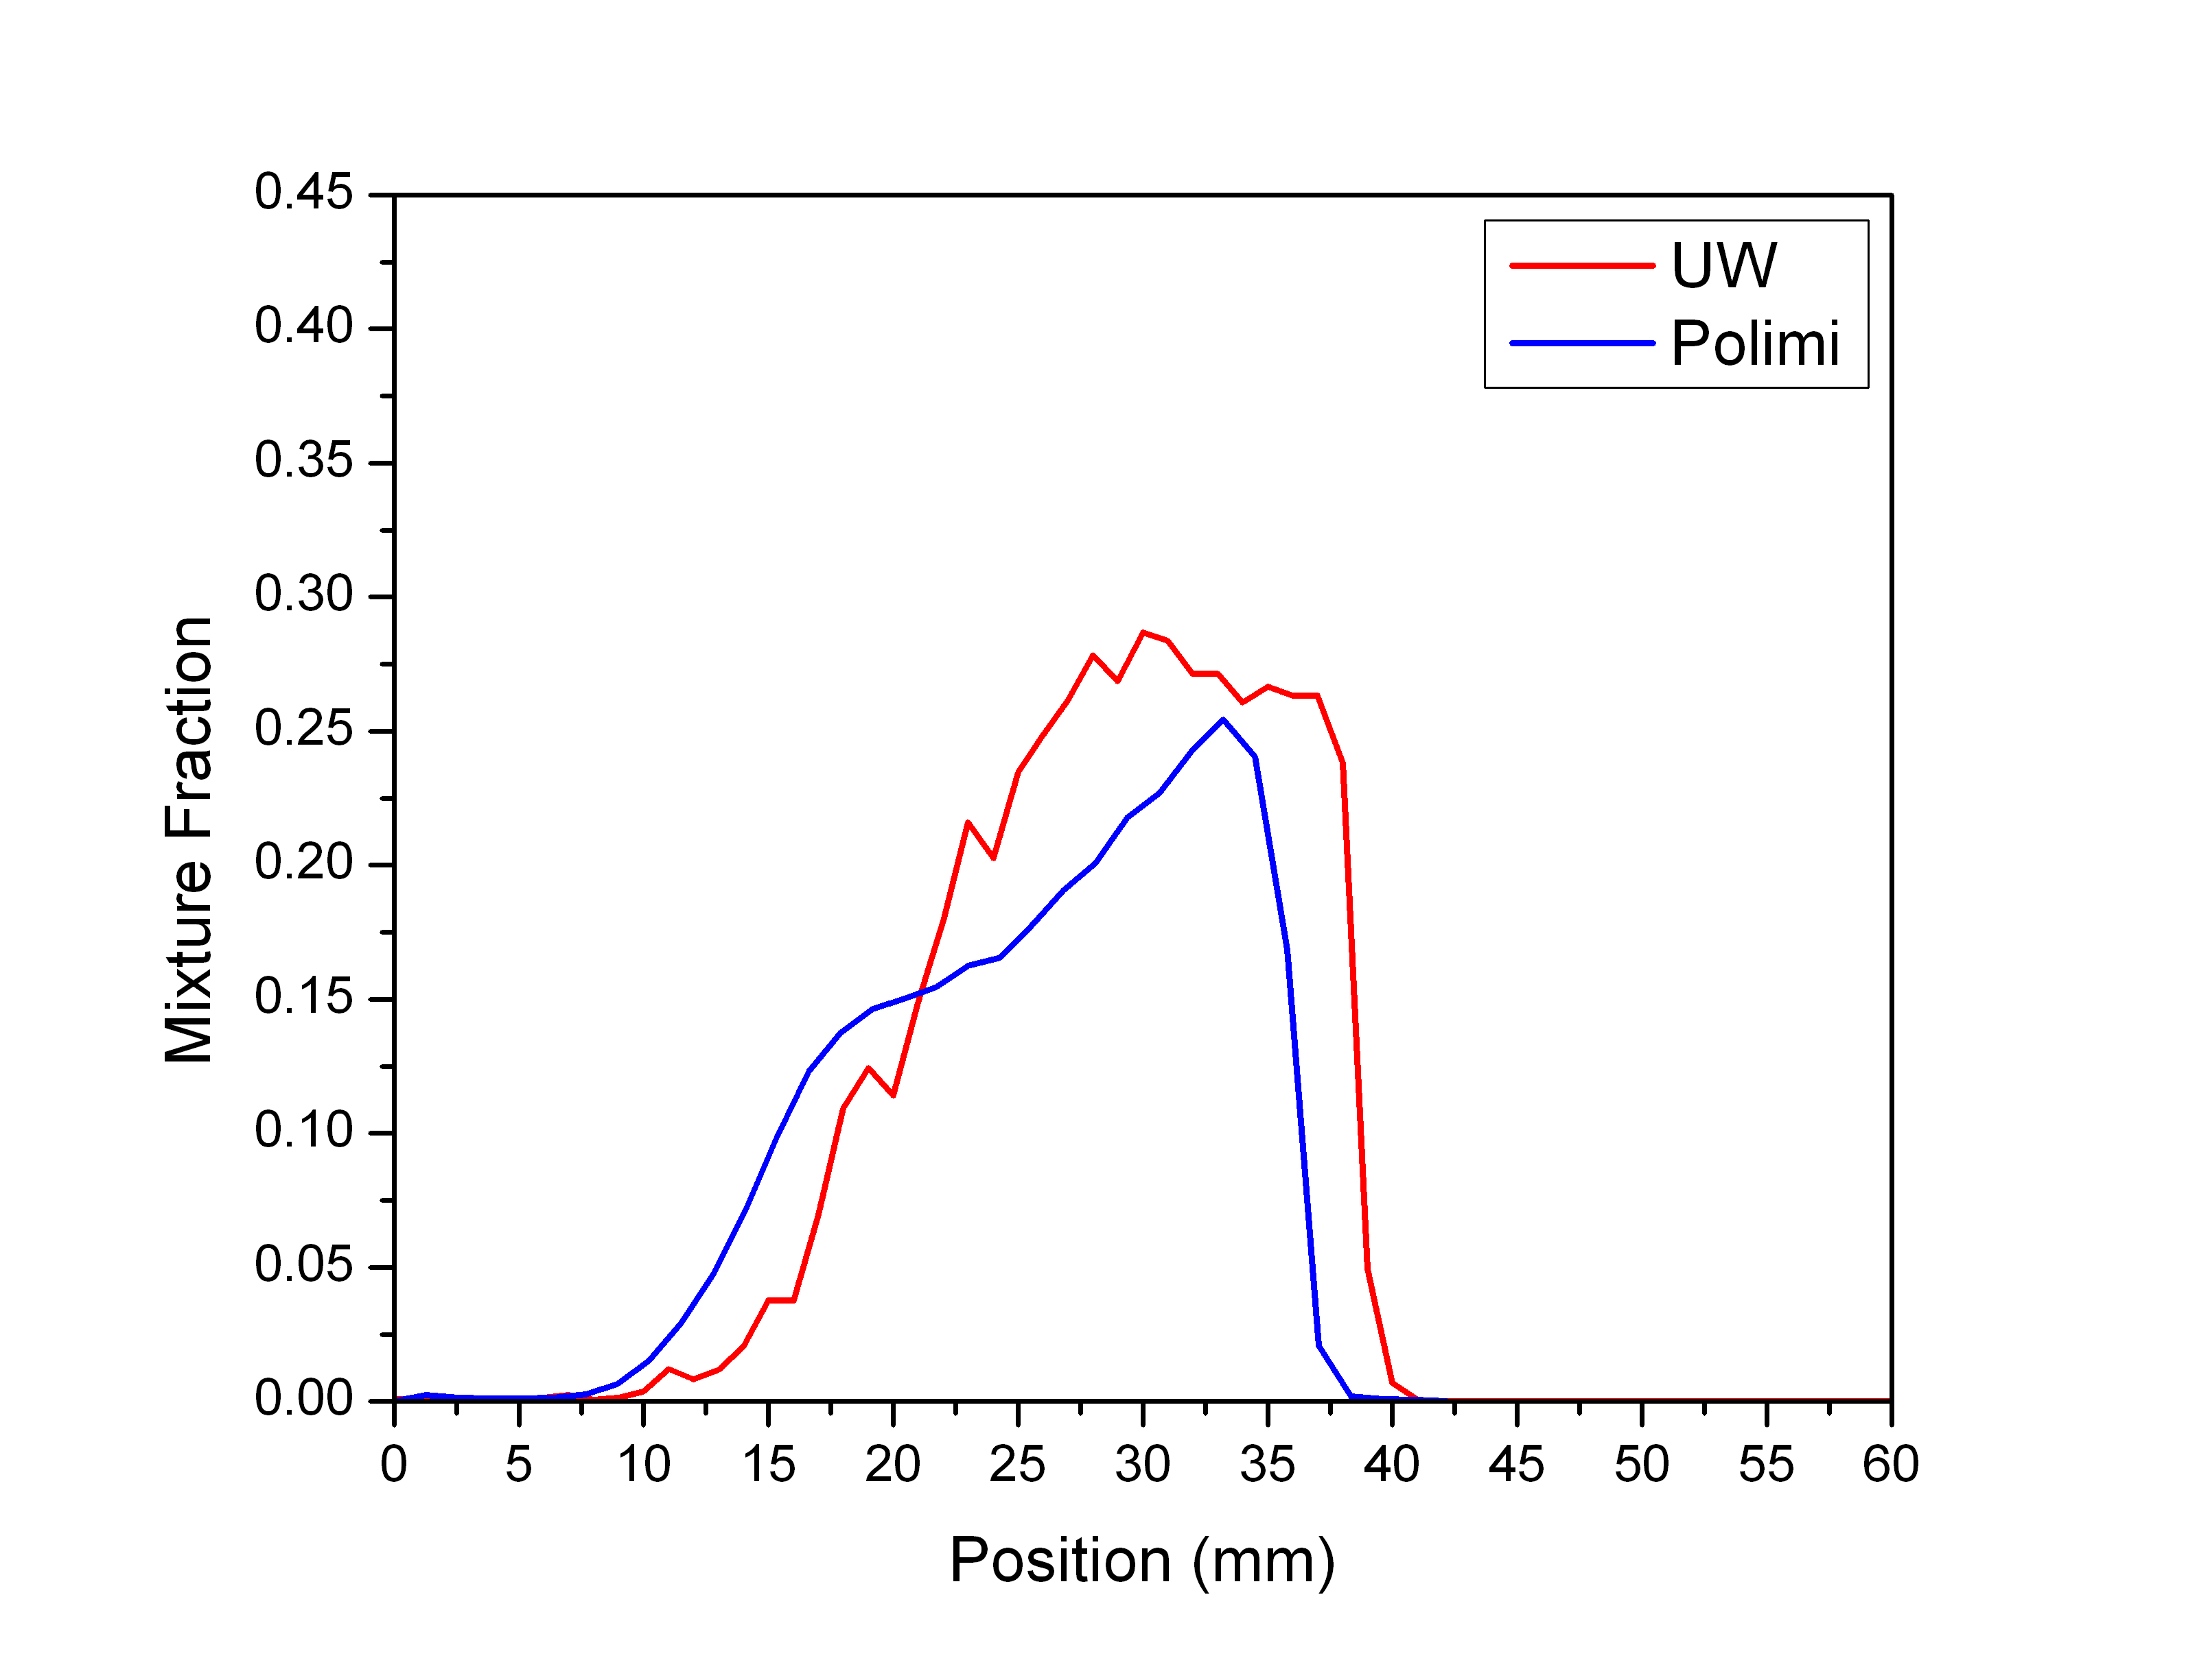
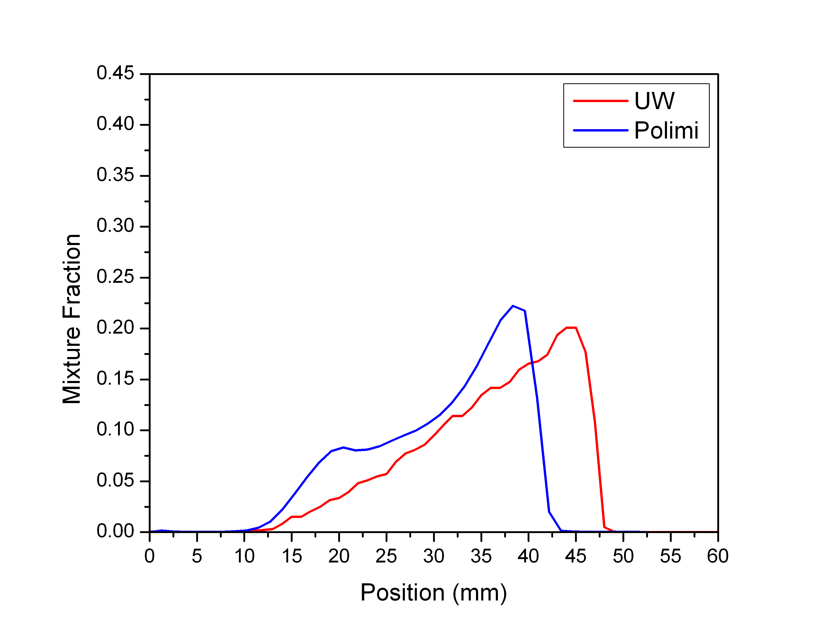
Mixture Fraction Profile – Spray Axis
0.6 ms ASOI
1.0 ms ASOI
1.4 ms ASOI

Slide 29
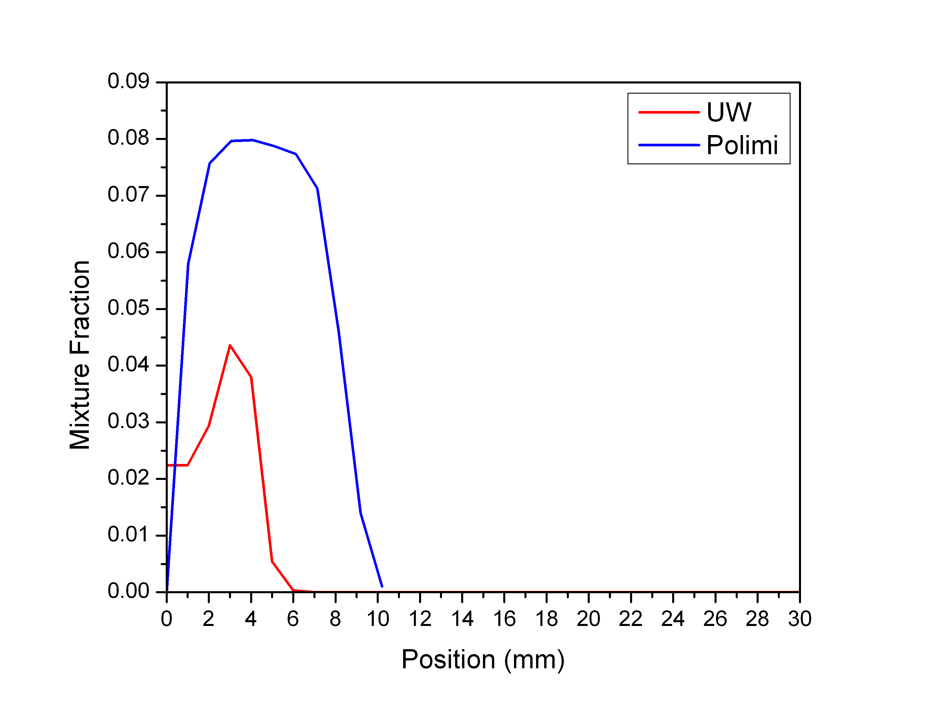
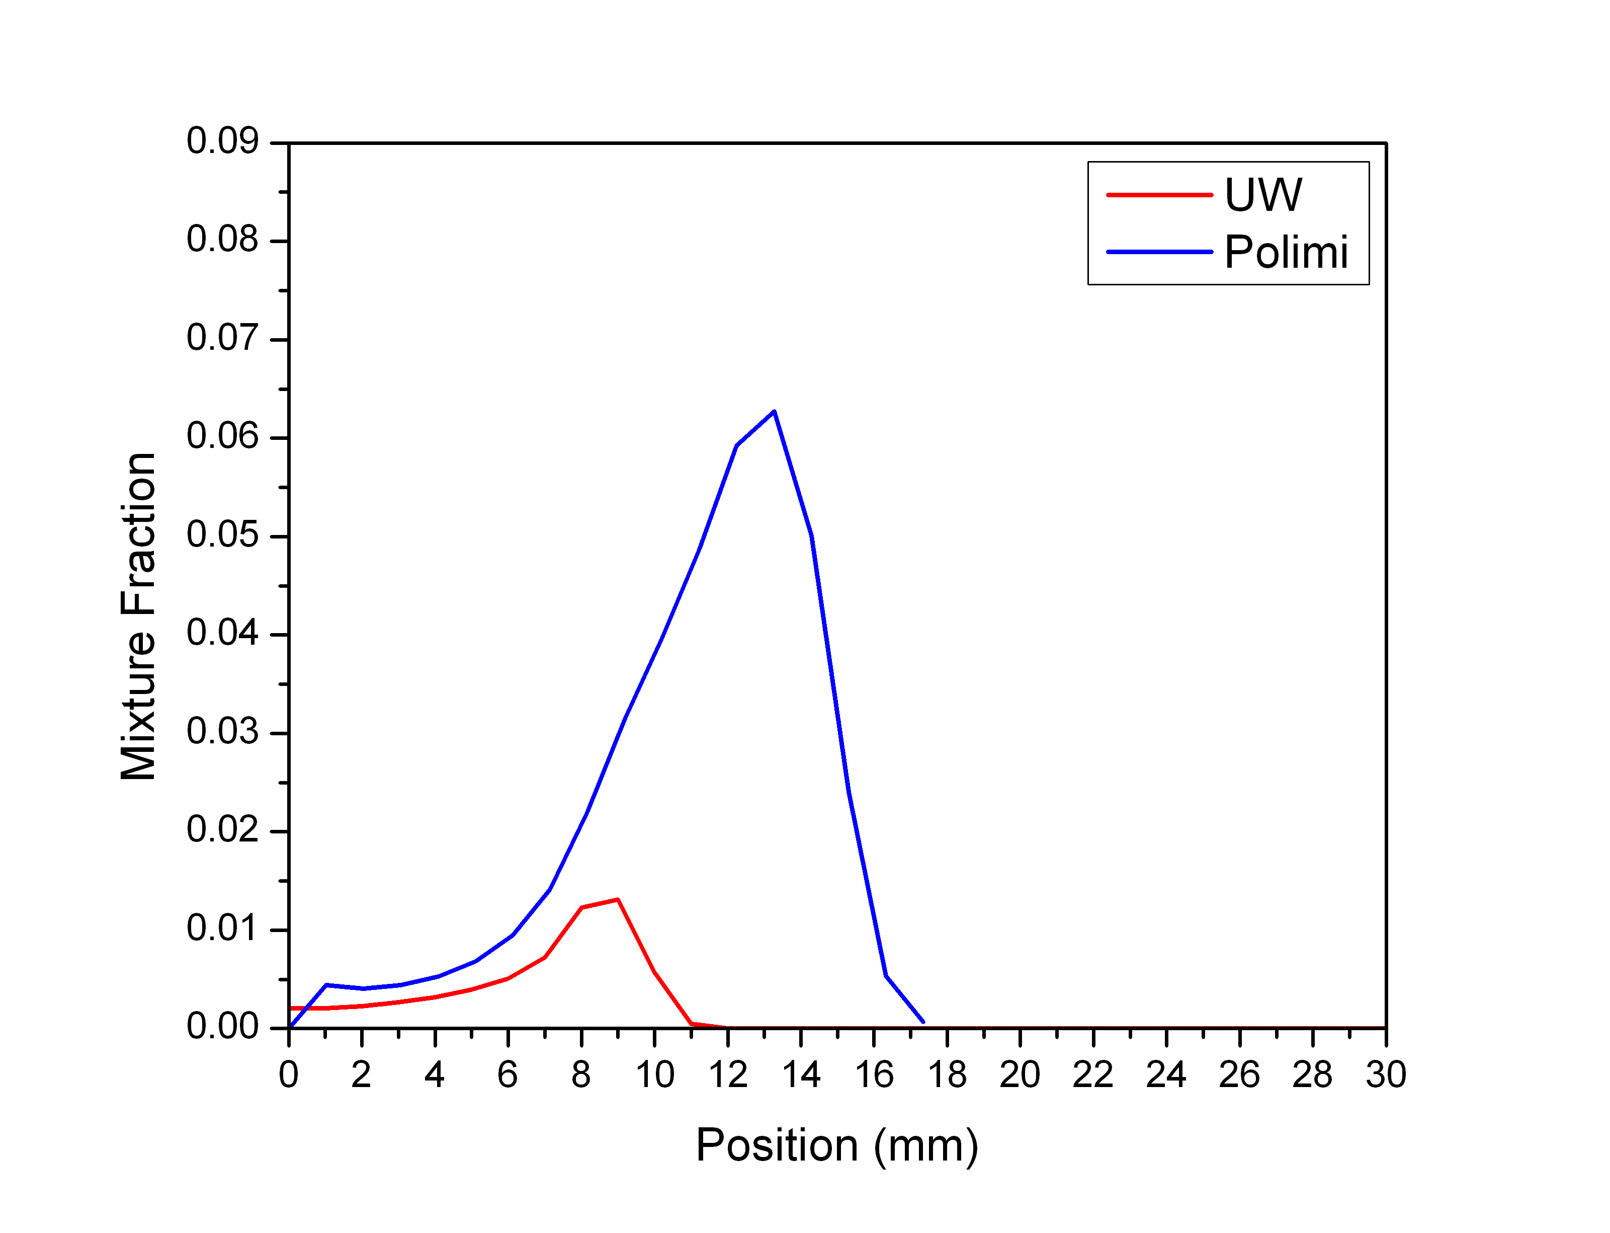
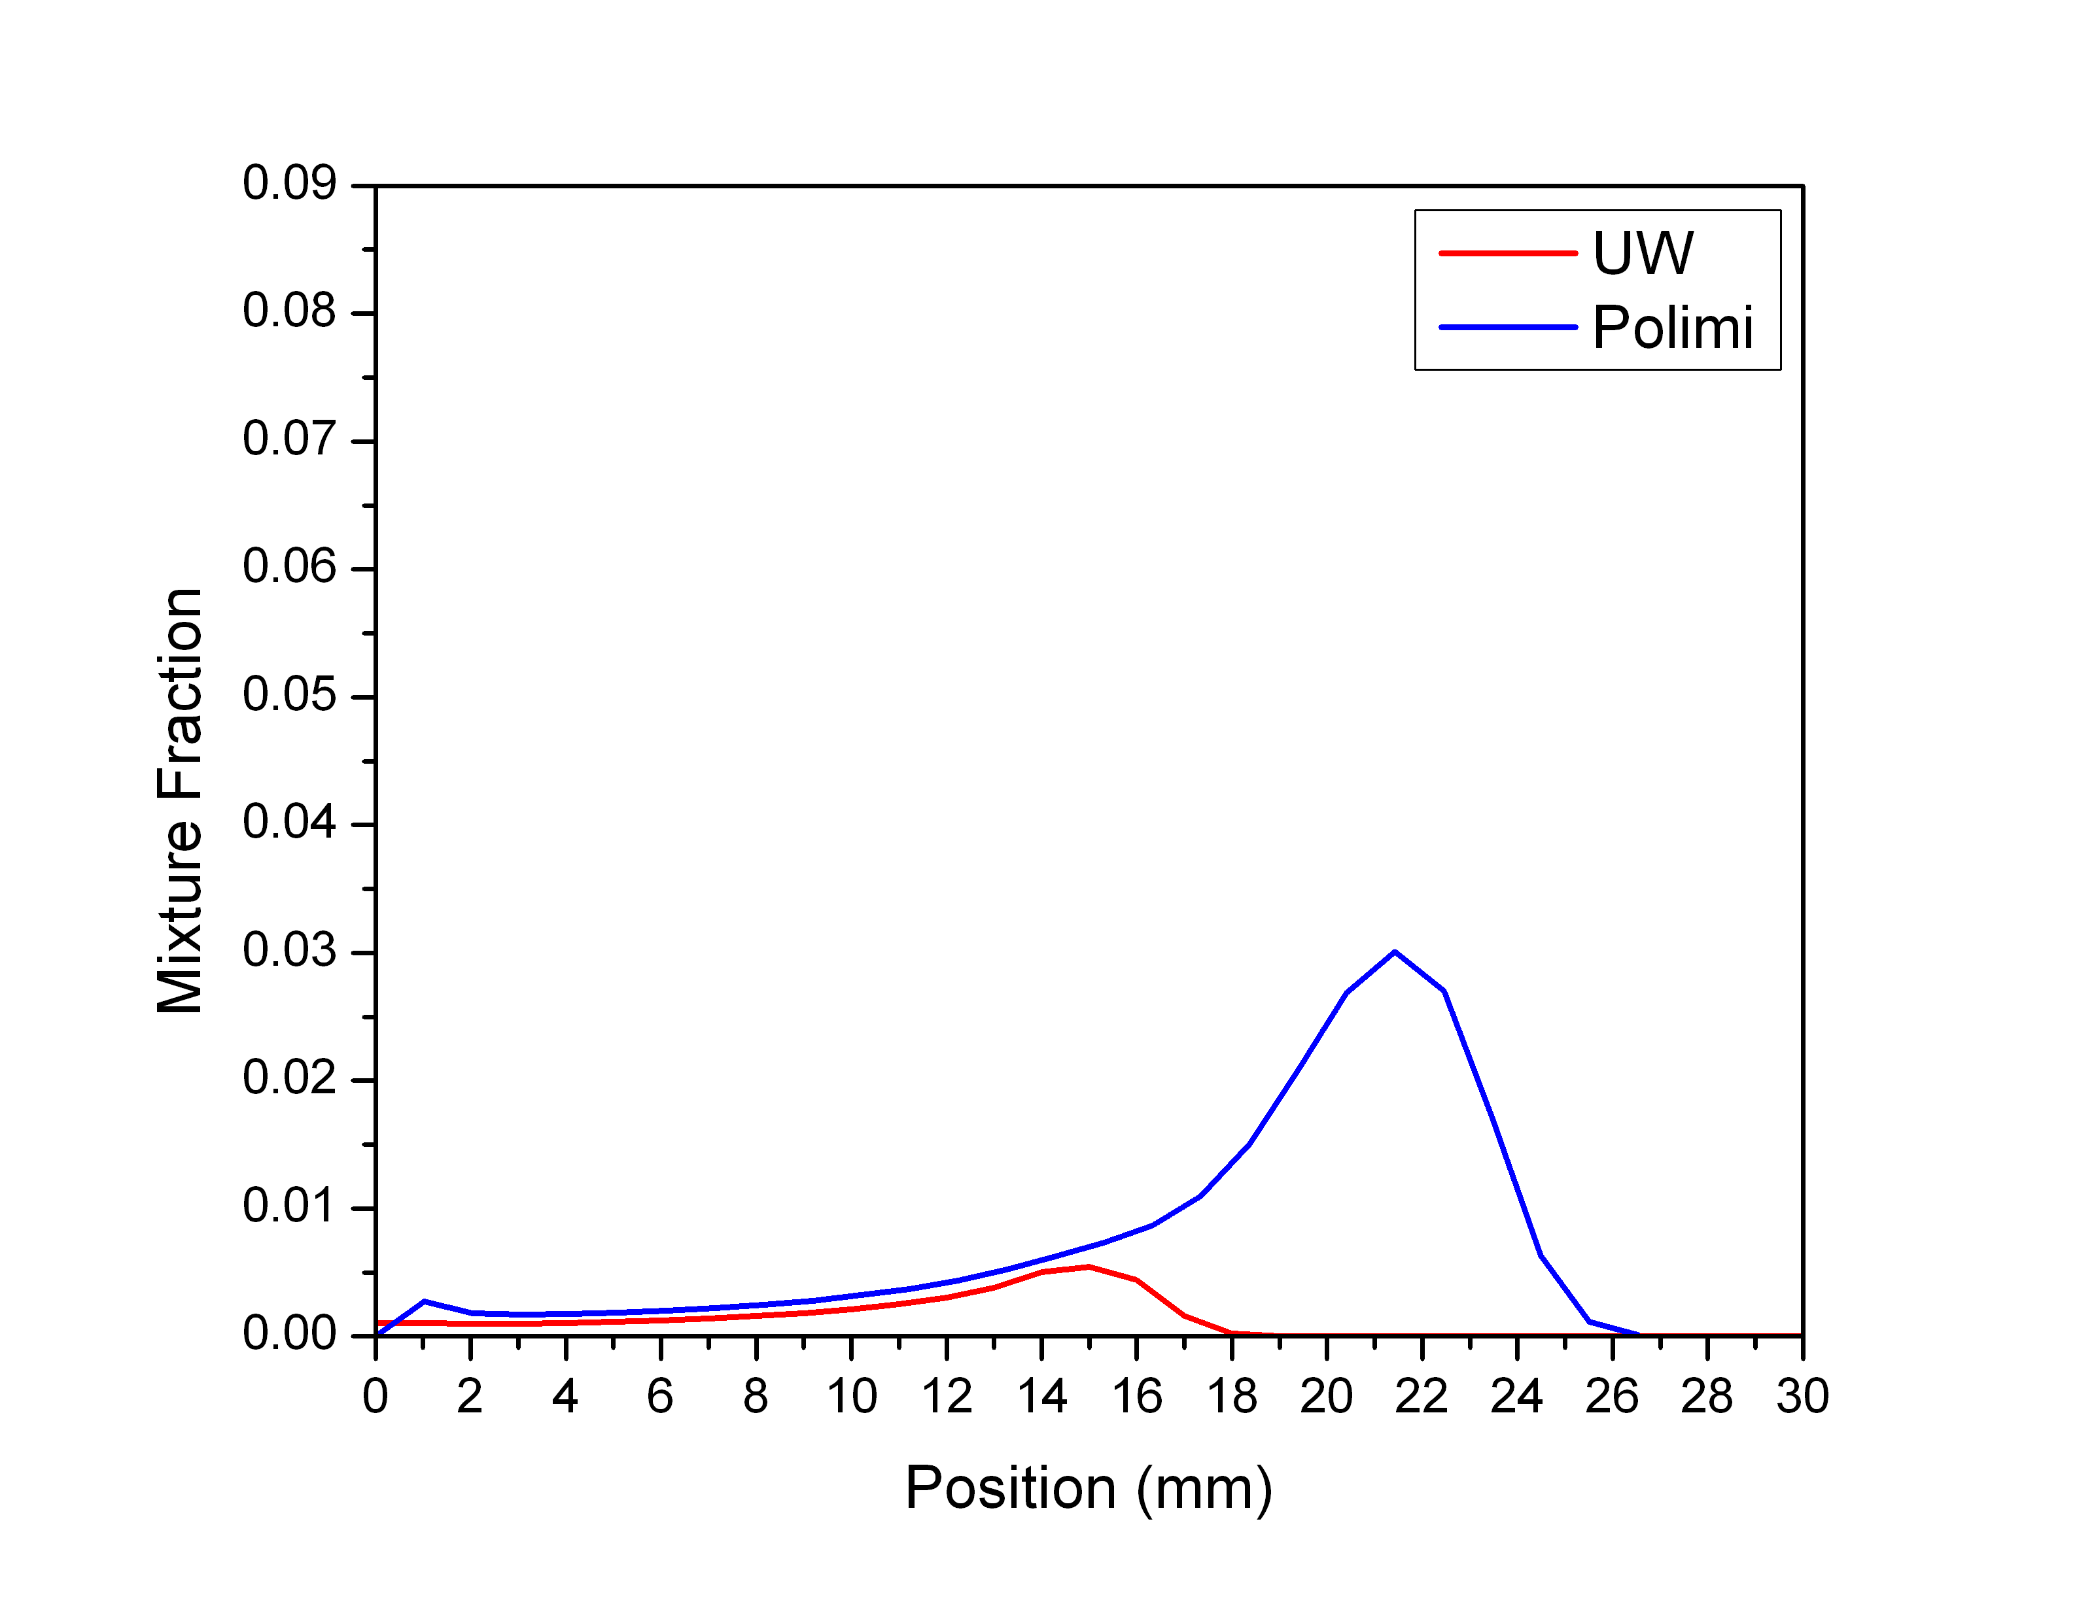
Mixture Fraction Profile – Injector Axis
0.6 ms ASOI
1.0 ms ASOI
1.4 ms ASOI

Slide 30
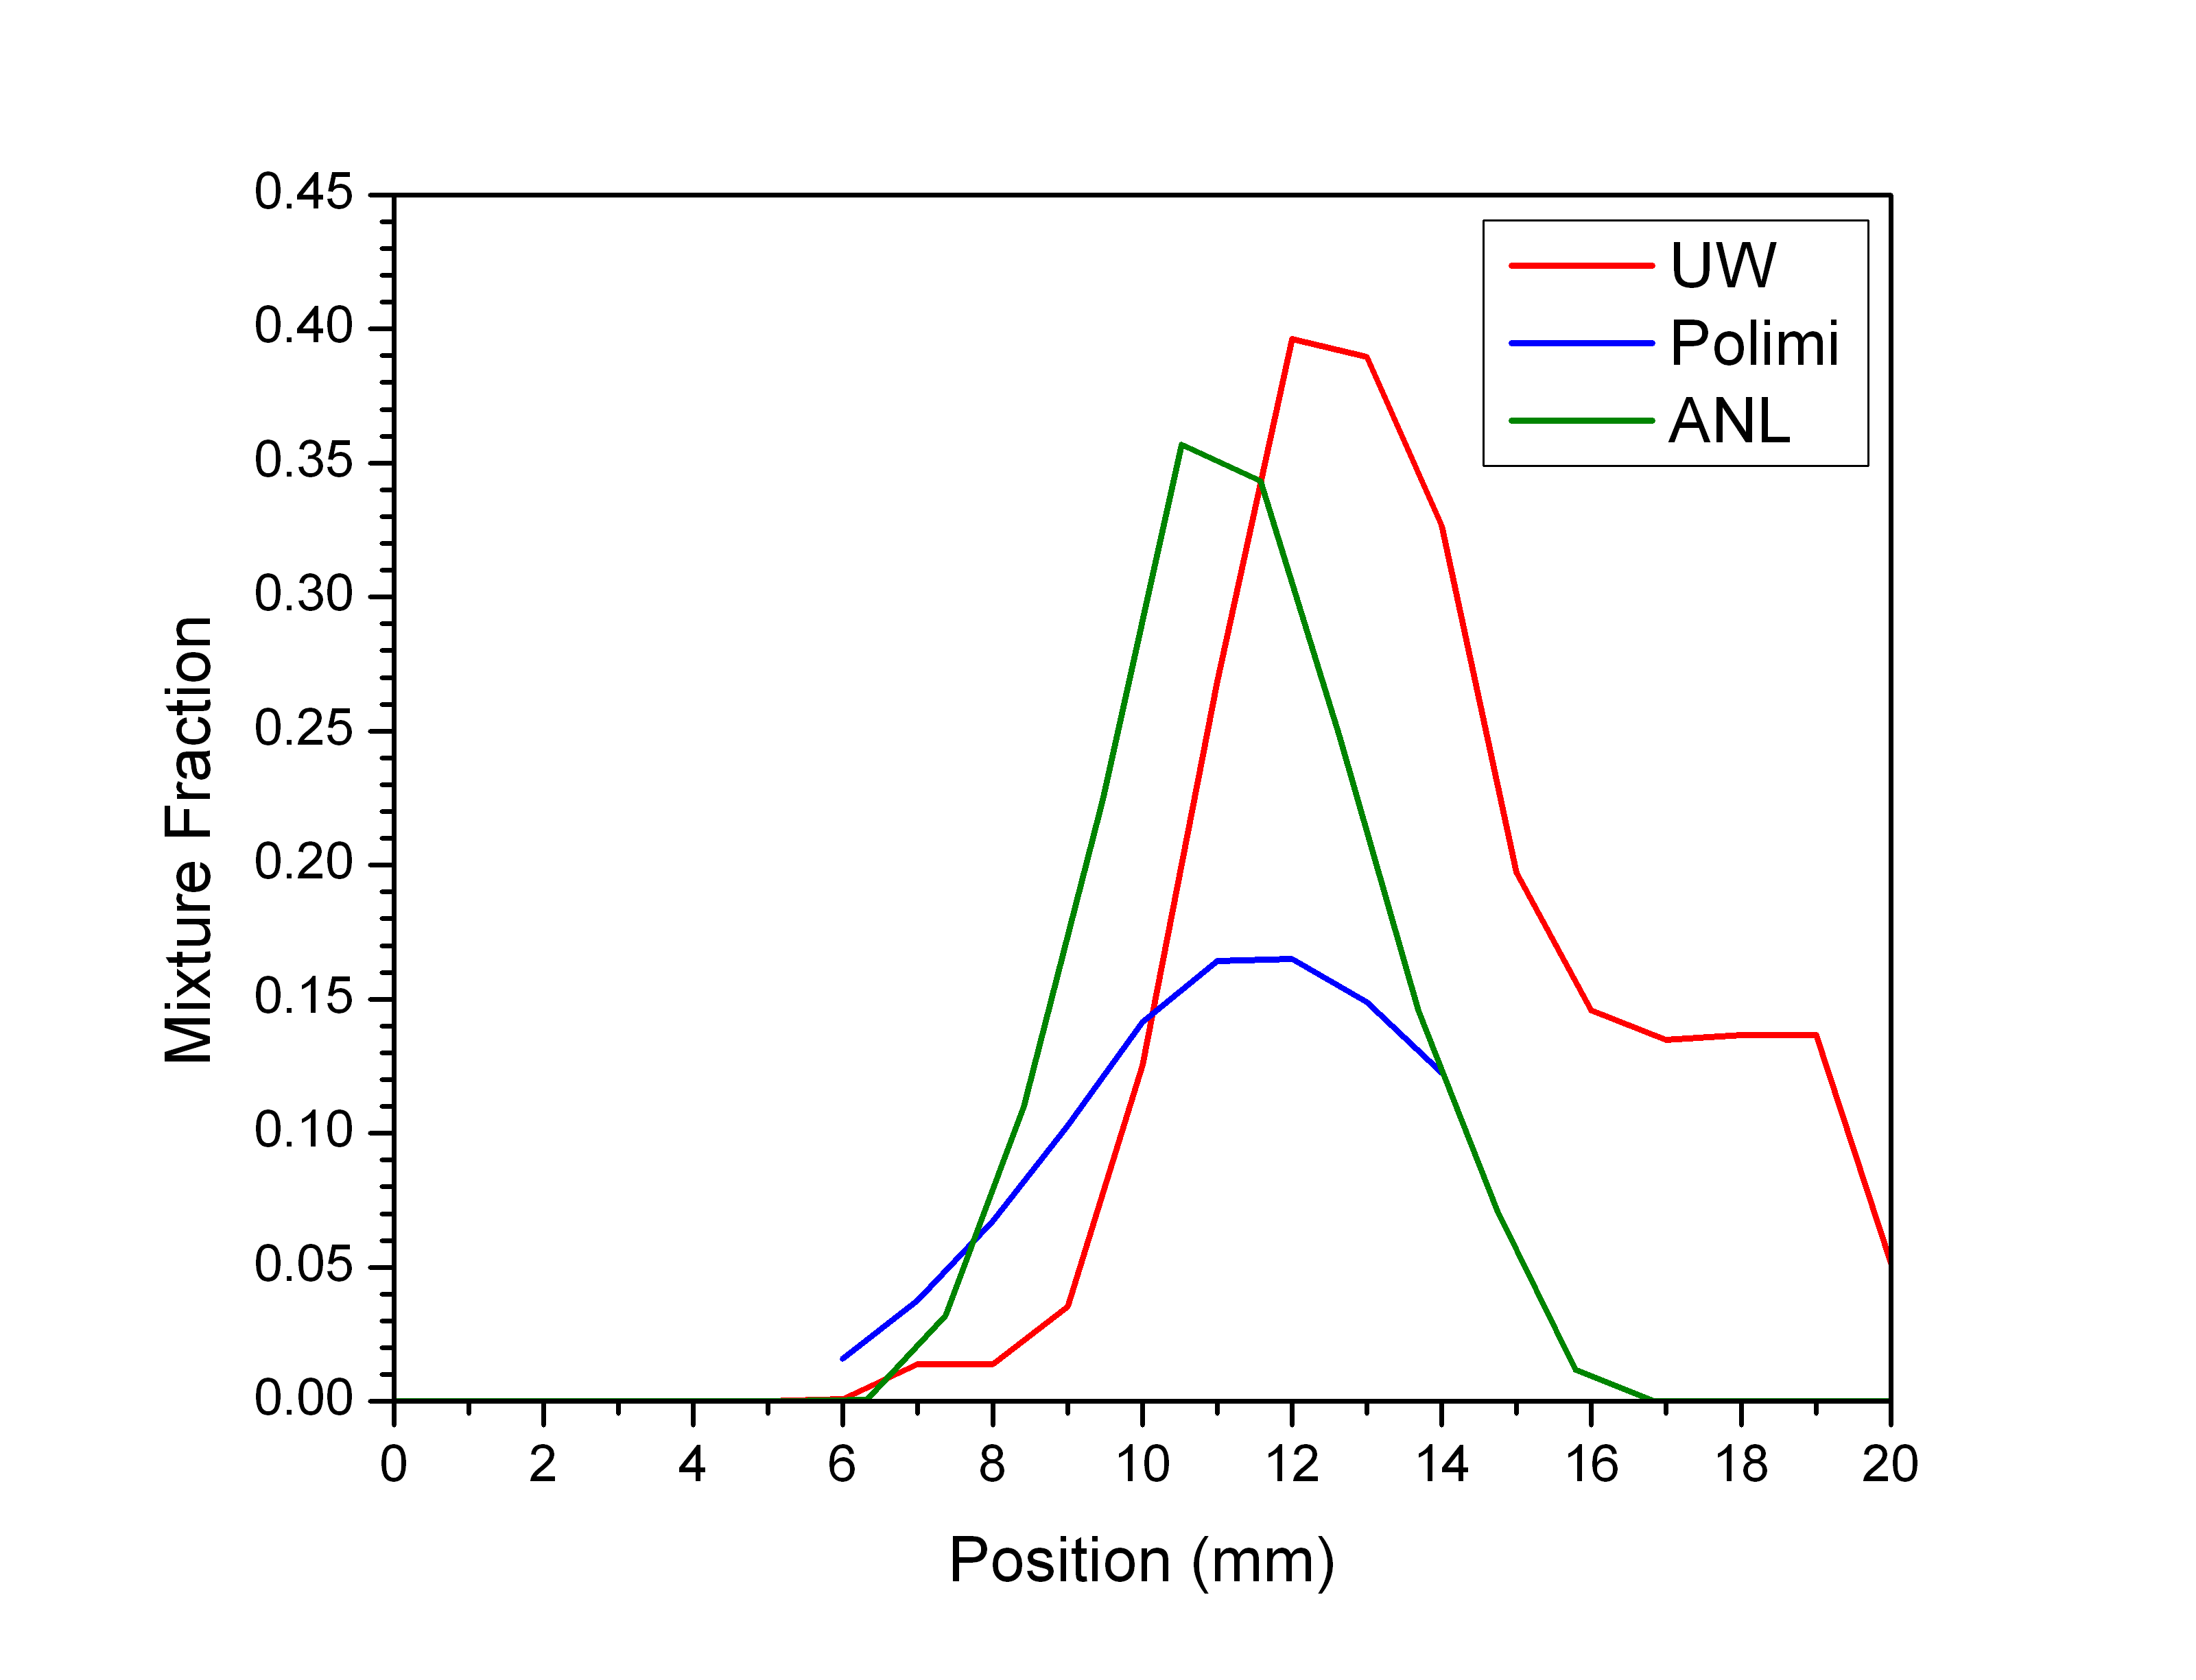
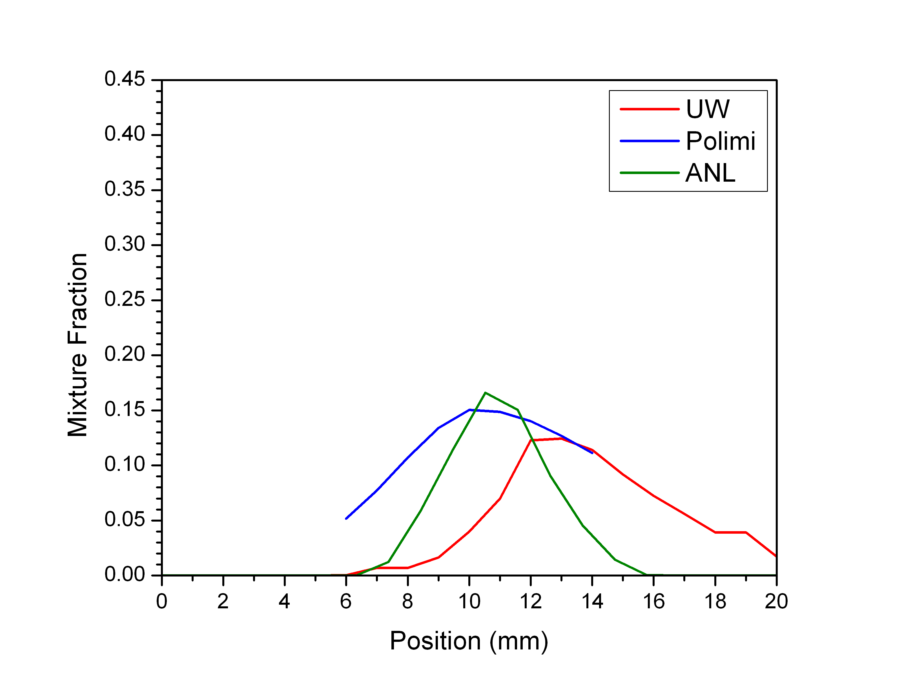
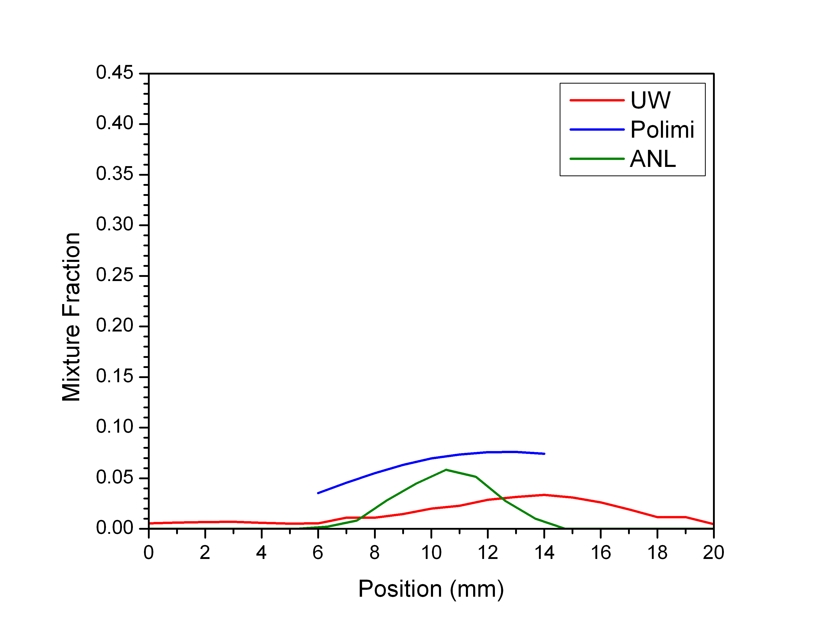
Mixture Fraction Profile – Radial Profile
0.6 ms ASOI
1.0 ms ASOI
1.4 ms ASOI

Slide 31
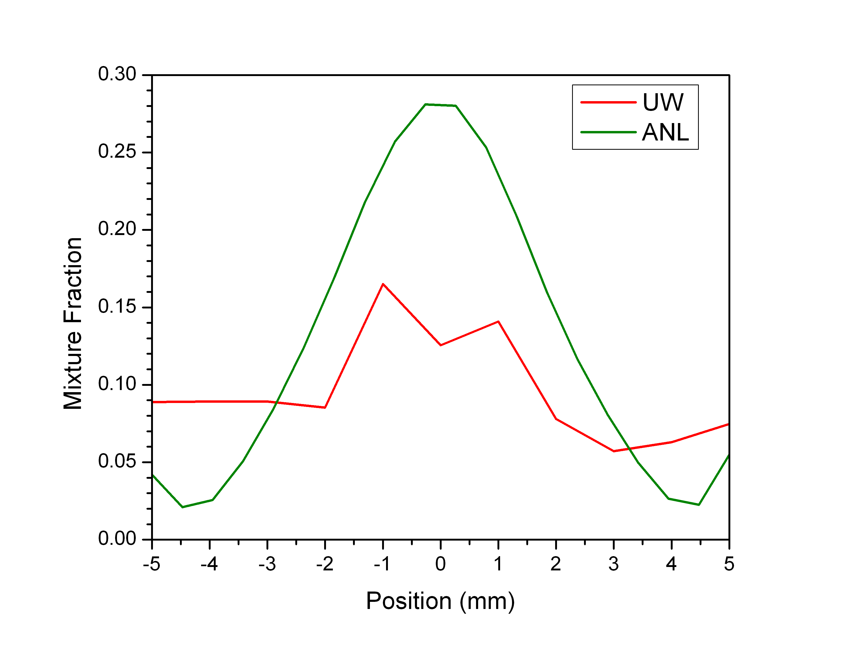
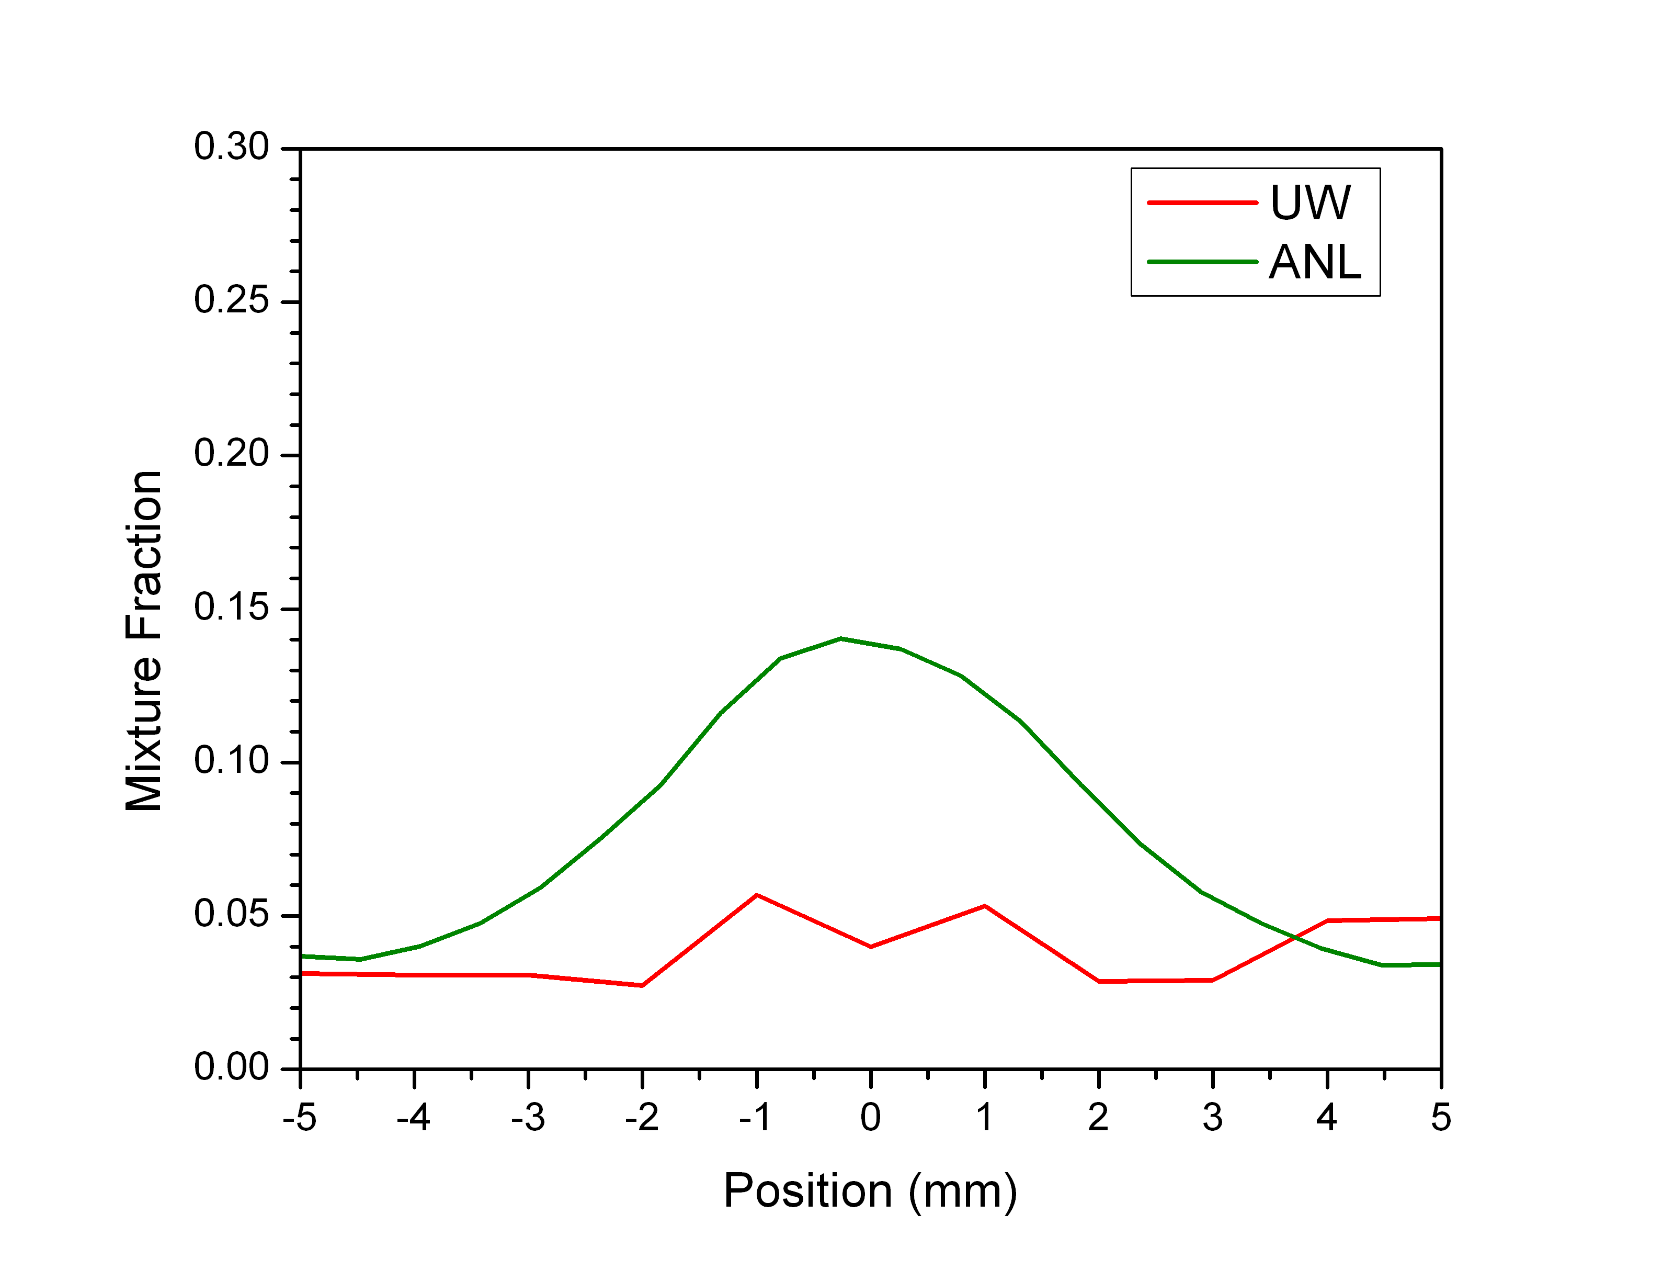
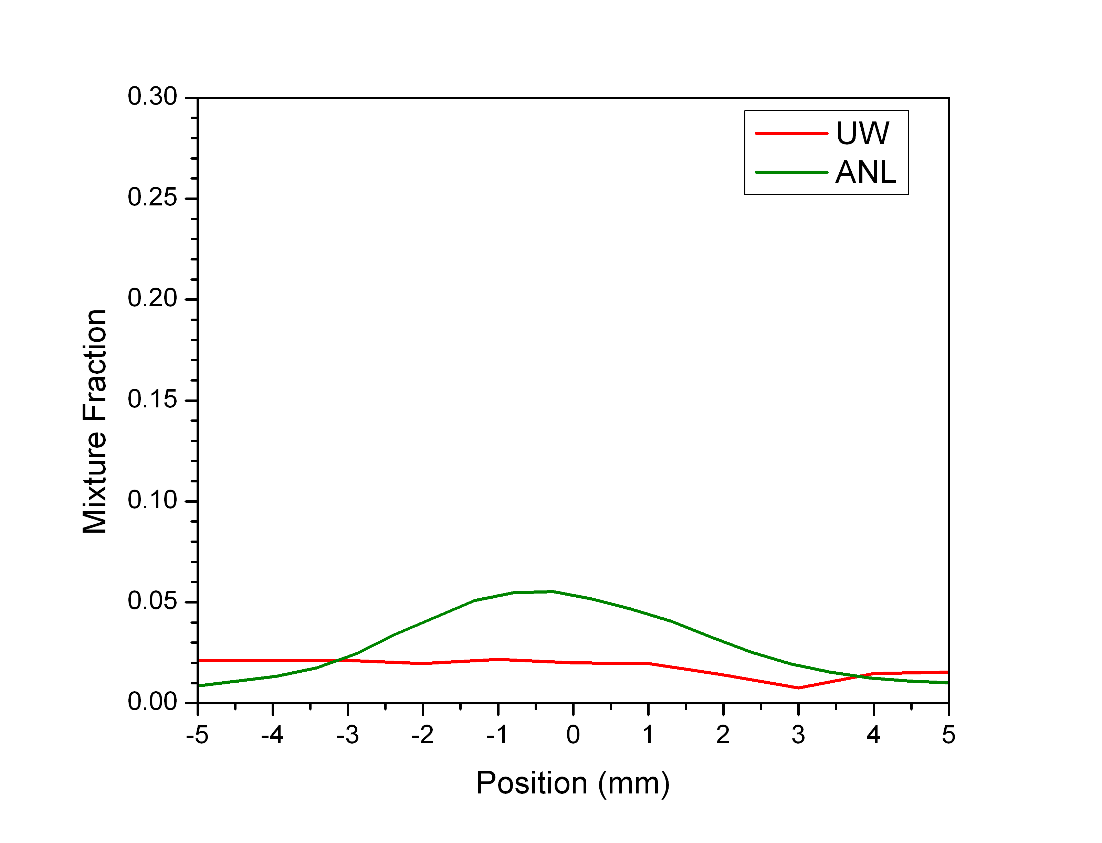
Mixture Fraction Profile – Transverse Profile
0.6 ms ASOI
1.0 ms ASOI
1.4 ms ASOI

Slide 32
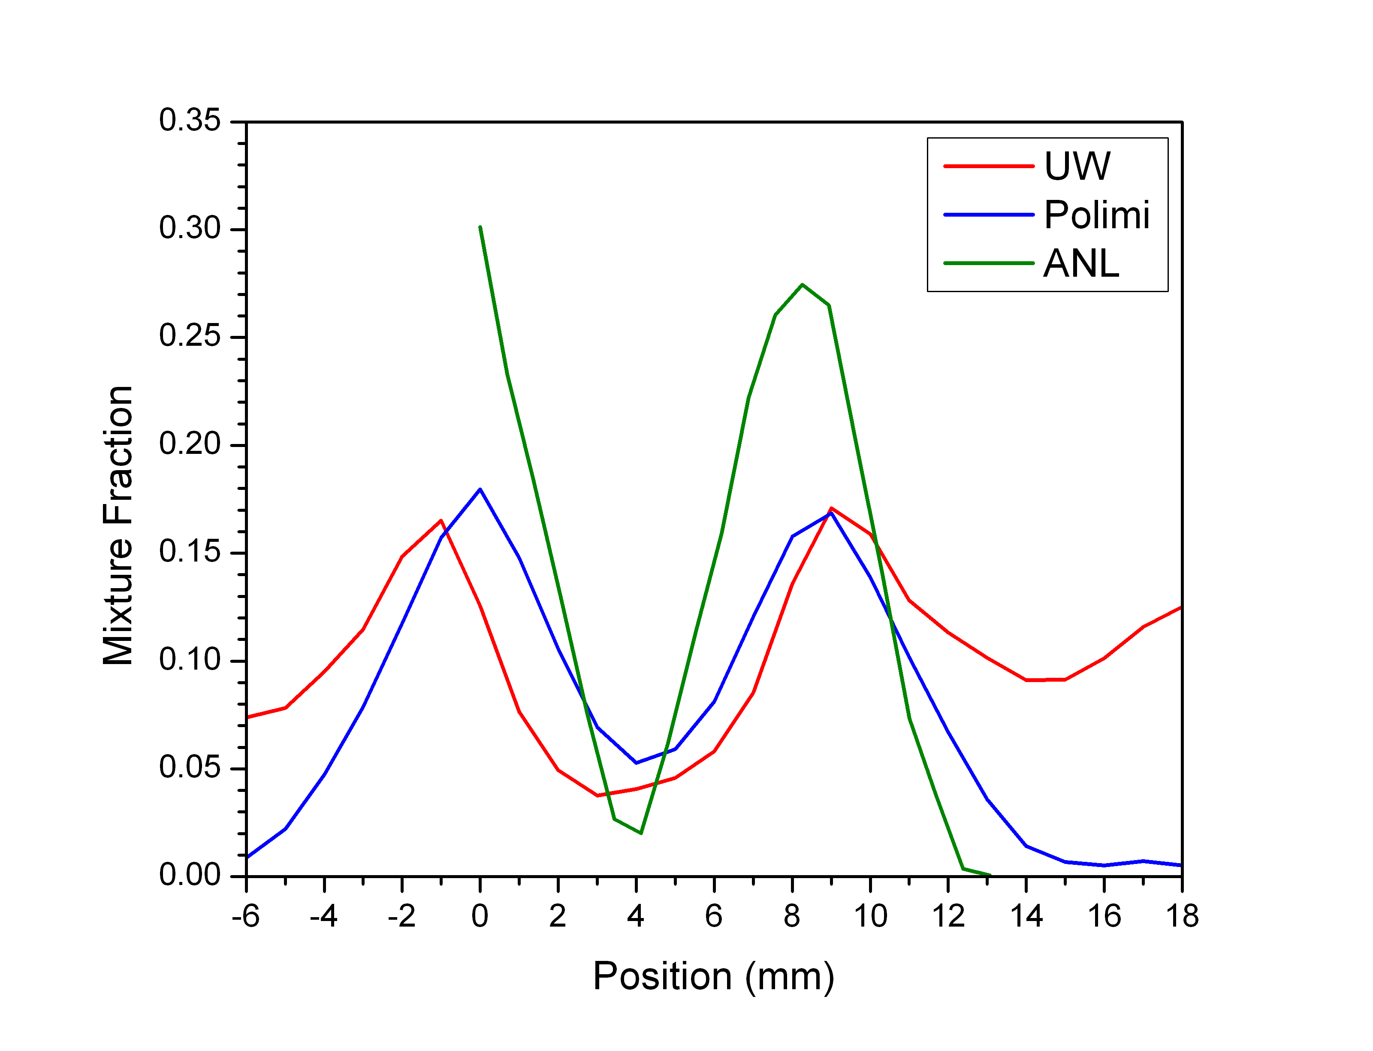
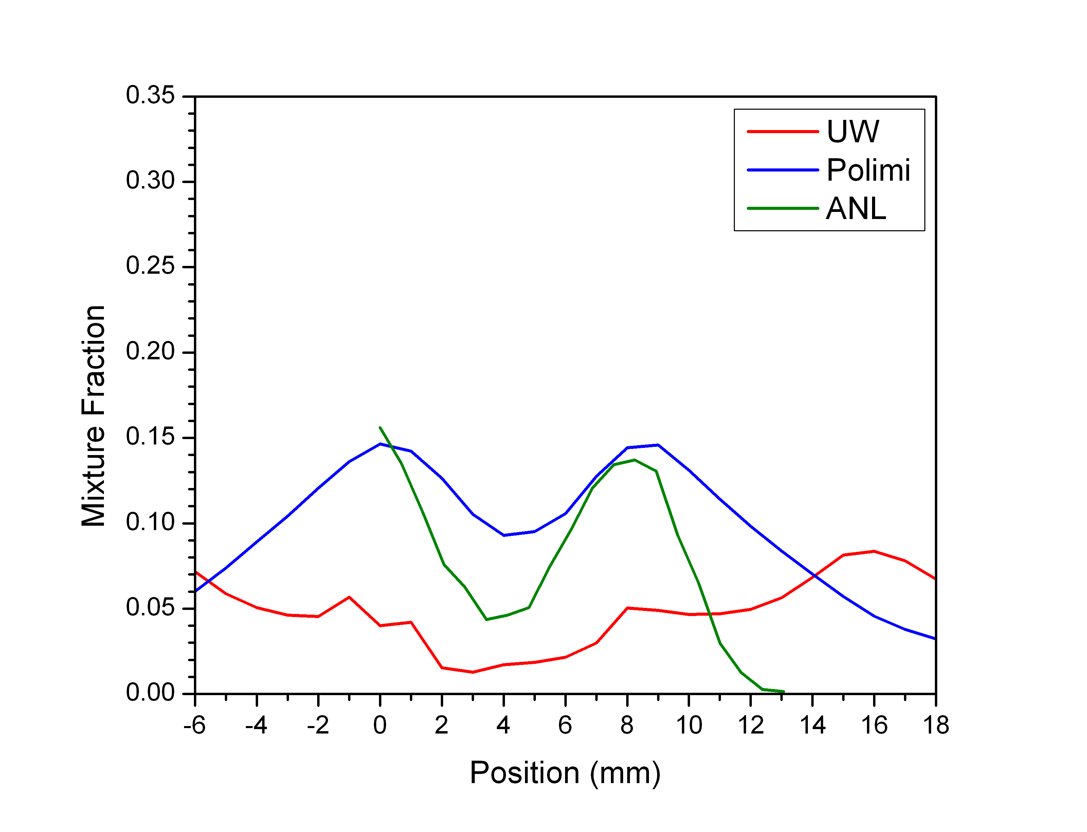
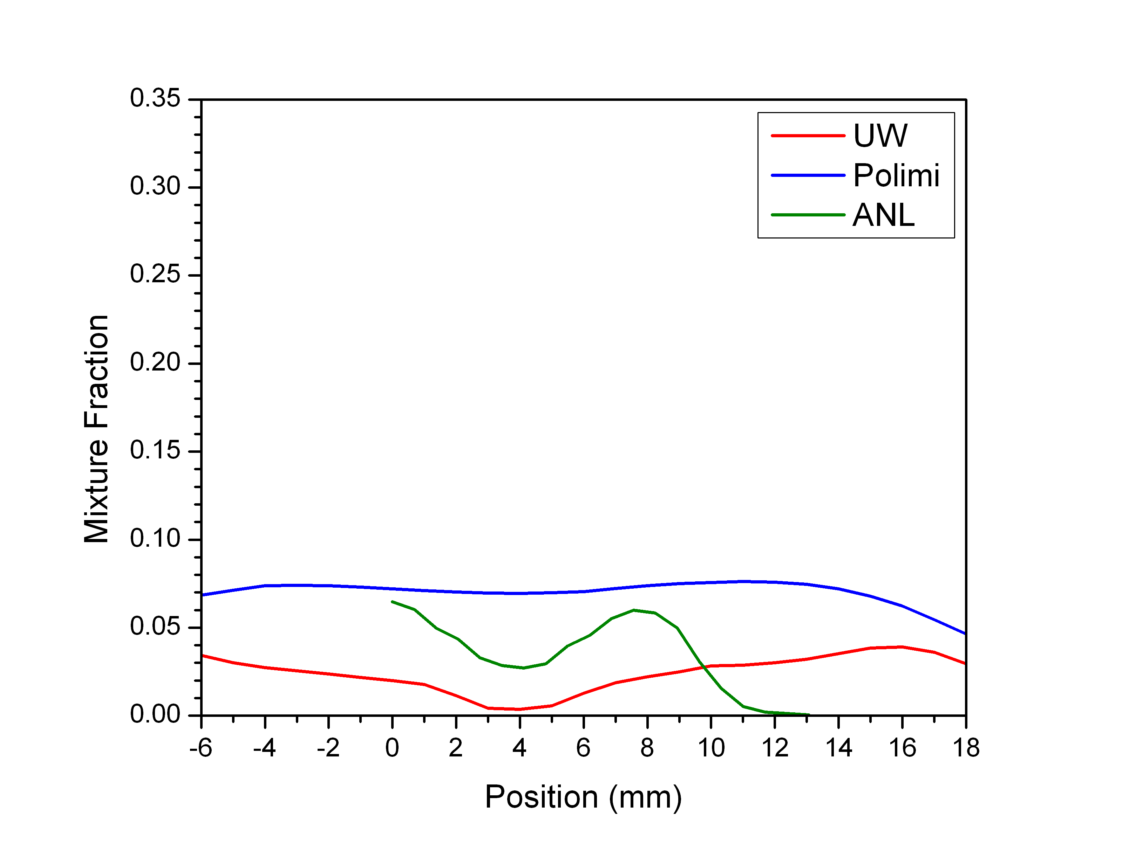
Mixture Fraction Profile – Dual-plume Profile
0.6 ms ASOI
1.0 ms ASOI
1.4 ms ASOI

Slide 33
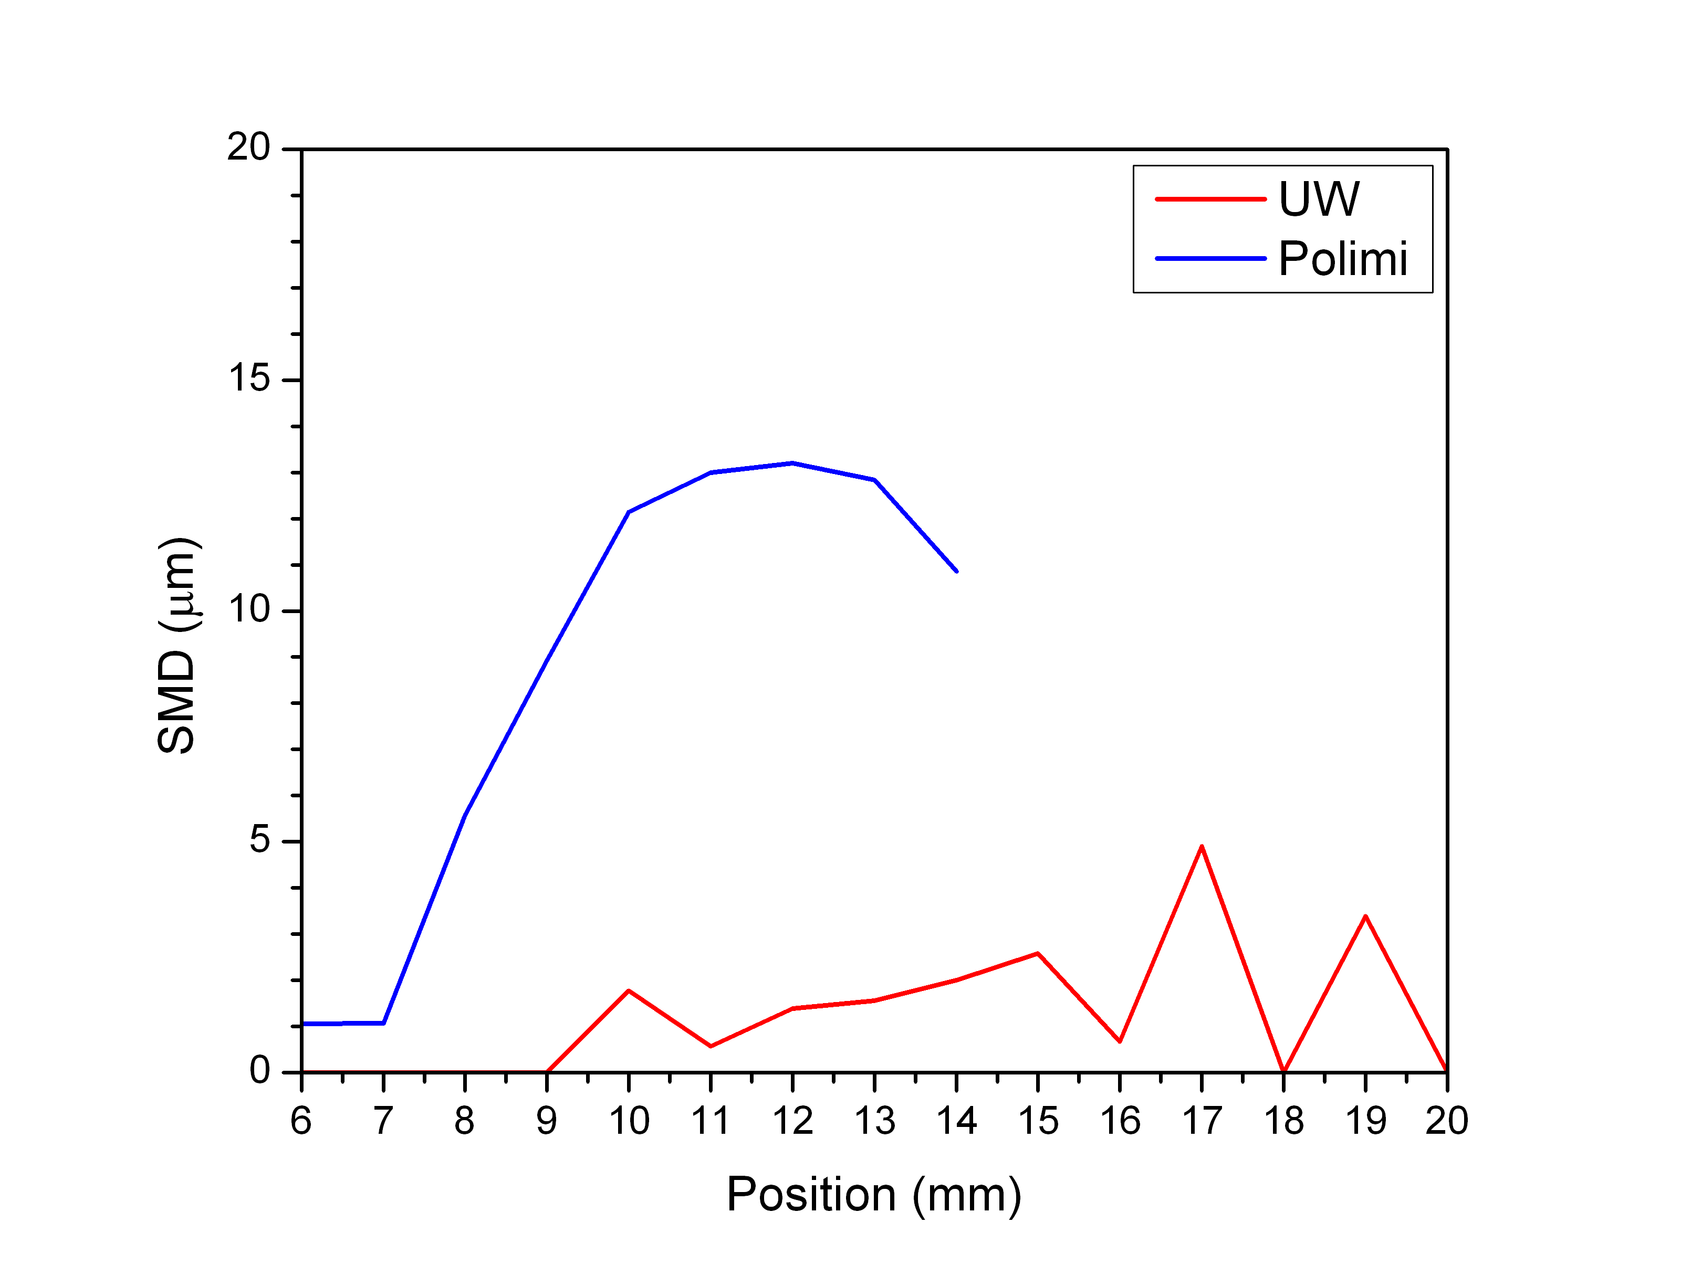
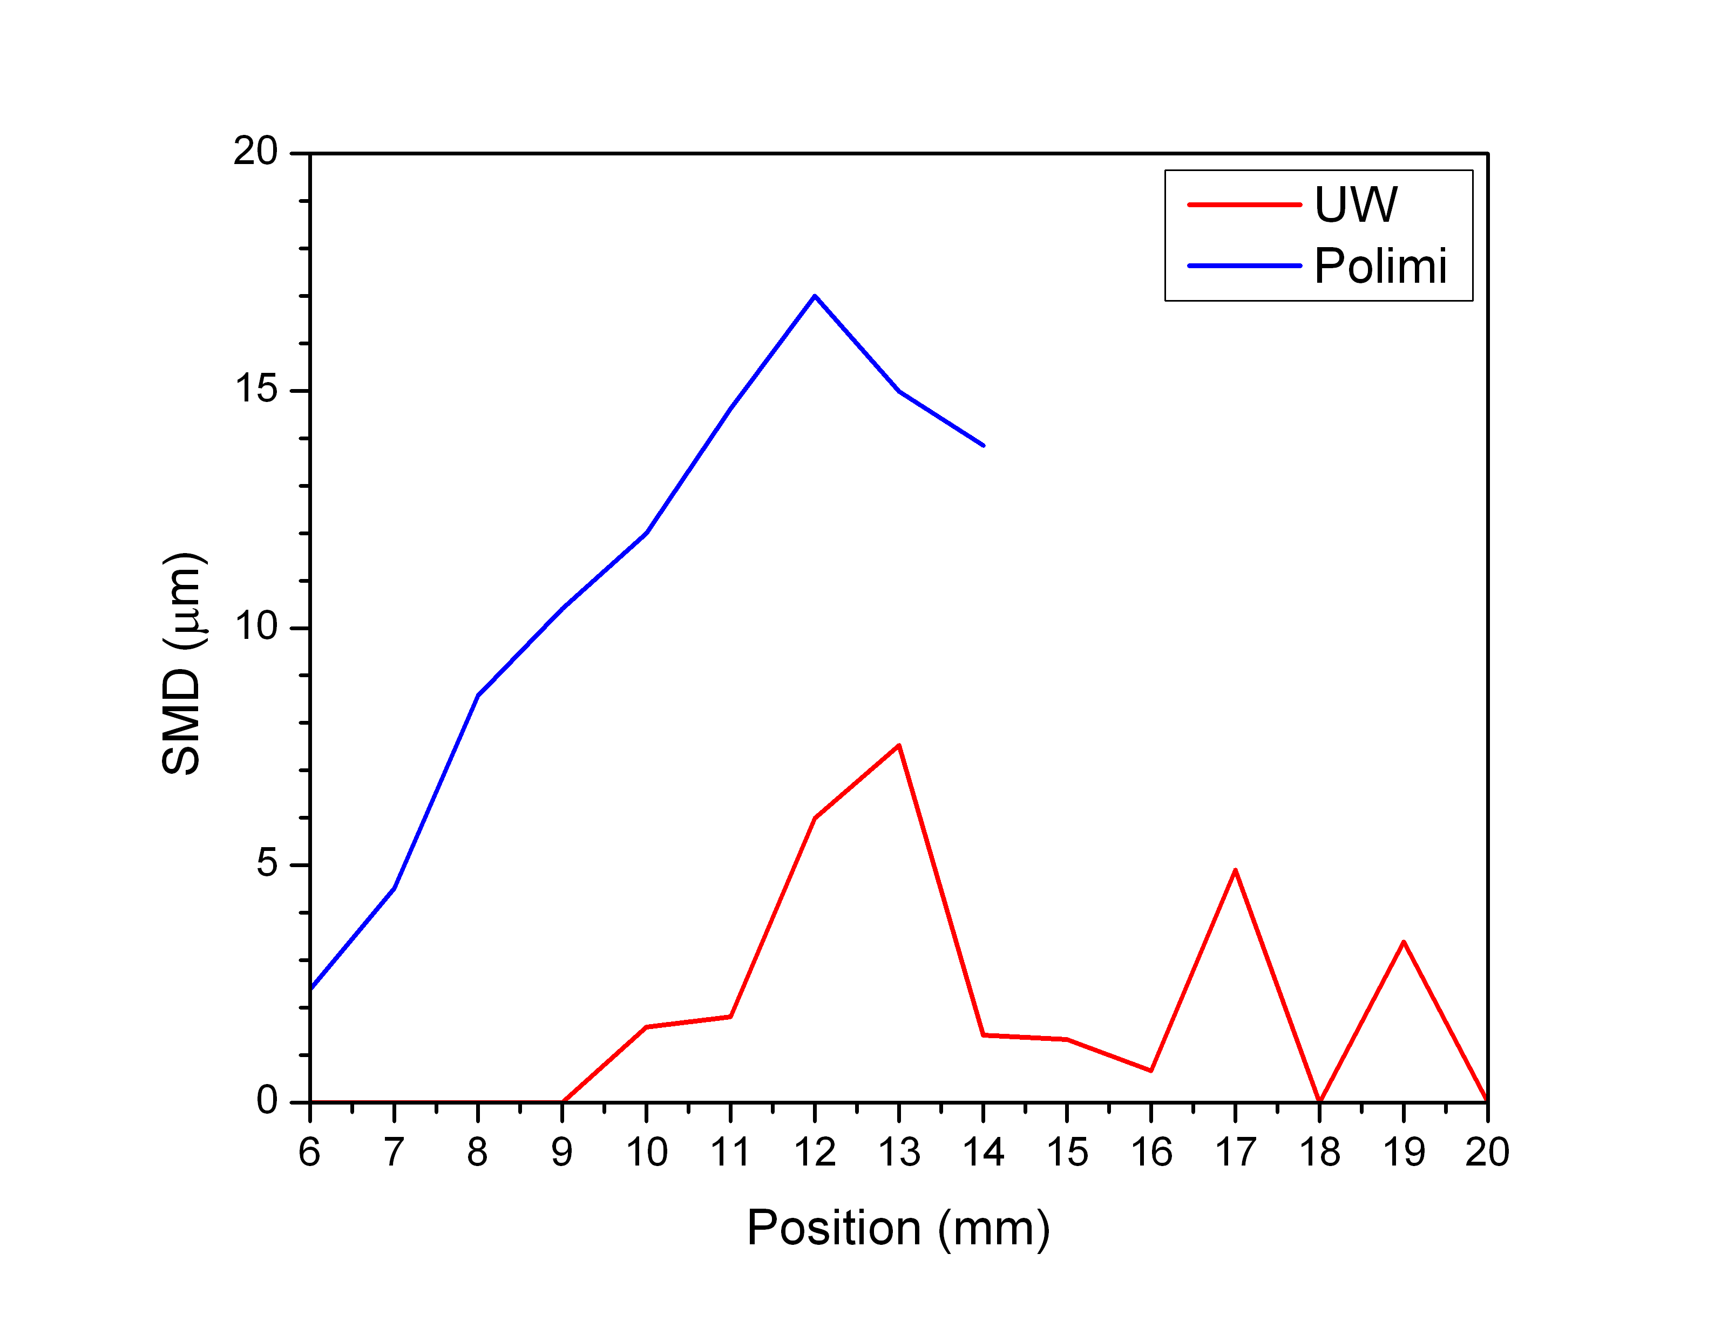
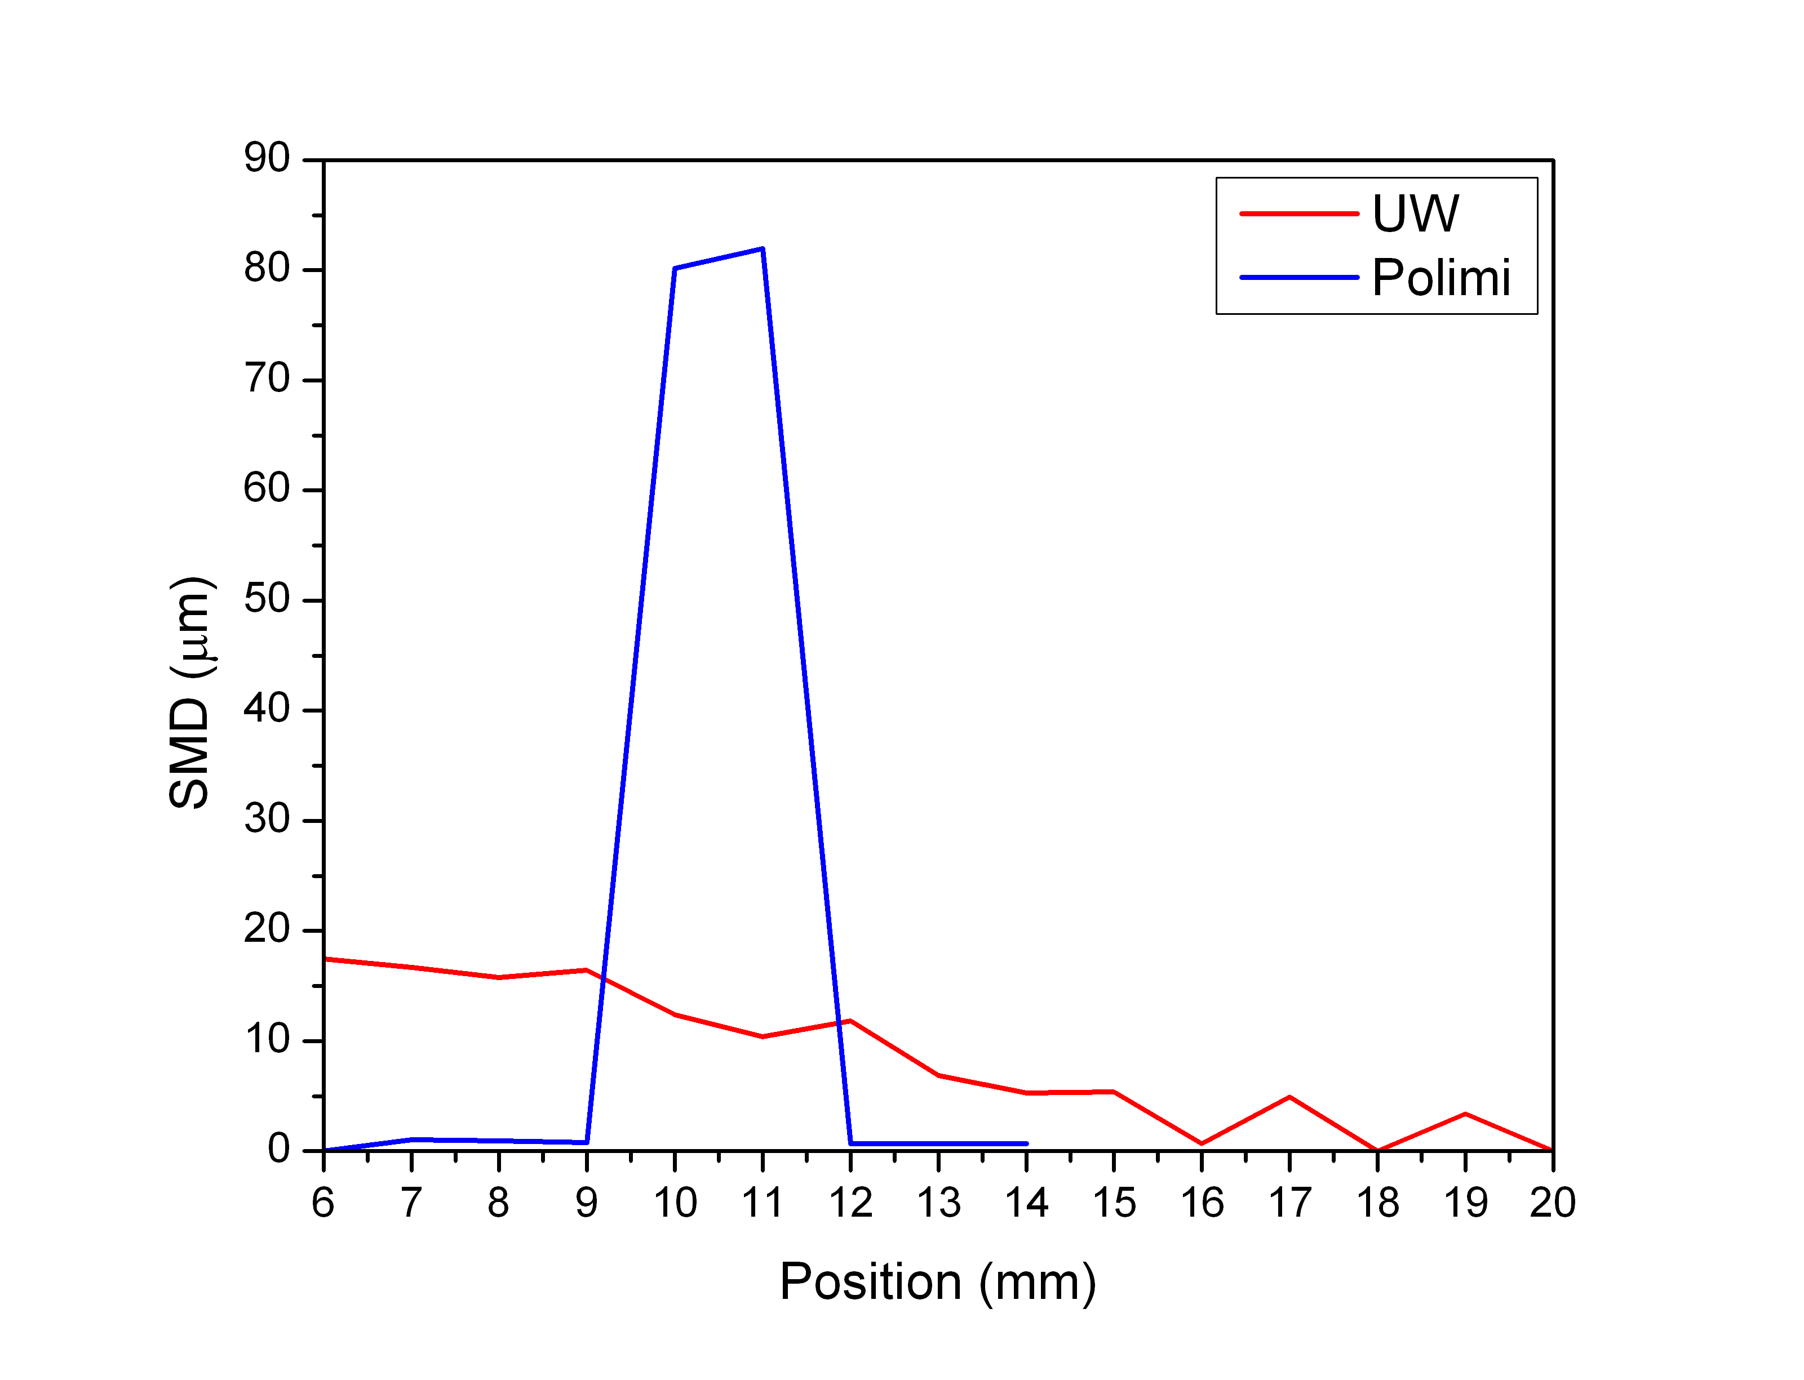
SMD Profile – Radial Profile
0.6 ms ASOI
1.0 ms ASOI
1.4 ms ASOI

Slide 34
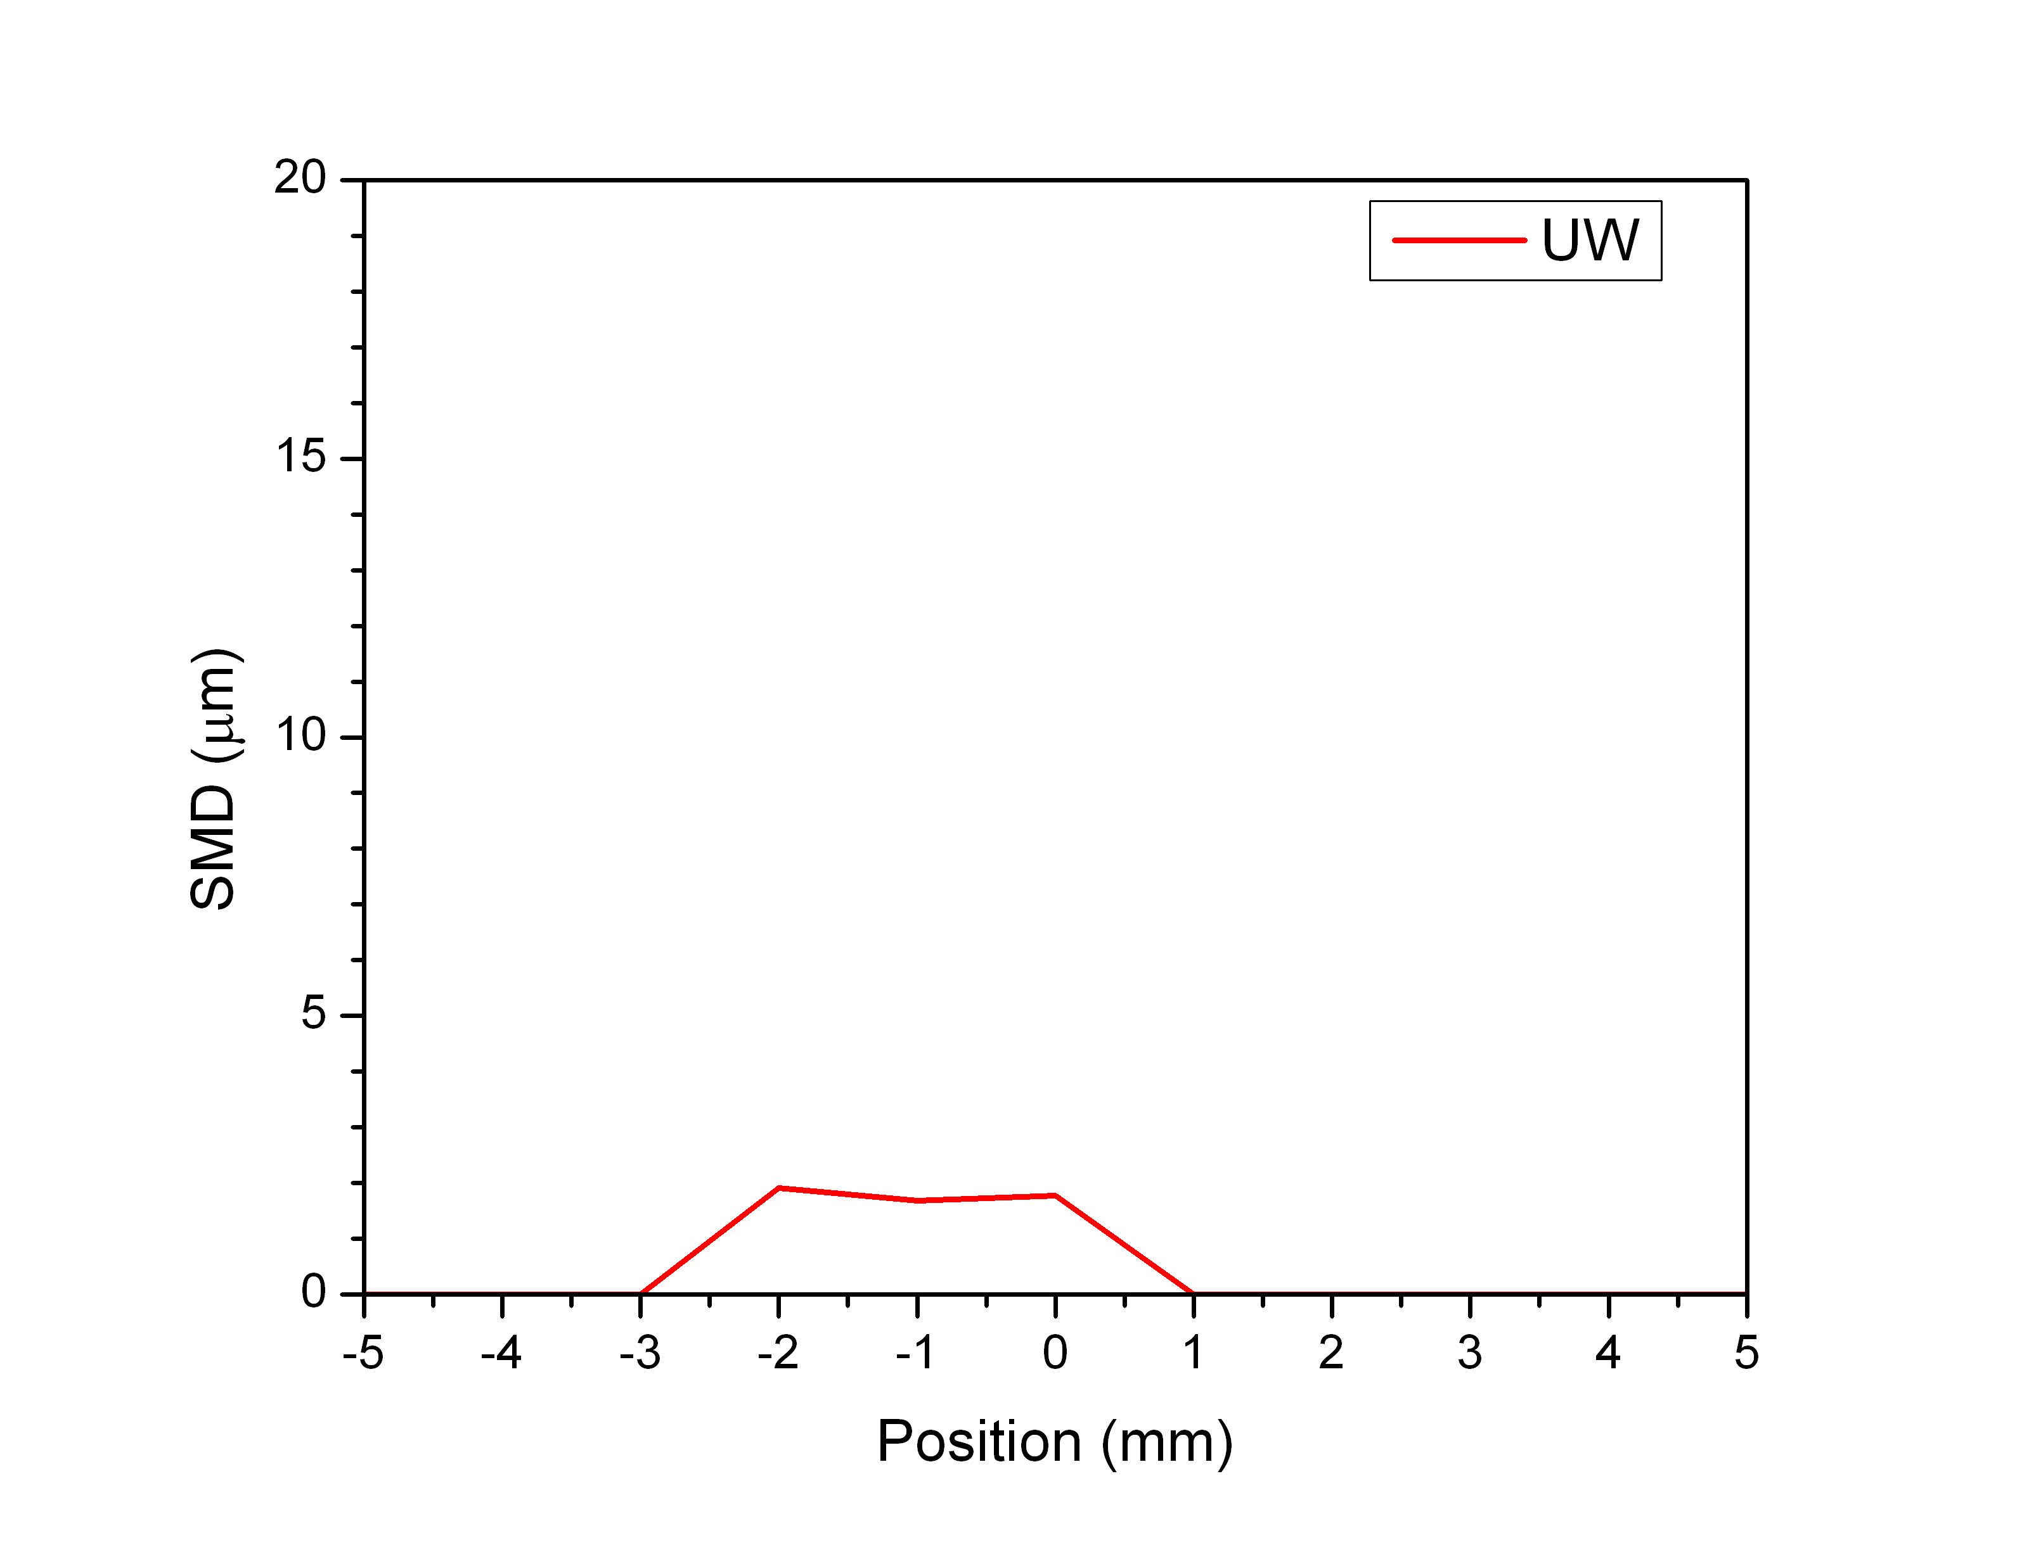
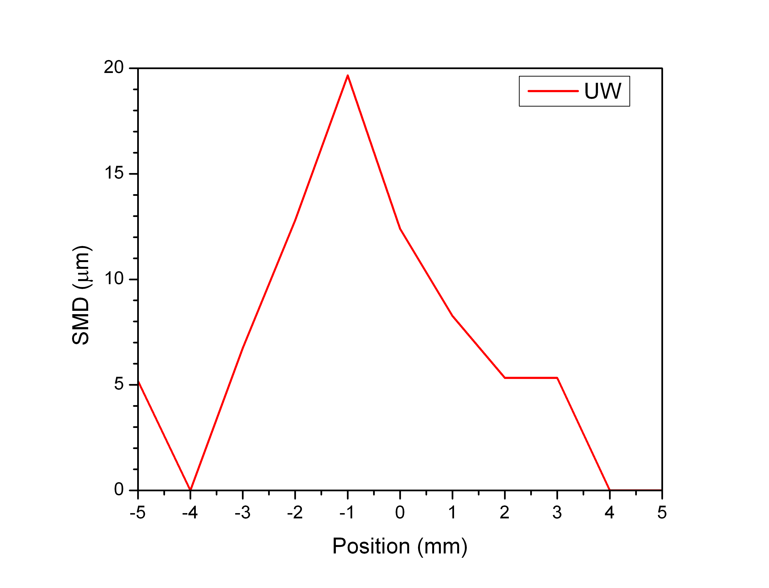
SMD Profile – Transverse Profile
0.6 ms ASOI
1.0 ms ASOI
1.4 ms ASOI

Slide 35
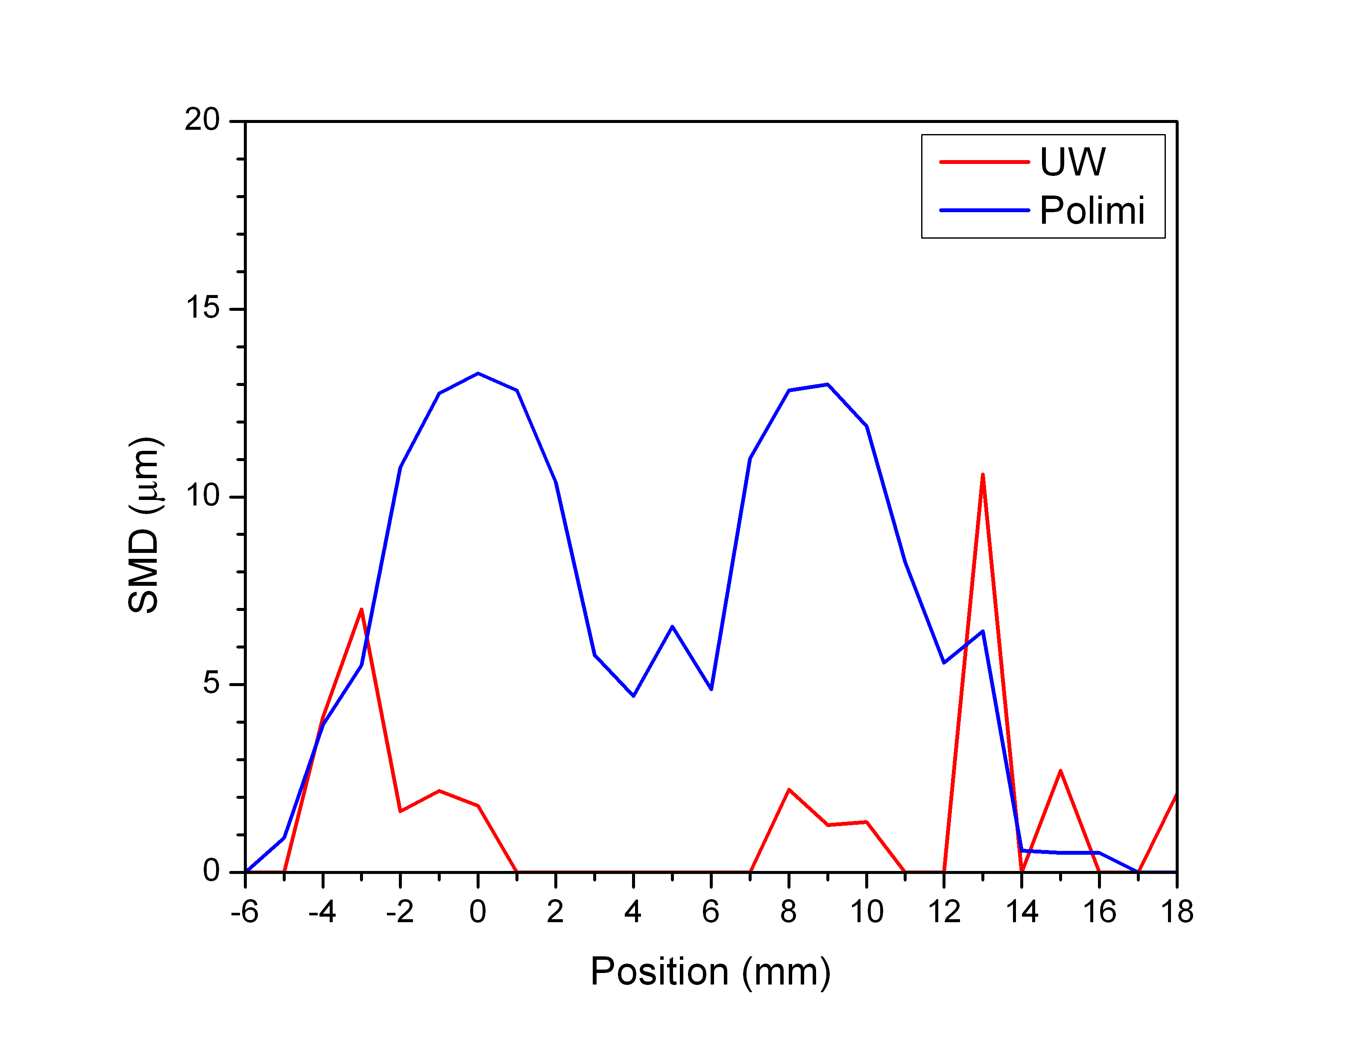
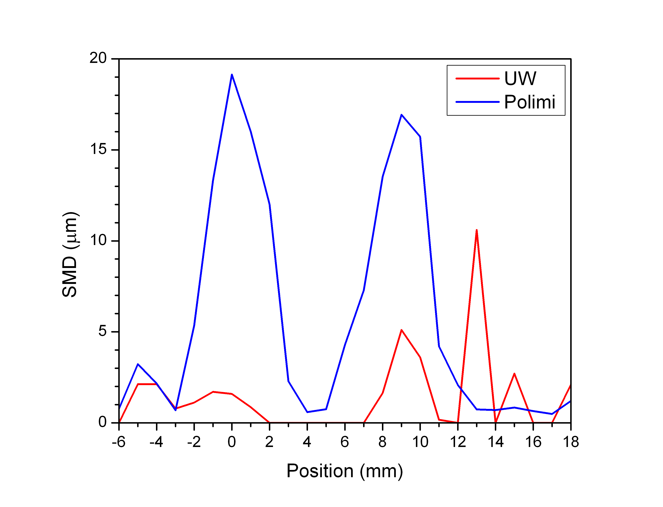
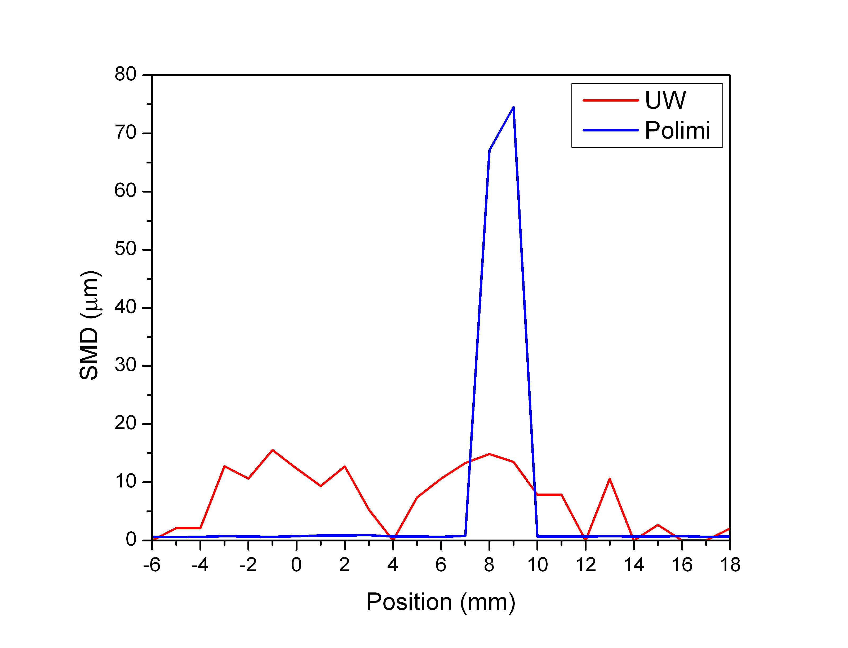
SMD Profile – Dual-plume Profile
0.6 ms ASOI
1.0 ms ASOI
1.4 ms ASOI

Slide 36
Summary
Penetration all similar to experimental data
Initial transients should be investigated more
Liquid vaporization time incorrect?
Best practice to compare liquid images?
Upstream (near-nozzle) vapor behavior, detached or not?
Some simulations may be under-resolved

Slide 37
Future Work
More accurate boundary conditions from experiments
Hole specific boundary conditions?
Parametric variations
Better ways to understand spray-to-spray interactions

Slide 39
Mixture Fraction Profile – Spray Axis
0.6 ms ASOI

Slide 40
Mixture Fraction Profile – Spray Axis
0.8 ms ASOI

Slide 41
Mixture Fraction Profile – Spray Axis
1.0 ms ASOI

Slide 42
Mixture Fraction Profile – Spray Axis
1.2 ms ASOI

Slide 43
Mixture Fraction Profile – Spray Axis
1.4 ms ASOI

Slide 44
Mixture Fraction Profile – Injector Axis
0.6 ms ASOI

Slide 45
Mixture Fraction Profile – Injector Axis
0.8 ms ASOI

Slide 46
Mixture Fraction Profile – Injector Axis
1.0 ms ASOI

Slide 47
Mixture Fraction Profile – Injector Axis
1.2 ms ASOI

Slide 48
Mixture Fraction Profile – Injector Axis
1.4 ms ASOI

Slide 49
Mixture Fraction Profile – Radial Profile
0.6 ms ASOI

Slide 50
Mixture Fraction Profile – Radial Profile
0.8 ms ASOI

Slide 51
Mixture Fraction Profile – Radial Profile
1.0 ms ASOI

Slide 52
Mixture Fraction Profile – Radial Profile
1.2 ms ASOI

Slide 53
Mixture Fraction Profile – Radial Profile
1.4 ms ASOI

Slide 54
Mixture Fraction Profile – Transverse Profile
0.6 ms ASOI

Slide 55
Mixture Fraction Profile – Transverse Profile
0.8 ms ASOI

Slide 56
Mixture Fraction Profile – Transverse Profile
1.0 ms ASOI

Slide 57
Mixture Fraction Profile – Transverse Profile
1.2 ms ASOI

Slide 58
Mixture Fraction Profile – Transverse Profile
1.4 ms ASOI

Slide 59
Mixture Fraction Profile – Dual-plume Profile
0.6 ms ASOI

Slide 60
Mixture Fraction Profile – Dual-plume Profile
0.8 ms ASOI

Slide 61
Mixture Fraction Profile – Dual-plume Profile
1.0 ms ASOI

Slide 62
Mixture Fraction Profile – Dual-plume Profile
1.4 ms ASOI

Slide 63
Mixture Fraction Profile – Dual-plume Profile
0.6 ms ASOI

Slide 64
SMD Profile – Radial Profile
0.6 ms ASOI

Slide 65
SMD Profile – Radial Profile
0.8 ms ASOI

Slide 66
SMD Profile – Radial Profile
1.0 ms ASOI

Slide 67
SMD Profile – Radial Profile
1.2 ms ASOI

Slide 68
SMD Profile – Radial Profile
1.4 ms ASOI

Slide 69
SMD Profile – Transverse Profile
0.6 ms ASOI

Slide 70
SMD Profile – Transverse Profile
0.8 ms ASOI

Slide 71
SMD Profile – Transverse Profile
1.0 ms ASOI

Slide 72
SMD Profile – Transverse Profile
1.2 ms ASOI

Slide 73
SMD Profile – Transverse Profile
1.4 ms ASOI

Slide 74
SMD Profile – Dual-plume Profile
0.6 ms ASOI

Slide 75
SMD Profile – Dual-plume Profile
0.8 ms ASOI

Slide 76
SMD Profile – Dual-plume Profile
1.0 ms ASOI

Slide 77
SMD Profile – Dual-plume Profile
1.2 ms ASOI

Slide 78
SMD Profile – Dual-plume Profile
1.4 ms ASOI

