Slide 1
Spray G – Drop Sizing
Gasoline Spray (Spray G)
Topic 3.4 Drop size measurement
    Scott Parrish (GM)

Slide 2
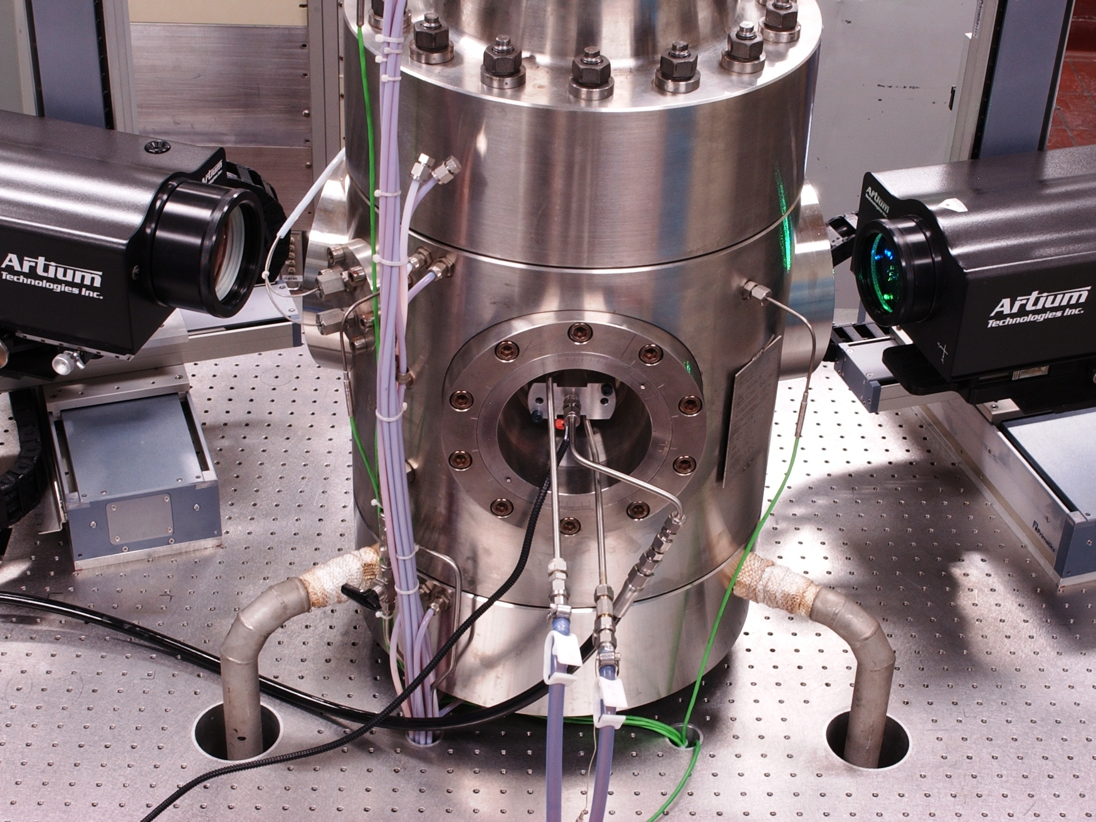
Optics
Collection angle (°) | 35
Refractive Index | 1.39
 | Ch 1 | Ch 2
Wavelengths (nm) | 532 | 491
Focal length (mm) | 320 | 320
Beam spacing (mm) | 60 | 60
Beam diameter (mm) | 3.5 | 3.5
Frequence Shift (MHz) | 40 | 45
Fring spacing (μm) | 2.9 | 2.9
Beam waist diameter (μm) | 61.9 | 59.2
Slit width (μm) | variable (25-50)
Processors Set-Up
FFT Bins | 2048 | 2048
Analog filter (MHz) | 80 | 80
Variable Mixer (MHz) | 45 | 35
Sample Rate (MHz) | 160 | 160
BD Decimation | none | none
Amplitude threashold (mV) | 100 | 200

Slide 3
Spray G – Drop Sizing (GM)
PDI Measurement Locations
15 mm
10 mm
Note: perform preliminary measurements to identify center of plume

Slide 4
Spray G – Drop Sizing (GM)
13 mm Radial
15 mm

Slide 5
Spray G – Drop Sizing (GM)
10 mm Radial
15 mm

Slide 6
Spray G – Drop Sizing (GM)
15 mm
10 mm
Radial Scan
Transverse Scan

Slide 7
Spray G – Drop Sizing (GM)

Slide 8
Spray G – Drop Sizing (GM)
15 mm
10 mm
Radial Scan
Transverse Scan

Slide 9
Spray G – Drop Sizing (GM)
15 mm
-3 mm Transverse

Slide 10
Spray G – Drop Sizing (GM)
3 mm Transverse
15 mm

Slide 11
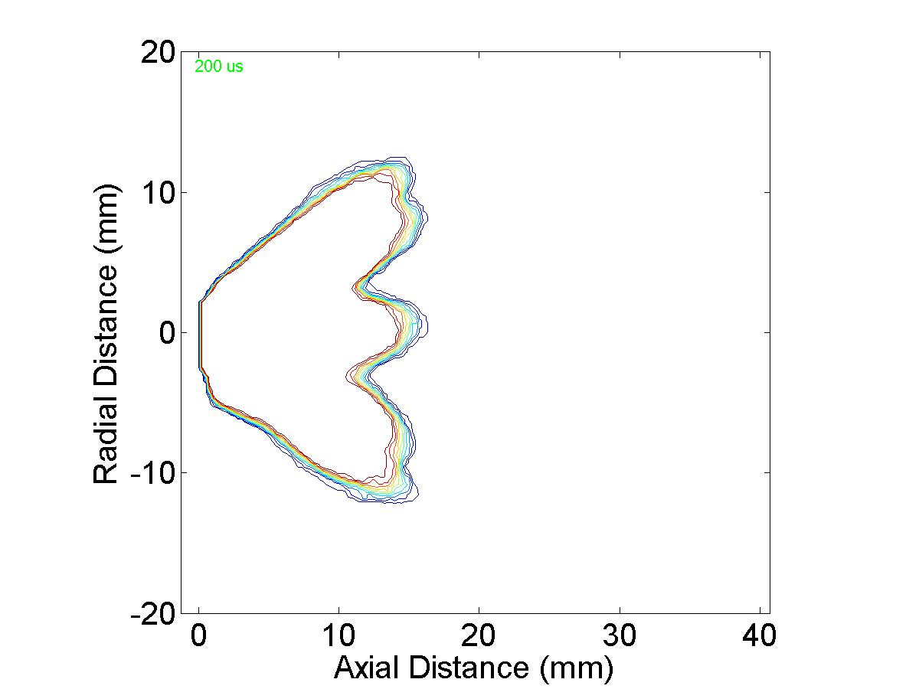
Spray G – Drop Sizing (GM)
200 μs

Slide 12
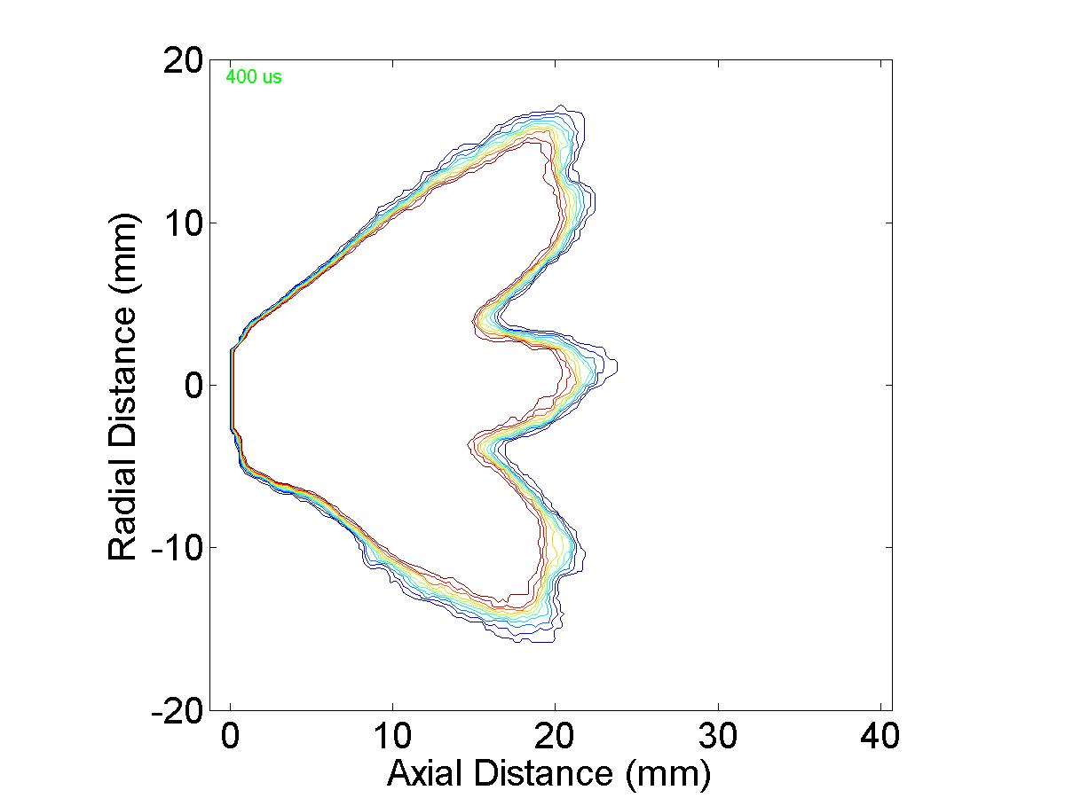
Spray G – Drop Sizing (GM)
400 μs

Slide 13
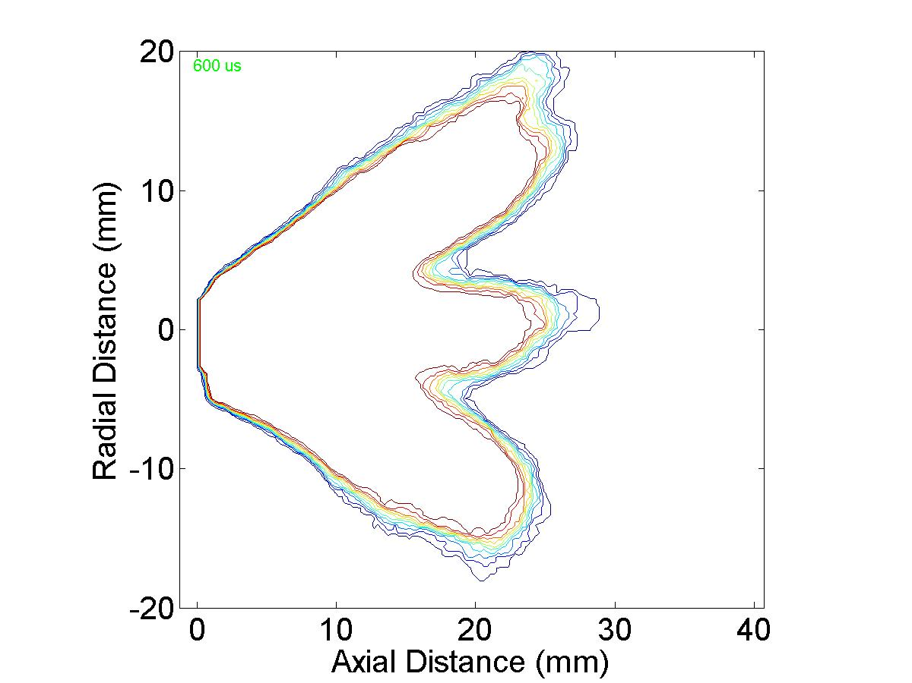
Spray G – Drop Sizing (GM)
600 μs

Slide 14
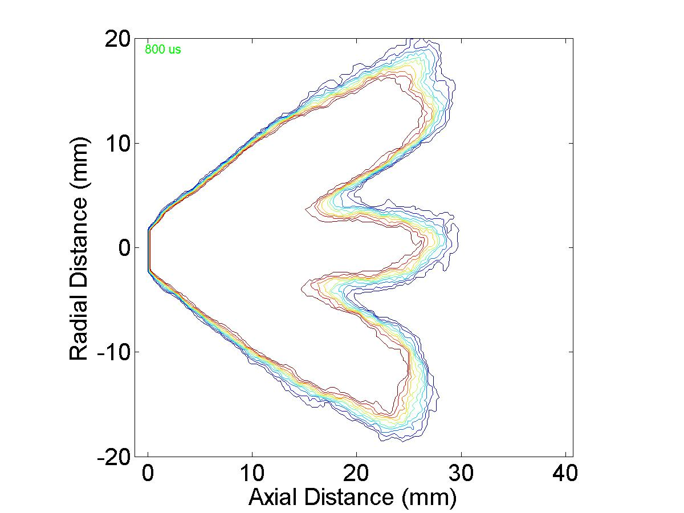
Spray G – Drop Sizing (GM)
800 μs

Slide 15
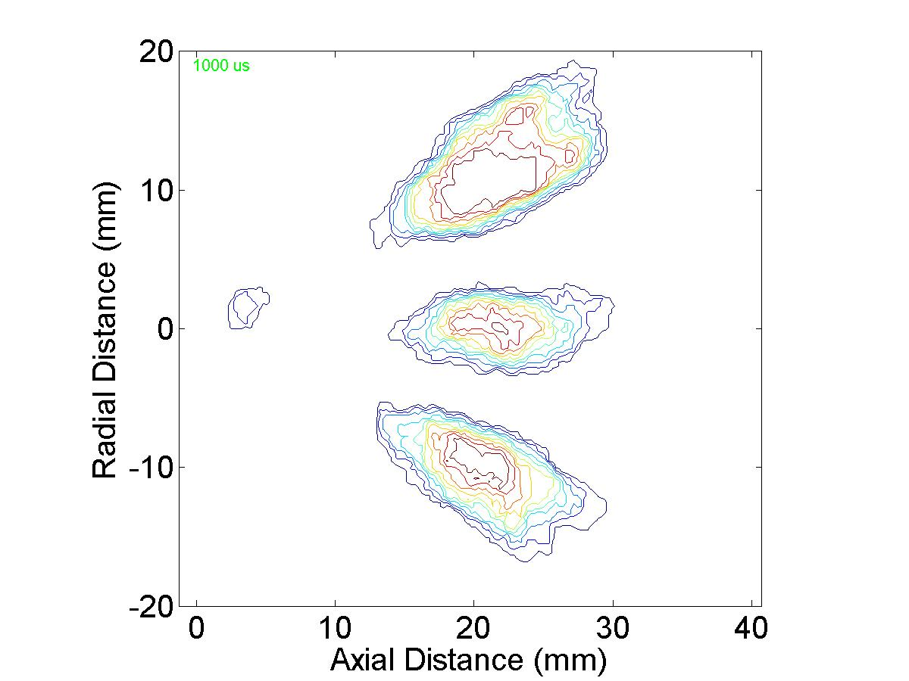
Spray G – Drop Sizing (GM)
1000 μs

