Slide 1
Engine Combustion Network Liquid-length measurements via diffused back-illumination
Michele Bardi (CMT)
Julien Manin (Sandia)
Lyle Pickett (Sandia)
ECN Web-meeting September 2011

Slide 2
Table of content: Diffused back-illumination
Experimental setup
Processing and preliminary results
Experimental exploration to understand the results
Conclusions
Future exploration

Slide 3
Experimental setup for diffused back-illumination
High speed digital camera for time-resolve spray development and liquid length measurement (50 000 frames per second)
Diffuser back illumination with LED lighting (duration as short as 1 µs)
Nikkor lens 100 mm f/2.4 (approx. 7.5 pix/mm)
Spray A as target condition – Other conditions explored
Phantom
50 kfps
Nikkor lens
100 mm, f/2.4

Slide 4
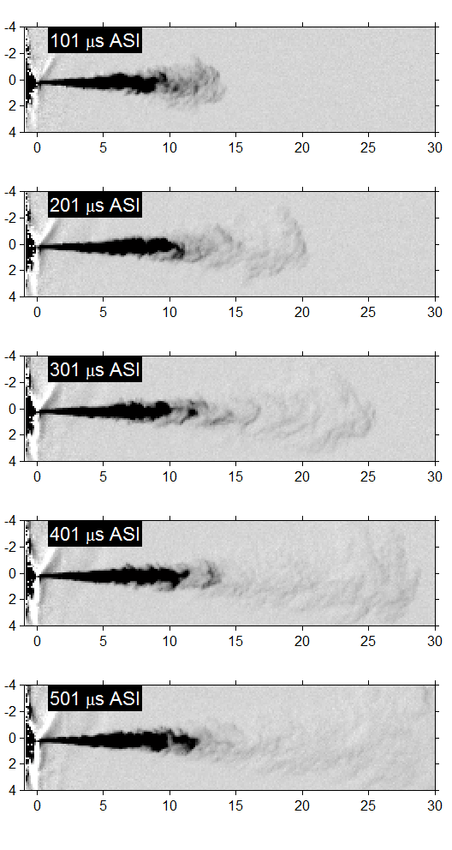
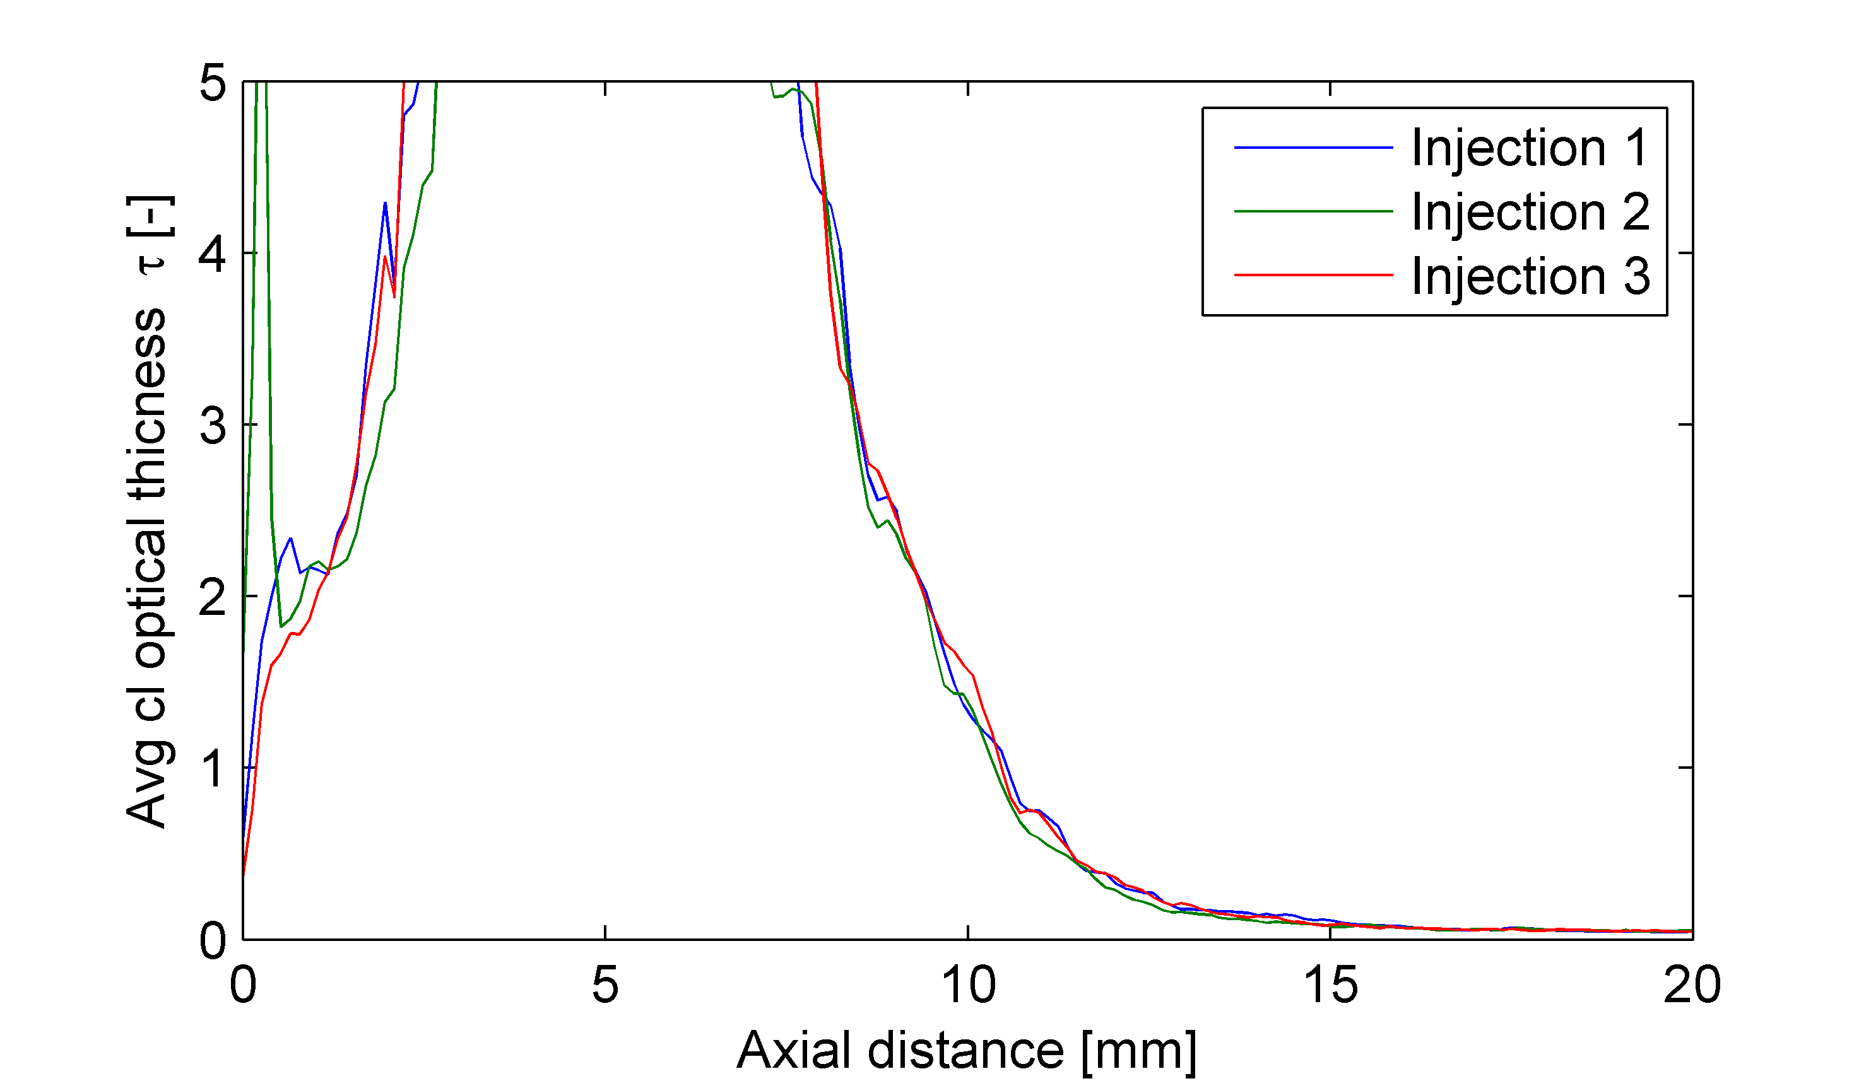
Results
Good news:
The short pulse LED allows to freeze the images and visualize features in the LL region
The optical thickness profile obtained shows low shot 2 shot dispersion
Bad news
The spray vapor phase is detected
Time resolution is not enough to follow the spray features at LL
Spray A conditions
Where is the LL?
Chip average image

Slide 5
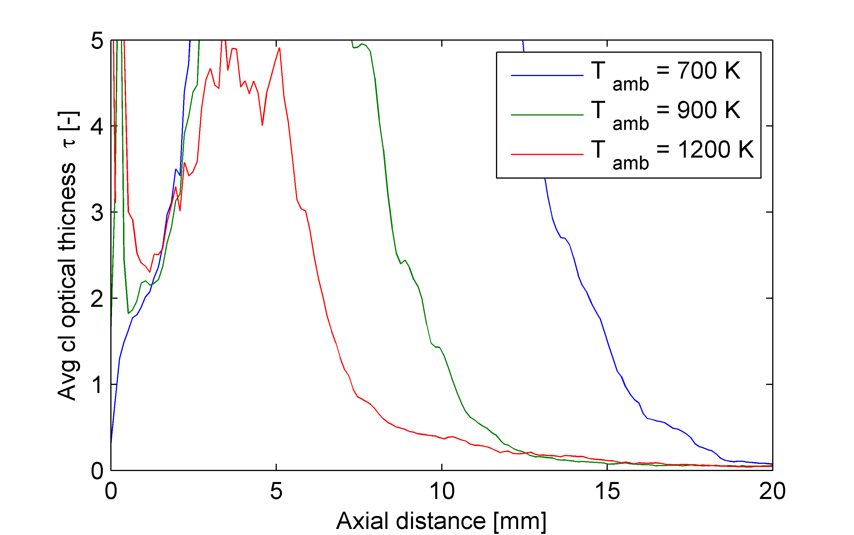
Results
When the test is repeated at different temperatures the profile change
The LL definition should be robust for all (as much as possible) test conditions
Density gradient in LL region are higher at high temperature…
..beam steering too!

Slide 6
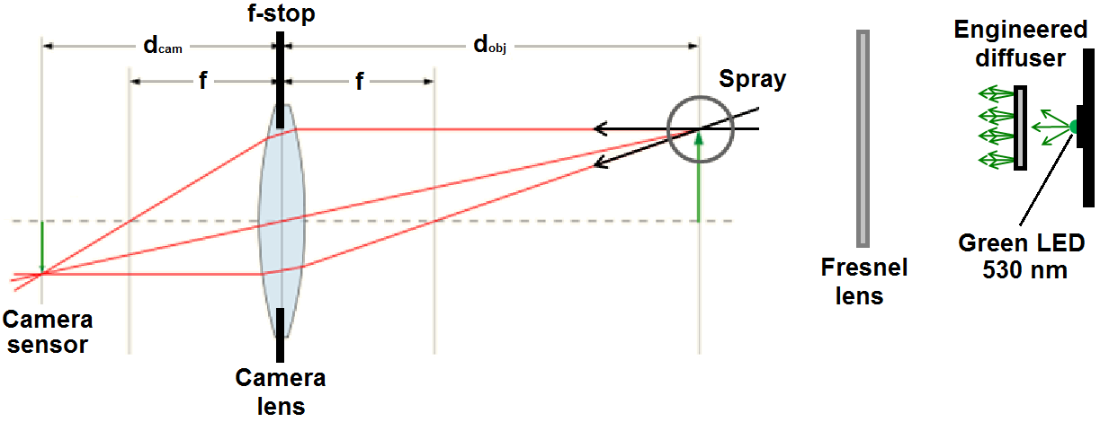
Temperature gradients deviate the light and vaporized regions becomes gray
Theoretically, the rays take different paths through the spray but arrive at the same pixel with diffused back-illumination
Droplet light-scattering should cause extinction of the light, providing information of the liquid concentration
Beam steering in the vapor region changes the paths of the rays that are not collected by the imaging system anymore

Slide 7
Optimized setup
The test have been repeated changing the f/#
High speed digital camera for time-resolve spray development and liquid length measurement (150 000 frames per second)
Nikkor lens 50 mm f/1.2 (approx. 10 pix/mm)
Blue, quad die Pulse LED – more light → duration as short as 100 ns
Blue LED
460 nm

Slide 8
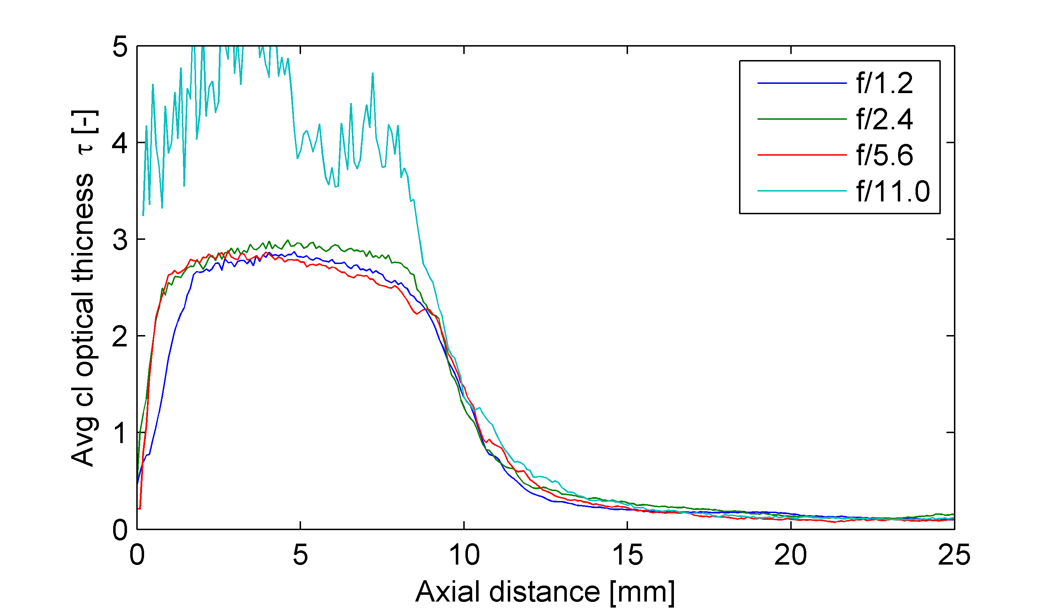
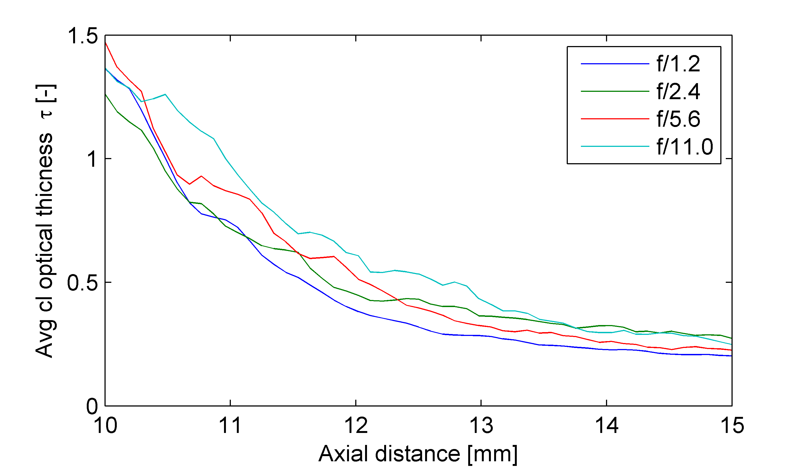
Preliminar results: what we have learned (for the moment)
All the curves collapse in the first part
Exception f/11.0: the illumination was low. If possible is better not to have have 0-counts even under the spray
The f/# affects the results depending on the threshold employed
Spray A conditions

Slide 9
(Preliminar) Conclusions
To obtained quantitative results with Diffused back-illumination technique the beam steering has to be carefully taken in to account
In order to make an apple-2-apple comparison between the institutions it is important to agree on the imaging system collection angle
The dynamic range of the camera has to be fully employed avoiding saturation as well as 0-counts areas
The use of a Fresnel lens after the diffuser is a powerful tool to improve the efficiency of the illumination system

Slide 10
Moving toward quantitative results …work in progress
The tests have been coupled backlit imaging with simultaneous laser extinction measurement
The time resolution has been improved to analyze the features observed in the LL region
To understand the beam steering, a ray tracing model has been developed: how the spray’s density gradient affect the path of the light

Slide 11
Thanks for the attention!

